Slide 1


UNIT-3 Multiple encryption and triple DES
Prof. R. K. Karangiya
rekha.karangiya@darshan.ac.in
Information & Network Security (2170709) Darshan Institute of Engineering & Technology

Slide 2
Outline
Multiple encryption and triple DES
Electronic Code Book Mode
Cipher Block Chaining Mode
Cipher Feedback Mode
Output Feedback Mode
Counter Mode
Notes:
X.800 and RFC 2828
International Telecommunication Union (ITU)

Slide 3
Block Cipher Modes of Operations
To apply a block cipher in a variety of applications, five "modes of operation" have been defined.
Electronic Code Book (ECB)
Cipher Block Chaining (CBC)
Cipher Feedback (CFB)
Output Feedback (OFB)
Counter (CTR)
The five modes are intended to cover a wide variety of applications of encryption for which a block cipher could be used.
These modes are intended for use with any symmetric block cipher, including triple DES and AES.

Slide 4
Block Cipher Modes of Operations
Block cipher: operates on ﬁxed length b-bit input to produce b-bit ciphertext.
What about encrypting plaintext longer than b bits?
Break plaintext into b-bit blocks (padding if necessary) and apply cipher on each block.

Slide 5
1. ECB Encryption & Decryption
P₁
P₂
P_{N}
64-bit
64-bit
64-bit
K
K
…
K
Encrypt
Encrypt
Encrypt
64-bit
64-bit
64-bit
C₁
C₂
C_{N}
C₁
C₂
C_{N}
64-bit
64-bit
64-bit
K
K
…
K
Decrypt
Decrypt
Decrypt
64-bit
64-bit
64-bit
P₁
P₂
P_{N}

Slide 6


Electronic Code Book (ECB) (cont…)
In ECB Mode Plaintext handled one block at a time and each block of plaintext is encrypted using the same key.
The term codebook is used because, for a given key, there is a unique ciphertext for every b-bit block of plaintext.
$C_{j}=E(K, P_{j})$ $j=1,..,N$
$P_{j}=D(K, C_{j})$ $j=1,..,N$

Slide 7
Electronic Code Book (ECB) (cont…)
ECB Advantages:
No block synchronization between sender and receiver is required.
OK if some blocks are lost in transit.
Bit errors caused by noisy channels only affect the corresponding block but not succeeding blocks.
Block cipher operating can be parallelized.

Slide 8
Electronic Code Book (ECB) (cont…)
ECB Disadvantages:
Identical plaintexts result in identical ciphertexts.
An attacker recognizes if the same message has been sent twice simply by looking at the ciphertext.
Plaintext blocks are encrypted independently of previous blocks.
An attacker may reorder ciphertext blocks which results in valid plaintext.

Slide 9
Substitution Attack on ECB
Consider an electronic bank transfer
The attacker sends $1.00 transfers from his account at bank A to his account at bank B repeatedly.
He can check for ciphertext blocks that repeat, and he stores blocks 1,3 and 4 of these transfers.
He now simply replaces block 4 of other transfers with the block 4 that he stored before.
All transfers from some account of bank A to some account of bank B are redirected to go into the attacker’s B account.
1 | 2 | 3 | 4 | 5
Sending Bank A | Sending Account # | Receiving Bank B | Receiving Account # | Amount $

Slide 10
Electronic Code Book (cont…)
Strength: it’s simple.
Weakness:
Problem: with long message, repetition in plaintext may cause repetition in ciphertext.
Typical application:
Secure transmission of short pieces of information (e.g. a temporary encryption key).

Slide 11
2. CBC - Encryption & Decryption
P₁
P₂
P_{N}
IV
C_{N-1}
K
K
…
K
Encrypt
Encrypt
Encrypt
C₁
C₂
C_{N}
C₁
C₂
C_{N}
K
K
…
K
Decrypt
Decrypt
Decrypt
IV
C_{N-1}
P₁
P₂
P_{N}

Slide 12
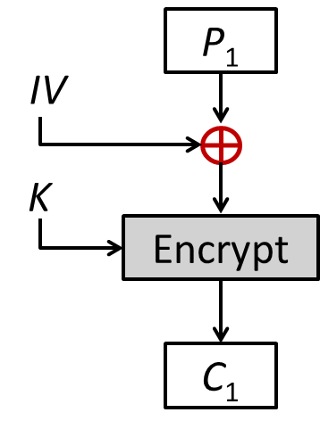
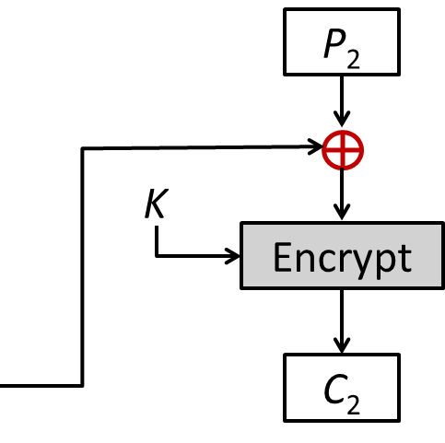
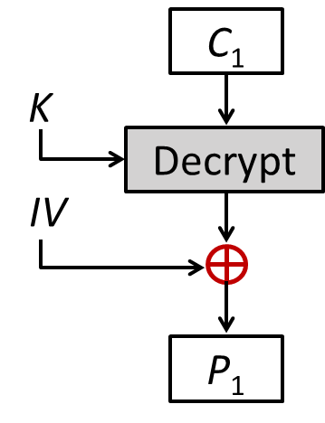
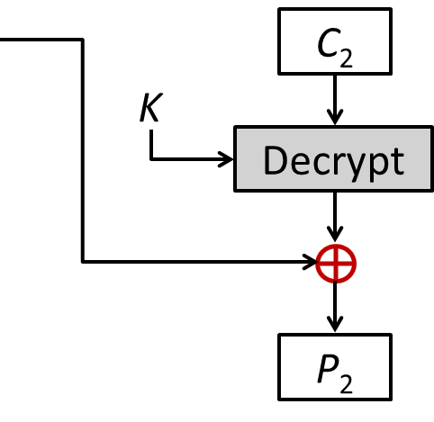
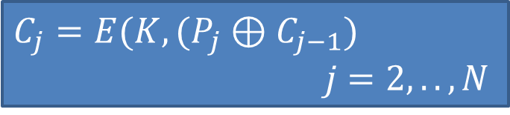

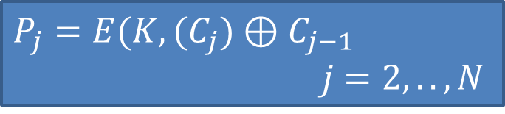

Cipher Block Chaining (CBC) (cont…)
$$C_{1}=E(K, (P_{1}⊕IV)$$
$C_{j}=E(K, (P_{j}⊕C_{j−1})$ $j=2,..,N$
$$P_{1}=D(K, C_{1})⊕IV$$
$P_{j}=E(K, (C_{j})⊕C_{j−1}$ $j=2,..,N$

Slide 13
Cipher Block Chaining (CBC) (cont…)
CBC is a technique in which the same plaintext block, if repeated, produces different ciphertext blocks.
In this scheme, the input to the encryption algorithm is the XOR of the current plaintext block and the preceding ciphertext block and the same key is used for each block.
To produce the first block of ciphertext, an initialization vector (IV) is XORed with the first block of plaintext.

Slide 14
Cipher Block Chaining (CBC) (cont…)
Initialisation Vector (IV) must be known by sender/receiver, but it should be kept secret from attacker.
On decryption, the IV is XORed with the output of the decryption algorithm to recover the first block of plaintext.

Slide 15
Substitution Attack on CBC
Consider the last example (electronic bank transfer).
If the IV is properly chosen for every wire transfer, the attack will not work at all.
If the IV is kept the same for several transfers, the attacker would recognize the transfers from his account at bank A to back B.

Slide 16
Cipher Block Chaining (CBC) (cont…)
Strength: because of the chaining mechanism of CBC, it is an appropriate mode for encrypting messages of length greater than b bits.
Typical application:
General-purpose block oriented transmission
Authentication

Slide 17
3. Cipher Feedback Mode (CFB)
For AES, DES, or any block cipher, encryption is performed on a block of b bits. In DES, b = 64 and in AES, b = 128.
However, it is possible to convert a block cipher into a stream cipher, using cipher feedback (CFB) mode, output feedback (OFB) mode, and counter (CTR) mode.
A stream cipher eliminates the need to pad a message to be an integral number of blocks.

Slide 18
CFB Encryption
C_{N-1}
IV
Shift register b-s bits | s bits
Shift register b-s bits | s bits
K
K
K
Encrypt
Encrypt
Encrypt
…
Select s bits
Discard b-s bits
Select s bits
Discard b-s bits
Select s bits
Discard b-s bits
S bits
S bits
S bits
P₁
P₂
P_{N}
C₁
C₂
C_{N}
S bits
S bits
S bits
Notes:
Unit od transmission is 8 bits
Common value of s=8

Slide 19
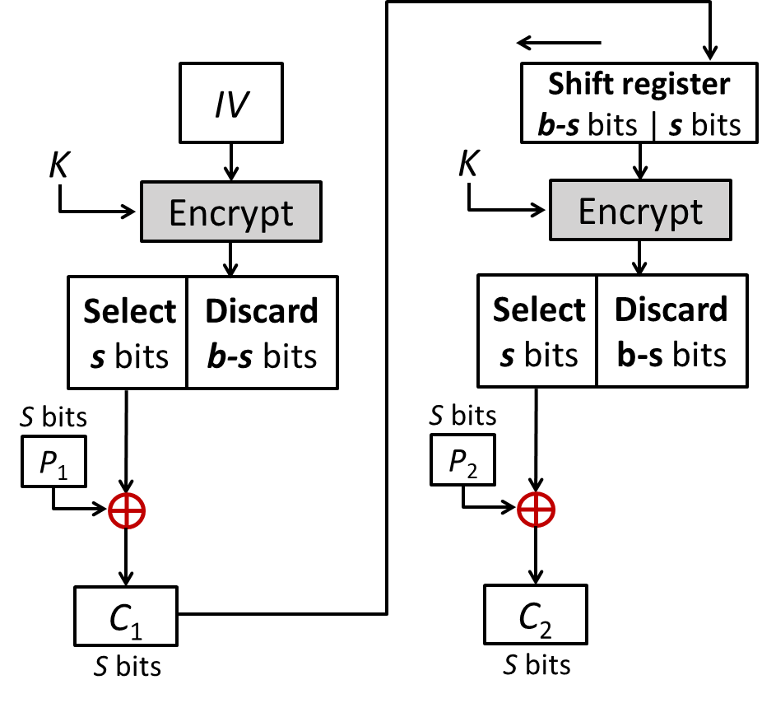
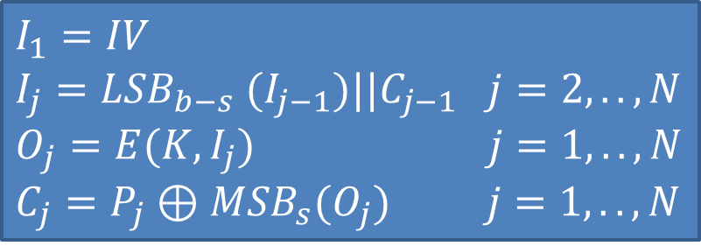
CFB Encryption (cont…)
$$I_{1}=IV$$
$I_{j}={LSB}_{b−s} (I_{j−1})||C_{j−1}$ $j=2,..,N$
$O_{j}=E(K, I_{j})$ $j=1,..,N$
${C_{j}=P}_{j}⊕{MSB}_{s}(O_{j})$ $j=1,..,N$

Slide 20
CFB Decryption
C_{N-1}
IV
Shift register b-s bits | s bits
Shift register b-s bits | s bits
K
K
K
Encrypt
Encrypt
Encrypt
…
Select s bits
Discard b-s bits
Select s bits
Discard b-s bits
Select s bits
Discard b-s bits
C₁
C₂
C_{N}
S bits
S bits
S bits
P₁
P₂
P_{N}
S bits
S bits
S bits
Notes:
Unit od transmission is 8 bits
Common value of s=8

Slide 21
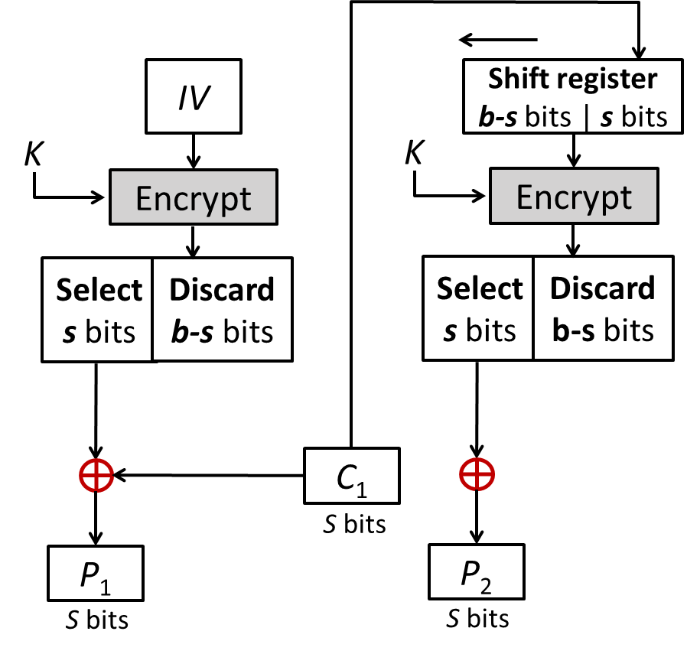
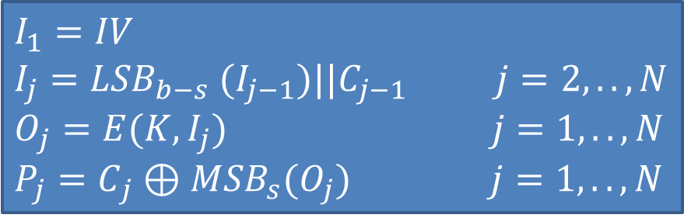
CFB Decryption (Cont…)
$$I_{1}=IV$$
$I_{j}={LSB}_{b−s} (I_{j−1})||C_{j−1}$ $j=2,..,N$
$O_{j}=E(K, I_{j})$ $j=1,..,N$
${P_{j}=C}_{j}⊕{MSB}_{s}(O_{j})$ $j=1,..,N$

Slide 22
Cipher Feedback Mode (CFB) (cont…)
The input to the encryption function is a b-bit shift register that is initially set to some initialization vector (IV).
The leftmost (most significant) s bits of the output of the encryption function are XORed with the first segment of plaintext P1 to produce the first unit of ciphertext C1 , which is then transmitted.
In addition, the contents of the shift register are shifted left by s bits, and C1 is placed in the rightmost (least significant) s bits of the shift register.
For decryption, the same scheme is used, except that the received ciphertext unit is XORed with the output of the encryption function to produce the plaintext unit.

Slide 23
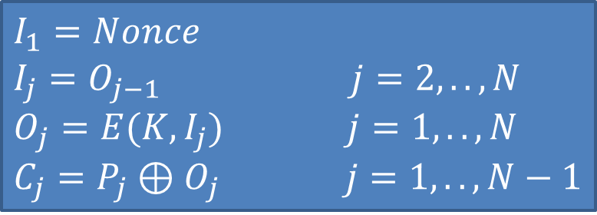
OFB Encryption
Nonce
K
K
…
K
Encrypt
Encrypt
Encrypt
P₁
P₂
P_{N}
C₁
C₂
C_{N}
$$I_{1}=Nonce$$
$I_{j}{=O}_{j−1}$ $j=2,..,N$
$O_{j}=E(K, I_{j})$ $j=1,..,N$
${C_{j}=P}_{j}⊕O_{j}$ $j=1,..,N−1$

Slide 24
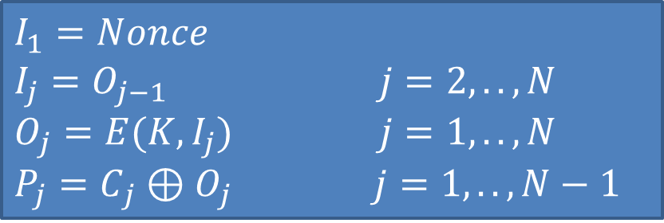
OFB Decryption
Nonce
K
K
…
K
Encrypt
Encrypt
Encrypt
C₁
C₂
C_{N}
P₁
P₂
P_{N}
$$I_{1}=Nonce$$
$I_{j}{=O}_{j−1}$ $j=2,..,N$
$O_{j}=E(K, I_{j})$ $j=1,..,N$
${P_{j}=C}_{j}⊕O_{j}$ $j=1,..,N−1$

Slide 25
Output Feedback Mode(OFB) (cont..)
The output feedback (OFB) mode is similar in structure to that of CFB.
For OFB, the output of the encryption function is fed back to become the input for encrypting the next block of plaintext.
In CFB, the output of the XOR unit is fed back to become input for encrypting the next block.
The other difference is that the OFB mode operates on full blocks of plaintext and ciphertext, whereas CFB operates on an s-bit subset.

Slide 26
OFB Mode (cont..)
Nonce: A time-varying value that has at most a negligible chance of repeating, for example, a random value that is generated anew for each use, a timestamp, a sequence number, or some combination of these.
Each bit in the ciphertext is independent of the previous bit or bits.
This avoids error propagation.
Pre-compute of forward cipher is possible.

Slide 27

5. CTR Encryption
Counter 1
Counter 2
Counter N
K
K
…
K
Encrypt
Encrypt
Encrypt
P₁
P₂
P_{N}
C₁
C₂
C_{N}
$$C_{j}=P_{j}⊕E\left(K,T_{j}\right) j=1,..,N$$

Slide 28

CTR Decryption
Counter 1
Counter 2
Counter N
K
K
…
K
Encrypt
Encrypt
Encrypt
C₁
C₂
C_{N}
P₁
P₂
P_{N}
$$P_{j}=C_{j}⊕E\left(K,T_{j}\right) j=1,..,N$$

Slide 29
Counter Mode (CTR) (cont…)
Counter (CTR) mode has increased recently with applications to ATM (asynchronous transfer mode) network security and IP sec (IP security).
A counter equal to the plaintext block size is used.
The counter value must be different for each plaintext block that is encrypted.
Typically, the counter is initialized to some value and then incremented by 1 for each subsequent block.

Slide 30
Advantages of the CTR Mode
Strengths:
Needs only the encryption algorithm.
Random access to encrypted data blocks.
blocks can be processed (encrypted or decrypted) in parallel.
Simple and fast encryption/decryption.
Counter must be
Must be unknown and unpredictable.
pseudo-randomness in the key stream is a goal.

Slide 31
Summary of all modes
Operation Mode | Description | Type of Result
ECB | Each n-bit block is encrypted independently with same key. | Block Cipher
CBC | Same as ECB, but each block is XORed with previous cipher text. | Block Cipher
CFB | Each s-bit block is XORed with s-bit key which is part of previous cipher text. | Stream Cipher
OFB | Same as CFB, but input to the encryption is preceding encryption output. | Stream Cipher
CTR | Same as OFB, but a counter is used instead of nonce. | Stream Cipher

Slide 32
Multiple Encryption
Given the potential vulnerability of DES to a brute-force attack, there has been considerable interest in finding an alternative.
For DES requires 2⁵⁶ operations for brute force attack.
One approach is to design a completely new algorithm, of which AES is a prime example.
Another alternative, which would preserve the existing investment in software and equipment, is to use multiple encryption with DES and multiple keys.

Slide 33










Double DES
Key K₁
Key K₂
Plaintext
Encryption
Encryption
Ciphertext
$${X=E(K}_{1}, P)$$
Encryption
$${C=E(K}_{2}, )$$
$${E(K}_{1}, P)$$
$$X=$$
$${E(K}_{1}, P)$$
$$=$$
$${D(K}_{2}, C)$$
Key K₂
Key K₁
$${P=D(K}_{1}, )$$
$${D(K}_{2}, C)$$
Decryption
$${X=D(K}_{2}, C)$$
Decryption
Ciphertext
Plaintext
Decryption

Slide 34
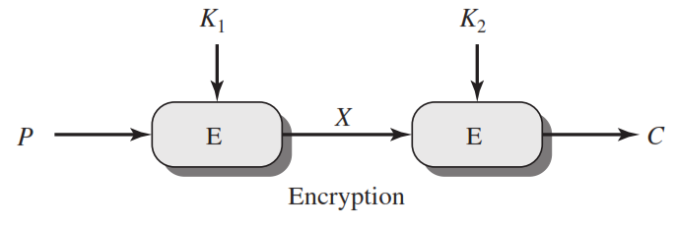
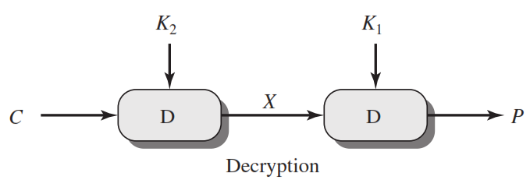
Double DES
C=E(K₂,E(K₁, P))
X = E(K₁, P) = D(K₂, C)
P=D(K₁,D(K₂, C))

Slide 35
Double DES
For double DES, 2 × 56-bit keys, meaning 112-bit key length.
Requires 2¹¹² operations for brute force attack.
Meet-in-the-middle attack makes it easier.

Slide 36
Meet in the Middle Attack
This attack involves encryption from one end, decryption from the other and matching the results in the middle.
Suppose cryptanalyst knows P_{i} and corresponding C_{i}.
Now, the aim is to obtain the values of K₁ and K₂.
No. of Encryptions and Decryptions: 2⁵⁶ + 2⁵⁶ = 2⁵⁷
For Double DES requires 2⁵⁷ operations for brute force attack.
All Possible keys
K₁ = 2⁵⁶
All Possible keys
K₂ = 2⁵⁶
Known
Plaintext
Known
Ciphertext
Middle Text
Encryption
Decryption

Slide 37
Meet in the Middle Attack Step-1
For all possible values (2⁵⁶) of key K1, the cryptanalyst would encrypt the known plaintext by performing E(K1,P).
The cryptanalyst would store output in a table.
Possible Keys (Key = K1)
00
01
10
11
P
Table of Cipher Text
Encrypt
010
110
101
000
Cryptanalyst encryption operation

Slide 38
Meet in the Middle Attack Step-2
Cryptanalyst decrypt the known ciphertext with all possible values of K2.
In each case cryptanalyst will compare the resulting value with the all values in the table of ciphertext.
Possible Keys (Key = K1)
00
01
10
11
Table of Cipher Text
C
Decrypt
111
110
001
011
For each result do a table look up
Cryptanalyst decryption operation

Slide 39
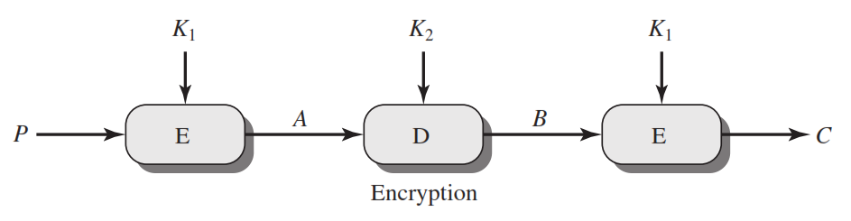
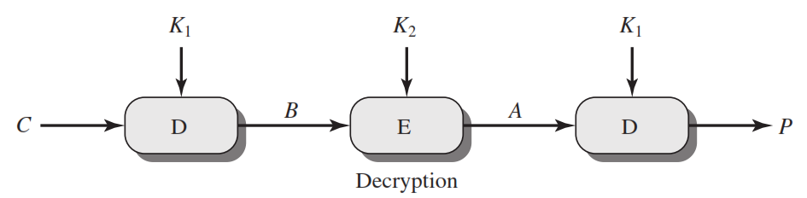
Triple DES
C=E(K₁,D(K₂, E(K₁,P)))
P=D(K₁,E(K₂, D(K₁,C)))

Slide 40
Meet in the Middle Attack
Possible Keys (Key = K1)
00
10
11
Possible Keys (Key = K1)
00
01
10
P
Table of Cipher Text
Table of Cipher Text
C
E
010
101
000
Find equal match and store corresponding K1 and K2.
111
011
001
D
01
110
110
11
Values of K1=01 and K2=11

Slide 41


Triple DES
Key K₁
Key K₂
Key K₁
A
B
E
Plaintext
E
D
Ciphertext
$$C=E(K_{1}, D\left(K_{2}, E\left(K_{1}, P\right)\right))$$
Key K₁
Key K₂
Key K₁
B
A
D
Ciphertext
D
E
Plaintext
$$P=D(K_{1}, E\left(K_{2}, D\left(K_{1}, C\right)\right))$$

Slide 42


