Slide 1


UNIT-4 Asymmetric Ciphers
Prof. R. K. Karangiya
rekha.karangiya@darshan.ac.in
Information & Network Security (2170709) Darshan Institute of Engineering & Technology

Slide 2
Outline
Public Key Cryptosystems with Applications
Requirements and Cryptanalysis
RSA algorithm
RSA computational aspects and security
Diffie-Hillman Key Exchange algorithm
Man-in-Middle attack
Notes:
X.800 and RFC 2828
International Telecommunication Union (ITU)

Slide 3



Symmetric Key Encryption
Secret key shared by sender and recipient
Secret key shared by sender and recipient
K
K
Transmitted
cipher text
Y = E(K, X)
X
X
Plaintext
input
Encryption Algorithm
(e.g. AES)
Decryption Algorithm
(reverse of encryption algorithm)
Plaintext
output

Slide 4
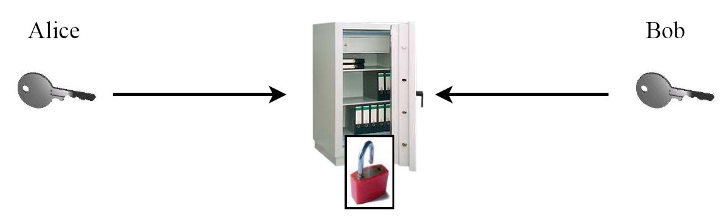
Symmetric Key Encryption example
Safe with a strong lock, only Alice and Bob have a copy of the key
Alice encrypts: locks message in the safe with her key
Bob decrypts: uses his copy of the key to open the safe

Slide 5
Asymmetric Key Encryption with Public Key
Bob’s Public key ring
The entire encrypted message serves as a confidentiality.
Joy
Ted
Mike
Alice
PU_{a}
Alice’s public key
PR_{a}
Alice’s private key
Transmitted
cipher text
Y = E(PU_{a}, X)
X
X
Plaintext
input
Plaintext
output
Encryption Algorithm
(e.g. RSA)
Decryption Algorithm
Bob
Alice

Slide 6
Asymmetric Key Encryption with Private Key
The entire encrypted message serves as a digital signature.
Alice’s Public key ring
Joy
Ted
Mike
Bob
PR_{b}
Bob’s private key
PU_{b}
Bob’s public key
Transmitted
cipher text
Y = E(PR_{b}, X)
X
X
Plaintext
input
Plaintext
output
Encryption Algorithm
(e.g. RSA)
Decryption Algorithm
Bob
Alice

Slide 7


Asymmetric Key Encryption example
New Idea:
Use the good old mailbox principle:
Everyone can drop a letter
But Only the owner has the
correct key to open the box
Public Key
Private Key

Slide 8
Authentication and Confidentiality
Source A
Source B
Message
source
X
Encryption
Algorithm
Y
Encryption
Algorithm
Z
Decryption
Algorithm
Y
Decryption
Algorithm
X
Message
Dest.
PUb
PRb
Key pair
source
PRa
PUa
Key pair
source
Z = E(PU_{b}, E(PR_{a}, X))
X = D(PU_{a}, D(PR_{B}, Z))

Slide 9
Applications for Public-Key Cryptosystems
Encryption/decryption: The sender encrypts a message with the recipient’s public key.
Digital signature: The sender “signs” a message with its private key. Signing is achieved by a cryptographic algorithm applied to the message or to a small block of data that is a function of the message.
Key exchange: Two sides cooperate to exchange a session key. Several different approaches are possible, involving the private key(s) of one or both parties.

Slide 10
RSA Algorithm
RSA is a block cipher in which the Plaintext and Ciphertext are represented as integers between 0 and n-1 for some value of n.
Large messages can be broken up into a number of blocks.
Each block would then be represented by an integer.
Step-1: Generate Public key and Private key.
Step-2: Encrypt message using Public key.
Step-3: Decrypt message using Private key.

Slide 11
Step-1: Generate Public key and Private key
Select two large prime numbers: p and q
Calculate modulus : n = p * q
Calculate Euler’s totient function : φ(n) = (p-1) * (q-1)
Select e such that e is relatively prime to φ(n) and 1 < e < φ(n)
Determine d such that d * e ≡ 1 (mod φ(n))
Publickey : PU = { e, n }
Privatekey : PR = { d, n }
Two numbers are relatively prime if they have no common factors other than 1 or (gcd(φ(n) , e)=1).

Slide 12
Step-2 and 3: Encryption and Decryption
Step-2: Encryption using Public Key:
Plaintext: M
Ciphertext: C = Me mod n
Step-3: Decryption using Private Key:
Ciphertext: C
Plaintext: M = C^{d} mod n

Slide 13
Step-1: Generate Public key and Private key
Select two large prime numbers: p = 3 and q = 11
Calculate modulus : n = p * q = 3 * 11 = 33
Calculate Euler’s totient function : φ(n) = (p-1) * (q-1)
φ(n) = ( 3 – 1 ) * ( 11 – 1 ) = 20
Select e such that e is relatively prime to φ(n) and 1 < e < φ(n)
We have several choices for e :3, 7, 11, 13, 17, 19 Let’s take e = 7
Determine d such that d * e ≡ 1 (mod φ(n))
? * 7 ≡ 1 (mod 20), 3 * 7 ≡ 1 (mod 20)
? * 7 (mod 20) ≡ 1, 3 * 7 (mod 20) ≡ 1
Public key : PU = { e, n } , PU = { 7, 33 }
Private key : PR = { d, n }, PR = { 3, 33 }
This is equivalent to finding d which satisfies de = 1 + j.φ(n) where j is any integer.
We can rewrite this as
d = (1 + j. φ(n)) / e

Slide 14
Step-2 : Encrypt Message
Encryption using Public Key:
C = Me mod n
Ciphertext
Input Message
Public key
PU = { e, n } , PU = { 7, 33 }
For message M = 14
C = 14⁷ mod 33
C = [(14¹ mod 33) X (14² mod 33) X (14⁴ mod 33)] mod 33
C = (14 X 31 X 4) mod 33 = 1736 mod 33
C = 20

Slide 15
Step-3 : Decrypt Message
Decryption using Private Key:
M = C^{d} mod n
Plaintext
Message
Cipher
Message
Private key
PR = { d, n } , PR = { 3, 33 }
For Ciphertext C = 20
M = 20³ mod 33
M = [(20¹ mod 33) X (20² mod 33)] mod 33
M = (20 X 4) mod 33 = 80 mod 33
M = 14

Slide 16
Example RSA Algorithm
Encryption
Decryption
Plaintext
14
14⁷ mod 33 = 20
Ciphertext
20
20³ mod 33 = 14
Plaintext
14
PU = 7, 33
PR = 3, 33

Slide 17
RSA Example - 1
Find n, φ(n), e, d for p=7 and q= 19 then demonstrate encryption and decryption for M = 6
n = p * q = 7 * 19 = 133
Finding e relatively prime to 108
e = 2 => GCD( 2, 108 ) = 2 (no)
e = 3 => GCD( 3, 108 ) = 3 (no)
e = 5 => GCD( 5, 108 ) = 1 (Yes)
φ(n) = ( p – 1 ) * ( q – 1) = 108
Finding d such that (d * e ) mod φ(n) = 1
We can rewrite this as d = (1 + j . φ(n)) / e
j = 0 => d = 1 / 5 = 0.2 ← integer ? (no)
j = 1 => d = 109 / 5 = 21.8 ← integer ? (no)
j = 2 => d = 217 / 5 = 43.4 ← integer ? (no)
j = 3 => d = 325 / 5 = 65 integer ? (yes)
Public key :
PU = { e, n } = {5, 133}
Private key :
PR = { d, n } = {65, 133}

Slide 18
RSA Example – cont…
Encryption:
C = Me mod n
PU = { e, n } , PU = { 5, 133 }
For message M = 6
C = 6⁵ mod 133
C = 7776 mod 33
C = 62
Decryption:
M = C^{d} mod n
PR = { d, n } , PU = { 65, 133 }
For C = 62
M = 62⁶⁵ mod 133
M = 2666 mod 33
M = 6

Slide 19
RSA Example - 2
P and Q are two prime numbers. P=7, and Q=17. Take public key E=5. If plain text value is 10, then what will be cipher text value according to RSA algorithm?
n = 119
φ(n) = 96
e = 5
d = 77
PU = { 5, 119 }
PR = {77, 119}
C = 10⁵ mod 119 => C = 40

Slide 20
RSA Example - 3
P and Q are two prime numbers. P=17, and Q=11. If plain text value is 88, then what will be cipher text value according to RSA algorithm?
n = 187
φ(n) = 160
e = 7
d = 23
PU = { 7, 187 }
PR = {23, 187}
C = 88⁷ mod 187 => C = 11

Slide 21
Diffie-Hellman key Exchange
The purpose of the Diffie-Hellman algorithm is to enable two users to securely exchange a key that can be used for subsequent encryption of message.
The effectiveness of an algorithm is depends on the difficulty of computing discrete logarithms.

Slide 22
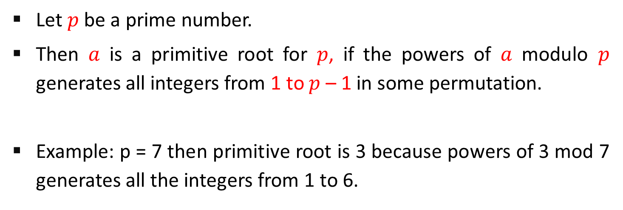
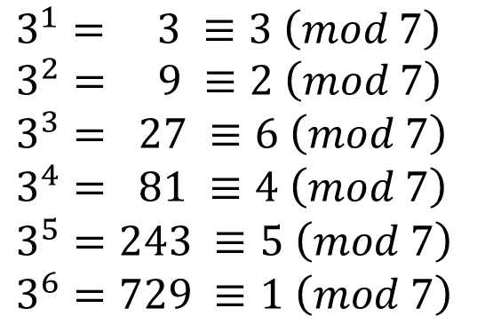
Primitive root
Let $p$ be a prime number.
Then $a$ is a primitive root for $p$, if the powers of $a$ modulo $p$ generates all integers from 1 to $p$ – 1 in some permutation.
Example: p = 7 then primitive root is 3 because powers of 3 mod 7 generates all the integers from 1 to 6.
$$a mod p, a^{2}mod p, …, a^{p−1}mod p$$
$$3^{1}= 3 ≡3 \left(mod 7\right)$$
$$3^{2}= 9 ≡2 \left(mod 7\right)$$
$$3^{3}= 27 ≡6 \left(mod 7\right)$$
$$3^{4}= 81 ≡4 \left(mod 7\right)$$
$$3^{5}=243 ≡5 \left(mod 7\right)$$
$$3^{6}=729 ≡1 \left(mod 7\right)$$

Slide 23


Discrete Logarithm
For any integer $b$ and a primitive root $a$ of prime number $p$, we can find a unique exponent $i$ such that
The exponent $i$ is referred as the discrete logarithm of $b$ for the base $a$, mod $p$. It expressed as below.
$$b= a^{i}\left(mod p\right) where 0≤i≤(p−1)$$
$$bd\log_{a,p}(b)$$

Slide 24

Diffie-Hellman Key Exchange – Cont…
User A and User B agree on two large prime numbers q and α. User A and User B can use insecure channel to agree on them.
User A selects a random integer $X_{A}<q$ and calculates $Y_{A}$.
User B selects a random integer $X_{B}<q$ and calculates $Y_{B}$.

Slide 25
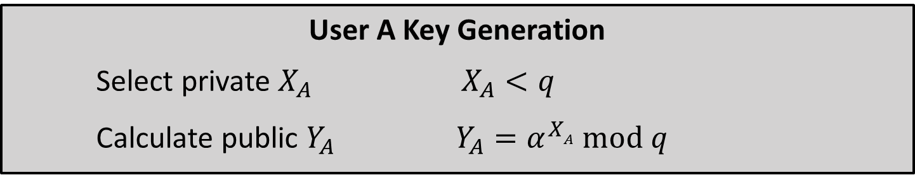
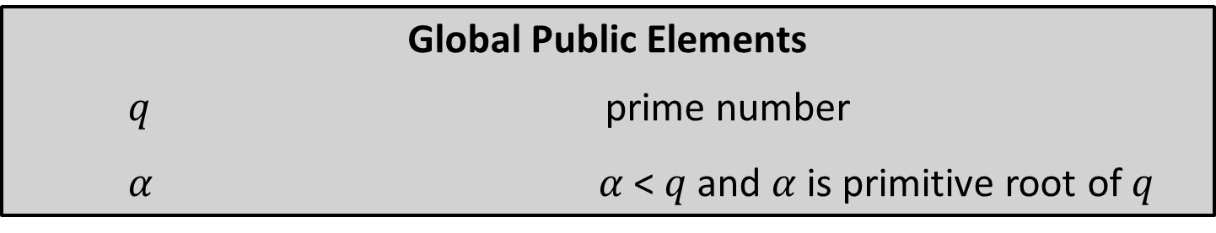

Diffie-Hellman Key Exchange – Cont…
Global Public Elements
$q$ prime number
$α$ $α$ < $q$ and $α$ is primitive root of $q$
User A Key Generation
Select private $X_{A}$ $X_{A}<q$
Calculate public $Y_{A}$ $Y_{A}=α^{XA} mod q$
User B Key Generation
Select private $X_{B}$ $X_{B}<q$
Calculate public $Y_{B}$ $Y_{B}=α^{XB} mod q$

Slide 26
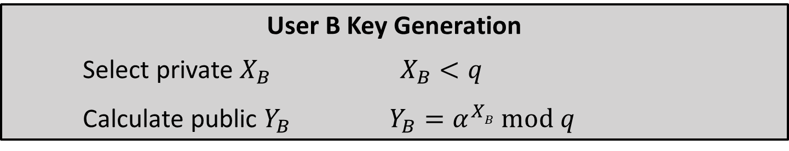



Diffie-Hellman Key Exchange – Cont…
User A Key Generation
Select private $X_{A}$ $X_{A}<q$
Calculate public $Y_{A}$ $Y_{A}=α^{XA} mod q$
User B Key Generation
Select private $X_{B}$ $X_{B}<q$
Calculate public $Y_{B}$ $Y_{B}=α^{XB} mod q$
Calculation of Secret Key by User A
$K= {\left(Y_{B}\right)}^{XA} mod q$
Calculation of Secret Key by User b
$K= {\left(Y_{A}\right)}^{XB} mod q$

Slide 27
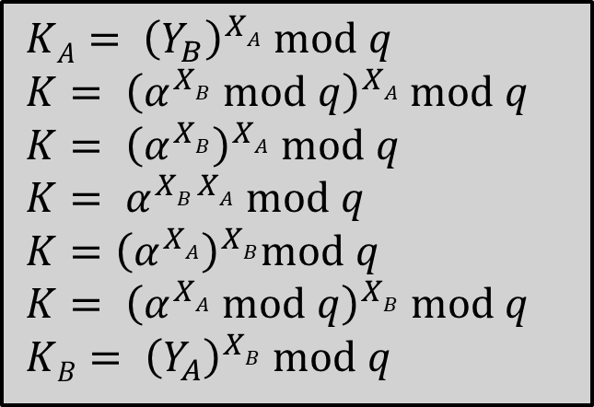
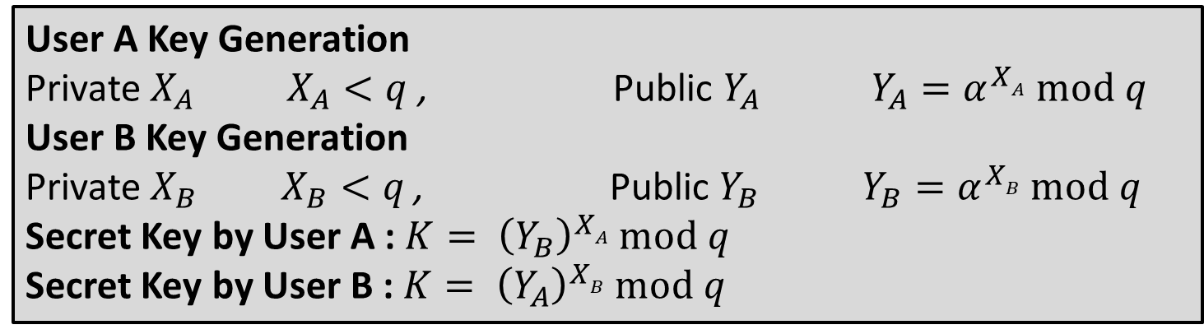
Diffie-Hellman Key Exchange – Cont…
User A Key Generation
Private $X_{A}$ $X_{A}<q$ , Public $Y_{A}$ $Y_{A}=α^{XA} mod q$
User B Key Generation
Private $X_{B}$ $X_{B}<q$ , Public $Y_{B}$ $Y_{B}=α^{XB} mod q$
Secret Key by User A : $K= {\left(Y_{B}\right)}^{XA} mod q$
Secret Key by User B : $K= {\left(Y_{A}\right)}^{XB} mod q$
$KA= {\left(Y_{B}\right)}^{XA} mod q$
$K= {\left(α^{XB} mod q\right)}^{XA} mod q$
$K= {\left(α^{XB}\right)}^{XA} mod q$
$K= α^{XB XA} mod q$
$K={\left(α^{XA}\right)}^{XB}mod q$
$K= {\left(α^{XA} mod q\right)}^{XB} mod q$
$KB= {\left(Y_{A}\right)}^{XB} mod q$

Slide 28
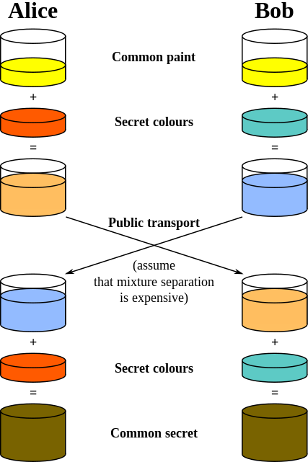

Slide 29
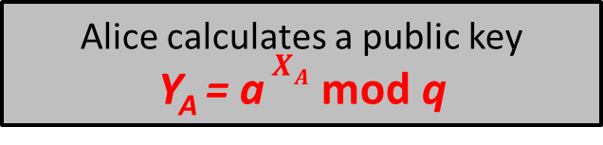
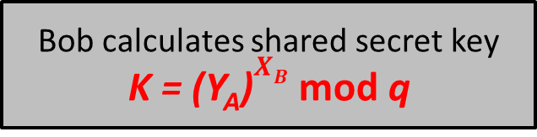
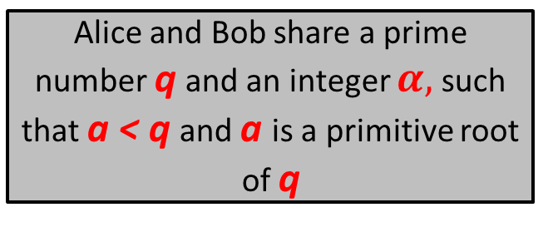
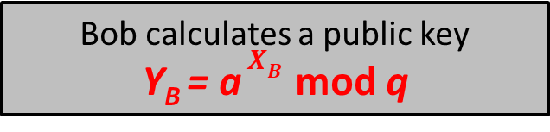
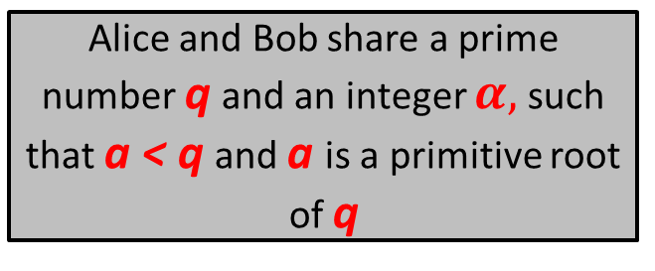
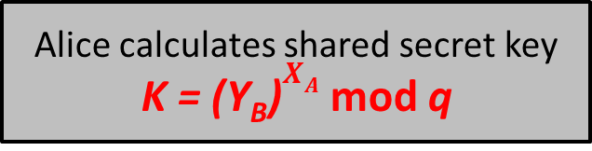
Diffie-Hellman Key Exchange Illustration
Alice
Bob
Alice and Bob share a prime number q and an integer $α,$ such that a < q and a is a primitive root of q
Alice and Bob share a prime number q and an integer $α,$ such that a < q and a is a primitive root of q
Alice generates a private key X_{A} such that X_{A} < q
Bob generates a private key X_{B} such that X_{B} < q
Alice calculates a public key
Y_{A} = a $X_{A}$ mod q
Y_{A}
Bob calculates a public key
Y_{B} = a $X_{B}$ mod q
Y_{B}
Alice receives Bob’s public key Y_{B} in plaintext
Bob receives Alice’s public key Y_{A} in plaintext
Alice calculates shared secret key
K = (Y_{B})$X_{A}$ mod q
Bob calculates shared secret key
K = (Y_{A})$X_{B}$ mod q

Slide 30
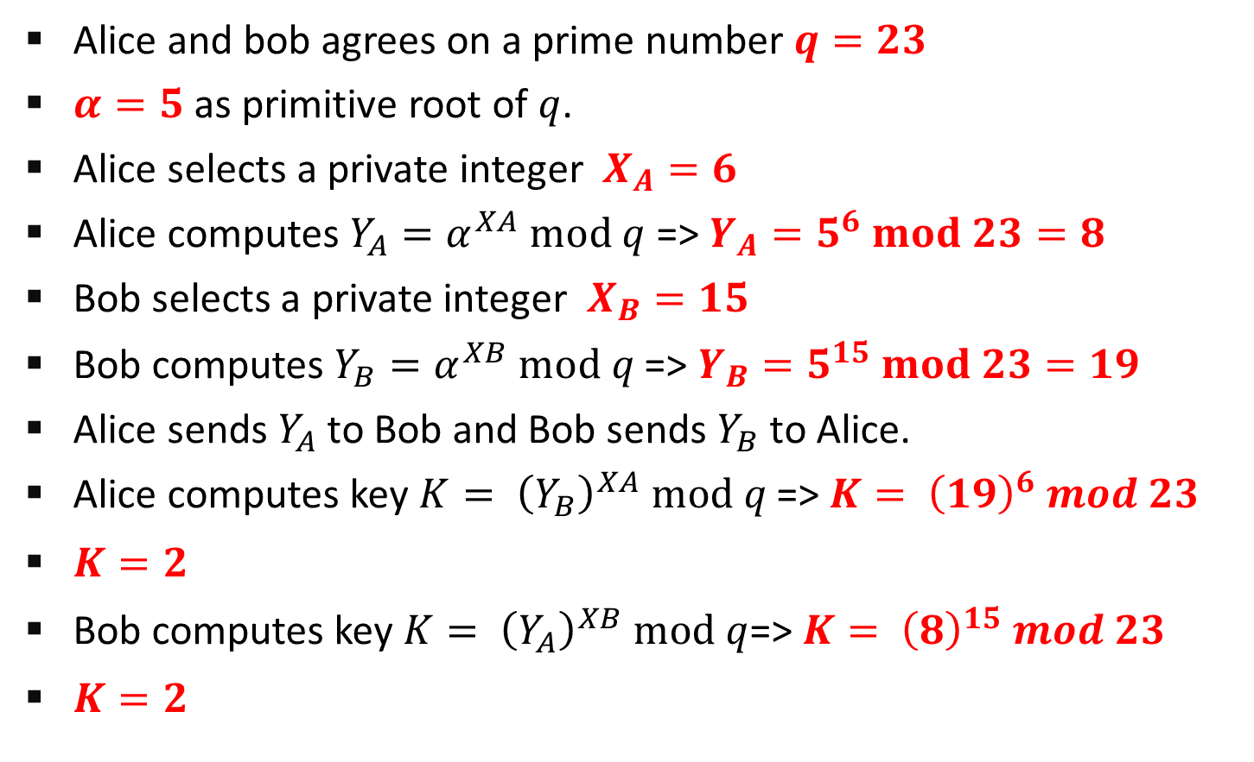
Diffie-Hellman Key Exchange Example
Alice and bob agrees on a prime number $q=23$
$α=5$ as primitive root of $q$.
Alice selects a private integer $X_{A}=6$
Alice computes $Y_{A}=α^{XA} mod q$ => $Y_{A}=5^{6} mod 23=8$
Bob selects a private integer $X_{B}=15$
Bob computes $Y_{B}=α^{XB} mod q$ => $Y_{B}=5^{15} mod 23=19$
Alice sends $Y_{A}$ to Bob and Bob sends $Y_{B}$ to Alice.
Alice computes key $K= {\left(Y_{B}\right)}^{XA} mod q$ => $K= {\left(19\right)}^{6} mod 23$
$K=2$
Bob computes key $K= {\left(Y_{A}\right)}^{XB} mod q$=> $K= {\left(8\right)}^{15} mod 23$
$K=2$

Slide 31
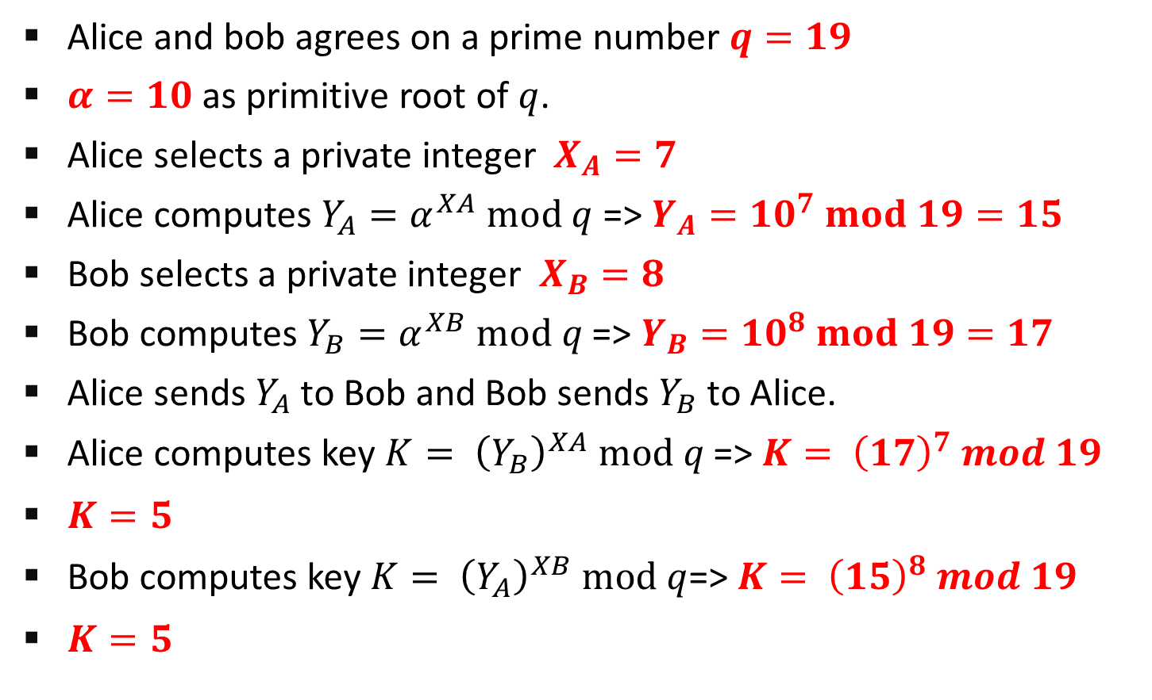
Diffie-Hellman Key Exchange Example
Alice and bob agrees on a prime number $q=19$
$α=10$ as primitive root of $q$.
Alice selects a private integer $X_{A}=7$
Alice computes $Y_{A}=α^{XA} mod q$ => $Y_{A}={10}^{7} mod 19=15$
Bob selects a private integer $X_{B}=8$
Bob computes $Y_{B}=α^{XB} mod q$ => $Y_{B}={10}^{8} mod 19=17$
Alice sends $Y_{A}$ to Bob and Bob sends $Y_{B}$ to Alice.
Alice computes key $K= {\left(Y_{B}\right)}^{XA} mod q$ => $K= {\left(17\right)}^{7} mod 19$
$K=5$
Bob computes key $K= {\left(Y_{A}\right)}^{XB} mod q$=> $K= {\left(15\right)}^{8} mod 19$
$K=5$

Slide 32
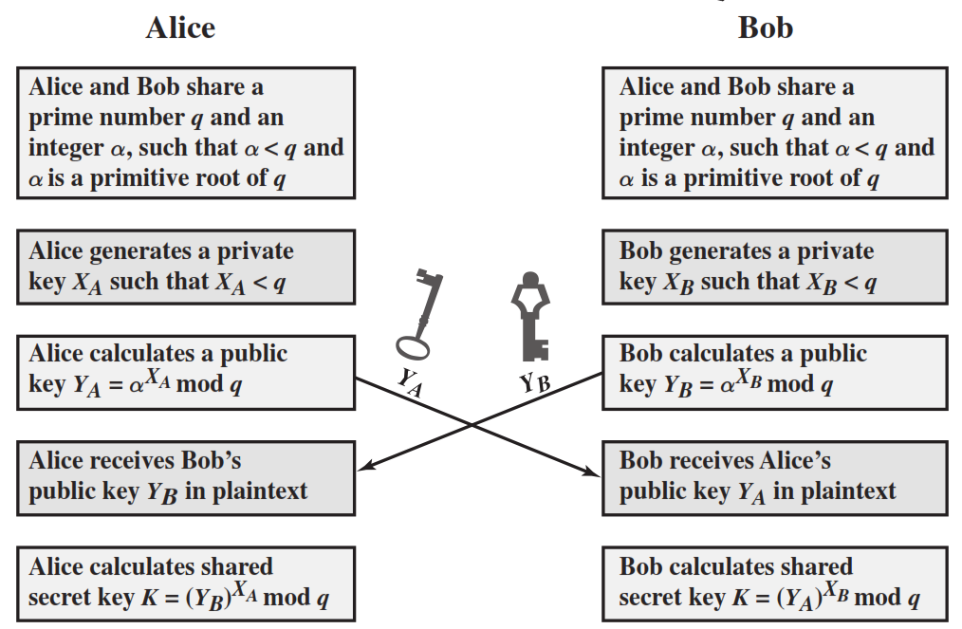
Diffie-Hellman Key Exchange Illustration

Slide 33
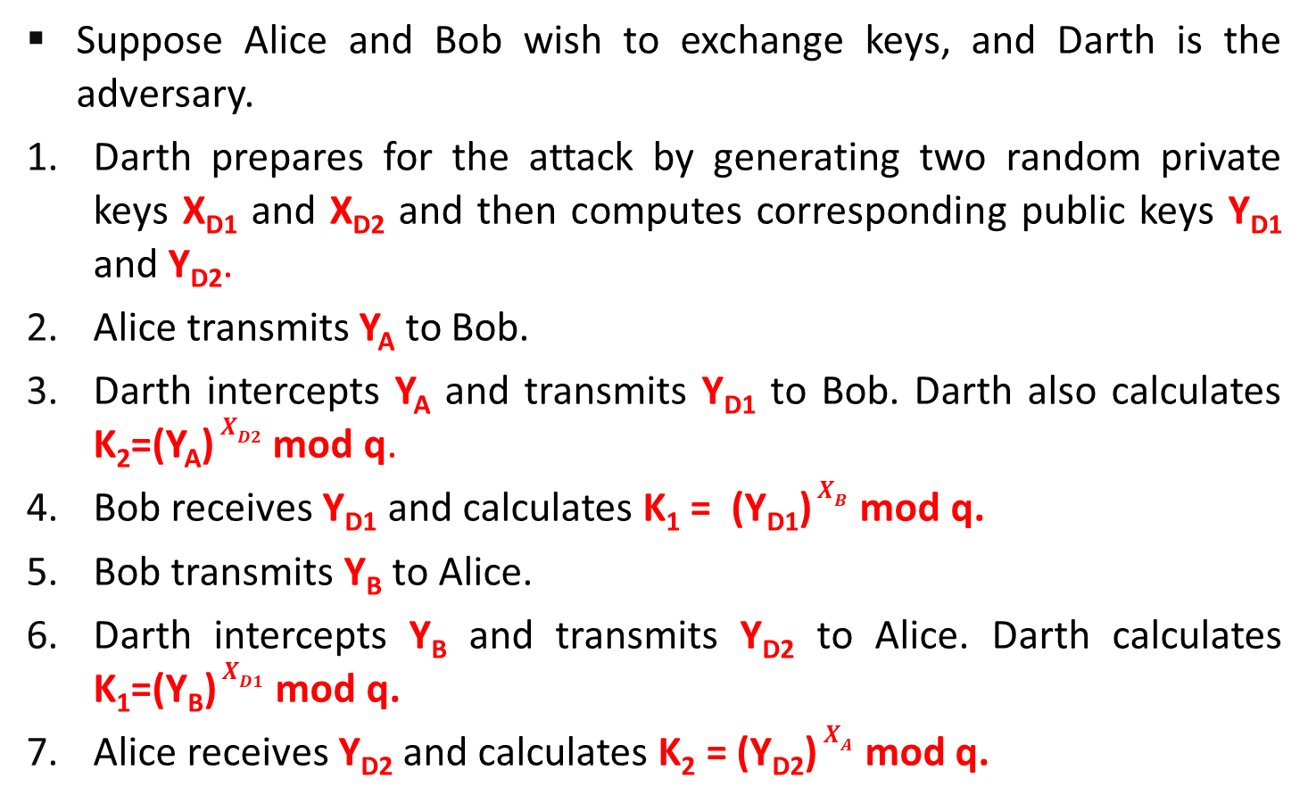
Man in the middle attack
Suppose Alice and Bob wish to exchange keys, and Darth is the adversary.
Darth prepares for the attack by generating two random private keys X_{D1} and X_{D2} and then computes corresponding public keys Y_{D1} and Y_{D2}.
Alice transmits Y_{A} to Bob.
Darth intercepts Y_{A} and transmits Y_{D1} to Bob. Darth also calculates K₂=(Y_{A}) $X_{D2}$ mod q.
Bob receives Y_{D1} and calculates K₁ = (Y_{D1}) $X_{B}$ mod q.
Bob transmits Y_{B} to Alice.
Darth intercepts Y_{B} and transmits Y_{D2} to Alice. Darth calculates K₁=(Y_{B}) $X_{D1}$ mod q.
Alice receives Y_{D2} and calculates K₂ = (Y_{D2}) $X_{A}$ mod q.

Slide 34
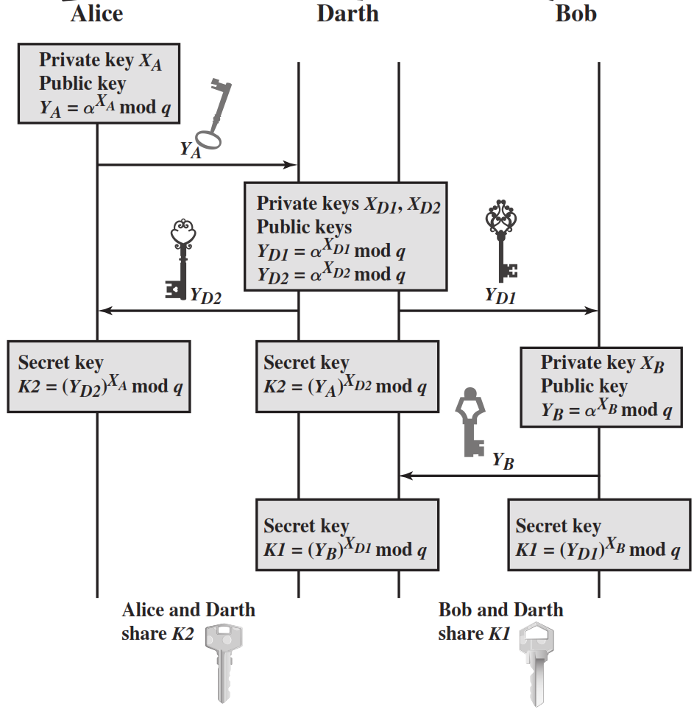

Slide 35
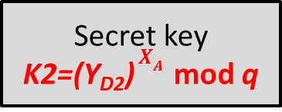
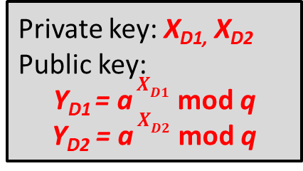

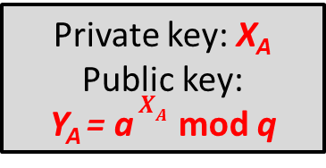
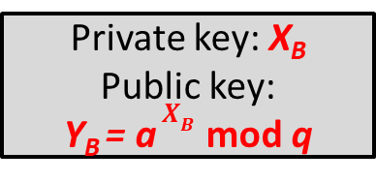


Alice | Darth | Bob
Private key: X_{A}
Public key:
Y_{A} = a $X_{A}$ mod q
Y_{A}
Private key: X_{D1,} X_{D2} Public key:
Y_{D1} = a $X_{D1}$ mod q
Y_{D2} = a $X_{D2}$ mod q
Y_{D2}
Y_{D1}
Private key: X_{B}
Public key:
Y_{B} = a $X_{B}$ mod q
Secret key
K2=(Y_{D2}) $X_{A}$ mod q
Secret key
K2=(Y_{A}) $X_{D2}$ mod q
Y_{B}
Secret key
K1=(Y_{B}) $X_{D1}$ mod q
Secret key
K1=(Y_{D1}) $X_{B}$ mod q
Alice and Darth
share Key K2
Darth and Bob
share Key K1

Slide 36

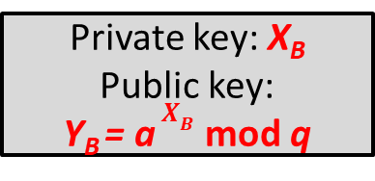
Alice | Darth | Bob
Private key: X_{A}
Public key:
Y_{A} = a $X_{A}$ mod q
Private key: X_{B}
Public key:
Y_{B} = a $X_{B}$ mod q
Y_{A}
Y_{B}
Private key: X_{D1,} X_{D2} Public key:
Y_{D1} = a $X_{D1}$ mod q
Y_{D2} = a $X_{D2}$ mod q
Y_{D2}
Y_{D1}
Secret key
K2=(Y_{D2}) $X_{A}$ mod q
Secret key
K2=(Y_{A}) $X_{D2}$ mod q
Secret key
K1=(Y_{D1}) $X_{B}$ mod q
Secret key
K1=(Y_{B}) $X_{D1}$ mod q
Alice and Darth
share Key K2
Darth and Bob
share Key K1

Slide 37
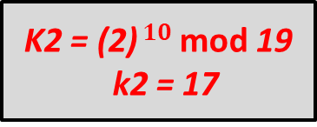
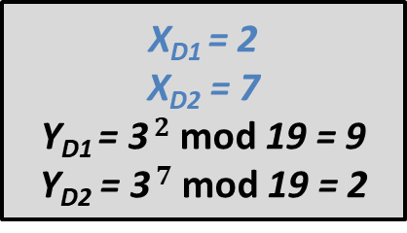

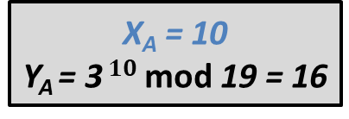



q = 19 and a = 3
q = 19 and a = 3
Alice | Darth | Bob
X_{A} = 10
Y_{A} = 3 $10$ mod 19 = 16
X_{B} = 11
Y_{B} = 3$11$ mod 19 = 10
Y_{A} = 16
Y_{B} = 10
X_{D1} = 2
X_{D2} = 7
Y_{D1} = 3 $2$ mod 19 = 9
Y_{D2} = 3 $7$ mod 19 = 2
Y_{D2} = 2
Y_{D1} = 9
K2 = (2) $10$ mod 19
k2 = 17
K2 = (16) $7$ mod 19 k2 = 17
K1 = (9) $11$ mod 19
k1 = 5
K1 = (10) $2$ mod 19 k1 = 5
Alice and Darth
share Key K2 = 17
Darth and Bob
share Key K1 = 5

Slide 38


