Slide 1


UNIT-6 Message Authentication Codes
Prof. Rupesh G. Vaishnav
rupesh.vaishnav@darshan.ac.in
94280-37452
Information & Network Security (2170709) Darshan Institute of Engineering & Technology

Slide 2
Outline
Message Authentication Codes
MAC requirements and security
MACs based on Hash Functions
MACs based on Block Ciphers
Notes:
X.800 and RFC 2828
International Telecommunication Union (ITU)

Slide 3
Message Authentication
Message authentication is a procedure to verify that received messages come from the genuine source and have not been altered.
Message authentication may also verify sequencing and timeliness.
Message authentication is a mechanism or service used to verify the integrity of a message.
Message authentication assures that data received are exactly as sent (i.e., contain no modification, insertion, deletion, or replay).

Slide 4
Message Authentication Requirements
Disclosure: Release of message contents
Traffic analysis: Discovery of the pattern of traffic between parties
Masquerade: Insertion of messages into the network from a fraudulent source
Content modification: Changes to the contents of a message
Sequence modification: Any modification to a sequence of messages between parties
Timing modification: Delay or replay of messages
Source repudiation: Denial of transmission of message by source
Destination repudiation: Denial of receipt of message by destination

Slide 5
Message Authentication Requirements
Disclosure
Traffic analysis
Masquerade
Content modification
Sequence modification
Timing modification
Source repudiation
Destination repudiation
Requires Message Confidentiality
Requires Message Authentication
Requires Digital Signature

Slide 6
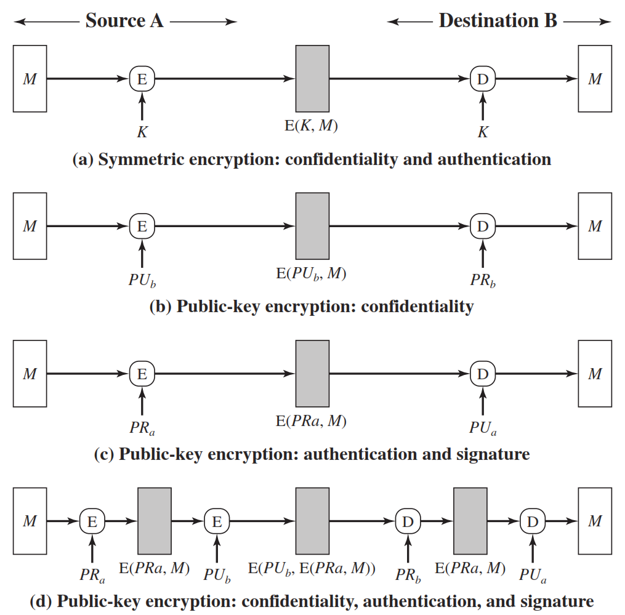

Slide 7
Message Authentication Code
An alternative authentication technique involves the use of a secret key to generate a small fixed-size block of data, known as a cryptographic checksum or MAC
MAC is appended to the message. This technique assumes that two communicating parties, say A and B, share a common secret key K.
When A has a message to send to B, it calculates the MAC as a function of the message and the key
MAC = C ( K , M )

Slide 8
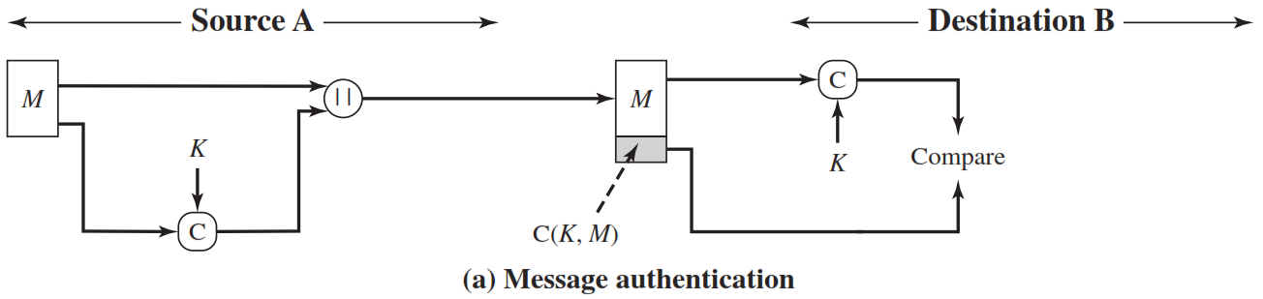
Message Authentication Code
The receiver is assured that the message has not been altered. If an attacker alters the message but does not alter the MAC, then the receiver’s calculation of the MAC will differ from the received MAC.
Because the attacker is assumed not to Know the secret key, the attacker cannot alter the MAC to correspond to the alterations in the message.

Slide 9
Message Authentication code - Cont…
The receiver is assured that the message is from the alleged sender.
Because no one else knows the secret key, no one else could prepare a message with a proper MAC.
A MAC function is similar to encryption. One difference is that the MAC algorithm need not be reversible, as it must be for decryption.
In general, the MAC function is a many-to-one function. The domain of the function consists of messages of some arbitrary length, whereas the range consists of all possible MACs and all possible keys.
If an n-bit MAC is used, then there are 2 ^{n} possible MACs

Slide 10
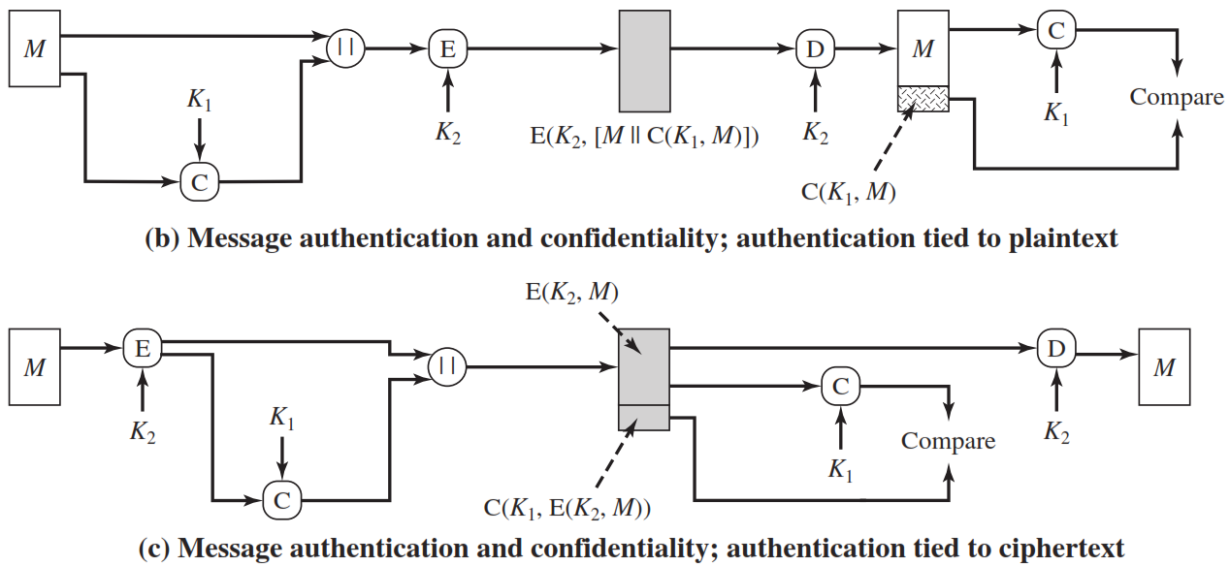
Message Authentication code - Cont…

Slide 11
MAC Based on Hash Functions - HMAC
Cryptographic hash functions such as MD5 and SHA generally execute faster in software than symmetric block ciphers such as DES.
Library code for cryptographic hash functions is widely available.

Slide 12
Design objectives for HMAC
To use, without modifications, available hash functions.
To allow for easy replaceability of the embedded hash function in case faster or more secure hash functions are found or required.
To preserve the original performance of the hash function without incurring a significant degradation.
To use and handle keys in a simple way.
To have a well understood cryptographic analysis of the strength of the authentication mechanism based on reasonable assumptions about the embedded hash function.

Slide 13
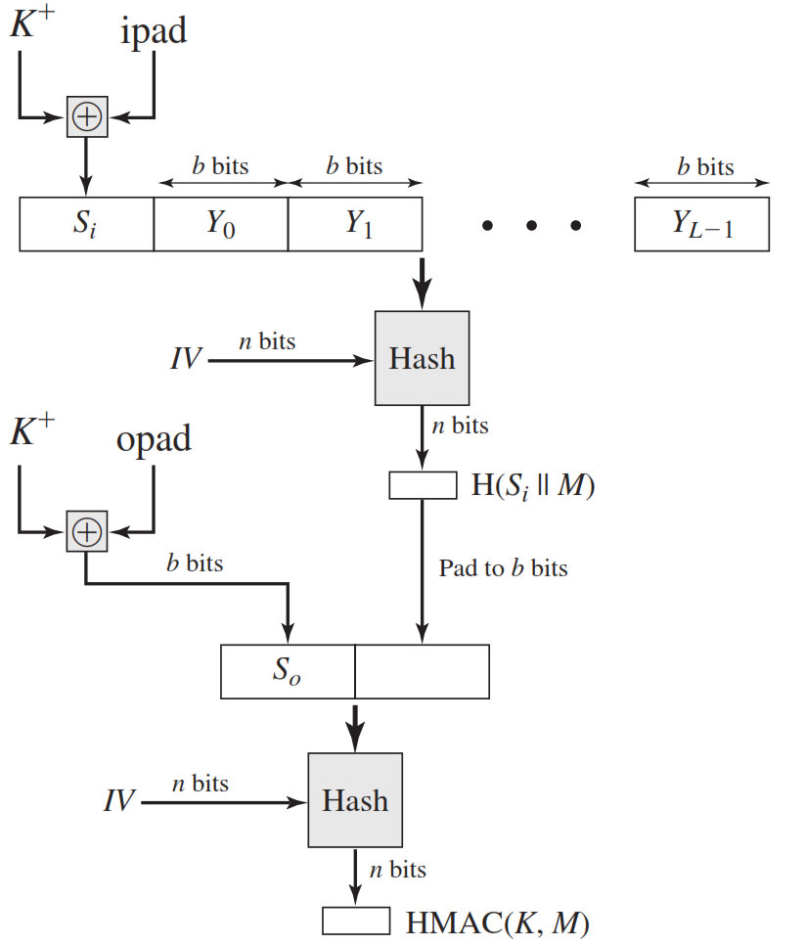
HMAC Structure
Append zeros to the left end of K to create a b-bit string K⁺
XOR K⁺ with ipad to produce the b-bit block Si.
Append M to Si.
Apply H to the stream generated in step 3.
XOR K⁺ with opad to produce the b-bit block S₀.
Append the hash result from step 4 to S₀.
Apply H to the stream generated in step 6 and output the result.

Slide 14
HMAC Structure
H = embedded hash function (e.g., MD5, SHA-1, RIPEMD-160)
IV = initial value input to hash function
M = message input to HMAC
Yi = i ^{th} block of M
L = number of blocks in M
n = length of hash code produced by embedded hash function
K ⁺ = K padded with zeros on the left so that the result is b bits in length
ipad = 00110110 (36 in hexadecimal) repeated b/8 times
opad = 01011100 (5C in hexadecimal) repeated b/8 times

Slide 15
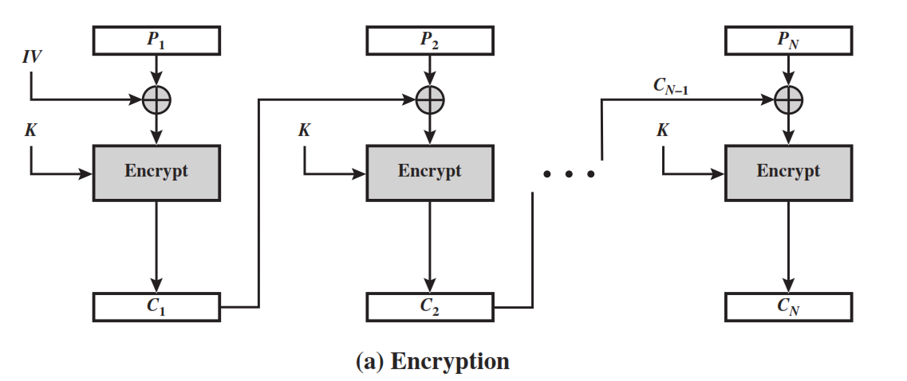
MAC based on Block Ciphers
The Data Authentication Algorithm (DAA), based on DES, has been one of the most widely used MACs for a number of years.
The algorithm can be defined as using the cipher block chaining (CBC) mode of operation of DES (Figure 6.4) with an initialization vector of zero.

Slide 16
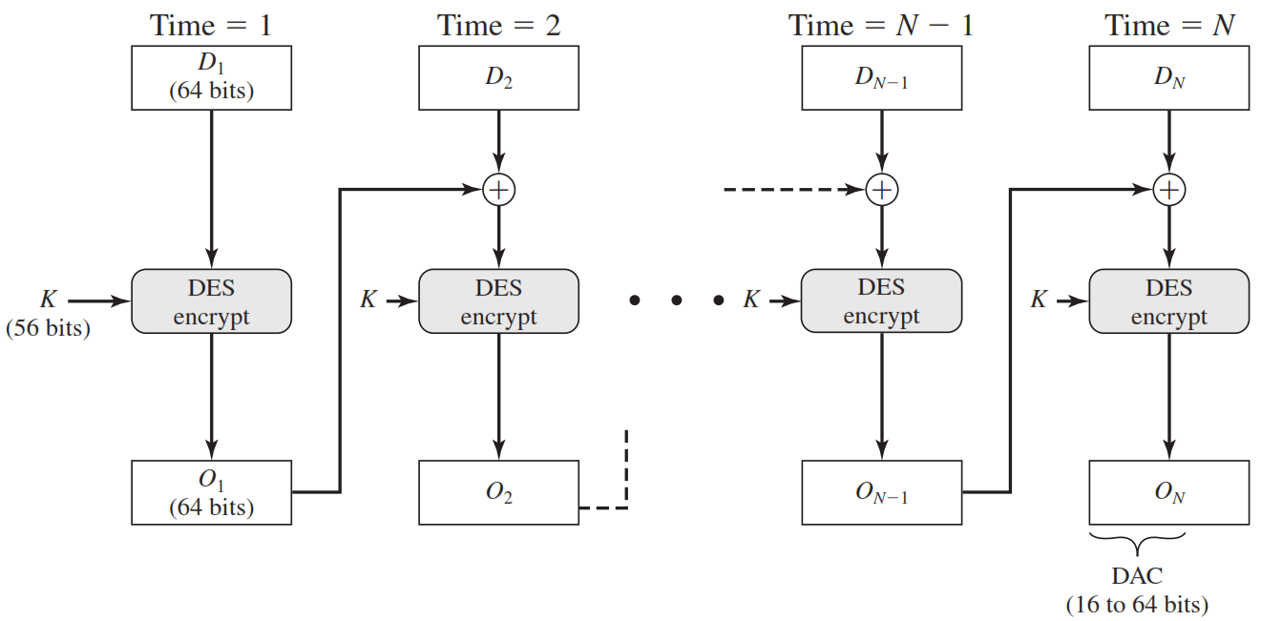
Data Authentication Algorithm (DAA)

Slide 17
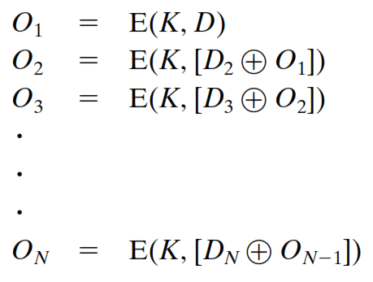
Data Authentication Algorithm (DAA)
The data (e.g., message, record, file, or program) to be authenticated are grouped into contiguous 64-bit blocks:
D1, D2, …. Dn. If necessary, the final block is padded on the right with zeroes to form a full 64-bit block. Using the DES encryption algorithm E and a secret key K, a data authentication code (DAC) is calculated as follows

Slide 18
Cipher-Based Message Authentication Code (CMAC)
Cipher-based Message Authentication Code (CMAC) mode of operation for use with AES and triple DES.
First, let us define the operation of CMAC when the message is an integer multiple n of the cipher block length b. For AES, b = 128, and for triple DES, b = 64. The message is divided into n blocks (M1, M2,… Mn)

Slide 19
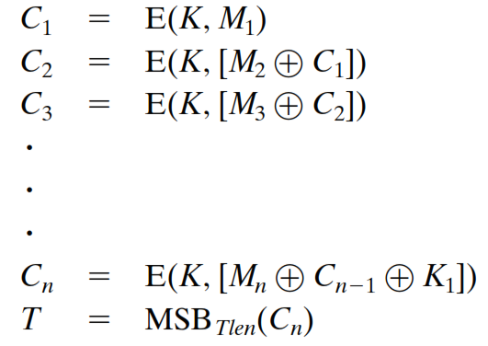
Cipher-Based Message Authentication Code (CMAC)
The algorithm makes use of a k-bit encryption key K and a b-bit constant, K1.
For AES, the key size k is 128, 192, or 256 bits; for triple DES, the key size is 112 or 168 bits.
CMAC is calculated as follows

Slide 20
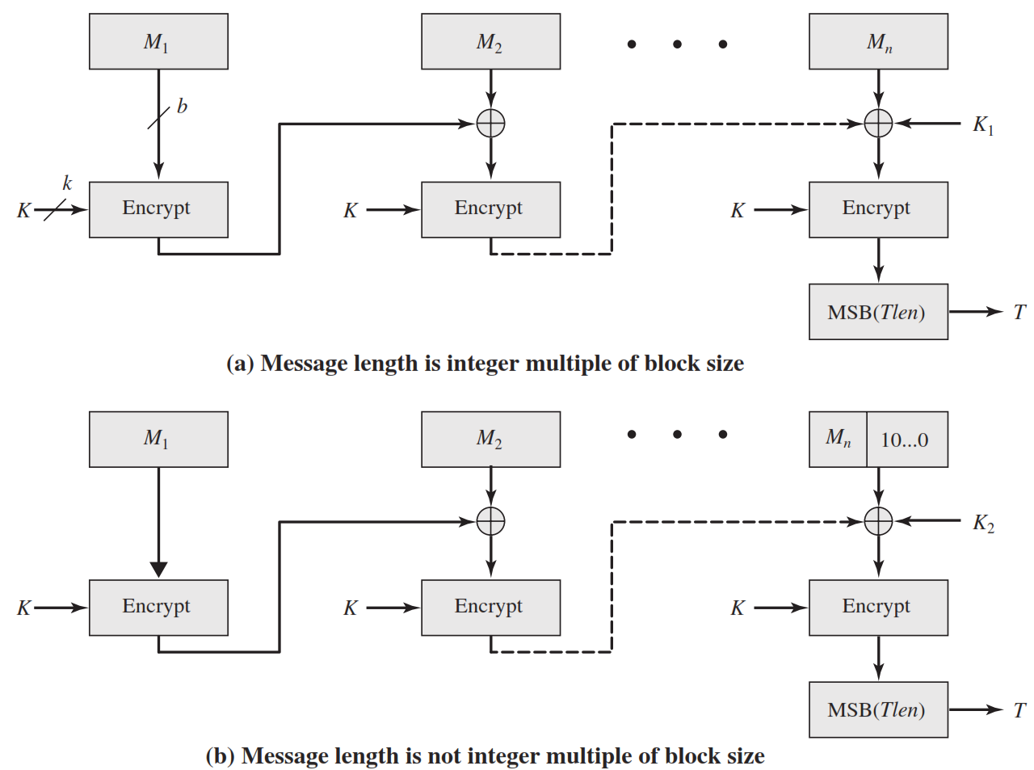
Cipher-Based Message Authentication Code (CMAC)

Slide 21


