Slide 1

Unit – 4: Wireless LAN
Mobile Computing and Wireless Communication (2170710)
Prof. Maulik Trivedi
 9998265805
→ maulik.trivedi@darshan.ac.in
Computer Engineering | Darshan Institute of Engineering & Technology

Slide 2
Outline
Introduction
Advantages of Wireless LAN
Applications of WLAN
IEEE Standard
Type of WLAN
Adhoc Vs. Infrastructure Mode
IEEE 802.11 Architecture
Wired Equivalent Privacy (WEP)
WEP Algorithm
802.1X Authentication
3G vs. WIFI

Slide 3
Introduction
WLAN is a local area data network without wires.
Mobile users can access information and network resources through wireless LAN as they attend meetings, collaborate with other users, or move to other locations in the premises.
WLAN is not a replacement for the wired infrastructure. It is implemented as an extension to a wired LAN within a building or campus.
Wireless LAN is commercially known as WiFi or Wi-Fi.
Wi-Fi is an acronym for Wireless Fidelity.

Slide 4
Advantages of WLAN
Mobility
Low Implementation Costs
Installation Speed and Simplicity
Network Expansion
Reduced Cost-of-Ownership
Higher User to Install Base Ratio
Reliability
Scalability
Usage of ISM band

Slide 5
Applications of WLAN
Office/Campus Environment
Factory Shop Floor
Homes
Workgroup Environment
Heritage Buildings
Public Places
War/Defense Sites

Slide 6
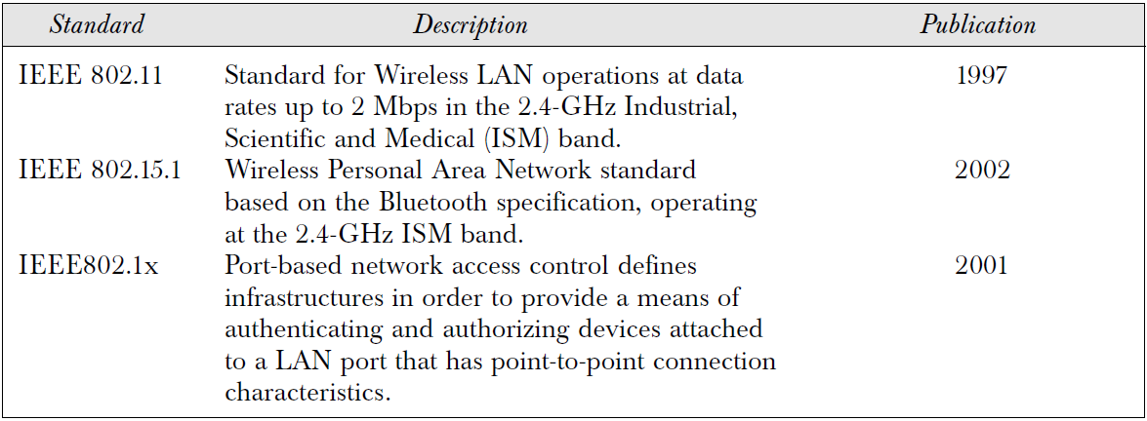
IEEE Standards related to WLAN

Slide 7
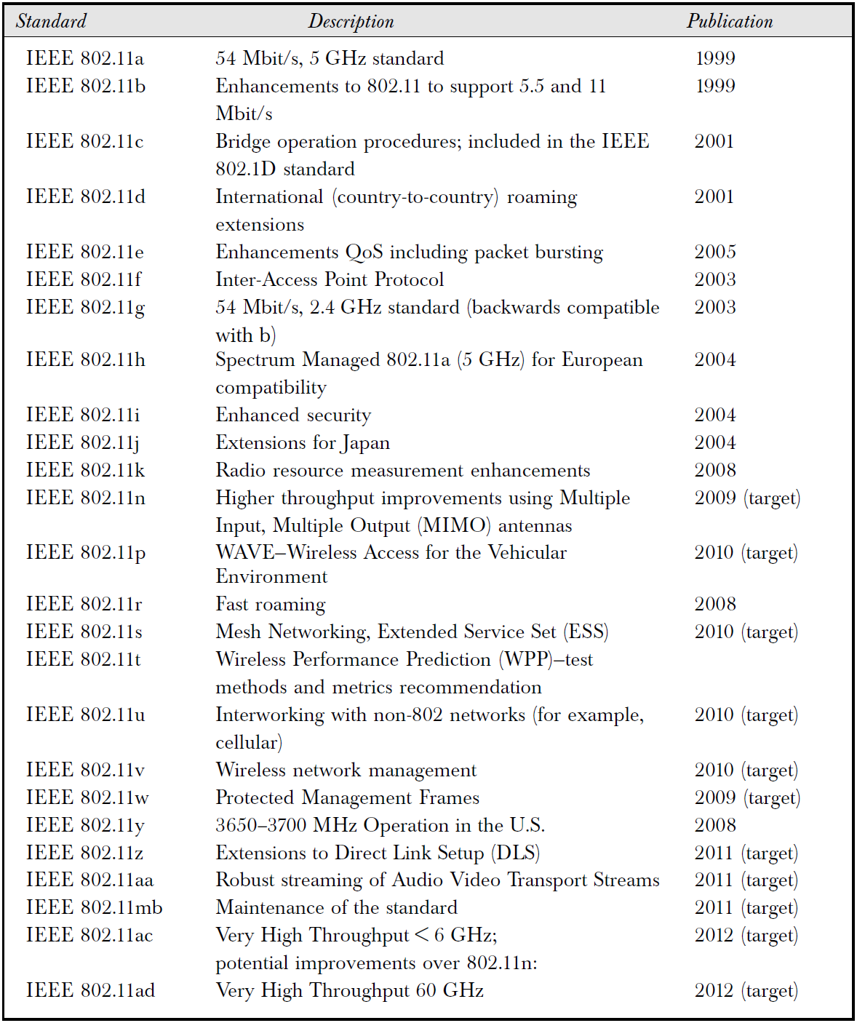

Slide 8
Types of WLAN
802.11
HyperLAN (or HiperLAN)
HomeRF
Bluetooth
MANET

Slide 9
Adhoc versus Infrastructure Mode
In an adhoc mode, there is no access point or infrastructure.
A number of mobile stations form a cluster communicate with each other.
In an infrastructure mode, the mobile stations (MS) are connected to a base station or Access Point (AP).
This is similar to a star network where all the mobile stations are attached to the base station.
Through a protocol the base station manages the dialogues between the AP and the MS.

Slide 10
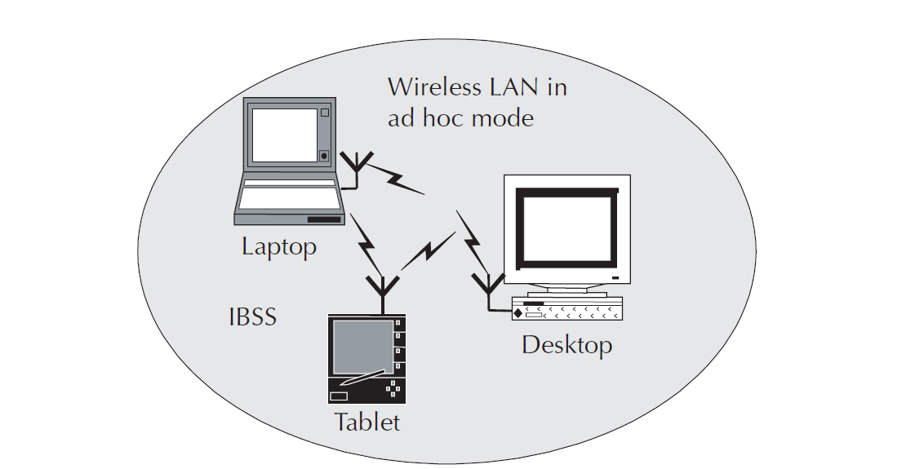
Adhoc Mode

Slide 11
Infrastructure Mode

Slide 12
IEEE 802.11 Architecture
In the 802.11 architecture, one cell or a BSS is controlled by one Base Station.
This base station is called Access Point or AP in short.
Although a wireless LAN may be formed by a single cell, with a single Access Point, most installations will be formed by several cells, where the access points are connected through some kind of backbone.
This backbone is called Distribution System (or DS). This backbone is typically Ethernet and, in some cases, is wireless itself.
The whole interconnected Wireless LAN, including the different cells, their respective Access Points and the Distribution System, is seen as a single 802 network to the upper layers of the OSI model and is called as Extended Service Set (ESS).

Slide 13
IEEE 802.11 Stack
The 802.11 standards cover definitions for both MAC (Medium Access Control) and Physical Layer.
The standard currently defines a single MAC, which interacts with three PHYs: Frequency Hopping Spread Spectrum, Direct Sequence Spread Spectrum and InfraRed.

Slide 14
Physical Layer
The architecture of the Physical layer comprises of the two sub layers for each station:
Physical Layer Convergence Procedure (PLCP):
PLCP sub layer is responsible for the Carrier Sense (CS) part of the Carrier Sense Multiple Access/Collision Avoidance (CSMA/CA) protocol.
PLCP layer prepares the MAC Protocol Data Unit (MPDU) for transmission.
The PLCP also delivers the incoming frames from the wireless medium to the MAC layer.

Slide 15
Physical Layer – Cont…
Physical Medium Dependent (PMD):
The PMD provides the actual transmission and reception of physical layer entities between stations through the wireless media.
This sub layer provides the modulation/demodulation of the transmission.

Slide 16
FHSS Physical Layer
In Frequency Hopping Spread Spectrum (FHSS) mode, the layer carries the clocking information to synchronize the receiver clock with the clock of the transmitted packet.
FHSS PMD is responsible for converting the binary bit sequence into analog signal and transmit the PPDU frame into the air.
FHSS PMD does this using the frequency hopping technique.

Slide 17
DSSS Physical Layer
DSSS PLCP is responsible for synchronizing and receiving the data bits correctly.
DSSS PMD translates the binary digital sequence into analog radio signals and transmits the PPDU frame into the air.
The DSSS physical layer operates within the ISM band.

Slide 18
Wired Equivalent Privacy (WEP)
WEP was designed to protect users of a WLAN from casual eavesdropping and was intended to offer following facilities:
Reasonably strong encryption - It relies on the difficulty of recovering the secret key through a brute force attack. The difficulty grows with the key length.
Self-synchronizing - Each packet contains the information required to decrypt it. There is no need to deal with lost packets.
Efficient - It can be implemented in software with reasonable efficiency.
Exportable - Limiting the key length leads to a greater possibility of export beyond US.

Slide 19
WEP Algorithm
It is assumed that the secret key has been distributed to both the transmitting and receiving stations by some secure means.
On the transmitting station, the 40-bit secret key is concatenated with a 24-bit Initialization Vector (IV) to produce a seed for input into the WEP PRNG (Pseudo Random Number Generator).
The seed is passed into the PRNG to produce a stream of pseudorandom octets.
The plaintext PDU is then XOR-ed with the pseudo-random keystream to produce the cipher-text PDU.
This cipher-text PDU is then concatenated with the 24-bits IV and transmitted on the wireless media.

Slide 20
WEP Algorithm – Cont…
The receiving station reads the IV and concatenates it with the secret key, producing the seed that it passes to the PRNG.
The receiver’s PRNG produces identical keystream used by the transmitting station. When this PRNG is XORed with the ciphertext, the original plaintext PDU is produced.
It is worth mentioning that the plaintext PDU is also protected with a CRC to prevent random tampering with the ciphertext in transit.

Slide 21
Possible Attacks
Passive attacks
Active attacks
Active attacks to decrypt traffic
Dictionary-building attack
Hijacking a session

Slide 22
802.1X Authentication
To prevent attacks on wireless LAN, the IEEE specification committee on 802.11 included the 802.1x authentication framework.
The 802.1x framework provides the link layer with extensible authentication, normally seen in higher layers.
802.1x requires three entities:
The supplicant Resides on the wireless LAN client
The authenticator Resides on the access point
The authentication server Resides on the server authenticating the client (e.g., RADIUS Kerberos, or other servers)

Slide 23
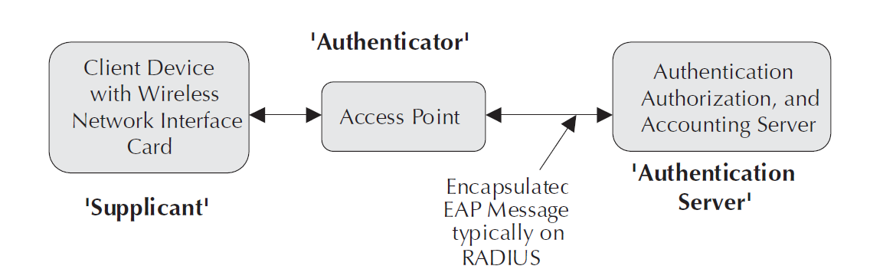
802.1X Authentication – Cont…

Slide 24
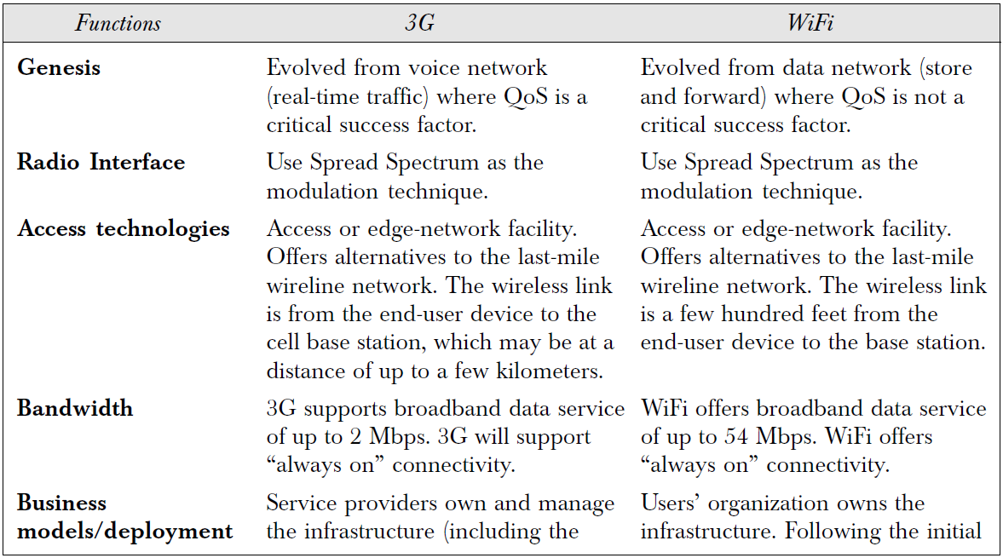
3G Vs. Wifi

Slide 25
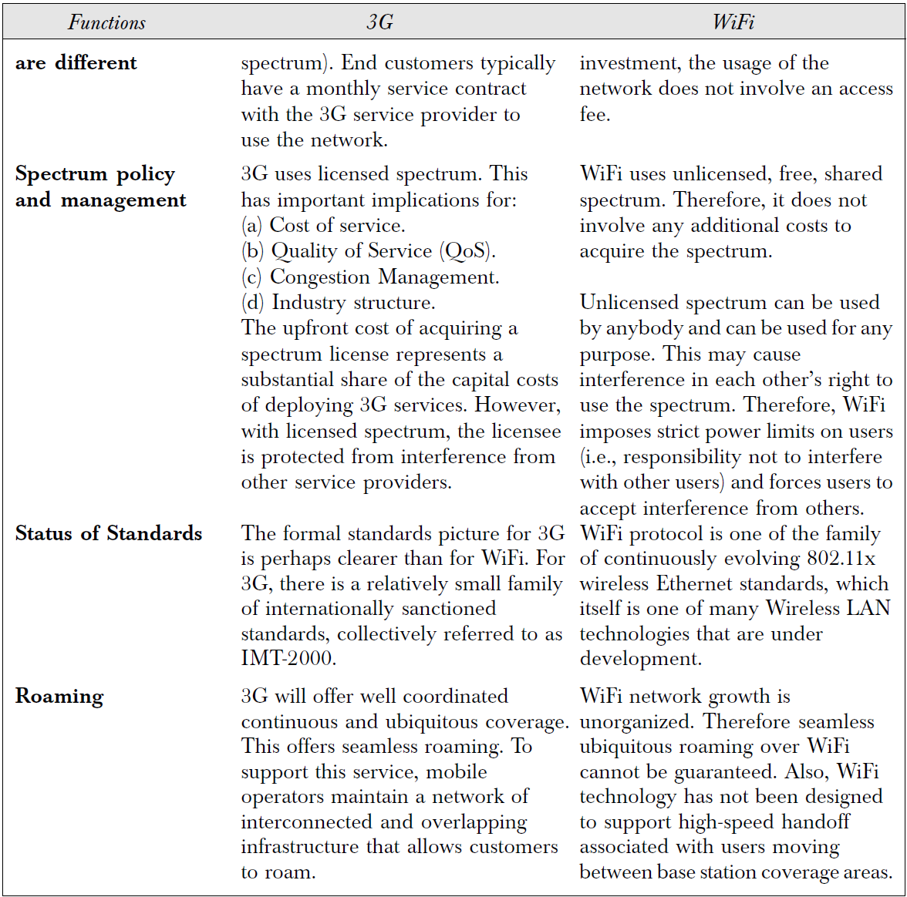

Slide 26
Summary
Introduction (Wireless LAN)
Advantages of Wireless LAN
Applications of WLAN
IEEE Standard
Type of WLAN (802.11, HyperLAN, HomeRF, Bluetooth, MANET)
Adhoc Vs. Infrastructure Mode
IEEE 802.11 Architecture (IEEE 802.11 Stack)
Wired Equivalent Privacy (WEP) (Protect user of WLAN)
WEP Algorithm
802.1X Authentication
3G vs. WIFI

Slide 27
Thank You

