Slide 1
Unsupervised Decomposition of Multi-Author Document
Kautsya Kanu (2012ME20780)
Sayantan Sengupta (2015ANZ8478)

Slide 2
Introduction
“The number of choices an author has to formulate a sentence in terms of grammar structure is rather high, and the assumption in this approach is that the concrete choices is made intuitively and unconsciously” - Gunther Specht
Decompose document, written collaboratively by multiple authors based on authorial components.
Exploit the writing styles of different Authors.

Slide 3
Application
Plagiarism detection: A main cluster is formed for the main author and one or more paragraphs for intrusive paragraphs.
Verification of collaborated student works such as Bachelors/Masters thesis to determine the amount of work done by each student.

Slide 4
Key Challenges
Easy to decompose based on topics and contexts(text segmentation)
Multiple-Author same topic ?
Quantify the differences of the grammatical writing styles of the authors
No prior information about the author’s written texts (supervised classification ruled out)
Number of authors unknown

Slide 5
Previous Approaches
Most common approach for feature extraction : tf-idf which measures the significance of a word compared to the whole document collection. [Larsen et al. (1999)].
Dividing texts based on topics rather than authors, [choi (2000), Brants et al. (2002), Misra et al. (2009) and Henning and Labor(2009)
Koppel et al. (2011) approach require manual translations and concordance to be available beforehand.
Akiva and Koppel (2013) investigated this limitations and presented a generic unsupervised method, but – Performance degraded when authors more than two and valid only for special types of documents(Bible Books).

Slide 6
Baseline
Assumptions:
Every sentence is completely written by only one of the authors.
Every author has written consecutive sequences of sentences.
The key idea is to exploit the difference in the posterior probability of the Naïve-Bayesian model to increase the precision and accuracy of the classification process.
- Khaled Aldebei, Xiangjian He, Jie Yang “Unsupervised Decompostion of a multi-author document based on Naive-Bayesian model” Proceedings of the 53rd Annual Meeting of the Association for Computational Linguistics (Short Papers), pages 501–505, Beijing, China

Slide 9
Main Points
Input to GMM :- segments are featurised using a binary vector reflecting words appearing atleast 3 times in the document.
GMM training:- Iterative EM algorithm
Segments re-vectorized using binary representation of 1500 most frequently appeared words.
Choose vital segments based on the Segmentation Elicitation, difference of the posterior probabilities of each segments according to other classes.
Train a Naïve Bayes model on the segments and test it on the sentences.

Slide 10
Data Set
690 Blogs written by Gary Becker and Richard Posner
1,182 New York Times Articles written by four authors (MD,GC,TF,PK)
Challenging , since each author has written a lot of different topics and some topics are taken by both authors.

Slide 11
Results
Data set | Final Accuracy | #Sentences | #Authors
Becker Posner | 0.82 | 9638 | 2
GC-TF-PK | 0.674 | 11984 | 3
MD-TF-PK | 0.703 | 13422 | 3
MD-GC-PK | 0.661 | 13448 | 3
MD-GC-TF-PK | 0.614 | 15584 | 4

Slide 12
Variability of Clustering Recall with change in V(Chunk Size)

Slide 13
Variability of Accuracy with change in V(Chunk Size)

Slide 14
Limitations of the Baseline
No NLP features used for identifying authors.
Bag of words is a weak model.
Accuracy depends on parameter V (chunk of sentences picked from each author).
Changing V from 200 to 50 reduces the accuracy from 85% to 49%.

Slide 15
Our Method
Main Idea: Quantify the differences of the grammatical writing styles and use this information to build paragraph clusters, whereby each cluster is assigned to a different author.
S1: “My chair started squeaking a few days ago and it’s driving me nuts.”
S2: “Since a few days my chair is squeaking-it’s simply annoying”
Semantically similar

Slide 16
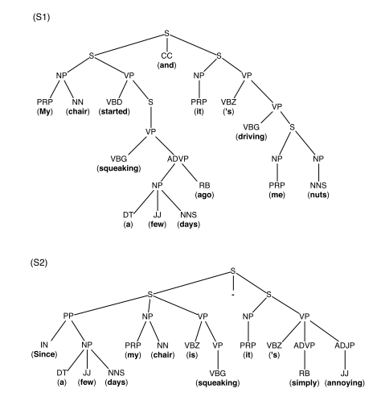

Slide 18
Specifications
Value of P and Q is set to 2 and 3 respectively.
Concrete words are omitted (?) – Intended to examine building structure of the sentences.
Grammar tree is created using StanfordParser.
Labels are POS tags of Penntree bank.

Slide 19
Questions?

