Slide 1


Bank of Baroda Hackathon - 2022
Technology Partner
Your Team Name : ML SQUAD
Your team bio : Four students allied to Innovate using Automation & Machine Learning.
Date : 20-09-2022

Slide 2
Problem Statement
Bank handles large volumes of cheques in the clearing process. The process involves many technical verifications including signature verification. Some of these steps are manual and require human intervention to complete the process. The current process requires the high human capital deployment and longer processing time.
Why we decide to solve this ?
We decided to solve this problem because manual processing of cheque requires lot of time which can be reduced by the use of Computer Vision.
The main purpose behind AI based cheque clearance system is to reduce the processing time while also making the process less prone to errors and possible frauds.
Automated Cheque Processing if feasible and scalable.

Slide 3
User Segment & Pain Points
Which user /advertiser segment would be early adopter of your product & why?
Our early adopters will be the bank employees who are involved in the cheque clearing procedures.
Our product can also be embedded with ATMs so that the whole cheque processing can actually become automated.
Our product also consist of a user-friendly app, so that user can easily process cheques while sitting in their home without compromising security.
After embedding with ATM, customers of banks don’t need to go to branches for deposition of cheques.
Our product will make the process of clearing cheques faster, which will benefit the bank and bank staffs and can increase the productivity of the employees.

Slide 4
Pre-Requisite
What are the alternatives/competitive products for the problem you are solving?
Currently, cheques are manually processed and there is no alternative for this project in India.
In US, there are few banks who is implementing Automated Cheque Processing but their solution is not so effective.

Slide 5
Azure Tools Or Resources
Azure OCR :- The Computer Vision Read API is Azure's latest OCR technology (learn what's new) that extracts printed text (in several languages), handwritten text (in several languages), digits, and currency symbols from image. It's optimized to extract text from text-heavy images with mixed languages. It supports extracting both printed and handwritten text in the same image or document. It is multilingual. Azure Cosmos DB :- Azure Cosmos DB is a fully managed NoSQL database for modern app development. Single-digit millisecond response times, and automatic and instant scalability, guarantee speed at any scale. Business continuity is assured with SLA-backed availability and enterprise-grade security. Azure App Service :- Azure App Service lets you create apps faster with a one-of-a kind cloud service to quickly and easily create enterprise-ready web and mobile apps for any platform or device and deploy them on a scalable and reliable cloud infrastructure. We need it to create mobile application.

Slide 6
Any Supporting Functional Documents
Present your solution, talk about methodology, architecture & scalability
Extract different parts of Cheque: As per RBI rules we can extract different parts of cheque using RBI’s "CTS-2010 Standard" for Cheque Forms – Speciﬁcations for veriﬁcation.
Match Signature from bank database: Match the signature from cheque with respect to signature from bank database. Also check for forge signature using neural networks techniques.
Validating the cheque: If all checks passes then proceed to next step otherwise detection of potential frauds will be processed further for investigation.
Check for overwriting/correction: The writing should be checked for overwriting/correct using neural networks if found bounce the cheque. (Image processing)
Data Entry: After all the veriﬁcation is done the details of the cheque will be extracted using Azure Computer Vision API (conﬁgured for Multiple Languages) and start transaction process.

Slide 7
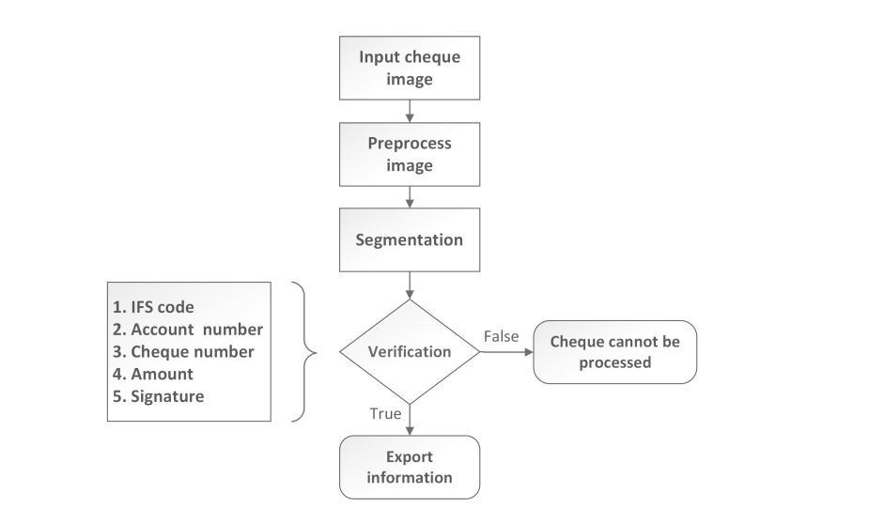
Flow Chart For Automated Cheque Processing

Slide 8
Key Differentiators & Adoption Plan
How is your solution better than alternatives and how do you plan to build adoption?
Our product requires negligible human interaction for processing which is far better than manual processing of cheques.
Text extraction accuracy is more than 98%.
Convenient. Customers don’t need to go to branches of bank, they can process their cheques from nearest ATMs or through Mobile App.
Cost Effective. Our product can be easily implemented with the existing system with just little change in the system.
Adoption :- The bank employees can upload the cheque image to our software. After processing, they will get a confirmation message (if processing successful), and transaction will take place.
For ATM implementation, we just need to attach a small module consisting of a camera and a button. User will proceed by clicking button and they will get the details of transaction. They can proceed to complete the transaction.

Slide 9
GitHub Repository Link & supporting diagrams, screenshots, if any
How far it can go?
Github Link : https://github.com/kautuk-astu/ACP-ML-SQAUD/upload/main/idea

Slide 10
Thank You
Team members :-
Kautuk Astu
Utsarg Baranwal
Prakhar Gupta
Parth Gupta

