Slide 1
Programming Languages 1 - C

Slide 2
Model of a computing machine
Computing machine (Computer): “a machine that stores and manipulates information under the control of a changeable program that is stored in its memory.”
Pocket calculator: not a computer ! Manipulates information, but is built to do a specific task (no changeable stored program)
This model is named the “von Neumann architecture” (John von Neumann – 1945; EDVAC - Electronic Discrete Variable Automatic Computer – the first stored-program computer)
Stored-program concept: earlier ideas in theoretical articles of: Alan Turing (1936), Konrad Zuse (1936)

Slide 3
The von Neumann architecture
CPU
Input Device
Output Device
ALU
CU
Main memory
(RAM)
Secondary
storage

Slide 4
The von Neumann architecture
Central Processing Unit (CPU): the “brain” of the machine.
CU: Control Unit
ALU: Arithmetic and Logic Unit
Carries out all basic operations of the computer
Examples of basic operation: adding two numbers, testing to see if two numbers are equal.
Main memory (called RAM for Random Access Memory): stores programs and data
Fast but volatile
Secondary memory: provides permanent storage
Human-computer interaction: through input and output devices.
keyboard, mouse, monitor
Information from input devices is processed by the CPU and may be sent to the main or secondary memory. When information needs to be displayed, the CPU sends it to the output device(s).

Slide 5
How it works
How does a computer execute a program ? (example programs: a computer game, a word processor, etc)
the instructions that comprise the program are copied from the permanent secondary memory into the main memory
After the instructions are loaded, the CPU starts executing the program.
For each instruction, the instruction is retrieved from memory, decoded to figure out what it represents, and the appropriate action carried out. (the fetch- execute cycle)
Then the next instruction is fetched, decoded and executed.

Slide 6
Machine level programming
Example: suppose we want the computer to add two numbers, and if the preliminary result is less than 10, then add 10 to the result
The instructions that the CPU carries out might be :
[INSTR1] Load into ALU the number from mem location 15
[INSTR2] Load into ALU the number from mem location 7
[INSTR3] Add the two numbers in the ALU
[INSTR4] If result is bigger than 10 jump to [INSTR6]
[INSTR5] Add 10 to the number in the ALU
[INSTR6] Store the result from ALU into mem location 3
The processors instruction set: all basic operations that can be carried out by a certain type of processor

Slide 7
Machine level programming
the instructions and operands are represented in binary notation (sequences of 0s and 1s).
Why binary ? Because computer hardware relies on electric/electronic circuits that have/can switch between 2 states
bit (binary digit)
Byte: 8 bits
The program carried out by the CPU, on a hypothetical processor type, could be:
1010 1111
1011 0111
0111
…
This way had to be programmed the first computers !
The job of the first programmers was to code directly in machine language and to enter their programs using switches

Slide 8
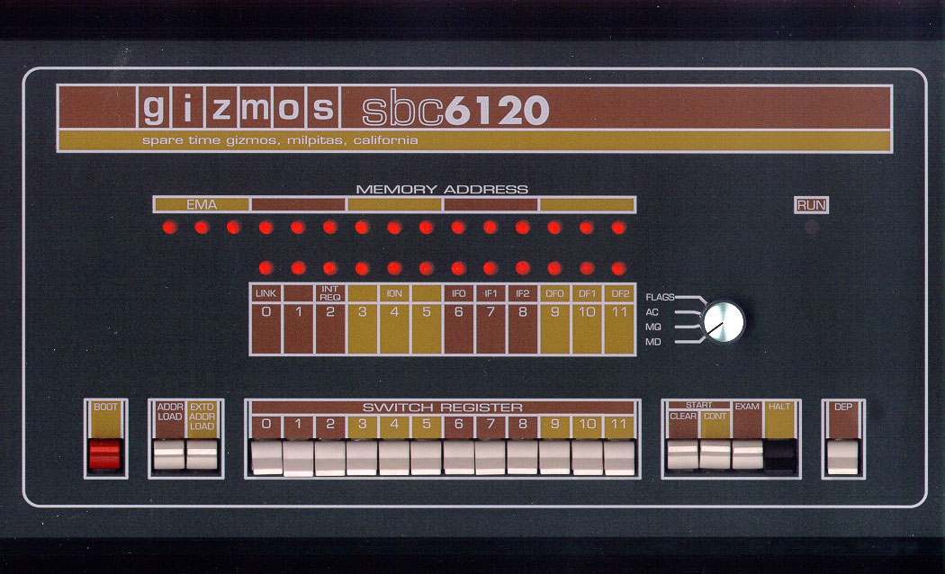
Example: old computer frontpanel
LEDS display the current memory address and contents of current memory location or registers
SWITCHES allow programmer to enter binary data / instructions

Slide 9
Higher level languages
Assembly language
First step from machine language
Uses symbolic names for operations
Example: a hypothetical assembly language program sequence:
1010 1111 LD1 15
1011 0111 LD2 7
0111 ADD 0011 1010 CMP 10
0010 1100 JGE 12
0110 1010 ADD 10
… …

Slide 10
Assembly language (cont)
Translation of assembly language into machine language: in the beginning done manually, later done by a special computer program – the assembler
Disadvantages: Low-level language:
programmer must learn the instruction set of the particular processor
Program must be rewritten in order to run on a different processor type – program is not portable

Slide 11
Higher level languages
High level languages
Using more abstract instructions
Portable programs result
Example: a hypothetical program sequence:
DEFVAR a,b,c;
BEGIN
READ a
READ b
READ c
c := a+b
IF (c <10) THEN c:=c+10
PRINT c
END …

Slide 12
High level languages
Writing portable programs, using more abstract instructions
A high level instruction (statement) is translated into many machine instructions
Translation of high level language into machine instructions: done by special computer programs – compilers or interpreters

Slide 13
Compilers/Interpreters
Source
Code
Compiler
Machine
Code
Source
Code
Interpreter
Input
data
Executable
Program
Output
data
Input
data
Output
data
Compiler: analyzes program and translates it into machine language
Executable program: can be run independently from compiler as many times => fast execution
Interpreter: analyzes and executes program statements at the same time
Execution is slower
Easier to debug program

Slide 14
Operating Systems
Operating system: a program that controls the entire operation of a computer system:
Handles all input and output (I/O) operations that are performed on a computer
manages the computer system’s resources
handles the execution of programs (including multitasking or multiuser facilities)
Most famous OS families:
Windows
Unix

Slide 15
Higher Level Languages
Programming Paradigms:
Imperative Programming: describes the exact sequences of commands to be executed
Structured programming, procedural programming
FORTRAN, C, PASCAL, …
Object oriented programming
C++, Java, C#, …
Declarative programming: program describes what it should do, not how
Functional programming
Lisp, ML, …
Logic Programming
Prolog

Slide 16
The C Programming Language
Developed by Dennis Ritchie at AT&T Bell Laboratories in the early 1970s
Growth of C tightly coupled with growth of Unix: Unix was written mostly in C
Success of PCs: need of porting C on MS-DOS
Many providers of C compilers for many different platforms => need for standardization of the C language
1990: ANSI C (American National Standards Institute)
International Standard Organization: ISO/IEC 9899:1990
1999: standard updated: C99, or ISO/IEC 9899:1999

