Slide 1
Programming Languages 1 - C
Types, Operators and Expressions

Slide 2
Content
Variable Names
Data Types and Sizes
Constants
Declarations
Arithmetic Operators
Relational and Logical Operators
Type Conversions
Increment and Decrement Operators
Bitwise Operators
Assignment Operators and Expressions
Conditional Expressions
Precedence and Order of Evaluation

Slide 3
Variables
In C, a variable must be declared before it can be used.
Global variables
declared outside any functions
created when the program starts
destroyed when the program terminates
Local variables
declared at the start of any block of code, but most are found at the start of each function.
created when the function is called
destroyed on return from that function.

Slide 4
Variable Names
Every variable has a name and a value.
The name identifies the variable, the value stores data.
Limitation on names
Every variable name in C must start with a letter, the rest of the name can consist of letters, numbers and underscore characters. Variable name can start with underscore also.
C recognizes upper and lower case characters as being different.
Finally, you cannot use any of C's keywords like main, while, switch etc as variable names.
The rules governing variable names also apply to the function names.

Slide 5
Conventions
Avoid using only capital letters in variable names.
These are used for names of constants.
Some old implementations of C only use the first 8 characters of a variable name.
Most modern ones don't apply this limit though.

Slide 6
Example: Some Valid Variable Names
x result outfile bestyet
x1 x2 out_file best_yet
power impetus gamma hi_score

Slide 7
Keywords of C
auto | break | case | char | const | continue | default | do
double | else | enum | extern | float | for | goto | if
int | long | register | return | short | signed | sizeof | static
struct | switch | typedef | union | unsigned | void | volatile | while

Slide 8
Basic Data Types
char | a single byte, capable of holding one character in the local character set
int | an integer, typically reflecting the natural size of integers on the host machine
float | single-precision floating point
double | double-precision floating point
The type determines the set of values it can have and what operations can be performed on it.

Slide 9
Modifiers
short
long
signed
unsigned

Slide 10
Data Types in Real World
type | bytes | bits | range
char | 1 | 8 | −128 ↔ 127
unsigned char | 1 | 8 | 0 ↔ 255
short int | 2 | 16 | −32,768 ↔ 32,767
unsigned short int | 2 | 16 | 0 ↔65,535
int | 4 | 32 | -2,147,483,648 ↔ +2,147,483,647
unsigned int | 4 | 32 | 0 ↔ 4,294,967,295
long int | 4 | 32 | -2,147,483,648 ↔ +2,147,483,647
unsigned long int | 4 | 32 | 0 ↔ 4,294,967,295
float | 4 | 32 | single-precision floating point
double | 8 | 64 | double-precision floating point
long double | 8 | 64 | extended-precision floating point

Slide 11
Data Types in Real World
type | bytes | bits | range
char | 1 | 8 | −128 ↔ 127
unsigned char | 1 | 8 | 0 ↔ 255
short int | 2 | 16 | −32,768 ↔ 32,767
unsigned short int | 2 | 16 | 0 ↔65,535
int | 4 | 32 | -2,147,483,648 ↔ +2,147,483,647
unsigned int | 4 | 32 | 0 ↔ 4,294,967,295
long int | 4 | 32 | -2,147,483,648 ↔ +2,147,483,647
unsigned long int | 4 | 32 | 0 ↔ 4,294,967,295
float | 4 | 32 | single-precision floating point
double | 8 | 64 | double-precision floating point
long double | 8 | 64 | extended-precision floating point
type | bytes | bits | range
char | 1 | 8 | −128 ↔ 127
unsigned char | 1 | 8 | 0 ↔ 255
short int | 2 | 16 | −32,768 ↔ 32,767
unsigned short int | 2 | 16 | 0 ↔65,535
int | 4 | 32 | -2,147,483,648 ↔ +2,147,483,647
unsigned int | 4 | 32 | 0 ↔ 4,294,967,295
long int | 4 | 32 | -2,147,483,648 ↔ +2,147,483,647
unsigned long int | 4 | 32 | 0 ↔ 4,294,967,295
float | 4 | 32 | single-precision floating point
double | 8 | 64 | double-precision floating point
long double | 8 | 64 | extended-precision floating point

Slide 12
Example: Sizes of C Data Types
#include <stdio.h>
/* view the sizes of C basic data types */
int main()
{
printf("sizeof(char) == %d\n", sizeof(char));
printf("sizeof(short) == %d\n", sizeof(short));
printf("sizeof(int) == %d\n", sizeof(int));
printf("sizeof(long) == %d\n", sizeof(long));
printf("sizeof(float) == %d\n", sizeof(float));
printf("sizeof(double) == %d\n", sizeof(double));
printf("sizeof(long double) == %d\n", sizeof(long double));
return 0;
}

Slide 13
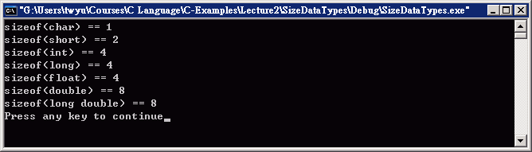
Example: Sizes of C Data Types
#include <stdio.h>
/* view the sizes of C basic data types */
int main()
{
printf("sizeof(char) == %d\n", sizeof(char));
printf("sizeof(short) == %d\n", sizeof(short));
printf("sizeof(int) == %d\n", sizeof(int));
printf("sizeof(long) == %d\n", sizeof(long));
printf("sizeof(float) == %d\n", sizeof(float));
printf("sizeof(double) == %d\n", sizeof(double));
printf("sizeof(long double) == %d\n", sizeof(long double));
return 0;
}

Slide 14
Header Files
<limits.h>
and
<float.h>

Slide 15
Constants
Integer constants
Floating point constants
Character constants
String constants
Enumeration constants
A constant has a value that cannot be changed.

Slide 16
Integer Constants
Can be expressed in the following ways:
1234 (decimal)
0xff (Hexadecimal)
0100 (Octal)
'\xf' (Hex character)

Slide 17
Example: Integer Constants
int i=255; /* i assigned the decimal value of 255 */ i -= 0xff; /* subtract 255 from i */
i += 010; /* Add Octal 10 (decimal 8) */
/* Print 15 - there are easier ways... */
printf ("%i \n", '\xf');

Slide 18
Integer Constants
Integer constants are assumed to have a datatype of int; if not fit, the compiler will assume the constant is a long.
Integer constants with modifiers
1234L /* long int constant (4 bytes) */
1234U /* unsigned int */
1234UL /* unsigned long int */

Slide 19
Floating Point Constants
Floating point constants contain a decimal point or exponent. By default they are double.
123.4 (double)
1e-2 (double)
124.4f (float)
1e-2f (float)

Slide 20
Character Constants
Character constants are actually integers, written as one character within single quotes, such as
'x' (an visible character)
'\000' (Octal)
'\xhh' (Hexadecimal)

Slide 21
Escape Sequences
\a | alert (bell) character | \\ | backslash
\b | backspace | \? | question mark
\f | formfeed | \' | single quote
\n | newline | \" | double quote
\r | carriage return | \000 | octal number
\t | horizontal tab | \xhh | hexadecimal number
\v | vertical tab

Slide 22
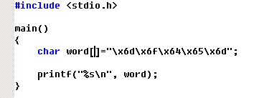
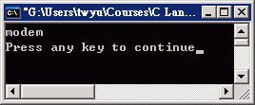
Example: Character Constants

Slide 23
String Constants
C does not have a "string" data type.
To create a string you have to use a char array or a char pointer.
They are actually a sequence of char items terminated with a \0.
char str[] = "String Constant";
or
char *str = "String Constant";

Slide 24
Enumeration Constants
enum is closely related to the #define preprocessor.
It allows you to define a list of aliases which represent integer numbers.
#define SUN 0
#define MON 1
#define TUE 2
#define WED 3
#define THU 4
#define FRI 5
#define SAT 6
enum week {
Sun, Mon, Tue, Wed, Thu, Fri, Sat
};

Slide 25
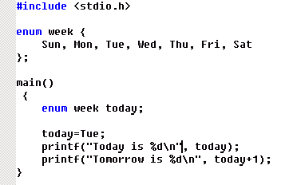
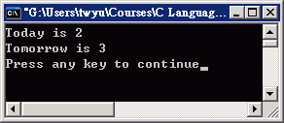
Example: Weekday

Slide 26
Example: More Enumeration Constants
enum boolean { NO, YES };
enum escapes {
BELL = '\a', BACKSPACE = '\b',
TAB = '\t', NEWLINE = '\n',
VTAB = '\v', RETURN = '\r'
};
enum months {
JAN = 1, FEB, MAR, APR, MAY, JUN,
JUL, AUG, SEP, OCT, NOV, DEC
}; /* FEB = 2, MAR = 3, etc. */

Slide 27
Variable Declarations
single
declarations
multiple
declarations
int lower;
int upper;
int step;
char c;
char line[1000];
int lower, upper, step;
char c, line[1000];

Slide 28
Declarations and Initializations
single
declarations
multiple
declarations
int lower;
int upper;
int step;
char c;
char line[1000];
int lower=0;
int upper=300;
int step=20;
char c='\0';
char line[1000];
int lower=0, upper=300, step=200;
char c='\0', line[1000];
int lower, upper, step;
char c, line[1000];

Slide 29
const ⎯ Defined Variables as constants
const double e = 2.71828182845905;
const char msg[] = "warning: ";
int strlen(const char[]);
Variables defined with const qualifier whose values can not be changed.
They must have initializers.

Slide 30
Variable Scope & Life Span
Variable Scope ⎯
The area of the program where that variable is valid, i.e.,
the parts of the program that have access to that variable.
determined by the location of the declaration.
Life Span ⎯
the length of time that the variable remains in memory.
determined by the location of the declaration.

Slide 31
Where do you Declare Variables?
Outside any function definition
.e.g. Prior to the start of the main() function
Global/external variables
Within a function, after the opening {
Local to the function
Within a block of code, after the {
Local to the area surrounded by the {} braces

Slide 32
Example: Scope
#include <stdio.h>
int m, n=2;
double val1=0.1, val2=0.2;
void fun(double val1, int q);
main()
{
int num=5;
printf("0:val1=%lf,val2=%lf,m=%d,n=%d,num=%d\n", val1, val2, m, n, num);
fun(val2,num);
printf("3:val1=%lf,val2=%lf,m=%d,n=%d,num=%d\n", val1, val2, m, n, num);
}
void fun(double val2, int q)
{
int n=1000;
val1 = 1.234;
val2 = 5.678;
q=7;
printf("1:val1=%lf,val2=%lf,m=%d,n=%d,num=%d\n", val1, val2, m, n, q);
val1=4.5;
printf("2:val1=%lf,val2=%lf,m=%d,n=%d,num=%d\n", val1, val2, m, n, q);
}

Slide 33
Example: Scope
#include <stdio.h>
int m, n=2;
double val1=0.1, val2=0.2;
void fun(double val1, int q);
main()
{
int num=5;
printf("0:val1=%lf,val2=%lf,m=%d,n=%d,num=%d\n", val1, val2, m, n, num);
fun(val2,num);
printf("3:val1=%lf,val2=%lf,m=%d,n=%d,num=%d\n", val1, val2, m, n, num);
}
void fun(double val2, int q)
{
int n=1000;
val1 = 1.234;
val2 = 5.678;
q=7;
printf("1:val1=%lf,val2=%lf,m=%d,n=%d,num=%d\n", val1, val2, m, n, q);
val1=4.5;
printf("2:val1=%lf,val2=%lf,m=%d,n=%d,num=%d\n", val1, val2, m, n, q);
}
0:val1=0.100000,val2=0.200000,m=0,n=2,num=5
1:val1=1.234000,val2=5.678000,m=0,n=1000,num=7
2:val1=4.500000,val2=5.678000,m=0,n=1000,num=7
3:val1=4.500000,val2=0.200000,m=0,n=2,num=5

Slide 34
Static keyword
Static variables have a property of preserving their value even after they are out of their scope!
A static int variable remains in memory while the program is running. A normal or auto variable is destroyed when a function call where the variable was declared is over.
Static variables are allocated memory in data segment, not stack segment.
Static variables (like global variables) are initialized as 0 if not initialized explicitly.
Static variables can only be initialized using constant literals.
Static global variables and functions are also possible.

Slide 35
Example
#include<stdio.h>
int fun()
{
int count = 0;
count++;
return count;
}
int main()
{
printf("%d ", fun());
printf("%d ", fun());
return 0;
}
#include<stdio.h>
int fun()
{
static int count = 0;
count++;
return count;
}
int main()
{
printf("%d ", fun());
printf("%d ", fun());
return 0;
}

Slide 36
static Variables/Functions important
/* Example of the static keyword */
char name[100]; /* Variable accessible from all files */
static int i; /* Variable accessible only from this file */
static int max_so_far(int); /* Function accessible
only from this file */
int max_so_far(int curr)
{
static int biggest=0; /* Variable whose value is retained
between each function call */
if( curr > biggest ) biggest = curr;
return biggest;
}

Slide 37
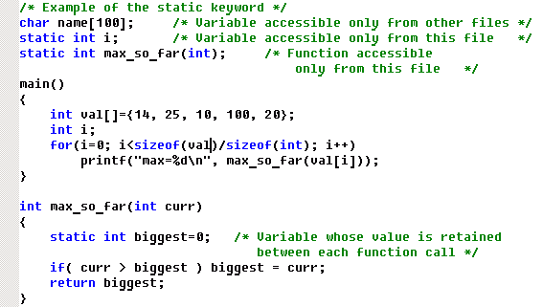
Example static Variables/Functions

Slide 38
Arithmetic Operators

Slide 39
Arithmetic Operators
Operation | Operator | Example | Value of Sum before | Value of sum after
Multiply | * | sum = sum * 2; | 4 | 8
Divide | / | sum = sum / 2; | 4 | 2
Addition | + | sum = sum + 2; | 4 | 6
Subtraction | - | sum = sum -2; | 4 | 2
Increment | ++ | ++sum; sum++; | 4 | 5
Decrement | -- | --sum; sum--; | 4 | 3
Modulus | % | sum = sum % 3; | 4 | 1

Slide 40
Precedence
The binary + and - operators have the same precedence, which is lower than the precedence of *, / and %, which is in turn lower than unary + and -.
Arithmetic operators associate left to right.

Slide 41
Example: Precedence
x=2; y=10; z=4; w=2;
-42
-x+y*-z/w*2-x+y/5
-44
(((-x)+(((y*(-z))/w)*2)-x)+(y/5))
-40
-20
-40
-2
-4
2

Slide 42
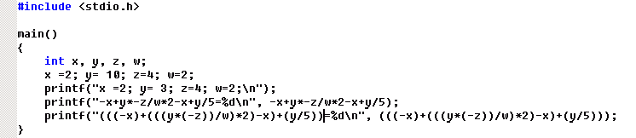
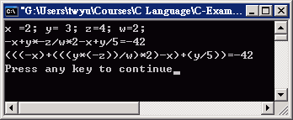
Example: Precedence

Slide 43
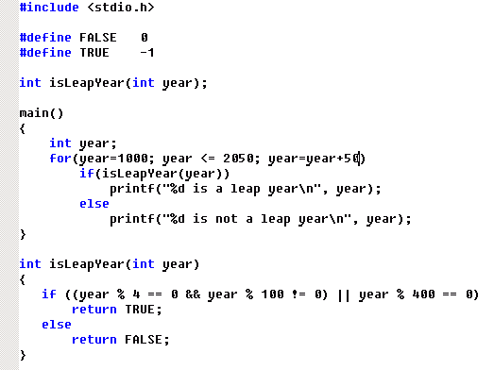
Example: Modulus

Slide 44
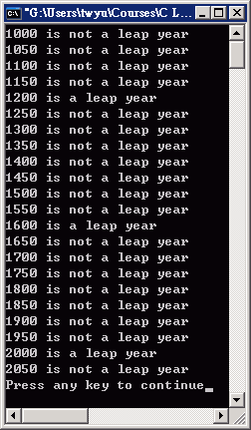
Example: Modulus
only for integer

Slide 45
Relational and Logical Operators

Slide 46
Relation Operators
Operator | Meaning
== | equal to
!= | not equal
< | less than
<= | less than or equal to
> | greater than
>= | greater than or equal to

Slide 47
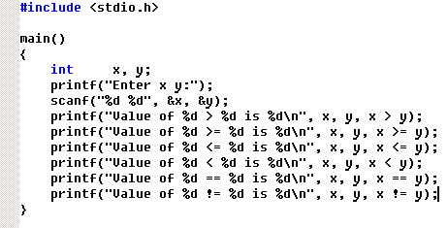
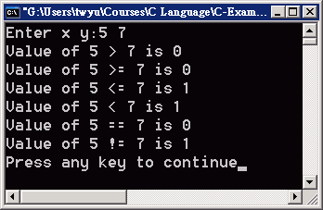
Example: Relation Operator

Slide 48
Logical Operators
Operator | Meaning
&& | and
|| | or
! | not
Operand 1 | Operand 2 | op1 || op2 | op1 && op2 | ! op1
0 | 0 | 0 | 0 | 1
0 | non-zero | 1 | 0 | 1
non-zero | 0 | 1 | 0 | 0
non-zero | non-zero | 1 | 1 | 0

Slide 49
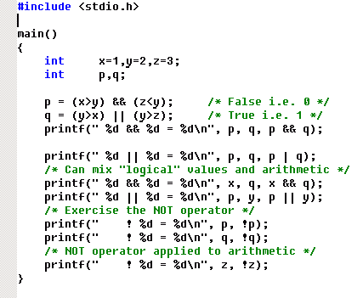
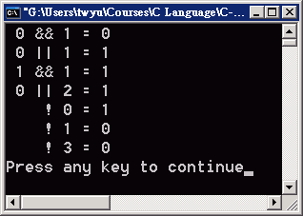
Example: Logical Operator

Slide 50
Type Conversions

Slide 51
Type Conversions
Implicit type conversion
also known as coercion
automatically done by the compiler when type mismatch on operands
narrower type → wider type
Explicit type conversion
Done by programmer
Type casting

Slide 52
Implicit Type Conversion
General rules for binary operators (+-*/%etc)
If either operand is long double the other is converted to long double.
Otherwise, if either operand is double the other is converted to double
Otherwise, if either operand is float the other is converted to float
Otherwise, convert char and short to int
Then, if an operand is long convert the other to long.

Slide 53
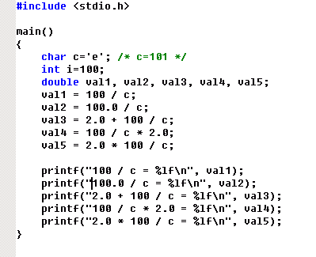
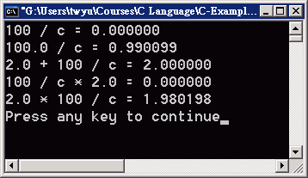
Example: Coercion

Slide 54
Example: atoi
/* atoi: convert s to integer */
int atoi(char s[])
{
int i, n;
n = 0;
for (i = 0; s[i] >= '0' && s[i] <= '9'; ++i)
n = 10 * n + (s[i] - '0');
return n;
}
Converted to integer before subtraction.

Slide 55
Type Casting
(type name) expression

Slide 56
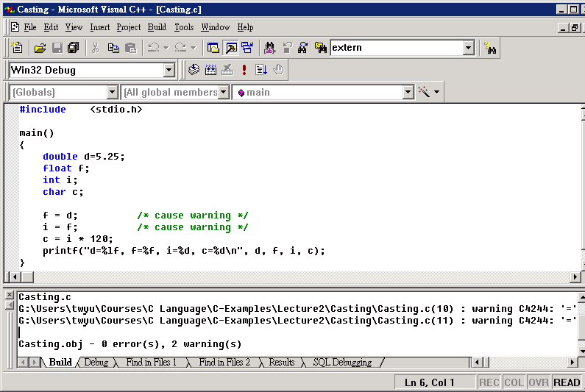
Type Casting

Slide 57
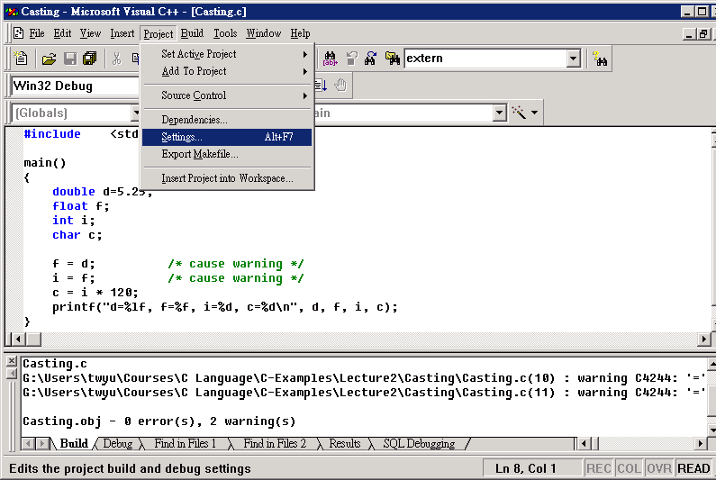
Type Casting

Slide 58
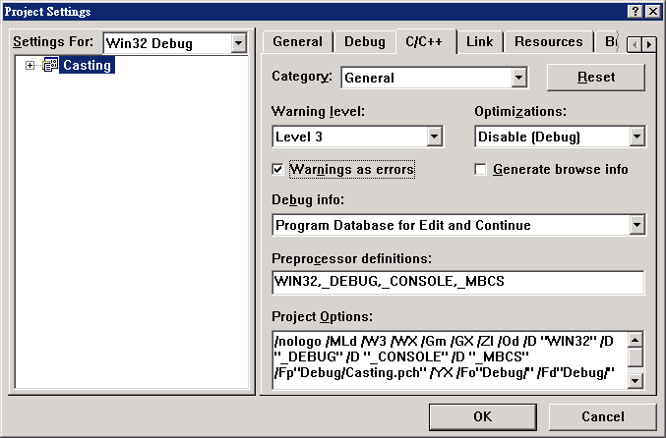
Type Casting
gcc: -Werror

Slide 59
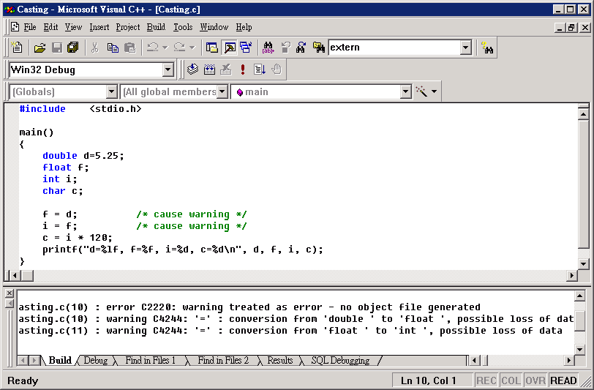
Type Casting

Slide 60

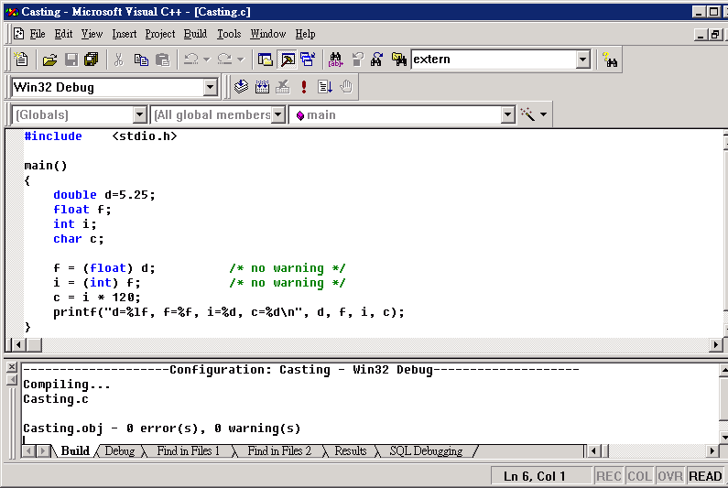
Type Casting

Slide 61
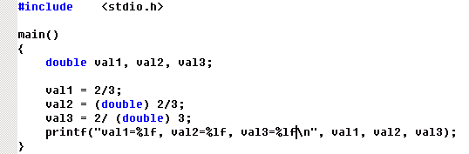
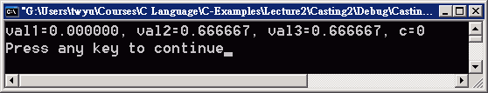
Type Casting
The cast operator has the same high precedence as other unary operators.

Slide 62
Increment and Decrement Operators

Slide 63
Increment and Decrement Operators
Prefix: value changed before being used
Postfix: value used before being changed
++ (Increment Operator)
Prefix: ++n
Postfix: n++
-- (Decrement Operator)
Prefix: --n
Postfix: n--

Slide 64
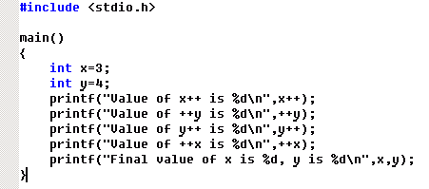
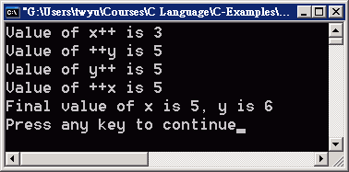
Example: Increment and Decrement Operators

Slide 65
Example: Squeeze
/* squeeze: delete all c from s */
void squeeze(char s[], int c)
{
int i, j;
for (i = j = 0; s[i] != '\0'; i++)
if (s[i] != c) s[j++] = s[i];
s[j] = '\0';
}

Slide 66
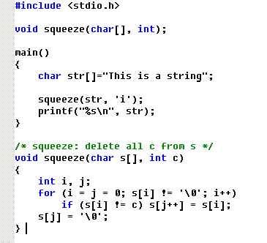
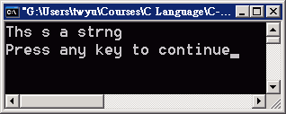
Example: Squeeze

Slide 67
Bitwise Operators

Slide 68
Bitwise Operators
Operation | Operator | Comment | Value of Sum before | Value of sum after
AND | & | sum = sum & 2; | 4 | 0
OR | | | sum = sum | 2; | 4 | 6
Exclusive OR | ^ | sum = sum ^ 2; | 4 | 6
1's Complement | ~ | sum = ~sum; | 4 | -5
Left Shift | << | sum = sum << 2; | 4 | 16
Right Shift | >> | sum = sum >> 2; | 4 | 1
1=00000000 00000000 00000000 00000001
2=00000000 00000000 00000000 00000010
4=00000000 00000000 00000000 00000100
8=00000000 00000000 00000000 00001000
16=00000000 00000000 00000000 00010000
5=00000000 00000000 00000000 00000101
11111111 11111111 11111111 11111010
-5=11111111 11111111 11111111 11111011

Slide 69
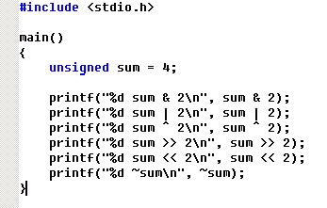
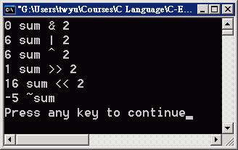
Example: Bitwise Operators
1=00000000 00000000 00000000 00000001
2=00000000 00000000 00000000 00000010
4=00000000 00000000 00000000 00000100
8=00000000 00000000 00000000 00001000
16=00000000 00000000 00000000 00010000
5=00000000 00000000 00000000 00000101
11111111 11111111 11111111 11111010
-5=11111111 11111111 11111111 11111011

Slide 70
Example: getbits
data
unsigned getbits(unsigned x, int p, int n)
position
#bits
unsigned x;
x = getbits(0xabababab, 19, 6);
X = ?

Slide 71
Example: getbits
data
unsigned getbits(unsigned x, int p, int n)
position
#bits
unsigned x;
x = getbits(0xabababab, 19, 6);
0xabababab=10101011 10101011 10101011 10101011

Slide 72
Example: getbits
data
unsigned getbits(unsigned x, int p, int n)
position
#bits
unsigned x;
x = getbits(0xabababab, 19, 6);
0xabababab=10101011 10101011 10101011 10101011
0xabababab=10101011 10101011 10101011 10101011
X = 101110_{b} = 46₁₀

Slide 73
Example: getbits
data
unsigned getbits(unsigned x, int p, int n)
position
#bits
X = 101110_{b} = 46₁₀
unsigned x;
x = getbits(0xabababab, 19, 6);
0xabababab=10101011 10101011 10101011 10101011
>> 14
00000000 00000010 10101110 10101110
&
00000000 00000000 00000000 00111111
00000000 00000000 00000000 00101110

Slide 74
Example: getbits
data
unsigned getbits(unsigned x, int p, int n)
position
#bits
~(11111111 11111111 11111111 11000000)
≡ ~(~0 << n)
X = 101110_{b} = 46₁₀
unsigned x;
x = getbits(0xabababab, 19, 6);
p–n+1
0xabababab=10101011 10101011 10101011 10101011
>> 14
00000000 00000010 10101110 10101110
&
00000000 00000000 00000000 00111111
00000000 00000000 00000000 00101110

Slide 75
Example: getbits
/* getbits: get n bits from position p */
unsigned getbits(unsigned x, int p, int n)
{
return (x >> (p+1-n)) & ~(~0 << n);
}

Slide 76
Assignment Operators and Expressions

Slide 77
Assignment Operators
≡
i = i + 2;
i += 2;
≡
x = x * (y + 1);
x *= y + 1;
≡
exp₁ = exp₁ op (exp₂)
exp₁ op= exp₂

Slide 78
Assignment Operators
Operator | Operation Performed
= | Simple assignment
*= | Multiplication assignment
/= | Division assignment
%= | Remainder assignment
+= | Addition assignment
–= | Subtraction assignment
<<= | Left-shift assignment
>>= | Right-shift assignment
&= | Bitwise-AND assignment
^= | Bitwise-exclusive-OR assignment
|= | Bitwise-inclusive-OR assignment

Slide 79
Example: bitcount
X=01101110 11100010 11111001 11001101
&
00000000 00000000 00000000 00000001
/* bitcount: count 1 bits in x */
int bitcount(unsigned x)
{
int b;
for (b = 0; x != 0; x >>= 1)
if (x & 01) b++;
return b;
}
x = x >> 1

Slide 80
Conditional Expressions

Slide 81
Conditional Expressions
int a, b, z;
. . . . . .
if (a > b)
z = a;
else
z = b;
int a, b, z;
. . . . . .
z = a > b ? a : b
expr₁ ? expr₂ : expr₃

Slide 82
Example: min/max
. . . . . . . . . . . . . .
main()
{
char str[MAXLINE];
int val1, val2;
printf("Enter First integer:"); /* get 1st int string */
getlinestr(str, MAXLINE);
val1 = atoi(str); /* convert string to value */
printf("Enter second integer:"); /* get 2nd int string */
getlinestr(str, MAXLINE);
val2 = atoi(str); /* convert string to value */
if(val1 <= val2)
printf("The min/max are %d/%d\n", val1, val2);
else
printf("The min/max are %d/%d\n", val2, val1);
}

Slide 83
Example: min/max
. . . . . . . . . . . . . .
main()
{
char str[MAXLINE];
int val1, val2;
printf("Enter First integer:"); /* get 1st int string */
getlinestr(str, MAXLINE);
val1 = atoi(str); /* convert string to value */
printf("Enter second integer:"); /* get 2nd int string */
getlinestr(str, MAXLINE);
val2 = atoi(str); /* convert string to value */
printf("The min/max are %d/%d\n",
val1>=val2 ? val2 : val1, /* min(val1, val2) */
val1<val2 ? val2 : val1); /* max(val1, val2) */
}

Slide 84
Example: Male/Female
int sex; /* 0:female, 1: male */
sex = 1;
printf("%s is a good student.\n", sex ? "He", "She");

Slide 85
Precedence and Order of Evaluation

Slide 86
Precedence and Order of Evaluation
Operators | Associativity
() [] -> . | left to right
! ~ ++ -- + - * (type) sizeof | right to left
* / % | left to right
+ - | left to right
<< >> | left to right
< <= > >= | left to right
== != | left to right
& | left to right
^ | left to right
| | left to right
&& | left to right
|| | left to right
?: | right to left
= += -= *= /= %= &= ^= |= <<= >>= | right to left
, | left to right

Slide 87
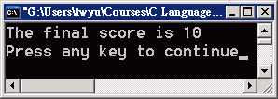
Example
main()
{
int score, bonus;
score = 50;
bonus = 10;
printf("The final score is %d\n",
score + bonus > 0 ? bonus : 0);
}

Slide 88
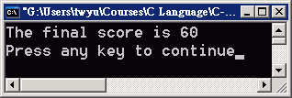
Example
main()
{
int score, bonus;
score = 50;
bonus = 10;
printf("The final score is %d\n",
score + (bonus > 0 ? bonus : 0));
}

