Slide 1
Control Statements in C

Slide 2
C Keywords
auto double int struct
break else long switch
case enum register typedef
char extern return union
const float short unsigned
continue for signed void
default goto sizeof volatile
do if static while
The words in bold print are used in control statements. They
change the otherwise sequential execution of the assignment
statements in a function block

Slide 3
assignment statement
Statements are the instructions given to the computer to perform any kind of action , be it data movements, be it making decisions or be it repeating actions.
Statements are the smallest executing unit of a C program.
aResult = 10;
aResult = countB; aResult = (aValue + 100) / countD; aResult = sqrt (aValue);

Slide 4
Compound Statement: Block of Statements
A compound statement in C is a sequence of statements enclosed by a pair of braces { }.
{ const int MAX_BINS = 11; int orderNumber; int binNumber; printf("Enter order number: "); scanf("%d", &orderNumber); binNumber = orderNumber % MAX_BINS; printf("Bin number is %d\n", binNumber); }

Slide 5
Control Structures in C
Control structures control the flow of execution in a program or function.
There are three kinds of execution flow:
Sequence:
the execution of the program is sequential.
Selection/Decision:
A control structure which chooses alternative to execute.
Repetition/Loop:
A control structure which repeats a group of statements.

Slide 6
Sequence
The sequence construct means the statements are being executed sequentially. This represents the default flow of statements.
Statement 1
Statement 2
Statement 3

Slide 7
Selection/Decision
The selection construct means the execution of statements depending upon when a condition evaluates true, a set of statements is followed.
Condition?
true
Block 1
false
Block 2

Slide 8
Repetition / Loop / Iteration
The iteration construct means repetition of a set of statements depending upon a condition / test. Till the time a condition is true {or false depending upon the loop}, a set-of-statements are repeated again and again. As soon as the condition becomes false { or true }, the loop ends

Slide 9
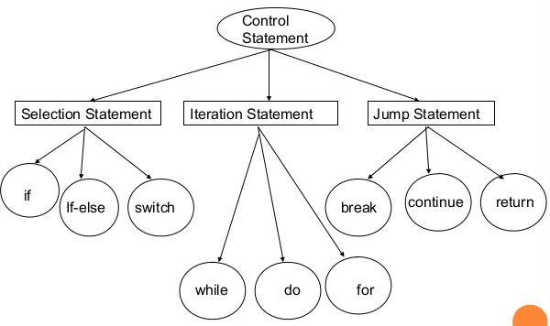
Flow of Control

Slide 10
Conditions
A program may choose among alternative statements by testing the value of key variables.
e.g., if( your_grade > 60 )
printf(“you are passed!”);
Condition is an expression that is either false (represented by 0) or true (represented by 1).
e.g., “your_grade > 60” is a condition.
Conditions may contain relational or equality operators, and have the following forms.
variable relational-operator variable (or constant)
variable equality-operator variable (or constant)

Slide 11
Operators Used in Conditions
Operator | Meaning | Type
< | Less than | Relational
> | Greater than | Relational
<= | Less than or equal to | Relational
>= | Greater than or equal to | Relational
== | Equal to | Equality
!= | Not equal to | Equality

Slide 12
Examples of Conditions
Operator | Condition | Meaning
<= | x <= 0 | x less than or equal to 0
< | Power < MAX_POW | Power less than MAX_POW
== | mom_or_dad == ‘M’ | mom_or_dad equal to ‘M’
!= | num != SETINEL | num not equal to SETINEL

Slide 13
Logical Operators
There are three kinds of logical operators.
&&: and
||: or
!: not
Logical expression is an expression which uses one or more logical operators, e.g.,
(temperature > 90.0 && humidity > 0.90)
!(n <= 0 || n >= 100).

Slide 14
The Truth Table of Logical Operators
Op 1 | Op 2 | Op 1 && Op2 | Op 1 || Op2
nonzero | nonzero | 1 | 1
nonzero | 0 | 0 | 1
0 | nonzero | 0 | 1
0 | 0 | 0 | 0
Op 1 | ! Op 1
nonzero | 0
0 | 1

Slide 15
Operator Precedence
An operator’s precedence determines its order of evaluation.
Unary operator is an operator that has only one operand.
!, +(plus sign), -(minus sign), and &(address of)
They are evaluated second only after function calls.
Operator | Precedence
function calls | highest
! + - &
* / %
+ -
< <= >= >
== !=
&&
||
= | lowest

Slide 16
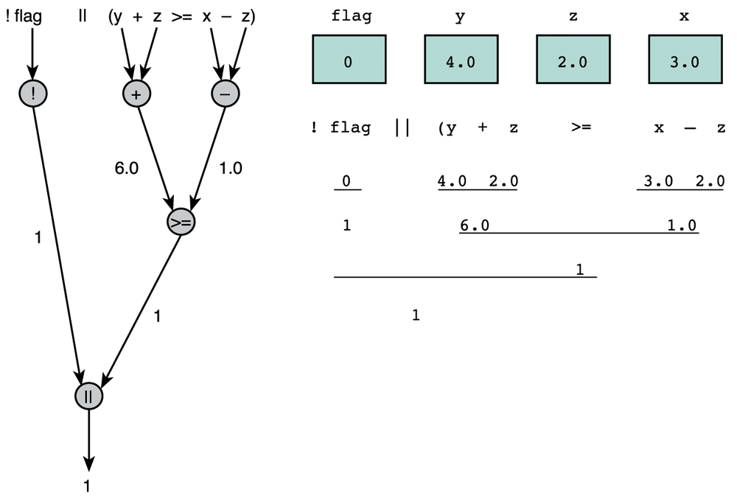
Evaluation for !flag || (y + z >= x - z)
The result of this expression is true
Evaluation tree

Slide 17
Comparing Characters
We can also compare characters in C using the relational and equality operators.
Expression | Value
‘9’ >= ‘0’ | 1 (true)
‘a’ < ‘e’ | 1 (true)
‘Z’ == ‘z’ | 0 (false)
‘a’ <= ‘A’ | system dependent

Slide 18
DeMorgan’s Theorem
DeMorgan’s theorem gives us a way of transforming a logical expression into its complement.
The complement of expr₁ && expr₂ is comp₁ || comp₂, where comp₁ and comp₂ are the complement of expr₁ and expr₂, respectively.
The complement of expr₁ || expr₂ is comp₁ && comp₂.
e.g., age > 25 && (status == ‘S’ || status ==‘D’)
is equal to
!(age <=25 || (status != ‘S’) && status != ‘D’)

Slide 19
The if Statement
The if statement is the primary selection control structure.
Syntax: if (condition) statement;
else statement;
An example of two alternatives:
if ( rest_heart_rate > 56 )
printf(“Keep up your exercise program!\n”);
else
printf(“Your heart is in excellent health!\n”);
An example of one alternative:
if ( x != 0.0 )
product = product * x;

Slide 20
Flowchart
Flowchart is a diagram that shows the step-by-step execution of a control structure.
A diamond-shaped box represents a decision.
A rectangular box represents an assignment statement or a process.

Slide 21
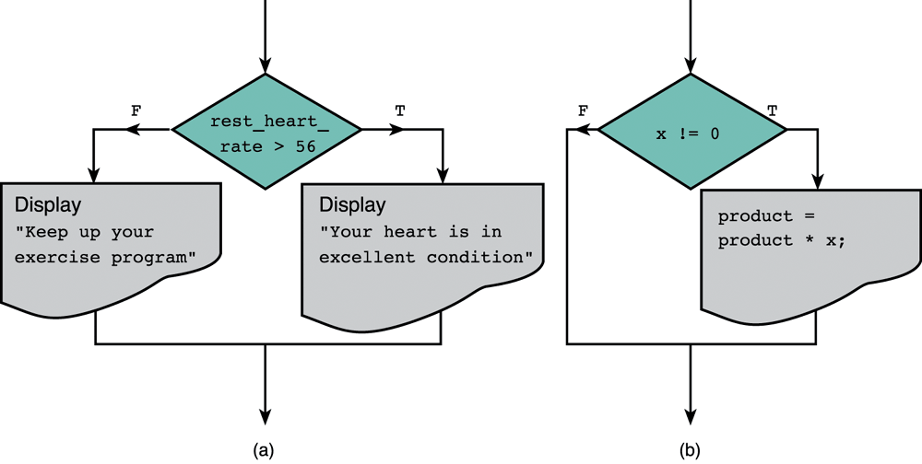
Flowcharts of if Statements with (a) Two Alternatives and (b) One Alternative
Decision
Decision

Slide 22
simple “if” statement
if (aNumber != 1000) countA++;

Slide 23
“if” with a block of statements
if (aValue <= 10) { printf("Answer is %8.2f\n", aValue); countB++; } // End if

Slide 24
“if” – “else” with a block of statements
if (aValue <= 10) { printf("Answer is %8.2f\n", aValue); countB++; } // End if else { printf("Error occurred\n"); countC++; } // End else

Slide 25
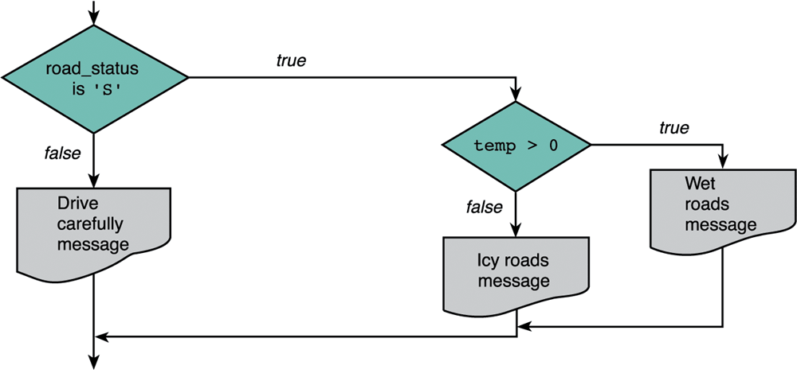
An Example for the Flowchart of Nested if Statements
Another if statement
Main if statement

Slide 26
Nested if Statements
Nested if statement is an if statement with another if statement as its true task or false task.
e.g.,
if (road_status == ‘S’)
else printf(“Drive carefully!\n”);
if (temp > 0) { printf(“Wet roads ahead!\n”); }else{ printf(“Icy roads ahead!\n”); }

Slide 27
nested “if” statement
if (aValue == 1) countA++; else if (aValue == 10) countB++; else if (aValue == 100) countC++; else countD++;

Slide 28
Multiple-Alternative Decisions
If there are many alternatives, it is better to use the syntax of multiple-alternative decision.
Syntax:
if (condition₁)
statement₁
else if (condition₂)
statement₂
…
else if (condition_{n})
statement_{n}
else
statement_{e}

Slide 29
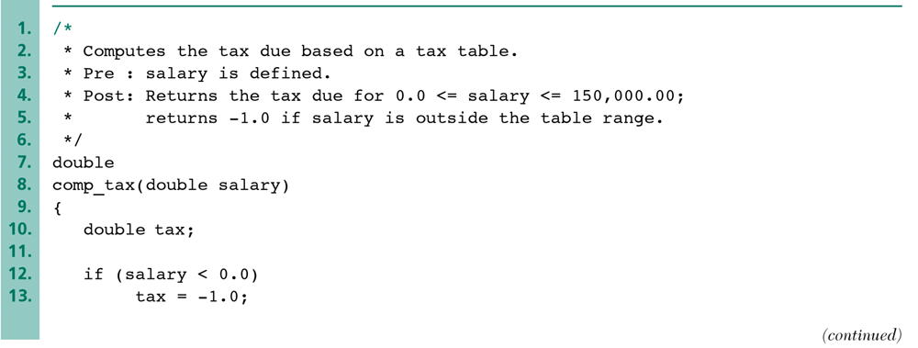
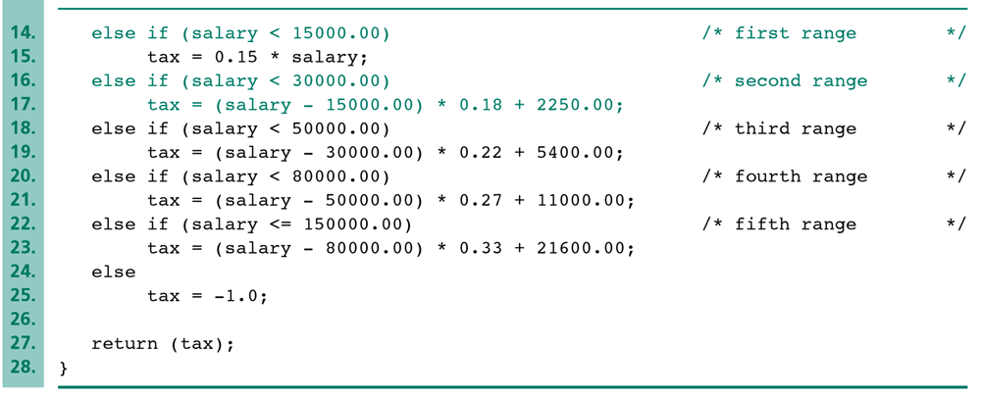
An Example of Multiple-Alternative Decisions

Slide 30
Repetition in Programs
In most software, the statements in the program may need to repeat for many times.
e.g., calculate the value of n!.
If n = 10000, it’s not elegant to write the code as 1*2*3*…*10000.
Loop is a control structure that repeats a group of steps in a program.
Loop body stands for the repeated statements.
There are three C loop control statements:
while, for, and do-while.

Slide 31
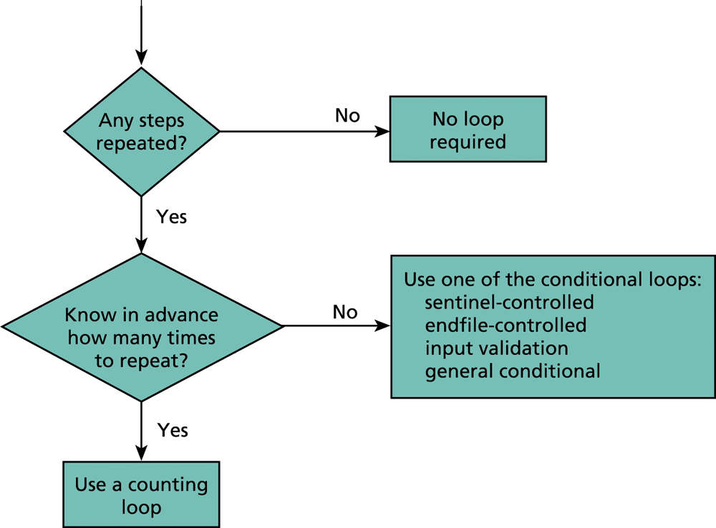
Flow Diagram of Loop Choice Process
e.g., read the content in a file
e.g., calculate the value of n!

Slide 32
Comparison of Loop Choices (1/2)
Kind | When to Use | C Structure
Counting loop | We know how many loop repetitions will be needed in advance. | while, for
Sentinel-controlled loop | Input of a list of data ended by a special value | while, for
Endfile-controlled loop | Input of a list of data from a data file | while, for

Slide 33
Comparison of Loop Choices (2/2)
Kind | When to Use | C Structure
Input validation loop | Repeated interactive input of a value until a desired value is entered. | do-while
General conditional loop | Repeated processing of data until a desired condition is met. | while, for

Slide 34
The while Statement in C
The syntax of while statement in C:
while (loop repetition condition)
statement
Loop repetition condition is the condition which controls the loop.
The statement is repeated as long as the loop repetition condition is true.
A loop is called an infinite loop if the loop repetition condition is always true.

Slide 35
“while” with a single statement
while (aResult >= 1000) aResult = aResult / aValue;

Slide 36
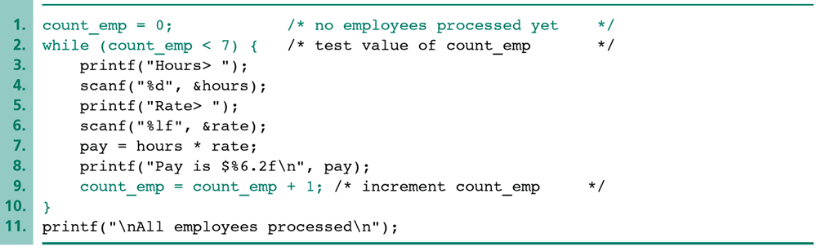
An Example of a while Loop
Loop repetition condition
Statement
Loop control variable is the variable whose value controls loop repetition.
In this example, count_emp is the loop control variable.

Slide 37
“while” with a block of statements
while (aResult >= 1000) { aResult = aResult / aValue; printf("Result is %9.4f\n", aResult); } // End while

Slide 38
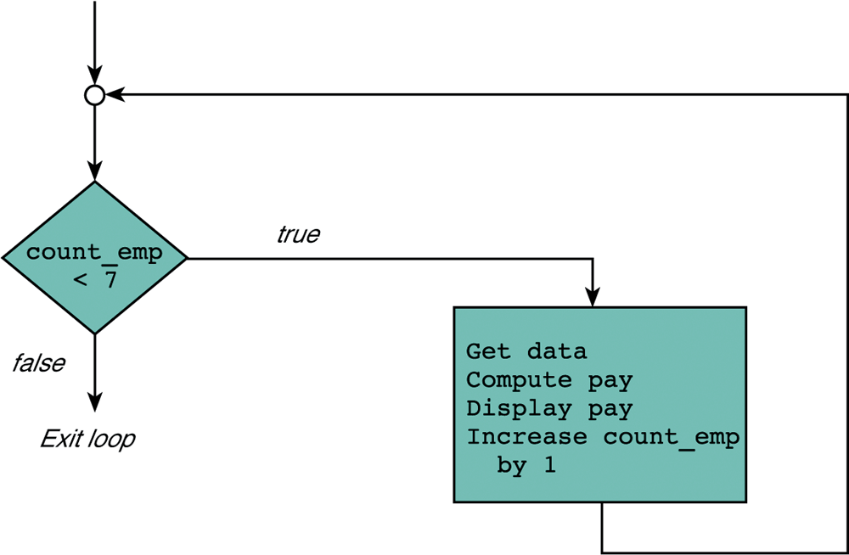
Flowchart for a while Loop
Loop repetition condition
Statement

Slide 39
“while” with nested “if” statements
aResult = MAX_VALUE;
while (aResult >= 1000) { countW++; // nested if statement if (aValue == 1) countA++; else if (aValue == 10) countB++; else if (aValue == 100) countC++; else countD++; aResult = aResult / aValue; } // End while

Slide 40
“while” performing an infinite loop
while (1) { receiveFrom (aClient, aRequest); theResults = processRequest(aRequest); sendTo (aClient, theResults); } // End while

Slide 41
Compound Assignment Operators (1/2)
The loop body usually consists of statements of the form: variable = variable op expression.
e.g., count_emp = count_emp + 1;
C provides compound assignment operators which enable a more concise notation for this kind of statements.
“variable op = expression” is the same to “variable = variable op expression.”

Slide 42
Compound Assignment Operators (2/2)
Simple Assignment Operators | Compound Assignment Operators
count_emp = count_emp + 1; | count_emp += 1;
time = time -1; | time -= 1;
product = product * item; | product *= item;
total = total / number; | total /= number;
n = n % (x+1); | n %= x+1;

Slide 43
The for Statement in C
The syntax of for statement in C:
for (initialization expression;
loop repetition condition;
update expression)
statement
The initialization expression set the initial value of the loop control variable.
The loop repetition condition test the value of the loop control variable.
The update expression update the loop control variable.

Slide 44
“for” with a single statement
for (i = 1; i <= MAX_LENGTH; i++) printf("#");

Slide 45
“for” with a block of statements
for (i = 0; i < MAX_SIZE; i++) { printf("Symbol is %c\n", aBuffer[i]); aResult = aResult / i; } // End for

Slide 46
“for” performing an infinite loop
for (;;) { receiveFrom (client, request); results = processRequest(request); sendTo (client, Results); } // End for

Slide 47
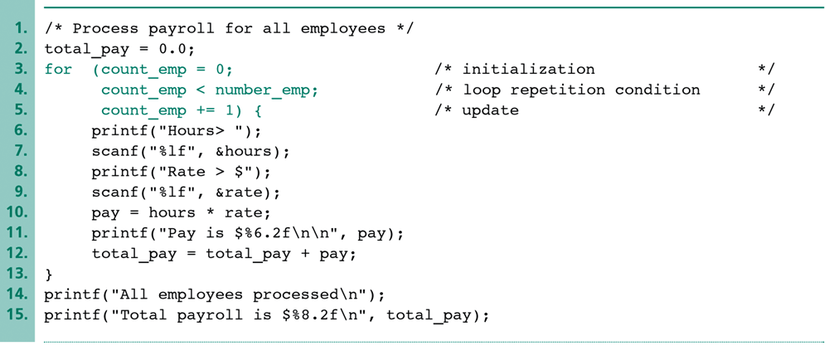
An Example of the for Loop
Initialization Expression
Loop repetition condition
Update Expression
count_emp is set to 0 initially.
count_emp should not exceed the value of number_emp.
count_emp is increased by one after each iteration.

Slide 48
Increment and Decrement Operators
The statements of increment and decrement are commonly used in the for loop.
The increment (i.e., ++) or decrement (i.e., --) operators are the frequently used operators which take only one operand.
The increment/decrement operators increase or decrease the value of the single operand.
e.g., for (int i = 0; i < 100; i++){ … }
The variable i increase one after each iteration.

Slide 49
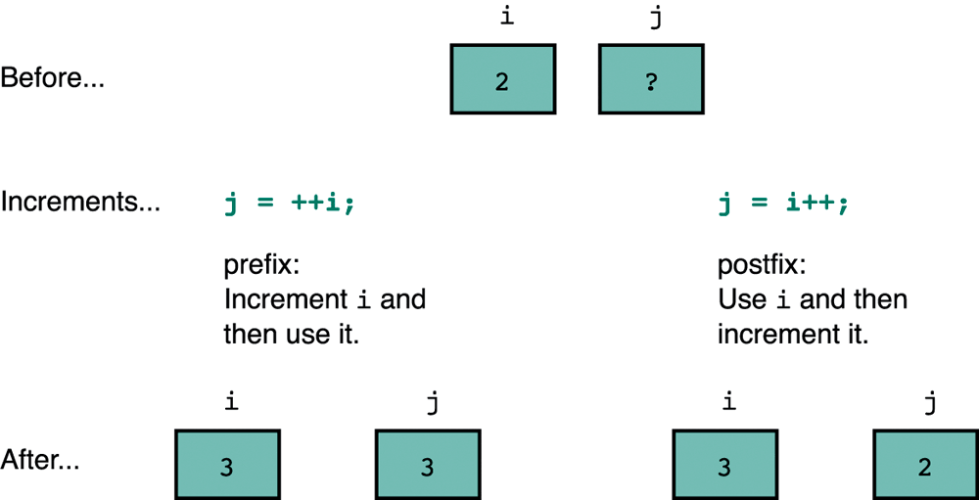
Comparison of Prefix and Postfix Increments
The value of the expression (that uses the ++/-- operators) depends on the position of the operator.
The value of j is not
increased
The value of j is increased

Slide 50
Sentinel-Controlled Loops
Sometimes we may not know how many times the loop will repeat.
One way to do this is to choose a sentinel value as an end marker.
The loop exits when the sentinel value is read.
If the user wish to exit the loop, he or she has to input the sentinel value.
It is similar to the “logout” function in many applications.

Slide 51
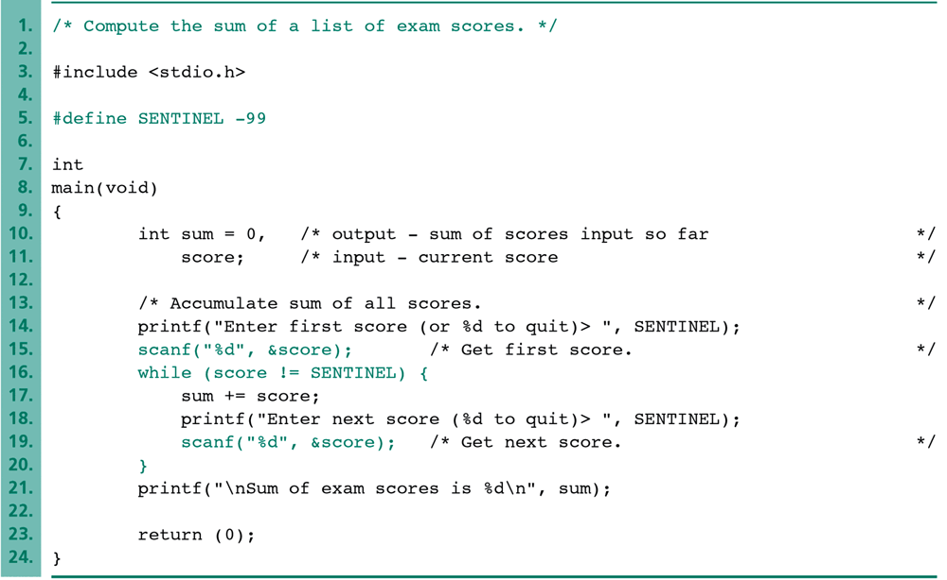
An Example of Sentinel-Controlled while Loops
If the user wish to exit the loop,
he or she has to input -99.

Slide 52
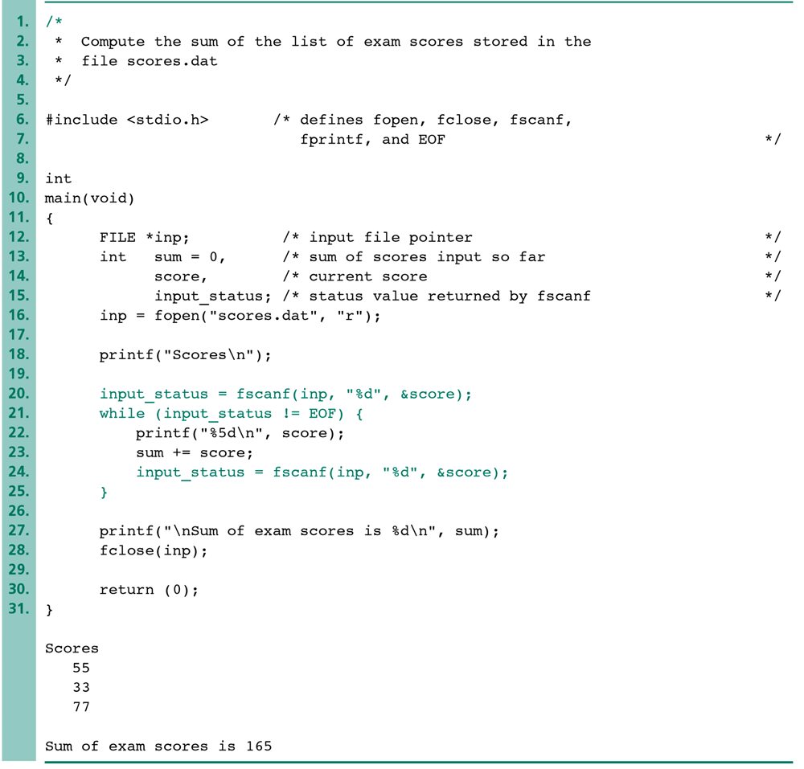
An Example of Endfile-Controlled Loops
fscanf is a function used to read file.
EOF stands for the special value of end-file returned by fscanf.
This loop repeats until reading the end of the file.

Slide 53
Nested Loops
Nested loops consist of an outer loop with one or more inner loops.
e.g.,
for (i=1;i<=100;i++){
for(j=1;j<=50;j++){
…
}
}
The above loop will run for 100*50 iterations.
Outer loop
Inner loop

Slide 54
The do-while Statement in C
The syntax of do-while statement in C:
do statement while (loop repetition condition);
The statement is first executed.
If the loop repetition condition is true, the statement is repeated.
Otherwise, the loop is exited.

Slide 55
An Example of the do-while Loop
/* Find even number input */
do{ printf(“Enter a value: ”);
scanf(“%d”, &num);
}while (num % 2 !=0)
This loop will repeat if the user inputs odd number.

Slide 56
Break and Continue
Flow of Control
Recall how loops provide "graceful" and clear flow of control in and out
In RARE instances, want to alter natural flow
Break;
Forces loop to exit immediately.
Continue;
Skips rest of loop body
These statements violate natural flow. Only used when absolutely necessary!

Slide 57
The break and continue Statements
break
Causes immediate exit from a while, for, do/while or switch structure
Program execution continues with the first statement after the structure
Common uses of the break statement
Escape early from a loop
Skip the remainder of a switch structure

Slide 58
The break and continue Statements (II)
continue
Skips the remaining statements in the body of a while, for or do/while structure
Proceeds with the next iteration of the loop
while and do/while
Loop-continuation test is evaluated immediately after the continue statement is executed
for structure
Increment expression is executed, then the loop-continuation test is evaluated

Slide 59
3 #include <stdio.h>
4
5 int main()
6 {
7 int x;
8
9 for ( x = 1; x <= 10; x++ ) {
10
11 if ( x == 5 )
12 continue;
13
14
15 printf( "%d ", x );
16 }
17
18
19 return 0;
20 }

Slide 60
The break Keyword

Slide 61
break
// Using break to exit a loop (break.c).
#include <stdio.h>
main() {
int i;
for(i=0; i<100; i++) {
if(i == 10) break; // terminate loop if i is 10
printf("i: %d \n", i);
}
printf("Loop complete.");
}

Slide 62
The continue Keyword

Slide 63
The switch Statement
The switch statement is used to select one of several alternatives when the selection is based on the value of a single variable or an expression.
switch (controlling expression) {
case label₁:
statement₁
break;
case label₂:
statement₂
break;
…
case label_{n}:
statement_{n}
break;
default:
statement_{d};
}
If the result of this controlling expression matches label₁, execute staement₁ and then break this switch block.
If the result matches none of all labels, execute the default statement_{d}.

Slide 64
“switch” statement
switch (aNumber) { case 1 : countA++; break; case 10 : countB++; break; case 100 : case 500 : countC++; break; default : countD++; } // End switch

Slide 65
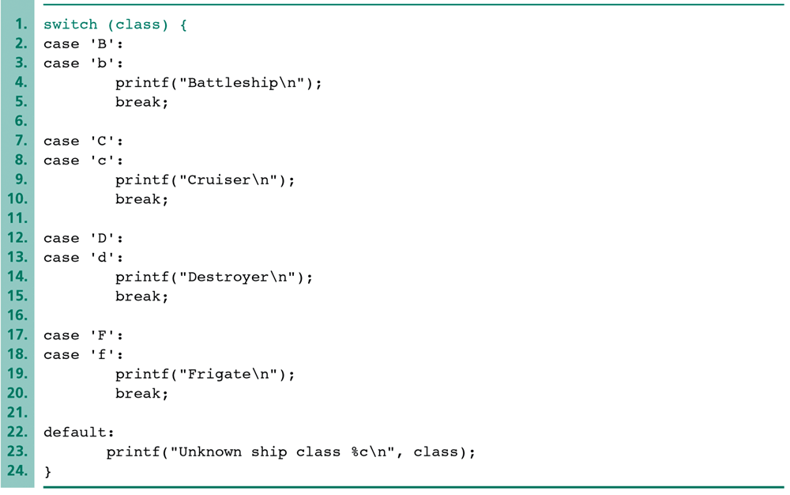
An Example of a switch Statement with Type char Case Labels
class is a char variable.
Two or more cases can execute the same statement.

