Slide 1
Recursion

Slide 2
What is recursion?
Sometimes, the best way to solve a problem is by solving a smaller version of the exact same problem first
Recursion is a technique that solves a problem by solving a smaller problem of the same type

Slide 3
Recursion
Recursive functions
Functions that call themselves
Can only solve a base case
Divide a problem up into
What it can do
What it cannot do
What it cannot do resembles original problem
The function launches a new copy of itself (recursion step) to solve what it cannot do
Eventually base case gets solved
Gets plugged in, works its way up and solves whole problem

Slide 4
Recursion
Example: factorials
5! = 5 * 4 * 3 * 2 * 1
Notice that
5! = 5 * 4!
4! = 4 * 3! ...
Can compute factorials recursively
Solve base case (1! = 0! = 1) then plug in
2! = 2 * 1! = 2 * 1 = 2;
3! = 3 * 2! = 3 * 2 = 6;

Slide 5
Recursion vs. Iteration
Repetition
Iteration: explicit loop
Recursion: repeated function calls
Termination
Iteration: loop condition fails
Recursion: base case recognized
Both can have infinite loops
Balance
Choice between performance (iteration) and good software engineering (recursion)

Slide 6
USE OF RECURSION
For every recursive algorithm, there is an equivalent iterative algorithm.
Iteration can be used in place of recursion
An iterative algorithm uses a looping construct
A recursive algorithm uses a branching structure
Recursive solutions are often less efficient, in terms of both time and space, than iterative solutions
Recursion can simplify the solution of a problem, often resulting in shorter, more easily understood source code

Slide 7
Iterative Factorial
int Factorial(int n)
{
int fact = 1;
for(int count = 2; count <= n; count++)
fact = fact * count;
return fact;
}

Slide 8
How recursion is handled
Every time a function is called, the function values, local variables, parameters and return addresses are pushed onto the stack.
Over and Over again
You might run out!

Slide 9
Advantages
To write efficient programs using a minimum amount of code.
Nominal chance of syntax and logical errors.
Increases the program efficiency.

Slide 10
Disadvantages
Can cause infinite loops and other unexpected results if not written properly.
If the end condition is not defined then the recursion will repeat forever, causing the program to crash or hang the entire computer system.

Slide 11
Examples
Factorial function
Fibonacci sequence
Multiplication of natural numbers
Binary search
Tower of Hanoi

Slide 12
How do I write a recursive function?
Determine the size factor
Determine the base case(s)
(the one for which you know the answer)
Determine the general case(s)
(the one where the problem is expressed as a smaller version of itself)
Verify the algorithm
(use the "Three-Question-Method")

Slide 13
Three-Question Verification Method
The Base-Case Question:
Is there a nonrecursive way out of the function, and does the routine work correctly for this "base" case?
The Smaller-Caller Question:
Does each recursive call to the function involve a smaller case of the original problem, leading inescapably to the base case?
The General-Case Question:
Assuming that the recursive call(s) work correctly, does the whole function work correctly?

Slide 14
Deciding whether to use a recursive solution
When the depth of recursive calls is relatively "shallow"
The recursive version does about the same amount of work as the nonrecursive version
The recursive version is shorter and simpler than the nonrecursive solution

Slide 15
Example Using Recursion: The Fibonacci Series
Fibonacci series: 0, 1, 1, 2, 3, 5, 8...
Each number is the sum of the previous two
Can be solved recursively:
fib( n ) = fib( n - 1 ) + fib( n – 2 )
Code for the fibaonacci function
long fibonacci( long n )
{
if (n == 0 || n == 1) // base case
return n;
else
return fibonacci( n - 1) + fibonacci( n – 2 );
}

Slide 16
Example Using Recursion: The Fibonacci Series
Set of recursive calls to function fibonacci
f( 3 )
return
f( 2 )
+
f( 1 )
return
f( 1 )
+
f( 0 )
return 1
return 1
return 0

Slide 17
2 Recursive fibonacci function */
3 #include <stdio.h>
4
5 long fibonacci( long );
6
7 int main()
8 {
9 long result, number;
10
11 printf( "Enter an integer: " );
12 scanf( "%ld", &number );
13 result = fibonacci( number );
14 printf( "Fibonacci( %ld ) = %ld\n", number, result );
15 return 0;
16 }
17
18 /* Recursive definition of function fibonacci */
19 long fibonacci( long n )
20 {
21 if ( n == 0 || n == 1 )
22 return n;
23 else
24 return fibonacci( n - 1 ) + fibonacci( n - 2 );
25 }

Slide 18
Tower of Hanoi
It can be solved by using recursion technique.
There exist three peg namely A, B & C.
Several disks of different diameters are placed in peg A.
The large disk is always below the smaller one.
The objective is to move those disks to peg C, using peg B as auxiliary.
Only the top disk can be moved to other peg.
Only one disk may be moved at a time.

Slide 19
Algorithm (TOH)
To move n disks from A to C, using B as auxiliary
If n=1, move the single disk from A to C and stop.
Move the top n-1 disks from A to B, using C as auxiliary.
Move the remaining disk from A to C.
Move the n-1 disks from B to C, using A as auxiliary.

Slide 20
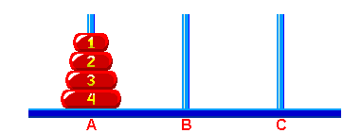
Practice ‘Towers of Hanoi’
Problem:
The Classical Towers of Hanoi - an initial position of all disks is on post 'A‘.

Slide 21
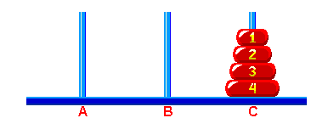
The target solution of the puzzle is to build the tower on post 'C'.
The number of discs can vary, but there are only three towers.
The goal is to transfer the discs from one tower to another tower.
However you can move only one disk at a time and you can never
place a bigger disc over a smaller disk.

Slide 22
Algorithm to solve the above problem:
Move the top 3 disks from Source to Auxiliary tower,
Move the 4th disk from Source to Destination tower,
Move the 3 disks from Auxiliary tower to Destination tower.
Transfer the top 3 disks from Source to Auxiliary tower can again be thought as a fresh problem and can be solve in the same manner.

Slide 23
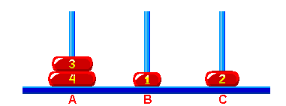
Let us do it step by step:
At first move the ‘Disc1’ to ‘B’ and ‘Disc2’ to ‘C’ as in following figure:

Slide 24
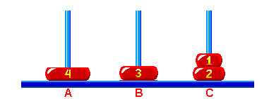
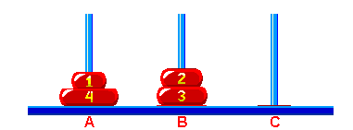
Move the ‘Disc1’ to the top of the ‘Disc2’ at ‘C’ and ‘Disc3’ at ‘B’.
Move the ‘Disc1’ to ‘A’ at the top of ‘Disc4’ and ‘Disc2’ at ‘B’ to the top
of ‘Disc3’.

Slide 25
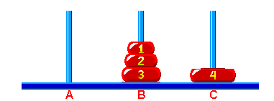
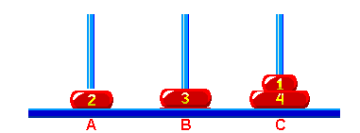
Move the ‘Disc1’ at ‘B’ to the top of ‘Disc2’ and ‘Disc4’ at ‘A’.
Move the ‘Disc1’ at ‘C’ to the top of ‘Disc4’ and ‘Disc2’ at ‘A’.

Slide 26
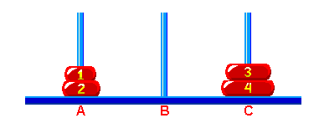
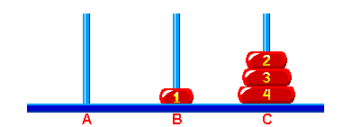
Move the ‘Disc1’ at ‘A’ to the top of ‘Disc2’ and ‘Disc3’ to the top of
‘disc4’ at ‘A’.
Move the ‘Disc1’ at ‘B’ and ‘Disc2’ at ‘B’ to the top of ‘Disc3’.

Slide 27
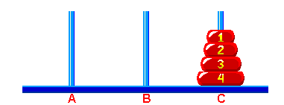
Move the ‘Disc1’ at the top of ‘Disc2’ at ‘C’.
Congratulations you got your answer. Code implementation is up to
you people as hint use the concept of stack and just follow the steps
Above described.

Slide 28
Program
#include <stdio.h>
void towerOfHanoi(int n, char from_rod, char to_rod, char aux_rod)
{
if (n == 1)
{
printf("Move disk 1 from rod %c to rod %c.\n", from_rod, to_rod);
return;
}
towerOfHanoi(n-1, from_rod, aux_rod, to_rod);
printf("Move disk %d from rod %c to rod %c.\n", n, from_rod, to_rod);
towerOfHanoi(n-1, aux_rod, to_rod, from_rod);
}
int main()
{
int n = 4; // Number of disks
towerOfHanoi(n, 'A', 'C', 'B'); // A, B and C are names of rods
return 0;
}

