Slide 1
Arrays

Slide 2
Scalar Variables versus Aggregate Variables
So far, the only variables we’ve seen are scalar: capable of holding a single data item.
C also supports aggregate variables, which can store collections of values.
There are two kinds of aggregates in C: arrays and structures.
The focus of the chapter is on one-dimensional arrays, which play a much bigger role in C than do multidimensional arrays.

Slide 3
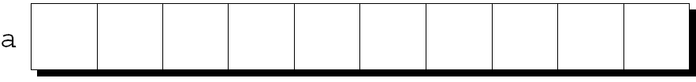
One-Dimensional Arrays
An array is a data structure containing a number of data values, all of which have the same type.
These values, known as elements, can be individually selected by their position within the array.
The simplest kind of array has just one dimension.
The elements of a one-dimensional array a are conceptually arranged one after another in a single row (or column):

Slide 4
One-Dimensional Arrays
To declare an array, we must specify the type of the array’s elements and the number of elements:
int a[10];
The elements may be of any type; the length of the array can be any (integer) constant expression.
Use a macro to define the length of an array #define N 10
…
int a[N];

Slide 5
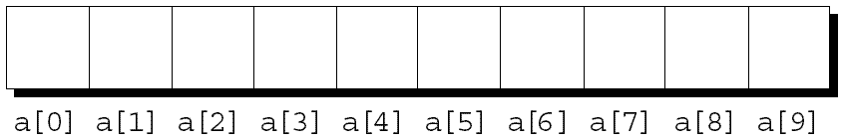
Array Subscripting
To access an array element, write the array name followed by an integer value in square brackets.
This is referred to as subscripting or indexing the array.
The elements of an array of length n are indexed from 0 to n – 1.
If a is an array of length 10, its elements are designated by a[0], a[1], …, a[9]:

Slide 6
Array Subscripting
Expressions of the form a[i] are values, so they can be used in the same way as ordinary variables:
a[0] = 1;
printf("%d\n", a[5]);
++a[i];
In general, if an array contains elements of type T, then each element of the array is treated as if it were a variable of type T.

Slide 7
Array Subscripting
Many programs contain for loops whose job is to perform some operation on every element in an array.
Examples of typical operations on an array a of length N:
for (i = 0; i < N; i++)
a[i] = 0; /* clears a */
for (i = 0; i < N; i++)
scanf("%d", &a[i]); /* reads data into a */
for (i = 0; i < N; i++)
sum += a[i]; /* sums the elements of a */

Slide 8
Array Subscripting
C doesn’t require that subscript bounds be checked; if a subscript goes out of range, the program’s behavior is undefined.
A common mistake: forgetting that an array with n elements is indexed from 0 to n – 1, not 1 to n:
int a[10], i;
for (i = 1; i <= 10; i++)
a[i] = 0;

Slide 9
Array Subscripting
An array subscript may be any integer expression:
a[i+j*10] = 0;
The expression can even have side effects:
i = 0;
while (i < N)
a[i++] = 0;

Slide 10
Array Subscripting
Be careful when an array subscript has a side effect:
i = 0;
while (i < N)
a[i] = b[i++];
The expression a[i] = b[i++] accesses the value of i and also modifies i, causing undefined behavior.
The problem can be avoided by removing the increment from the subscript:
for (i = 0; i < N; i++)
a[i] = b[i];

Slide 11
Array Initialization
An array, like any other variable, can be given an initial value at the time it’s declared.
The most common form of array initializer is a list of constant expressions enclosed in braces and separated by commas:
int a[10] = {1, 2, 3, 4, 5, 6, 7, 8, 9, 10};

Slide 12
Array Initialization
If the initializer is shorter than the array, the remaining elements of the array are given the value 0:
int a[10] = {1, 2, 3, 4, 5, 6};
/* initial value of a is {1, 2, 3, 4, 5, 6, 0, 0, 0, 0} */
Using this feature, we can easily initialize an array to all zeros:
int a[10] = {0};
/* initial value of a is {0, 0, 0, 0, 0, 0, 0, 0, 0, 0} */
There’s a single 0 inside the braces because it’s illegal for an initializer to be completely empty.
It’s also illegal for an initializer to be longer than the array it initializes.

Slide 13
Array Initialization
If an initializer is present, the length of the array may be omitted:
int a[] = {1, 2, 3, 4, 5, 6, 7, 8, 9, 10};
The compiler uses the length of the initializer to determine how long the array is.

Slide 14
Array Programming Style
Define constant for highest array subscript:
#define MAXEMPS 10
Use constant in array declaration:
float Sales[MAXEMPS];
Use constant in loops:
for (I = 0; I < MAXEMPS; I++)
fscanf(istream,”%f”,&(Sales[I]));
If MAXEMPS changes, only need to change one location

Slide 15
Using the sizeof Operator with Arrays
The sizeof operator can determine the size of an array (in bytes).
If a is an array of 10 integers, then sizeof(a) is typically 40 (assuming that each integer requires four bytes).
We can also use sizeof to measure the size of an array element, such as a[0].
Dividing the array size by the element size gives the length of the array:
sizeof(a) / sizeof(a[0])

Slide 16
Using the sizeof Operator with Arrays
Some programmers use this expression when the length of the array is needed.
A loop that clears the array a:
for (i = 0; i < sizeof(a) / sizeof(a[0]); i++)
a[i] = 0;
Note that the loop doesn’t have to be modified if the array length should change at a later date.

Slide 17
Using the sizeof Operator with Arrays
Some compilers produce a warning message for the expression i < sizeof(a) / sizeof(a[0]).
The variable i probably has type int (a signed type), whereas sizeof produces a value of type size_t (an unsigned type).
Comparing a signed integer with an unsigned integer can be dangerous, but in this case it’s safe.

Slide 18
Using the sizeof Operator with Arrays
To avoid a warning, we can add a cast that converts sizeof(a) / sizeof(a[0]) to a signed integer:
for (i = 0; i < (int) (sizeof(a) / sizeof(a[0])); i++)
a[i] = 0;
Defining a macro for the size calculation is often helpful:
#define SIZE ((int) (sizeof(a) / sizeof(a[0])))
for (i = 0; i < SIZE; i++)
a[i] = 0;

Slide 19
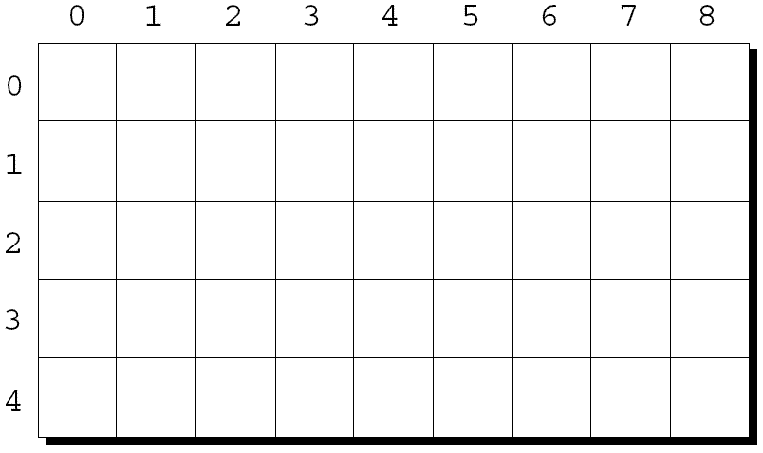
Multidimensional Arrays
An array may have any number of dimensions.
The following declaration creates a two-dimensional array (a matrix, in mathematical terminology):
int m[5][9];
m has 5 rows and 9 columns. Both rows and columns are indexed from 0:

Slide 20
Multidimensional Arrays
To access the element of m in row i, column j, we must write m[i][j].
The expression m[i] designates row i of m, and m[i][j] then selects element j in this row.
Resist the temptation to write m[i,j] instead of m[i][j].
C treats the comma as an operator in this context, so m[i,j] is the same as m[j].

Slide 21
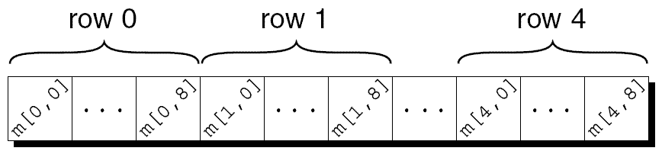
Multidimensional Arrays
Although we visualize two-dimensional arrays as tables, that’s not the way they’re actually stored in computer memory.
C stores arrays in row-major order, with row 0 first, then row 1, and so forth.
How the m array is stored:

Slide 22
Multidimensional Arrays
Nested for loops are ideal for processing multidimensional arrays.
Consider the problem of initializing an array for use as an identity matrix. A pair of nested for loops is perfect:
#define N 10
double ident[N][N];
int row, col;
for (row = 0; row < N; row++)
for (col = 0; col < N; col++)
if (row == col)
ident[row][col] = 1.0;
else
ident[row][col] = 0.0;

Slide 23
Initializing a Multidimensional Array
We can create an initializer for a two-dimensional array by nesting one-dimensional initializers:
int m[5][9] = {{1, 1, 1, 1, 1, 0, 1, 1, 1},
{0, 1, 0, 1, 0, 1, 0, 1, 0},
{0, 1, 0, 1, 1, 0, 0, 1, 0},
{1, 1, 0, 1, 0, 0, 0, 1, 0},
{1, 1, 0, 1, 0, 0, 1, 1, 1}};
Initializers for higher-dimensional arrays are constructed in a similar fashion.
C provides a variety of ways to abbreviate initializers for multidimensional arrays

Slide 24
Initializing a Multidimensional Array
If an initializer isn’t large enough to fill a multidimensional array, the remaining elements are given the value 0.
The following initializer fills only the first three rows of m; the last two rows will contain zeros:
int m[5][9] = {{1, 1, 1, 1, 1, 0, 1, 1, 1},
{0, 1, 0, 1, 0, 1, 0, 1, 0},
{0, 1, 0, 1, 1, 0, 0, 1, 0}};

Slide 25
Initializing a Multidimensional Array
If an inner list isn’t long enough to fill a row, the remaining elements in the row are initialized to 0:
int m[5][9] = {{1, 1, 1, 1, 1, 0, 1, 1, 1},
{0, 1, 0, 1, 0, 1, 0, 1},
{0, 1, 0, 1, 1, 0, 0, 1},
{1, 1, 0, 1, 0, 0, 0, 1},
{1, 1, 0, 1, 0, 0, 1, 1, 1}};

Slide 26
Initializing a Multidimensional Array
We can even omit the inner braces:
int m[5][9] = {1, 1, 1, 1, 1, 0, 1, 1, 1,
0, 1, 0, 1, 0, 1, 0, 1, 0,
0, 1, 0, 1, 1, 0, 0, 1, 0,
1, 1, 0, 1, 0, 0, 0, 1, 0,
1, 1, 0, 1, 0, 0, 1, 1, 1};
Once the compiler has seen enough values to fill one row, it begins filling the next.
Omitting the inner braces can be risky, since an extra element (or even worse, a missing element) will affect the rest of the initializer.

Slide 27
Constant Arrays
An array can be made “constant” by starting its declaration with the word const:
const char hex_chars[] =
{'0', '1', '2', '3', '4', '5', '6', '7', '8', '9',
'A', 'B', 'C', 'D', 'E', 'F'};
An array that’s been declared const should not be modified by the program.

Slide 28
Constant Arrays
Advantages of declaring an array to be const:
Documents that the program won’t change the array.
Helps the compiler catch errors.
const isn’t limited to arrays, but it’s particularly useful in array declarations.

Slide 29
Character Arrays
String “first” is really a static array of characters
Character arrays can be initialized using string literals
char string1[] = "first";
Null character '\0' terminates strings
string1 actually has 6 elements, equivalent to
char string1[] = { 'f', 'i', 'r', 's', 't', '\0' };
Can access individual characters string1[ 3 ] is ‘s’
Array name is address of array, so & not needed for scanf
scanf( "%s", string2 );
Reads characters until whitespace encountered
Can write beyond end of array, be careful

Slide 30
Passing Arrays to Functions
To pass an array argument to a function, specify the name of the array without any brackets
int myArray[ 24 ];
myFunction( myArray, 24 );
Array size usually passed to function
Arrays passed call-by-reference
Name of array is address of first element
Function knows where the array is stored
Modifies original memory locations
Passing array elements
Passed by call-by-value
Pass subscripted name (i.e., myArray[ 3 ]) to function

Slide 31
Sorting Arrays
Sorting data
Important computing application
Virtually every organization must sort some data
Bubble sort (sinking sort)
Several passes through the array
Successive pairs of elements are compared
If increasing order (or identical ), no change
If decreasing order, elements exchanged
Repeat
Example:
original: 3 4 2 6 7
pass 1: 3 2 4 6 7
pass 2: 2 3 4 6 7
Small elements "bubble" to the top

Slide 32
Selection Sorting
One approach (N is # elements in array):
1. Find smallest value in A and swap with A[0]
2. Find smallest value in A[1] .. A[N-1] and swap with A[1]
3. Find smallest value in A[2] .. A[N-1] and swap with A[2]
4. Continue through A[N-2]

Slide 33
Selection Sort Example
A A
6 1
4 Find smallest 4
8 and swap 8
10 with A[0] 10
1 6
A A
1 1
4 Find 2nd 4
8 smallest and 8
10 swap with A[1] 10
6 6
A A
1 1
4 Find 3rd 4
8 smallest and 6
10 swap with A[2] 10
6 8
A A
1 1
4 Find 4th 4
6 smallest and 6
10 swap with A[3] 8
8 10

Slide 34
Selection Sort Notes
If array has N elements, process of finding smallest repeated N-1 times (outer loop)
Each iteration requires search for smallest value (inner loop)
After inner loop, two array members must be swapped
Can search for largest member to get descending-order sort

Slide 35
Selection Sort Algorithm
A K Smallest
6 6
4 1 4
8 2
10 3
1 4 1
But we need location of smallest, not its value to swap
For J is 0 to N-2
Find smallest value in A[J], A[J+1] .. A[N-1]
Store subscript of smallest in Index
Swap A[J] and A[Index]
Find smallest in A[J..N-1]
Suppose J is 0
Smallest = A[0];
for (K = 1; K < N; K++)
if (A[K] < Smallest)
Smallest = A[K];

Slide 36
Selection Sort Algorithm
J is 0, find smallest:
A K SmallAt
6 0
4 1 1
8 2
10 3
1 4 4
Swap A[SmallAt],A[0]
Find location of smallest rather than value:
SmallAt = 0;
for (K = 1; K < N; K++)
if (A[K] < A[SmallAt])
SmallAt = K;
Swapping two elements:
Temp = A[J];
A[J] = A[SmallAt];
A[SmallAt] = Temp;

Slide 37
Searching Arrays: Linear Search and Binary Search
Search an array for a key value
Linear search or Sequential search
Simple
Compare each element of array with key value
Useful for small and unsorted arrays
Binary search
For sorted arrays
Compares middle element with key
If equal, match found
If key < middle, looks in first half of array
If key > middle, looks in last half
Repeat
Very fast; at most n steps, where 2^{n} > number of elements
30 element array takes at most 5 steps
2⁵ > 30 so at most 5 steps

