Slide 1
Economic Equilibrium
Lecture 15

Slide 2
Concepts
Full Employment
Prices (stable prices. Inflation should be less than the limit above which people start losing confidence)
Investment and Savings (should be equal. Saving might be unproductive (gold) or speculated (property). No contribution to economic activity.)
Aggregate Demand (should grow. If not growth, at least maintain it.)
Business Cycles (The business cycle, also known as the economic cycle or trade cycle, is the downward and upward movement of gross domestic product around its long-term growth trend. The length of a business cycle is the period of time containing a single boom and contraction in sequence.)
Why business cycles happen?
Shock, natural occurrence, government policies

Slide 3
Keynes’ Tract
Relates money supply variability and uncertainty to inflation and deflation.
Variability of prices is a major cause of business cycles.
Wages and other costs of production adjust more slowly than prices.
Therefore price variability affects profits and therefore investment.
Investment cycles cause business cycles.

Slide 4
The General Theory
According to the classical economics model, the consumer has insatiable wants.
The consumer sells his/her labor in exchange for enough income to buy the goods.
The money value of all the incomes received must be equal to the value of the output produced, in an economy in perfect competition
So how can unsold goods pile up in warehouses, causing firms to lay off workers?

Slide 5
The General Theory (2)
  If spending constraints are in effect due to culture/social norms, unavailability of desired goods, then there will be a difference between (unlimited) demand and “effective demand”.
  Actual (effective) demand will usually be “deficient” to purchase total output. Hence unsold stocks.

Slide 6
The General Theory (3)
Microeconomics and macroeconomics do not operate on the same basis. One cannot assume that what is true for an economic agent at the level of the individual consumer or firm is true in aggregate. This amounts to the fallacy of composition.
  In microeconomics, relative price effects dominate. This is not true in macroeconomics. In macroeconomics, income effects dominate, making income more important in determining aggregate economic behavior.
  Micro: Price effect Macro: Income effect

Slide 7
Consumption and Savings
People split their incomes between consumption and savings
Savings depend more on social norms and future expectations than current interest rates.

Slide 8
The General Theory (4)
Therefore, consumption depends primarily upon income, not interest rates.
  “People don’t change their standard of living simply because the interest rate changes a few points.”

Slide 9
The General Theory (5)
Saving occurs as the result of a habit, convention, or social norm. People on average set aside a certain percentage of their income. Saving is not a function of interest rates.
Investment is related to interest rates, but also to business people's expectations for the future.

Slide 10
The General Theory (6)
There is no coordinating variable to bring supply and demand together in the loanable funds (capital) market.
  There is no reason to assume that supply equals demand in this market.
  There is no reason to believe that there will be adequate funds available to provide adequate investment demand.
  Since AD = C + I + G + NX, if investment demand is deficient, then AD < AS, and inventories may pile up, with unemployment a natural outcome.
  AD=Aggregate Demand, C=Consumption, I=Investment, G= Government , NX= Foreign trade
  Without the coordinating variable, this will be the normal outcome, with AD = AS ( Aggregate Supply) only happening accidentally.

Slide 11
The General Theory (7)
Investment is a large and long-term commitment, and is based on weakly supported expectations about the future. This makes investment very different from consumption. Investment decisions will be erratic and emotional, and the risks associated with investment are very high. As a result, business decision makers will tend to under-invest, further worsening the problem of deficient investment.

Slide 12
The General Theory (8)
It may be a natural outcome of the organization and institutions of modern economies that prices and wages may not be fully flexible. This would result in markets (like the labor and goods markets) being unable to clear, leading to unemployment and aggregate supply exceeding demand.

Slide 13
The General Theory (9)
Money plays a key role in the economy. The use of money leads to uncertainty, and makes “piercing the veil” impossible. A money economy is fundamentally different from a barter economy. The classical dichotomy cannot hold.
What is classical dichotomy?
  real GDP and other real variables can be determined without knowing the level of the nominal money supply or the rate of inflation. An economy exhibits the classical dichotomy if money is neutral, affecting only the price level, not real variables
  Keynes Postulated
  Interest rates are established in the money market.
  People may rationally hoard money, holding money for purposes other then making transactions.

Slide 14
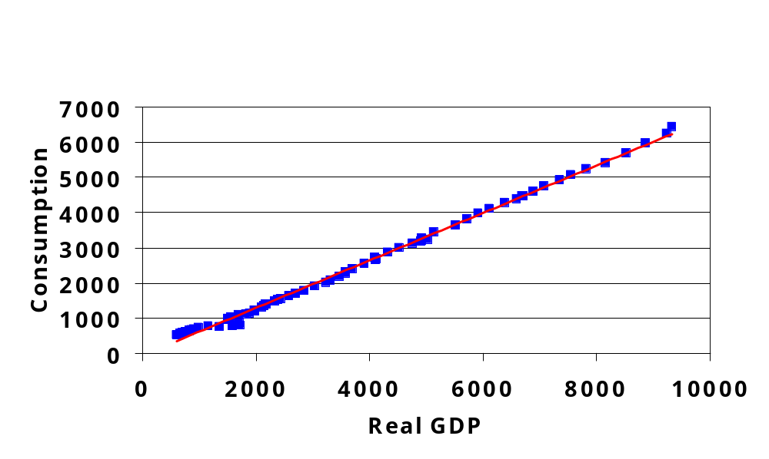
Consumption
U.S. Annual Data, 1929 - 2001

Slide 15
Consumption Function
c = mpc = ΔC/ΔYd = marginal propensity to consume
C
C = C₀ + mpc x Yd
Or
C = C₀ + cYd
ΔC
ΔYd
C₀
Yd

Slide 16
Real GDP exceeds
planned expenditure
45º line
10.0
Total Expenditure
C+I+G
Aggregate planned expenditure
(trillions of 1992 dollars/year)
8.0
f
d
e
6.0
b
c
Equilibrium
expenditure
4.0
a
C₀
Planned
expenditure
exceeds
real GDP
G
I
0
2
4
6
8
10
Real GDP (trillions of 1992 dollars per year)

