Slide 1
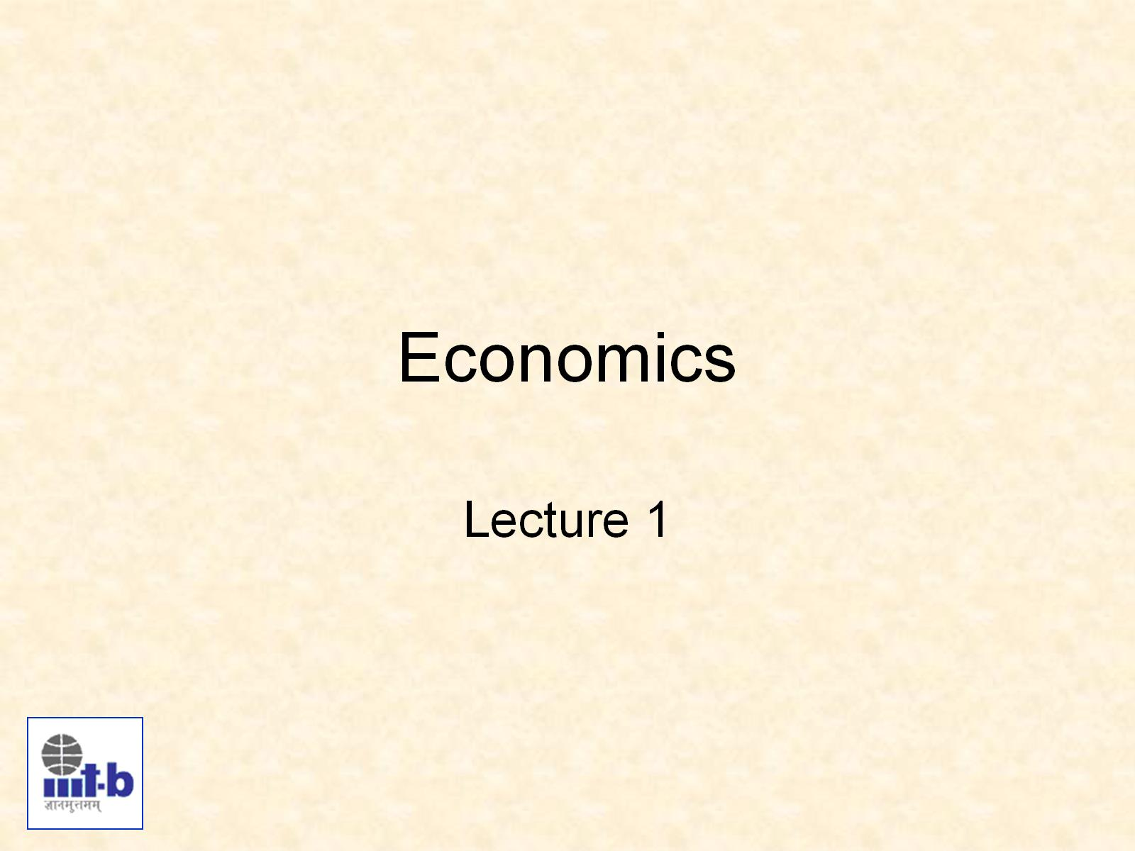
Economics

Slide 2
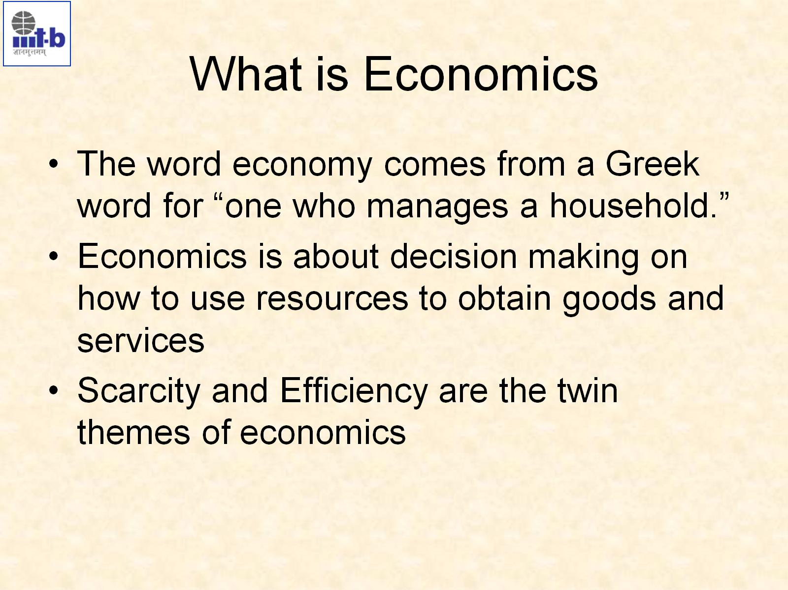
What is Economics
have to achieve certain goals because of a decision
we cannot sum the goals of all the people in country; country's goal depends on its government

Slide 3
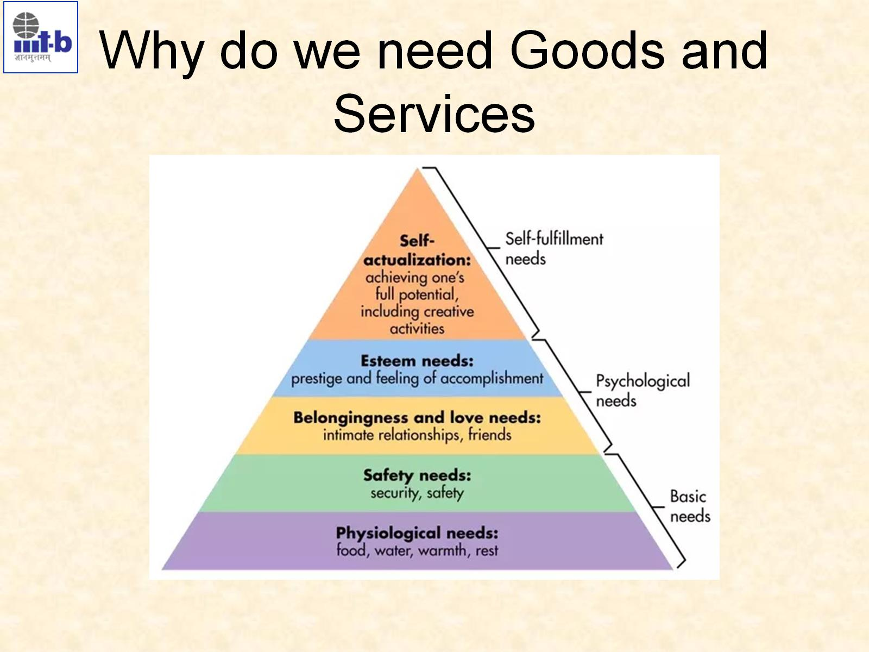
Why do we need Goods and Services
Hierarchy of needs
The Selfish Gene : every
living gene wants to survive
and make progenies
Dalai Lama
BMW vs Alto
protection from elements, security, order, law, stability, freedom from fear.
Psychological vs
feeling of belongingness vs individual achievement
Government usually takes care of the bottom four

Slide 4
Used value is the value that I get from it.
Exchange value is the value got from buying and selling it.
examples : air, water, diamond
Nudge Theory
Difference between nudge and incentive
(i) esteem for oneself (dignity, achievement, mastery, independence) and (ii) the desire for reputation or respect from others (e.g., status, prestige).

Slide 5
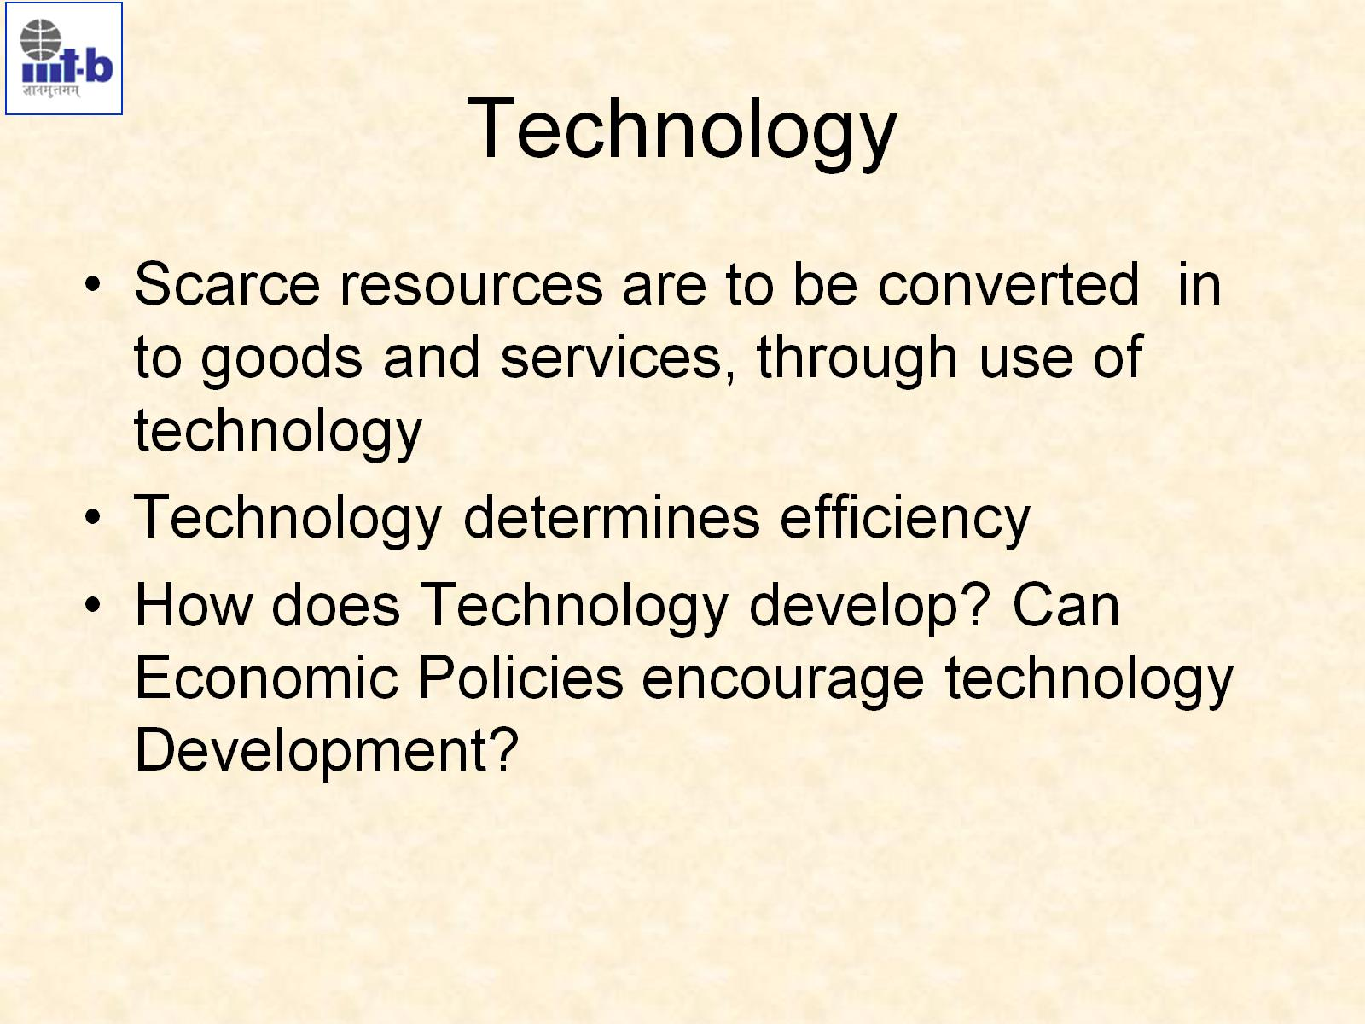
Technology

Slide 6
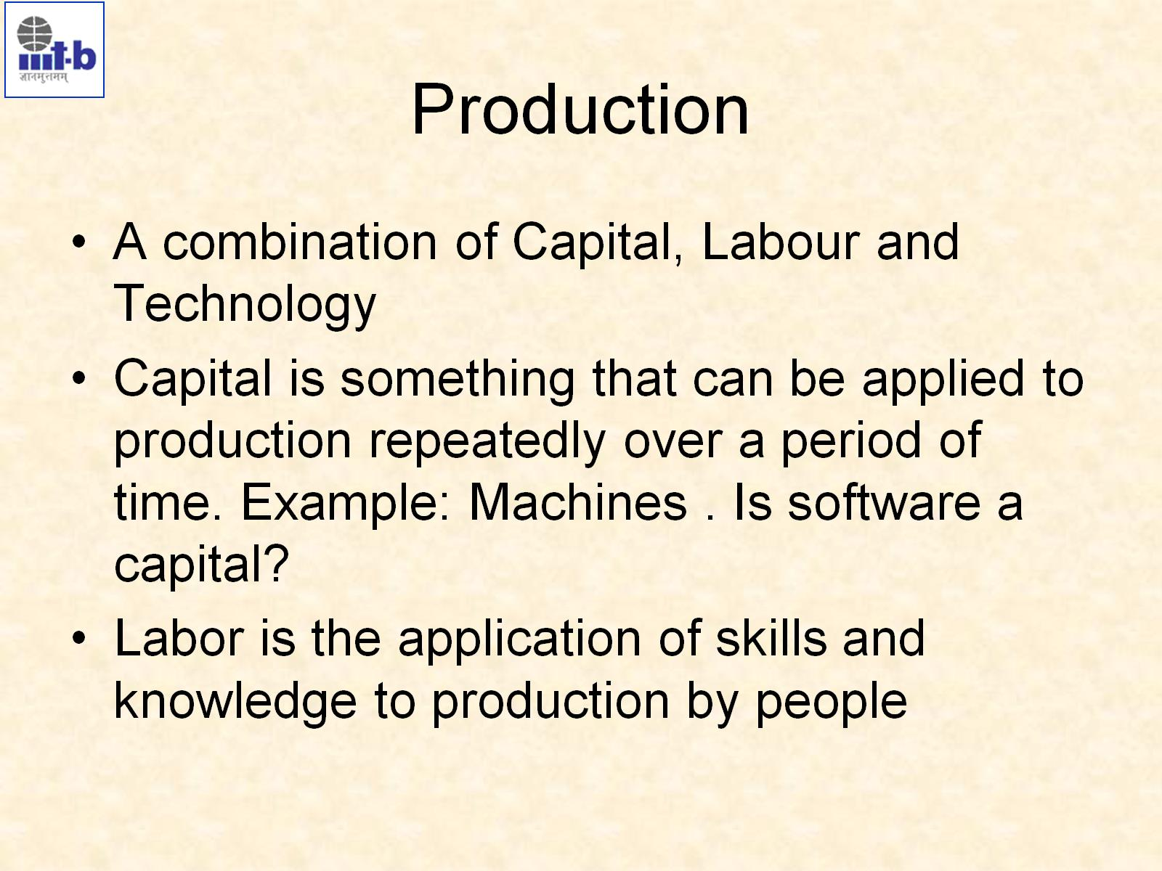
Production
IMP

Slide 7
Capital
Conditions to call something a capital:
Long life span (more than one year)
Used for producing something else from it
Clothes are not capital because they are consumed by itself.
Coffee machine is capital because it produces coffee which is then consumed.
Land is capital.
Pen is technically capital but they are inexpensive.
According to the Indian accounting system, price needs to be more than 5000 for it to be a capital.
Accounting is done on a yearly basis.
Capital should be transferrable.
When software was distributed on CD and floppy then it was transferrable but now it is not. Now we have license rights and not property rights.
Land can be sold either in ownership or lease form.

Slide 8
Is software a capital?
Software are distributed on an annual license basis.
Perpetual : never ending or changing
Perpetually licensed software is capital.
License given on per ‘use’ or ‘computation’ basis is not capital.
Use/computation price is more expensive.
Data centre vs cloud

Slide 9
Labour
Labour vs robotic automation
Capital requires suitable knowledge base to use and maintain it.
Encyclopedic vs Tacit knowledge

Slide 10
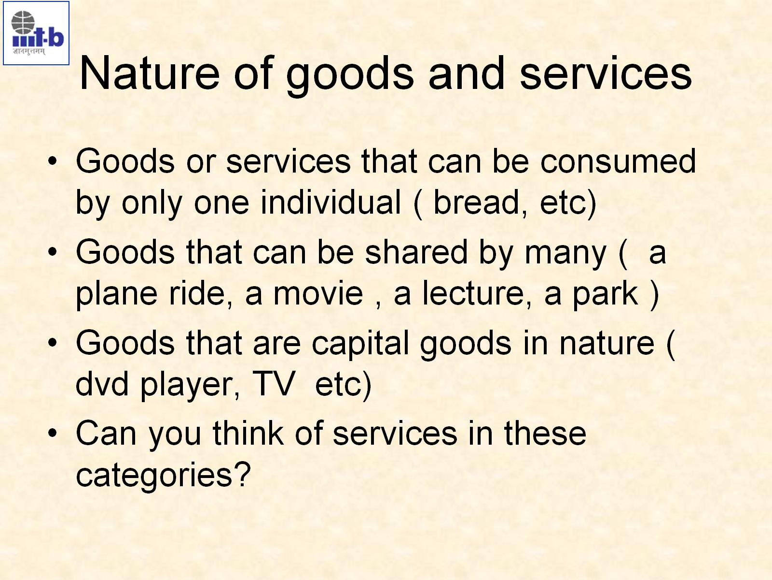
Nature of goods and services

Slide 11
Goods and Services
Meaning | Goods are the material items that can be seen, touched or felt and are ready for sale to the customers. | Services are amenities, facilities, benefits or help provided by other people.
Nature | Tangible | Intangible
Variability | Identical | Diversified
Storage Ownership | Goods can be stored for use in future or multiple use. Transferrable | Services cannot be stored. Non transferrable

Slide 12
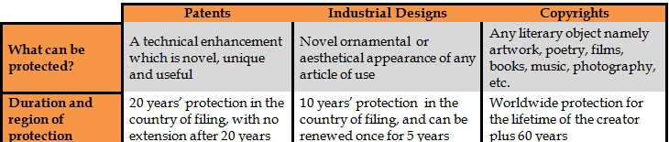
misc
SaaS : Software as a Service
Copyright vs patent
Product is a combination of many goods

Slide 13
Can of you think of services in these catagories?
Only one individual : doctor, tailor
Shared by many : concert, streaming
Capital : perpetually licensed software, IT maintenance, warranty on products, credit card, banking

Slide 14
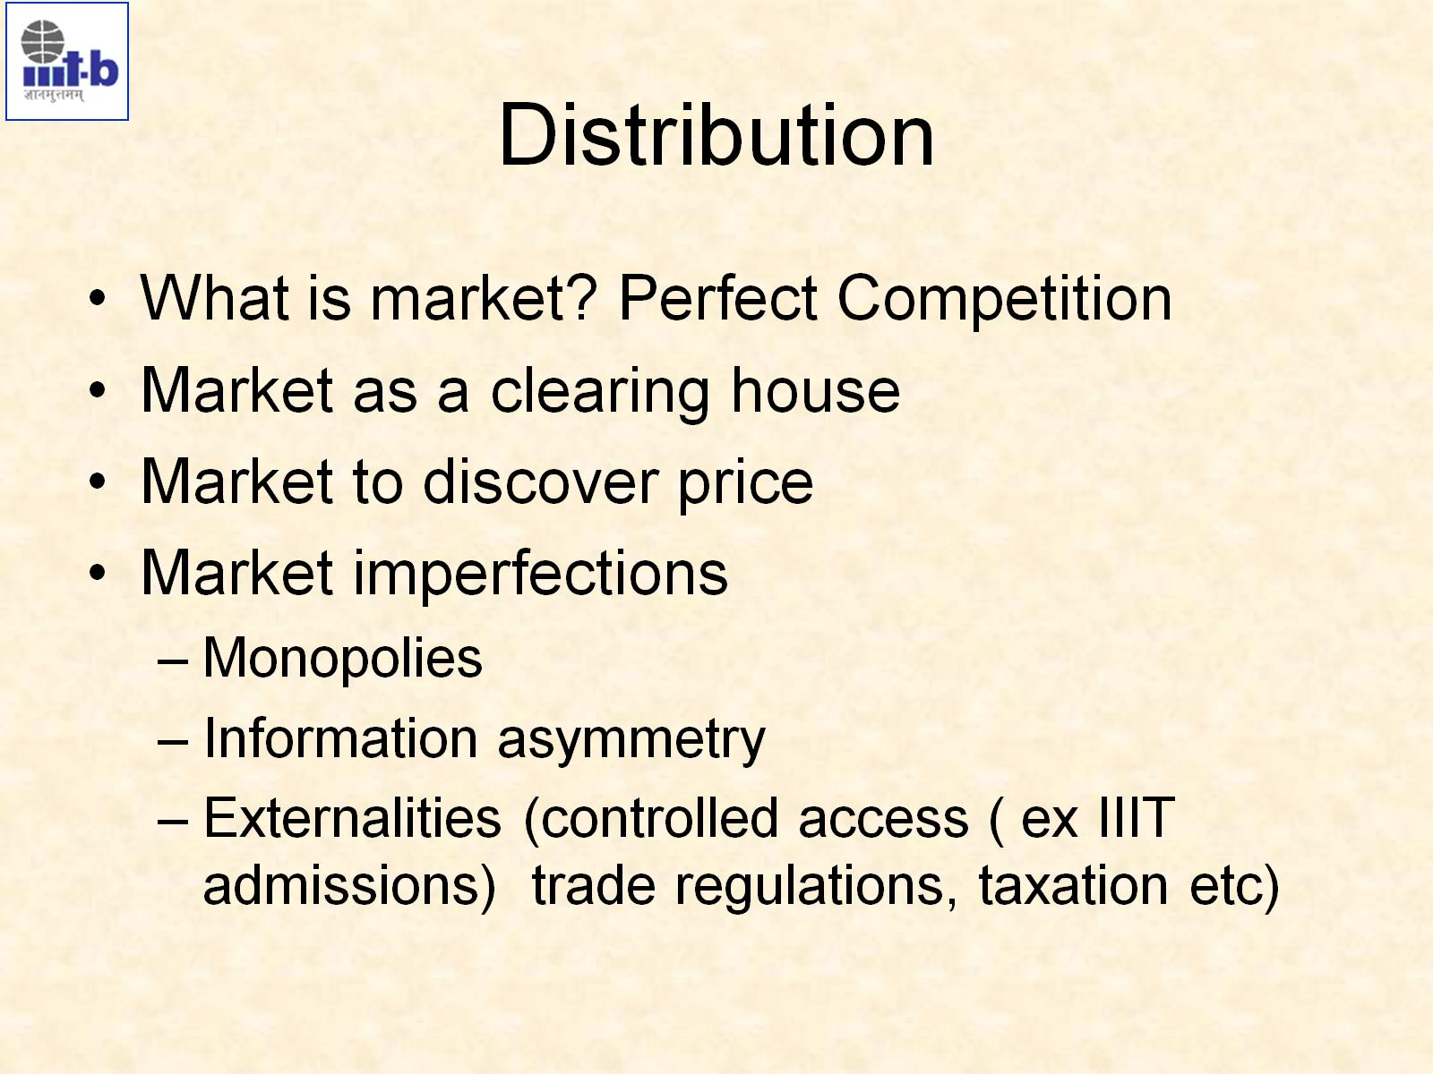
Distribution

Slide 15
Distribution
A point-of-sale for a good or a service can be physical or online.
“you go to them or they come to you” example : retail store and Swiggy
Marketplace : a place where producers and consumers come together and proximity is established physically or virtually. Example : Amazon, Ola, Swiggy
It is the efficient way of distribution of goods.
Discover prices : find out price through negotiations
Discovery is called the clearing function of the market. (cleared = sold)
Market collects and distributes goods and services so it is a clearing house.
The prices have crashed nearly 91 per cent in the past couple of months from Rs 21.51 per kg on October 17 to Rs 1 per kg on December 24. The prices have crashed due to sudden rise in supply of summer onions in the market. The summer crop, harvested in March and April, has a storage life of about six months.
Price discovery is the overall process, whether explicit or inferred, of setting the spot price or the proper price of an asset, security, commodity, or currency. The process of price discovery looks at a number of tangible and intangible factors, including supply and demand, investor risk attitudes, and the overall economic and geopolitical environment. Simply put, it is where a buyer and a seller agree on a price and a transaction occurs.

Slide 16
contd
Why should I pay someone else for organizing the market?
Middlemen; 5 is paid to the farmer when I pay 20 for the kilo
Farmers’ Market is organised in some places but it is not the dominant way of sale. Why?
The factor of convenience
I do not have all the information to ascertain the price.
Price inflation during the Big Billion Day sale.
Perfect competition
All the required information is known.
Everyone must buy and sell at the clearing price.
Price is the only factor of decision; nothing else can influence anyone.
There is no cap or restriction on demand and supply.
We may not have the capacity to search for information and quality of good may remain unknown. Example : who knows whether it is single estate coffee or not

Slide 17
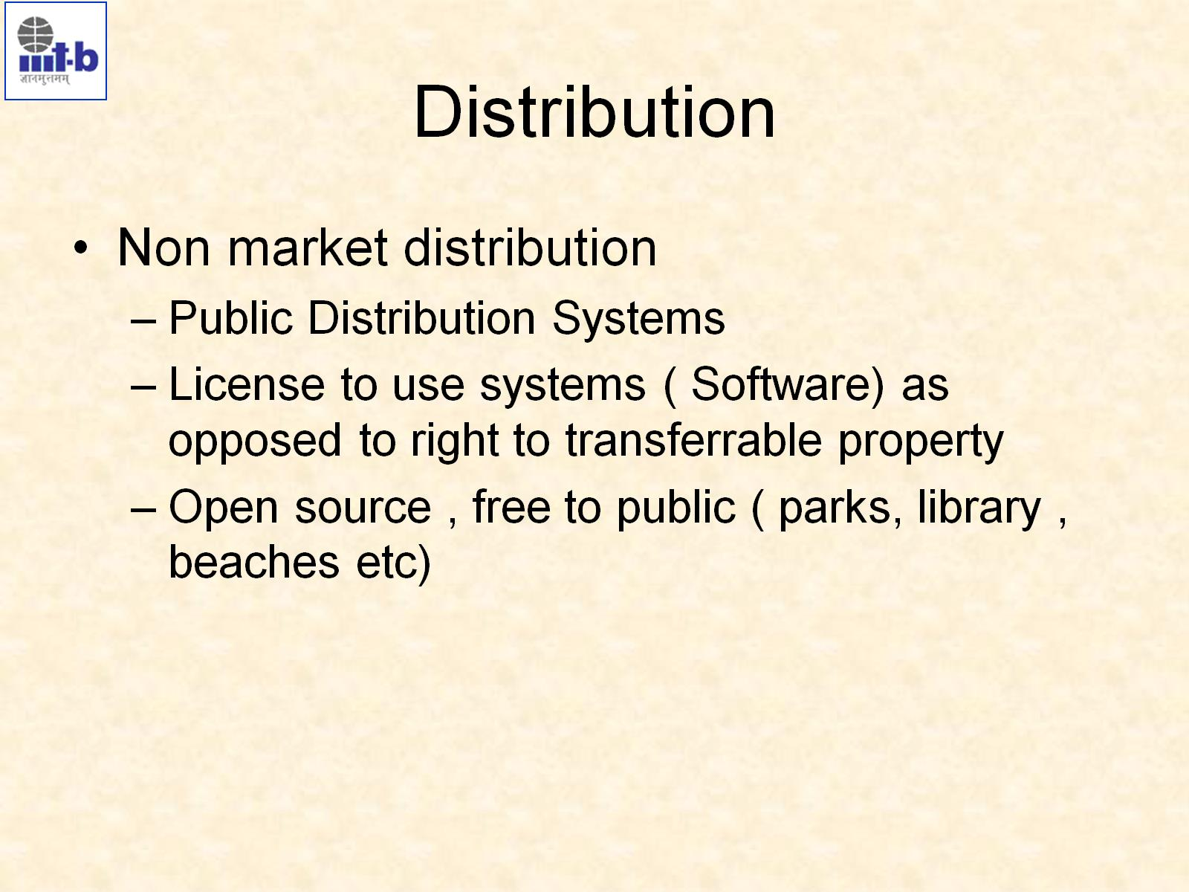
Distribution
IMPORTANT
Ration shop, Mid-day meal
Air and rail tickets can be thought of as license and not goods because they are not transferrable.

Slide 18
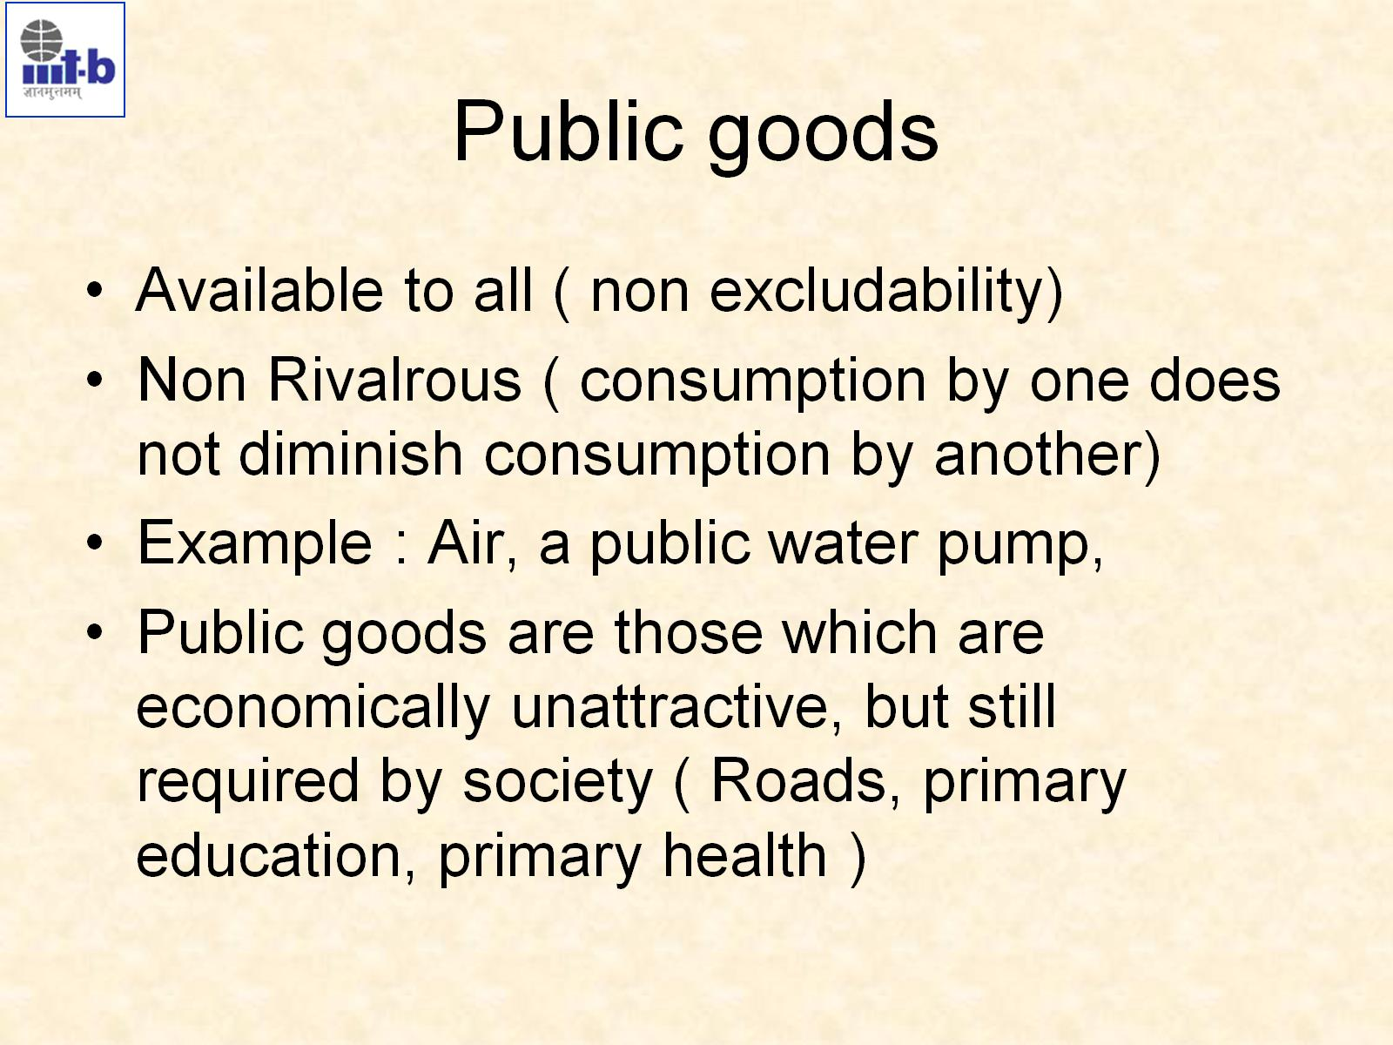
Public goods

Slide 19
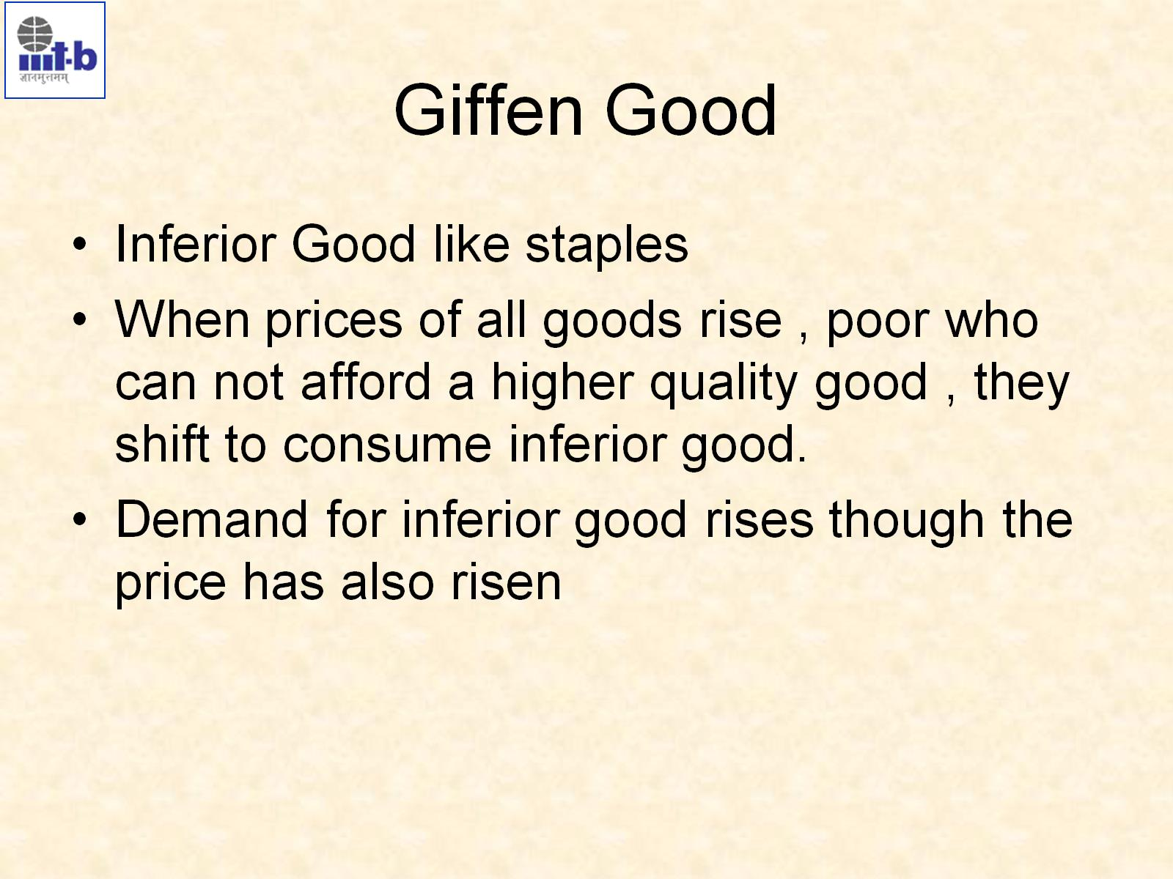
Giffen Good

Slide 20
Giffen goods
A Giffen good is basically a type of inferior good (good whose demand falls when income increases) which has no close substitutes. Let us take the example of potatoes and cheese to understand this.
A poor consumer spends a large part of his income on potatoes as it is one of the cheapest vegetable available in the market. Cheese, on the other hand, is considered a superior food that can be say consumed in place of potatoes but is expensive to buy.
When price of potatoes rise, people give up spending on all other goods and concentrate all their purchasing power towards procurement of potatoes as that is a necessary staple for them and there is no other close substitute. However, when price of potatoes fall, people decrease their consumption of potatoes even further to make use of their increased purchasing power to buy more of superior goods like cheese. That’s how Giffen goods work and defy the law of demand.

Slide 21
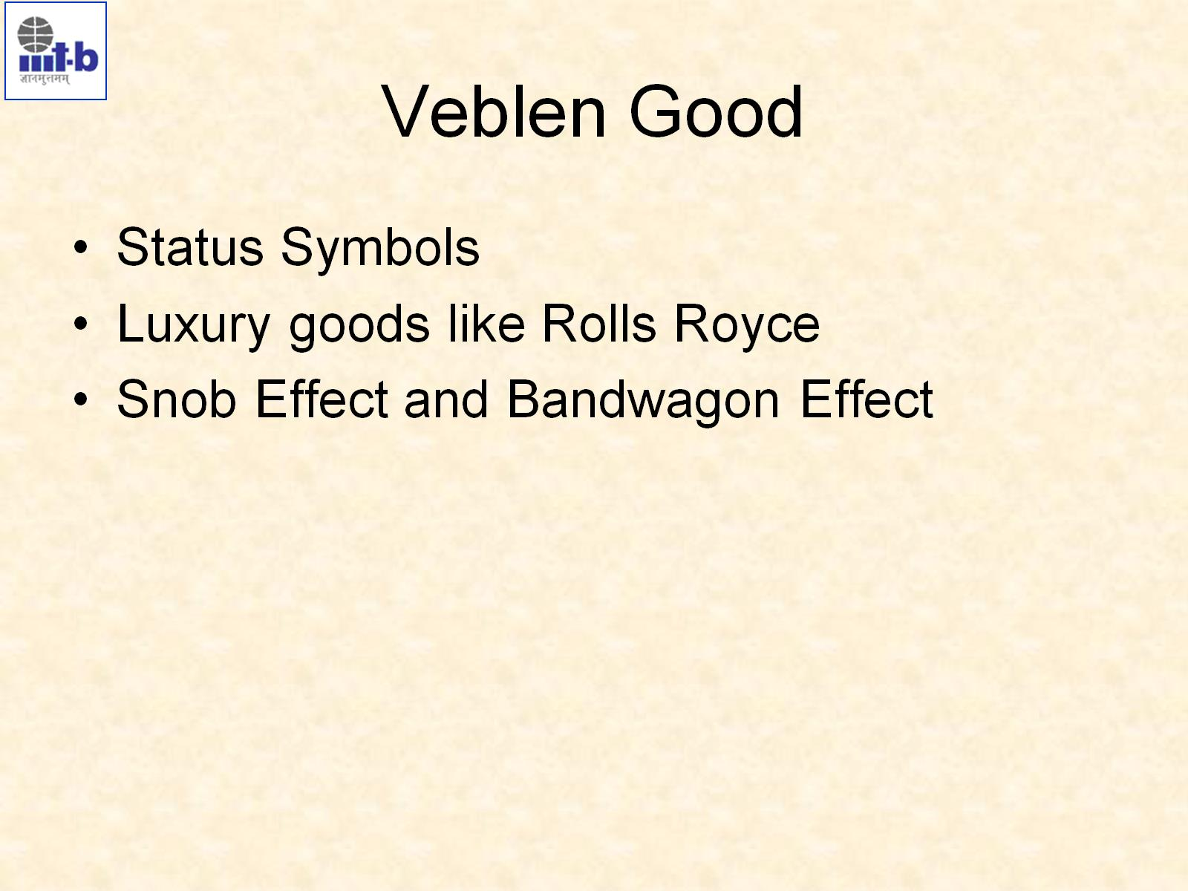
Veblen Good

Slide 22
Veblen goods
Veblen goods on the other hand, relate to prestige goods such as diamond, gold, antique paintings etc which are used as status symbols. They are wanted for prestige and distinction. Psychology that, higher the price, higher is the worth of the good exist in case of these goods. If the price falls, value/ prestige associated with the good also falls down leading to a fall in quantity demanded of the good as well.
Conspicuous consumption is the practice of purchasing goods or services to publicly display wealth rather than to cover basic needs. The word 'Conspicuous' here means lavish or wasteful spending. This kind of spending is generally made by people who have considerable amount of disposable income to spend on goods and services which are not necessary, but are more luxurious in nature.

Slide 23
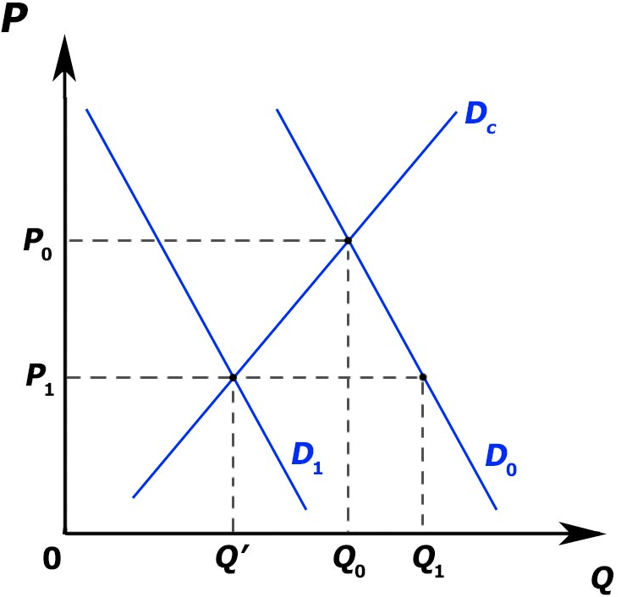
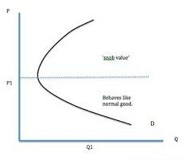
Snob effect (negative externality)
snob : a person with an exaggerated respect for high social position or wealth who seeks to associate with social superiors and looks down on those regarded as socially inferior.
Snob effect refers to the desire to possess a unique commodity having a prestige value.
Snob effect
D0 : initial demand curve; D1 : new demand curve; Price : P0 to P1

Slide 24
Bandwagon effect (positive externality)
bandwagon : used in reference to an activity, cause, etc. that is currently fashionable or popular and attracting increasing support.
People start copying the purchasing behavior of the snobs.
The snobs are no longer snob.
Bandwagon effect refers to the desire or demand for a good by a person who wants to be in style because possession of a good is in fashion and therefore many others have it.

Slide 25
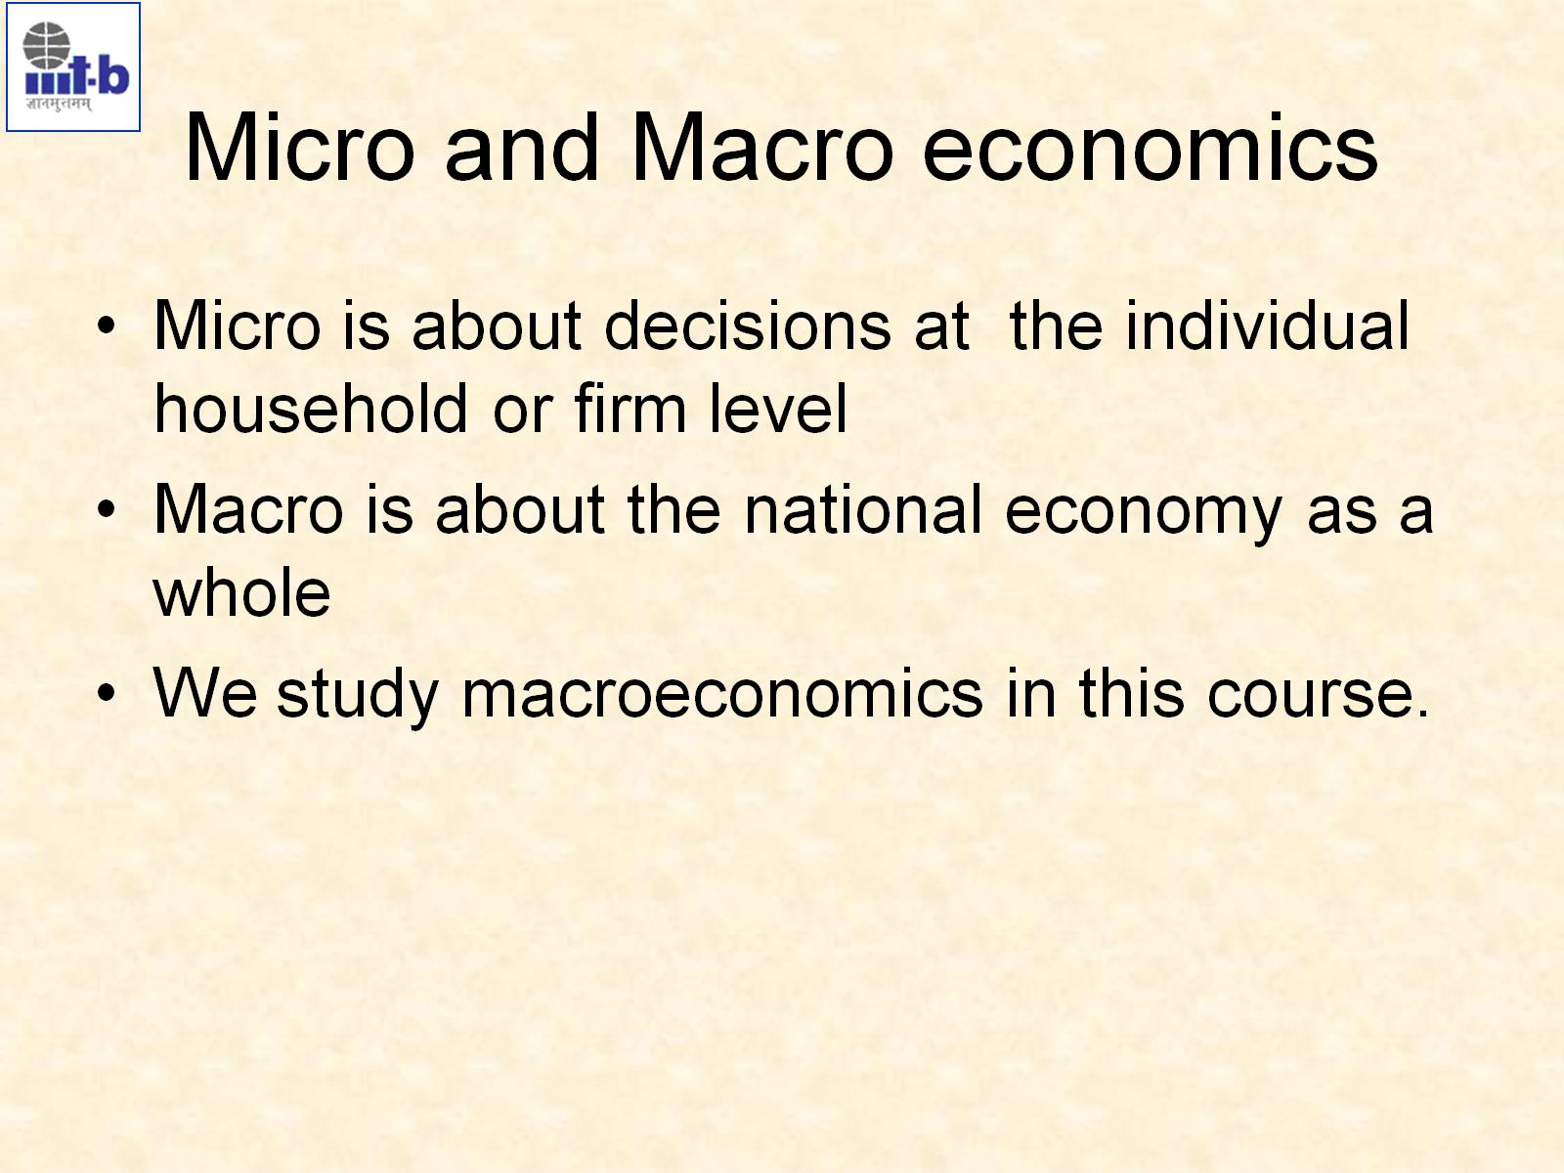
Micro and Macro economics

