Slide 1
Economic Organization
Lecture 4

Slide 2
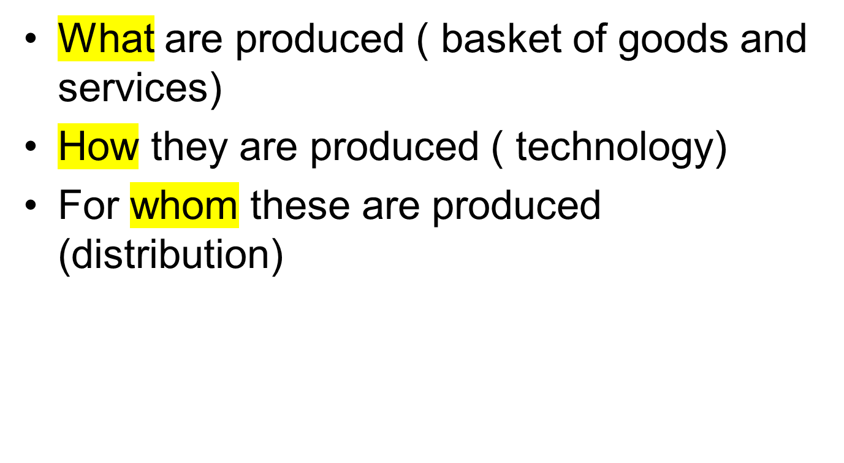
The three issues

Slide 3
Inputs
Natural Resources ( Land, minerals etc)
Capital
Labour
These combine to produce output goods or services
Transportation is a service, inputs are roads, fuel, vehicles

Slide 4
Production Possibility
The maximum an economy can produce is constrained by the inputs.
The combination is made possible by knowledge.
Is knowledge an input to production process?
How is knowledge produced? Is it then an output?
d/f b/w production possibility and PPF
Production depends on technology and resources

Slide 5
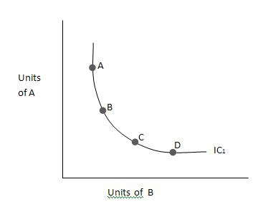
Production Possibility Frontier
A nation, given its constraints can only produce a limited basket of goods and services, this limit is the production possibility frontier.
There could be trade offs. We can choose to produce one good or service less and produce some thing else more.
Defense goods ( guns, tanks ) vs Development goods ( education, health)

Slide 6
Waste
Production also generates wastes, there is an environmental impact. Light bulbs generate heat.
Future cost of current production

Slide 7
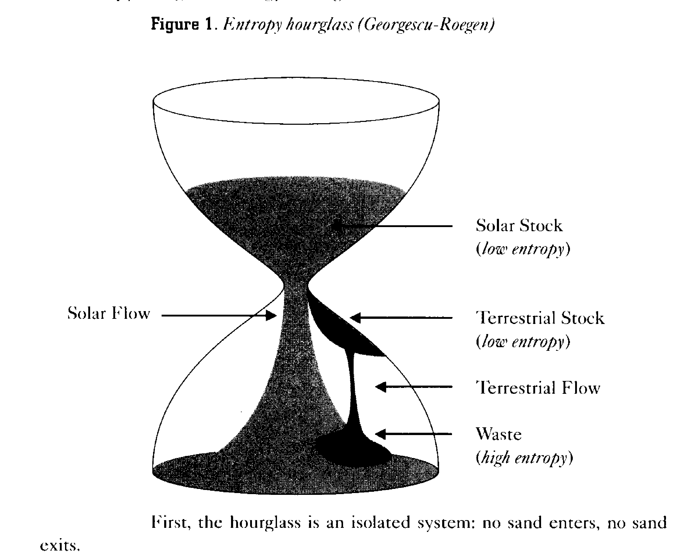


Slide 8
Entropy Process
Source: Herman Daly, "Beyond Growth", p. 29, 1996.
The main thrust of Georgescu-Roegen's ideas can be summarized in his "entropy hourglass" analogy: "Entropy Hourglass" (Georggescu-Roegen)
First, the hourglass is an isolated system: no sand enters, no sand exit.
Second, within the glass there is neither creation nor destruction of sand, the amount of sand in the glass is constant. This, of course, is the analog of the first law of thermodynamics-conservation of matter / energy,
Third, there is a continuing running-down of sand in the top chamber, and an accumulation of sand in the bottom chamber. Sand in the bottom chamber has used up its potential to fall and thereby do work, it is high-entropy or unavailable (used up) matter / energy. Sand in the top chamber still has potential to fall- it is low-entropy or available (still useful) matter/ energy. This is the second law of thermodynamics: entropy (or "used-up-ness") increases in an isolated system. The hourglass analogy is particularly apt since entropy is time's arrow in the physical world.

Slide 9
First, the hourglass is an isolated system: no sand enters, no sand exit.
Second, within the glass there is neither creation nor destruction of sand, the amount of sand in the glass is constant. This, of course, is the analog of the first law of thermodynamics-conservation of matter / energy,
Third, there is a continuing running-down of sand in the top chamber, and an accumulation of sand in the bottom chamber. Sand in the bottom chamber has used up its potential to fall and thereby do work, it is high-entropy or unavailable (used up) matter / energy. Sand in the top chamber still has potential to fall- it is low-entropy or available (still useful) matter/ energy. This is the second law of thermodynamics: entropy (or "used-up-ness") increases in an isolated system. The hourglass analogy is particularly apt since entropy is time's arrow in the physical world.
The analogy can be extended by considering the sand in the upper chamber to be the stock of low-entropy energy in the sun. Solar energy arrives to earth as a flow whose amount is governed by the constricted middle of the hourglass, which limits the rate at which sand falls, the rate at which solar energy flows to earth. Suppose that over ancient geologic ages some of the falling sand had gotten stuck against the inner surface of the bottom chamber, but at the top of the bottom chamber, before it had fallen all the way. This becomes a terrestrial dowry of low-entropy matter / energy, a stock that we can use up at a rate of our own choosing. We use it by drilling holes into its surface through which the trapped sand can fall to the bottom of the lower chamber. This terrestrial source of low-entropy matter / energy can be used at a rate of our own choosing, unlike the energy of the sun, which arrives at a fixed flow rate. We cannot "mine" the sun to use tomorrow's Sunlight today, but we can mine terrestrial deposits and, in a sense, use up tomorrow's petroleum today.
There is thus an important asymmetry between Our two sources of low entropy. The solar Source is stock-abundant, but flow-limited. The terrestrial Source is stock-limited, but flow-abundant (temporarily). Peasant societies lived off the abundant solar flow; industrial societies have come to depend on enormous supp1ements from the limited terrestrial stocks.
Reversing this dependence will be an enormous evolutionary shift. Evolution has in the past consisted of slow adaptations of our "endosomatic organs" (heart, lungs, etc.), which run on solar energy. But the present path of evolution has shifted to rapid adaptations of our "exosomatic organs" (cars, airplanes, etc.), which depend on terrestrial low entropy. The uneven ownership of exosomatic organs and of the terrestrial stocks of low entropy from which they are made is the root of social conflict in industrial societies.
Unlike a real hourglass, this one cannot be turned upside down! This dependence is completely abstracted from in the neoclassical economist's starting point, the circular flow of exchange value."

Slide 10
Alternative Economic Systems
Market Economies ( driven by private profit, laissez – faire)
Command Economy ( government controlled)
Mixed Economy ( a mixture of both, private production, government regulation)

Slide 11
Sustainability
Is continuous growth possible? ( limits to growth, by Club of Rome)
Environmental Impact
Concern for future generations
Will science find solutions on a continuing basis?
The Club of Rome is an organization of individuals who share a common concern for the future of humanity and strive to make a difference. Our members are notable scientists, economists, businessmen and businesswomen, high level civil servants and former heads of state from around the world. Our mission is to promote understanding of the global challenges facing humanity and to propose solutions through scientific analysis, communication and advocacy.

Slide 12
The Context
Living standards increased significantly due to technological progress and adoption of capitalism.
However, this rapid economic growth has negatively affected the environment and natural resources e.g. overfishing, pollution.
What are the future consequences of our actions?
How can we lessen our impact on the environment?
What are the limitations of these approaches?

Slide 13
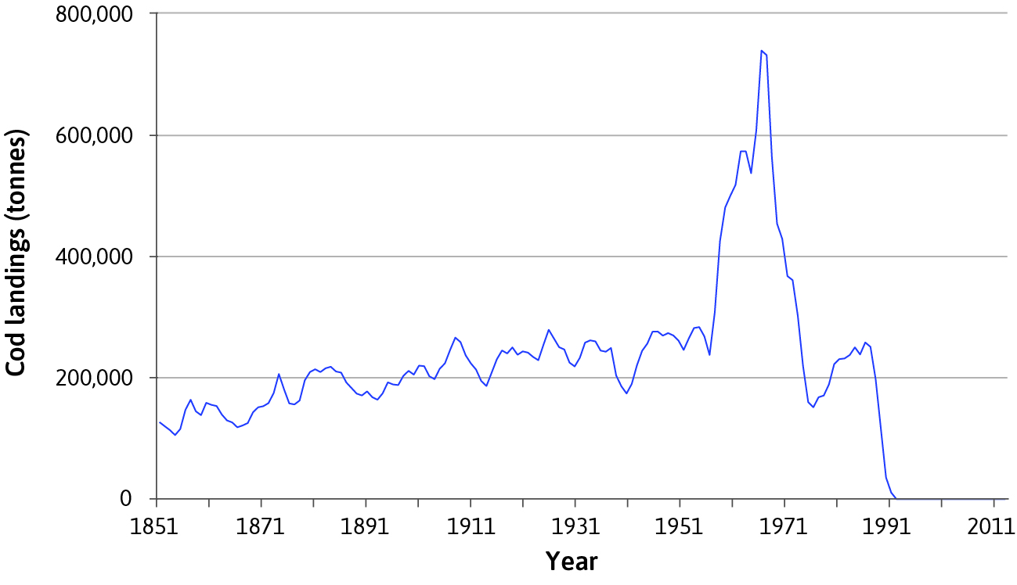
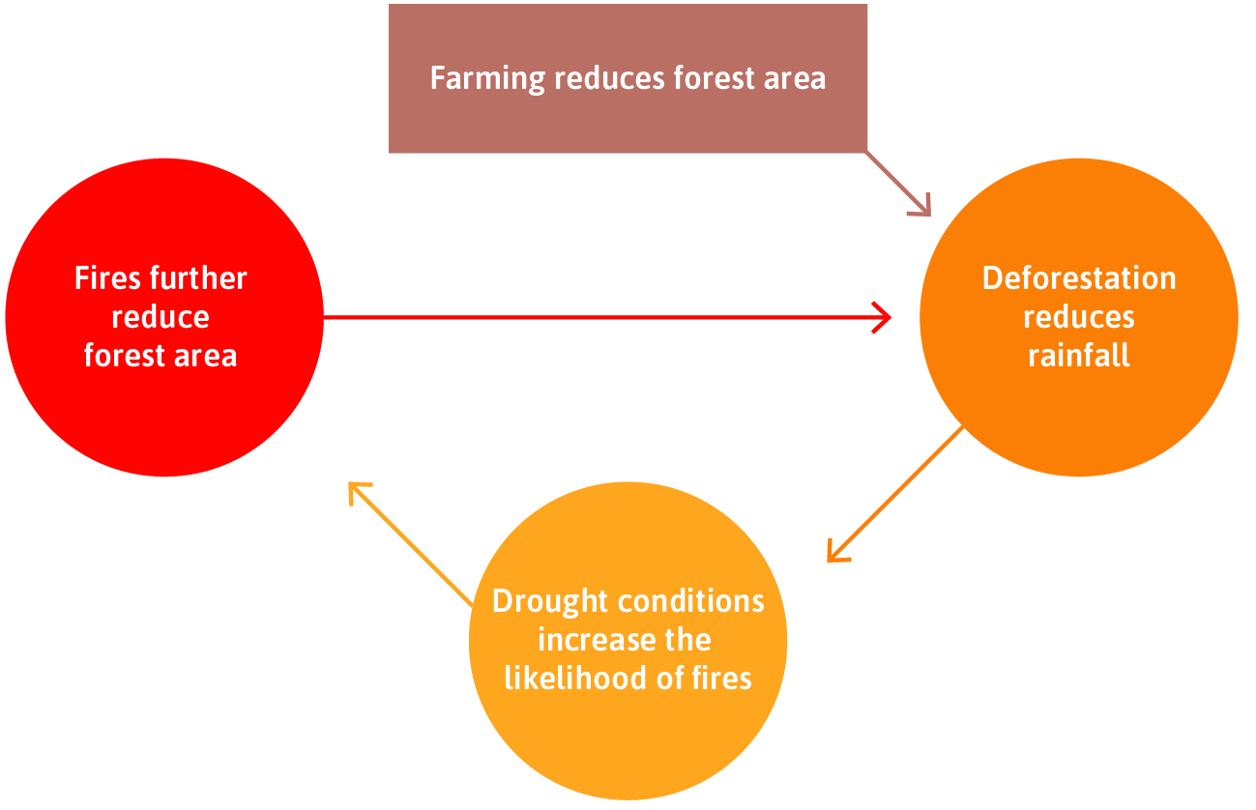
Short term vs Long Term
Economic growth is a challenge to natural resource management.
Changes (e.g. overfishing, deforestation) may become self-reinforcing due to positive feedback processes.

Slide 14
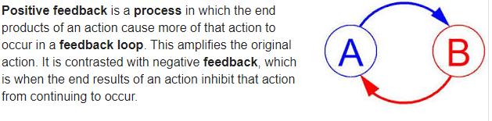

Slide 15
Climate Change
The issue of climate change: Using economic models to explain why environmental degradation occurs.
Discuss and evaluate environmental policies
Measuring costs and benefits: methods and limitations

Slide 16
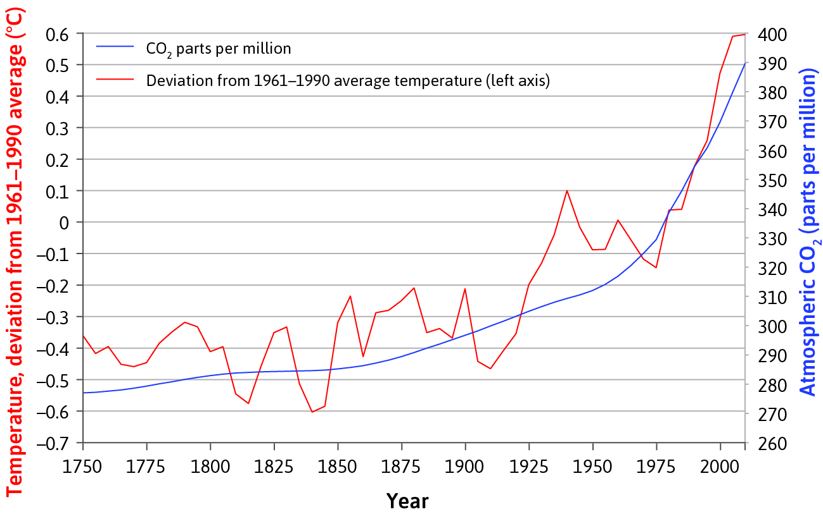
Climate Change
Climate change is a particularly difficult environmental problem to handle, for various reasons:
Capping emissions is not enough (stock of CO2 matters, not the flow)
May be irreversible
Requires global cooperation
Conflicts of interest (between/within countries and generations)
Worst-case scenario is catastrophic

Slide 17
Stock and Flow resources
Stock resources (non-renewable)
These resources have taken millions of years to form and so they are finite (can be exhausted), which is why we call them non-renewable – they are not going to be replenished in the near future. (Whilst new coal or gas may be created over millions of years, this is not useful on a human timescale). Some stock resources may have their exploitable life extended, while others are consumed in a single use, such as fossil fuels; metals, such as copper and steel may be recyclable and re-used. Examples of stock resources include fossil fuels (coal, oil, gas) as well as minerals such as gold, copper, tin, uranium etc.
Flow resources (renewable)
In contrast to stock resources, flow resources are renewed within a short timescale, either through natural physical systems or biotic reproduction. Some flow resources require careful management by human society in order to ensure their continuous availability, such as fish stocks or forests. These are known as critical flow resources. If these are exploited too intensively such that they can no longer be renewed, then they become stock (non-renewable) resources. For instance, overfishing can become unsustainable, leading to the fish population no longer being able to reproduce at a rate required to maintain fish stocks into the future. Other flow resources do not depend on human management, such as solar energy, wind or tides. Examples of flow resources include fish stocks, forests, fresh water, wind, solar energy and tidal range.
Flow resources have low embodiment of entropy.

Slide 18
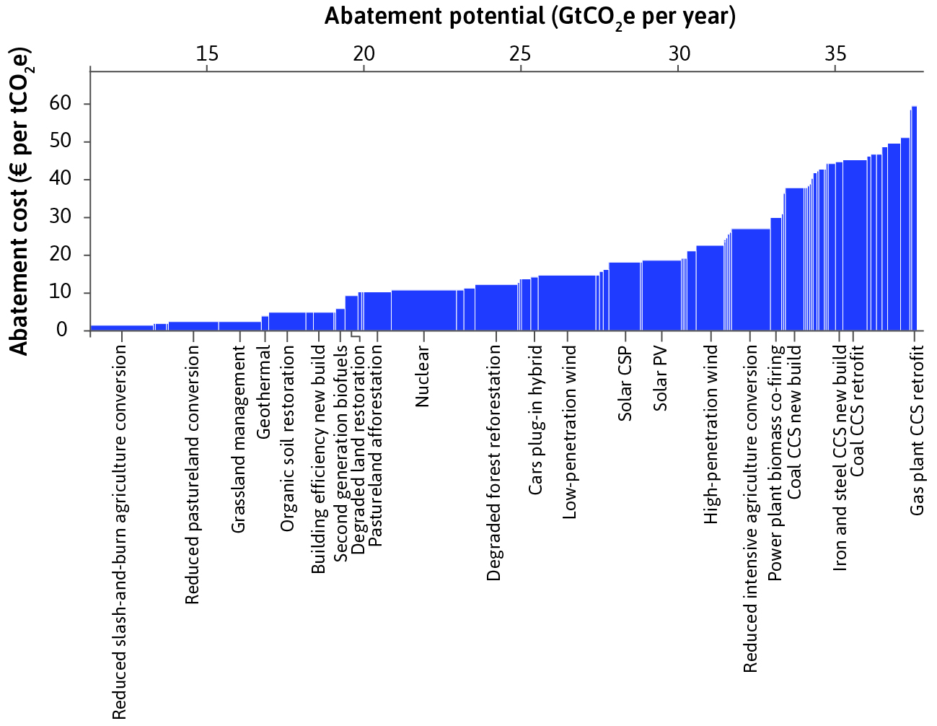
Abatement cost curve
Abatement policies can address climate change. The degree of abatement chosen depends on the relative costs and benefits.
The abatement cost curve shows the per-unit cost of abating greenhouse gas emissions using abatement policies, ranked from the most cost-effective to the least (the marginal cost curve).

