Slide 1
Comparative Advantage

Slide 2
Trade and Comparative Advantage
The production possibility curve is bowed because individuals specialize in the production of goods for which they have a comparative advantage and trade with others.

Slide 3
Trade and Comparative Advantage
To produce on the production possibilities curve, individuals must produce those goods for which they have a comparative advantage.

Slide 4
Trade and Comparative Advantage
Adam Smith argued that humankind’s proclivity to trade leads to individuals using their comparative advantage.

Slide 5
Markets, Specialization, and Growth
The growth in per capita income in the past two millennia has been astonishing.
This owes largely to the introduction of markets and democracy.

Slide 6
Markets, Specialization, and Growth
Markets allow specialization, leading to trade and growth.

Slide 7
Markets, Specialization, and Growth
As people are allowed to compete and specialize, they get better at what they do, develop new technologies, and the market grows ever larger.

Slide 8
Comparative Advantage does not work with trade barriers.
Free trade may lead to dumping of goods.
Dumping gives rise to surge in market share. Eg : Amazon
Export price needs to be real and not brought down by any government subsidy.
Free Trade : pushes people to give their best but causes unemployment too.
Comparative Advantage : 1. Trade is free
2. Price is natural
Washington consensus : Free trade and democracy
Salary negotiation is also a trade though the applicant has very little bargaining power.
Comparative Advantage assumes everybody is equal.

Slide 9
Growth in the Past Two Millennia
$6,000
$5,000
$4,000
Per capita income
(in 1990 international dollars)
$3,000
$2,000
$1,000
0
500
1000
1500
2000
McGraw-Hill/Irwin
© 2004 The McGraw-Hill Companies, Inc., All Rights Reserved.

Slide 10
The Benefits of Trade
When people trade, both parties expect to benefit from the trade.
Otherwise, why would they have traded in the first place?

Slide 11
The Benefits of Trade
The argument for the benefits of trade underlies the general policy of laissez-faire.
  Laissez-faire – an economic policy of leaving coordination of individuals’ actions to the market.

Slide 12
Production Possibilities without Trade
India can produce 4,000 yards of textile per day or 1 ton of chocolate per day.
Belgium can produce 1,000 yards of textile a day or 4 tons of chocolate per day.

Slide 13
Production Possibilities without Trade
India has a comparative advantage in producing textiles.
Belgium has a comparative advantage in chocolate.

Slide 14
Production Possibilities without Trade
5
4
India
Textiles
(in thousands of yards)
3
2
Belgium
1
1 2 3 4 5
Chocolate (in tons)
McGraw-Hill/Irwin
© 2004 The McGraw-Hill Companies, Inc., All Rights Reserved.

Slide 15
Production Possibilities without Trade
India has chosen to produce 2,000 yards of textiles and 0.5 tons of chocolate.
Belgium has chosen to produce 500 yards of textile and 2 tons of chocolate.

Slide 16
Production Possibilities without Trade
Point A: The combination of textile and chocolate chosen by India.
Point B: The combination of textile and chocolate chosen by Belgium.
Point C: The joint combination without trade.

Slide 17
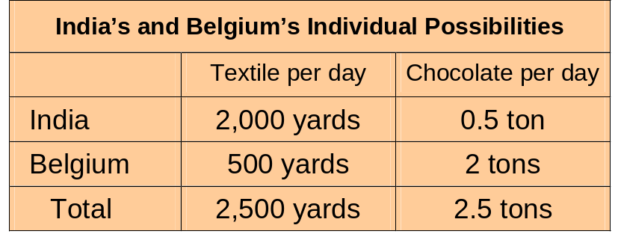
Production Possibilities without Trade

Slide 18
Production Possibilities without Trade
5
4
Textiles
(in thousands of yards)
India
3
C
A
2
Belgium
1
B
1 2 3 4 5
Chocolate (in tons)
McGraw-Hill/Irwin
© 2004 The McGraw-Hill Companies, Inc., All Rights Reserved.

Slide 19
Production Possibilities without Trade
The two extreme combinations are both countries producing only textile (point D) and both producing only chocolate (point E).
The combined production possibilities curve with no trade is drawn by connecting these two points.

Slide 20
Production Possibilities without Trade
D
5
4
Textiles
(in thousands of yards)
India
3
C
Joint (no trade)
A
2
Belgium
1
B
E
1 2 3 4 5
Chocolate (in tons)
McGraw-Hill/Irwin
© 2004 The McGraw-Hill Companies, Inc., All Rights Reserved.

Slide 21
Production Possibilities with Trade
Point F: This is where each nation is focusing on that activity for which it has a comparative advantage.
  India produces 4,000 yards of textile.
  Belgium produces 4 tons of chocolate.

Slide 22
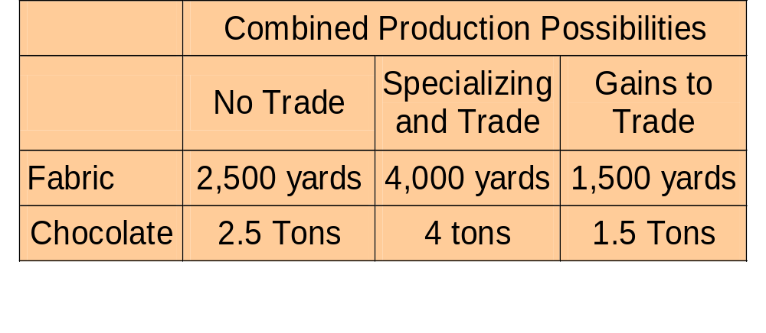
Production Possibilities with Trade

Slide 23
Production Possibilities with Trade
D
Gains from trade
5
Joint (with trade)
F
4
Textiles
(in thousands of yards)
3
C
Joint (no trade)
2
1
E
1 2 3 4 5
Chocolate (in tons)
McGraw-Hill/Irwin
© 2004 The McGraw-Hill Companies, Inc., All Rights Reserved.

Slide 24
Production Possibilities with Trade
The combined PPC is bowed out because of Point F – comparative advantage and specialization.

Slide 25
U.S. Textile Production and Trade
Two hundred yeas ago, the U.S had a comparative advantage in textile production.
Now, countries with cheaper labor, such as Bangladesh have the comparative advantage in textile production.

Slide 26
U.S. Textile Production and Trade
The gains from trade show up as higher pay for workers in Bangladesh and lower-priced cloth for U.S. consumers.

Slide 27
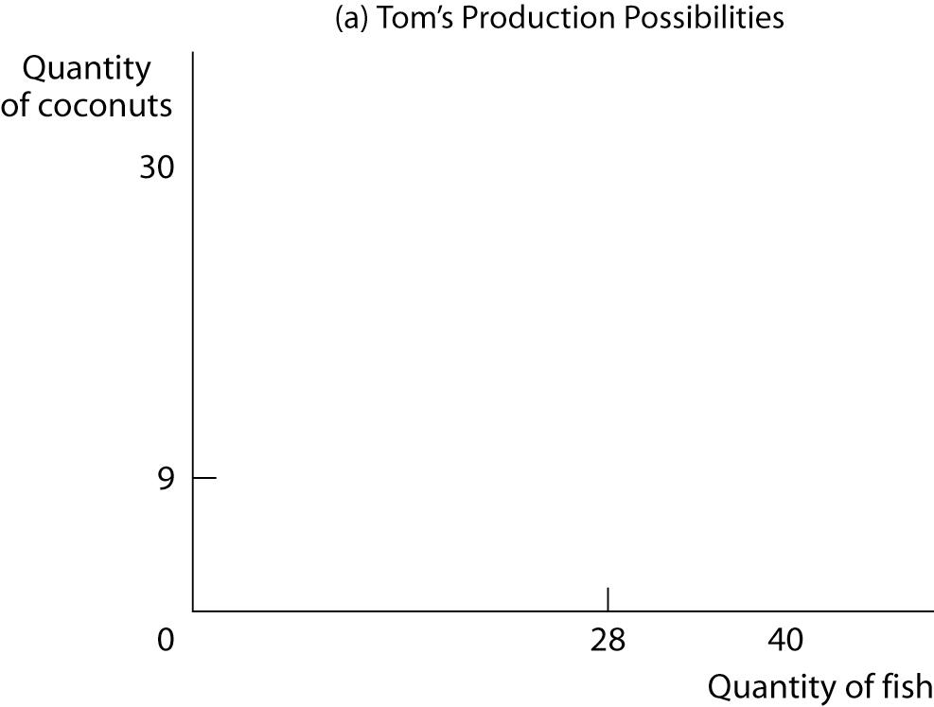
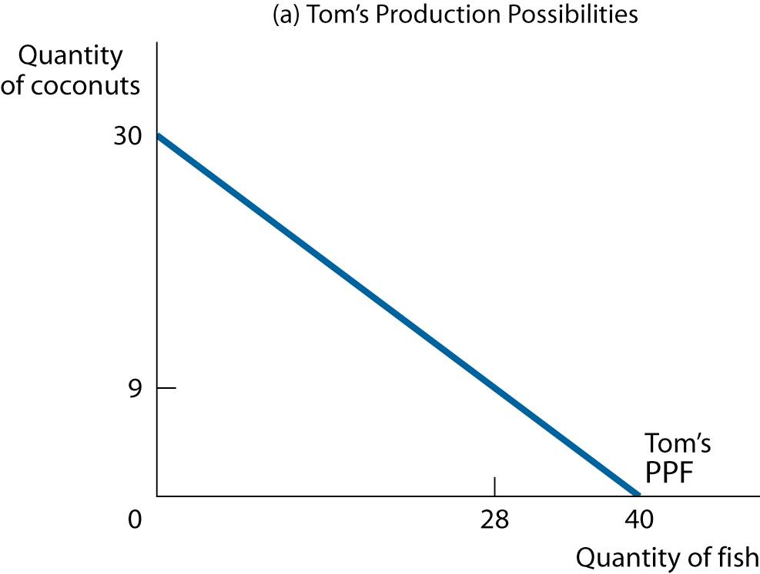
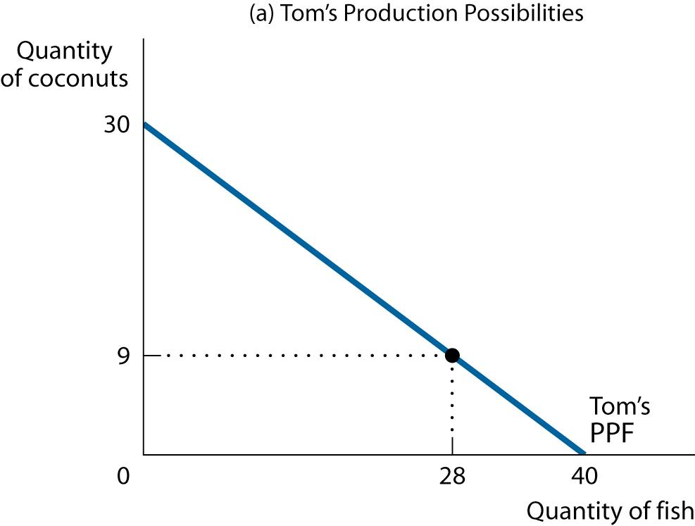
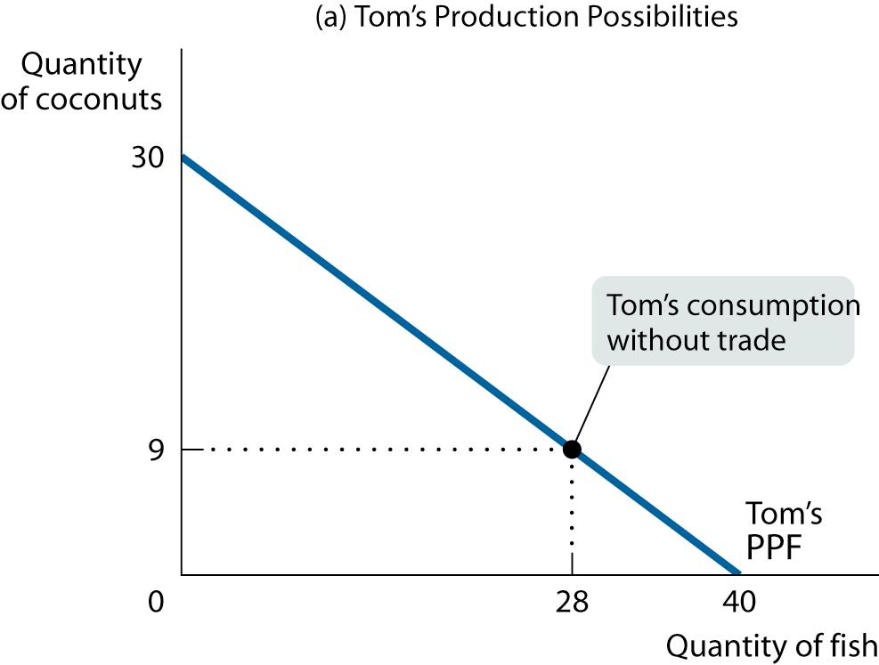
Comparative Advantage and Gains from Trade

Slide 28
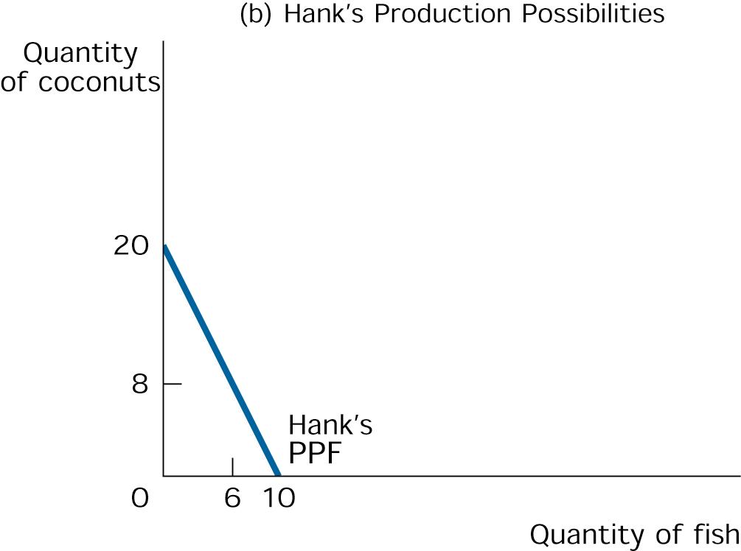
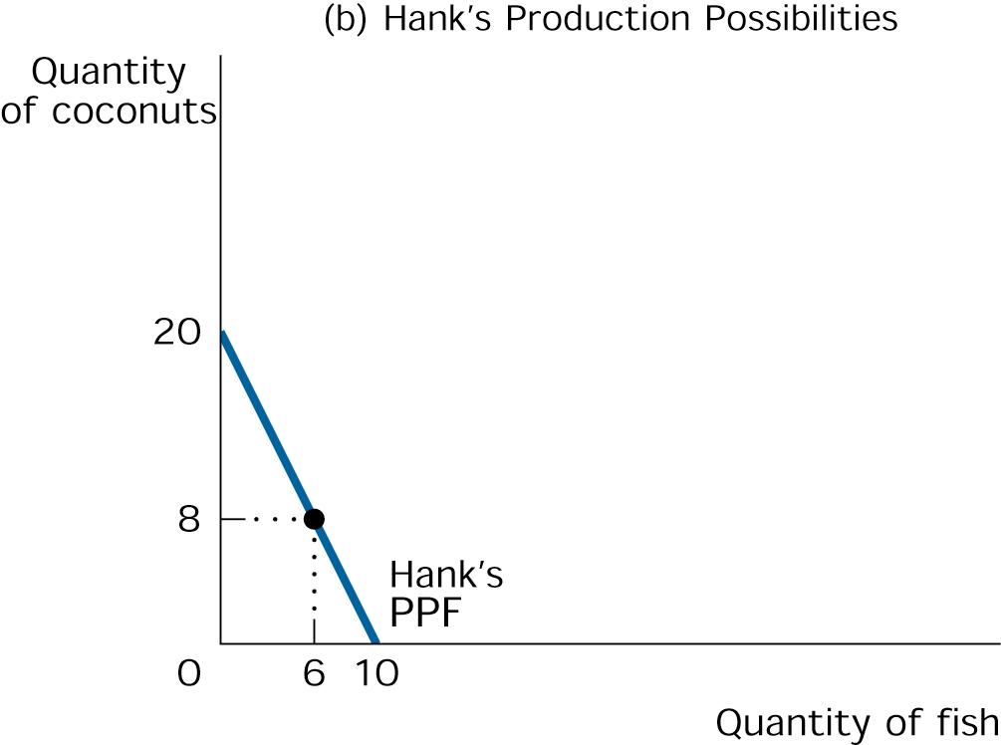
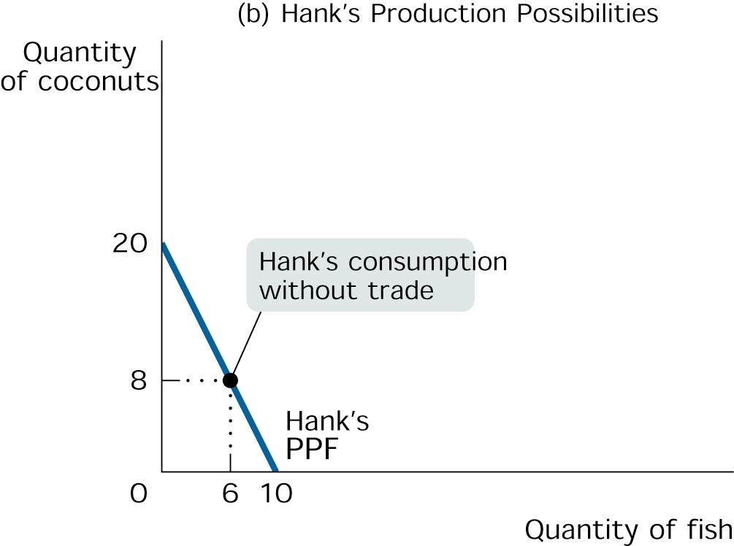
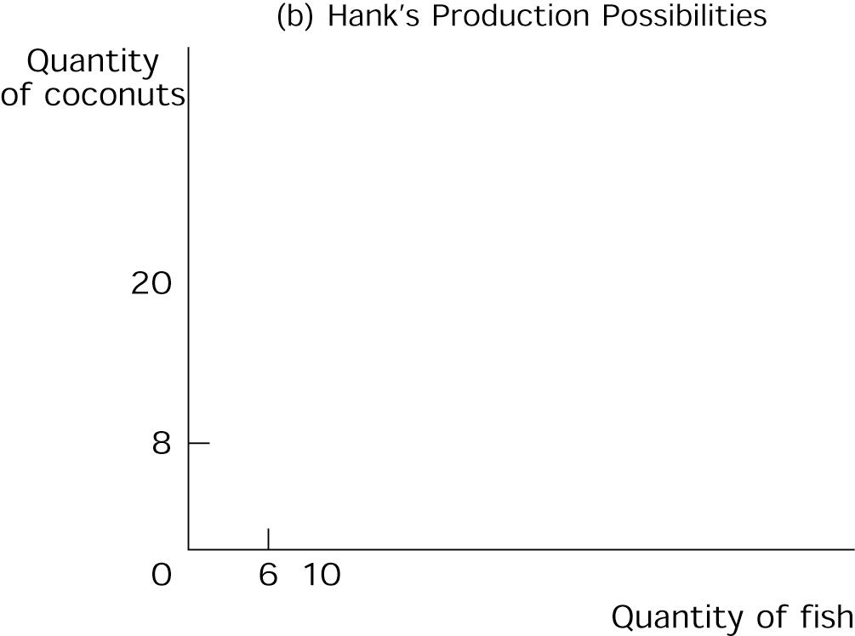
Comparative Advantage and Gains from Trade

Slide 29
Tom and Hank’s Opportunity Costs of Fish and Coconuts
 | Tom’s Opportunity Cost | Hank’s Opportunity Cost
One fish | 3/4 coconut | 2 coconuts
One coconut | 4/3 fish | 1/2 fish

Slide 30
Specialize and Trade
Both castaways are better off when they each specialize in what they are good at and trade.
It’s a good idea for Tom to catch the fish for both of them, because his opportunity cost of a fish in terms of coconuts not gathered is only 3⁄4 of a coconut, versus 2 coconuts for Hank.
Correspondingly, it’s a good idea for Hank to gather coconuts for the both of them.

Slide 31
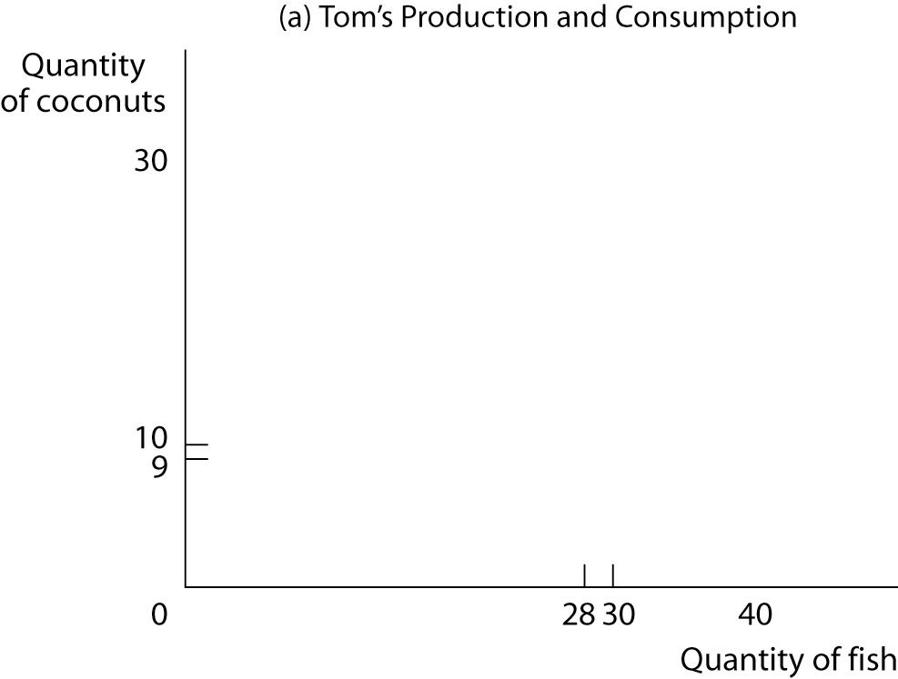
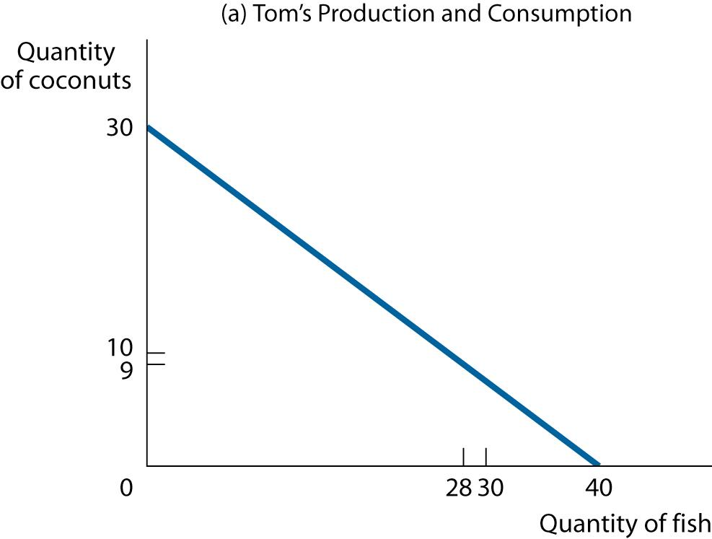
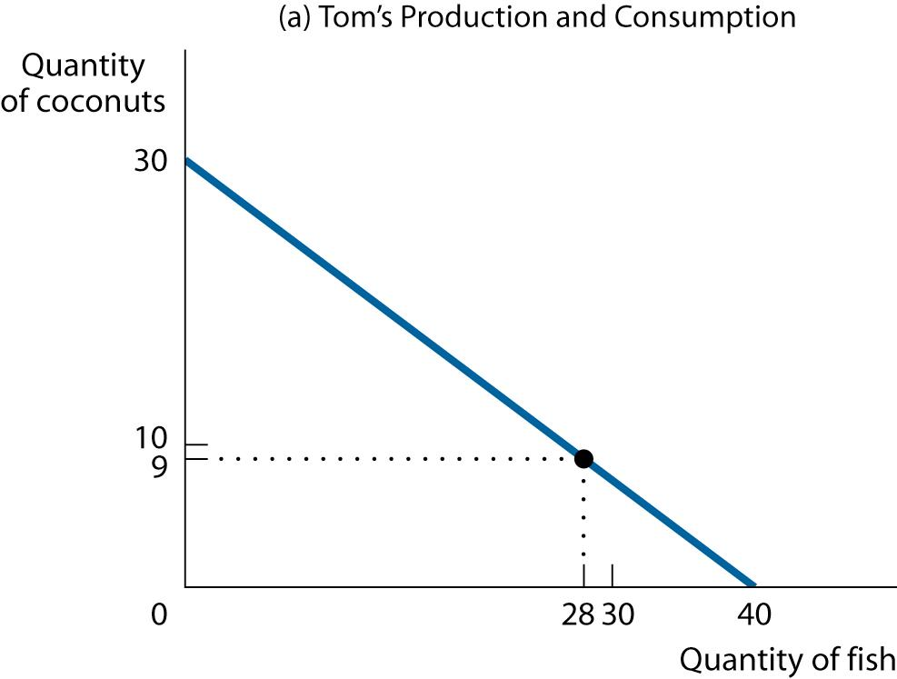
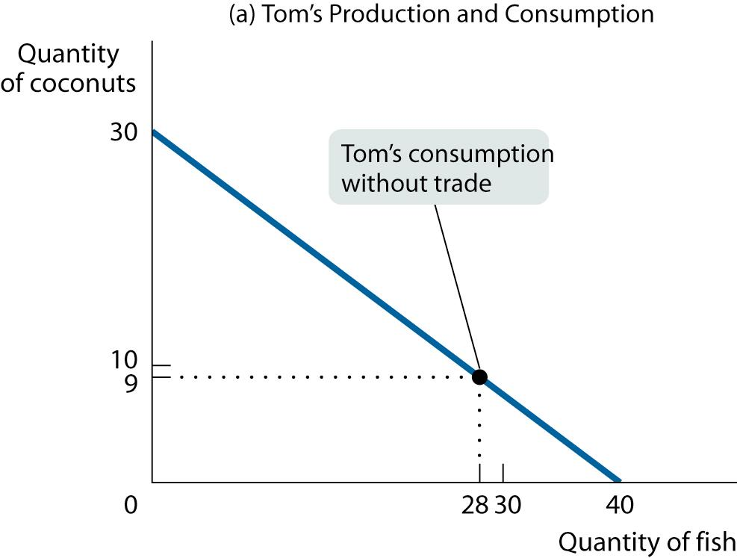
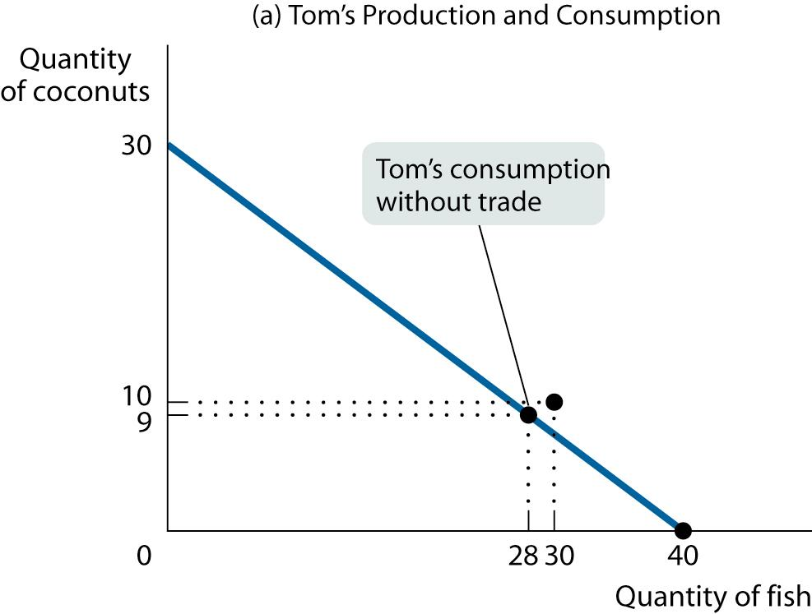
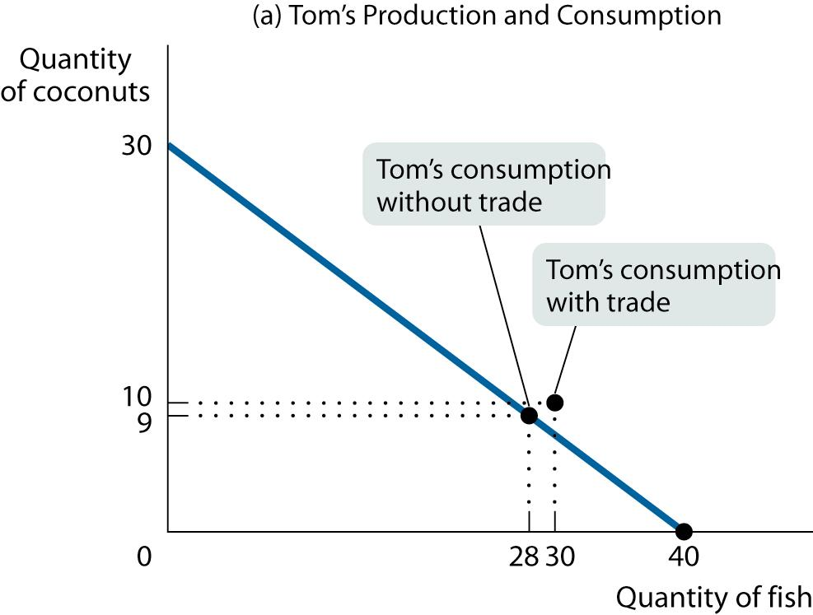
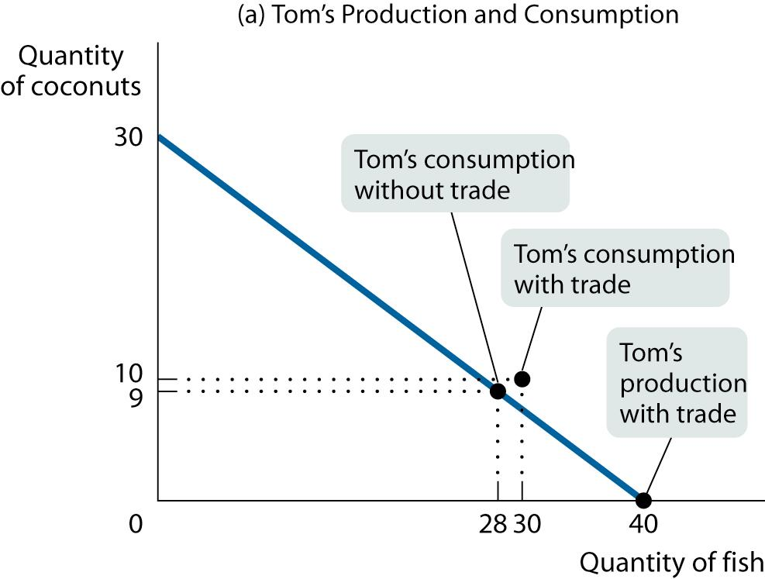
Comparative Advantage and Gains from Trade

Slide 32
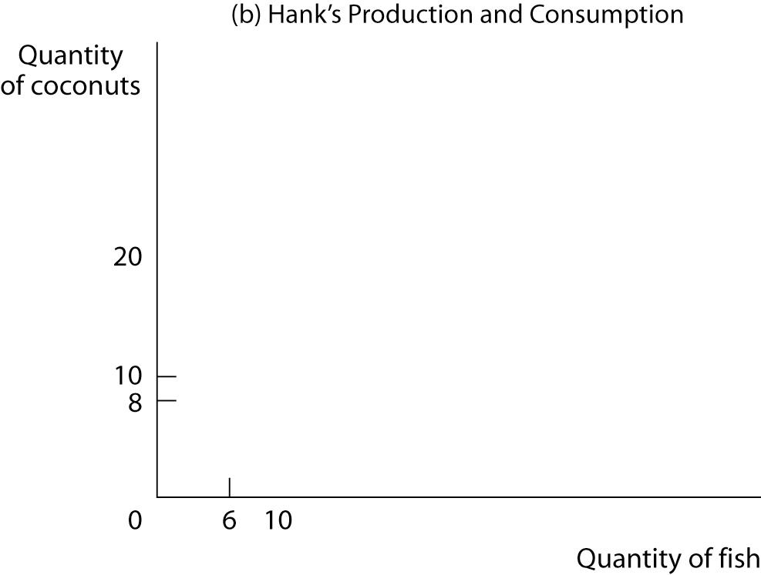
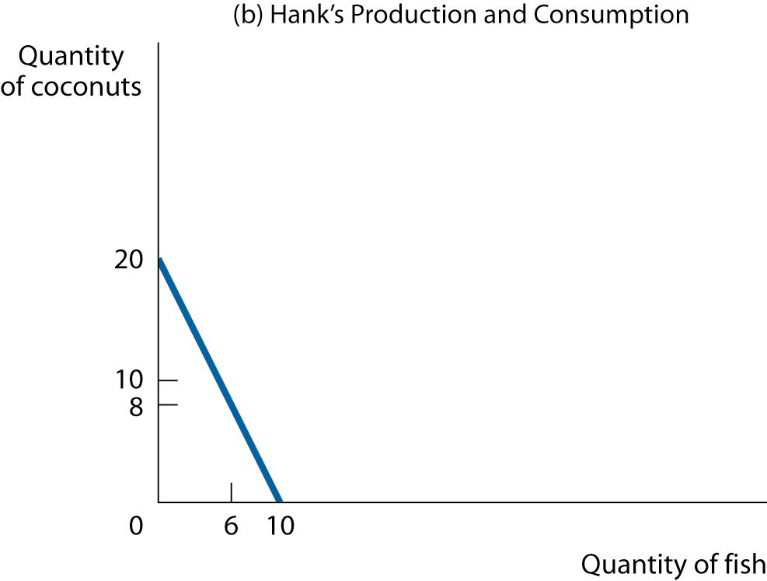
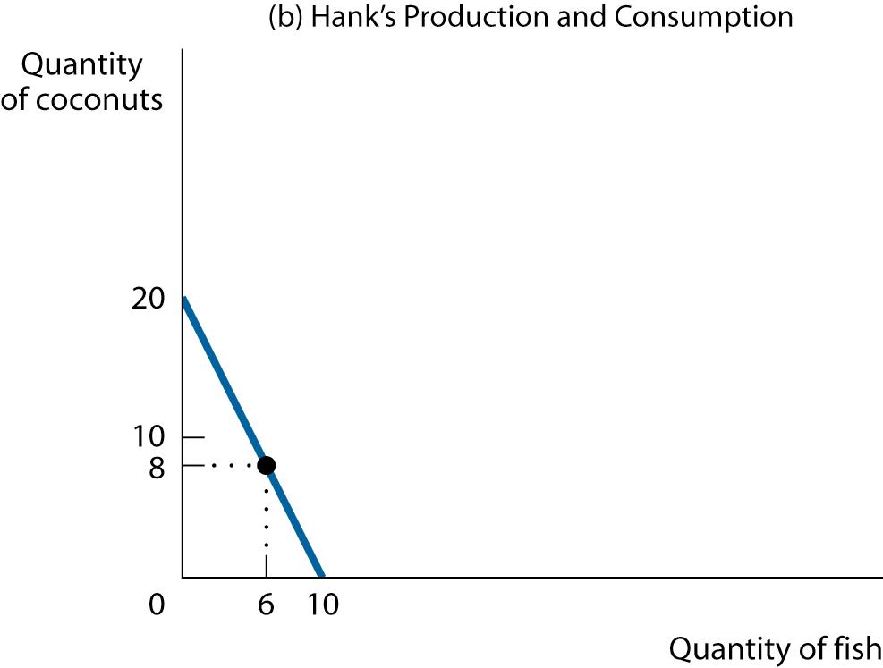
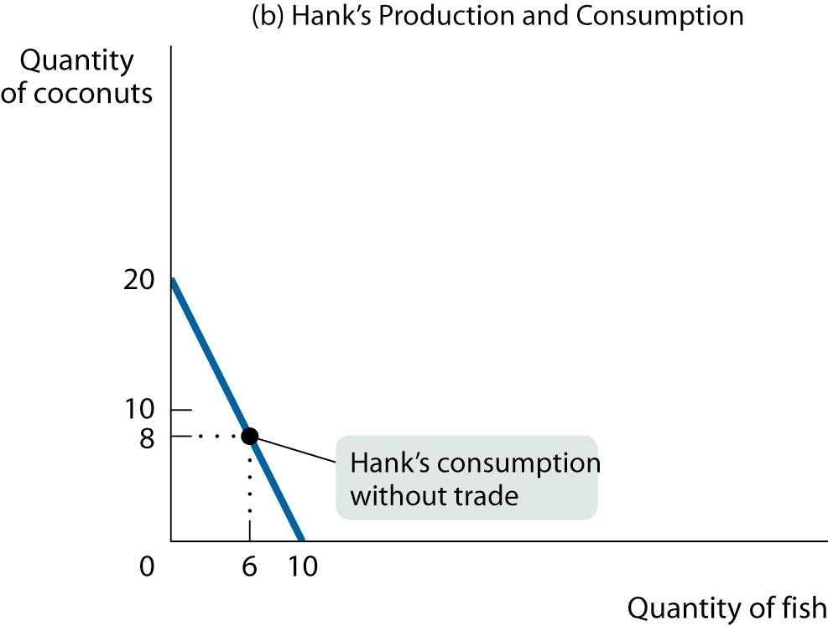
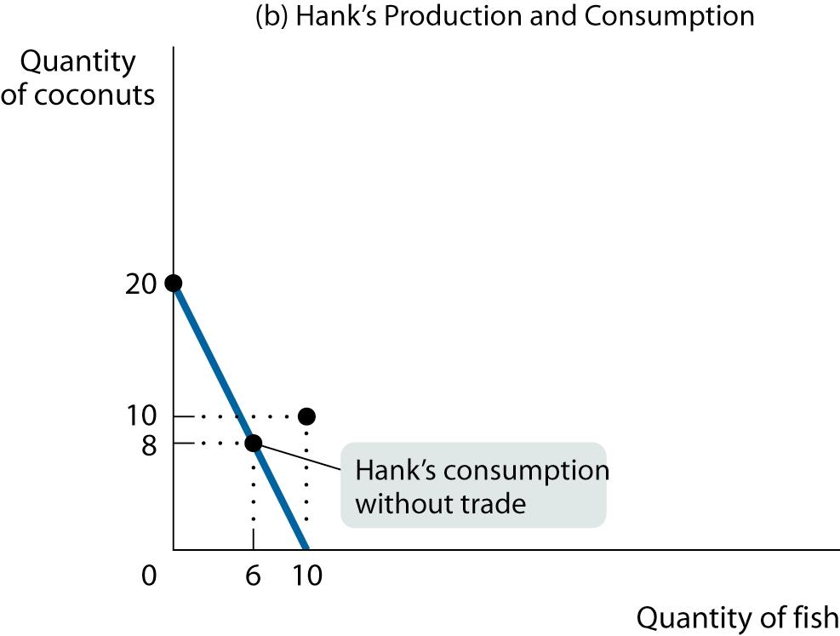
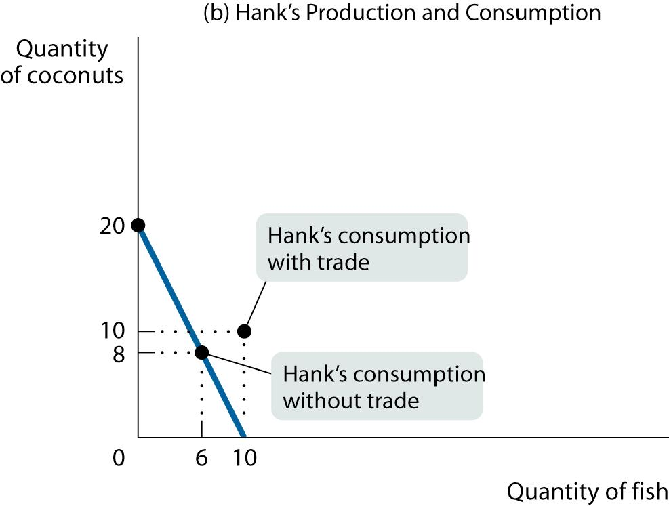
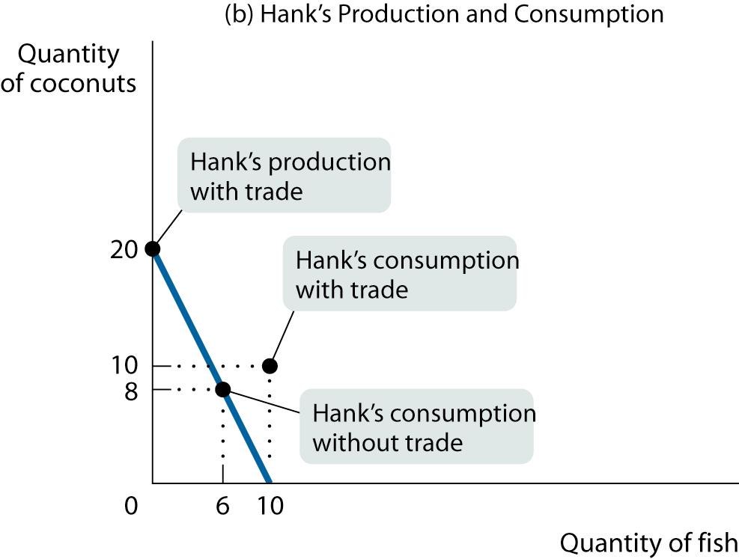
Comparative Advantage and Gains from Trade

Slide 33
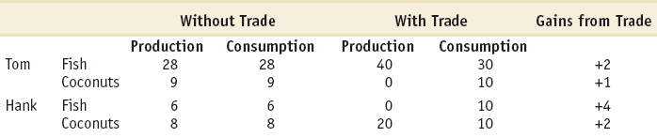
How the Castaways Gain from Trade
Both Tom and Hank experience gains from trade:
  Tom’s consumption of fish increases by two, and his consumption of coconuts increases by one.
  Hank’s consumption of fish increases by four, and his consumption of coconuts increases by two.

Slide 34
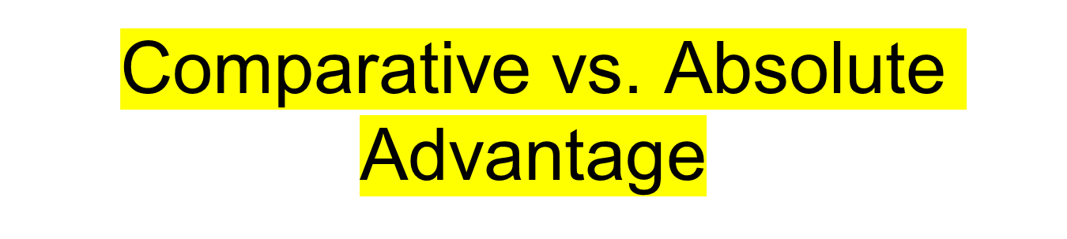
An individual has a comparative advantage in producing a good or service if the opportunity cost of producing the good is lower for that individual than for other people.
An individual has an absolute advantage in an activity if he or she can do it better than other people. Having an absolute advantage is not the same thing as having a comparative advantage.

Slide 35
Absolute Advantage is the inherent ability of a country that allows that country to produce specific goods in an efficient and effective manner at a relatively lower marginal cost. A country has an absolute advantage in producing a good if it can produce that good at lower marginal cost, lesser manpower, lesser time and lesser cost without compromising the quality.
Comparative Advantage refers to the country’s capability of producing the specific good at lower marginal cost and opportunity cost in comparison to other countries.
In absolute advantage where the emphasis is only on marginal cost, comparative advantage takes into account both marginal and opportunity cost.
https://www.educba.com/absolute-advantage-vs-comparative-advantage/

Slide 36
Tom vs. Hank—Absolute vs. Comparative
Tom has an absolute advantage in both activities: he can produce more output with a given amount of input (in this case, his time) than Hank.
But we’ve just seen that Tom can indeed benefit from a deal with Hank because comparative, not absolute, advantage is the basis for mutual gain.
So Hank, despite his absolute disadvantage, even in coconuts, has a comparative advantage in coconut gathering.
Meanwhile Tom, who can use his time better by catching fish, has a comparative disadvantage in coconut-gathering.

Slide 37
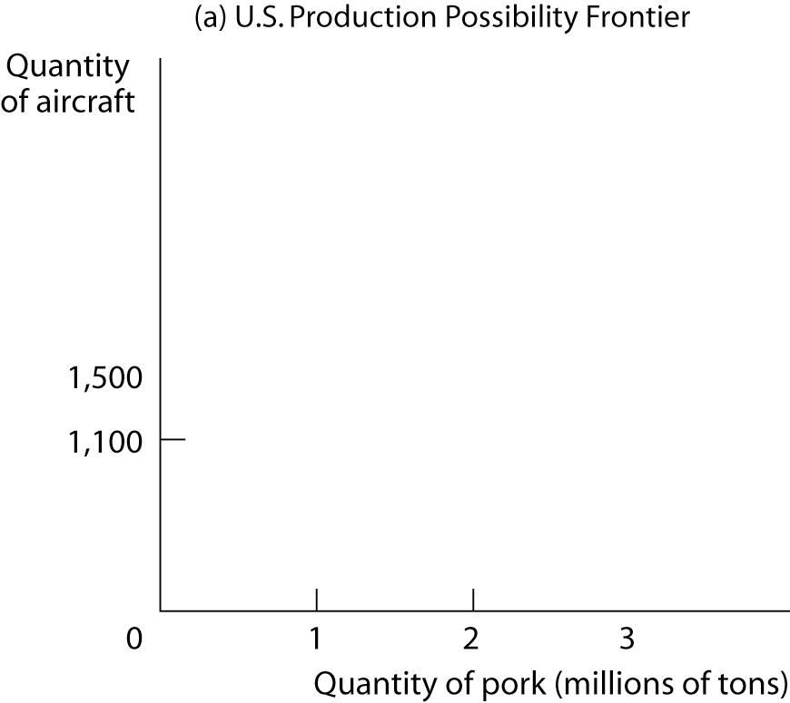
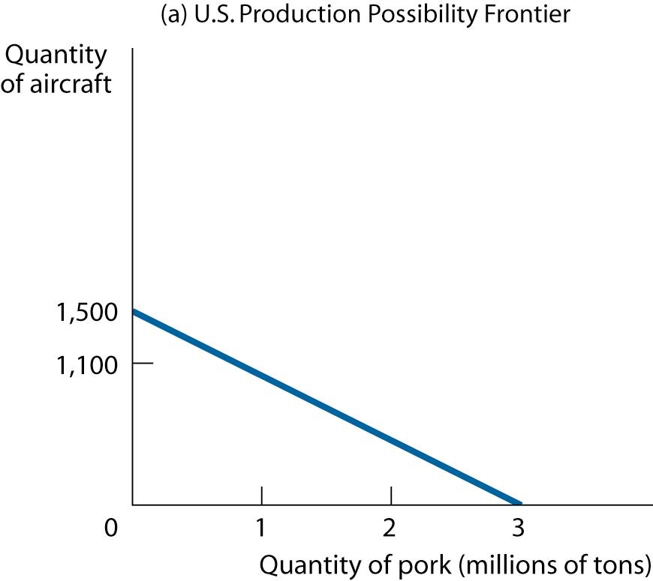
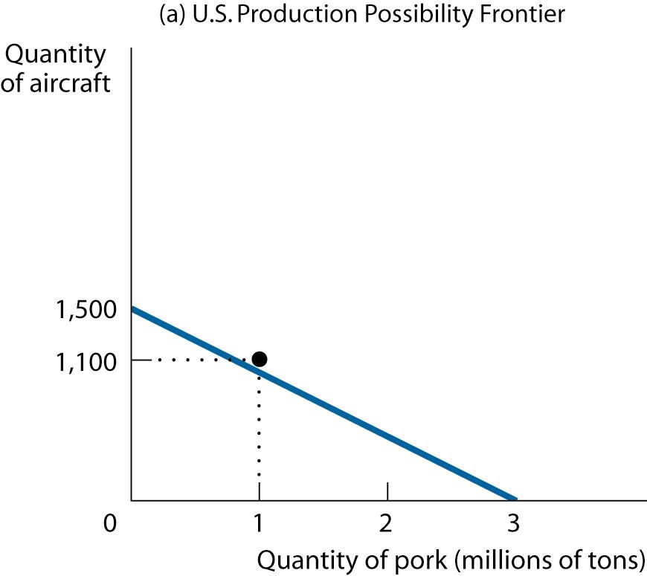
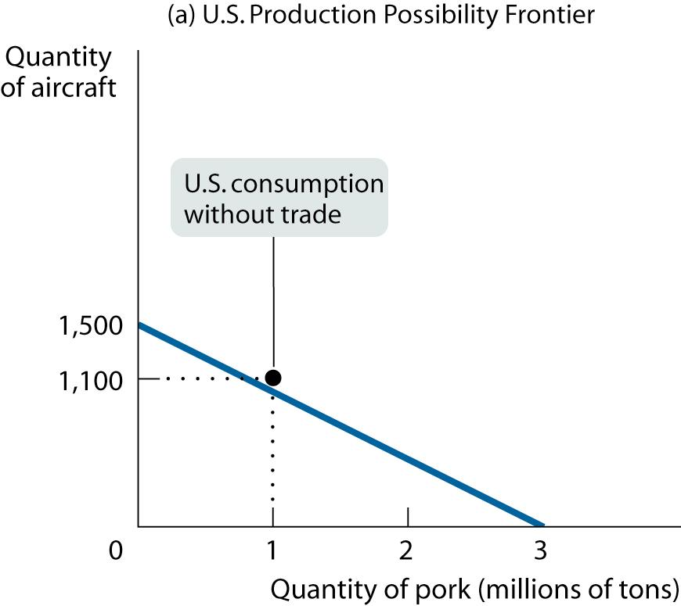
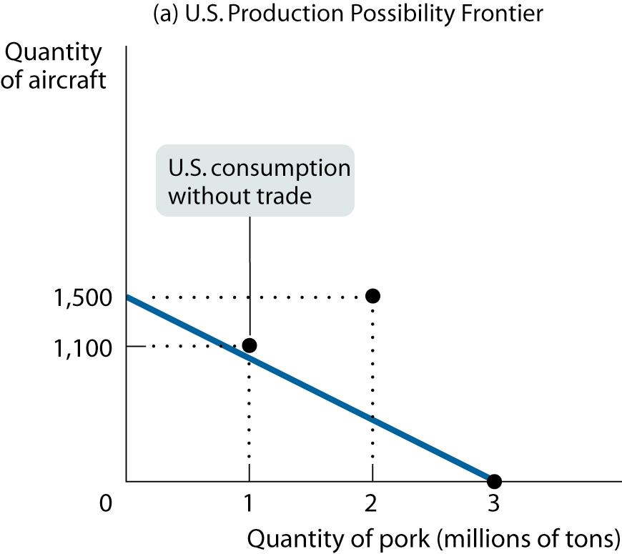
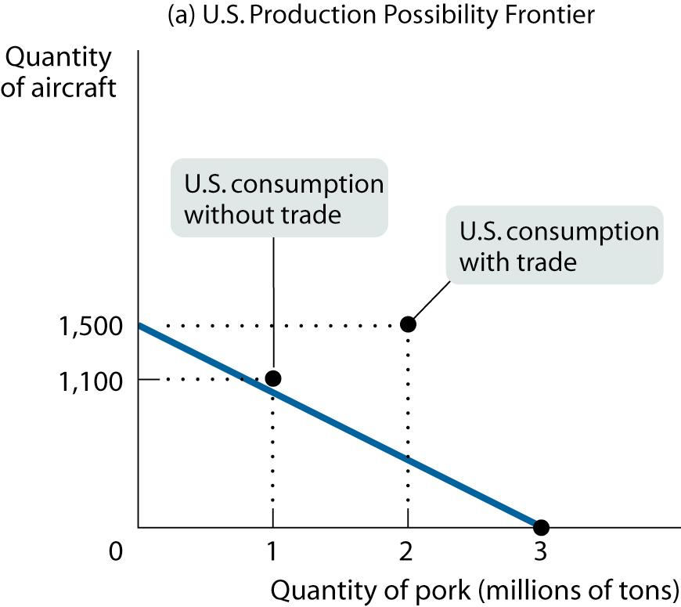
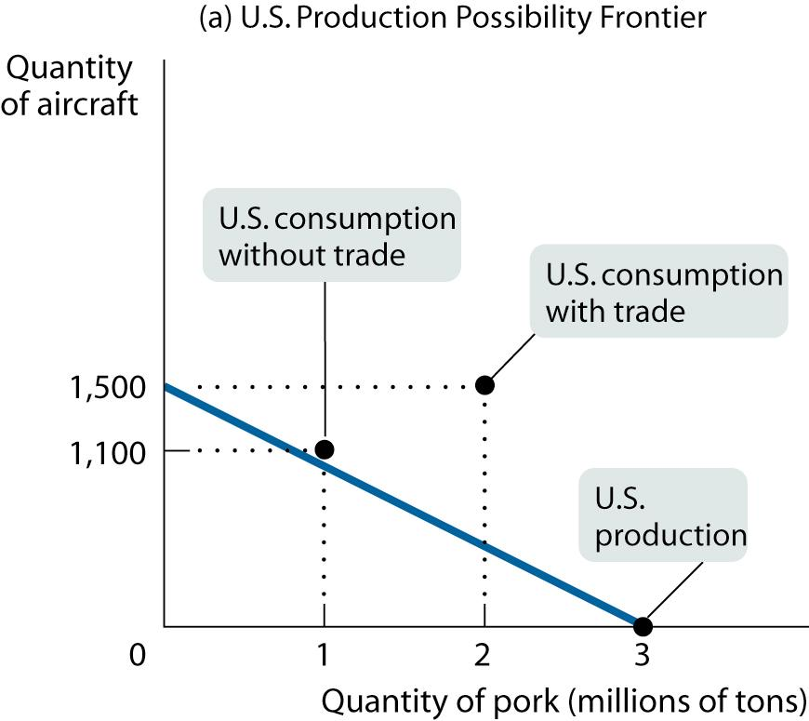
Comparative Advantage and International Trade (Ex.: The U.S. Economy)

Slide 38
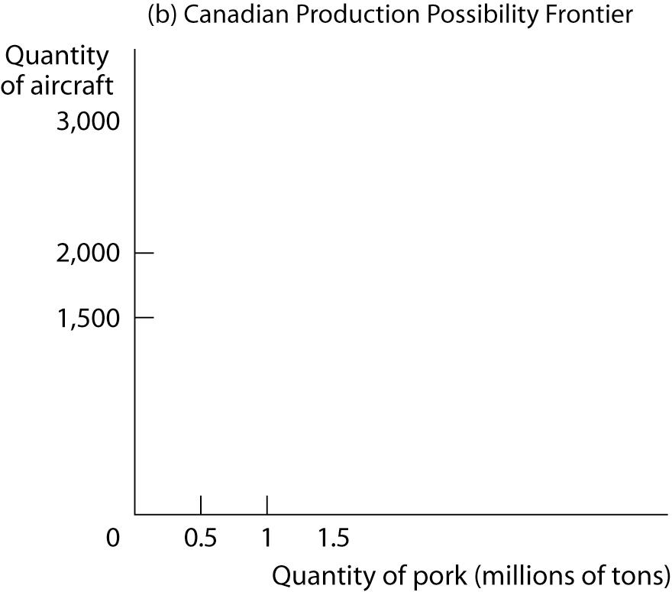
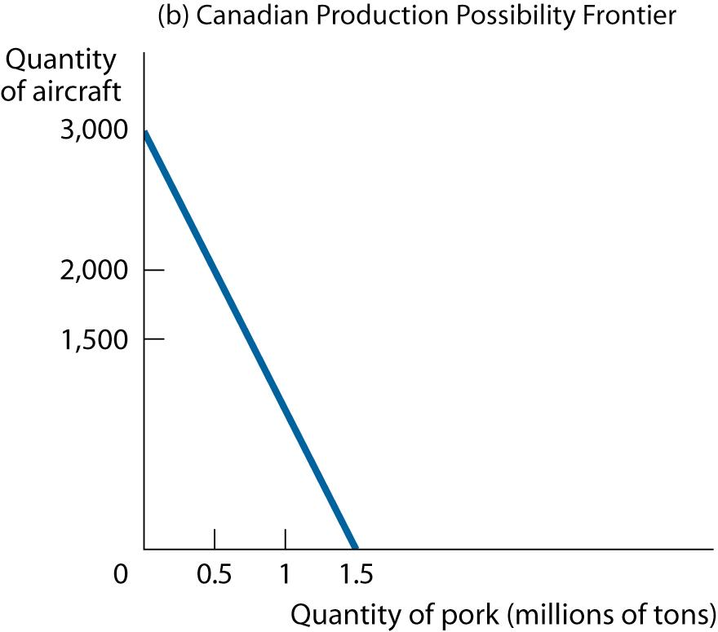

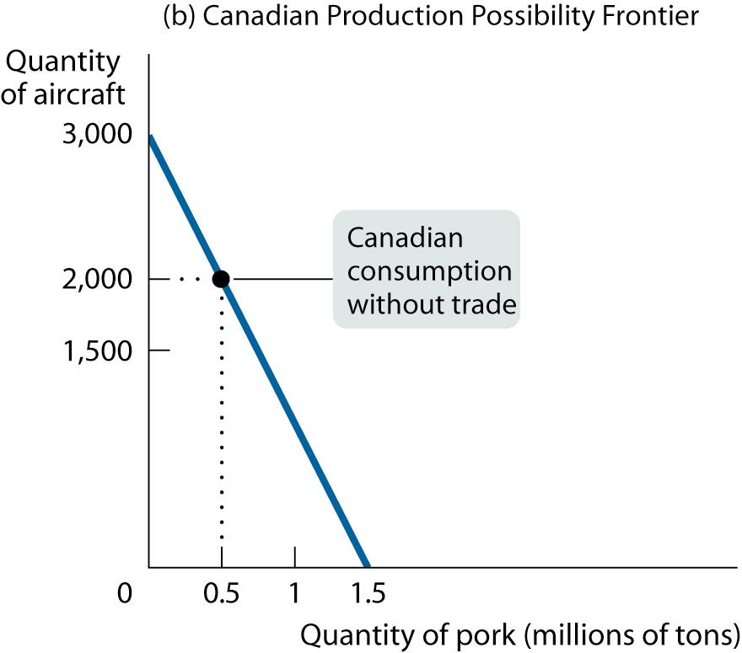
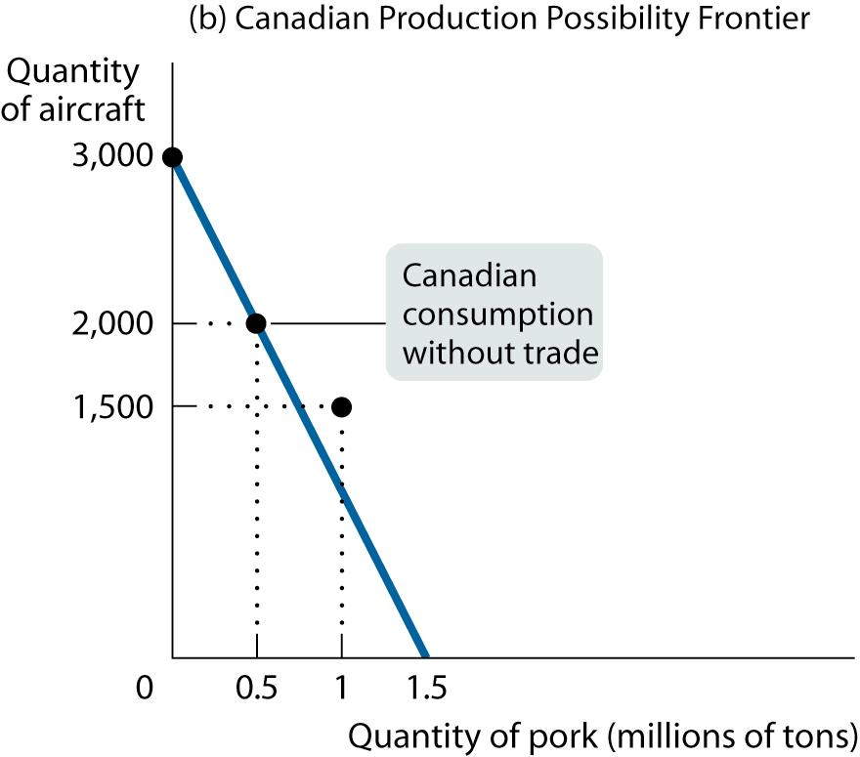
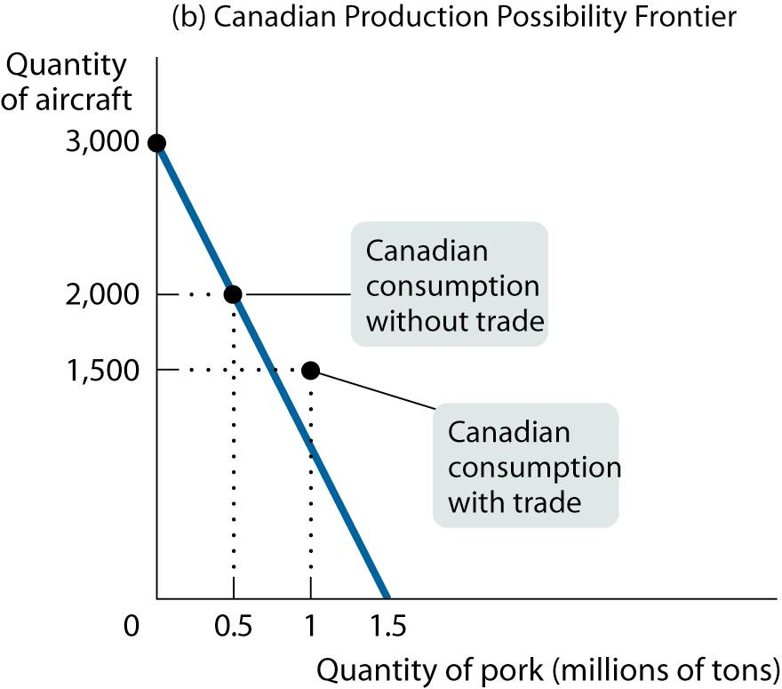
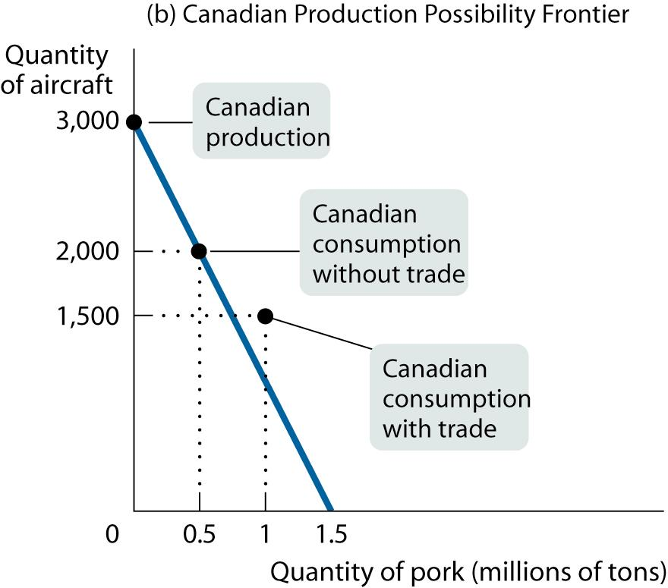
Comparative Advantage and International Trade (Ex.: The Canadian Economy)

Slide 39
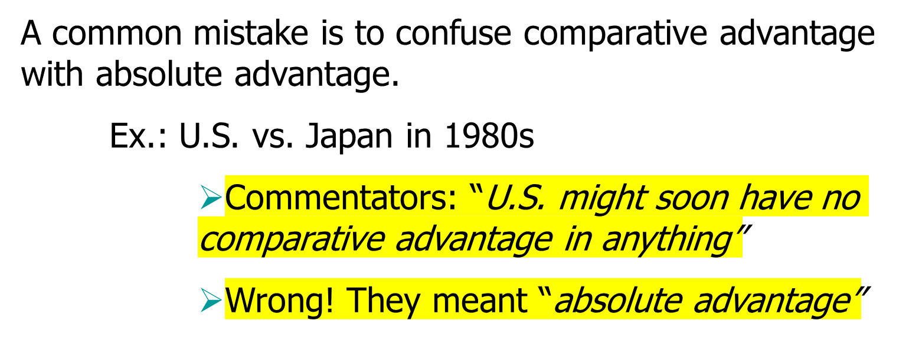
PITFALLS: Misunderstanding Comparative Advantage

Slide 40
Summing up
Specialization leads to higher production
Everyone has different Opportunity costs, everyone has comparative advantage/disadvantage in something.
It is comparative and not absolute advantage the basis for mutual gain.

