Slide 1
Innovation
Lecture 2

Slide 2
What is Innovation
There is no single, simple definition of innovation. It may be looked as a process by which knowledge on:
(a) how to produce a new product or
(b) how to produce an existing product more efficiently or more economically or
(c) how to reorganise the methods of production or
distribution or usage so as to increase the effectiveness eg : Amazon delivery
is made a reality.

Slide 3
Innovation
Novelty and Usefulness are the two characteristics of innovation
Both discovery and invention are not innovation.

Slide 4
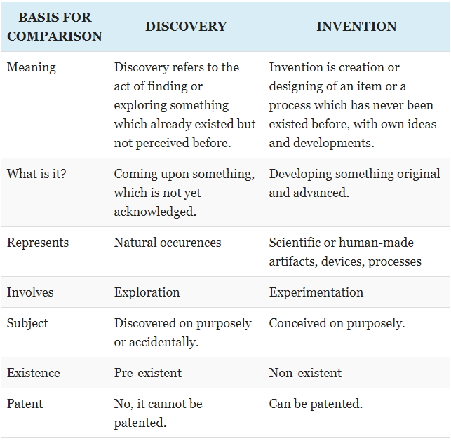


Slide 5
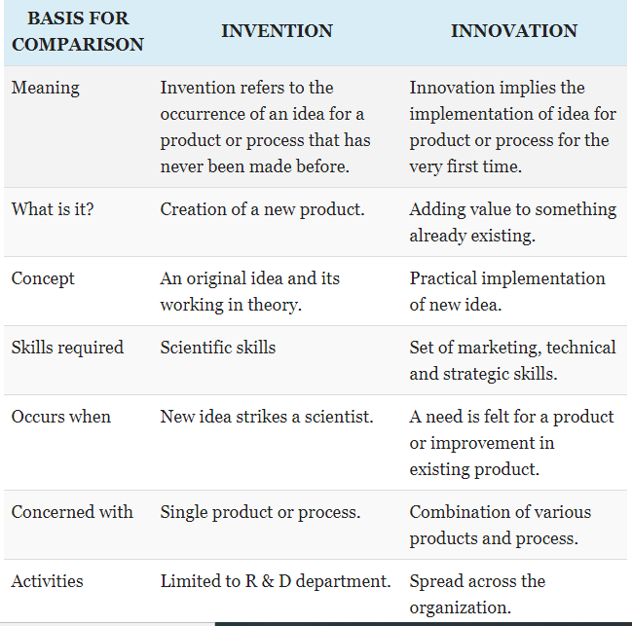

Slide 6
Types of Innovation
steam engine, internet, electricity
Inventions can be radical (major advance over existing goods) or incremental (improvement of an existing good).
General purpose technologies can be applied to many industries e.g. electricity, transportation.
Knowledge can be codified (can be precisely written down) or tacit (non-written).

Slide 7
General purpose vs Final innovation
GP is intermediate. Eg: electricity (which is then used for illumination, hot/cold water), transportation
Final is consumed. Eg: multiplex, coffee

Slide 8
Innovation systems
Innovation is a process, but also a system that connects users, firms, and governments.
An innovation system specifies
The relationship between all parties involved in innovation and diffusion (e.g. private firms, governments, scientists), and
The factors that affect social interactions between these groups (e.g. laws, policies, social norms).
Innovation systems differ across countries and often co-evolve with industries in related markets.
Blame of being less innovative cannot be put on the people; it is the fault of the entire innovation system.

Slide 9
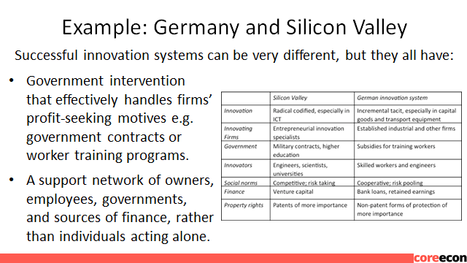
Innovation systems

Slide 10
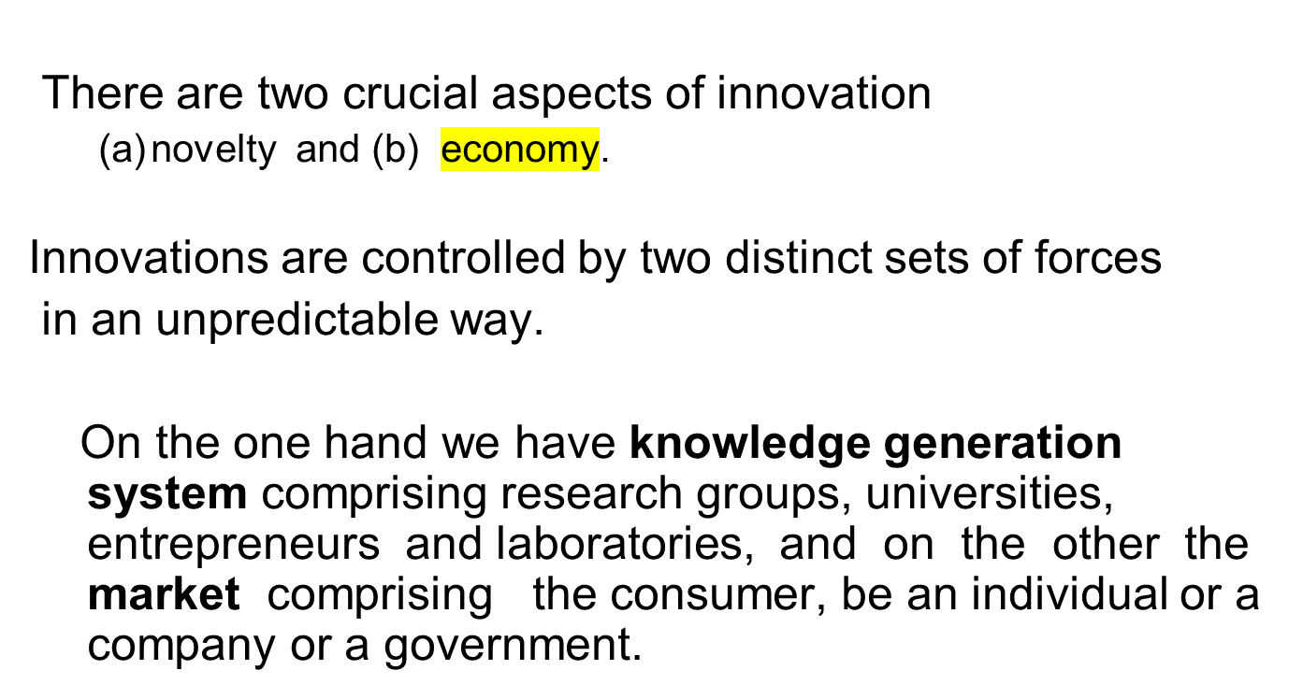
Innovation

Slide 11

In 1939 the New York Times reported on the success of recent experiments that obviously foretold the arrival of a potentially fascinating new product: television. But the New York Times did not think that television had much of a future – at least not in the United States. This most prominent and influential of all American newspapers solemnly declared: “Television will never be a serious competitor for radio, because people must sit and keep their eyes glued on a screen; the average American family hasn’t time for it.” ( from Rosenberg)

Slide 12
IBM in personal computing
3M Post-it notes
Videocon washing machines in Punjab

Slide 13
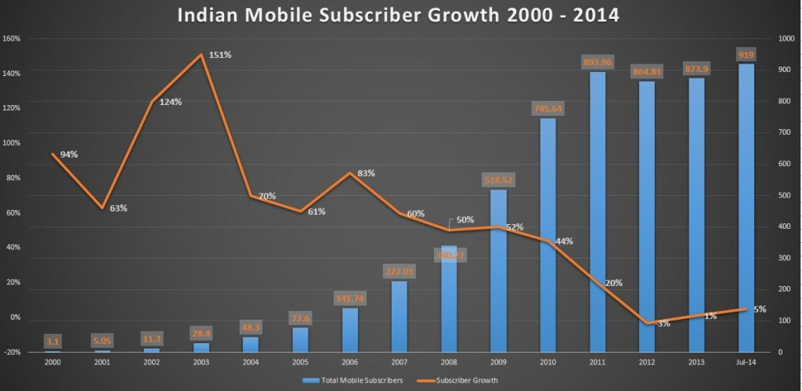
Indian Mobile phone growth
(http://trak.in/tags/business/2007/06/19/indian-telecommunication-story-from-10-million-to-150-million-mobile-subscribers-in-5-years/)

Slide 14
Market Uncertainty
Why there is sudden jump from 2008?
Can market be manipulated?

Slide 15
Research Uncertainty
Cancer Cure
Efficient solar photovoltaic
Driverless cars
There is a risk involved in research. We don’t know the time and investment that will be required and whether will we be successful at all?

Slide 16
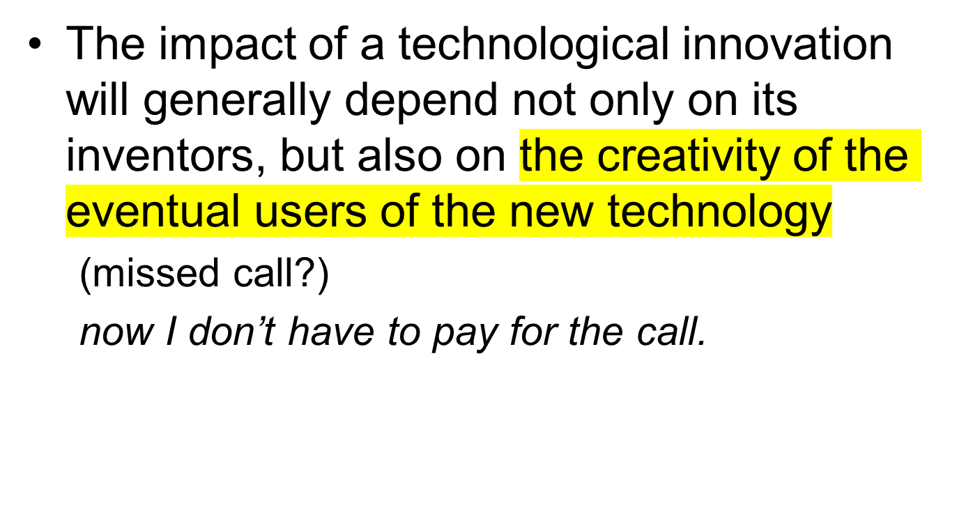
Impact of Innovation on Economic Process

Slide 17
Intellectual property rights can promote innovation but are a barrier to knowledge diffusion.
What characterizes successful innovation systems?
How can governments promote innovation?
What effects can technological innovation have on labour markets?

Slide 18
Intellectual Property
Old times of innovation in garage are now gone.
Intellectual Property Rights:
1. only it has the right to use.
2. license others to use the property
3. prosecute offenders. Make them stop and pay compensation.
Positive aspect : the money that comes after innovating provides motivation to innovate.
Why patents are given for limited time?
Some people may file patents and never use them and put to public use. This is called blocking the patent.
Product and process patent
Provisional patent. Before full patent is granted, it is open for contest.

Slide 19
Product and Process Patent
There is strict divergence between product and process patent regimes. The developed countries follow product patent system. On the other, process patent system is preferred by the developing world. The two systems are known for their different levels of protection to inventors.
Under a process patent, the patent is granted for a particular manufacturing process, and not for the product itself. Any other person can produce the same product through some other process, modifying the various parameters. The implication is that there will be more than one producer for the same product because of the possibility of different process for the manufacturing of the product.
Weakness of the process patent regime is that it gives less protection for the inventor. There is high tendency for competitors to reengineer the original invention by discovering a new process with less strain and investment. Benefit of process patent regime is that it reduces the element of monopoly.
In the case of product patent, it is an exclusive right given to the original inventor of a product. This means that no other manufacturer can provide the same product through the same or any other process. The implication is that there will not be a competitor for the producer as it is the product which is patented. Product patent system gives higher level of protection to the inventor as there will not be any other patent holder. TRIPs follow the product patent regime.
India’s 1970 Patent Act allowed only process patent before it was amended in 2005 to comply with WTO’s TRIPs provisions under which there is only product patents.

Slide 20
Innovation and Labor Market
Arrival of computers at LIC took away jobs.
Innovation creates more jobs than it kills.
Wage increases for new jobs and decreases for the dated ones.
No innovation is neutral. It affect different people differently.
Y2K bug : change from YY to YYYY.

