Slide 1
Innovation, Technology and Economic Growth
Lecture 3

Slide 2
Schumpeterian growth
Schumpeterian growth is a particular type of economic growth which is generated by the endogenous introduction of products and/or process innovations.
The term “endogenous” refers to innovations that result from R&D investments undertaken by forward-looking, profit-seeking firms.
The term “Schumpeterian growth” is used to honour Joseph Schumpeter who described the evolution of capitalism through a process of creative destruction. (example of buses and tongas)

Slide 3
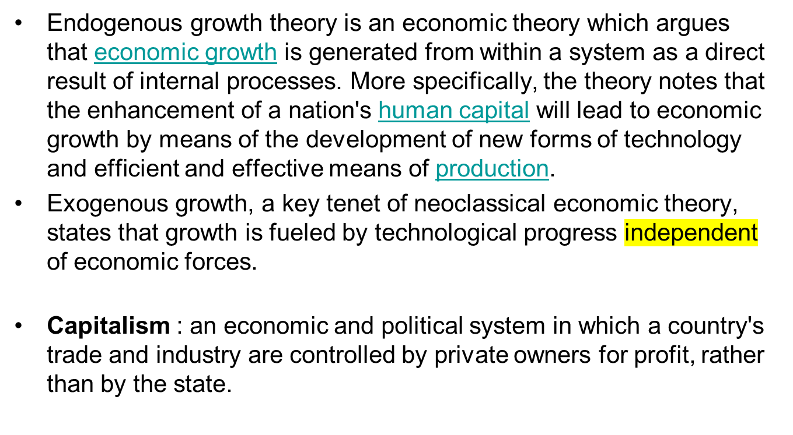

Slide 4
Openness of Economy and Innovation
First, trade, by increasing the size of the market, raises the profitability of R&D investment and increases the long-run rate of innovation and growth in all trading countries.
Second, economic openness, by facilitating the exchange of information, increases the scope of knowledge spill overs, raises the productivity of researchers and accelerates the rates of innovation and growth in the global economy.
Third, trade openness, by reallocating economic resources across sectors and between R&D investment and manufacturing activities, affects the long-run rates of innovation and growth.

Slide 5
Explaining the contrasts – the changing policy environment
India’s pre-1990 self reliance policy environment created capabilities in sectors like atomic energy and space. But internal and external barriers to the flow of ideas and resources made the country relatively isolated.
Due to tightly regulated trade, royalty payments and weak patent enforcement, ISI not only discouraged innovation but also prevented India from exploiting its comparative advantage in labor-intensive sectors such as electronics assembly.
A highlight of that period was asking IBM and Coca Cola to leave the country after the parent firms refused to dilute their 100% equity in the subsidiaries.
Import substitution initiative

Slide 6
Protection of home grown companies through:
Tax the import
Ban the import
Weak patent enforcement made Indian companies copy the patented goods.
This protection has both positive and negative aspects.
Government required 50% Indian shareholding in foreign companies so IBM and Coca Cola left.

Slide 7
Embracing the world
Policy changes since the 1980s have emphasized private initiative. Trade and foreign investment, and innovation started driving the economic growth.
Liberalization is any process whereby a state lifts restrictions on some private individual activities. Liberalization occurs when something which used to be banned is no longer banned, or when government regulations are relaxed.
Changes made it easier access to technologies, royalty payments were eased and foreign trademarks and brands could be used freely in the domestic market.
After accession to the World Trade Organization (WTO), and signing of the Trade-Related Aspects of Intellectual Property Rights (TRIPS), Patents Act of 1970 amended thrice – in 1999, 2002 and 2005 - to make it TRIPS-compliant (product patent)
Emblematic of the 1980s were policies to ensure that India became to the software industry what East Asia had become to the hardware industry. Software was the first industry where self reliance and the ideology of self-reliance was explicitly rejected.

Slide 8
What are the ways in which a country gains forex?
Export, Remittance, Tourism, Exporting knowledge, borrowing money
World Bank vs International Monetary Fund
Why still no innovation?
Sense of security and belongingness
Lack of organization of innovation
Poor investment in R&D
Lack of creativity and the ability to convert that creative process into a profitable business
How to judge the level of innovation?
Research papers and patents
Startups
Economic growth due to innovation

Slide 9
Impacts on R&D and innovation
India’s R&D investment grew 2.6 times in real terms between 1995-96 and 2006-07,primarily in Pharma, followed by ICT, transport and Defence. In private sector, as a share of total sales in all industries, R&D spending grew from approximately 0.5% in 2002-03 to 0.87% in 2009-10.
Eleven times more patents were granted to Indian inventors or assignees in the period 1995-2008 than in 1976-1994. The share of Indian firms increased from less than 8% to 16%, with 82% of patents being Chemistry-related in the latter period. Indeed, of the top twenty Indian patenting firms, sixteen were in the pharmaceuticals industry.

Slide 10
Limits to innovation - 1
Despite the increase in patenting, a study on innovation, based on patents granted by European, Japanese and the US patent offices, ranks India 58 out of 82 countries for the period 2002-05.
Although India is viewed as an attractive location for R&D, investments were only 3.5% of the total FDI in services, R&D spending as a share of GDP grew only marginally, from approximately 0.7% to 0.9% between 1995-96 and 2006-07.

Slide 11
Limits to innovation – 2 three points
In a 2007 survey of 137 firms by the National Knowledge Commission ( NKW) , more than half of all firms mentioned the lack of collaboration with universities and R&D labs.
Biggest barrier to innovation for all firms was “skill shortages due to lack of emphasis on industrial Innovation, problem solving, design, experimentation”
New Service sector jobs absorbed all the new college graduates with attractive salaries, and the available man-power for manufacturing and even for post-graduate education and research work in universities suffered

Slide 12
Limits to innovation -3
Although spending on education grew from 1.5% of GDP to 3.5% in 2005-06, only 7% of population of relevant age groups goes for higher education.
But there too, in 2007-08, annual public spending per student in higher education in India was US$400, compared with US$3986 (Brazil), US$2728 (China) and US$1024 (Russia).
Higher education characterized by islands of excellence: 30 institutions award 65% of PhDs in science, while 20 institutions award 80% of PhDs in engineering

