Slide 1
Production Functions
Lecture 6

Slide 2
Definition
A production function is a function that specifies the output of a firm, an industry, or an entire economy for all combinations of inputs.
A production function can be expressed in a functional form as
  Q= f (X1,X2, …. Xn)
    where: Q = quantity of output
    X1, X2…,Xn are quantities of factor inputs (such as capital, labour, land or raw materials).

Slide 3
Cobb–Douglas production function
In its most standard form for production of a single good with two factors, the function is Y = AL ^{α} K ^{β}
where:
Y = total production (the monetary value of all goods produced in a year)
L = labor input (the total number of person-hours worked in a year)
K = capital input (the monetary worth of all machinery, equipment, and buildings)
A = total factor productivity
α and β are the output elasticities of labor and capital, respectively. These values are constants determined by available technology. ???
Output elasticity measures the responsiveness of output to a change in levels of either labor or capital used in production, ceteris paribus. For example if α = 0.15, a 1% increase in labor would lead to approximately a 0.15% increase in output.
Further, if:
  α + β = 1,
the production function has constant returns to scale: Doubling capital K and labor L will also double output Y. If
  α + β < 1,
  decreasing returns to scale
  > 1,
  Increasing returns to scale
Elasticity : change in Y / change in L or K

Slide 4
CDPF is hypothetical and works for simple agricultural system.
A = output / input; it takes into account factors like knowledge, technology and efficiency which cannot be explicitly measured.
Lumpy Cost Function
Like a staircase; eg: 180+1 passengers

Slide 5
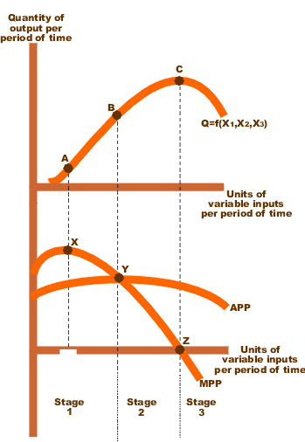
A quadratic production function
production dips

Slide 6
Economies of Scale
Increasing Returns : if for every one percent additional input , the output increases by more than one percent
Diminishing Returns: The increase is less than increase in inputs
Constant returns
cases on alpha and beta

Slide 7
Factor Productivity (the constant, A)
Total Factor Productivity is the measure of output that can not be explained by inputs alone.
Technology Growth and Efficiency Improvements are two factors affecting total Factor Productivity

Slide 8
Technological progress and living standards
Firms can earn innovation rents by introducing new technology.
Firms that cannot keep up with innovation eventually fail (creative destruction).
Technological progress and capital goods accumulation are complementary:
New technologies require new machines
Technological advance is needed for increasingly capital-intensive methods of production to be profitable.
This process allows a sustained increase in average living standards.

Slide 9
Schumpeterian rents are earned by innovators and occur during the period of time between the introduction of an innovation and its successful diffusion. It is expected that successful innovations, in time, will be imitated, but until that occurs, the innovator will earn Schumpeterian rents.
Short term, can be patentable or non patentable (if trivial, eg: master switch for lights)
Creative Destruction : email vs fax

Slide 10
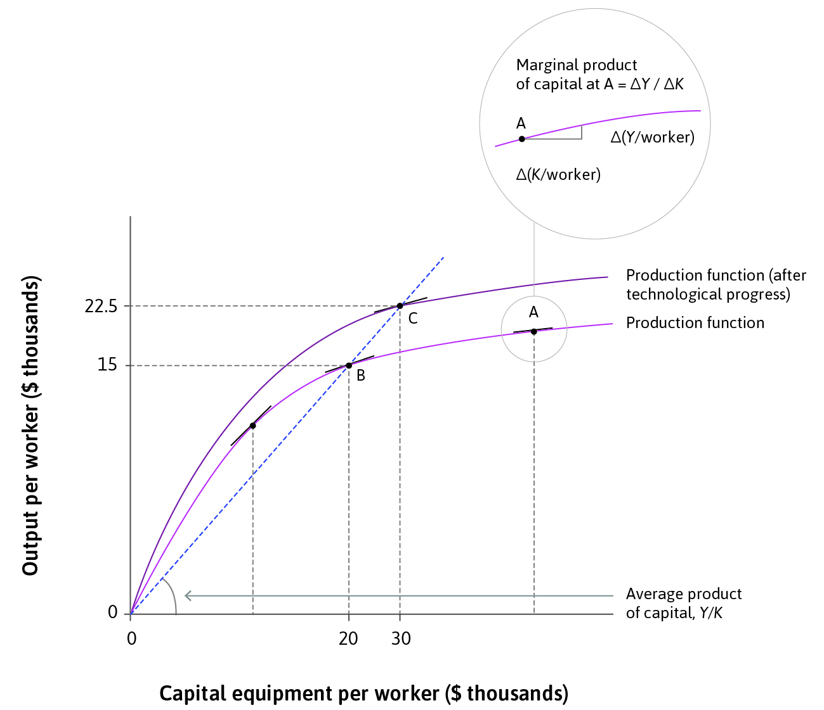
Modelling technological progress ????
Capital intensity of production: capital goods per worker
Labour productivity: output per worker
Technological progress rotates the production function upwards.
This increases the APL and offsets the diminishing marginal returns to capital…
Which makes it profitable to invest domestically, leading to increased capital intensity.

Slide 11
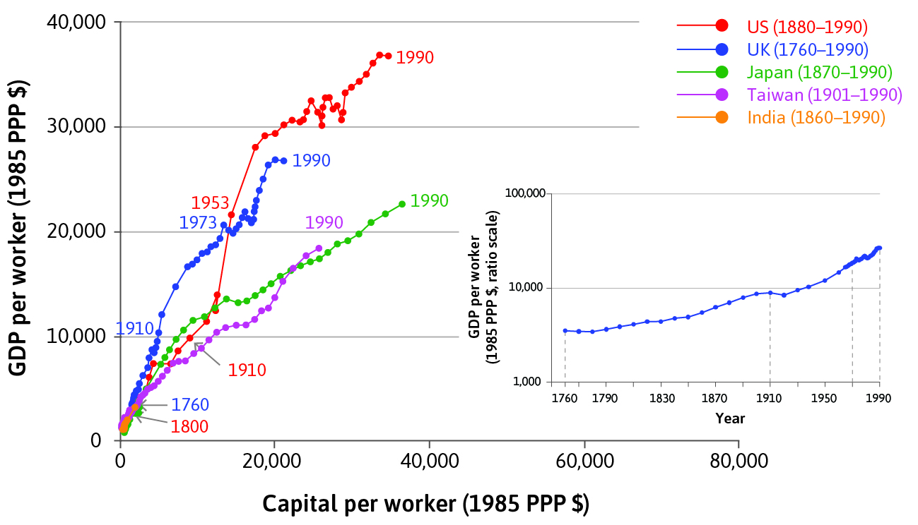
Technological progress over time
Countries that are rich today have had labour productivity rise over time as they became more capital intensive.
Unlike the concave production function, capital productivity remained roughly constant over time in the technology leaders.
This is because these countries experienced a combination of capital accumulation and technological progress.

Slide 12
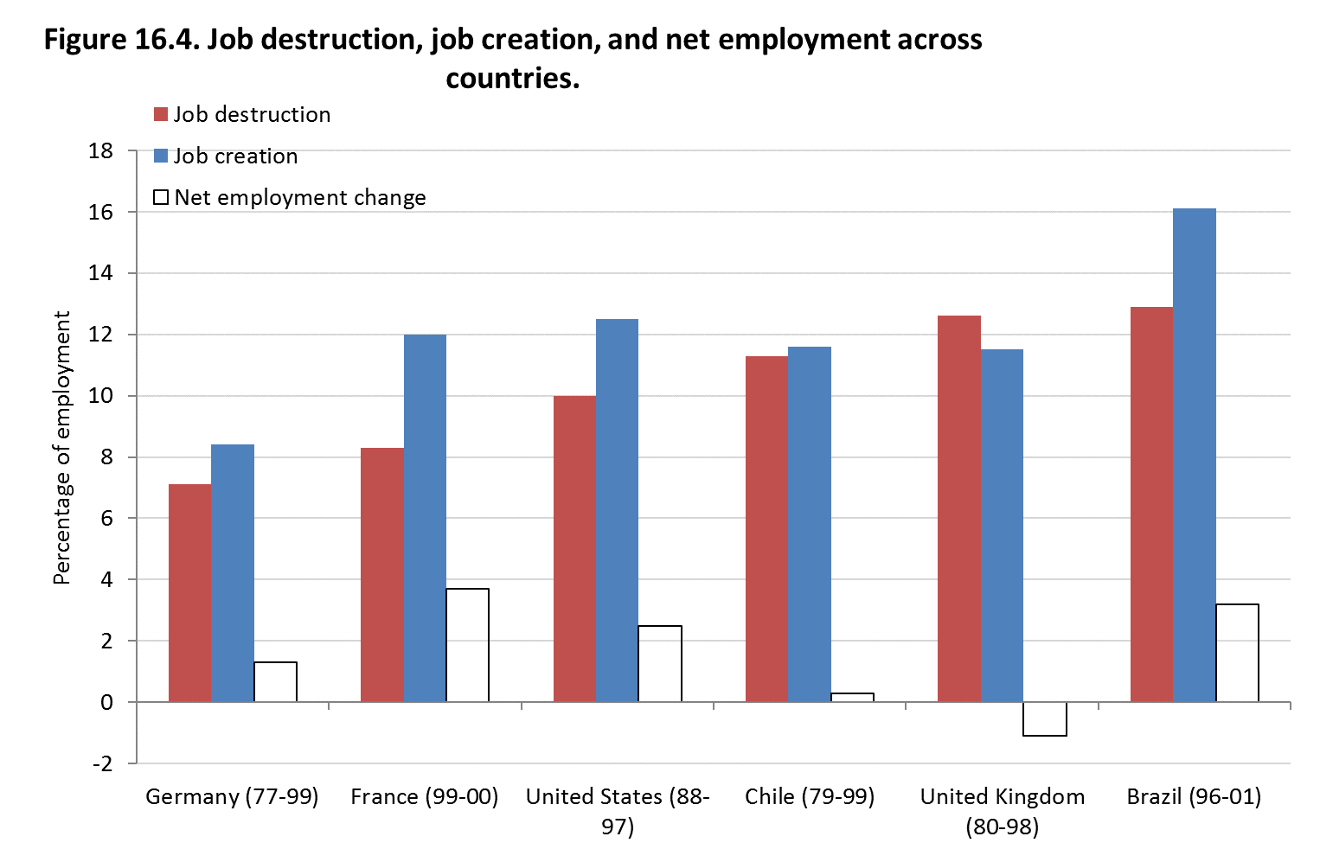
Job creation/destruction
Labour-saving technological progress can also create jobs
e.g. reallocation of work from low- to high-productivity firms
Net employment change = job creation – job destruction
UK outsourced their work and hence jobs.

Slide 13
Criticisms
Are the input variables independent ? Capital which is a major input, is influenced by interest and wage rates.
Natural resources, how does one account for its value
Information goods Vs traditional goods

Slide 14
Discuss
Does economies of scale applies to products of Information Technology?
Can one determine wage rate from production functions?

