Slide 1
IBM APPLIED DATA SCIENCE CAPSTONE
Will the First Stage Land?
Predicting SpaceX Falcon 9 landing success to price a launch
Kautzar
October 1, 2026
GitHub repository: https://github.com/kautzarichramsyah/Applied-Data-Science-Capstone

Slide 2
Outline
1
Executive Summary
Slides 3
6
Results: Dashboard with Plotly Dash
Slides 38–42
2
Introduction
Slides 4
7
Results: Predictive analysis (classification)
Slides 43–46
3
Methodology
Slides 5–16
8
Conclusion and innovative insights
Slides 47–48
4
Results: Insights drawn from EDA (visualization + SQL)
Slides 17–33
9
Appendix
Slides 49
5
Results: Launch sites proximity analysis (Folium)
Slides 34–37
2

Slide 3
Executive Summary
90
66.7%
83.3%
84.4%
Falcon 9 launches analysed (2010–2020)
first stages that landed successfully
test accuracy (15 of 18 launches)
SVM accuracy across 50 data splits
Methods: collected launch data from the SpaceX REST API and Wikipedia, cleaned it with pandas, explored it with SQL, seaborn, Folium and a Plotly Dash app, then tuned four classifiers with GridSearchCV.
What drives landing success: experience. Success rose from 0% (2010–2013) to 84–90% (2019–2020), and newer boosters (FT, B4, B5) land far more often than v1.0/v1.1.
Where and what: KSC LC-39A has the best record (76.9%); ES-L1, GEO, HEO and SSO orbits landed every time, GTO only 51.9%.
Prediction: all four tuned classifiers reach 83.3% on the 18-launch test set; across 50 resampled splits SVM is the best and most stable model (84.4%). Errors are false positives.
3

Slide 4
Introduction
Space Y wants to bid against SpaceX — so it needs to know what a Falcon 9 launch really costs
BACKGROUND
SpaceX advertises Falcon 9 launches at about $62 million; other providers charge upwards of $165 million. Most of the saving comes from landing and reusing the first stage.
WHY IT MATTERS
If we can predict whether the first stage will land, we can estimate the true cost of a launch — the information a competing bidder needs.
Questions we set out to answer
How do payload mass, orbit, launch site and flight number affect landing success?
Has landing success improved over time, and with which booster versions?
Can a machine learning model predict a successful landing — and how reliably?
4

Slide 5
01
Methodology
Data collection, wrangling, EDA, interactive analytics and classification
5

Slide 6
Methodology
Executive summary of the methodology
1
Data collection: SpaceX REST API (requests + json_normalize) and web scraping of Wikipedia (BeautifulSoup)
2
Data wrangling: Filter Falcon 9, fill missing payload with the mean, convert 8 landing outcomes into the Class label (1 = landed)
3
EDA: Visualization (seaborn scatter, bar and line charts) and SQL queries on SQLite
4
Interactive visual analytics: Folium maps (markers, clusters, distance lines) and a Plotly Dash dashboard
5
Predictive analysis: Standardize, split 80/20, tune LR / SVM / Decision Tree / KNN with GridSearchCV (cv=10), evaluate on the test set and with repeated cross-validation
6

Slide 7
Data Collection
Two complementary sources for 2010–2020 Falcon 9 launches
SPACEX REST API
GET api.spacexdata.com/v4/launches/past (IBM static snapshot for consistent results). IDs for rocket, launchpad, payload and core are resolved with extra API calls to get booster version, site coordinates, payload mass, orbit, landing outcome, reuse and block.
WIKIPEDIA WEB SCRAPING
"List of Falcon 9 and Falcon Heavy launches" (9 June 2021 revision). HTML launch tables are parsed with BeautifulSoup into flight number, date, booster, site, payload, orbit, customer and outcomes.
Result: 90 Falcon 9 launches × 17 columns (API) and 121 scraped launch records, saved as CSV for wrangling.
Cleaning: Falcon 1 launches removed; 5 missing PayloadMass values replaced with the mean; 26 missing LandingPad values kept (no landing pad used).
7

Slide 8
Data Collection – SpaceX API
1
2
3
4
5
›
›
›
›
GET request
Launch data from the SpaceX REST API
Normalize
response.json() → pd.json_normalize()
Enrich
getBoosterVersion, getLaunchSite, getPayloadData, getCoreData
Filter
Keep Falcon 9 only (drop Falcon 1) → 90 launches
Clean
Fill missing PayloadMass with the mean; export CSV
Key code
response = requests.get(static_json_url) # status 200
data = pd.json_normalize(response.json())
getBoosterVersion(data); getLaunchSite(data); getPayloadData(data); getCoreData(data)
data_falcon9 = df[df['BoosterVersion'] != 'Falcon 1']
data_falcon9['PayloadMass'] = data_falcon9['PayloadMass'].fillna(data_falcon9['PayloadMass'].mean())
GitHub notebook: https://github.com/kautzarichramsyah/Applied-Data-Science-Capstone/blob/main/1_spacex_data_collection_api.ipynb
8

Slide 9
Data Collection – Scraping
1
2
3
4
5
›
›
›
›
Request
GET the Wikipedia Falcon 9 launch list page
Parse
BeautifulSoup(response.text, "html.parser")
Find tables
soup.find_all("table") → launch tables
Extract
Column names from <th>; rows from <td>
Save
launch_dict → DataFrame → CSV
WHY A SECOND SOURCE
Wikipedia adds human-readable mission details (customer, launch outcome, booster landing) that cross-check the API records.
CHECK
soup.title returns "List of Falcon 9 and Falcon Heavy launches - Wikipedia", confirming the right page was parsed; 121 launch rows extracted.
GitHub notebook: https://github.com/kautzarichramsyah/Applied-Data-Science-Capstone/blob/main/2_webscraping_falcon9.ipynb
9

Slide 10
Data Wrangling
Turning eight landing outcomes into one binary label
Outcome | Meaning | Count | Class
True ASDS | Landed on drone ship | 41 | 1
None None | No landing attempted | 19 | 0
True RTLS | Landed on ground pad | 14 | 1
False ASDS | Drone ship landing failed | 6 | 0
True Ocean | Controlled ocean landing | 5 | 1
False Ocean | Ocean landing failed | 2 | 0
None ASDS | Drone ship, no attempt | 2 | 0
False RTLS | Ground pad landing failed | 1 | 0
PROCESS
value_counts() of LaunchSite, Orbit and Outcome; bad_outcomes = outcomes 1, 3, 5, 6, 7; Class = 0 if outcome in bad_outcomes else 1.
RESULT
Mean of Class = 0.667: two out of three Falcon 9 first stages landed. CCAFS SLC 40 hosted 55 of the 90 launches; GTO is the most common orbit (27).
GitHub notebook: https://github.com/kautzarichramsyah/Applied-Data-Science-Capstone/blob/main/3_data_wrangling.ipynb
10

Slide 11
EDA with Data Visualization
Charts plotted and why
Chart | Variables | Why
Scatter (catplot) | Flight number vs. launch site, coloured by Class | Does experience at a site improve landings?
Scatter (catplot) | Payload mass vs. launch site | Do heavy payloads land less often? Site payload limits
Bar chart | Success rate by orbit type | Compare landing success across orbits
Scatter (catplot) | Flight number vs. orbit type | Does the experience effect differ by orbit?
Scatter (catplot) | Payload mass vs. orbit type | Payload–orbit interaction
Line chart | Yearly average success rate | Trend of landing success over time
Then: one-hot encoding of Orbit, LaunchSite, LandingPad and Serial → features_one_hot (90 × 80), cast to float64 for modelling.
GitHub notebook: https://github.com/kautzarichramsyah/Applied-Data-Science-Capstone/blob/main/5_eda_dataviz.ipynb
11

Slide 12
EDA with SQL
Spacex.csv loaded into SQLite table SPACEXTABLE; queries performed
Displayed the names of the unique launch sites (SELECT DISTINCT)
Displayed 5 records where launch sites begin with 'CCA' (LIKE, LIMIT)
Total payload mass carried by boosters launched by NASA (CRS) (SUM)
Average payload mass carried by booster version F9 v1.1 (AVG)
Date of the first successful landing on a ground pad (MIN)
Boosters with drone-ship success and payload between 4,000 and 6,000 kg (AND, ranges)
Total number of successful and failed mission outcomes (GROUP BY, COUNT)
Booster versions that carried the maximum payload mass (subquery with MAX)
2015 drone-ship landing failures with month, booster and site (substr on Date)
Ranking of landing outcomes between 2010-06-04 and 2017-03-20 (GROUP BY, ORDER BY DESC)
GitHub notebook: https://github.com/kautzarichramsyah/Applied-Data-Science-Capstone/blob/main/4_eda_with_sql.ipynb
12

Slide 13
Build an Interactive Map with Folium
Map objects created and why
Map object | Purpose
folium.Circle + folium.Marker (DivIcon) | Mark and label each of the 4 launch sites at its latitude / longitude
MarkerCluster | Group the 56 launch records per site so overlapping launches stay readable
Green / red folium.Marker icons | Show each launch outcome (class 1 = landed, 0 = failed) at its site
MousePosition | Read coordinates of nearby coastline, towns, railways and highways
folium.PolyLine + distance label | Draw lines from CCAFS SLC-40 to its proximities and show the haversine distance
Questions answered: are sites near the Equator and the coast? Which site has the best outcome ratio? How far are sites from cities and transport links?
GitHub notebook: https://github.com/kautzarichramsyah/Applied-Data-Science-Capstone/blob/main/6_launch_site_location_folium.ipynb
13

Slide 14
Build a Dashboard with Plotly Dash
Plots and interactions added and why
Component | What it does | Why
Dropdown (site-dropdown) | All Sites or one of 4 launch sites | Compare sites or focus on one
Pie chart (success-pie-chart) | All sites: share of successes per site. One site: success vs. failure | See which site contributes most and which has the best rate
Range slider (payload-slider) | 0–10,000 kg in 1,000 kg steps | Filter launches by payload
Scatter (success-payload-scatter-chart) | Payload vs. class, coloured by booster version | Find payload ranges and boosters with the most success
Two callbacks: the pie chart takes the dropdown as Input; the scatter takes both the dropdown and the slider as Inputs.
GitHub notebook: https://github.com/kautzarichramsyah/Applied-Data-Science-Capstone/blob/main/spacex_dash_app.py
14

Slide 15
Predictive Analysis (Classification)
How the classification models were built, tuned, evaluated and the best one selected
1
2
3
4
5
›
›
›
›
Prepare
Y = Class; X = 83 features (numeric + one-hot)
Standardize
StandardScaler().fit(X).transform(X)
Split
train_test_split, test_size=0.2, random_state=2 → 72 / 18
Tune
GridSearchCV, cv=10, for LR, SVM, Tree, KNN
Evaluate & select
Test accuracy, confusion matrix, then 50-split repeated CV
Model | Hyperparameters searched
Logistic regression | C ∈ {0.01, 0.1, 1}, penalty = l2, solver = lbfgs
Support vector machine | kernel ∈ {linear, rbf, poly, sigmoid}, C and gamma ∈ logspace(-3, 3, 5)
Decision tree | criterion, splitter, max_depth 2–18, min_samples_leaf, min_samples_split
K-nearest neighbours | n_neighbors 1–10, algorithm, p ∈ {1, 2}
GitHub notebook: https://github.com/kautzarichramsyah/Applied-Data-Science-Capstone/blob/main/8_machine_learning_prediction.ipynb
15

Slide 16
Results
Summary of exploratory analysis, interactive analytics and predictive results
Exploratory data analysis
Interactive analytics
Predictive analysis
Landing success rose from 0% (2010–2013) to 90% (2019)
Overall success rate 66.7% across 90 launches
ES-L1, GEO, HEO, SSO: 100%; GTO: 52%
Newer boosters (FT, B4, B5) land far more often
All sites are on the coast, close to the Equator
KSC LC-39A: most successes (41.7%) and best rate (76.9%)
CCAFS SLC-40 is 0.87 km from the coastline
2,000–5,000 kg payloads land most often
All 4 models: 83.3% test accuracy (15 of 18)
100% recall, 80% precision; errors are false positives
SVM is best over 50 splits: 84.4% ± 8.0%
Decision tree overfits (75.1%)
16

Slide 17
02
Insights Drawn from EDA
EDA with visualization and EDA with SQL
17

Slide 18
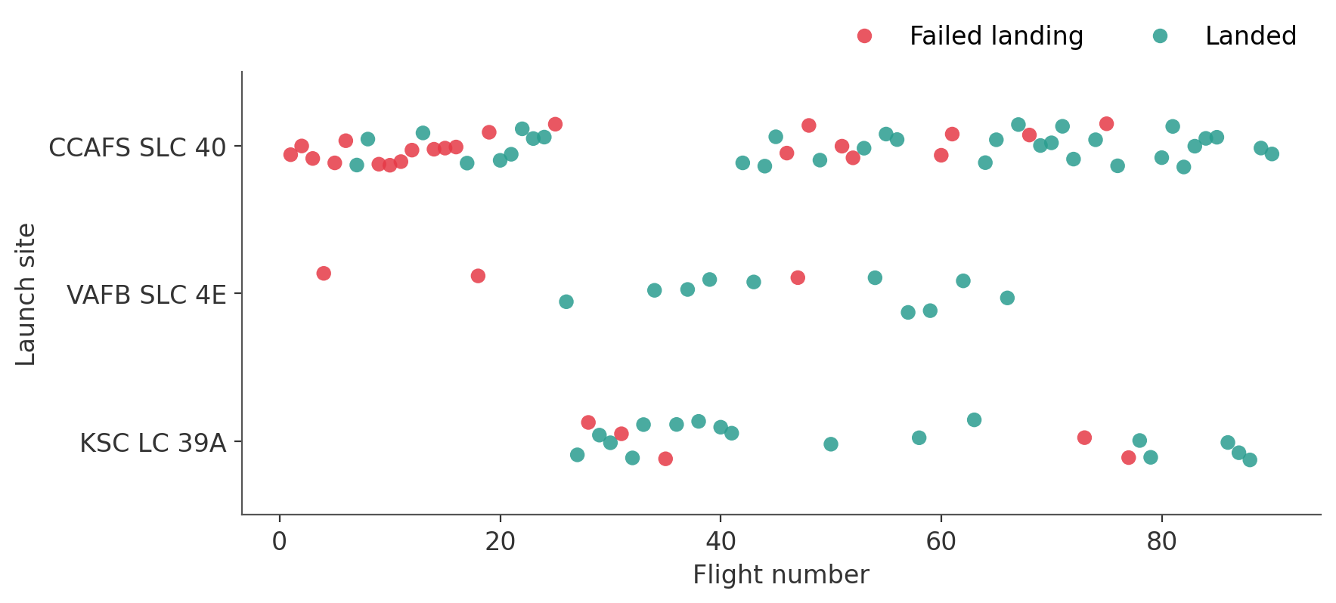
Flight Number vs. Launch Site
INSIGHT
Early flights (mostly from CCAFS SLC 40) failed to land. As flight numbers grow, green dominates at every site — experience matters more than location. KSC LC 39A only joined after flight 26 and started strong.
18

Slide 19
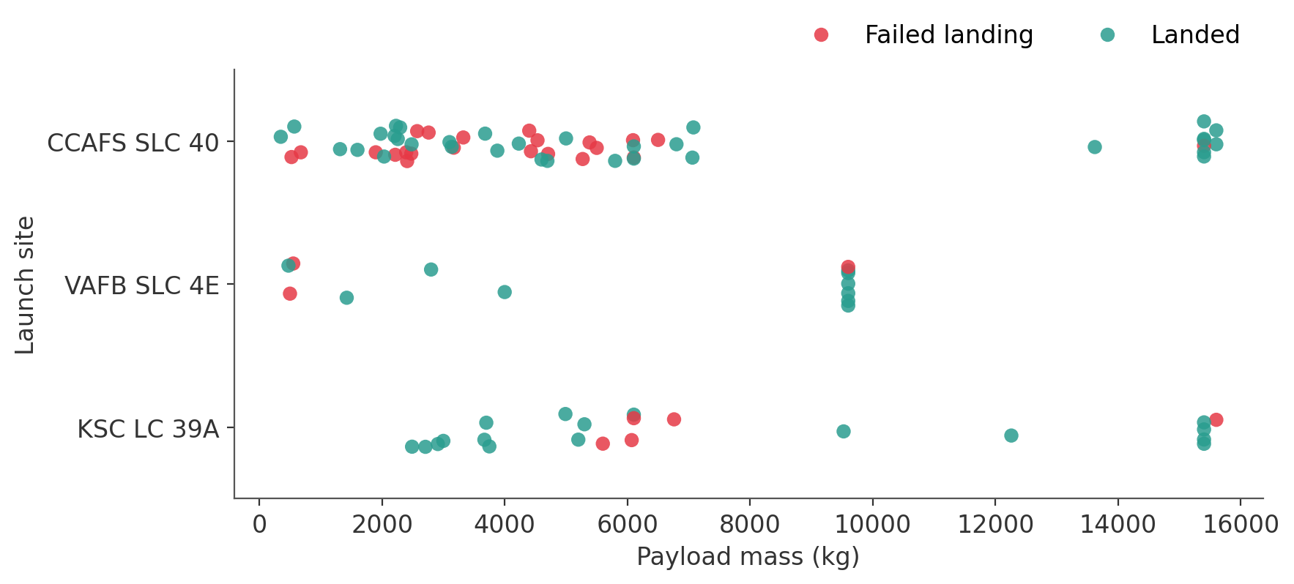
Payload vs. Launch Site
INSIGHT
VAFB SLC 4E launched no payloads above 10,000 kg. Heavy payloads (> 8,000 kg) mostly landed (87%), largely because they flew late on Block 5 boosters.
19

Slide 20
Success Rate vs. Orbit Type
INSIGHT
ES-L1, GEO, HEO and SSO landed every time, but with 1–5 launches each. Among the busy orbits, VLEO (86%) and LEO (71%) beat ISS (62%) and GTO (52%), the hardest orbit to recover from.
20

Slide 21
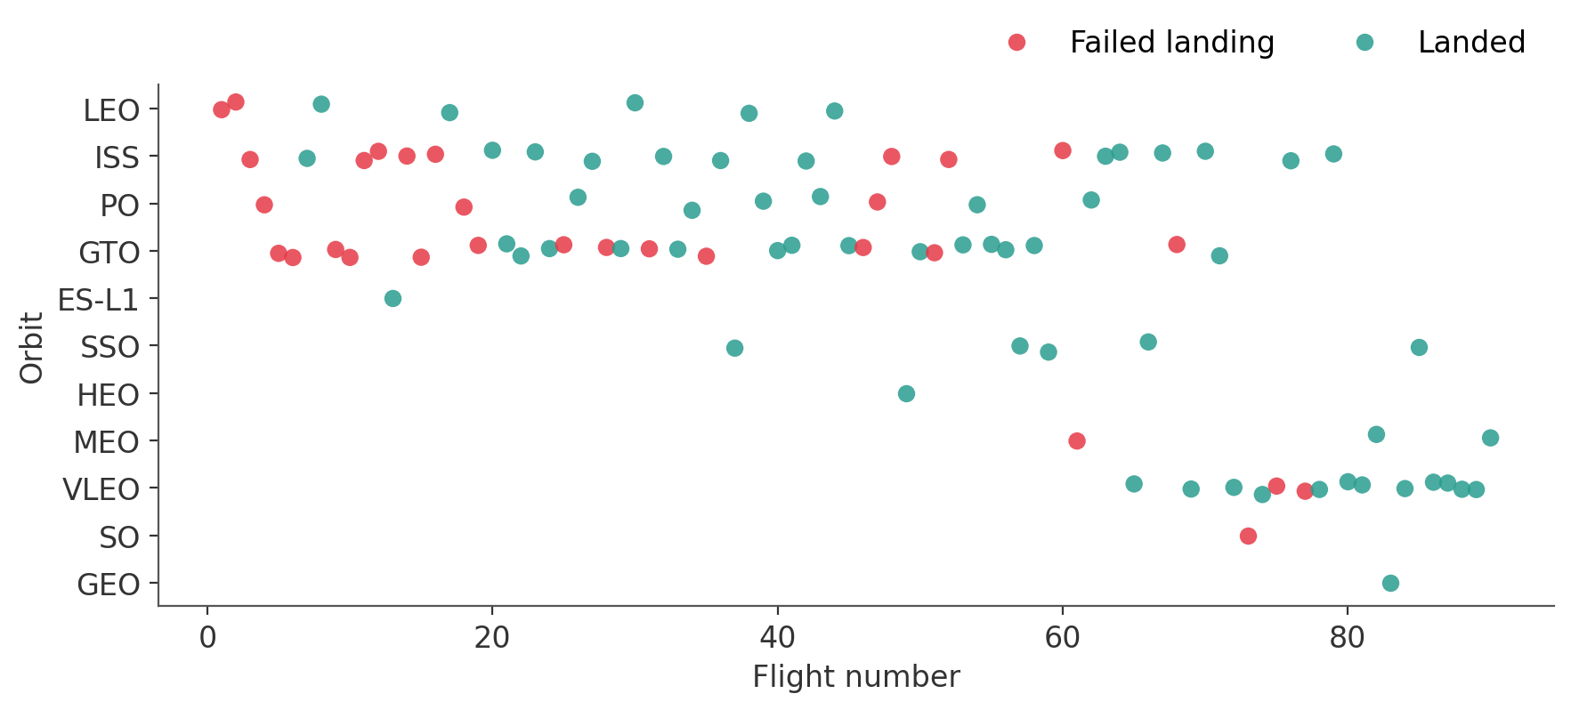
Flight Number vs. Orbit Type
INSIGHT
In LEO, success clearly tracks flight number. In GTO there is no such trend: failures continue into the later flights, so orbit energy, not just experience, limits recovery.
21

Slide 22
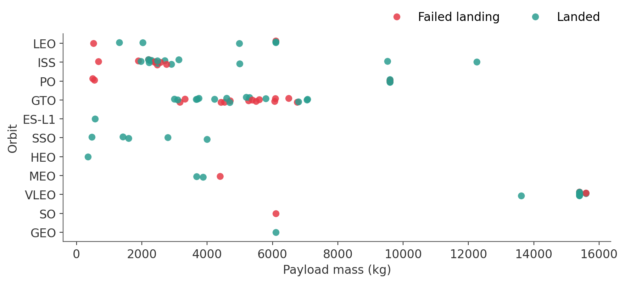
Payload vs. Orbit Type
INSIGHT
Heavy payloads land well in Polar, LEO, ISS and VLEO orbits. GTO payloads (3,000–7,000 kg) are a mix of successes and failures, with no clear payload threshold.
22

Slide 23
Launch Success Yearly Trend
INSIGHT
No landings succeeded from 2010 to 2013. The rate climbed steadily from 2013, dipped in 2018 as Block 5 was introduced, and reached 90% in 2019.
23

Slide 24
All Launch Site Names
Query SELECT DISTINCT Launch_Site FROM SPACEXTABLE
Launch_Site
CCAFS LC-40
VAFB SLC-4E
KSC LC-39A
CCAFS SLC-40
EXPLANATION
DISTINCT returns each launch site once. SpaceX used four sites: three in Florida (CCAFS LC-40, CCAFS SLC-40, KSC LC-39A) and one in California (VAFB SLC-4E).
24

Slide 25
Launch Site Names Begin with 'CCA'
Query SELECT Date, Booster_Version, Launch_Site, Payload, PAYLOAD_MASS__KG_, Customer, Landing_Outcome FROM SPACEXTABLE WHERE Launch_Site LIKE 'CCA%' LIMIT 5
Date | Booster_Version | Launch_Site | Payload | PAYLOAD_MASS__KG_ | Customer | Landing_Outcome
2010-06-04 | F9 v1.0 B0003 | CCAFS LC-40 | Dragon Spacecraft Qualification Unit | 0 | SpaceX | Failure (parachute)
2010-12-08 | F9 v1.0 B0004 | CCAFS LC-40 | Dragon demo flight C1, two CubeSats, barrel of Brouere cheese | 0 | NASA (COTS) NRO | Failure (parachute)
2012-05-22 | F9 v1.0 B0005 | CCAFS LC-40 | Dragon demo flight C2 | 525 | NASA (COTS) | No attempt
2012-10-08 | F9 v1.0 B0006 | CCAFS LC-40 | SpaceX CRS-1 | 500 | NASA (CRS) | No attempt
2013-03-01 | F9 v1.0 B0007 | CCAFS LC-40 | SpaceX CRS-2 | 677 | NASA (CRS) | No attempt
EXPLANATION
LIKE 'CCA%' matches sites starting with CCA and LIMIT 5 keeps the first five rows: the earliest Falcon 9 flights, all from CCAFS LC-40, carrying Dragon test and CRS missions with no successful landing.
25

Slide 26
Total Payload Mass
Query SELECT SUM(PAYLOAD_MASS__KG_) AS Total_Payload_Mass FROM SPACEXTABLE WHERE Customer = 'NASA (CRS)'
Total_Payload_Mass
45596
EXPLANATION
SUM over launches whose customer is 'NASA (CRS)': boosters carried 45,596 kg in total for NASA's Commercial Resupply Services missions.
26

Slide 27
Average Payload Mass by F9 v1.1
Query SELECT AVG(PAYLOAD_MASS__KG_) AS Avg_Payload_Mass FROM SPACEXTABLE WHERE Booster_Version = 'F9 v1.1'
Avg_Payload_Mass
2928.4
EXPLANATION
AVG over launches with booster version 'F9 v1.1': the average payload was 2,928.4 kg.
27

Slide 28
First Successful Ground Landing Date
Query SELECT MIN(Date) AS First_Ground_Pad_Success FROM SPACEXTABLE WHERE Landing_Outcome = 'Success (ground pad)'
First_Ground_Pad_Success
2015-12-22
EXPLANATION
MIN(Date) where Landing_Outcome = 'Success (ground pad)': the first successful ground-pad landing was on 22 December 2015.
28

Slide 29
Successful Drone Ship Landing with Payload between 4000 and 6000
Query SELECT Booster_Version FROM SPACEXTABLE WHERE Landing_Outcome = 'Success (drone ship)' AND PAYLOAD_MASS__KG_ > 4000 AND PAYLOAD_MASS__KG_ < 6000
Booster_Version
F9 FT B1022
F9 FT B1026
F9 FT B1021.2
F9 FT B1031.2
EXPLANATION
Four boosters landed on a drone ship while carrying 4,000–6,000 kg, all of the Full Thrust (FT) generation: B1022, B1026, B1021.2 and B1031.2.
29

Slide 30
Total Number of Successful and Failure Mission Outcomes
Query SELECT Mission_Outcome, COUNT(*) AS Total FROM SPACEXTABLE GROUP BY Mission_Outcome
Mission_Outcome | Total
Failure (in flight) | 1
Success | 98
Success | 1
Success (payload status unclear) | 1
EXPLANATION
GROUP BY Mission_Outcome with COUNT(*): 100 missions succeeded (98 + 1 with a trailing space + 1 with unclear payload status) and only 1 failed in flight.
30

Slide 31
Boosters Carried Maximum Payload
Query SELECT DISTINCT Booster_Version FROM SPACEXTABLE WHERE PAYLOAD_MASS__KG_ = (SELECT MAX(PAYLOAD_MASS__KG_) FROM SPACEXTABLE)
Booster_Version
F9 B5 B1048.4
F9 B5 B1049.4
F9 B5 B1051.3
F9 B5 B1056.4
F9 B5 B1048.5
F9 B5 B1051.4
F9 B5 B1049.5
F9 B5 B1060.2
F9 B5 B1058.3
F9 B5 B1051.6
F9 B5 B1060.3
F9 B5 B1049.7
EXPLANATION
A subquery finds the maximum payload (15,600 kg); 12 boosters carried it, all Block 5 (F9 B5) boosters.
31

Slide 32
2015 Launch Records
Query SELECT substr(Date,6,2) AS Month, Landing_Outcome, Booster_Version, Launch_Site FROM SPACEXTABLE WHERE substr(Date,1,4)='2015' AND Landing_Outcome='Failure (drone ship)'
Month | Landing_Outcome | Booster_Version | Launch_Site
01 | Failure (drone ship) | F9 v1.1 B1012 | CCAFS LC-40
04 | Failure (drone ship) | F9 v1.1 B1015 | CCAFS LC-40
EXPLANATION
substr(Date, 6, 2) gives the month and substr(Date, 1, 4) = '2015' the year. Two drone-ship landings failed in 2015, in January (B1012) and April (B1015), both from CCAFS LC-40.
32

Slide 33
Rank Landing Outcomes Between 2010-06-04 and 2017-03-20
Query SELECT Landing_Outcome, COUNT(*) AS Count FROM SPACEXTABLE WHERE Date BETWEEN '2010-06-04' AND '2017-03-20' GROUP BY Landing_Outcome ORDER BY Count DESC
Landing_Outcome | Count
No attempt | 10
Success (drone ship) | 5
Failure (drone ship) | 5
Success (ground pad) | 3
Controlled (ocean) | 3
Uncontrolled (ocean) | 2
Failure (parachute) | 2
Precluded (drone ship) | 1
EXPLANATION
GROUP BY landing outcome, ORDER BY count DESC. "No attempt" leads (10); drone-ship successes and failures tie at 5 each; ground-pad successes (3) were still rare in this early period.
33

Slide 34
03
Launch Sites Proximity Analysis
Interactive maps built with Folium
34

Slide 35
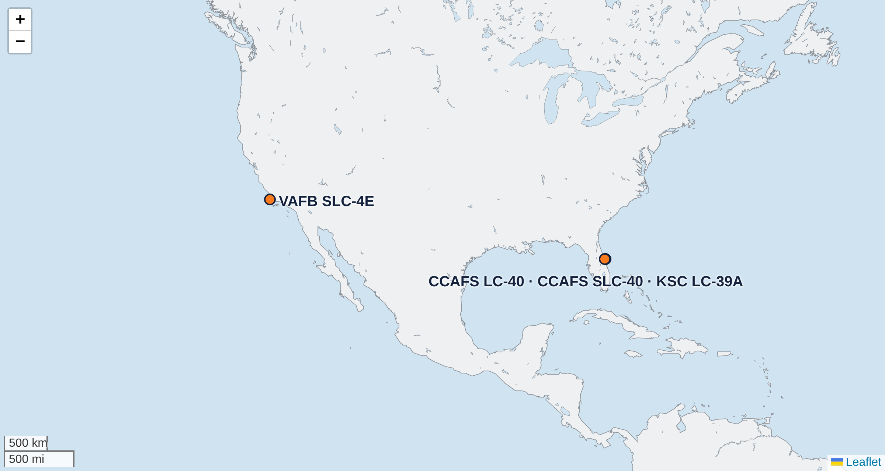
Folium Map — All Launch Sites
folium.Circle + folium.Marker at each site's latitude / longitude
FINDINGS
All four sites sit on a coast at the southern edge of the U.S. (close to the Equator). Florida sites launch east over the Atlantic; Vandenberg launches south over the Pacific for polar orbits.
35

Slide 36
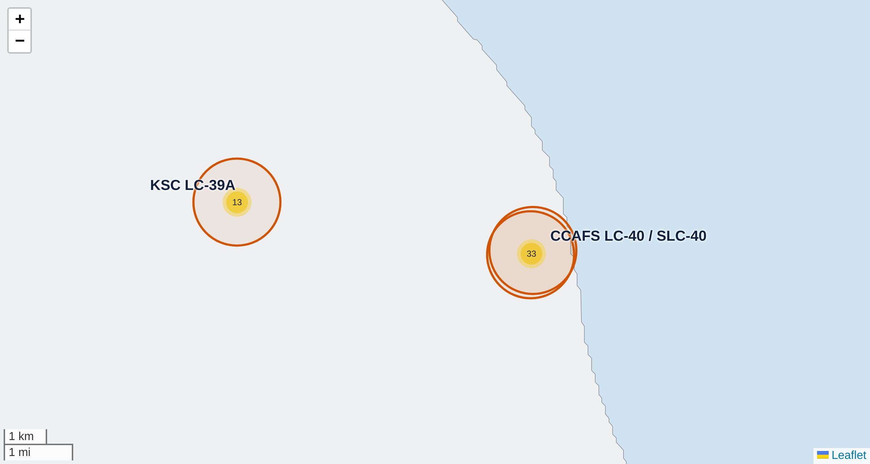
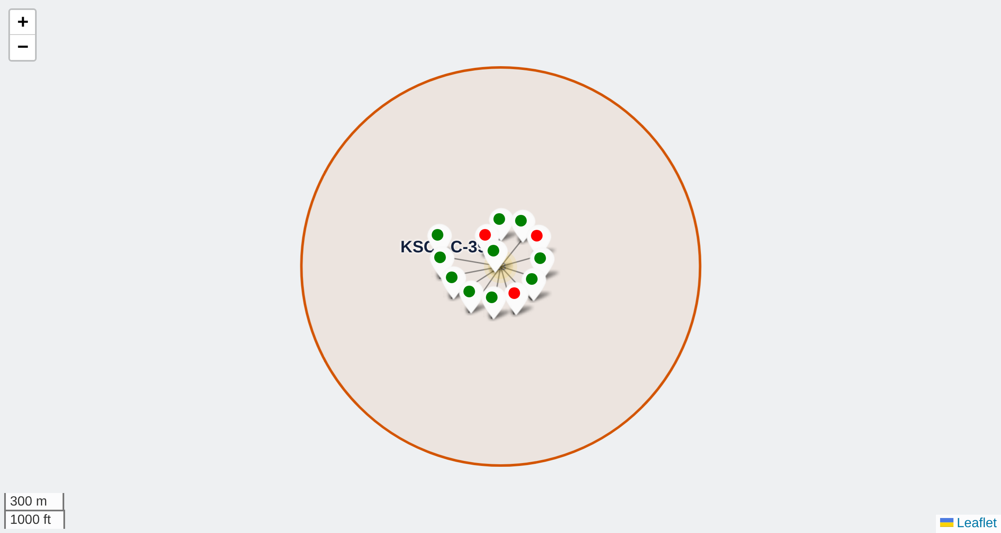
Folium Map — Launch Outcomes per Site
MarkerCluster of every launch: green marker = landed (class 1), red = failed (class 0)
Clusters show 13 launches at KSC LC-39A and 33 at the CCAFS pad
Clicking the KSC LC-39A cluster: 10 green, 3 red markers
FINDINGS KSC LC-39A has the best ratio (10 landed / 3 failed, 76.9%). The CCAFS pad (LC-40 + SLC-40) flew most launches but mostly early ones, so it has the most failures (10 / 23).
36

Slide 37
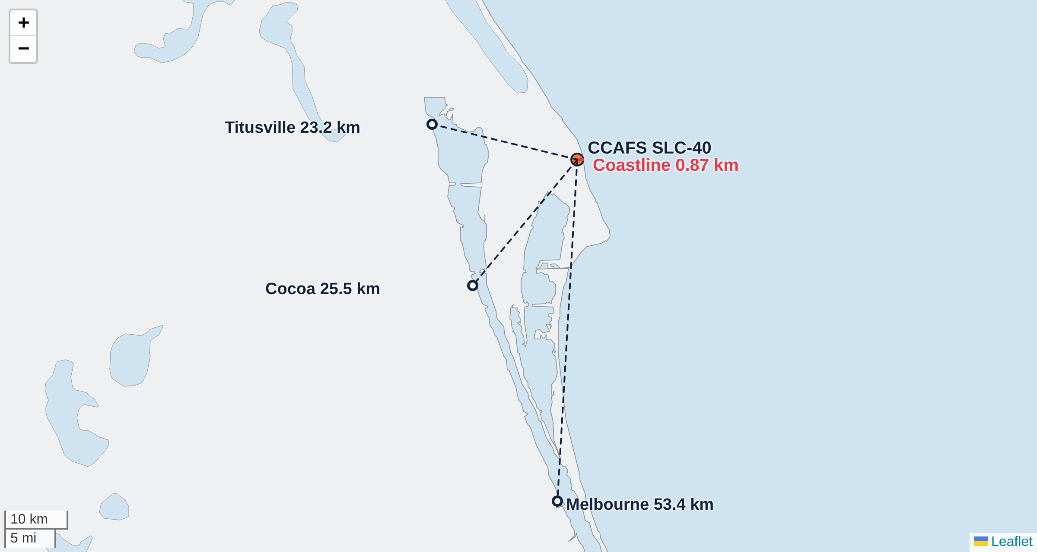
Folium Map — Proximity of CCAFS SLC-40
folium.PolyLine from the launch site, distances computed with the haversine formula
Nearest… | Distance
Coastline | 0.87 km
Titusville | 23.2 km
Cocoa | 25.5 km
Melbourne | 53.4 km
FINDINGS
The pad is under 1 km from the sea (safe abort and recovery over water) and 23+ km from the nearest towns for public safety.
37

Slide 38
04
Build a Dashboard with Plotly Dash
Interactive launch-records dashboard (spacex_dash_app.py)
38

Slide 39
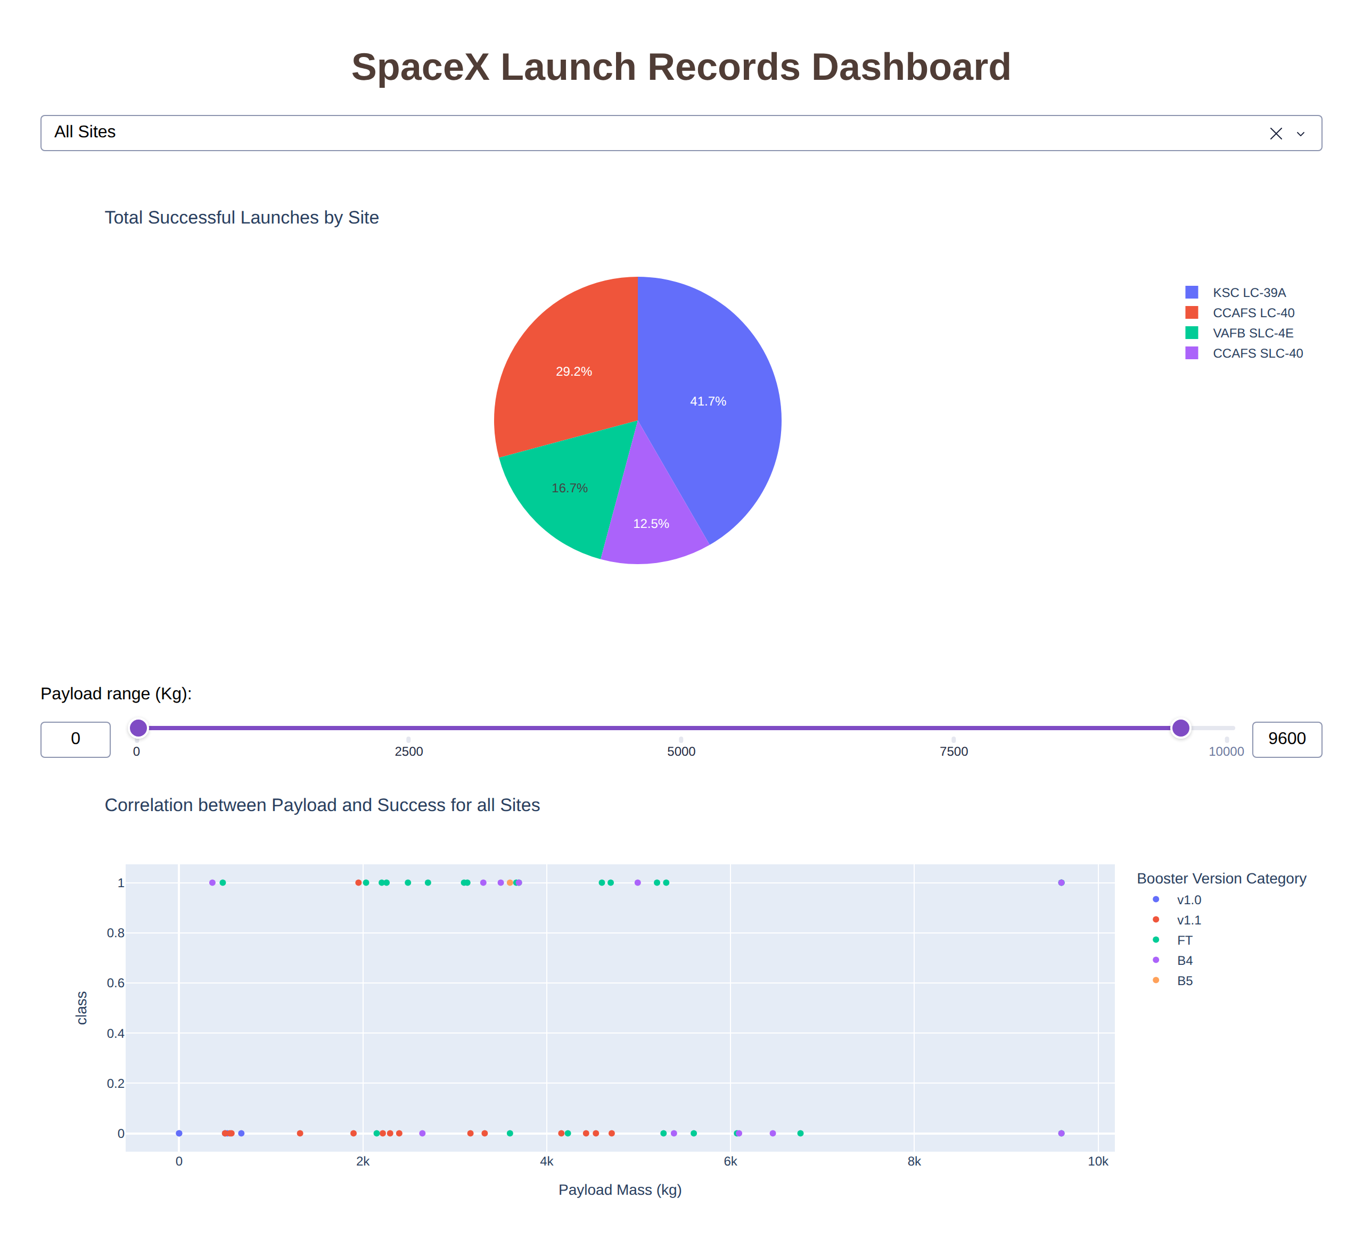
Dashboard Overview
Dropdown (site-dropdown): All Sites or one of the four launch sites.
Pie chart (success-pie-chart): all sites → share of successes per site; one site → success vs. failure.
Range slider (payload-slider): filters payload from 0 to 10,000 kg in 1,000 kg steps.
Scatter (success-payload-scatter-chart): payload vs. class, coloured by booster version; reacts to both the dropdown and the slider (two Inputs in one callback).
39

Slide 40
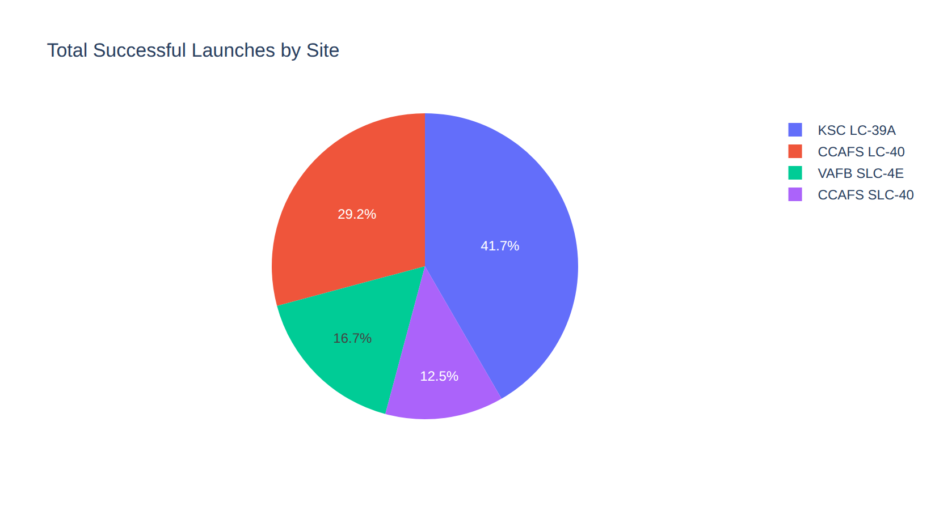
Dashboard — Successful Launches by Site
Dropdown = All Sites
FINDINGS
KSC LC-39A has the largest share of successful launches (41.7%), then CCAFS LC-40 (29.2%), VAFB SLC-4E (16.7%) and CCAFS SLC-40 (12.5%). Shares partly reflect how many missions each site flew.
40

Slide 41
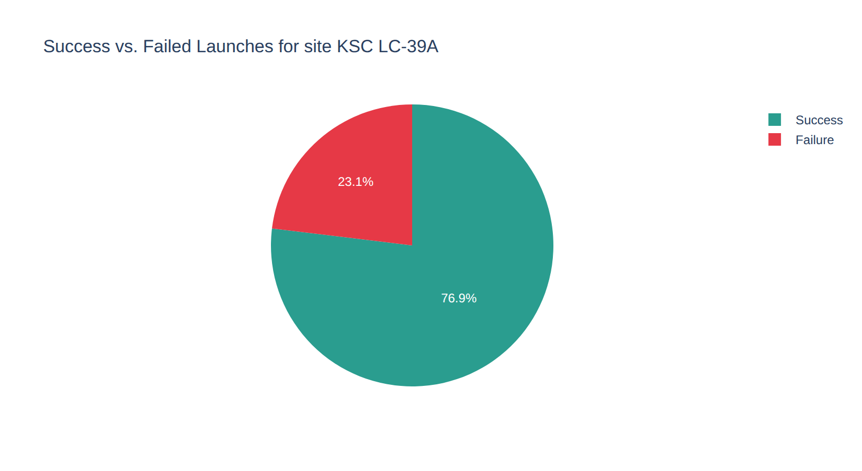
Dashboard — Site with the Highest Success Rate
Dropdown = KSC LC-39A
FINDINGS
KSC LC-39A landed 10 of 13 first stages: a 76.9% success rate, the best of any site (CCAFS LC-40 27%, CCAFS SLC-40 43%, VAFB SLC-4E 40%).
41

Slide 42
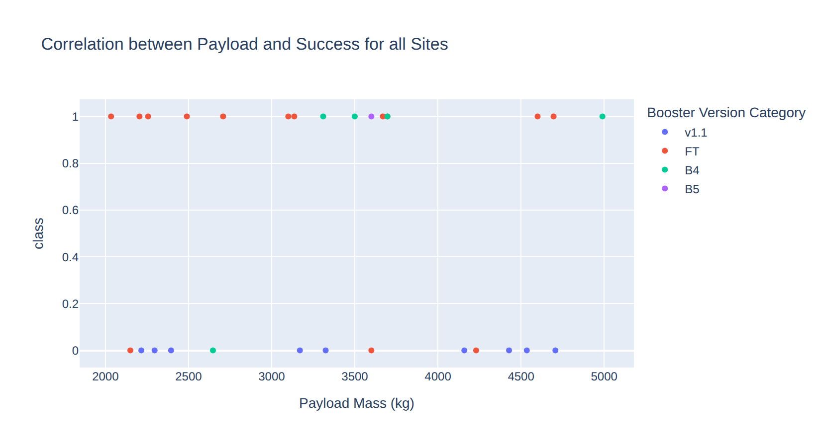
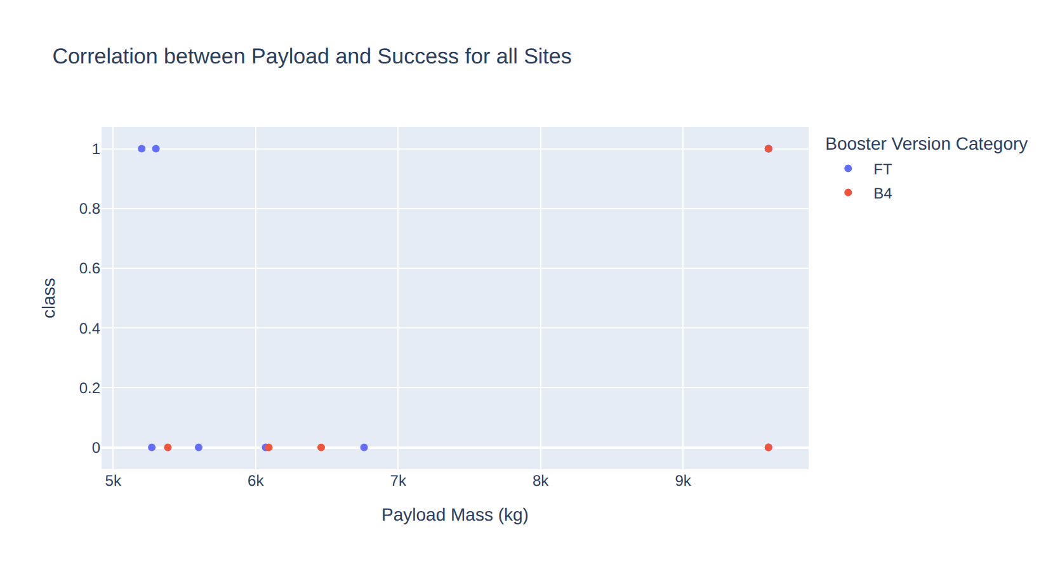
Dashboard — Payload vs. Launch Outcome
Same scatter, two slider settings (all sites)
Slider 2,000–5,000 kg: 16 of 29 landed (55%)
Slider 5,000–10,000 kg: 5 of 14 landed (36%)
Payload sweet spot: 2,000–5,000 kg has the most successes and the highest rate; below 2,000 kg only 23% landed (mostly early v1.0/v1.1 flights).
Booster matters most: FT boosters landed 16 of 24 (67%), B4 6 of 11; v1.1 landed only 1 of 15 and v1.0 none.
42

Slide 43
05
Predictive Analysis (Classification)
Classification results
43

Slide 44
Classification Accuracy
Bar chart of accuracy for all models. GridSearchCV (cv=10) on 72 training launches, scored on 18 test launches
Model | CV | Test | Prec. | Recall | F1
Logistic Regression | 84.6% | 83.3% | 80% | 100% | 88.9%
SVM | 84.8% | 83.3% | 80% | 100% | 88.9%
Decision Tree | 84.8% | 83.3% | 80% | 100% | 88.9%
KNN | 84.8% | 83.3% | 80% | 100% | 88.9%
FINDINGS
On this split every model gets 15 of 18 right (83.3%), with 100% recall and 80% precision. SVM, decision tree and KNN share the top CV score (84.8%), so one split cannot separate them; see the robustness check on the next slides. Y-axis starts at 70%.
44

Slide 45
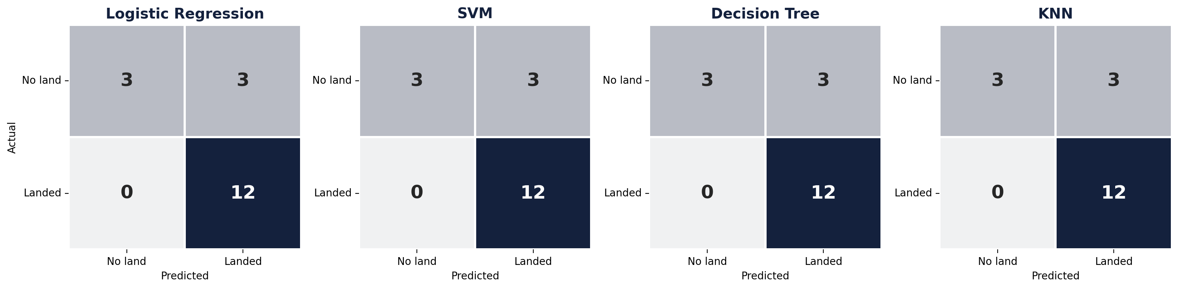
Confusion Matrix
Test set (18 launches) for all four tuned models
FINDINGS
All four models produce the same matrix: 12 true positives, 3 true negatives, 3 false positives and 0 false negatives. Every landing was caught, but 3 of the 6 failed landings were predicted to land, so the models are over-optimistic about failures.
45

Slide 46
Which Model Is Best? — Robustness Check
50 different train/test splits (5-fold × 10 repeats) using each model's tuned hyperparameters
BEST MODEL: SVM
SVM (sigmoid kernel) is the most accurate and stable: 84.4% ± 8.0%, ahead of KNN (84.1%) and logistic regression (82.6%). The decision tree drops to 75.1%: its single-split tie was luck, and it overfits. All models clearly beat the 66.7% baseline.
46

Slide 47
Conclusions
1
Experience pays off
2
Site and orbit matter
Landing success rose from 0% before 2014 to 90% in 2019; flight number is the strongest single signal.
KSC LC-39A has the best record (76.9%). GTO is the hardest orbit (52%); SSO, GEO, HEO and ES-L1 landed every time.
3
Hardware and payload
4
SVM is the best model
v1.0/v1.1 boosters rarely landed; FT, B4 and B5 account for nearly all successes. 2,000–5,000 kg payloads land most often.
All models reach 83.3% on the test set; across 50 splits SVM is best (84.4%). Errors are false positives, so treat predicted landings with care.
47

Slide 48
Innovative Insights — Beyond the Template
What a competing bidder like Space Y should take away
Payload is not a penalty: the heaviest band (8,000 kg+) lands most often (87%), because heavy missions flew late on mature boosters. Era confounds payload.
Price a GTO bid higher: GTO missions land only about half the time, so SpaceX's true cost on those launches is closer to expendable pricing.
One split is not enough: four models tied at 83.3% on the 18-launch test set, but resampling 50 splits showed SVM best and the decision tree overfitting (75%).
Next step: add launch year and booster block as explicit features and retrain on post-2020 launches to test whether accuracy holds.
48

Slide 49
Appendix
GitHub repository: https://github.com/kautzarichramsyah/Applied-Data-Science-Capstone
Data sources: SpaceX REST API (IBM static snapshot API_call_spacex_api.json), Wikipedia "List of Falcon 9 and Falcon Heavy launches", IBM Spacex.csv and spacex_launch_dash.csv.
Best hyperparameters:
  Logistic regression: C=0.01, penalty=l2, solver=lbfgs
  SVM (best model): kernel=sigmoid, C=1, gamma=0.0316
  Decision tree: criterion=gini, max_depth=8, min_samples_leaf=4, splitter=random
  KNN: n_neighbors=10, p=1, algorithm=auto
Repository contents: notebooks for data collection (API), web scraping, data wrangling, EDA with SQL, EDA with visualization, Folium maps and machine learning prediction, plus spacex_dash_app.py.
49

