Slide 1
IBM APPLIED DATA SCIENCE CAPSTONE
Will the First Stage Land?
Predicting SpaceX Falcon 9 landing success to price a launch
Kautzar
October 1, 2026
GitHub repository: https://github.com/kautzarichramsyah/Applied-Data-Science-Capstone

Slide 2
Outline
1
Executive summary
Slides 3
6
Results: Launch site proximity (Folium)
Slides 21–24
2
Introduction
Slides 4
7
Results: Plotly Dash dashboard
Slides 25–29
3
Methodology
Slides 5–11
8
Results: Predictive analysis
Slides 30–33
4
Results: EDA with visualization
Slides 12–18
9
Conclusion and innovative insights
Slides 34–35
5
Results: EDA with SQL
Slides 19–20
2

Slide 3
Executive Summary
90
66.7%
83.3%
84.4%
Falcon 9 launches analysed (2010–2020)
first stages that landed successfully
test accuracy (15 of 18 launches)
SVM accuracy across 50 data splits
Methods: collected launch data from the SpaceX REST API and Wikipedia, cleaned it with pandas, explored it with SQL, seaborn, Folium and a Plotly Dash app, then tuned four classifiers with GridSearchCV.
What drives landing success: experience. Success rose from 0% (2010–2013) to 84–90% (2019–2020), and newer boosters (FT, B4, B5) land far more often than v1.0/v1.1.
Where and what: KSC LC-39A has the best record (76.9%); ES-L1, GEO, HEO and SSO orbits landed every time, GTO only 51.9%.
Prediction: all four tuned classifiers reach 83.3% on the 18-launch test set; across 50 resampled splits SVM is the best and most stable model (84.4%). Errors are false positives.
3

Slide 4
Introduction
Space Y wants to bid against SpaceX — so it needs to know what a Falcon 9 launch really costs
BACKGROUND
SpaceX advertises Falcon 9 launches at about $62 million; other providers charge upwards of $165 million. Most of the saving comes from landing and reusing the first stage.
WHY IT MATTERS
If we can predict whether the first stage will land, we can estimate the true cost of a launch — the information a competing bidder needs.
Questions we set out to answer
How do payload mass, orbit, launch site and flight number affect landing success?
Has landing success improved over time, and with which booster versions?
Can a machine learning model predict a successful landing — and how reliably?
4

Slide 5
01
Methodology
Data collection, wrangling, EDA, interactive analytics and classification
5

Slide 6
Methodology Overview
Executive summary of the end-to-end pipeline
1
2
3
4
5
›
›
›
›
Collect
SpaceX REST API + Wikipedia web scraping
Wrangle
Filter Falcon 9, impute payload, build Class label
EDA
SQL queries and seaborn / matplotlib charts
Interactive
Folium maps and a Plotly Dash dashboard
Model
GridSearchCV over 4 classifiers, test-set evaluation
Tools: Python (requests, BeautifulSoup, pandas, NumPy, scikit-learn, seaborn, Folium, Plotly Dash) and SQLite via ipython-sql.
Outcome variable: Class = 1 if the first stage landed successfully (ocean, ground pad or drone ship), 0 otherwise.
Code: all notebooks and spacex_dash_app.py are in https://github.com/kautzarichramsyah/Applied-Data-Science-Capstone
6

Slide 7
Data Collection — SpaceX REST API
1
2
3
4
5
›
›
›
›
GET request
api.spacexdata.com/v4/launches/past
Normalize
response.json() → pd.json_normalize()
Enrich
Look up rocket, launchpad, payload and core IDs
Filter
Keep Falcon 9 only (drop Falcon 1) → 90 launches
Clean
Fill missing PayloadMass with the mean
Key code
response = requests.get(static_json_url)
data = pd.json_normalize(response.json())
getBoosterVersion(data); getLaunchSite(data); getPayloadData(data); getCoreData(data)
data_falcon9 = df[df['BoosterVersion'] != 'Falcon 1']
data_falcon9['PayloadMass'] = data_falcon9['PayloadMass'].fillna(data_falcon9['PayloadMass'].mean())
7

Slide 8
Data Collection — Web Scraping
1
2
3
4
5
›
›
›
›
Request
GET the Wikipedia "List of Falcon 9 and Falcon Heavy launches" page
Parse
Load the HTML into a BeautifulSoup object
Find tables
soup.find_all("table") → launch tables
Extract
Column names from <th>, rows from <td>
Save
Dictionary → DataFrame → CSV
WHY A SECOND SOURCE
Wikipedia adds human-readable mission details (customer, launch outcome, booster landing) that cross-check the API records.
CHECK
soup.title returns "List of Falcon 9 and Falcon Heavy launches - Wikipedia", confirming the right page was parsed before extracting rows.
8

Slide 9
Data Wrangling
Turning eight landing outcomes into one binary label
Outcome | Meaning | Count | Class
True ASDS | Landed on drone ship | 41 | 1
None None | No landing attempted | 19 | 0
True RTLS | Landed on ground pad | 14 | 1
False ASDS | Drone ship landing failed | 6 | 0
True Ocean | Controlled ocean landing | 5 | 1
False Ocean | Ocean landing failed | 2 | 0
None ASDS | Drone ship, no attempt | 2 | 0
False RTLS | Ground pad landing failed | 1 | 0
LABEL
landing_class = 0 if outcome in bad_outcomes else 1 → df['Class']
RESULT
Mean of Class = 0.667: two out of three Falcon 9 first stages landed. CCAFS SLC 40 hosted 55 of the 90 launches.
9

Slide 10
EDA and Interactive Visual Analytics — Methodology
Charts (seaborn)
SQL (SQLite)
Folium + Dash
Scatter / strip plots: flight number, payload vs site and orbit
Bar chart: success rate by orbit
Line chart: yearly success trend
One-hot encoding of categorical features for modelling
Loaded Spacex.csv into SPACEXTBL
SELECT DISTINCT, LIKE, SUM, AVG, MIN
Subqueries and GROUP BY / ORDER BY
Date filtering with substr()
Circles and markers for each launch site
MarkerCluster of green/red outcomes
PolyLine distances to coast and infrastructure
Dash: site dropdown, pie chart, payload slider, scatter
10

Slide 11
Predictive Analysis — Methodology
1
2
3
4
5
›
›
›
›
Prepare
Y = Class; X = 83 features (numeric + one-hot)
Standardize
StandardScaler().fit_transform(X)
Split
train_test_split, test_size=0.2 → 72 train / 18 test
Tune
GridSearchCV, cv=10, per model
Evaluate
Test accuracy + confusion matrix
Model | Hyperparameters searched
Logistic regression | C ∈ {0.01, 0.1, 1}, penalty = l2, solver = lbfgs
Support vector machine | kernel ∈ {linear, rbf, poly, sigmoid}, C and gamma ∈ logspace(-3, 3, 5)
Decision tree | criterion, splitter, max_depth 2–18, min_samples_leaf, min_samples_split
K-nearest neighbours | n_neighbors 1–10, algorithm, p ∈ {1, 2}
11

Slide 12
02
EDA with Visualization
What the scatter plots, bar and line charts reveal
12

Slide 13
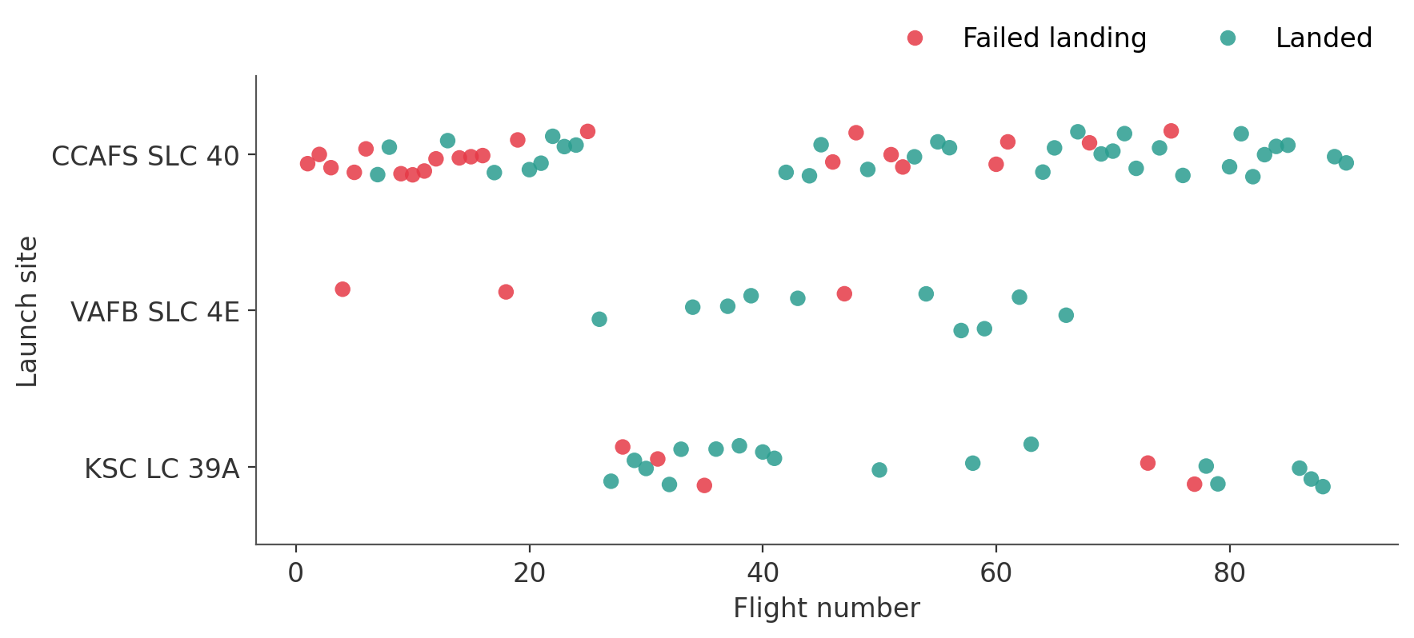
Flight Number vs. Launch Site
INSIGHT
Early flights (mostly from CCAFS SLC 40) failed to land. As flight numbers grow, green dominates at every site — experience matters more than location. KSC LC 39A only joined after flight 26 and started strong.
13

Slide 14
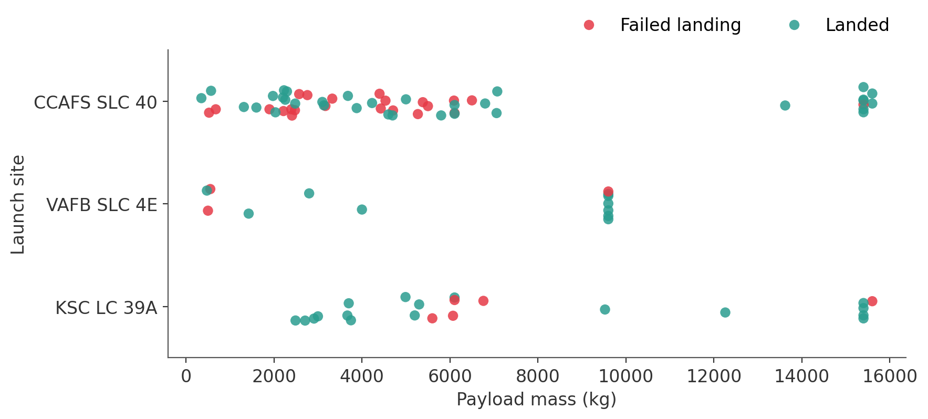
Payload Mass vs. Launch Site
INSIGHT
VAFB SLC 4E launched no payloads above 10,000 kg. Heavy payloads (> 8,000 kg) mostly landed (87%), largely because they flew late on Block 5 boosters.
14

Slide 15
Success Rate by Orbit Type
INSIGHT
ES-L1, GEO, HEO and SSO landed every time, but with 1–5 launches each. Among the busy orbits, VLEO (86%) and LEO (71%) beat ISS (62%) and GTO (52%), the hardest orbit to recover from.
15

Slide 16
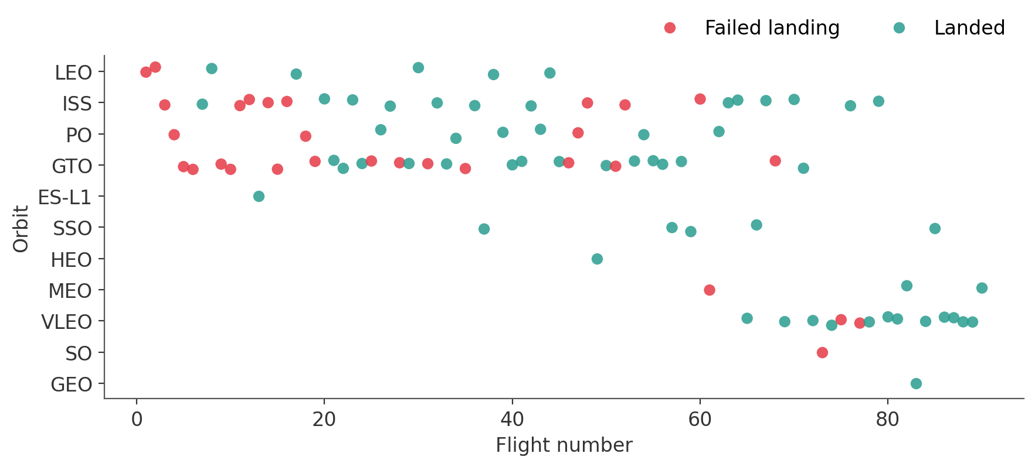
Flight Number vs. Orbit Type
INSIGHT
In LEO, success clearly tracks flight number. In GTO there is no such trend: failures continue into the later flights, so orbit energy, not just experience, limits recovery.
16

Slide 17
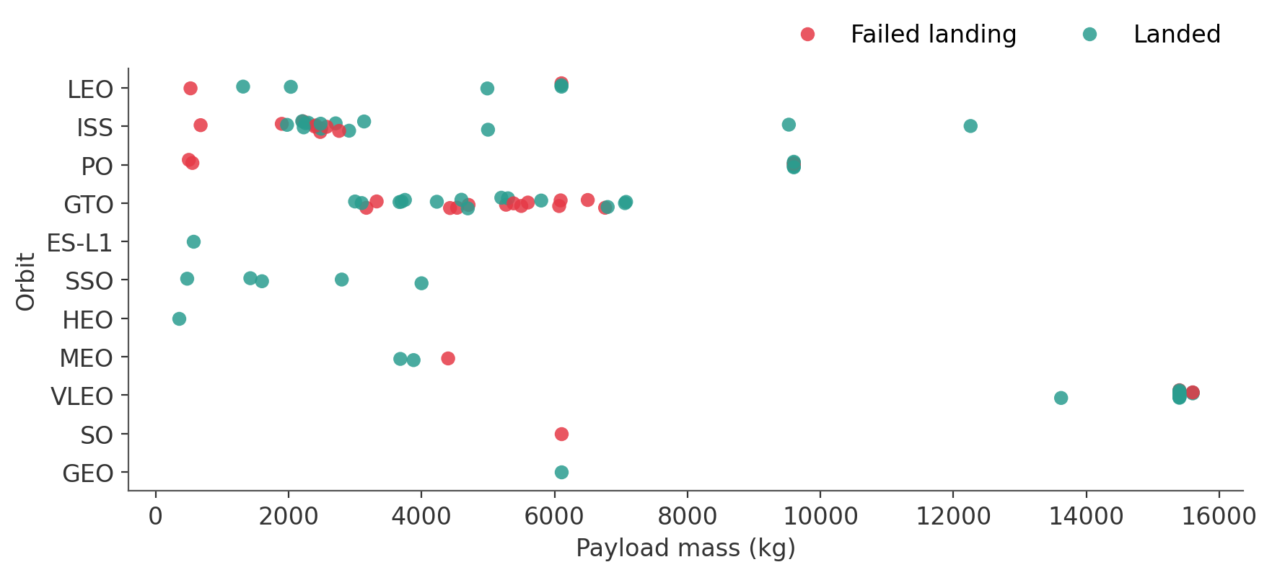
Payload Mass vs. Orbit Type
INSIGHT
Heavy payloads land well in Polar, LEO, ISS and VLEO orbits. GTO payloads (3,000–7,000 kg) are a mix of successes and failures, with no clear payload threshold.
17

Slide 18
Launch Success Yearly Trend
INSIGHT
No landings succeeded from 2010 to 2013. The rate climbed steadily from 2013, dipped in 2018 as Block 5 was introduced, and reached 90% in 2019.
18

Slide 19
EDA with SQL — Results (1/2)
SQLite on the SPACEXTBL table (Spacex.csv, 101 rows)
# | Question | Query (core) | Result
1 | Unique launch sites | SELECT DISTINCT Launch_Site FROM SPACEXTBL | CCAFS LC-40, VAFB SLC-4E, KSC LC-39A, CCAFS SLC-40
2 | 5 records where site begins with "CCA" | SELECT * FROM SPACEXTBL WHERE Launch_Site LIKE 'CCA%' LIMIT 5 | First 5 launches, all CCAFS LC-40
3 | Total payload for NASA (CRS) | SELECT SUM(PAYLOAD_MASS__KG_) ... WHERE Customer = 'NASA (CRS)' | 45,596 kg
4 | Average payload, F9 v1.1 | SELECT AVG(PAYLOAD_MASS__KG_) ... WHERE Booster_Version = 'F9 v1.1' | 2,928.4 kg
5 | First successful ground-pad landing | SELECT MIN(Date) ... WHERE Landing_Outcome = 'Success (ground pad)' | 22 December 2015
19

Slide 20
EDA with SQL — Results (2/2)
SQLite on the SPACEXTBL table (Spacex.csv, 101 rows)
# | Question | Query (core) | Result
6 | Drone-ship successes with payload 4,000–6,000 kg | ... WHERE Landing_Outcome = 'Success (drone ship)' AND PAYLOAD_MASS__KG_ BETWEEN 4000 AND 6000 | F9 FT B1022, B1026, B1021.2, B1031.2
7 | Mission outcomes | SELECT CASE WHEN Mission_Outcome LIKE 'Success%' ... GROUP BY Outcome | 100 success, 1 failure
8 | Boosters that carried the max payload | WHERE PAYLOAD_MASS__KG_ = (SELECT MAX(PAYLOAD_MASS__KG_) FROM SPACEXTBL) | 12 Block 5 boosters (e.g. B1048.4, B1049.4, B1051.3)
9 | 2015 drone-ship failures | WHERE substr(Date,1,4) = '2015' AND Landing_Outcome = 'Failure (drone ship)' | Jan: B1012, Apr: B1015 (CCAFS LC-40)
10 | Landing outcomes ranked, 2010-06-04 to 2017-03-20 | GROUP BY Landing_Outcome ORDER BY COUNT(*) DESC | No attempt 10; drone-ship success 5 and failure 5; ground pad 3 ...
20

Slide 21
03
Launch Sites Proximity Analysis
Interactive maps built with Folium
21

Slide 22
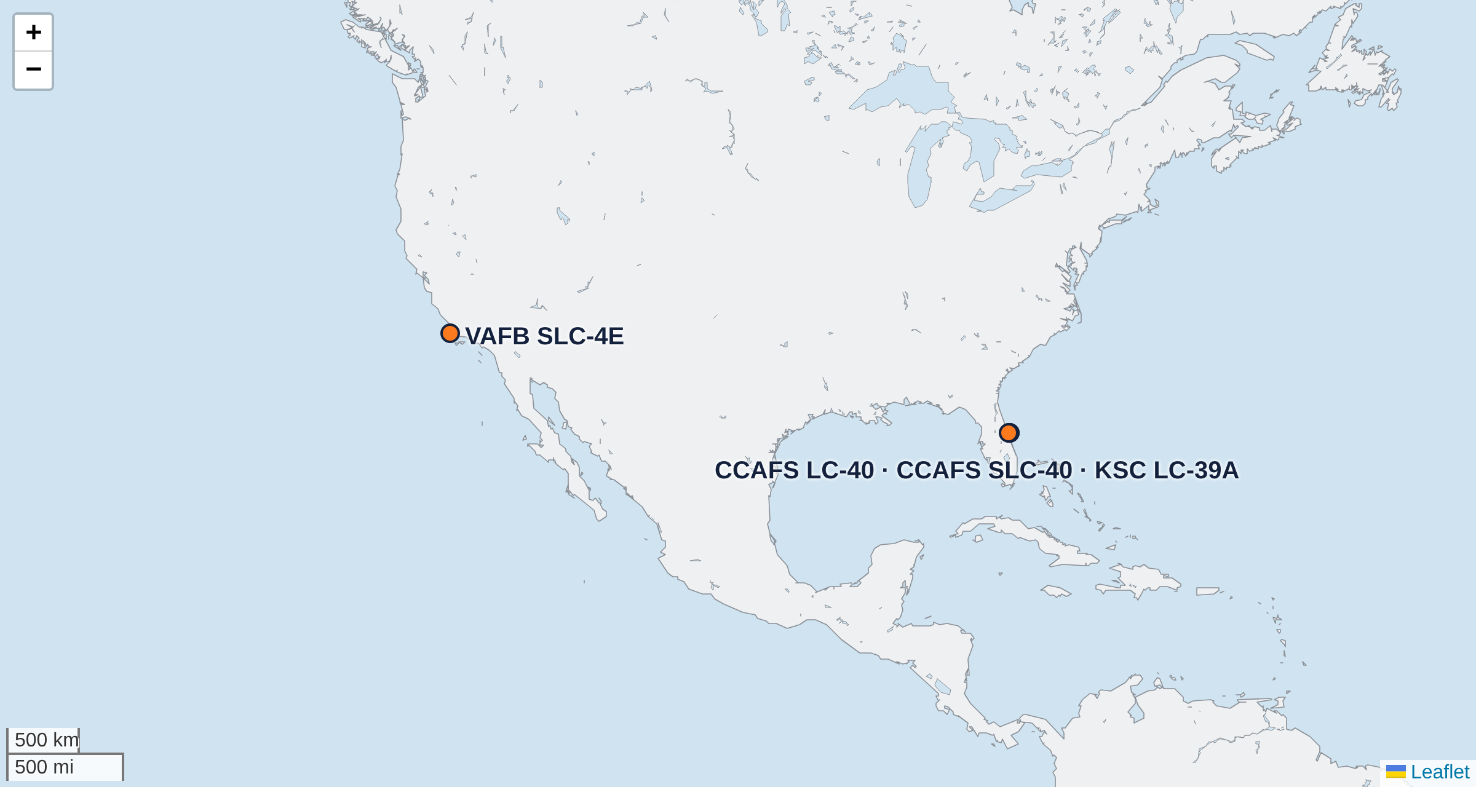
Folium Map — All Launch Sites
folium.Circle + folium.Marker at each site's latitude / longitude
FINDINGS
All four sites sit on a coast at the southern edge of the U.S. (close to the Equator). Florida sites launch east over the Atlantic; Vandenberg launches south over the Pacific for polar orbits.
22

Slide 23
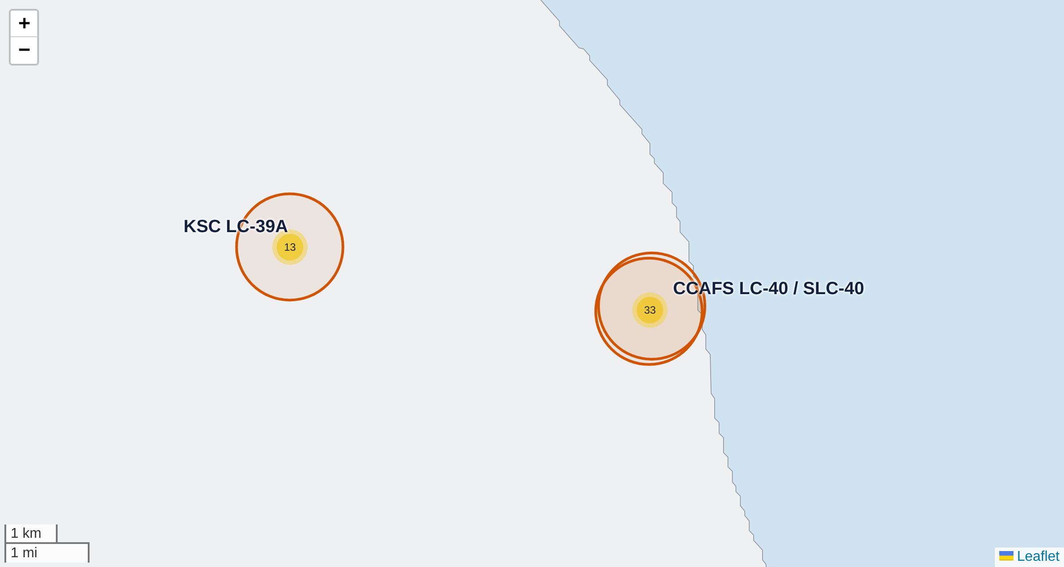
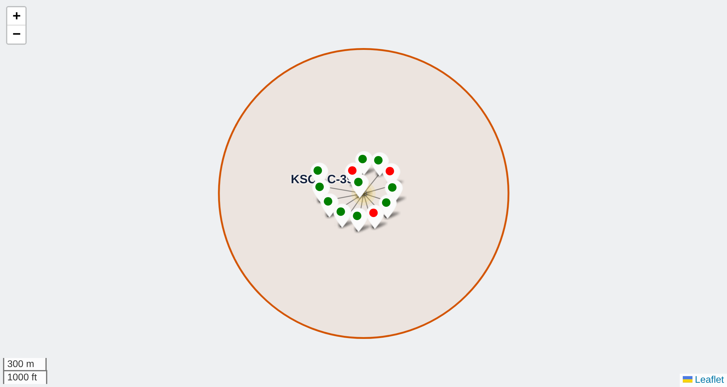
Folium Map — Launch Outcomes per Site
MarkerCluster of every launch: green marker = landed (class 1), red = failed (class 0)
Clusters show 13 launches at KSC LC-39A and 33 at the CCAFS pad
Clicking the KSC LC-39A cluster: 10 green, 3 red markers
FINDINGS KSC LC-39A has the best ratio (10 landed / 3 failed, 76.9%). The CCAFS pad (LC-40 + SLC-40) flew most launches but mostly early ones, so it has the most failures (10 / 23).
23

Slide 24
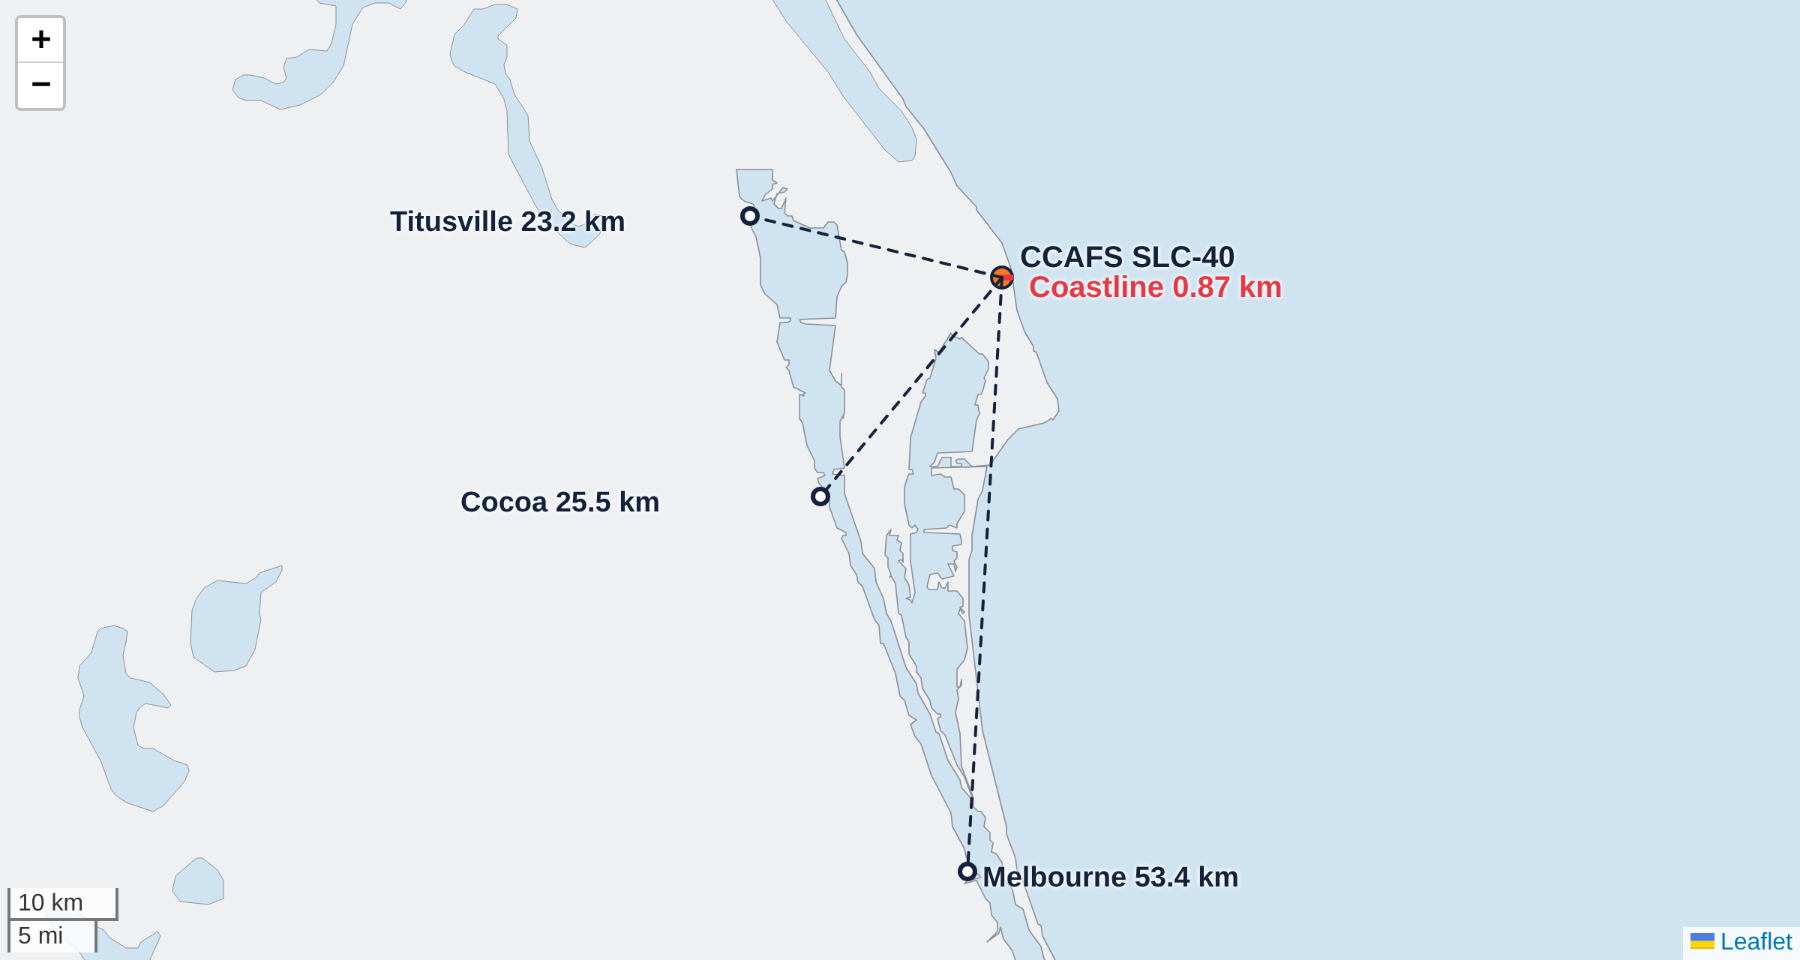
Folium Map — Proximity of CCAFS SLC-40
folium.PolyLine from the launch site, distances computed with the haversine formula
Nearest… | Distance
Coastline | 0.87 km
Titusville | 23.2 km
Cocoa | 25.5 km
Melbourne | 53.4 km
FINDINGS
The pad is under 1 km from the sea (safe abort and recovery over water) and 23+ km from the nearest towns for public safety.
24

Slide 25
04
Plotly Dash Dashboard
Interactive launch-records dashboard (spacex_dash_app.py)
25

Slide 26
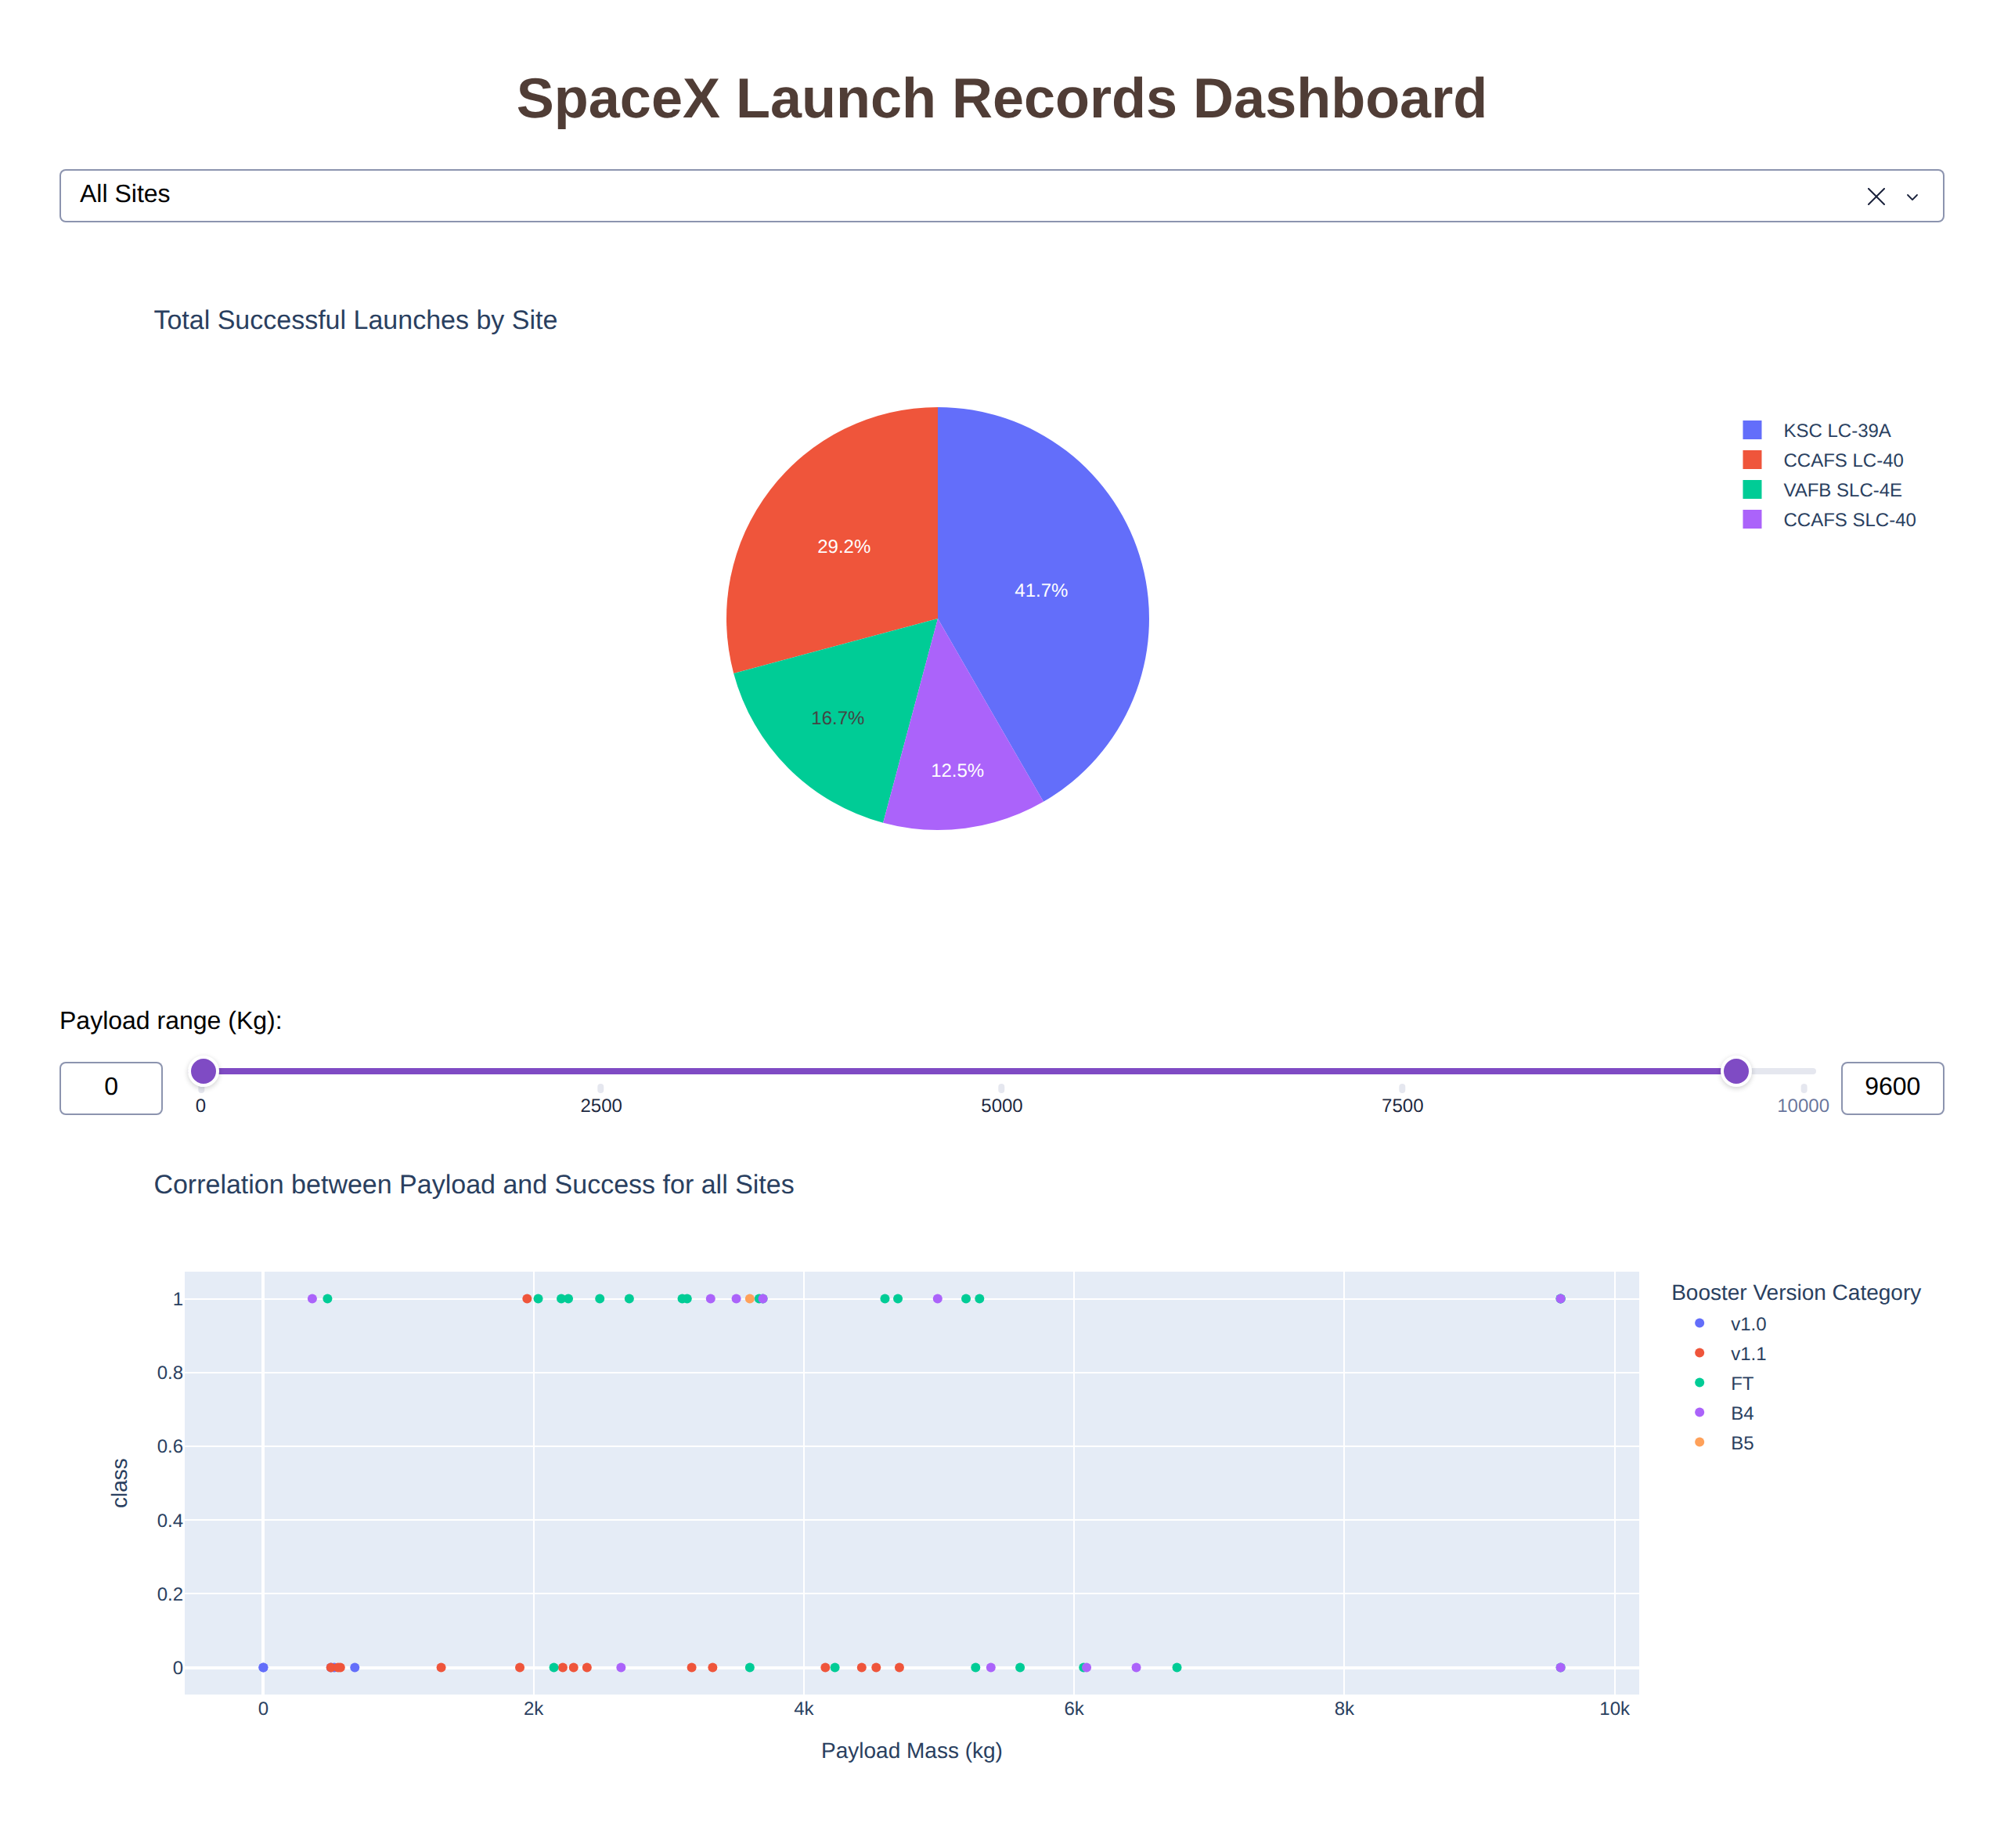
Dashboard Overview
Dropdown (site-dropdown): All Sites or one of the four launch sites.
Pie chart (success-pie-chart): all sites → share of successes per site; one site → success vs. failure.
Range slider (payload-slider): filters payload from 0 to 10,000 kg in 1,000 kg steps.
Scatter (success-payload-scatter-chart): payload vs. class, coloured by booster version; reacts to both the dropdown and the slider (two Inputs in one callback).
26

Slide 27
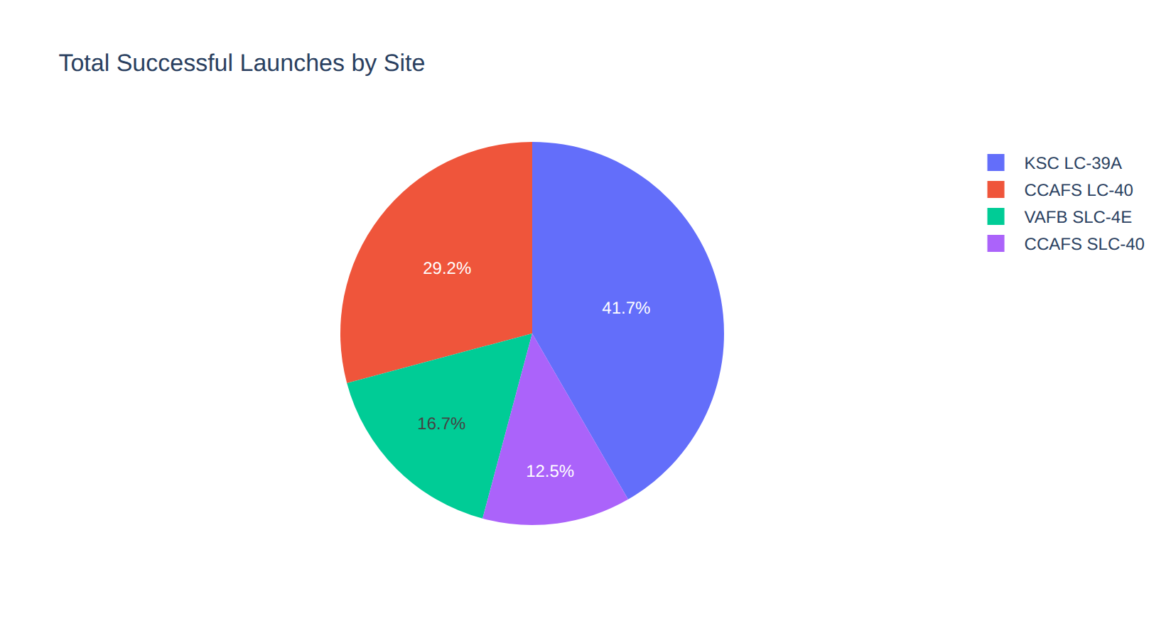
Dashboard — Successful Launches by Site
Dropdown = All Sites
FINDINGS
KSC LC-39A has the largest share of successful launches (41.7%), then CCAFS LC-40 (29.2%), VAFB SLC-4E (16.7%) and CCAFS SLC-40 (12.5%). Shares partly reflect how many missions each site flew.
27

Slide 28
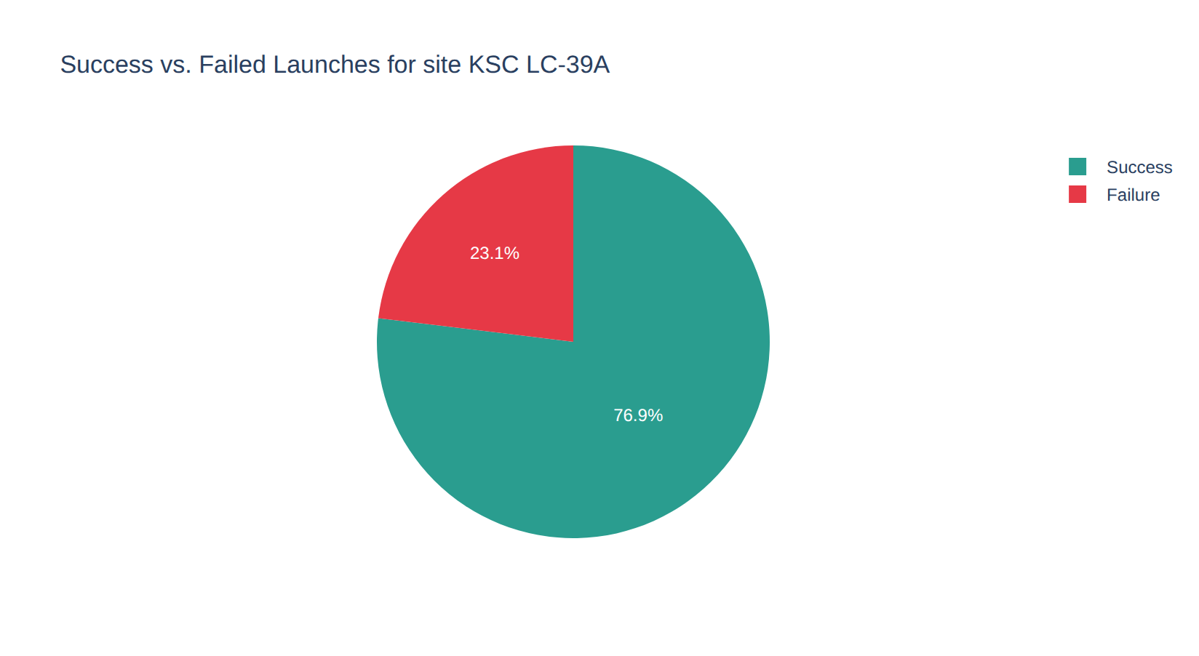
Dashboard — Site with the Highest Success Rate
Dropdown = KSC LC-39A
FINDINGS
KSC LC-39A landed 10 of 13 first stages: a 76.9% success rate, the best of any site (CCAFS LC-40 27%, CCAFS SLC-40 43%, VAFB SLC-4E 40%).
28

Slide 29
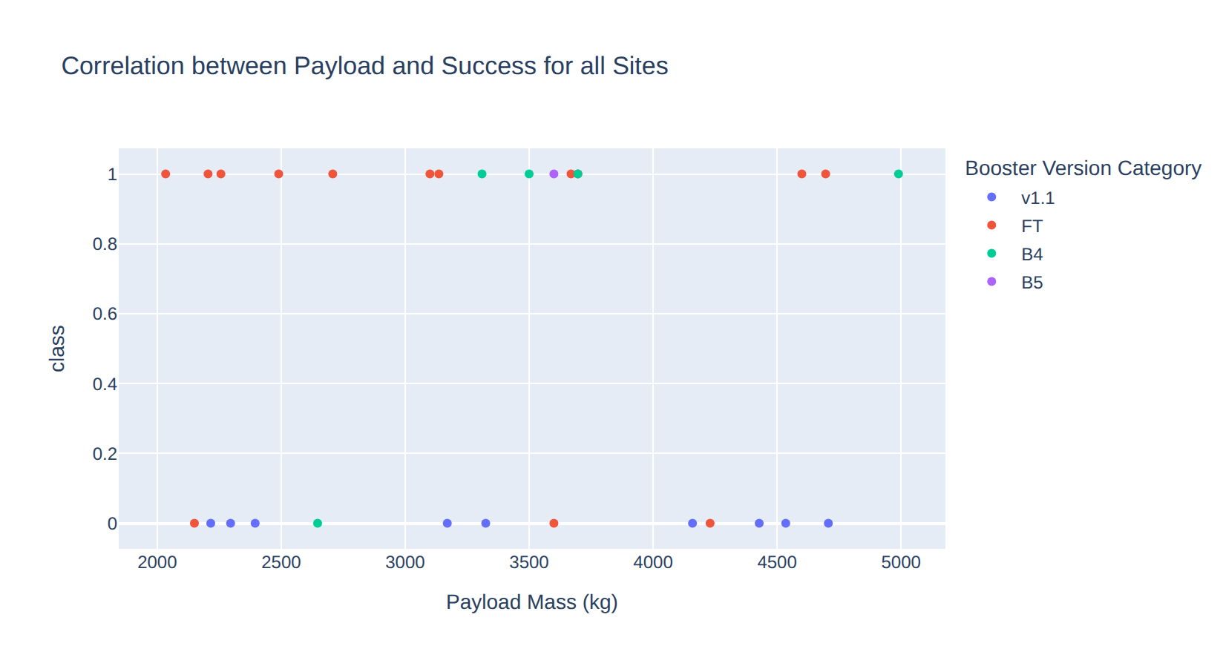
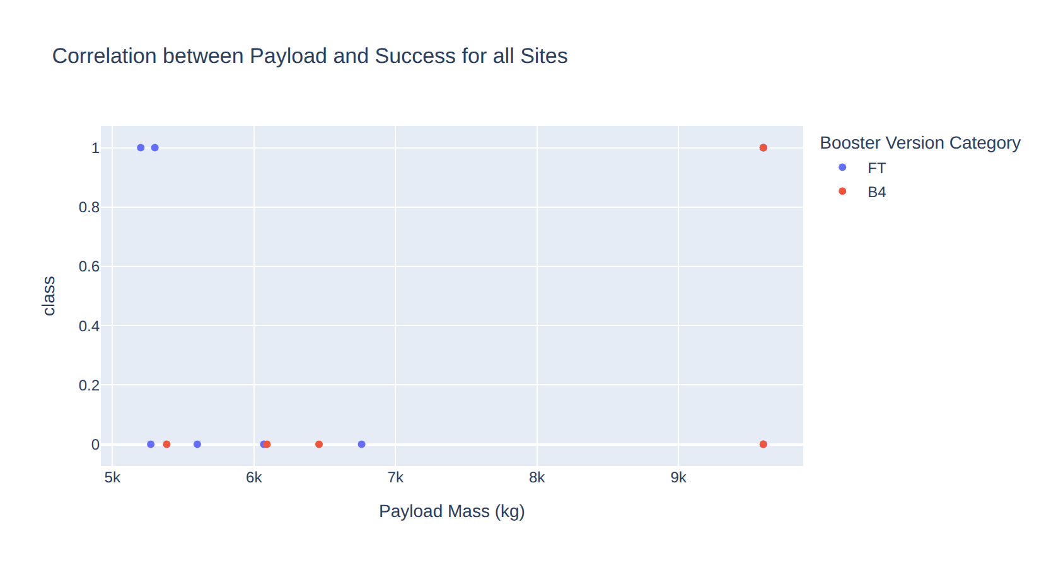
Dashboard — Payload vs. Launch Outcome
Same scatter, two slider settings (all sites)
Slider 2,000–5,000 kg: 16 of 29 landed (55%)
Slider 5,000–10,000 kg: 5 of 14 landed (36%)
Payload sweet spot: 2,000–5,000 kg has the most successes and the highest rate; below 2,000 kg only 23% landed (mostly early v1.0/v1.1 flights).
Booster matters most: FT boosters landed 16 of 24 (67%), B4 6 of 11; v1.1 landed only 1 of 15 and v1.0 none.
29

Slide 30
05
Predictive Analysis
Classification results
30

Slide 31
Classification Accuracy
GridSearchCV (cv=10) on 72 training launches, scored on 18 test launches
Model | CV | Test | Prec. | Recall | F1
Logistic Regression | 84.6% | 83.3% | 80% | 100% | 88.9%
SVM | 84.8% | 83.3% | 80% | 100% | 88.9%
Decision Tree | 84.8% | 83.3% | 80% | 100% | 88.9%
KNN | 84.8% | 83.3% | 80% | 100% | 88.9%
FINDINGS
On this split every model gets 15 of 18 right (83.3%), with 100% recall and 80% precision. SVM, decision tree and KNN share the top CV score (84.8%), so one split cannot separate them; see the robustness check on slide 33. Y-axis starts at 70%.
31

Slide 32
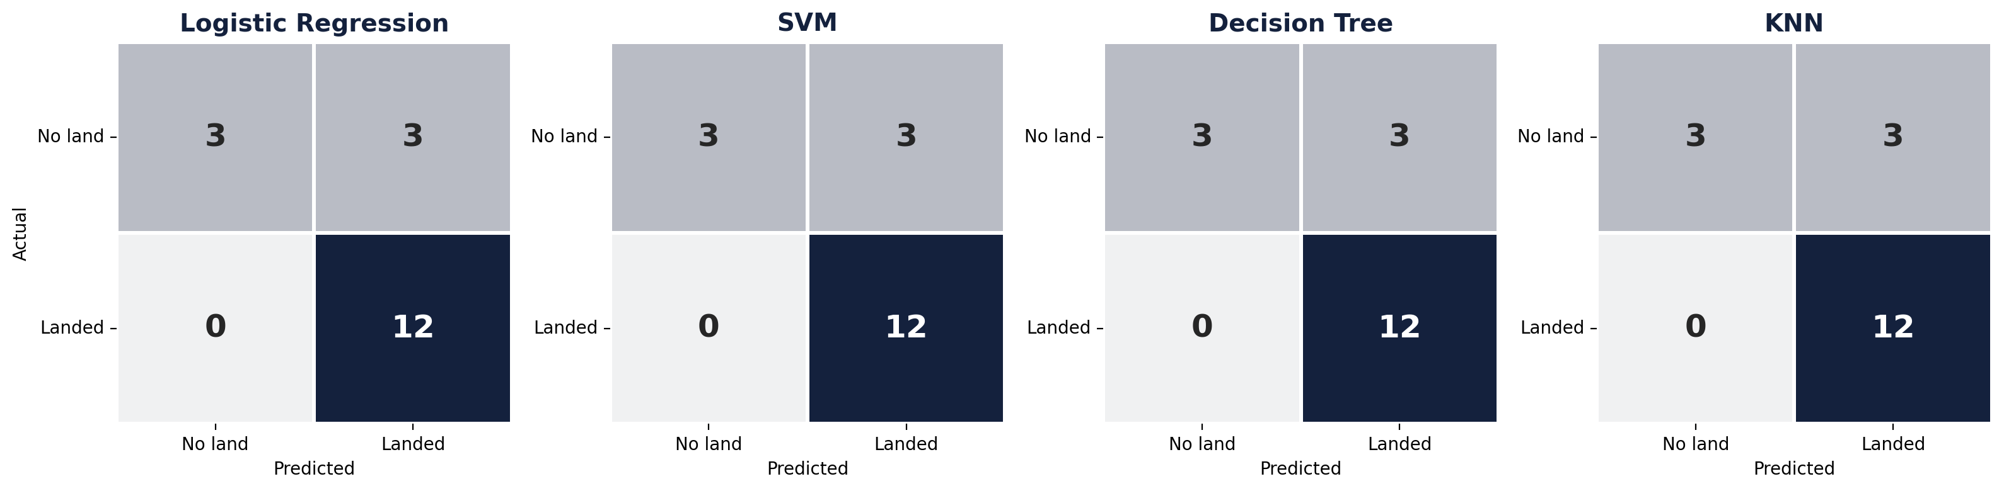
Confusion Matrices — All Four Models
FINDINGS
All four models produce the same matrix: 12 true positives, 3 true negatives, 3 false positives and 0 false negatives. Every landing was caught, but 3 of the 6 failed landings were predicted to land, so the models are over-optimistic about failures.
32

Slide 33
Which Model Is Best? — Robustness Check
50 different train/test splits (5-fold × 10 repeats) using each model's tuned hyperparameters
BEST MODEL: SVM
SVM (sigmoid kernel) is the most accurate and stable: 84.4% ± 8.0%, ahead of KNN (84.1%) and logistic regression (82.6%). The decision tree drops to 75.1%: its single-split tie was luck, and it overfits. All models clearly beat the 66.7% baseline.
33

Slide 34
Conclusions
1
Experience pays off
2
Site and orbit matter
Landing success rose from 0% before 2014 to 90% in 2019; flight number is the strongest single signal.
KSC LC-39A has the best record (76.9%). GTO is the hardest orbit (52%); SSO, GEO, HEO and ES-L1 landed every time.
3
Hardware and payload
4
SVM is the best model
v1.0/v1.1 boosters rarely landed; FT, B4 and B5 account for nearly all successes. 2,000–5,000 kg payloads land most often.
All models reach 83.3% on the test set; across 50 splits SVM is best (84.4%). Errors are false positives, so treat predicted landings with care.
34

Slide 35
Innovative Insights — Beyond the Template
What a competing bidder like Space Y should take away
Payload is not a penalty: the heaviest band (8,000 kg+) lands most often (87%), because heavy missions flew late on mature boosters. Era confounds payload.
Price a GTO bid higher: GTO missions land only about half the time, so SpaceX's true cost on those launches is closer to expendable pricing.
One split is not enough: four models tied at 83.3% on the 18-launch test set, but resampling 50 splits showed SVM best and the decision tree overfitting (75%).
Next step: add launch year and booster block as explicit features and retrain on post-2020 launches to test whether accuracy holds.
35

Slide 36
Appendix
GitHub repository: https://github.com/kautzarichramsyah/Applied-Data-Science-Capstone
Data sources: SpaceX REST API (IBM static snapshot API_call_spacex_api.json), Wikipedia "List of Falcon 9 and Falcon Heavy launches", IBM Spacex.csv and spacex_launch_dash.csv.
Best hyperparameters:
  Logistic regression: C=0.01, penalty=l2, solver=lbfgs
  SVM (best model): kernel=sigmoid, C=1, gamma=0.0316
  Decision tree: criterion=gini, max_depth=8, min_samples_leaf=4, splitter=random
  KNN: n_neighbors=10, p=1, algorithm=auto
Repository contents: notebooks for data collection (API), web scraping, data wrangling, EDA with SQL, EDA with visualization, Folium maps and machine learning prediction, plus spacex_dash_app.py.
36

