Slide 1
UIT2818 Project Work - Phase II
PROJECT PRESENTATION
FINAL REVIEW

Slide 2
INFANT CRY VOCALISATION

Slide 3
TEAM MEMBERS
KAVYASRI.V.J 3122 22 5002 056
KISHORE.P 3122 22 5002 060
MENTOR
Dr.R.Srinivasan,
Professor,
Department of Information Technology.

Slide 4
PROBLEM STATEMENT
Infants express their needs through crying, but interpreting the exact reason—whether it's hunger, pain, or discomfort—can be challenging and varies based on individual judgment.
This project proposes a deep learning–based solution that analyzes baby cry audio using signal processing techniques like Entropy features.
By classifying cries into emotional categories in real time, the system aims to provide accurate, objective support to caregivers and healthcare professionals, ultimately enhancing the quality of infant care.

Slide 5
LITERATURE SURVEY
TITLE | AUTHOR | YEAR | METHODOLOGY | SUMMARY
Deep Learning for Infant Cry Recognition | Yun-Chia Liang, Iven Wijaya, Ming-Tao Yang, Josue Rodolfo Cuevas Juarez, Hou-Tai Chang | 2022 | Used deep learning models (CNN, LSTM, and ANN) trained on MFCC features extracted from infant cry audio to classify different needs and health status. | CNN and LSTM models achieved high accuracy (~95%) in identifying infant health status and moderate accuracy (~60%) in recognizing specific needs from cry sounds.
Infant Cry Classification Using CNN–RNN | Tusty Nadia Maghfira, T. Basaruddin, Adila Krisnadhi | 2020 | A hybrid deep learning model combining Convolutional Neural Networks and Recurrent Neural Networks is used with 5-fold cross-validation on infant cry spectrograms. | The proposed CNN-RNN model achieved 94.97% accuracy in classifying five types of infant cries, outperforming previous methods.

Slide 6
A review of infant cry analysis and classification | Chunyan Ji, Thosini Bamunu Mudiyanselage, Yutong Gao, Yi Pan | 2021 | A comprehensive survey of infant cry classification techniques using machine learning and neural networks, including preprocessing, feature extraction (MFCC, spectrogram, prosodic features), and various classifiers (SVM, CNN, RNN). | This review discusses state-of-the-art approaches for infant cry analysis, highlighting the importance of cry-based health diagnostics and the need for large, labeled datasets for accurate classification.
Deep Learning Assisted Neonatal Cry Classification via Support Vector Machine Models | Ashwini K, P. M. Durai Raj Vincent, Kathiravan Srinivasan, Chuan-Yu Chang | 2021 | STFT-based spectrograms are input to a CNN for feature extraction, followed by SVM (RBF/linear/polynomial) for classifying infant cries. | CNN-SVM (RBF) achieved 88.89% accuracy, outperforming other methods for classifying limited neonatal cry data.
An Efficient Classification of Neonates Cry Signal using Computer Assisted Grouped Support Vector Network | R. V. Ranjitha, S. P. Jeba Sadhana | 2021 | Used grouped Support Vector Machine (SVM) with feature extraction from cry signals to classify neonatal distress. | Proposed system classifies infant cries into pain, hunger, and wet-diaper categories with improved accuracy using grouped SVM.

Slide 7
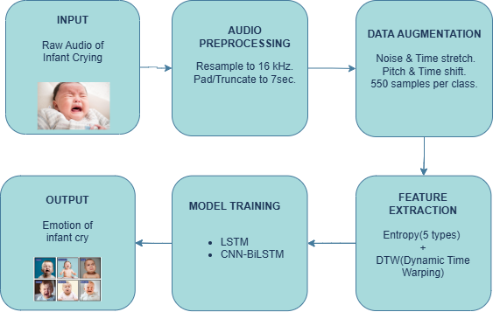
WORKFLOW

Slide 8

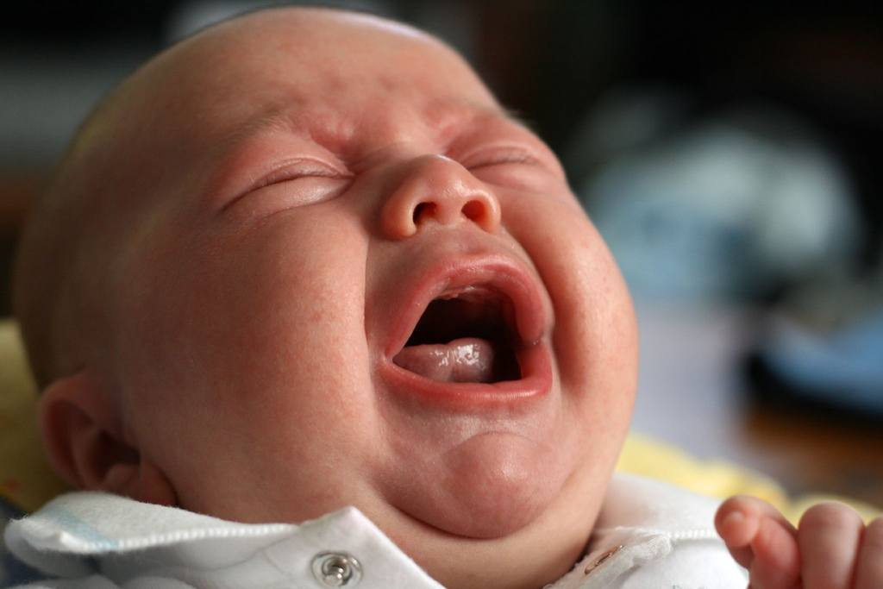
DATASET DESCRIPTION
Source: Kaggle – Baby Crying Sounds Dataset
Overview:
A labeled dataset containing real infant cry recordings categorized into emotional physical needs
Supports training of classification models for infant vocal emotion recognition
Details:
Participants: Collected from multiple infants
No. of Samples: 996 audio files
Emotion Categories: 6 distinct cry reasons (belly pain,burping,cold_hot,discomfort,hungry,tired)
Audio Format: WAV
Average Duration: ~5–8 seconds per clip
Annotations: Each file is labeled with the corresponding emotion class
Noise Handling: Some recordings may include environmental background noise

Slide 9
DATA AUGMENTATION
Time Stretching – Alters playback speed without changing pitch. → Helps model adapt to variations in crying pace.
Pitch Shifting – Raises or lowers the pitch of the cry. → Simulates vocal variations among different infants.
Background Noise Addition – Adds mild environmental noise. → Improves robustness in real-world hospital or home settings.
Time Shifting – Shifts audio slightly forward or backward in time. → Ensures model invariance to temporal misalignment.

Slide 10
FEATURE EXTRACTION
Spectral Entropy – Measures frame-wise randomness of the power spectrum to capture cry signal complexity.
Delta Entropy – Computes temporal change in spectral entropy to model dynamic cry transitions.
Shannon Entropy – Global entropy of the entire cry signal representing overall uncertainty.
Multi-Scale Entropy (MSE) – Extracts entropy at multiple temporal scales to capture short- and long-term complexity.
Band-Wise Spectral Entropy – Computes entropy across frequency sub-bands to encode frequency-specific energy distribution.
Dynamic Time Warping (DTW) – Measures temporal similarity between entropy sequences and class prototypes to handle time misalignment.

Slide 11
EXPERIMENTATION RESULTS
Feature Type | Classifier | Train Acc. | Train Loss | Val Acc. | Val Loss | Test Acc. | Test Loss
Entropy | LSTM | 80.04% | 0.4909 | 81.06% | 0.4843 | 79.70% | 0.5052
DTW | LSTM | 43.56% | 1.2046 | 42.12% | 1.1872 | 47.27% | 1.1568
Entropy and DTW | LSTM | 75.83% | 0.6926 | 73.46% | 0.4945 | 74.53% | 0.4885
Entropy | CNN-LSTM | 77.77% | 0.6020 | 60.46% | 1.4671 | 72.12% | 0.8209
Entropy | CNN-BiLSTM | 66.25% | 1.1655 | 40.08% | 1.3458 | 59.70% | 1.2503
Entropy and DTW | CNN-BiLSTM | 86.21% | 0.7117 | 55.67% | 0.8578 | 77.88% | 0.9067
DTW | MLP | 21.21% | 1.7717- | 16.29% | 1.7929- | 20.76% | 1.7731-
DTW | MLP | 23.75% | 1.7421 | 19.70% | 1.7793 | 20.61% | 1.7686
Entropy | MLP | 39.28% | 1.5002 | 29.39% | 1.6490 | 30.61% | 1.6150
DTW | CNN-BiLSTM | 21.02% | 1.7722 | 23.03% | 1.7691 | 18.18% | 1.7748
Multi-template DTW | CNN-BiLSTM | 24.32% | 1.7457 | 21.36% | 1.7742 | 25.45% | 1.7522

Slide 12
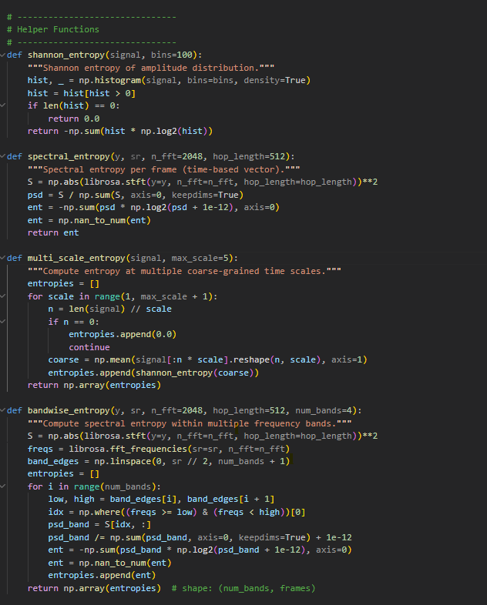
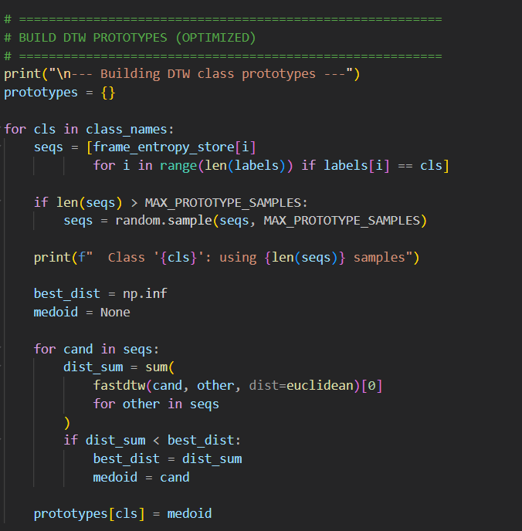
CODE SNIPPETS - FEATURE EXTRACTION

Slide 13
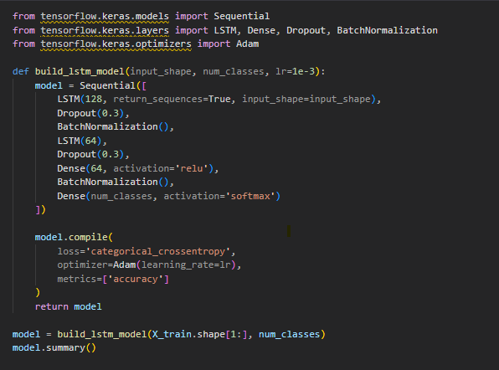
CODE SNIPPETS - LSTM MODEL ARCH.

Slide 14
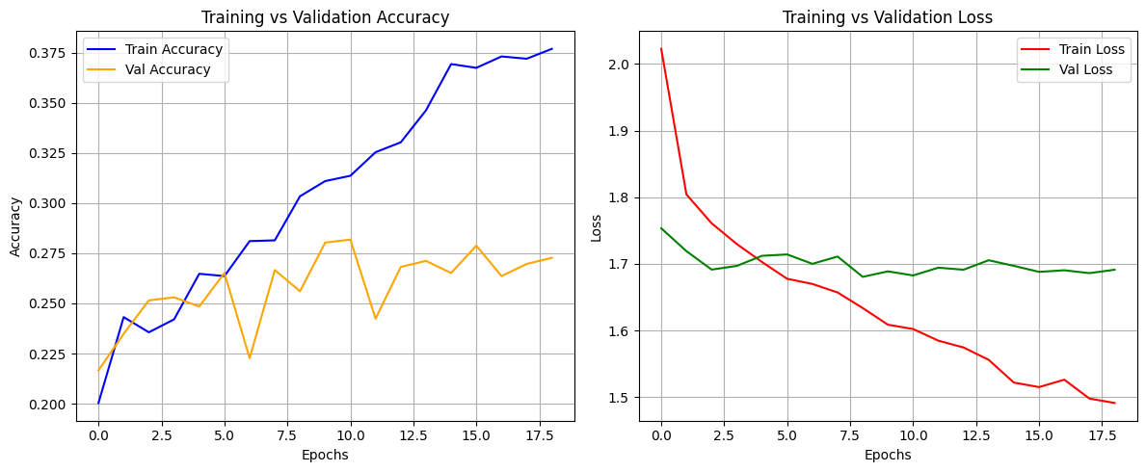
RESULTS

Slide 15
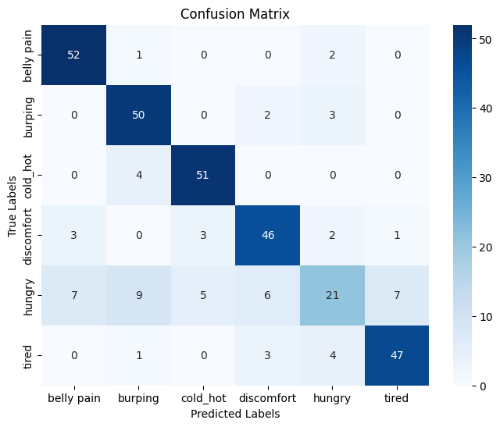
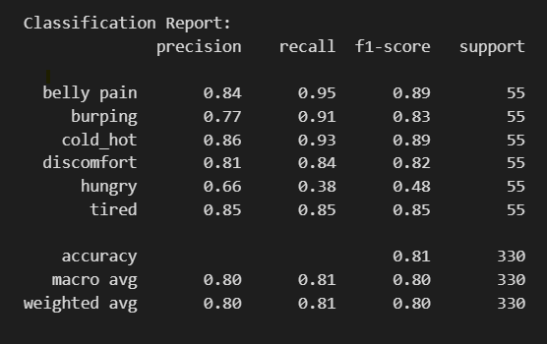
RESULTS

Slide 16
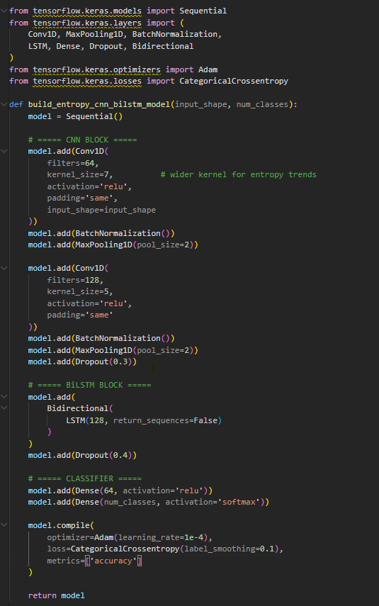
CODE SNIPPETS - CNN-BiLSTM MODEL ARCH.

Slide 17
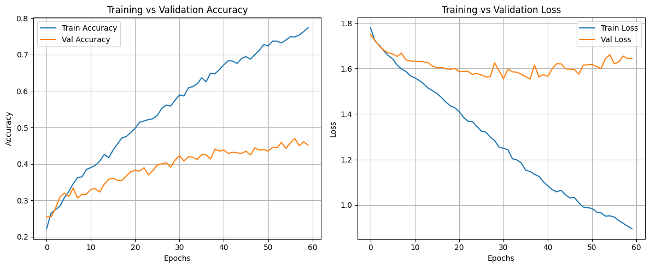
RESULTS

Slide 18
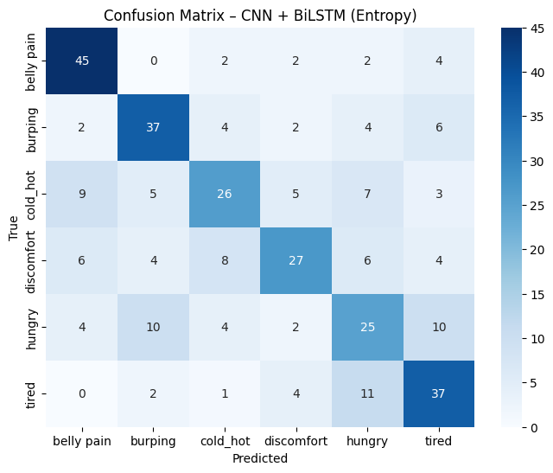
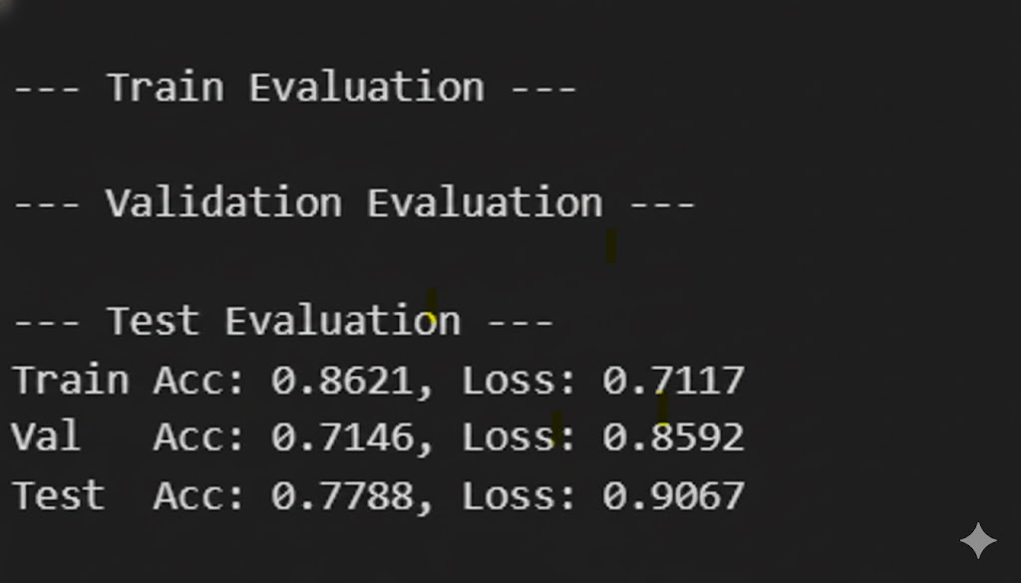
RESULTS

Slide 19
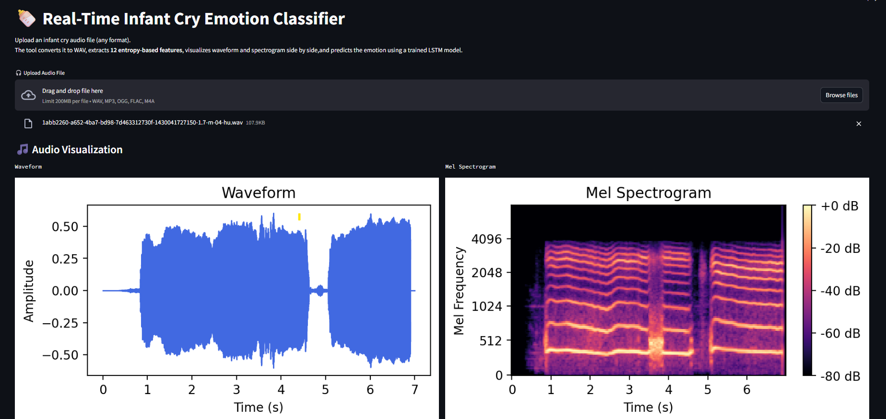
FRONTEND

Slide 20
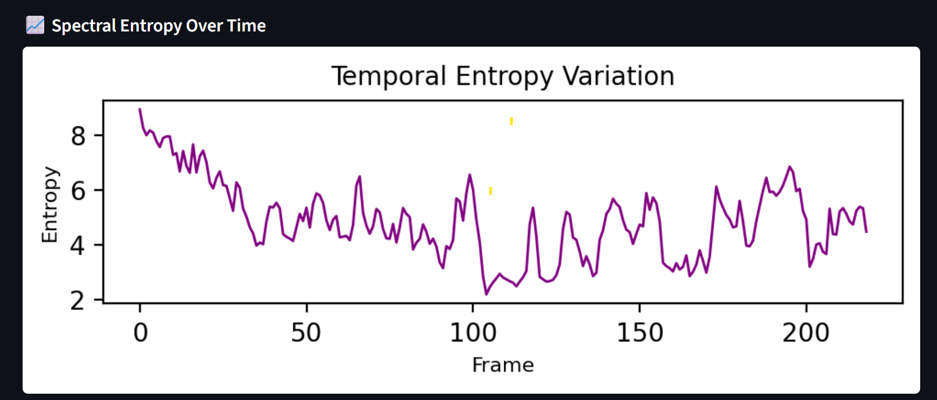
FRONTEND

Slide 21
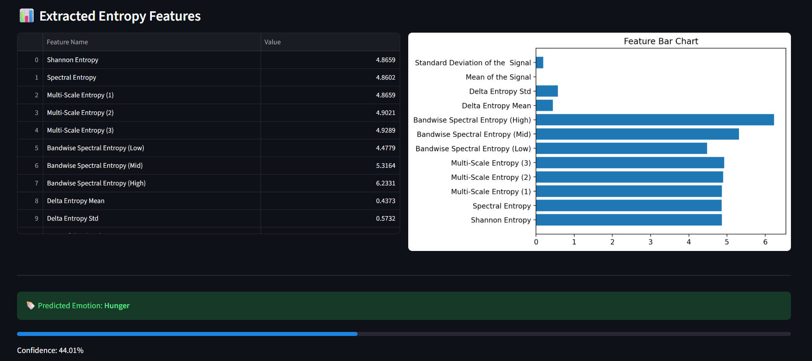
FRONTEND

Slide 22
CHALLENGES
Infant cry patterns show high variability, making consistent classification difficult.
Single feature approaches fail to capture the complete characteristics of cry signals.
Variations in audio quality, length, and noise introduce preprocessing challenges.
Model performance varies across architectures, affecting generalization and reliability.

Slide 23
CONFERENCE/JOURNAL PUBLICATION
Conference:
14th International Conference on Computing, Engineering and Technology (ICCET 2026) dated March 22–23, 2026 in Prince Shri Venkateshwara Padmavathy Engineering College, Chennai Collaborating with Samarkand State University, Uzbekistan
Selected Publication:
IEEE Xplore Digital Library
Paper Title:
Infant Cry Classification Using Entropy and Dynamic Time Warping Features with Machine Learning and Deep Learning Models
Status: Completed the online presentation in conference and applied for journal
Availability After Publication: The paper will be available online through the IEEE Xplore Digital Library, where it can be accessed and cited by researchers globally.

Slide 24
REFERENCES
] N. Maghfira, T. Basaruddin, and A. Krisnadhi, “Infant Cry Classification Using CNN–RNN,” Journal of Physics: Conference Series, vol. 1528, p. 012019, 2020. doi: 10.1088/1742-6596/1528/1/012019.
[2] C. Ji, T. B. Mudiyanselage, Y. Gao, and Y. Pan, “A Review of Infant Cry Analysis and Classification,” EURASIP Journal on Audio, Speech, and Music Processing, vol. 2021, no. 8, pp. 1–17, 2021. doi: 10.1186/s13636-021-00197-5.
[3] A. K. Ashwini, P. M. D. R. Vincent, K. Srinivasan, and C.-Y. Chang, “Deep Learning Assisted Neonatal Cry Classification via Support Vector Machine Models,” Frontiers in Public Health, vol. 9, article 670352, 2021. doi: 10.3389/fpubh.2021.670352.
[4] S. Kavitha, P. M. D. R. Vincent, and K. Srinivasan, “An Efficient Classification of Neonates Cry Signal Using Deep Learning Assisted Grouped Support Vector Network,” Frontiers in Public Health, vol. 9, article 670352, 2021. doi: 10.3389/fpubh.2021.670352.

Slide 25
Thank You!

