Slide 1


Project Title - SEASONAL AGRICULTURE PERFORMANCE ANALYSIS
Kavya B Raj
Kristu Jayanti College
AICTE STU ID : STU67729217aee921735561751
9/2/2026
Annual Review
‹#›

Slide 2

PROBLEM STATEMENT
  Performance of agriculture is subject to variation from season to season depending on different environmental and agricultural factors such as weather and availability of resources among others. The unprocessed data on agricultural productivity does not bring out these trends and factors. In this study, agricultural data will be analyzed to find patterns and variation in performance of agriculture from Kharif, Rabi and Zaid seasons.
9/2/2026
Annual Review
‹#›

Slide 3
PROJECT DESCRIPTION
  Analysis of 4,000 agricultural records
  Dataset containing 28 agricultural variables
  Comparison of Kharif, Rabi and Zaid
  Analysis of yield, production, profit and resource usage
  Investigation of environmental and farming factors
  Statistical and visualization-based analysis
  Development of data-driven insights and recommendations
9/2/2026
Annual Review
‹#›

Slide 4

WHO ARE THE END USERS?
  Farmers
For understanding seasonal and farming-performance patterns.
  Agricultural Departments
For evidence-based agricultural planning.
  Agricultural Researchers
For identifying relationships between farming and environmental variables.
  Agribusiness Stakeholders
For understanding production and profitability patterns.
  Data Analysts
For agricultural performance analysis.
9/2/2026
Annual Review
‹#›

Slide 5
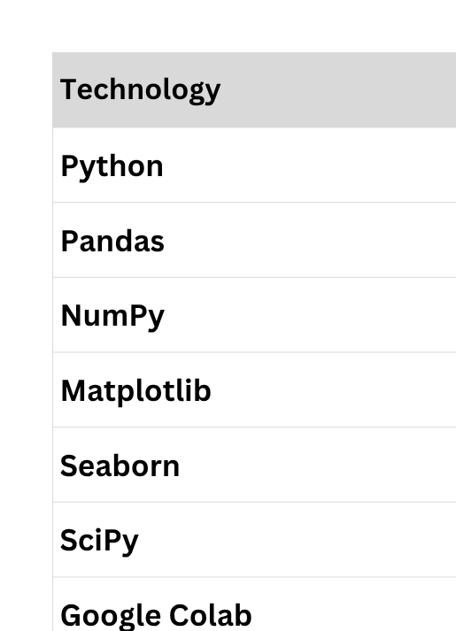

Technology Used
9/2/2026
Annual Review
‹#›
Notes:
5

Slide 6
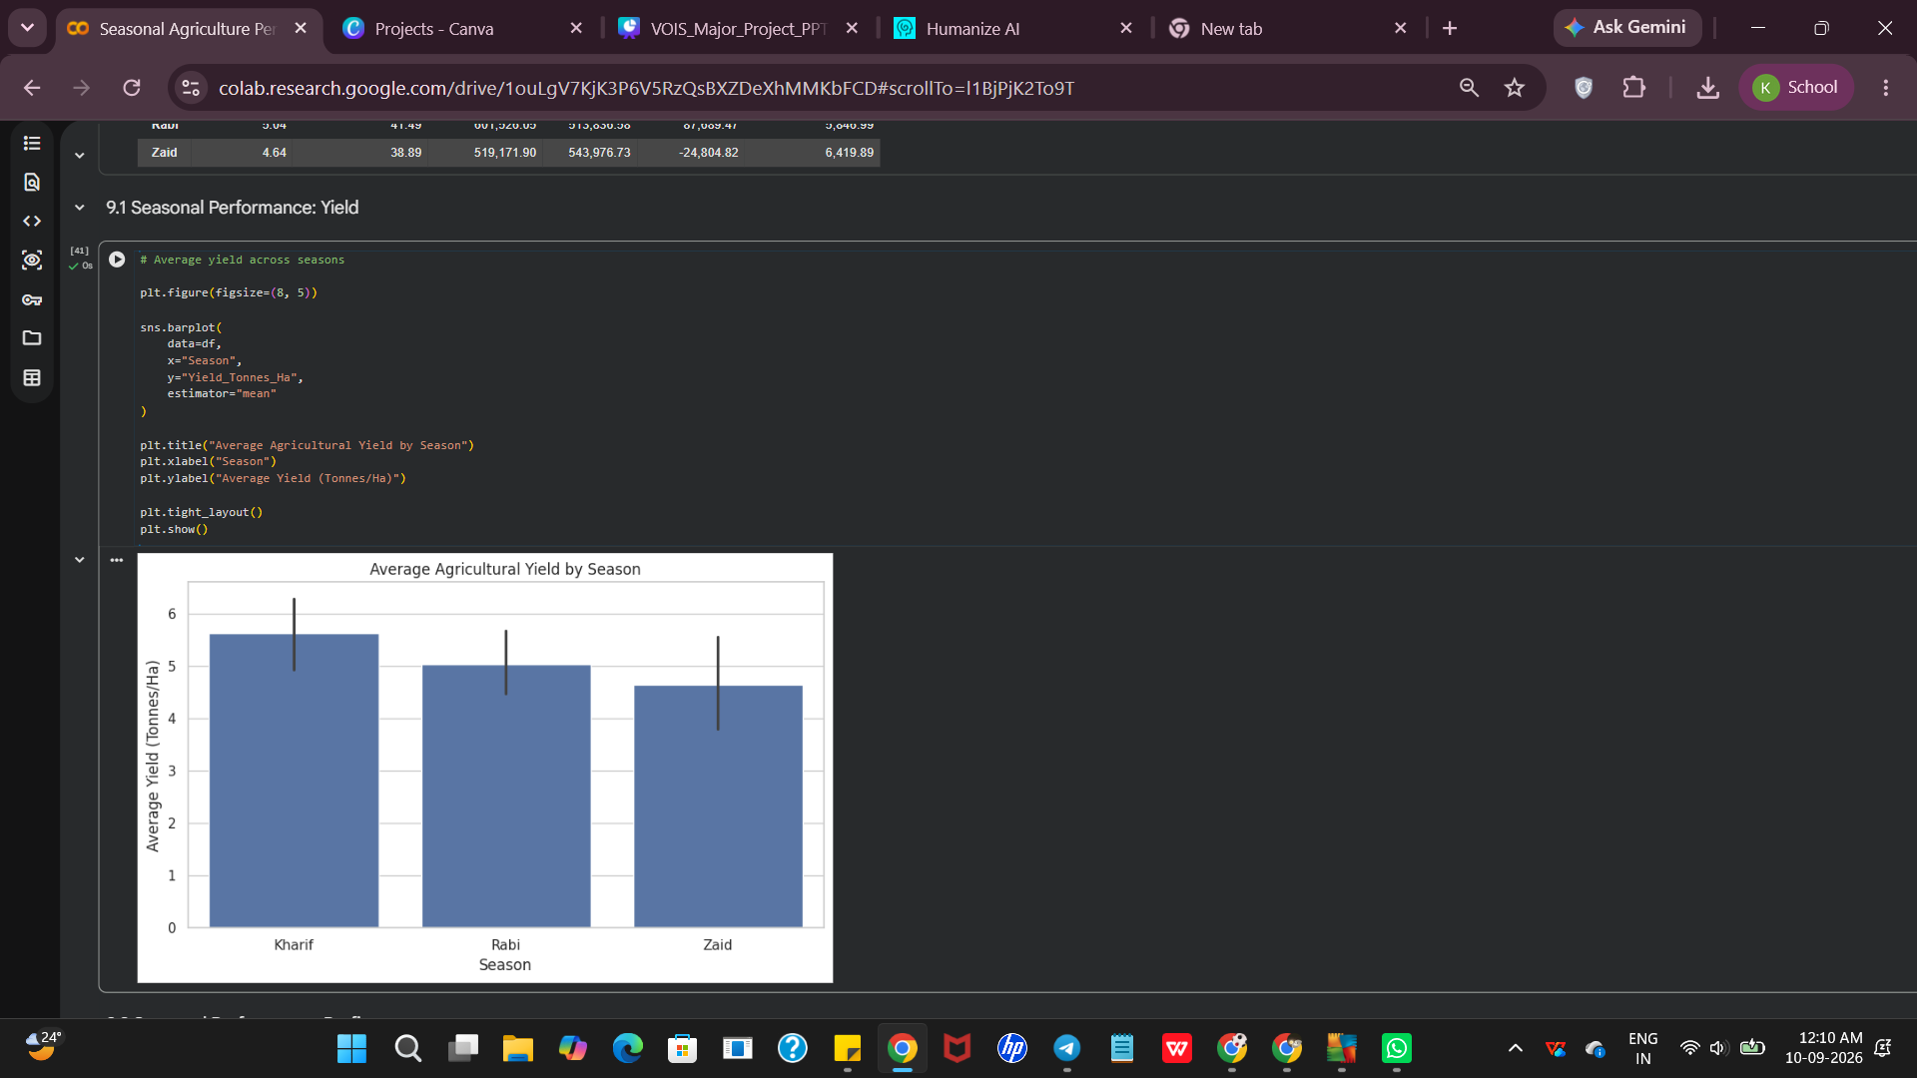
RESULTS
RESULT 1 — Seasonal Yield
Kharif: 5.63 tonnes/ha
Rabi: 5.04 tonnes/ha
Zaid: 4.64 tonnes/ha
Finding: Kharif recorded the highest average yield, while Zaid recorded the lowest.
9/2/2026
Annual Review
‹#›

Slide 7
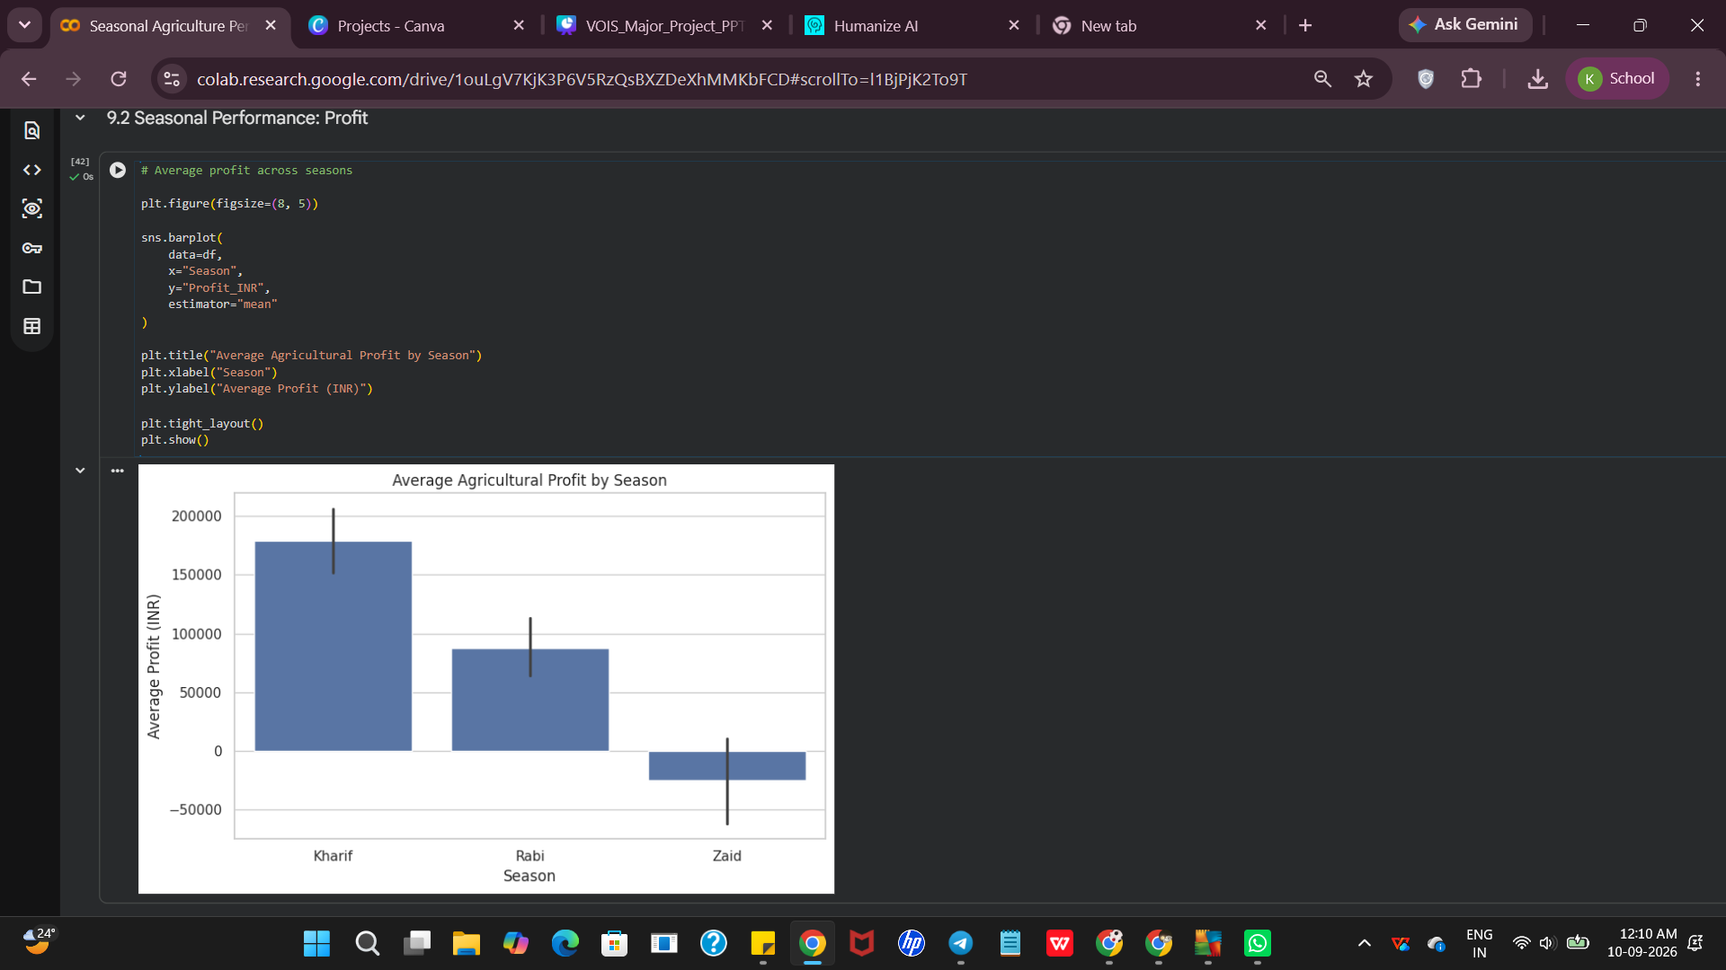
RESULTS
RESULT 2 — Seasonal Profit
Kharif — ₹178,914.65
Rabi — ₹87,689.47
Zaid — −₹24,804.82
Finding: Kharif showed the highest average profit, while Zaid showed negative average profitability.
9/2/2026
Annual Review
‹#›

Slide 8
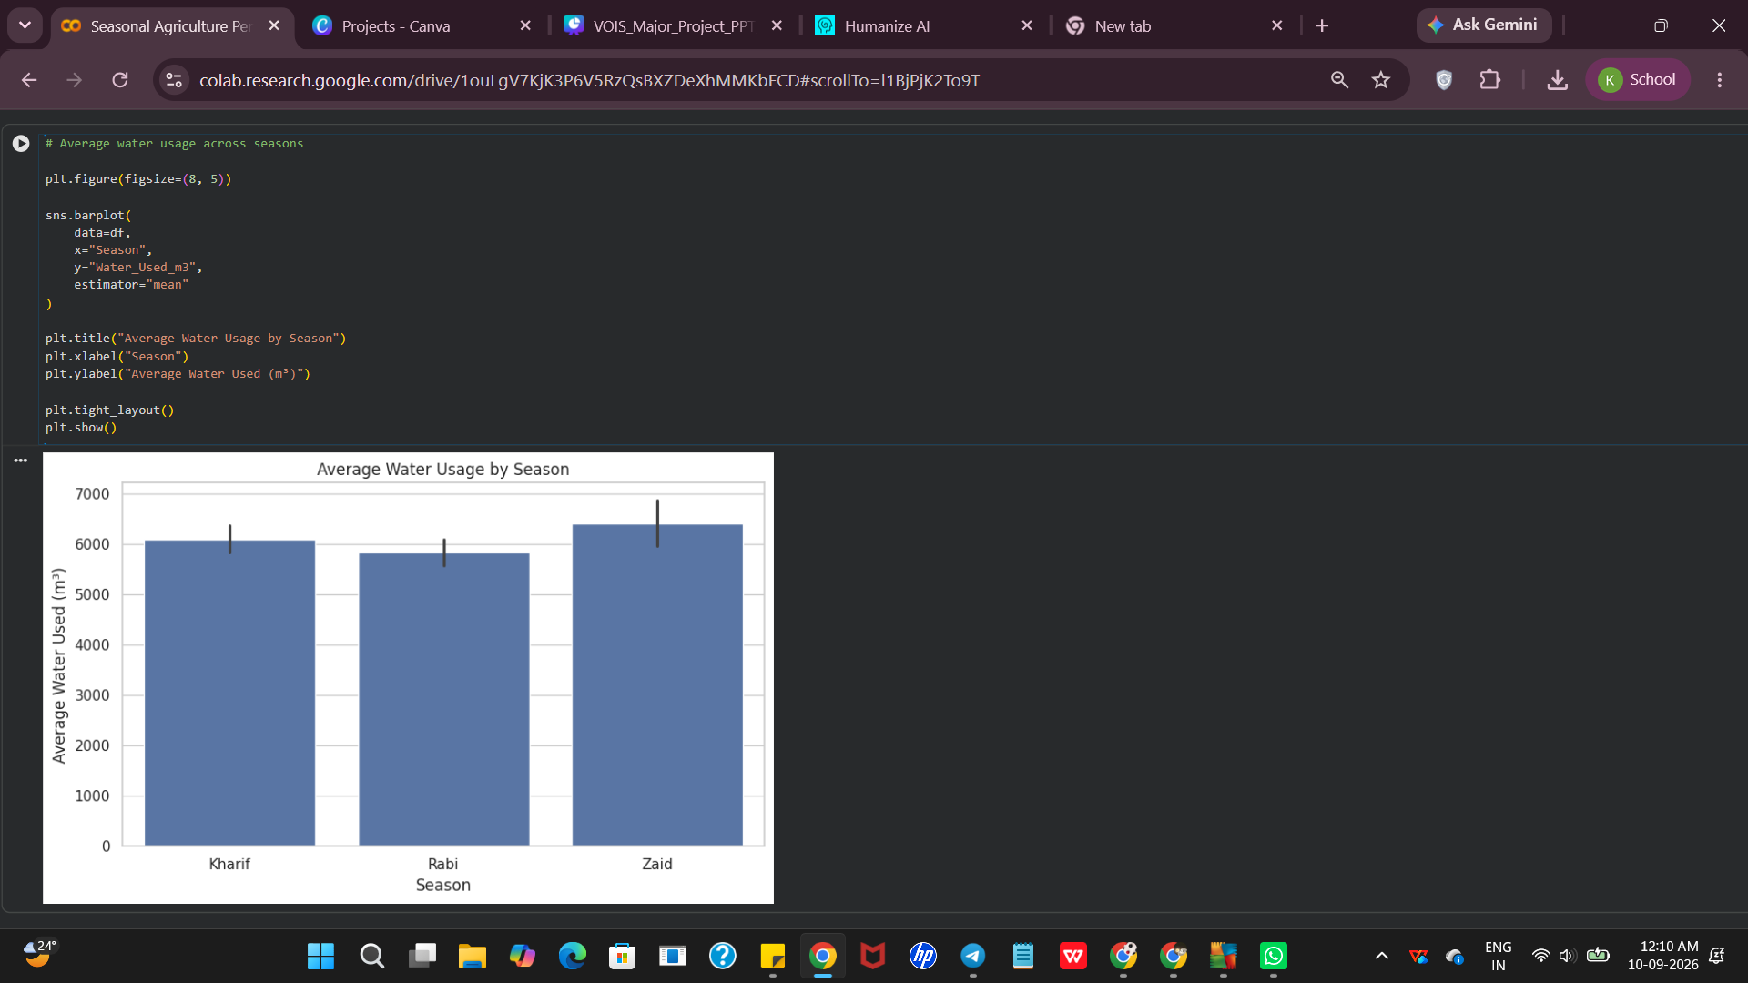
RESULTS
RESULT 3 — Water Usage
Kharif — 6,102.20 m³
Rabi — 5,846.99 m³
Zaid — 6,419.89 m³
Finding: Zaid had the highest average water usage despite having the lowest average yield.
9/2/2026
Annual Review
‹#›

Slide 9
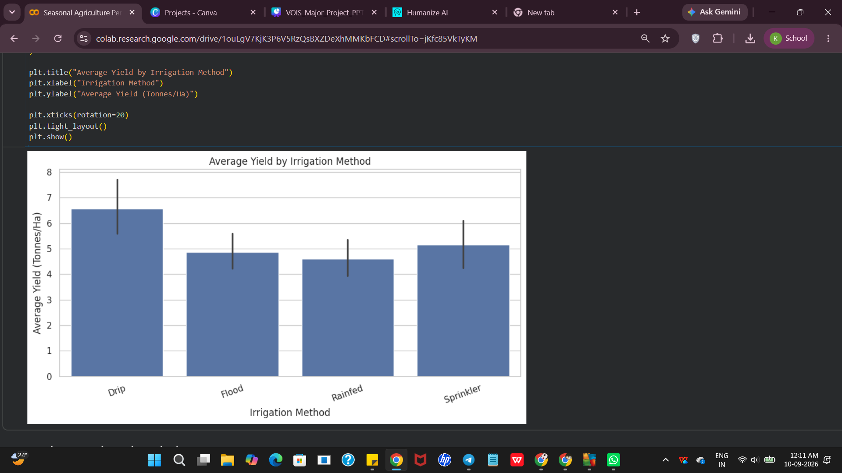
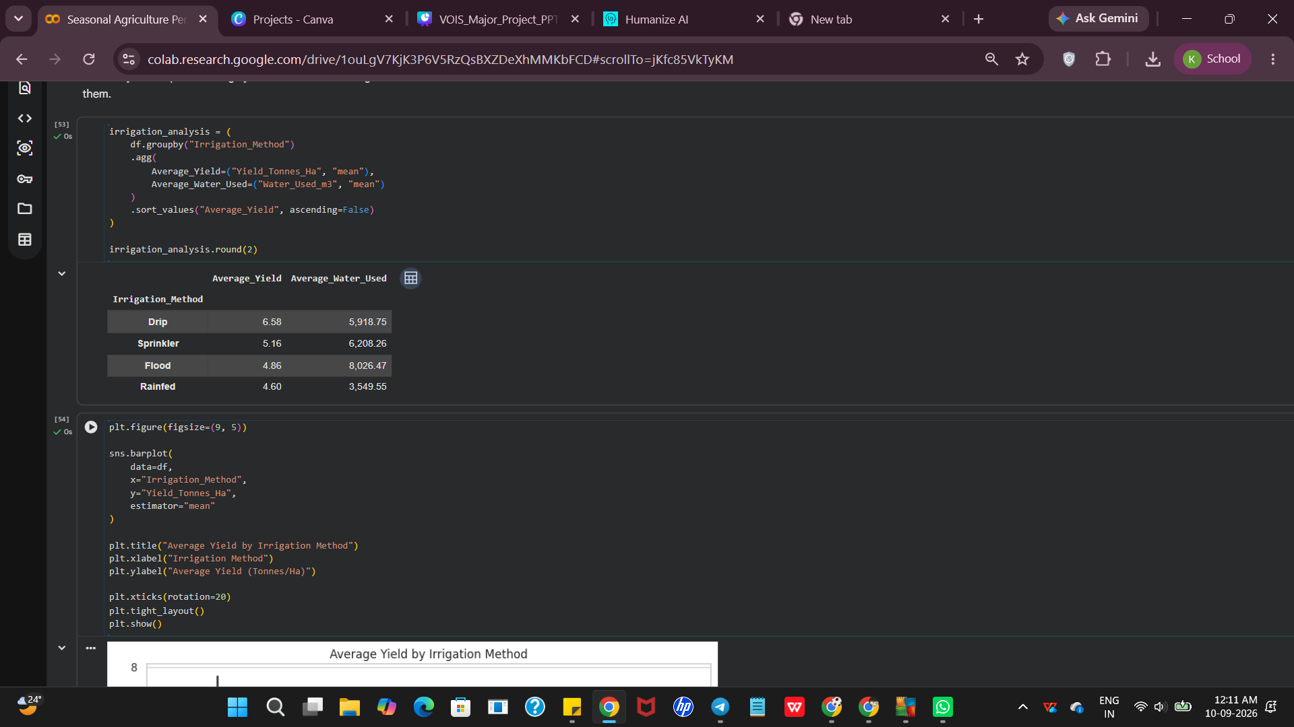
RESULTS
RESULT 4 — Irrigation
Drip irrigation recorded the highest average yield, while rainfed farming recorded the lowest.
9/2/2026
Annual Review
‹#›

Slide 10
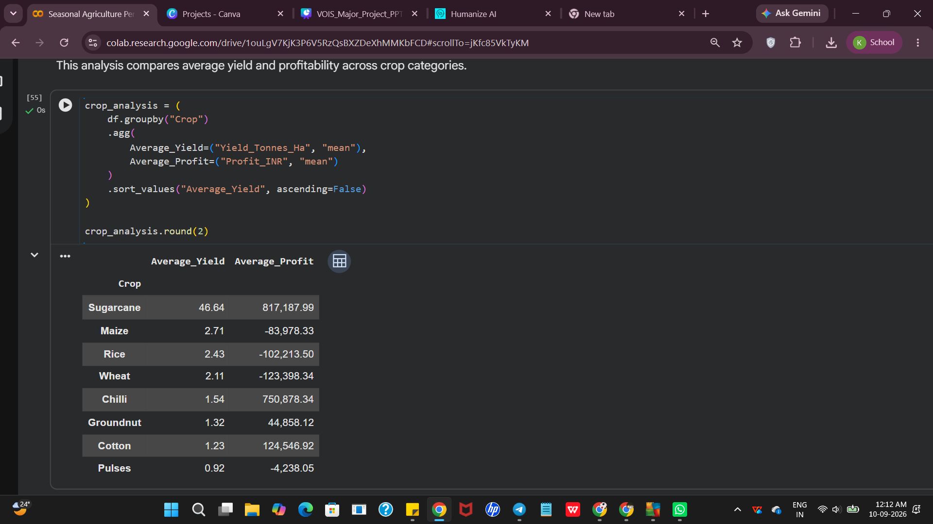
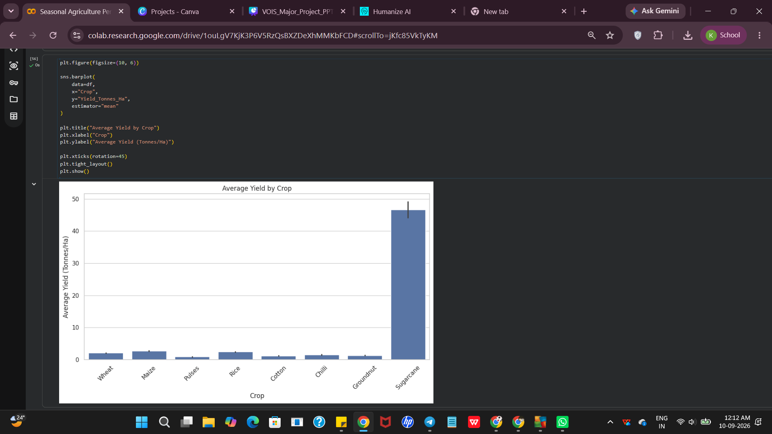
RESULTS
RESULT 5 — Crop Performance
Sugarcane recorded the highest average yield among the crops analyzed.
9/2/2026
Annual Review
‹#›

Slide 11
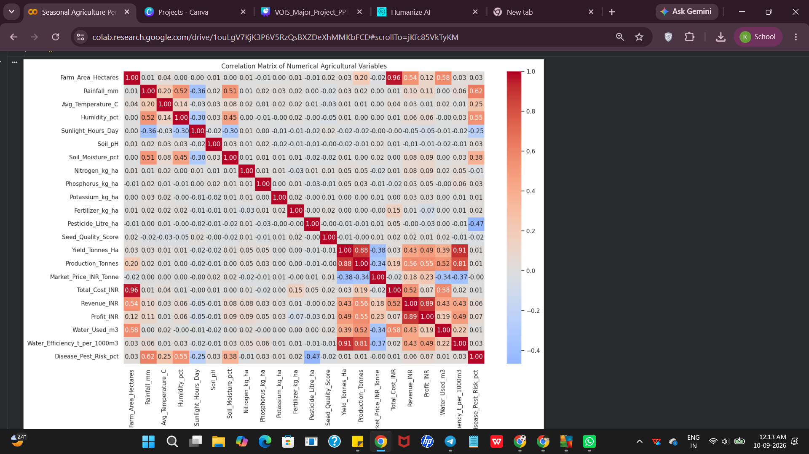
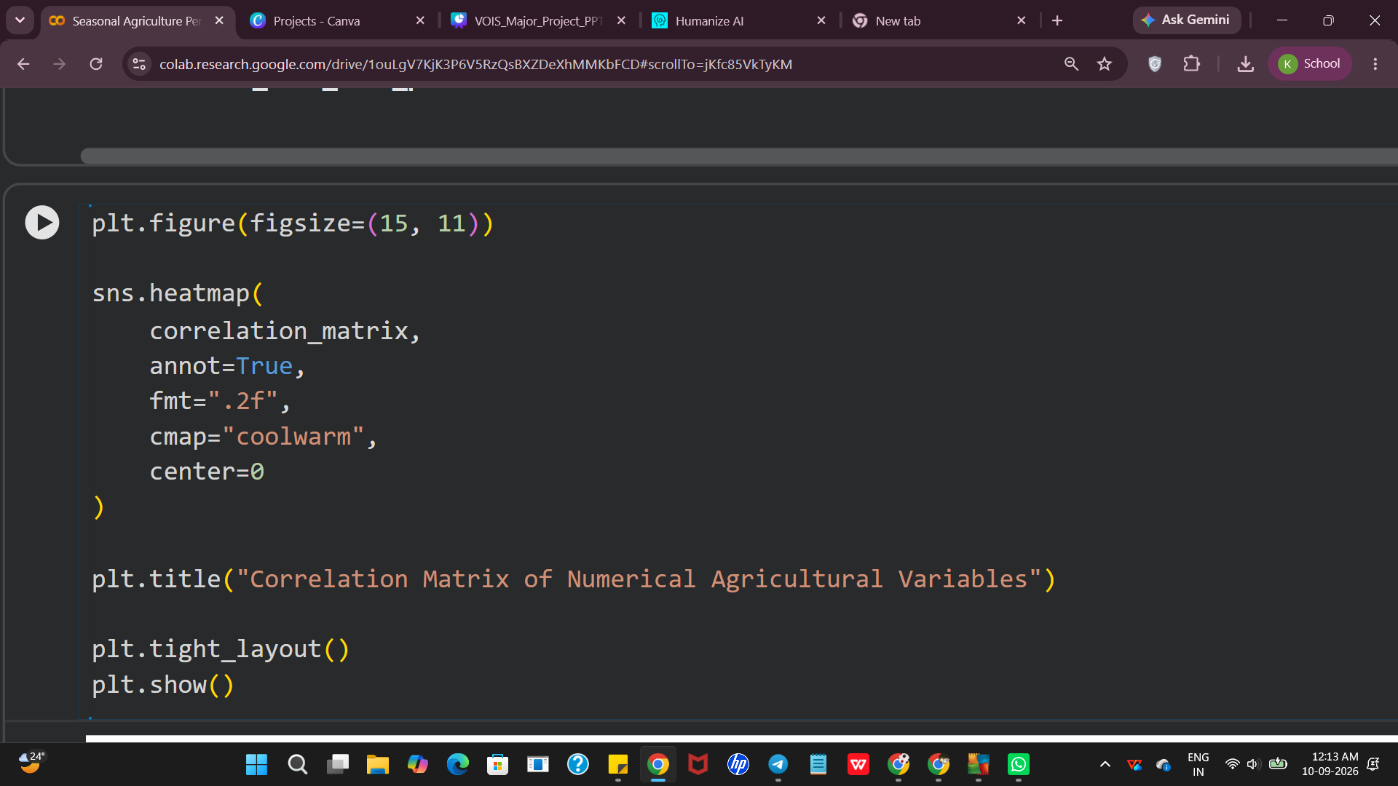
RESULTS
RESULT 6 — Correlation
9/2/2026
Annual Review
‹#›
Water efficiency showed the strongest positive association with yield (r = 0.91).

Slide 12
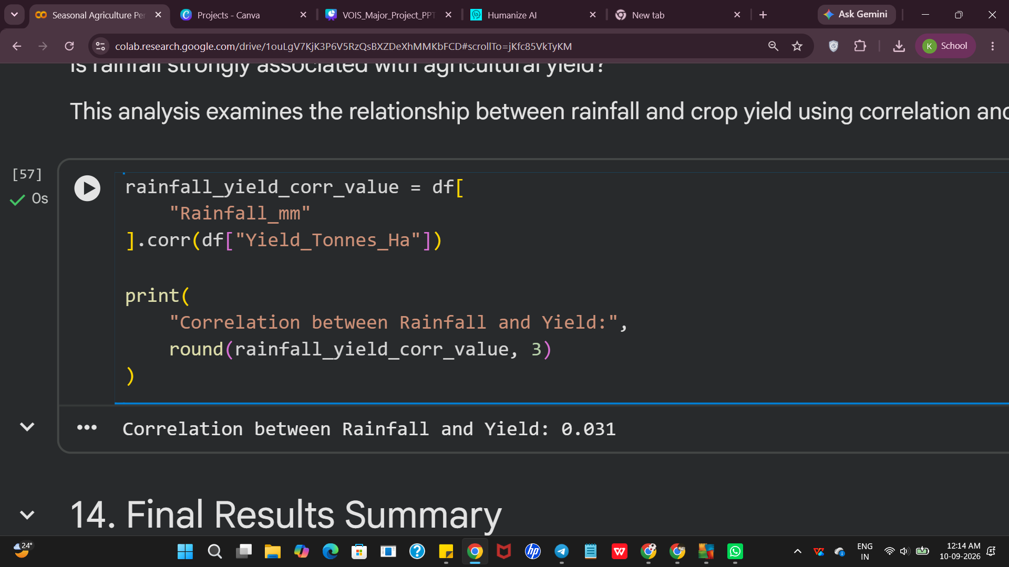
RESULTS
RESULT 7 — Rainfall vs Yield
Rainfall showed a very weak positive linear association with crop yield (r = 0.031).
9/2/2026
Annual Review
‹#›

Slide 13
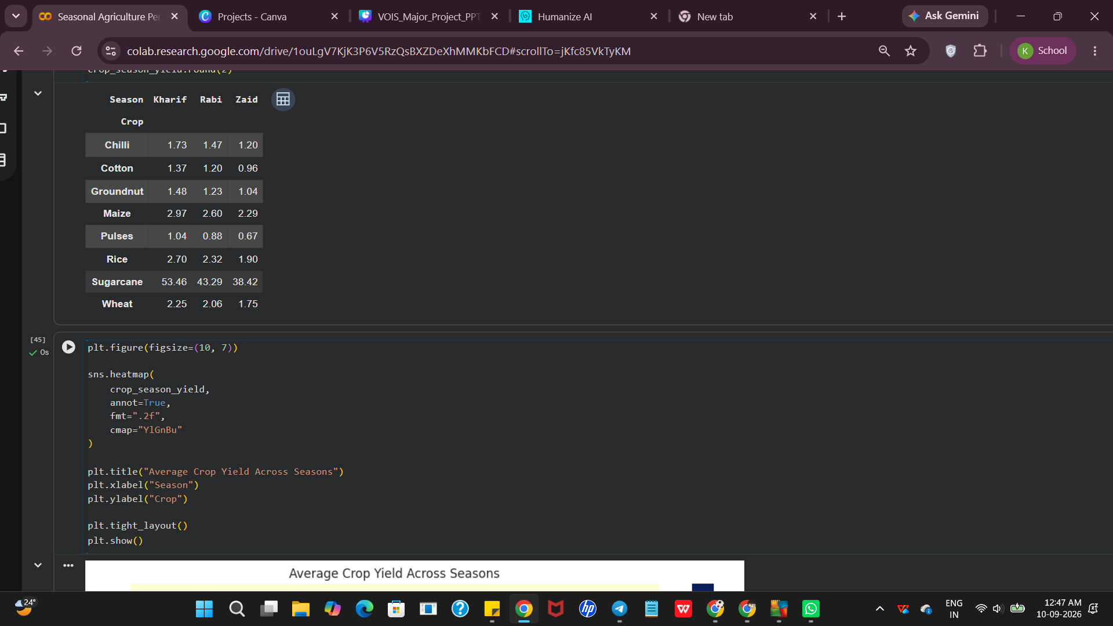
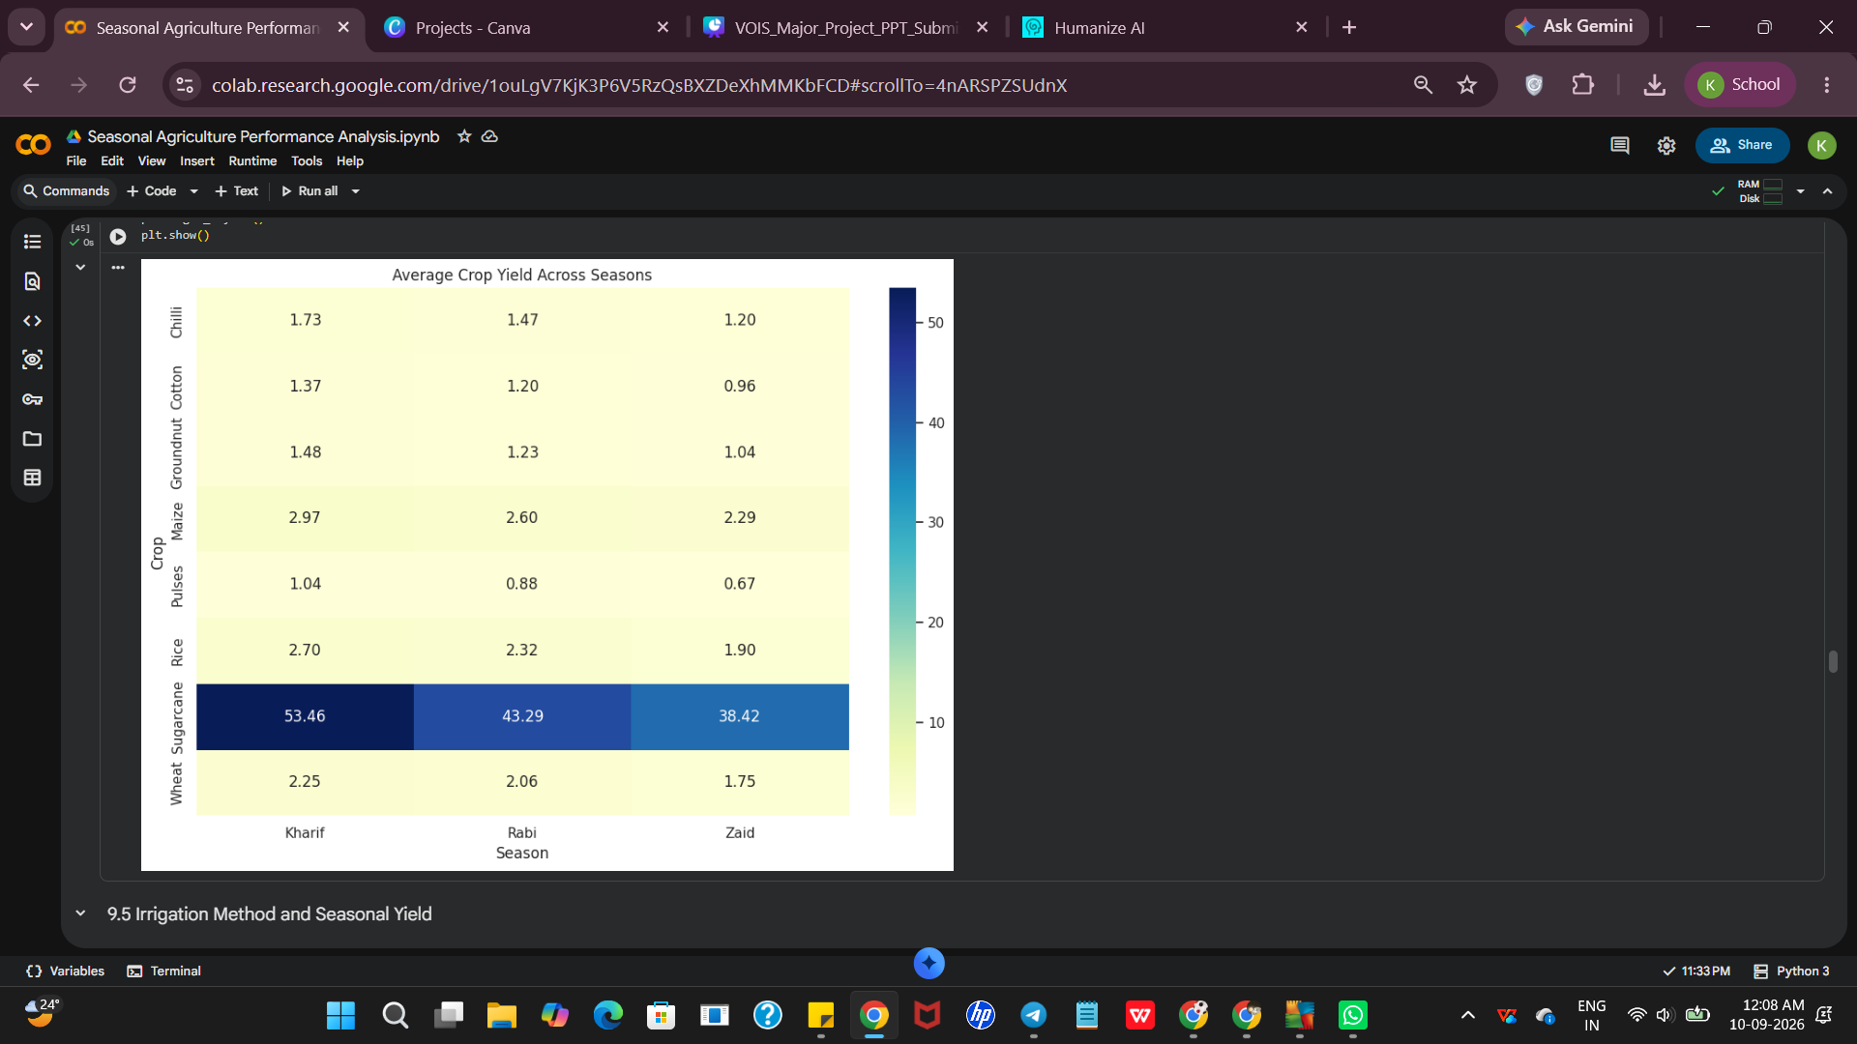
RESULTS
RESULT 8 — Multivariate Analysis
Crop yield varies across both crop type and season, allowing crop-season combinations to be compared simultaneously.
9/2/2026
Annual Review
‹#›

Slide 14
Future scope
  Use larger and multi-year agricultural datasets.
  Apply predictive machine learning models for yield forecasting.
  Develop real-time monitoring dashboards.
  Include additional factors such as soil nutrients, weather variations, and market conditions.
  Build decision-support systems for farmers and agricultural planners
9/2/2026
Annual Review
‹#›

Slide 15
GitHub Link
https://github.com/kav566/Seasonal-Agriculture-Performance-Analysis.git
9/2/2026
Annual Review
‹#›

Slide 16

VOIS Course completion certificate -
Course name- Data Visualization
9/2/2026
Annual Review
‹#›

Slide 17
Thank you
.
.
9/2/2026
Annual Review
‹#›

