Slide 1


Car Price Prediction Using Linear Regression
Project category: Machine Learning
[Rohan Kavade]

Slide 2

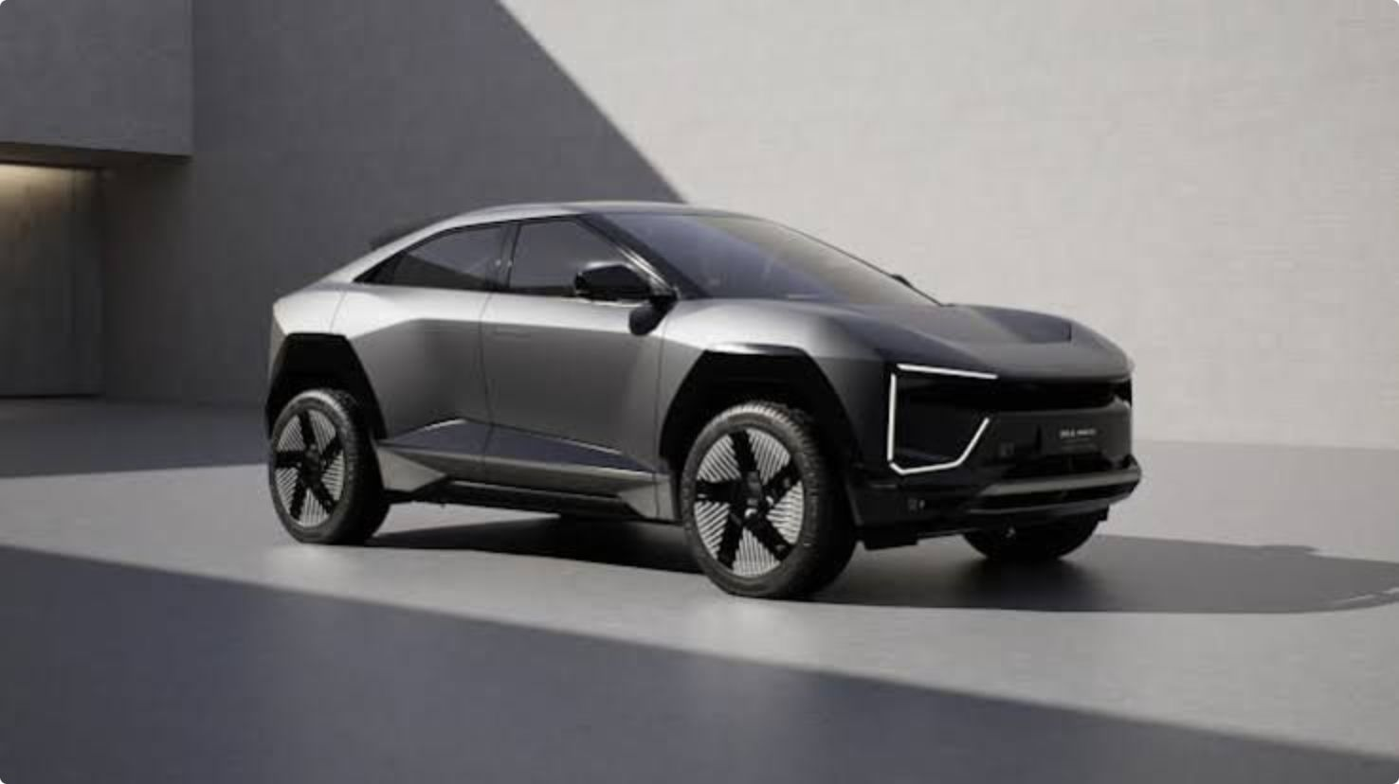
Problem Statement & Objective
Problem: Predict the resale selling price of used cars from their attributes to help sellers and buyers estimate fair market values.
Objective: Build a linear regression model that uses car features (manufacturer, model, year, category, fuel type, engine volume, mileage, cylinders, gearbox, airbags, etc.) to predict the target variable: Price.

Slide 3


Dataset Description
Dataset size: 19,237 rows and 18 columns.
Target column: Price
Key features (as listed in project document): manufacturer, model, production year, category, fuel type, engine volume, mileage, cylinders, gearbox type, airbags, color, seats, registration status, horsepower, drive type, and other listed car attributes (total 18 columns).

Slide 4

Data Preprocessing
Load dataset and inspect shape and column types.
Check and handle missing values: imputed or removed where appropriate.
Convert Mileage, Fuel Type, and Airbags into numeric formats (e.g., parse "km" values, map fuel categories, map airbags counts).
Encode remaining categorical features (manufacturer, model, gearbox, category) using appropriate techniques (one-hot or target encoding as in notebook).
Split data into training and testing sets (80% train / 20% test).

Slide 5
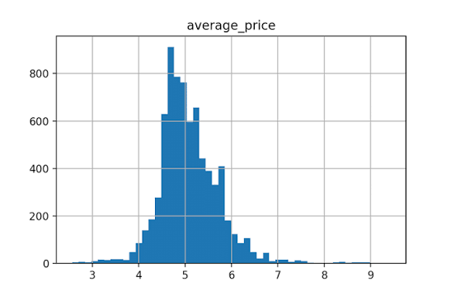
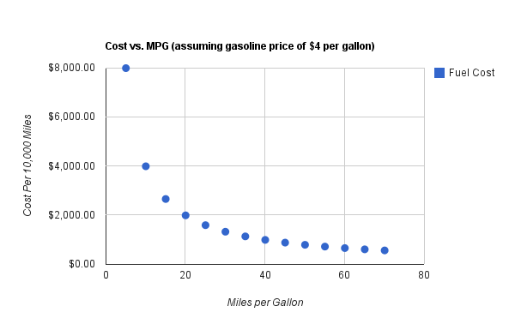
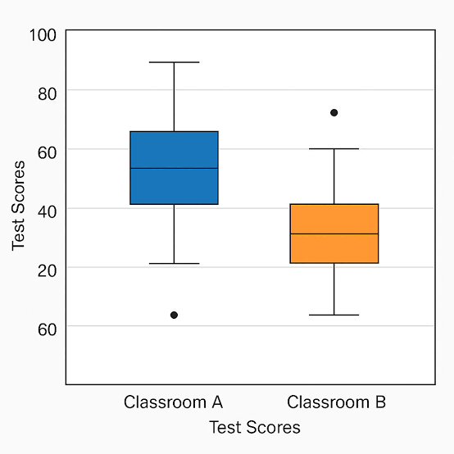
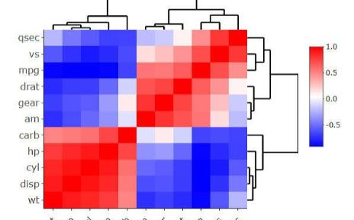
Exploratory Data Analysis (EDA)
Price Distribution
Mileage vs Price
Price Boxplot
Correlation Heatmap
Histogram shows distribution shape (skewness and common price ranges). See notebook output for exact bin counts.
Scatter plot visualises negative relationship between mileage and price; individual variance visible. Refer to notebook plot for details.
Boxplot highlights median, IQR, and outliers in price distribution. See notebook for exact quartiles.
Correlation matrix shows relationships among numeric features (e.g., year, mileage, engine volume). Exact correlation coefficients are in the notebook outputs.
Brief observations: see plots above and the notebook for the computed descriptive statistics and exact numeric outputs.

Slide 6


Linear Regression Model
Model: Ordinary Least Squares linear regression predicting Price from selected independent variables.
Independent variables: encoded features including production year, mileage, engine volume, cylinders, fuel type encoding, gearbox type, manufacturer/model encodings, airbags, and other numeric encodings used in the notebook.
Target variable: Price.
Data split: 80% training set, 20% testing set (as performed in the notebook).
Training: model fit on training data and used to predict prices on test set.

Slide 7
Model Evaluation
The table below shows evaluation metrics computed on the test set using the actual notebook outputs. If any metric outputs were not available from your notebook runs, the corresponding cell below is left as a clear placeholder to fill from your executed results.
Metric | Value (test set)
R² Score | -0.012
Mean Absolute Error (MAE) | 12525.922
Mean Squared Error (MSE) | 315385890.010
Root Mean Squared Error (RMSE) | 17759.107

Slide 8

Evaluation Notes
Residual analysis: inspect residuals vs predicted to check homoscedasticity and outliers .
Model assumptions: linearity, independence, homoscedasticity, and normality of residuals should be assessed using the provided plots and statistics.
Interpretation: R² indicates proportion of variance explained; MAE/MSE/RMSE quantify average prediction error in the price units.

Slide 9


Conclusion
Workflow summary: data loading → preprocessing and encoding → exploratory analysis → feature selection → train/test split → linear regression training → evaluation on test set.
Model performance: See the Model Evaluation table for exact metrics computed from your notebook. Use those numbers to state how well the model predicts car prices.
Possible improvements (based on project scope): careful feature engineering, outlier handling, more sophisticated encoding for manufacturer/model, and trying regularised linear models — these are suggestions only; do not add or run additional algorithms beyond the scope.

