Slide 1


Student Details
Name : Kavadi Balaji
Skills Build Email ID : balajikavadi2003@gmail.com
College Name : JNTUA College of Engineering,Pulivendula
College state : Andhra Pradesh
Internship domain : Front End Development(FED)
Internship start and end date : June 6th 2023 to July 4th 2023

Slide 2

PROJECT TITLE
ABOUT PORTFOLIO
A portfolio is a collection or showcase of an individual's or a company's work, accomplishments, and skills. It serves as a visual representation of their abilities and expertise in a specific field or industry. Portfolios can take various forms, such as physical documents, online websites, or digital presentations.
In a portfolio, one typically includes examples of their best work, such as writing samples, design projects, photography, artwork, or even software applications they have developed. The purpose of a portfolio is to demonstrate proficiency, creativity, and professionalism to potential clients, employers, or collaborators.
A well-organized and thoughtfully curated portfolio allows individuals to highlight their strengths, unique talents, and achievements. It provides a tangible way for others to evaluate their skills and make informed decisions about their capabilities. Additionally, portfolios often include descriptions, explanations, or annotations that provide context and insights into the projects showcased.

Slide 3
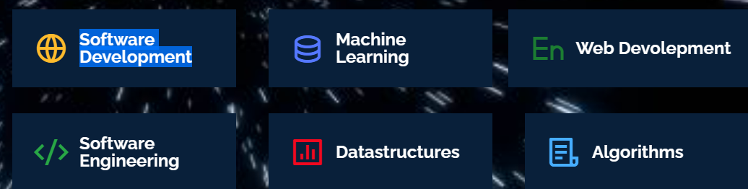

AGENDA IN PORTFOLIO
In my portfolio : Home, About me,Education,Projects,Skills,Resume and Contacts sections are present
Home: This section contains what’s my name, what sections available and emai,github,linkdin and Instagram icons.
About Me: This section contains where I was studying,my passion,interest towards software development, Birthday, Phone number,Email,City and my interests are:
Education: This section contains where I completed my Primary section,Intermediate and present pursuing B-Tech
and some online certificates from different learning platforms are:

Slide 4
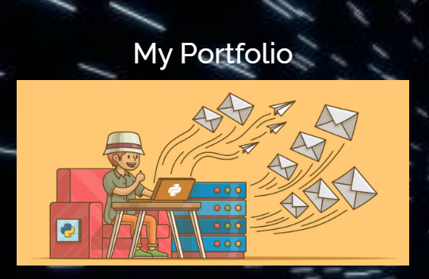
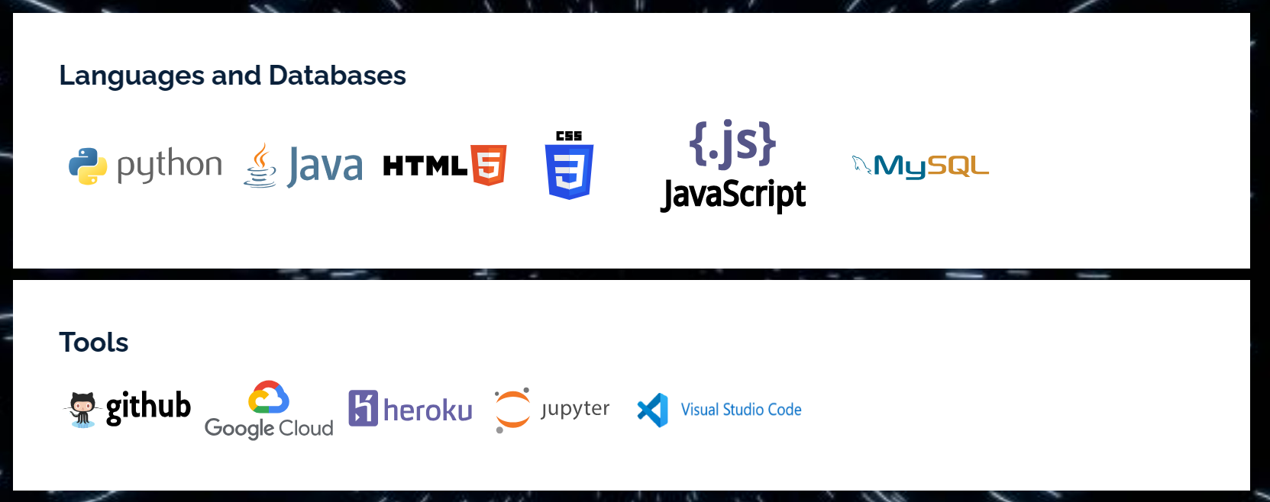
AGENDA IN PORTFOLIO
Projects: This section contains my first project portfolio.
Skills: This section contains my skills in languages and databases and tools in the web development.
Resume and Contacts: This sections contains my Resume and my contact details as my address,socialprofiles, Emails and Contacts.

Slide 5

PROJECT OVERVIEW
Purpose of Project:
1) Demonstrating Skills and Abilities: A portfolio project allows individuals to showcase their skills, talents, and abilities in a tangible and practical way.
2) Attracting Opportunities: A portfolio project can act as a powerful marketing tool, attracting potential clients, employers, or collaborators. It enables individuals to display their capabilities and accomplishments, increasing their chances of securing new projects, job offers, or partnerships.
Scope of Project:
1)Content Selection: Determine the types of work, projects, or samples that will be included in the portfolio. Consider including a variety of examples that showcase your skills, expertise, and range of abilities.
2)Depth of Information: Decide on the level of detail and information you will provide for each item in the portfolio. Consider the balance between providing enough context and keeping the portfolio concise and easily digestible. Objective of Project:
1)Professional Development and Learning: Creating a portfolio project can be an opportunity for individuals to reflect on their work, assess their skills, and identify areas for growth and improvement. It can serve as a platform for continuous learning, skill development, and self-improvement.
2) Career Advancement: A portfolio project can contribute to career advancement by showcasing an individual's progression, growth, and increased responsibilities over time. It can provide evidence of their readiness for higher-level positions, promotions, or expanded opportunities within their field.

Slide 6

END USERS of this project
The end users of a portfolio project can vary depending on the purpose and context of the portfolio. Here are some potential end users
Employers: Job seekers often create portfolios to showcase their skills and accomplishments to potential employers. Employers may review portfolios as part of the hiring process to assess a candidate's suitability for a role and determine their qualifications and expertise.
Educational Institutions: Students or aspiring professionals may create portfolios to support their applications to educational programs, scholarships, or internships. Educational institutions may review portfolios as part of the admissions process to assess an applicant's skills, creativity, and potential.
General Public: In some cases, portfolios may be created for a wider audience, such as the general public. This can apply to artists, photographers, writers, or any creative professional who wants to share their work with a broader audience for exposure, recognition, or sales.
Clients: If the portfolio project is created by a freelancer or a service provider, the primary end users would be potential clients. Clients may review the portfolio to evaluate the skills, style, and quality of work before deciding to hire or engage the individual or organization.
Investors or Funders: Entrepreneurs or startups may develop portfolios to attract potential investors or funders. The portfolio project would showcase the company's vision, past achievements, and potential for growth, aiming to secure financial support or partnerships.

Slide 7
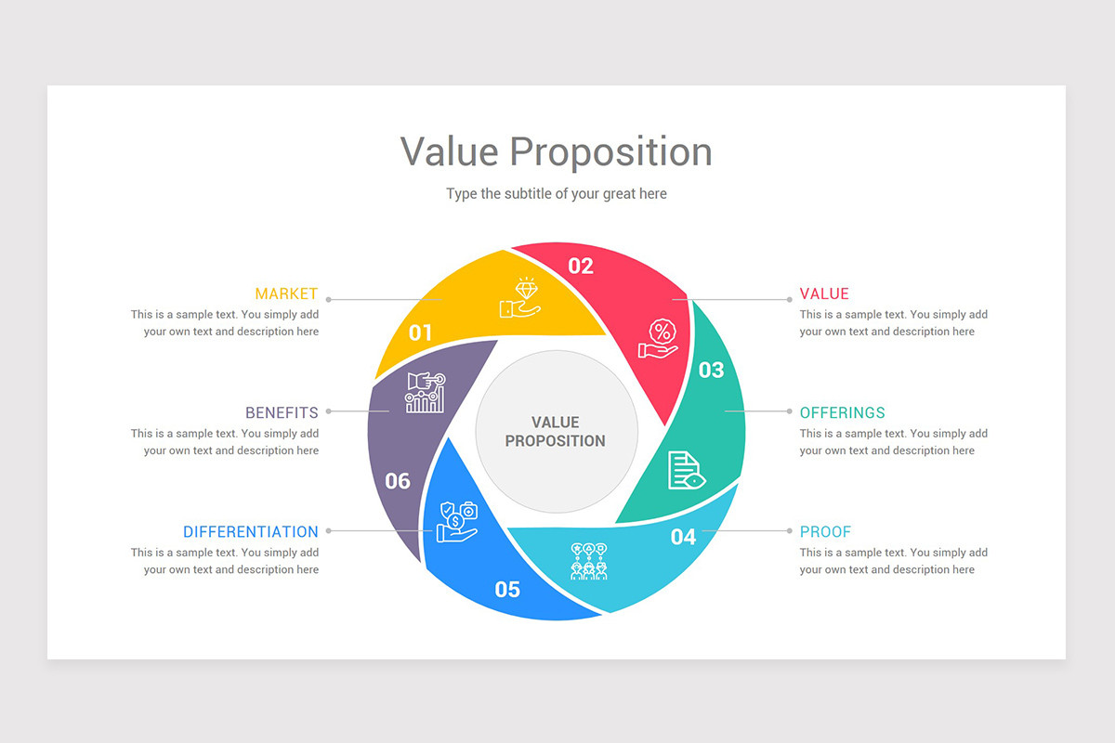
SOLUTION AND ITS VALUE PROPOSITION
The project(portfolio) it will address the needs of the end users and it brings value to it as by
Time and Cost Efficiency: Traditional portfolio management processes can be time-consuming and expensive and automates various aspects of portfolio management, reducing manual effort and saving time. Additionally, by optimizing asset allocations and minimizing risk, my solution aims to enhance efficiency and potentially.
My project help the end users such as for students and freelancers in my project and skills sections. As many interested people can access into my portfolio and watch and gain the beneficial certificates and badges that which it helps for strong resume buildup.
So that many end users can gain knowledge by completing the outstanding courses through my project.
There fore, through my project many end users get attracted and aiming to maximize returns, minimize risk, and provide customized solutions.my solution empowers, saves time, and enhances overall portfolio performance.

Slide 8
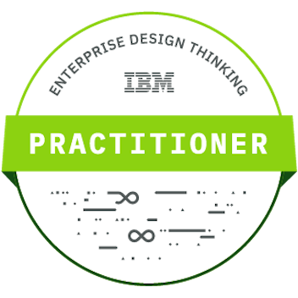
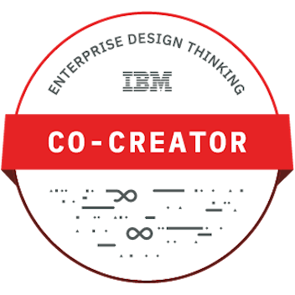
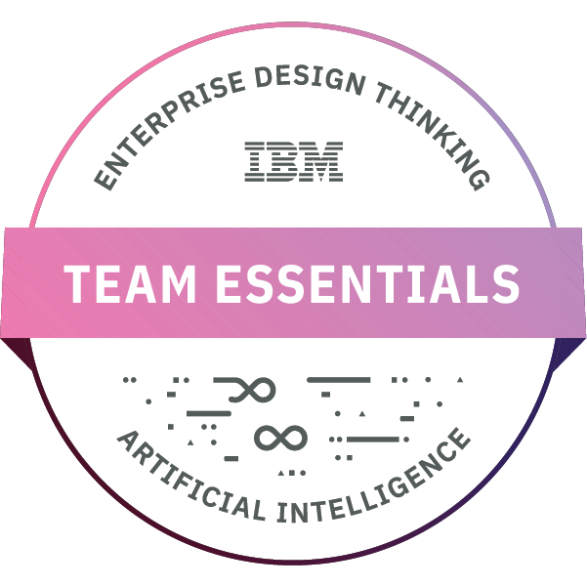
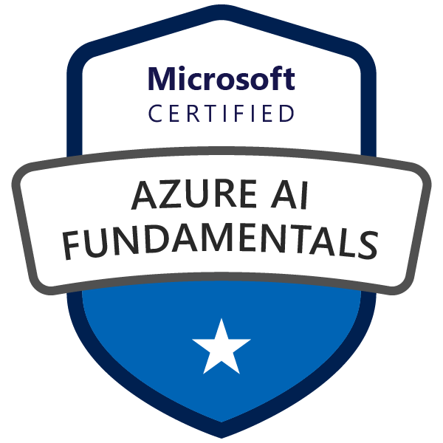

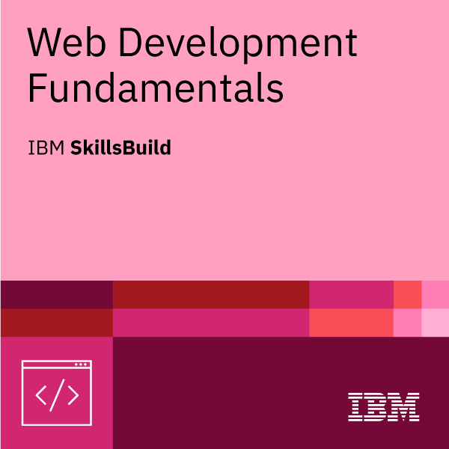
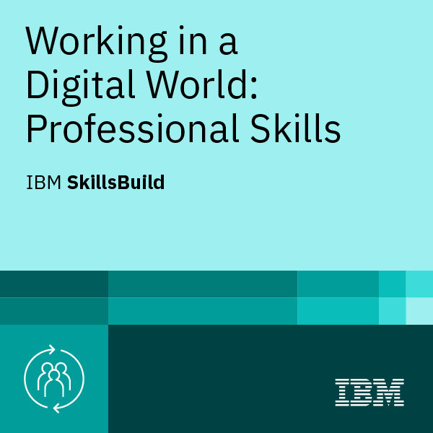
customize the project and make it your own
The unique aspects of my portfolio project are my projects,badges and my skills these are innovative,unique for my project.
As I felt a creative experience at the time of earning my badges. The tasks and quizes are very interesting to solve, through this I own a more knowledge and problem solving techniques.
The skills Languages and database like HTML,CSS,Javascript,Java and MySql. The mentioned skills are very much helpful to me to create a unique web page.
The Badges that I own are from Microsoft Certified as Azure AI Fundamentals, Azure Data Scientist and from IBM Edunet are as a Practitioner,Co-Creater,Team Essentials,Web Development Fundamentals,Professional Skills.
Therefore, these are unique, innovative and creatable or remarkable things made in my project called my “portfolio”

Slide 9
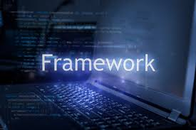
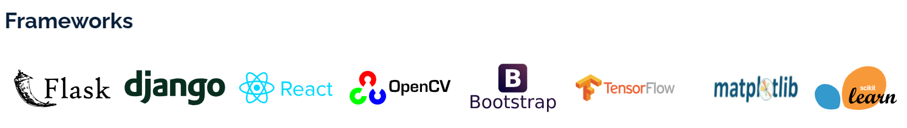
MODELLING
When it comes to choosing frameworks for my portfolio project, it depends on the specific requirements and goals of my project. However, I can provide with some popular frameworks that are commonly used in web development. Here are a few:
React.js which is also called as frond-end framework helps to a JavaScript library for building user interfaces, widely used for single-page applications.
Meteor which is also called as full-stack framework helps to a full-stack JavaScript framework that allows for building real-time web applications.
Bootstrap is a popular front-end framework for building responsive and mobile-first websites and web applications. It provides a collection of CSS and JavaScript components that can be used to create a consistent and visually appealing user interface.
Therefore, these are the frameworks I applied for my project. In the given below some frame works are there which are learned by me:

Slide 10

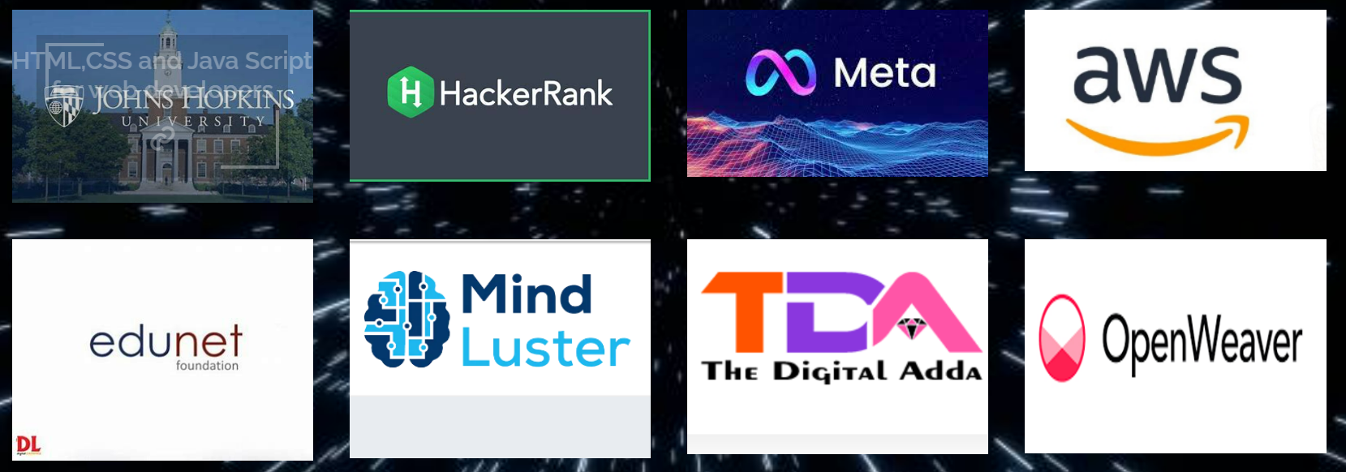
RESULTS
The project(portfolio) it is necessary for students and organizations it will address the needs of the end users and it brings value to it, because it will helps save funds and eliminates time theft by employees and students.
The data obtained in this project which was prepared based on the HTML,CSS,and Javascript these are the languages for Front End Wed development.
The effectiveness present in my project is my online certificates and badges from different companies that which are inspire to every end users.
There fore, through my project many end users get attracted and aiming to maximize returns, minimize risk, and provide customized solutions.my solution empowers, saves time, and enhances overall portfolio performance.

Slide 11

LINKS
https://github.com/kavadibalaji34/kavadibalaji34.github.io
The above link is refers to my project(portfolio) from the github repository which consists of html,css,javascript files.
This is my project portfolio link https://kavadibalaji34.github.io/
NOTE: To open the link please click the ctrl+click to follow it.

Slide 12


