Slide 1
Wheat Price Forecasting: Region-Wise Estimator
CSE7101- Capstone Project
Review-2
Batch Number: ISE_1
Under the Supervision of,
Dr. Murali Parameswaran
Professor
School of Computer Science and Engineering
Presidency University
Roll Number | Student Name
20221ISE0108 | Kavana R
20221ISE0109 | Pallavi J
20221ISE0104 | Bharathi Neeralakeri
Name of the Program: Information Science and Engineering
Name of the HoD: Dr. Zafar Ali Khan
Name of the Program Project Coordinator: Ms. Suma N G
Name of the School Project Coordinators: Dr. Sampath A K , Dr. Geetha A

Slide 2
Problem Statement Number: PSCS_150
Organization: Agriculture,FoodTech & Rural Development.
Category : Software
Problem Description: Developing solutions, keeping in mind the need to enhance the primary sector of India – Agriculture and to manage and process our agriculture procedure.

Slide 3
Content
Problem Statement
Objectives
Background and Related work for title Selection
Analysis of Problem Statement
Models Implemented
Results – Mysore
Next Step – TAT
Scaling Plan
Git-hub Link
Conclusion
References

Slide 4
Problem Statement
Farmers and agri-traders face challenges in predicting future demand and prices of organic crops. Existing systems mostly provide historical data or advisory services, but lack reliable market estimation and forecasting tools. This results in poor crop planning, financial losses, and uncertainty in the organic agriculture sector.

Slide 5
Objectives
Collect and preprocess district-wise wheat price datasets across Karnataka.
Implement and evaluate deep learning models (LSTM and GRU) on sequential price data to establish baseline performance.
Develop and finalize a Temporal Attention Transformer (TAT) for improved region-wise wheat price forecasting.
Build an interactive dashboard (HTML/JS + Flask backend) to visualize historical and forecasted wheat prices for each district.
Deliver actionable insights on price movements and volatility to support farmers, policymakers, and stakeholders in decision-making.

Slide 6
Background and Related work for title Selection
Prior research has explored time-series forecasting for agricultural commodities using ARIMA, SARIMA, Prophet, and deep learning models such as LSTM and GRU.
Datasets from Agmarknet and other government sources have been widely used in agri-economic studies.
Existing platforms (e.g., Agmarknet portal, FPO apps) mainly provide historical wheat prices or advisories, but lack predictive analytics for region-wise markets.
Gap: Very few systems focus on district-level wheat price forecasting across Karnataka, making this project novel and impactful.

Slide 7
Analysis of Problem Statement
Input:
Historical district-wise wheat price data (modal prices) from Agmarknet.
Processing (Completed):
Data cleaning and preparation of sequential price datasets.
Forecasting using deep learning models (LSTM, GRU).
Processing (Next Step):
Implementation of Temporal Attention Transformer (TAT) for improved long-range forecasting.
Output:
Future wheat price trends (short-term & medium-term).
Region-wise forecasts for Karnataka districts (e.g., Mysuru, Bengaluru, Hubli, etc.).
Impact:
Farmers → informed decisions on when/where to sell produce.
Policymakers → better region-wise market planning and interventions.
Traders/FPOs → improved price negotiation and trading strategies.

Slide 8
Models Implemented:
LSTM → Implemented, tested on Mysore
GRU → Implemented, tested on Mysore
Observation: GRU gave better accuracy than LSTM
Next: TAT to be implemented for final model

Slide 9
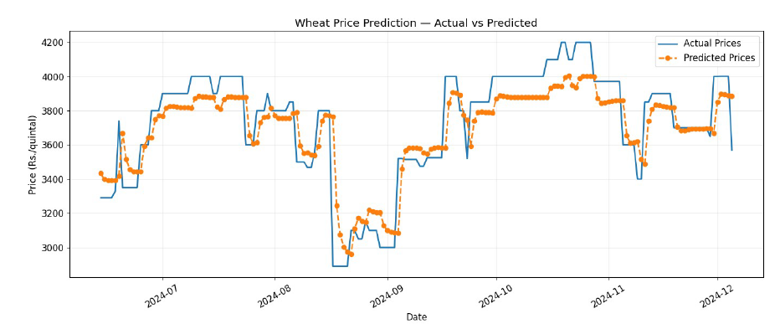
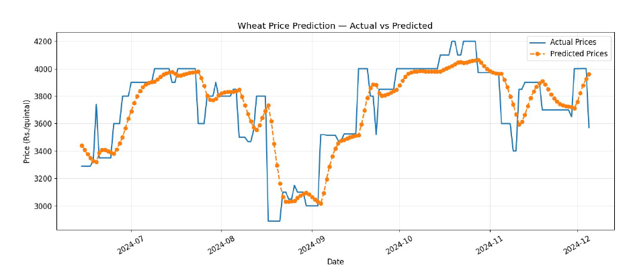
Results - Mysore
Model | MAE | RMSE | R²
LSTM | 125.93 | 187.23 | 0.6728
GRU | 117.78 | 153.95 | 0.7788
GRU
LSTM

Slide 10
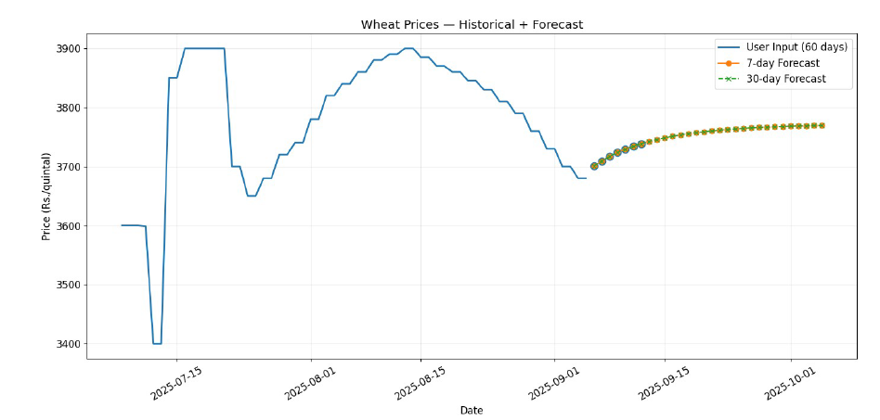
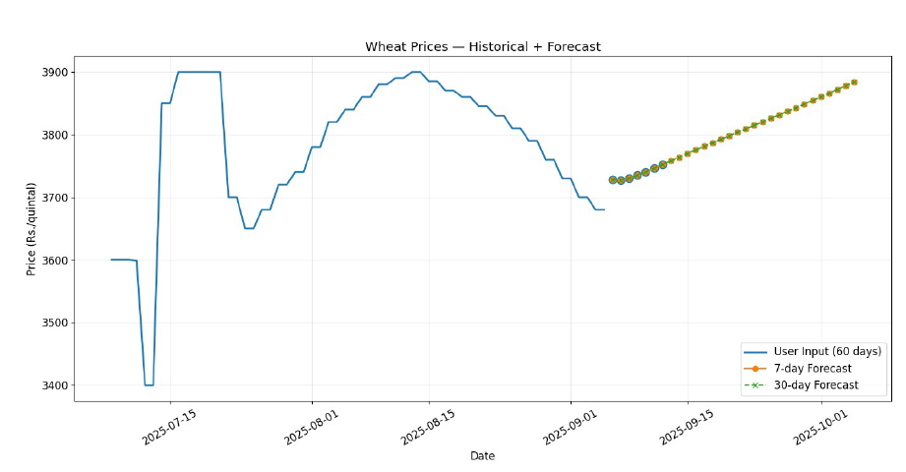
Results - Mysore
7-day & 30-day forecast plots
GRU
LSTM

Slide 11
Next Step — TAT
What is TAT?
Transformer with attention for time-series.
Why TAT?
Captures long dependencies better than LSTM/GRU.
Plan
Train & compare TAT vs GRU across districts in Karnataka.
Expected outcome
Better accuracy, more stable region-wise forecasts.

Slide 12
Scaling Plan — All Districts
Current → Mysore done.
Next → Extend to all Karnataka districts (Bengaluru, Hubli, etc.).
Approach → Build global TAT model with district embeddings OR per-district models.
Output → Region-wise wheat price forecasts integrated into dashboard.

Slide 13
Github Link
The Github link provided should have public access permission.
Github Link
https://github.com/kavan-r/OrganicCrop-Forecast

Slide 14
Conclusion:
GRU outperformed LSTM on Mysore dataset.
GRU MAE = 117.78 vs LSTM MAE = 125.93
Indicates GRU as better baseline for sequential wheat price forecasting.
LSTM & GRU implemented → GRU is better baseline.
Dashboard integration under progress.
Next step: TAT implementation for final model.
Final project will deliver district-wise wheat price forecasting system for Karnataka

Slide 15
References (IEEE Paper format)
A. Sharma and P. Gupta, “An innovative deep learning based approach for accurate agricultural crop price prediction,” IEEE Access, vol. 10, pp. 45012–45025, 2022.
R. K. Singh et al., “Automated agriculture commodity price prediction system with machine learning techniques,” in Proc. IEEE ICACCE, pp. 112–118, 2021.
S. Das and M. Jain, “Forecasting commodity prices using long short-term memory neural networks,” in Proc. IEEE Int. Conf. Big Data (BigData), pp. 245–252, 2020.
K. Reddy and H. Kulkarni, “A framework for crop price forecasting in emerging economies by analyzing the quality of time-series data,” IEEE Access, vol. 8, pp. 100111–100123, 2020.
B. Lim, S. Oreshkin, et al., “Temporal fusion transformers for interpretable multi-horizon time series forecasting,” in Proc. 34th Conf. Neural Inf. Process. Syst. (NeurIPS), 2021.

Slide 16
References (IEEE Paper format)
6. T. Chen, X. Wang, and Y. Liu, “Quantum temporal fusion transformer,” IEEE Trans. Quantum Eng., vol. 3, pp. 1–10, 2022.
7. L. Zhang et al., “An EnKF-LSTM assimilation algorithm for crop growth model,” IEEE Trans. Geosci. Remote Sens., vol. 59, no. 7, pp. 5523–5536, 2021.
8. H. Wu, Y. Pan, et al., “TAT: Temporal-aligned transformer for multi-horizon peak demand forecasting,” IEEE Trans. Power Syst., vol. 37, no. 5, pp. 3921–3932, 2022.
9. P. Sinha and A. Mehta, “A hybrid machine learning framework for optimizing crop selection via agronomic and economic forecasting,” IEEE Trans. Comput. Social Syst., vol. 9, no. 4, pp. 755–766, 2022.
10. X. Li, Y. Zhou, and J. Wang, “A unified hyperparameter optimization pipeline for transformer-based time series forecasting models,” IEEE Trans. Knowl. Data Eng., vol. 35, no. 6, pp. 6230–6242, 2023.

Slide 17


