Slide 1
Technologies used in today’s IT field
Kavan Brahmbhatt

Slide 2
Agenda
Description
Front-end technologies
Back-end technologies

Slide 3
Description
What is Front End and Back End Technologies ?
Frontend and Backend are the two most popular terms used in web development. These terms are very crucial for web development but are quite different from each other. Each side needs to communicate and operate effectively with the other as a single unit to improve the website’s functionality.

Slide 4
Front-end technologies

Slide 5
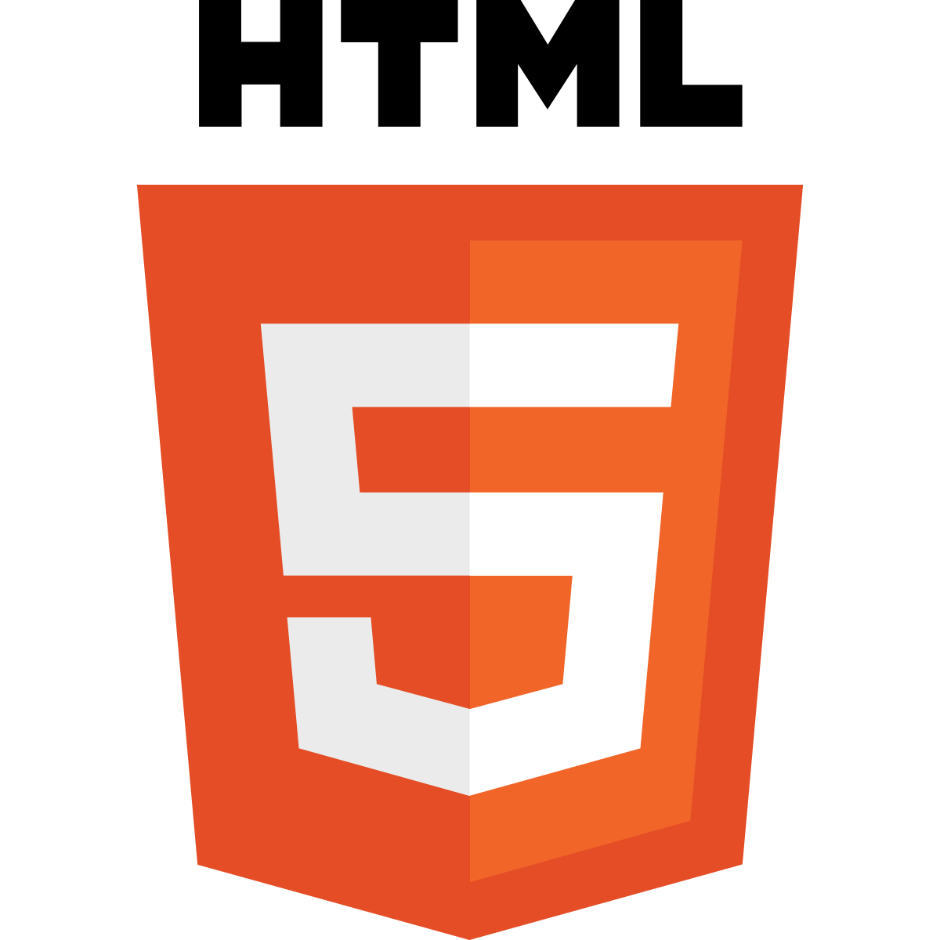
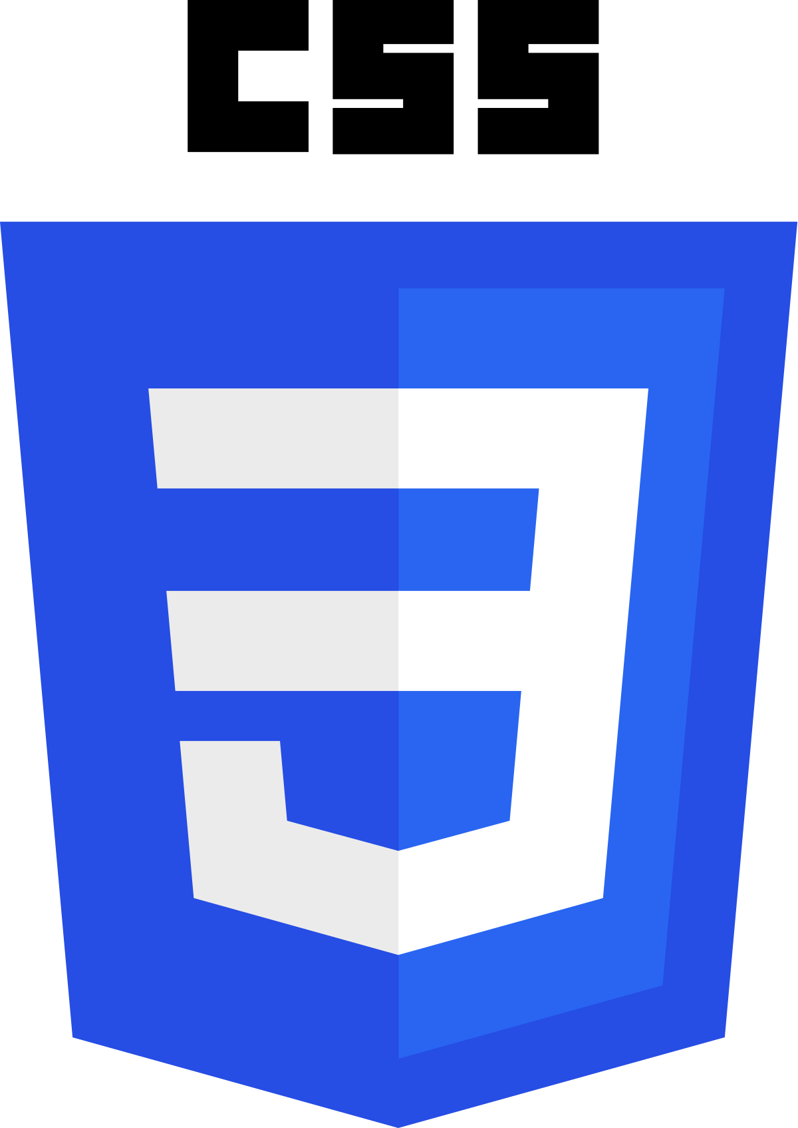
Front-end Technologies
HTML:- HTML stands for Hypertext Markup Language. It is used to design the front-end portion of web pages using a markup language. HTML is the combination of Hypertext and Markup language. Hypertext defines the link between the web pages. The markup language is used to define the text documentation within the tag which defines the structure of web pages.
CSS:- HTML stands for Hypertext Markup Language. It is used to design the front-end portion of web pages using a markup language. HTML is the combination of Hypertext and Markup language. Hypertext defines the link between the web pages. The markup language is used to define the text documentation within the tag which defines the structure of web pages.

Slide 6
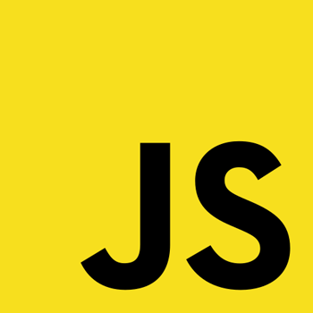
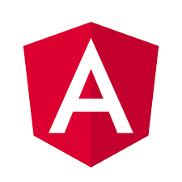
Front-end Technologies…
JavaScript:- JavaScript is a famous scripting language used to create magic on the sites to make the site interactive for the user. It is used to enhancing the functionality of a website to running cool games and web-based software.
Angular:- AngularJs is a JavaScript open-source front-end framework that is mainly used to develop single-page web applications(SPAs). It is a continuously growing and expanding framework which provides better ways for developing web applications. It changes the static HTML to dynamic HTML. It is an open-source project which can be free. It extends HTML attributes with Directives, and data is bound with HTML

Slide 7


Front-end Technologies…
React:- React is a declarative, efficient, and flexible JavaScript library for building user interfaces. ReactJS is an open-source, component-based front-end library responsible only for the view layer of the application. It is maintained by Facebook.
Flutter:- Flutter is an open-source UI development SDK managed by google. It is powered by Dart programming language. It builds performant and good-looking natively compiled applications for mobile (Ios, Android), web, and desktop from a single code base. The key selling point of flutter is flat development is made easier, expressive, and flexible UI and native performance.

Slide 8
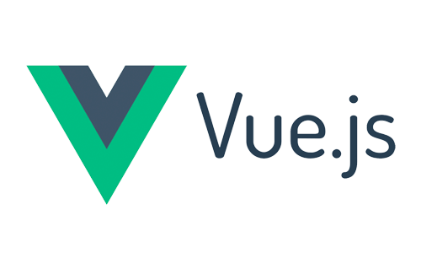

Front-end Technologies…
VueJS:- VueJS is an open source progressive JavaScript framework used to develop interactive web interfaces. It is one of the famous frameworks used to simplify web development. VueJS focusses on the view layer. It can be easily integrated into big projects for front-end development without any issues.
React Native:- React Native is a popular JavaScript-based mobile app framework that allows you to build natively-rendered mobile apps for iOS and Android. The framework lets you create an application for various platforms by using the same codebase.

Slide 9
Back-end technologies

Slide 10
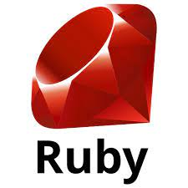
Back-end Technologies
Ruby:- A dynamic, open source programming language with a focus on simplicity and productivity. It has an elegant syntax that is natural to read and easy to write.
Ruby On Rails(ROR): Ruby on Rails or also known as rails is a server-side web application development framework that is written in the Ruby programming language, and it is developed by David Heinemeier Hansson under the MIT License. It supports MVC(model-view-controller) architecture that provides a default structure for database, web pages, and web services, it also uses web standards like JSON or XML for transfer data and HTML, CSS, and JavaScript for the user interface.

Slide 11
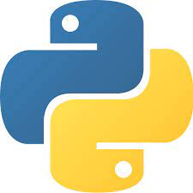


Back-end Technologies…
Python:- Python is a programming language that lets you work quickly and integrate systems more efficiently.
Django: Django is a high-level Python web framework that encourages rapid development and clean, pragmatic design. Built by experienced developers, it takes care of much of the hassle of web development, so you can focus on writing your app without needing to reinvent the wheel. It’s free and open source.
Flask: Flask is a web framework that provides libraries to build lightweight web applications in python. It is developed by Armin Ronacher who leads an international group of python enthusiasts (POCCO). It is based on WSGI toolkit and jinja2 template engine. Flask is considered as a micro framework.

Slide 12
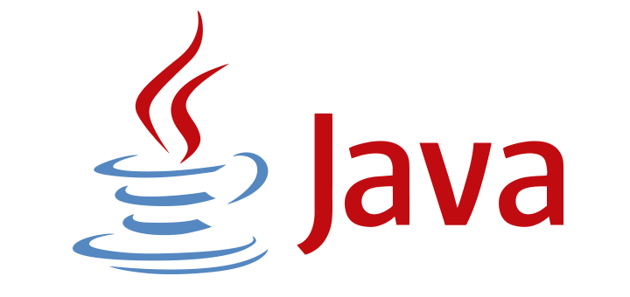

Back-end Technologies…
Java:- Java is one of the most popular and widely used programming languages and platforms. It is highly scalable. Java components are easily available.
Spring: Spring is a lightweight framework. It can be thought of as a framework of frameworks because it provides support to various frameworks such as Struts, Hibernate, Tapestry, EJB, JSF, etc. The framework, in broader sense, can be defined as a structure where we find solution of the various technical problems.

Slide 13


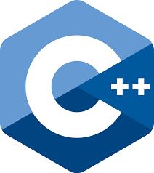
Back-end Technologies…
PHP:- PHP is a server-side scripting language designed specifically for web development. Since PHP code executed on the server-side, so it is called a server-side scripting language.
.NET:- .NET is a free, cross-platform, open source developer platform for building many different types of applications. With .NET, you can use multiple languages, editors, and libraries to build for web, mobile, desktop, games, IoT, and more.
C++:- It is a general-purpose programming language and widely used nowadays for competitive programming. It is also used as a backend language.

Slide 14

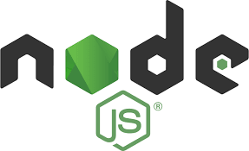
Back-end Technologies…
Go:- Go, also known as Golang, is an open-source, compiled, and statically typed programming language designed by Google. It is built to be simple, high-performing, readable, and efficient.
Node.js:- Node.js is an open-source and cross-platform runtime environment for executing JavaScript code outside a browser. You need to remember that NodeJS is not a framework, and it’s not a programming language. Most people are confused and understand it’s a framework or a programming language. We often use Node.js for building back-end services like APIs like Web App or Mobile App. It’s used in production by large companies such as Paypal, Uber, Netflix, Walmart, and so on.

Slide 15
Thank you
Kavan Brahmbhatt
kavanbrahmbhatt0910@gmail.com

