Slide 1
OOPS CONCEPTS
Kavan Brahmbhatt

Slide 2
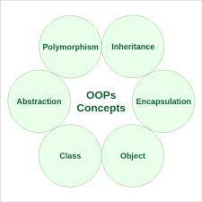
OOPS Concepts
Object means a real-world entity such as a pen, chair, table, computer, watch, etc. Object-Oriented Programming is a methodology or paradigm to design a program using classes and objects. It simplifies software development and maintenance by providing some concepts:
Class
Object
Inheritance
Polymorphism
Abstraction
Encapsulation

Slide 3
Class
Class is a user-defined data type which defines its properties and its functions. Class is the only logical representation of the data. For example, Human being is a class. The body parts of a human being are its properties, and the actions performed by the body parts are known as functions. The class does not occupy any memory space till the time an object is instantiated.

Slide 4
Object
Object is a run-time entity. It is an instance of the class. An object can represent a person, place or any other item. An object can operate on both data members and member functions.

Slide 5
inheritance
Inheritance is a process in which one object acquires all the properties and behaviors of its parent object automatically. In such a way, you can reuse, extend or modify the attributes and behaviors which are defined in other classes.
In Java, the class which inherits the members of another class is called derived class and the class whose members are inherited is called base class. The derived class is the specialized class for the base class.

Slide 6
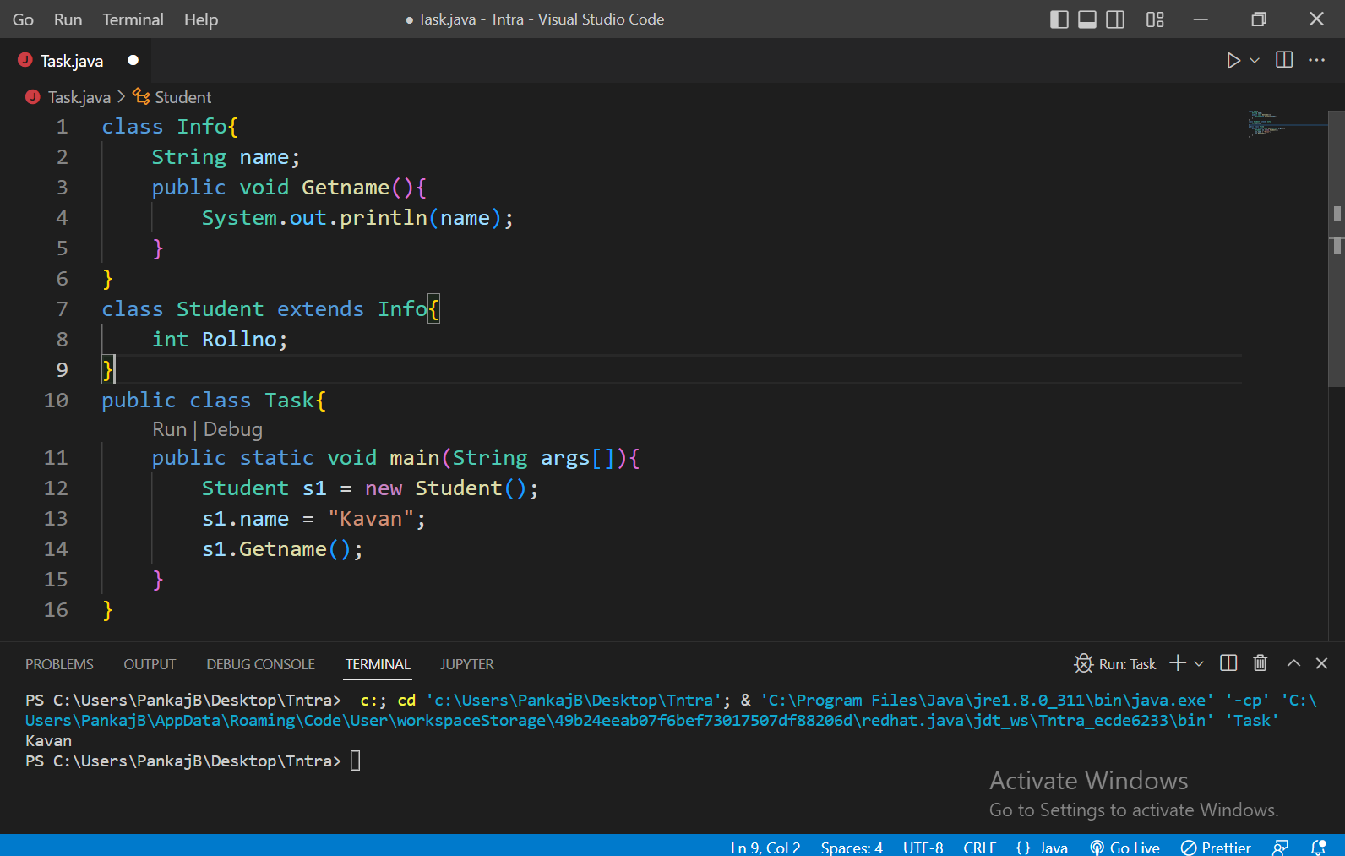

Slide 7
polymorphism
Polymorphism is the ability of an object to take on many forms. The most common use of polymorphism in OOP occurs when a parent class reference is used to refer to a child class object.
Any Java object that can pass more than one IS-A test is considered to be polymorphic. In Java, all Java objects are polymorphic since any object will pass the IS-A test for their own type and for the class Object.

Slide 8
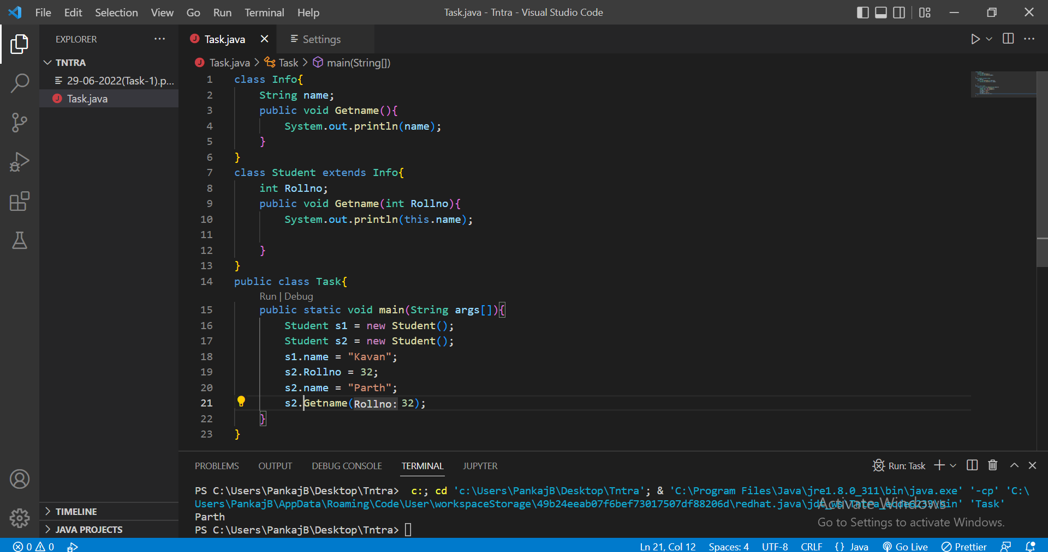

Slide 9
abstraction
Data Abstraction is the property by virtue of which only the essential details are displayed to the user. The trivial or the non-essential units are not displayed to the user. Ex: A car is viewed as a car rather than its individual components.
Data Abstraction may also be defined as the process of identifying only the required characteristics of an object ignoring the irrelevant details. The properties and behaviors of an object differentiate it from other objects of similar type and also help in classifying/grouping the objects.
Consider a real-life example of a man driving a car. The man only knows that pressing the accelerators will increase the speed of a car or applying brakes will stop the car, but he does not know how on pressing the accelerator the speed is actually increasing, he does not know about the inner mechanism of the car or the implementation of the accelerator, brakes, etc in the car. This is what abstraction is.
In java, abstraction is achieved by interfaces and abstract classes. We can achieve 100% abstraction using interfaces.

Slide 10
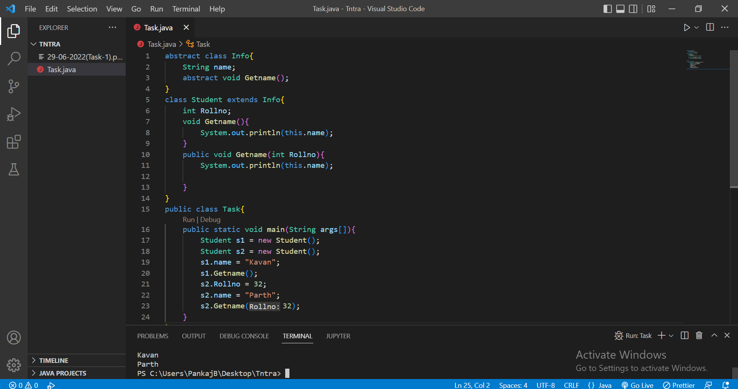

Slide 11
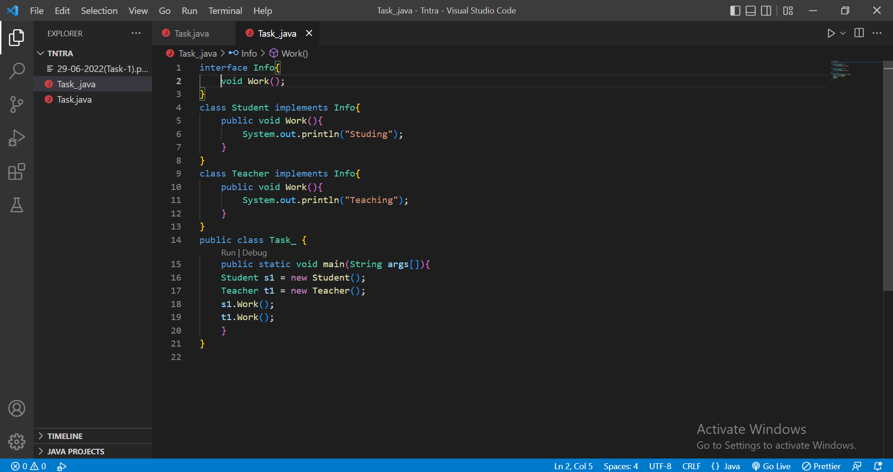

Slide 12
encapsulation
Encapsulation is defined as the wrapping up of data under a single unit. It is the mechanism that binds together code and the data it manipulates. Another way to think about encapsulation is, that it is a protective shield that prevents the data from being accessed by the code outside this shield.
Technically in encapsulation, the variables or data of a class is hidden from any other class and can be accessed only through any member function of its own class in which it is declared.
As in encapsulation, the data in a class is hidden from other classes using the data hiding concept which is achieved by making the members or methods of a class private, and the class is exposed to the end-user or the world without providing any details behind implementation using the abstraction concept, so it is also known as a combination of data-hiding and abstraction.

