Slide 1
◗
BOOBOOK
Sovereign passive RF intelligence for maritime enforcement
We fuse AIS gaps, passive RF detections and anomaly models into prioritised tasking alerts — starting at the choke points that matter.
Pre-seed validation pitch · June 2026

Slide 2
THE PROBLEM
The ocean is full of ships that don't want to be seen
1
2
3
Switch it off
Fake the signal
Below the threshold
Vessels disable AIS to fish illegally, smuggle or evade sanctions. AIS is cooperative — it relies on honesty.
Spoofed AIS broadcasts a false identity or position — invisible to AIS-only systems without an independent fix.
Vessels under 300 tonnes need not carry AIS at all. They simply don't appear.
AFMA & Border Force run repeated northern-water operations against foreign fishers — Operation Pristis 2026 ran Kimberley to Cape York. The pain is real and current.
02

Slide 3
THE OPENING
Sovereign gap, disciplined funding path
Sovereign gap
Capital asymmetry
Grant leverage
The RF maritime layer is dominated by offshore satellite providers. Boobook starts with a sovereign ground-based complement for instrumented choke points.
Some institutional capital remains defence-constrained. A dual-use, grant-aware path can fund validation without relying on classic venture timing.
DIDG may support eligible equipment, security, skilling or capability uplift — not core product R&D/prototyping. RDTI and customer pilots carry the R&D path.
The edge is disciplined staging: pre-seed validation first, RDTI where eligible, DIDG/ASCA only where the project actually fits.
03

Slide 4
SCOPE DISCIPLINE
What Boobook is — and is not
IS
IS NOT
Persistent RF monitoring of specific passages & choke points
A validation & cueing layer that shrinks the search area
Geolocation where ≥3 nodes' coverage overlaps
A way to flag detection opportunities for tasking
A continental coverage blanket
A replacement for satellites or patrol assets
Open-ocean geolocation from sparse nodes
Proof of intent or identity from a single fix
04

Slide 5
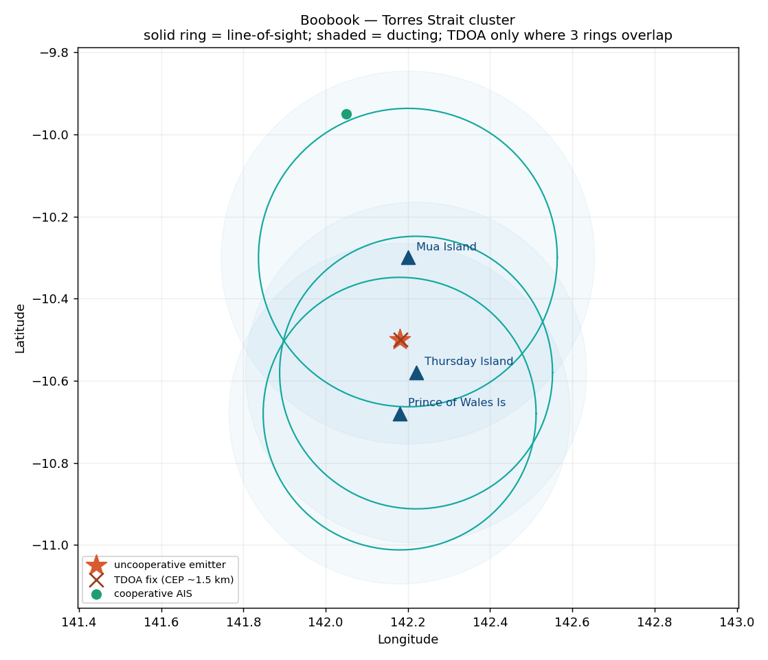
THE SOLUTION
Listen at the chokepoint, fuse, and cue
1
Receive
Passive SDR nodes pick up the AIS & VHF that working vessels still emit.
2
Geolocate
Time-difference-of-arrival across the cluster fixes position — within the overlap.
3
Correlate
RF present + AIS absent = a detection opportunity, ranked by confidence.
4
Reason
Behavioural models surface loitering, wrong-way and off-pattern tracks.
5
Cue
Prioritised alerts help enforcement task scarce patrol assets faster.
Simulated coverage map: solid = line-of-sight, shaded = ducting, TDOA only in the 3-ring overlap.
05

Slide 6
COVERAGE REALITY
Physics first: why choke points, not oceans
Ground-based VHF/AIS is line-of-sight. A coastal node hears ~35 km (to ~50–70 km over water in good ducting). TDOA geolocation needs the same emitter heard by three nodes at once — so it works only where a cluster's coverage rings overlap.
This is a feature, not a bug. Persistent coverage of the channels enforcement already cares about is something no satellite delivers — and it's achievable with a handful of nodes per passage.
06

Slide 7
GO TO MARKET
Civilian validation de-risks the defence path
Phase 1
Phase 2
Phase 3
Coastal AIS/VHF validation
One northern hotspot
Defence & allied
Prove live capture and RF-AIS correlation around a controlled harbour/passage. Sell as an intelligence layer to AFMA / ABF workflows.
Deploy a passage cluster. Use customer validation to support RDTI records and later eligible capability/security/equipment grants. Build the proprietary RF baseline.
A PROTECTED-capable platform for the ADF, then allied data-sharing where it matters most.
07

Slide 8
WHERE WE FIT
Ground persistence, not global breadth
 | HawkEye 360 / Unseenlabs | Boobook
Platform | Satellite RF | Ground RF at choke points
Coverage | Global, periodic revisit | Continuous, within cluster
Best at | Open-ocean breadth | Persistent passage watch
Sovereign / ITAR-free | No / partial | Yes
Role for us | Fusion partner offshore | Sovereign layer inshore
We don't beat satellites on breadth. We beat them on persistence where it counts — and we can feed their fusion platforms.
08

Slide 9
RISKS WE'RE NOT HIDING
The honest technical risk register
RF range / line-of-sight
TDOA in the wild
Coverage is choke-point, weather-sensitive at the edges.
Timing, multipath, survey error → real CEP 1–5 km, not metres.
Mitigation: Field-measure real coverage before any coverage claim.
Mitigation: Controlled 3-node test with a known transmitter.
Radar is separate hardware
Legal / compliance
X/S-band is a different front-end, not a label.
ACMA equipment rules; TIA Act limits on interception.
Mitigation: Phase 2/3; AIS+VHF first.
Mitigation: Metadata-only, no content capture, lawful basis per site.
09

Slide 10
THE PILOT
A 90-day, falsifiable validation
01
02
03
04
Capture
Correlate
Geolocate
Validate
Live Sydney Harbour AIS on a single RTL-SDR, persisted with timestamps & source IDs.
Dashboard of live tracks + AIS silence gaps. No dark-vessel claims yet.
3–4 node controlled TDOA test against a known transmitter; measured error distribution.
Customer discovery with AFMA / ABF / Maritime Border Command on workflow gaps.
Kill criteria: no clean live capture, no RF advisor, or no operator who says the alert helps → pause before spending.
10

Slide 11
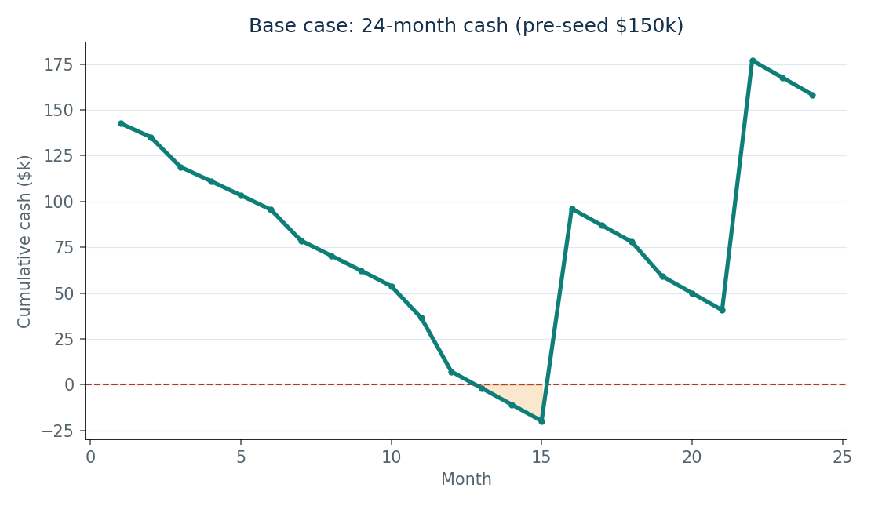
THE NUMBERS, HONESTLY
Built to find the funding floor, not hide it
$8.9k / $31.9k
node capex — infra-adjacent / remote
no base-case
DIDG inside 24mo
~$300k
total to survive the no-grant case
arrears
RDTI/grants arrive in arrears — they don't fund the first burn
11

Slide 12
FOUNDER & ASK
Built for this brief
Kavan Mehta — Founder
Actuarial & finance (UNSW). PE analyst building integrated models at Attalis Capital. AI consultant shipping Claude + MCP data platforms at NXT Bioscience. Ex-Army Reserves logistics.
The ask
~$150k pre-seed for the 90-day validation
An RF / signals engineering co-founder
Intros to AFMA, ABF & Maritime Border Command
A place in UNSW Defence 10x
My edge is the intelligence layer and commercial framing — not RF hardware. The first critical hire/partner is an RF/signals co-founder or advisor.
Validate first. Claim second. Build sovereign.
12

