Slide 1
Tutorial-1
D 3
December 8, 2021

Slide 2
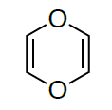
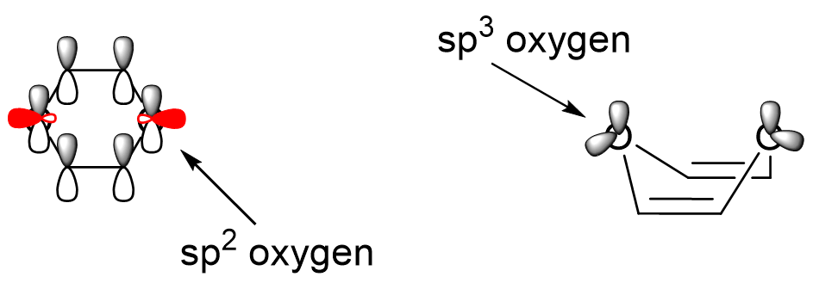
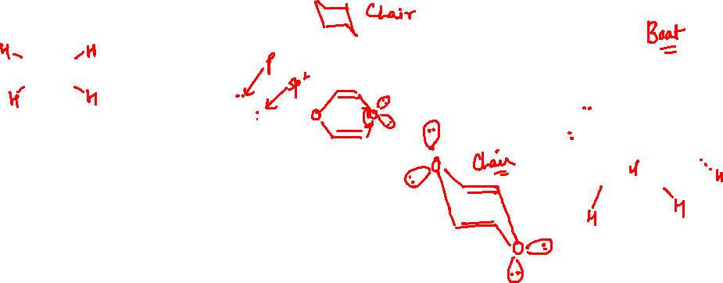
Q1.Classify the following compounds as aromatic/antiaromatic/non-aromatic based on
Huckel’s rule.
a
Non Aromatic

Slide 3
Is the number of electrons in the implied loop of pi electrons equal to 4n + 2 or 4n?
4n + 2
4n
Are there any factors that force the ring out of planarity?
Is the ring large enough to deviate from planarity?
Yes
No
Yes
No
Non aromatic
Non aromatic
Anti
aromatic
Aromatic

Slide 4
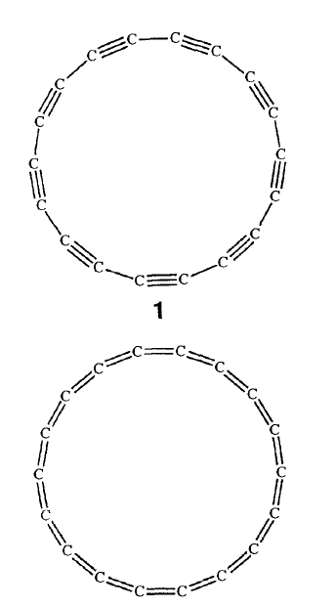
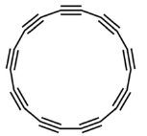
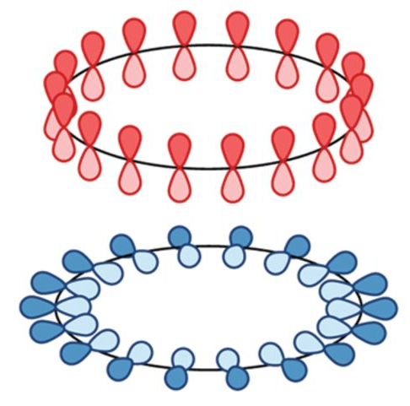
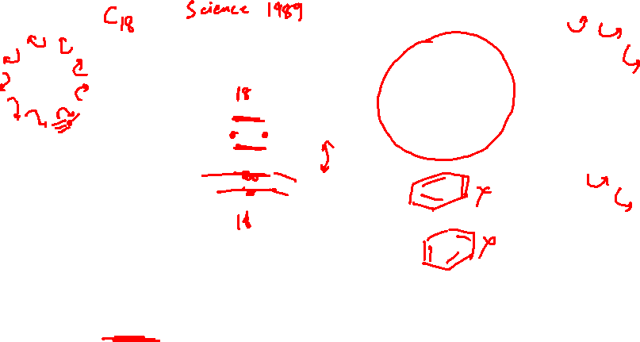
b
Aromatic
Aromatic Cyclo[18]carbon could have a distinctive form of aromaticity since it possesses two perpendicular systems of orbitals, one in-plane and one out-of-plane, with 4n + 2 π
electrons each. Both can stabilize the molecule.

Slide 5
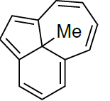
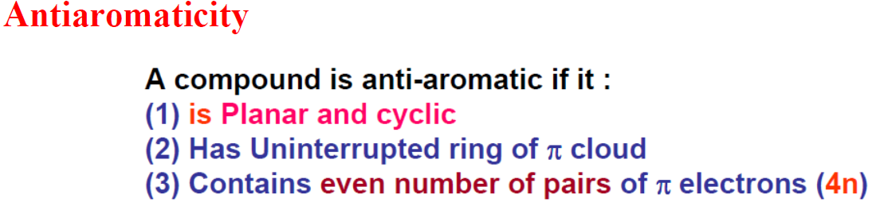
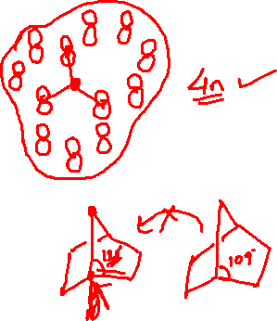
c
Count number of electrons
12 electrons = 4n system
Antiaromatic
Anti aromatic

Slide 6
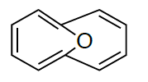
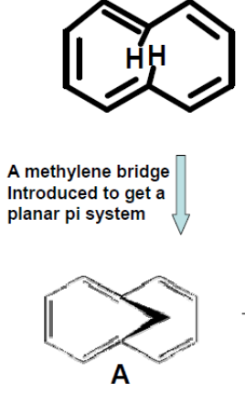
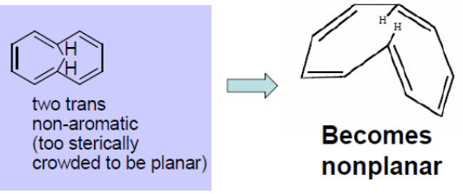
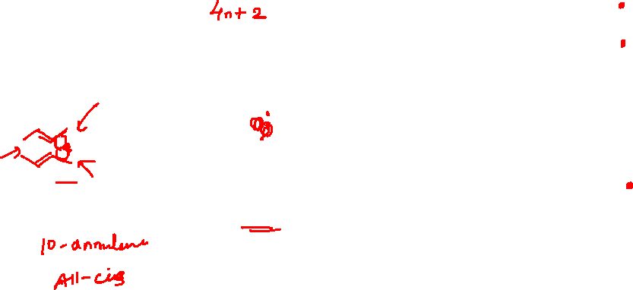
d
Aromatic

Slide 7
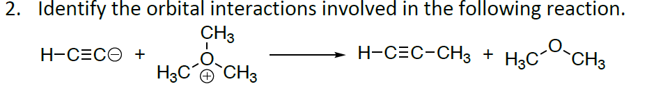
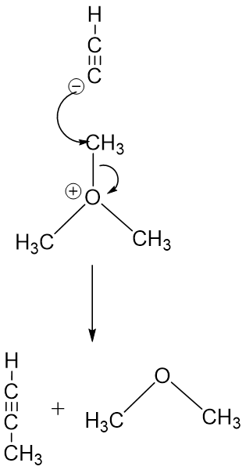
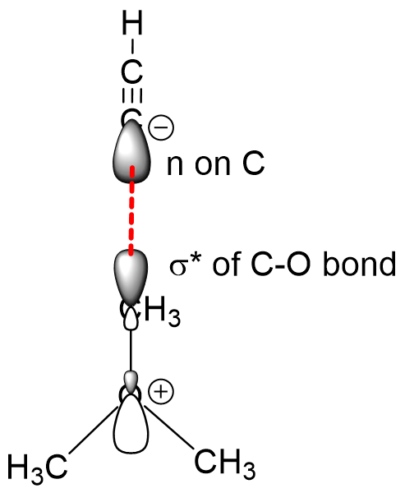
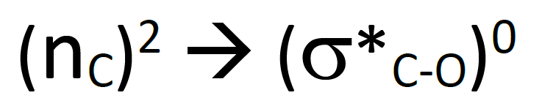


Slide 8
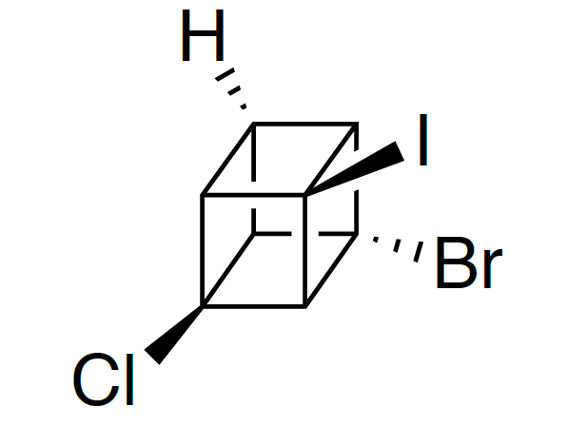
Q. 5 The molecule given below is a substituted cubane.
Identify
Total number of stereoisomers that exist.
Total number of pair of enantiomers

Slide 9
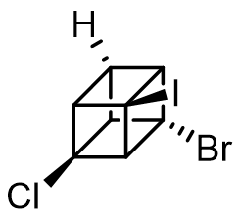
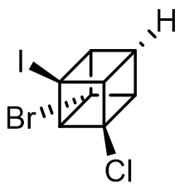
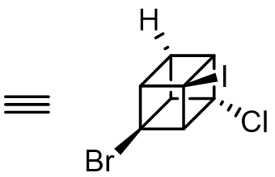
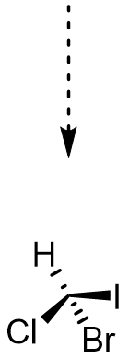
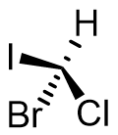
Enantiomers

Slide 10
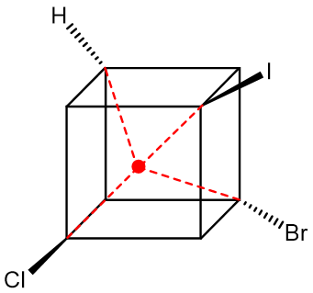
It has stereocenter at the middle point of cube.
(Stereocenter need not be situated at carbon always.)
Total stereoisomers = 2 (which are enantiomers)
Total number of pair of enantiomers
= 1

Slide 11
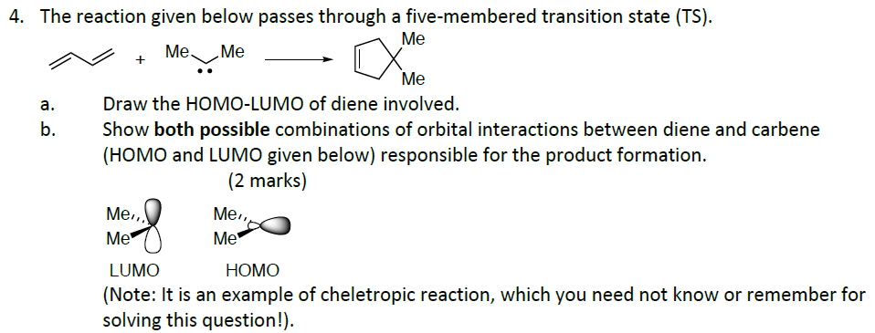
Orbital interaction- positive and negative lobes
Formation of Sigma orbital

Slide 12
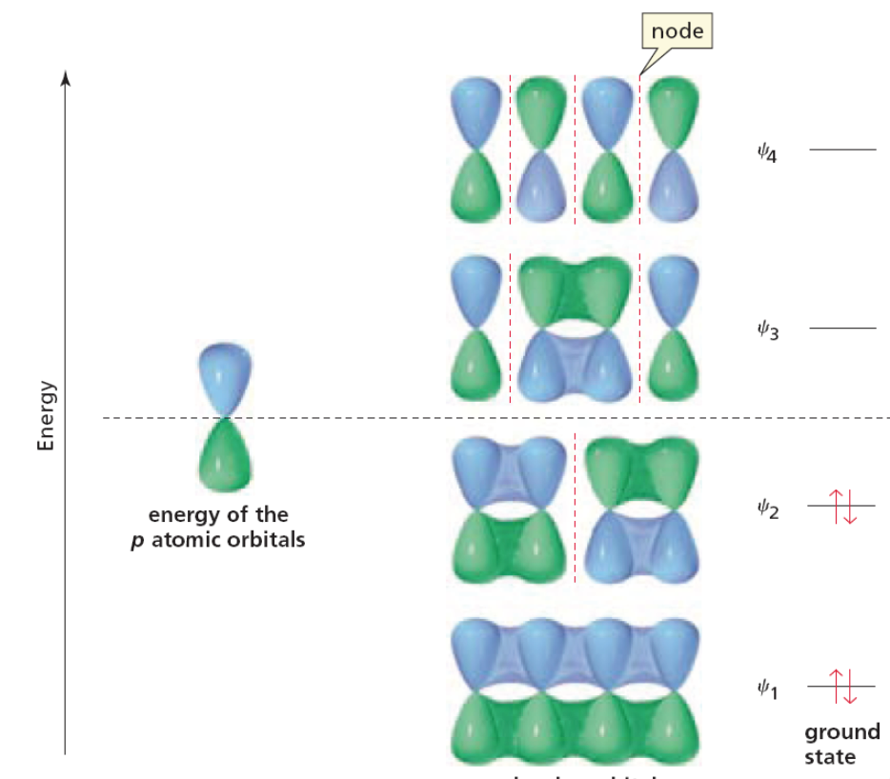
LUMO
HOMO

Slide 13
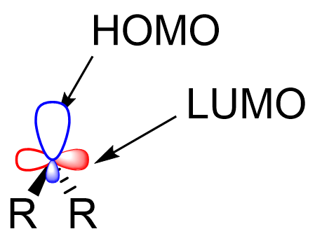
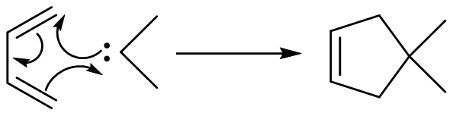
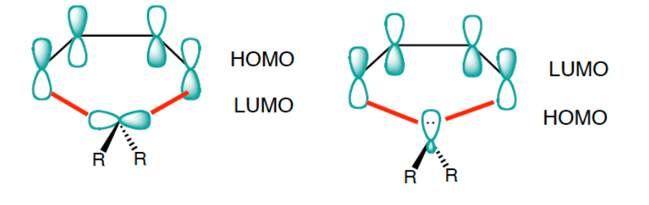

Slide 14
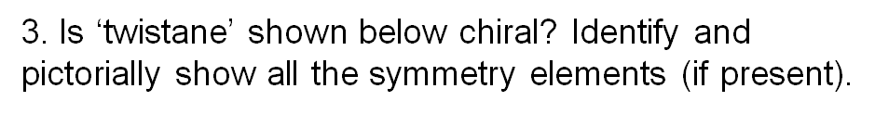
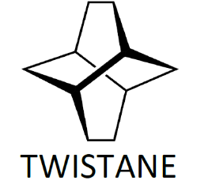
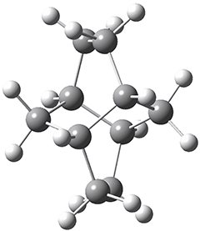
Try to find the symmetry elements
Chirality

Slide 15
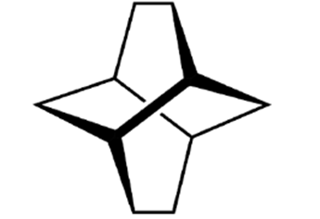
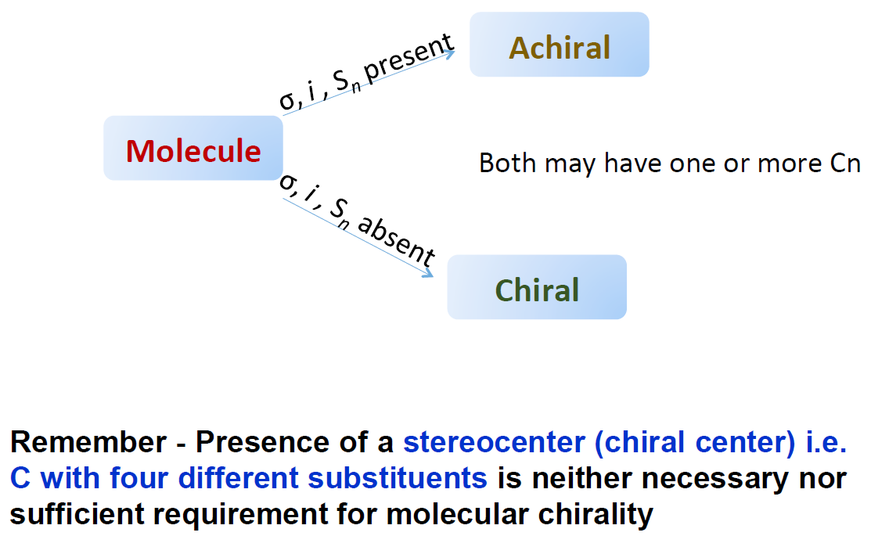
C₂
C₂
C₂
Chiral
3C₂

Slide 16
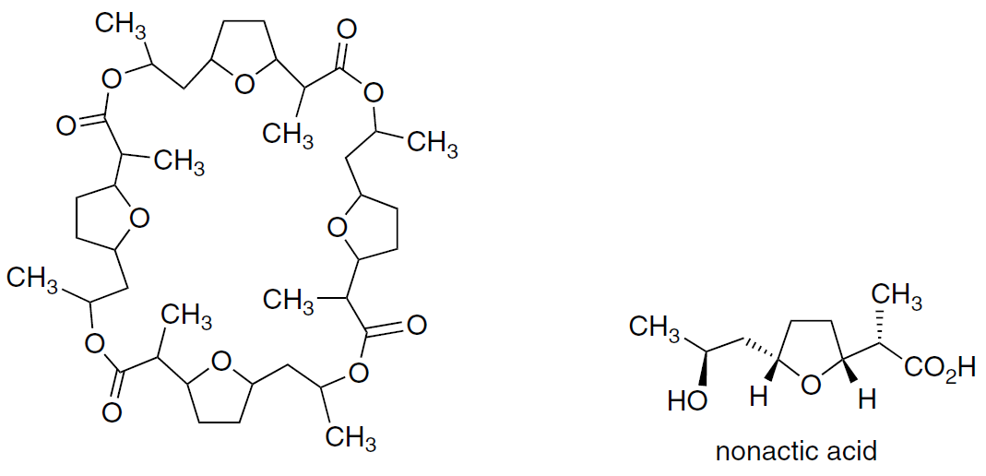
Q 6. Shown below is the structure of nanactin without any specification of stereochemistry. It was found to be optically inactive.
When completely hydrolyzed, it yields racemic nonactic acid.
Draw the sterochemical structure of nonactin from this information using appropriate wedges at the chiral centers.
When the whole molecule will become optically inactive ??
Mirror plane of symmetry
Inversion center (i)
Improper axis of symmetry (Sn)

Slide 18
On hydrolysis, since nonactin yields a racemic mixture, the structure has 2 molecules of NA and 2 molecules of NA*.
As nonactin is optically inactive, the structure must have one plane of symmetry or one inversion center or one Sn axis. The structure may be..
S4 axis (do not contain plane)
Inversion center

Slide 19
S4 axis
(do not contain plane)
Inversion center

Slide 20
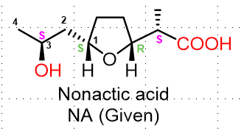

Slide 21
Thank you !

