Slide 1
OPTIMIZATION METHODS
Service placement
with Java
4 servers, 12 services
An approximate search with reproducible evidence
Prepared for Dr. Godar
01
Notes:
Present the problem in plain terms. Source: supplied Optimization_Methods_Week_00.pptx slides 2–4 and Week_01 slides 2–4. Project data: data/servers.csv and data/services.csv. The user confirmed service latency in milliseconds.

Slide 2
The optimization model
DECISION
One server choice for every service
OBJECTIVE
Minimize average service + server delay
CONSTRAINTS
CPU, RAM, storage and minimum service count
KNOWN INPUTS
Demands, capacities and latencies in stated units
D(x) = sum(service latency + assigned server latency) / 12
02
Notes:
Source: supplied Week 0 slides 4–12 and Week 1 slides 4–9, 20–22. Explain data versus decisions and objective versus constraints. p_i is own service latency, L_s is host latency. Equal service weighting assumes no supplied traffic frequencies. Minimum two is from the original code and configurable.

Slide 3
The search space and our budget
16,777,216
4 choices for each of 12 services
Maximum budget: 1,000,000 evaluations
Default stop: three complete batches without improvement
Each batch contains 10,000 evaluations
03
Notes:
Source: supplied Week 1 slides 10 and 15–16. Calculation 4^12 = 16,777,216 includes infeasible candidates. One million is a cap, not a count of feasible solutions. Default settings: SearchConfig.defaults(). Patience is checked at complete evaluation batches.

Slide 4
GRASP with move and swap descent
01
Construct a feasible starting placement
02
Choose randomly among good compatible hosts
03
Inspect moves and swaps for a feasible improvement
04
Repeat local descent until no strict improvement remains
05
Restart from a new placement, within the shared budget
At most 36 moves + 66 swaps per complete neighborhood
04
Notes:
Method design extends the lecture foundations. This is standard Greedy Randomized Adaptive Search Procedure structure, not a claimed new algorithm. See Optimizer.java. Every fifth construction attempt uses unrestricted feasible choices to maintain diversity. Complete neighborhoods have at most 36 moves and 66 swaps. Global budget or stopping can interrupt a pass. No global guarantee follows.

Slide 5
A hand-calculated evaluation check
Two hosts, three services, at least one service on each host
Candidate | Assignment | Delay | Demo cost | Feasible?
A | S1, S2, S1 | 12 ms | 1.0 | Yes
B | S2, S1, S2 | 17 ms | 1.1 | Yes
C | S1, S1, S1 | Excluded | Excluded | No
A has lower delay and lower cost than B.
C breaks a mandatory rule and cannot be selected.
05
Notes:
Source: Week 1 slides 20–22 and project SelfTest.toy(). Servers: delays 5/20 ms and CPU rates 0.2/0.1, capacities sufficient. Services: CPU [2,4,1], own latency [1,2,3]. Min one service per host. Candidate A delay (6+22+8)/3 = 12 and cost 0.4+0.4+0.2 = 1. Candidate B delay (21+7+23)/3 = 17 and cost .2+.8+.1 = 1.1. Candidate C fails the minimum-count rule.

Slide 6
A feasible placement with 27.75 ms delay
Host | Services | CPU / cap | RAM / cap | Storage / cap
S1 | 4 | 32 / 48 | 88 / 96 | 530 / 1000
S2 | 2 | 18 / 24 | 20 / 192 | 1100 / 1200
S3 | 2 | 10 / 16 | 56 / 64 | 1800 / 4000
S4 | 4 | 18 / 20 | 48 / 48 | 250 / 500
Average delay = (63 + 270) / 12 = 27.75 ms
All resource limits hold. Every server runs at least two services.
06
Notes:
Source: results/default-run/assignment.csv and server_usage.csv, seed 2026, default LATENCY objective, HYBRID. Every listed number is exported from the measured run. Delay calculation: service latencies sum to 63, assigned server latencies sum to 270, (63+270)/12=27.75 ms. Equality at S4 RAM capacity is feasible. This is best found, not certified global optimum.

Slide 7
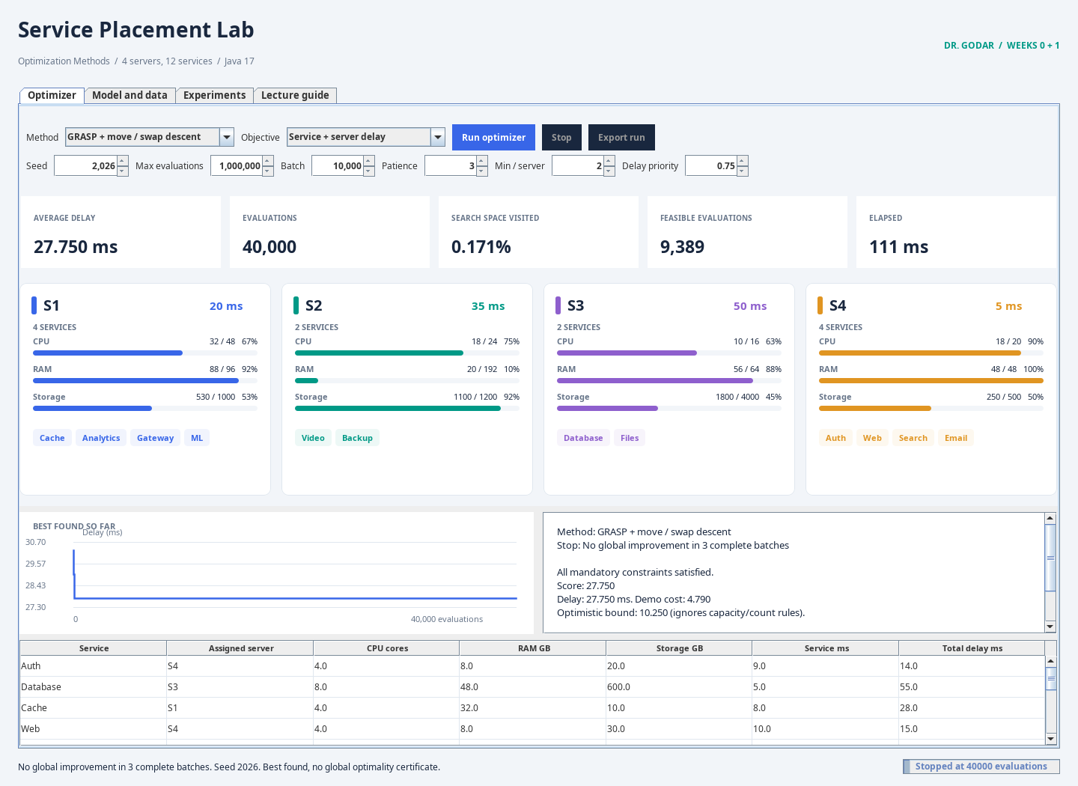
The Java dashboard
27.75 ms
Best found by evaluation 114
40,000 evaluations
28,696 distinct candidates
0.171% of the raw space visited
07
Notes:
Image: native Swing dashboard rendered from the project itself. Use the application for the live demonstration. It shows placement, resource utilization, convergence, evaluation accounting and the stopping reason. The image is a preview and not a screenshot from Microsoft PowerPoint. Default measured run: results/default-run.

Slide 8
Repeated runs give better evidence
20 paired seeds, 50,000 evaluations per method and run
4.93%
lower mean delay than uniform random search
Construction ties the hybrid on this objective.
08
Notes:
Source: results/comparison-latency/summary.csv and trials.csv. Seeds 2026–2045, 20 runs per method, 50,000 complete candidate evaluations per run, patience disabled, same evaluator and min two. Mean hybrid 27.75, constructive 27.75, random 29.1875 ms. Sample SD 0,0,0.9314497755. Random matched 27.75 in 4/20 runs. Runtime differences do not establish universal performance.

Slide 9
Cost and delay can favor different placements
The default objective minimizes delay.
An optional experiment combines normalized delay and cost.
The priority weight represents a stakeholder choice.
F = alpha × normalized delay + (1 - alpha) × normalized cost
Prices are illustrative. The plot shows sampled nondominated points.
A complete Pareto frontier is not certified.
09
Notes:
Source: supplied Week 0 slide 14 and Week 1 slides 6,12,16. Optional project extension uses illustrative CPU prices and normalized weighted sums. alpha chooses the importance of delay. The GUI sweep samples 11 weights with 20,000 evaluations each. Green means nondominated within the sample, not globally Pareto-optimal. Original user supplied no prices, energy, reliability, dependency or traffic data.

Slide 10
What the result supports
A feasible placement with explicit assumptions
A small visited subset of 16,777,216 assignments
Reproducible seeds, checks and baseline comparisons
Best found under a budget.
Global optimality is not certified.
10
Notes:
Source: Week 0 slides 16,18,20 and Week 1 slides 13–14,19–24,26–28. Project README, docs/REPORT.md, docs/LECTURE_MAP.md and SelfTest.java. Every lecture slide is mapped in the report package. Verification checks code against the model. Real deployment validation requires measured data and stakeholder review. GRASP is a design extension, not a method explicitly taught in these introductory decks.

