Slide 1

OPTIMIZATION METHODS
Week 0
The language of
better decisions
A friendly orientation before the formal course begins
Fourth-Year Software / Computer Engineering
Notes:
Optimization is the disciplined process of choosing among alternatives when some choices are better than others and limitations prevent us from having everything. In computing, the choice may be a server, route, schedule, feature set, or parameter value. This introductory lecture develops the language needed to describe such problems before any mathematical method is introduced.
[Sources]
- S. S. Rao, Engineering Optimization: Theory and Practice, 5th ed., Wiley, 2019.
- MIT OpenCourseWare, 6.079 Introduction to Convex Optimization: https://ocw.mit.edu/courses/6-079-introduction-to-convex-optimization-fall-2009/
[/Sources]

Slide 2
ORIENTATION
Optimization begins whenever choices compete
You have several choices—but cannot have everything.
CHOICE
PREFERENCE
LIMIT
Which laptop should I buy?
Fast, light and affordable
My budget is fixed
Optimization Methods • Week 0
02
Notes:
Optimization becomes relevant when three conditions appear together: there is a genuine choice, there is a way to compare the choices, and at least one limitation matters. A laptop purchase illustrates the pattern. Several models are available, speed and portability affect preference, and the budget limits what is acceptable. Without alternatives or a comparison criterion, there is no optimization problem.
[Sources]
- S. S. Rao, Engineering Optimization: Theory and Practice, 5th ed., Wiley, 2019.
- S. S. Rao, Engineering Optimization: Theory and Practice, 5th ed., Wiley, 2019.
- MIT OpenCourseWare, 6.079 Introduction to Convex Optimization: https://ocw.mit.edu/courses/6-079-introduction-to-convex-optimization-fall-2009/
[/Sources]

Slide 3
ORIENTATION
A simple definition is enough for today
Optimization means finding the best acceptable choice for a particular purpose.
best
acceptable
purpose
measured quality
obeys the rules
answers a need
Optimization Methods • Week 0
03
Notes:
The phrase “best acceptable choice for a particular purpose” contains three important ideas. “Best” requires a measurable comparison. “Acceptable” means that mandatory rules are satisfied. “Purpose” reminds us that the answer depends on the stakeholder’s need. A laptop that is best for gaming may not be best for travel, even when both choices are technically feasible.
[Sources]
- S. S. Rao, Engineering Optimization: Theory and Practice, 5th ed., Wiley, 2019.
- S. S. Rao, Engineering Optimization: Theory and Practice, 5th ed., Wiley, 2019.
- MIT OpenCourseWare, 6.079 Introduction to Convex Optimization: https://ocw.mit.edu/courses/6-079-introduction-to-convex-optimization-fall-2009/
[/Sources]

Slide 4
CORE LANGUAGE
Four questions organize every optimization problem
1
2
3
4
What can change?
What means better?
What must be true?
What is already known?
decision
objective
constraint
data
If one answer is unclear, the problem is not ready for an algorithm.
Optimization Methods • Week 0
04
Notes:
Every optimization problem can be organized by four questions. What can change identifies the decisions. What means better identifies the objective. What must be true identifies the constraints. What is already known identifies the data. If any answer is ambiguous, the computer cannot evaluate candidates consistently, so the model must be clarified before selecting an algorithm.
[Sources]
- S. S. Rao, Engineering Optimization: Theory and Practice, 5th ed., Wiley, 2019.
- S. S. Rao, Engineering Optimization: Theory and Practice, 5th ed., Wiley, 2019.
- MIT OpenCourseWare, 6.079 Introduction to Convex Optimization: https://ocw.mit.edu/courses/6-079-introduction-to-convex-optimization-fall-2009/
[/Sources]

Slide 5
CORE LANGUAGE
A decision variable is something we are allowed to choose
Which server?
DECISION
How much memory?
Which route?
Which features?
Not every number in a problem is a decision.
Optimization Methods • Week 0
05
Notes:
A decision variable represents something the optimizer is permitted to choose. Examples include selecting a server, assigning memory, choosing a route, or deciding which features enter a software release. A measured value is not automatically a decision. The price of a laptop is normally supplied data, while the selected laptop model is the decision.
[Sources]
- S. S. Rao, Engineering Optimization: Theory and Practice, 5th ed., Wiley, 2019.
- S. S. Rao, Engineering Optimization: Theory and Practice, 5th ed., Wiley, 2019.
- MIT OpenCourseWare, 6.079 Introduction to Convex Optimization: https://ocw.mit.edu/courses/6-079-introduction-to-convex-optimization-fall-2009/
[/Sources]

Slide 6
CORE LANGUAGE
An objective tells us what “better” means
lower cost
OBJECTIVE
shorter time
less energy
higher reliability
Different objectives can prefer different solutions.
Optimization Methods • Week 0
06
Notes:
The objective function expresses what “better” means. Common objectives are lower cost, shorter response time, lower energy use, or higher reliability. An objective must allow two acceptable candidates to be compared consistently. Different objectives can rank the same candidates differently, which is why the objective should reflect the real purpose of the problem.
[Sources]
- S. S. Rao, Engineering Optimization: Theory and Practice, 5th ed., Wiley, 2019.
- S. S. Rao, Engineering Optimization: Theory and Practice, 5th ed., Wiley, 2019.
- MIT OpenCourseWare, 6.079 Introduction to Convex Optimization: https://ocw.mit.edu/courses/6-079-introduction-to-convex-optimization-fall-2009/
[/Sources]

Slide 7
CORE LANGUAGE
A constraint is a rule the answer must respect
budget ≤ available money
CONSTRAINT
capacity not exceeded
deadline met
required service included
A cheap answer is useless if it breaks a mandatory rule.
Optimization Methods • Week 0
07
Notes:
A constraint is a compulsory condition that separates acceptable candidates from unacceptable ones. A budget may not be exceeded, server capacity must remain available, a deadline must be met, or a required service must be included. An attractive objective value cannot compensate for violating a mandatory rule unless the model explicitly permits a controlled trade-off.
[Sources]
- S. S. Rao, Engineering Optimization: Theory and Practice, 5th ed., Wiley, 2019.
- S. S. Rao, Engineering Optimization: Theory and Practice, 5th ed., Wiley, 2019.
- MIT OpenCourseWare, 6.079 Introduction to Convex Optimization: https://ocw.mit.edu/courses/6-079-introduction-to-convex-optimization-fall-2009/
[/Sources]

Slide 8
CORE LANGUAGE
Problem data are facts supplied to the model
prices
DATA
capacities
distances
task durations
Data are inputs; decisions are outputs of the model.
Optimization Methods • Week 0
08
Notes:
Problem data are values known before the optimization begins. Prices, capacities, distances, service demands, and task durations describe the instance being solved. Data influence the answer but are not selected by the optimizer. Keeping data separate from decisions makes the model clearer and allows the same algorithm to solve many different instances.
[Sources]
- S. S. Rao, Engineering Optimization: Theory and Practice, 5th ed., Wiley, 2019.
- S. S. Rao, Engineering Optimization: Theory and Practice, 5th ed., Wiley, 2019.
- MIT OpenCourseWare, 6.079 Introduction to Convex Optimization: https://ocw.mit.edu/courses/6-079-introduction-to-convex-optimization-fall-2009/
[/Sources]

Slide 9
CANDIDATES
A candidate solution is one complete proposal
CANDIDATE A
CANDIDATE B
Laptop: Model X
RAM: 16 GB
Storage: 512 GB
Price: 850 USD
Laptop: Model Y
RAM: 32 GB
Storage: 1 TB
Price: 1,250 USD
Optimization Methods • Week 0
09
Notes:
A candidate solution is one complete proposal containing values for every required decision. In the laptop example, a candidate identifies a particular model and its configuration. Candidate A and Candidate B can be compared only after the same objective and constraints are applied. A partial suggestion is not yet a candidate if important decisions remain unspecified.
[Sources]
- S. S. Rao, Engineering Optimization: Theory and Practice, 5th ed., Wiley, 2019.
- S. S. Rao, Engineering Optimization: Theory and Practice, 5th ed., Wiley, 2019.
- MIT OpenCourseWare, 6.079 Introduction to Convex Optimization: https://ocw.mit.edu/courses/6-079-introduction-to-convex-optimization-fall-2009/
[/Sources]

Slide 10
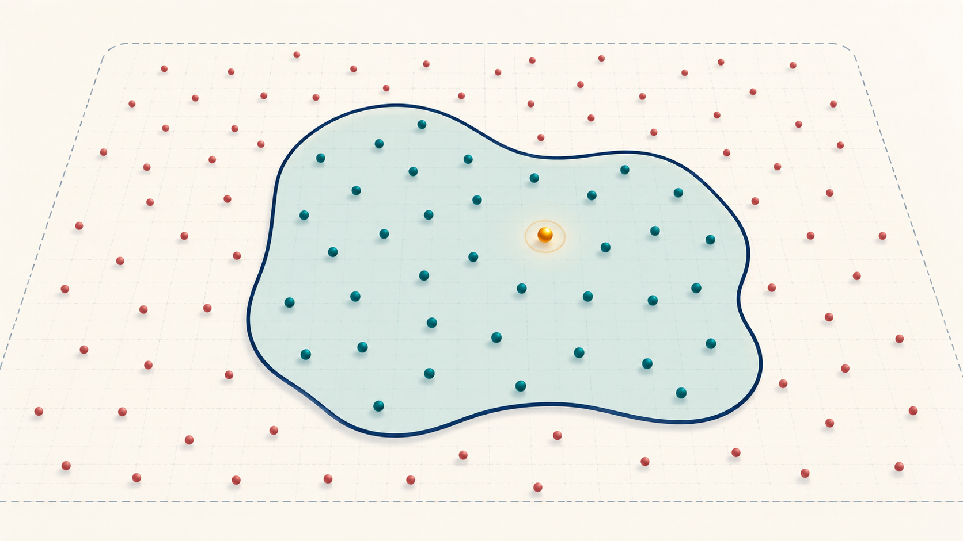
FEASIBILITY
Feasible means every mandatory rule is satisfied
FEASIBLE
INFEASIBLE
inside budget
over budget
enough capacity
overloaded
deadline satisfied
missing requirement
Optimization Methods • Week 0
10
Notes:
Feasibility answers a yes-or-no question: does the candidate satisfy every mandatory constraint? The graphic shows valid candidates inside the bounded region and invalid candidates outside it. The highlighted amber point is the best candidate among those that are feasible. An infeasible candidate may look attractive, but it cannot be selected as the final answer under the current rules.
[Sources]
- S. S. Rao, Engineering Optimization: Theory and Practice, 5th ed., Wiley, 2019.
- S. S. Rao, Engineering Optimization: Theory and Practice, 5th ed., Wiley, 2019.
- MIT OpenCourseWare, 6.079 Introduction to Convex Optimization: https://ocw.mit.edu/courses/6-079-introduction-to-convex-optimization-fall-2009/
[/Sources]

Slide 11

SEARCH SPACE
The search space is the set of all possible candidates
best found so far
An algorithm chooses which candidates to examine.
Optimization Methods • Week 0
11
Notes:
The search space is the complete set of candidates that the chosen representation can produce. The image presents this space as a landscape containing many possible solutions. High and low regions represent different objective values, while the highlighted point represents the best value. An optimization algorithm explores only part of a large landscape and uses evidence to decide where to search next.
[Sources]
- S. S. Rao, Engineering Optimization: Theory and Practice, 5th ed., Wiley, 2019.
- S. S. Rao, Engineering Optimization: Theory and Practice, 5th ed., Wiley, 2019.
- MIT OpenCourseWare, 6.079 Introduction to Convex Optimization: https://ocw.mit.edu/courses/6-079-introduction-to-convex-optimization-fall-2009/
[/Sources]

Slide 12
EVALUATION
Evaluation gives every candidate a consistent result
1
2
3
4
Candidate
Check rules
Measure quality
Record result
feasible or infeasible
objective value
optional runtime or resource evidence
Optimization Methods • Week 0
12
Notes:
Evaluation applies the model consistently to one candidate. First, the candidate is decoded into decisions. Second, every constraint is checked. Third, the objective value is calculated for feasible candidates. Finally, the result is recorded. Because every candidate passes through the same evaluator, comparisons remain fair and reproducible.
[Sources]
- S. S. Rao, Engineering Optimization: Theory and Practice, 5th ed., Wiley, 2019.
- S. S. Rao, Engineering Optimization: Theory and Practice, 5th ed., Wiley, 2019.
- MIT OpenCourseWare, 6.079 Introduction to Convex Optimization: https://ocw.mit.edu/courses/6-079-introduction-to-convex-optimization-fall-2009/
[/Sources]

Slide 13
OBJECTIVE DIRECTION
Some objectives are minimized; others are maximized
MINIMIZE
MAXIMIZE
cost • time • error • energy
profit • reliability • coverage • value
Direction alone is not enough—the exact measure must be stated.
Optimization Methods • Week 0
13
Notes:
Objectives can be written as minimization or maximization problems. Cost, time, error, and energy are usually minimized, whereas profit, coverage, reliability, and delivered value are usually maximized. The direction must be stated explicitly. Saying “optimize cost” is incomplete because it does not say whether the intended outcome is lower or higher.
[Sources]
- S. S. Rao, Engineering Optimization: Theory and Practice, 5th ed., Wiley, 2019.
- S. S. Rao, Engineering Optimization: Theory and Practice, 5th ed., Wiley, 2019.
- MIT OpenCourseWare, 6.079 Introduction to Convex Optimization: https://ocw.mit.edu/courses/6-079-introduction-to-convex-optimization-fall-2009/
[/Sources]

Slide 14
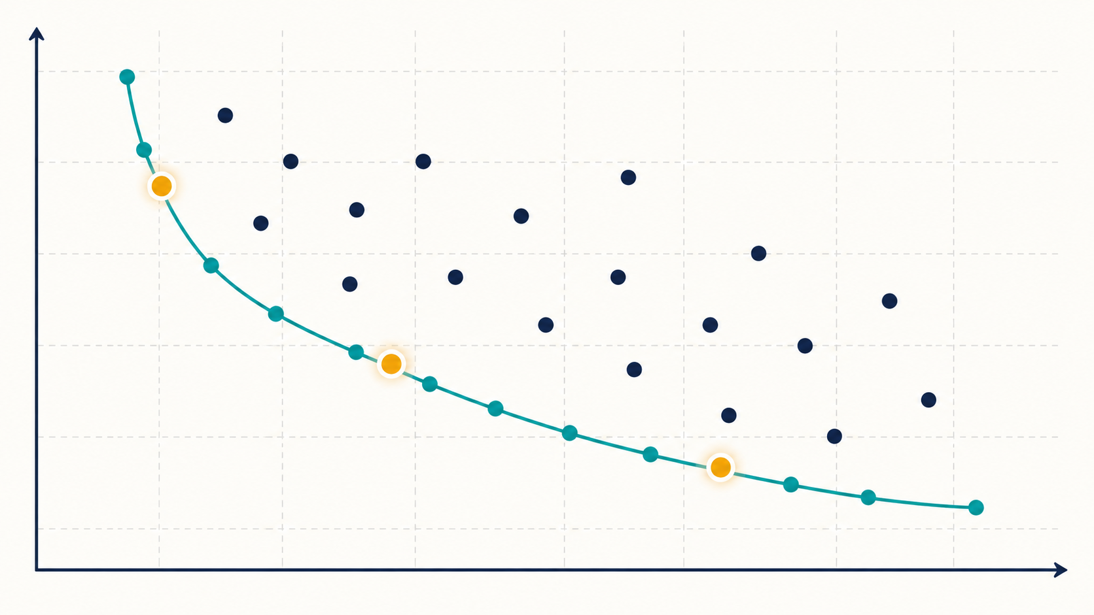
TRADE-OFFS
Two good objectives may disagree
Lower cost may mean
slower response.
Optimization can reveal choices;
people still decide priorities.
Optimization Methods • Week 0
14
Notes:
Real engineering problems often contain objectives that conflict. The graph shows a trade-off frontier: improving one objective tends to worsen the other. Points away from the frontier are dominated because another candidate performs at least as well on both measures. The amber points represent reasonable compromises, but choosing among them requires priorities from the decision maker.
[Sources]
- S. S. Rao, Engineering Optimization: Theory and Practice, 5th ed., Wiley, 2019.
- S. S. Rao, Engineering Optimization: Theory and Practice, 5th ed., Wiley, 2019.
- MIT OpenCourseWare, 6.079 Introduction to Convex Optimization: https://ocw.mit.edu/courses/6-079-introduction-to-convex-optimization-fall-2009/
[/Sources]

Slide 15
ALGORITHMS
An algorithm is a recipe for exploring candidates
1
2
3
4
5
Start
Create or modify
Evaluate
Compare
Stop and report
Different algorithms explore in different ways.
Optimization Methods • Week 0
15
Notes:
An optimization algorithm is a systematic procedure for exploring candidates. It begins from one or more candidates, creates new possibilities, evaluates their feasibility and quality, compares results, and stops according to a defined condition. Different algorithms mainly differ in how they generate candidates and use previous information to guide later exploration.
[Sources]
- S. S. Rao, Engineering Optimization: Theory and Practice, 5th ed., Wiley, 2019.
- S. S. Rao, Engineering Optimization: Theory and Practice, 5th ed., Wiley, 2019.
- MIT OpenCourseWare, 6.079 Introduction to Convex Optimization: https://ocw.mit.edu/courses/6-079-introduction-to-convex-optimization-fall-2009/
[/Sources]

Slide 16
METHOD FAMILIES
Methods differ in the promises they can make
EXACT
HEURISTIC
METAHEURISTIC
May prove the best answer for supported models.
Uses a useful rule to find a good answer quickly.
Uses a general strategy to explore difficult spaces.
Good method choice depends on structure, scale, time and evidence required.
Optimization Methods • Week 0
16
Notes:
Exact, heuristic, and metaheuristic methods offer different kinds of evidence. An exact method may prove optimality for a supported model, but computation can become expensive. A heuristic uses problem-specific knowledge to find a useful answer quickly. A metaheuristic uses a general search strategy and often produces strong solutions without guaranteeing that the global optimum was reached.
[Sources]
- S. S. Rao, Engineering Optimization: Theory and Practice, 5th ed., Wiley, 2019.
- S. S. Rao, Engineering Optimization: Theory and Practice, 5th ed., Wiley, 2019.
- MIT OpenCourseWare, 6.079 Introduction to Convex Optimization: https://ocw.mit.edu/courses/6-079-introduction-to-convex-optimization-fall-2009/
[/Sources]

Slide 17
APPLICATIONS
Optimization appears throughout computing
Routing
Cloud
AI
choose network paths
place and scale services
adjust parameters to reduce error
Software
Security
Scheduling
select tests and features
allocate limited defenses
assign tasks, rooms and time
Optimization Methods • Week 0
17
Notes:
Optimization appears throughout computing. Routing selects network paths, cloud optimization places and scales services, machine learning adjusts model parameters, software engineering prioritizes features and tests, cybersecurity allocates limited protection resources, and scheduling assigns tasks, rooms, processors, or time. The mathematical language changes little even when the application changes.
[Sources]
- S. S. Rao, Engineering Optimization: Theory and Practice, 5th ed., Wiley, 2019.
- S. S. Rao, Engineering Optimization: Theory and Practice, 5th ed., Wiley, 2019.
- MIT OpenCourseWare, 6.079 Introduction to Convex Optimization: https://ocw.mit.edu/courses/6-079-introduction-to-convex-optimization-fall-2009/
[/Sources]

Slide 18
JAVA ORIENTATION
In Java, keep the problem separate from the search
data describe the instance
ProblemData
Candidate
Evaluation
Evaluator
SearchMethod
ExperimentRunner
candidate stores decisions
evaluator checks and measures
search method explores
runner records evidence
Optimization Methods • Week 0
18
Notes:
A clean Java design separates the optimization problem from the search method. ProblemData stores known values, Candidate stores decisions, Evaluator checks constraints and calculates quality, SearchMethod controls exploration, and ExperimentRunner records evidence. This separation allows several algorithms to be compared on exactly the same model and reduces the risk of changing the problem unintentionally.
[Sources]
- S. S. Rao, Engineering Optimization: Theory and Practice, 5th ed., Wiley, 2019.
- S. S. Rao, Engineering Optimization: Theory and Practice, 5th ed., Wiley, 2019.
- MIT OpenCourseWare, 6.079 Introduction to Convex Optimization: https://ocw.mit.edu/courses/6-079-introduction-to-convex-optimization-fall-2009/
[/Sources]

Slide 19
CLASS ACTIVITY
Orientation activity: describe, do not solve
Choose a laptop for a software-engineering student
1
List three candidate laptops.
2
Choose one objective.
3
Write two constraints.
4
Identify the problem data.
5
Explain how each candidate would be evaluated.
Optimization Methods • Week 0
19
Notes:
The laptop activity converts an everyday decision into an optimization description. The candidate set contains several complete laptop configurations. The objective might minimize price or maximize a weighted performance score. Constraints could include budget, minimum memory, and required portability. Product specifications and prices are data used to evaluate every candidate consistently.
[Sources]
- S. S. Rao, Engineering Optimization: Theory and Practice, 5th ed., Wiley, 2019.
- S. S. Rao, Engineering Optimization: Theory and Practice, 5th ed., Wiley, 2019.
- MIT OpenCourseWare, 6.079 Introduction to Convex Optimization: https://ocw.mit.edu/courses/6-079-introduction-to-convex-optimization-fall-2009/
[/Sources]

Slide 20
COMMON CONFUSIONS
Three confusions to avoid from the beginning
DATA ≠ DECISION
OBJECTIVE ≠ CONSTRAINT
GOOD ≠ FEASIBLE
Price is known; which product to buy is chosen.
Low cost is preferred; budget is mandatory.
A high-quality solution may still break a rule.
Optimization Methods • Week 0
20
Notes:
Three distinctions prevent common modelling errors. Data are known inputs, while decisions are chosen outputs. An objective expresses preference, while a constraint is mandatory. Feasibility means that the rules are satisfied, but it does not necessarily mean that the candidate is good. Optimization first identifies acceptable candidates and then compares their quality.
[Sources]
- S. S. Rao, Engineering Optimization: Theory and Practice, 5th ed., Wiley, 2019.
- S. S. Rao, Engineering Optimization: Theory and Practice, 5th ed., Wiley, 2019.
- MIT OpenCourseWare, 6.079 Introduction to Convex Optimization: https://ocw.mit.edu/courses/6-079-introduction-to-convex-optimization-fall-2009/
[/Sources]

Slide 21
SUMMARY
The five words to remember
DECISION
OBJECTIVE
CONSTRAINT
DATA
CANDIDATE
what may change
what means better
what must be true
what is known
one complete proposal
Next: turn this language into a formal optimization model.
Optimization Methods • Week 0
21
Notes:
The five core words summarize the foundation of the course. A decision is what may change, an objective defines better, a constraint states what must remain true, data describe what is known, and a candidate is one complete proposal. Later lectures add mathematical notation and algorithms, but these five roles remain present in every optimization model.
[Sources]
- S. S. Rao, Engineering Optimization: Theory and Practice, 5th ed., Wiley, 2019.
- S. S. Rao, Engineering Optimization: Theory and Practice, 5th ed., Wiley, 2019.
- MIT OpenCourseWare, 6.079 Introduction to Convex Optimization: https://ocw.mit.edu/courses/6-079-introduction-to-convex-optimization-fall-2009/
[/Sources]

Slide 22
NEXT LECTURE
Week 1
Thinking clearly about better decisions
Models, problem types, engineering applications and Java evaluation
Questions?
Notes:
Week 1 turns this intuitive language into formal optimization models. Students will learn how decision variables, objective functions, constraints, and domains are written, how problems are classified, and why the problem structure determines which solution method is appropriate.
[Sources]
- S. S. Rao, Engineering Optimization: Theory and Practice, 5th ed., Wiley, 2019.
- S. S. Rao, Engineering Optimization: Theory and Practice, 5th ed., Wiley, 2019.
- MIT OpenCourseWare, 6.079 Introduction to Convex Optimization: https://ocw.mit.edu/courses/6-079-introduction-to-convex-optimization-fall-2009/
[/Sources]

