Slide 1

GDELT: Code 14
By: Aniket Jadhav
Shashank Kava
Arpit Chandra

Slide 2
Database
GDELT: Global Database of Events, Language, and Tone
Initiative to construct a catalog of human societal-scale behavior and beliefs across all countries of the world by Kalev Leetaru
Contains over a quarter-billion records
The data files use Conflict and Mediation Event Observations (CAMEO) coding for recording events

Slide 3
Problem Statement
What is the effect of political instability on economic growth of the nation?

Slide 4
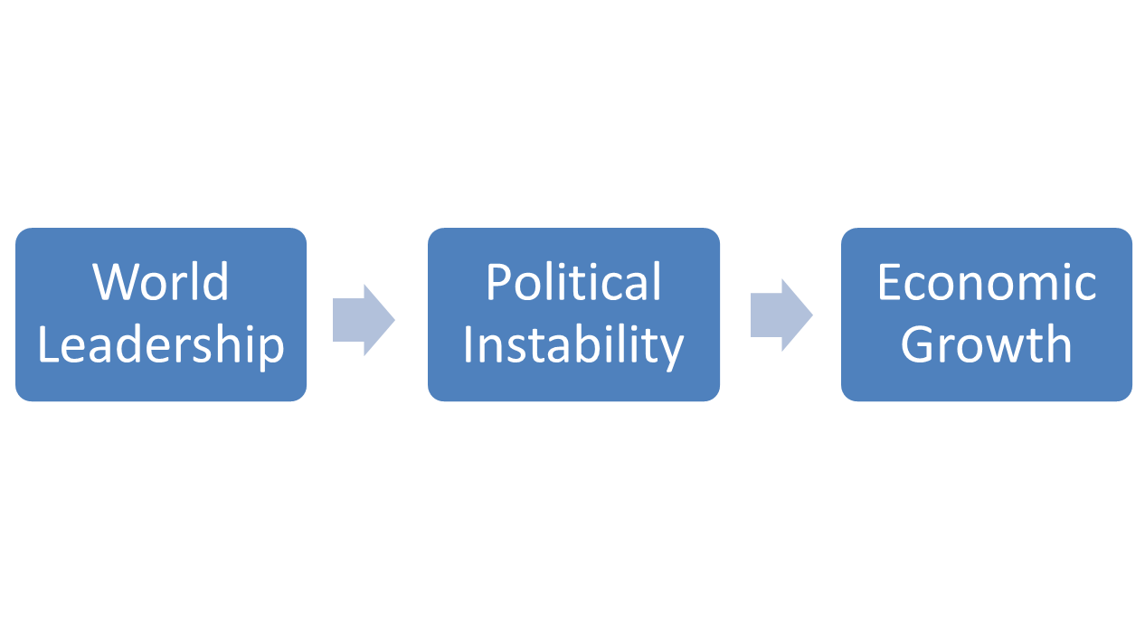
Event Codes:
1411: Demonstrate or rally for leadership change
1421: Conduct hunger strike for leadership change
1431: Conduct strike or boycott for leadership change
1441: Obstruct passage to demand leadership change

Slide 5
Nation Ties
Event Codes:
042: Make a visit
043: Host a visit
044: Meet at a ‘third’ location
05: Engage in diplomatic cooperation
06: Engage in material cooperation

Slide 6
Tools and Language
Amazon Services:
  Athena
Tableau
Tableau: Alteryx
BigQuery
Excel
Hive

Slide 7
Challenges
Big Data
MetaData
Data Cleaning

Slide 8
Thank You!

