Slide 1
SHOWING BOTS WHO SPREAD FAKE NEWS
by Karlis Dagilis, Arielle Dupiton and Shashank Kava

Slide 2
MOTIVATION

Slide 3
An Oxford University study found a quarter of the political stories shared on Twitter were based on misinformation
Some estimates suggest between 15% and 31% of Twitter users are automated tweeting algorithms
When comparing the highly automated accounts tweeting for Trump versus those messaging for Clinton, it appears that the pro-Trump tweets out-numbered pro-Clinton tweets 5-1 during pre-election period
References:
http://www.independent.co.uk/news/world/europe/french-voters-deluge-fake-news-stories-facebook-twitter-russian-influence-days-before-election-a7696506.html
https://blogs.cornell.edu/info4220/2015/03/10/bot-or-not-a-networks-analysis-of-social-media-bots-on-twitter/
http://comprop.oii.ox.ac.uk/wp-content/uploads/sites/89/2016/11/Data-Memo-US-Election.pdf

Slide 4
HOW DOES IT WORK?
Open https://twitter.com/fakeNewsViral
“analyze the news | World Gets Behind Putin’s Vow To Destroy New World Order”

Slide 5
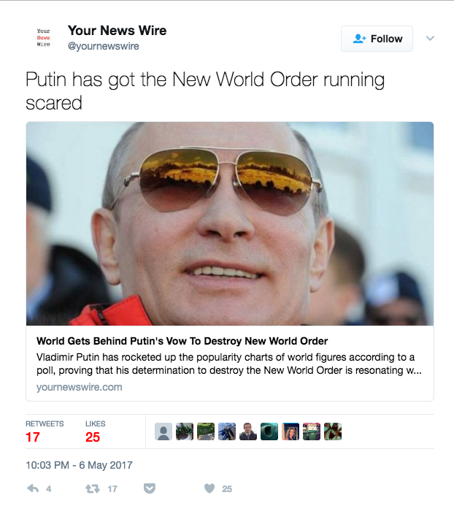
Finding fake news
http://yournewswire.com/world-gets-behind-putins-vow-to-destroy-new-world-order/

Slide 6
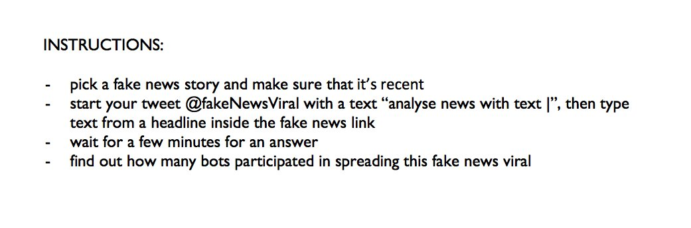
How to use the BOT?

Slide 7
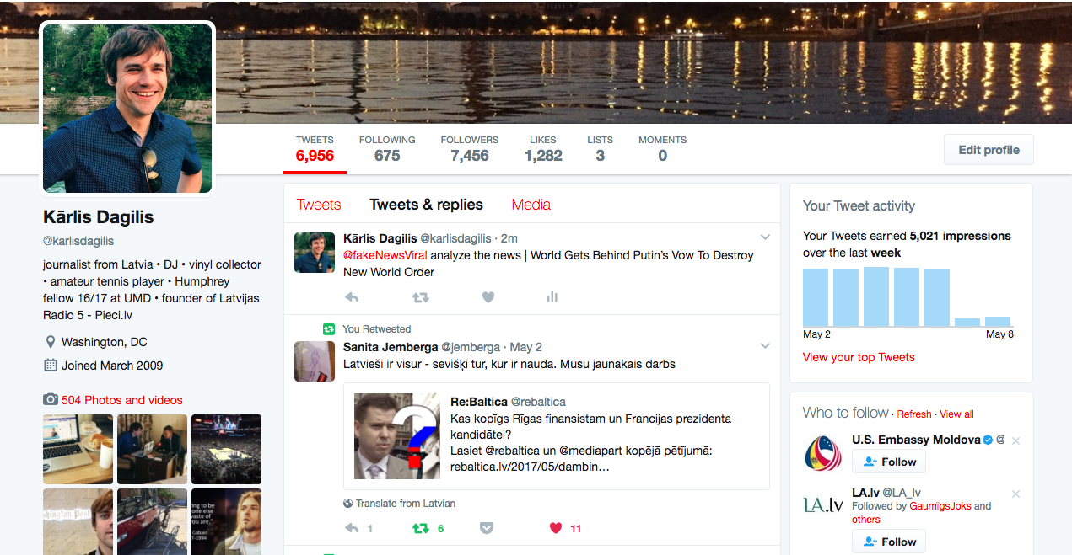

Slide 8
BACKEND

Slide 9
DATA
Relevant Columns:
Twitter handles sharing the news headline
Number of followers for each account

Slide 10
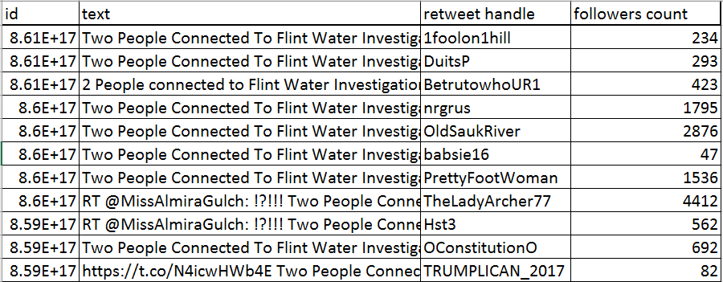
Data

Slide 11
APIs Used
Tweepy
BotOrNot

Slide 12
Tweepy
Tweet Collection
Status Update

Slide 13
BotOrNot
Analyzes user's friendship network, their Twitter content and temporal information, all in real time
Returns a bot or not score

Slide 14
BOT concept

Slide 15
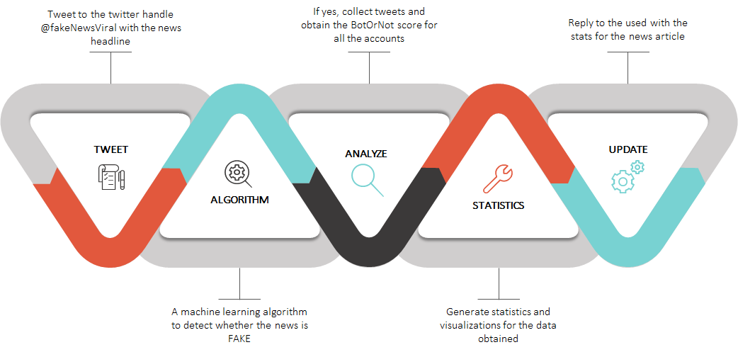

Slide 16
Easy to use twitter-bot for checking usage of bots spreading fake news on twitter;
User generated, can check out the content you actually want;
Has a visualization of the stats
STRENGTHS

Slide 17
CHALLENGES

Slide 18
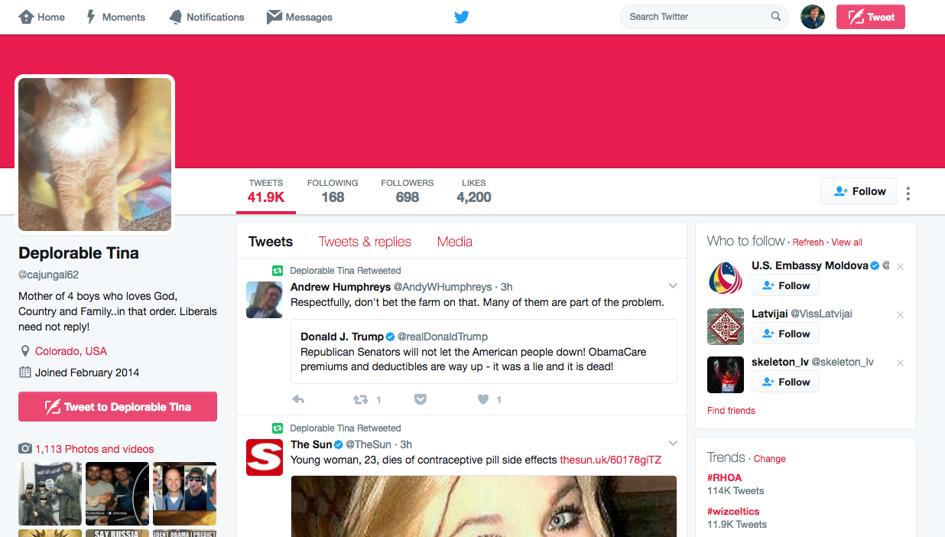

Slide 19
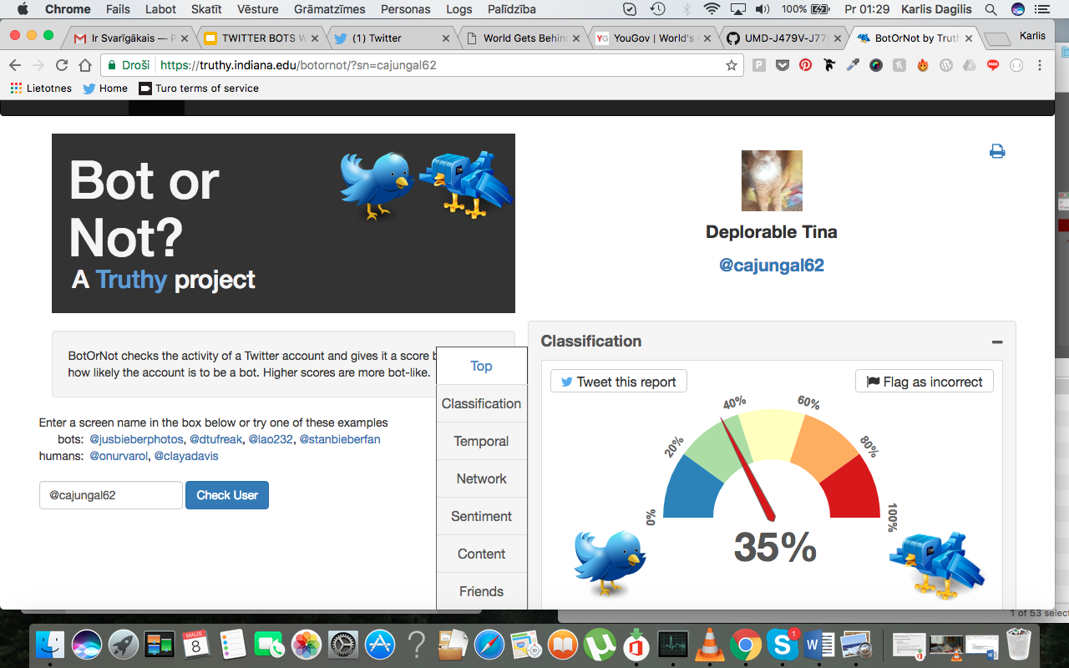
Accuracy for BotOrNot
“Bot or Not” might not working properly.
Sometimes it shows real people as a bot and other way around

Slide 20
OTHER CHALLENGES:
It takes some time for our bot to produce the results, so there might be confusion if you give him 5 tweets in a row;
Our bot can capture only small portion of one particular fake news
Vulnerable to hacking: One can tweet at our bot several times and kill it due to API limit.

Slide 21
Results
Open https://twitter.com/

Slide 22
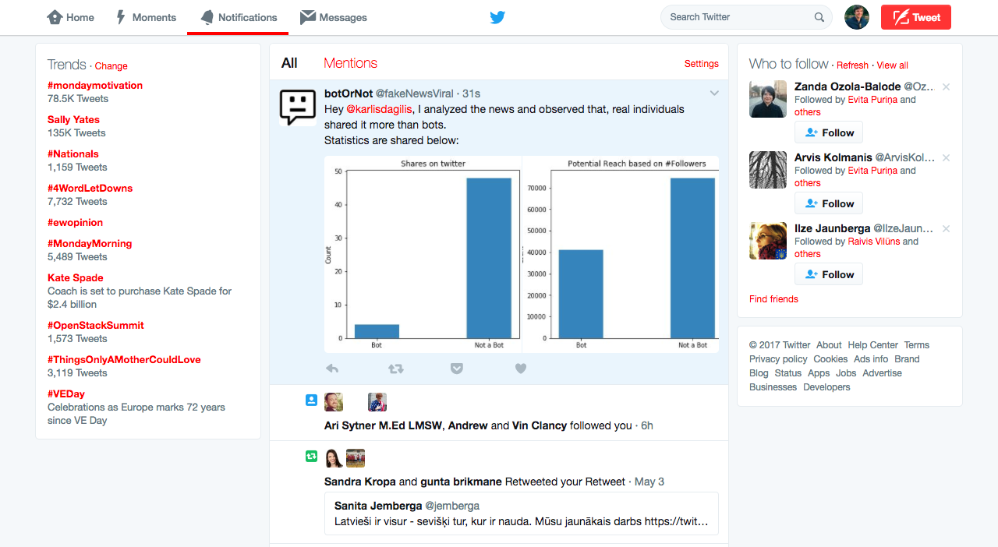

Slide 23
NEXT STEPS

Slide 24
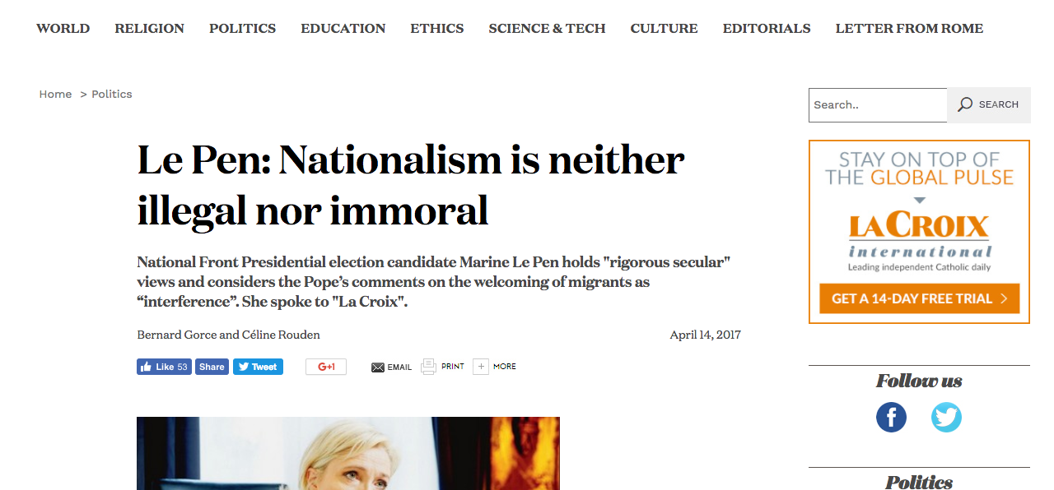
Machine Learning Algorithm: Fake or Not?

Slide 25
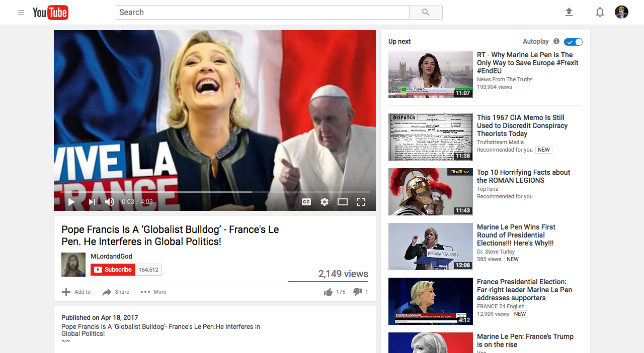
YouTube Bots

Slide 26
QUESTIONS?

