Slide 1

Flight Management System
ISAD253SL Databases
Kaveena Isuri Wijesinghe 10638375

Slide 2
Content
Introduction
Assumption
Extended Entity Relationship (EER) Diagram
Relational Mapping
Normalization
DB Diagram
Function
Stored Procedure
Triggers
Views

Slide 3
Introduction
Flight Management System
According to the ISAD253SL course work, a Flight management system database should be made. This database is made for Mihin air international airport in Sri Lanka. It is planning to activate a new database to improve the skill management system. This database requires to store details and details of international airports operated through Mihin Air, daily schedule flights and passenger check in information and seat booking details.
Database of each airports and each airlines represents with unique code assigned by the international air transport Association And also Airlines typically use a unique flight numbers. Each flight is scheduled for multiple flight legs per week. This leg has a unique numbers, date of flight, actual time etc.
If the flight leg is delayed or cancelled a special remarks included to the database with the reason .The details about the air crew and the passengers should be recorded in the database. A passenger can book a seat in any flight leg while it can be book by any number of passengers. Ticket number and class of travel are recorded in the database.
According to the rules of airline, passenger must have a seat except an infant. All the details of air crew employees include such as, staff ID, passport number, date joined, qualifications and working experience etc.
This new system should have facilities to display the seat booking details of each flight leg and should be capable of assigning an available seat to a new passenger. The boarding pass of passenger also should be printed with the necessary information along with the seat number and the gate number include as a result of the new system.
.

Slide 4
Assumption
1:1
Passenger : Flightleg
One Passenger have one Flightleg and One Flightleg have one Passenger
1:M
AirLine : AirCraft
One AirLine has many AirCraft.But,Many AirCraft have only one AirLine.
M:N
AirPort : AirLine
One Airport have many AirLine and only one AirLine have many AirPort.

Slide 5
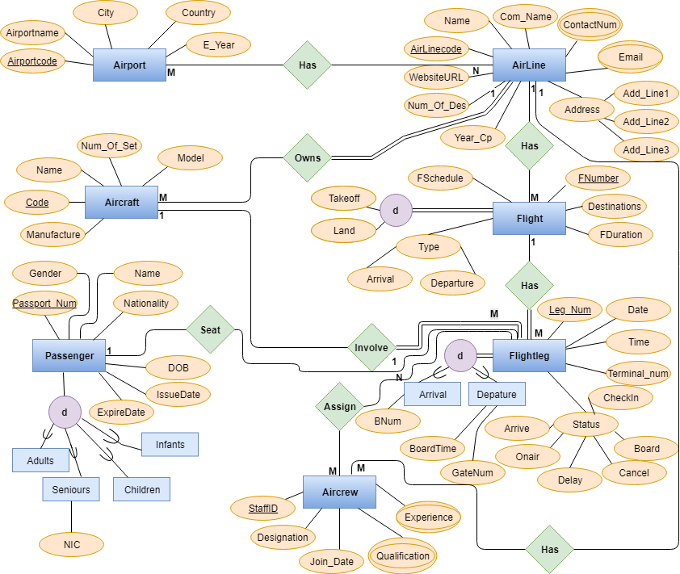
Extended Entity Relationship (EER) Diagram

Slide 6
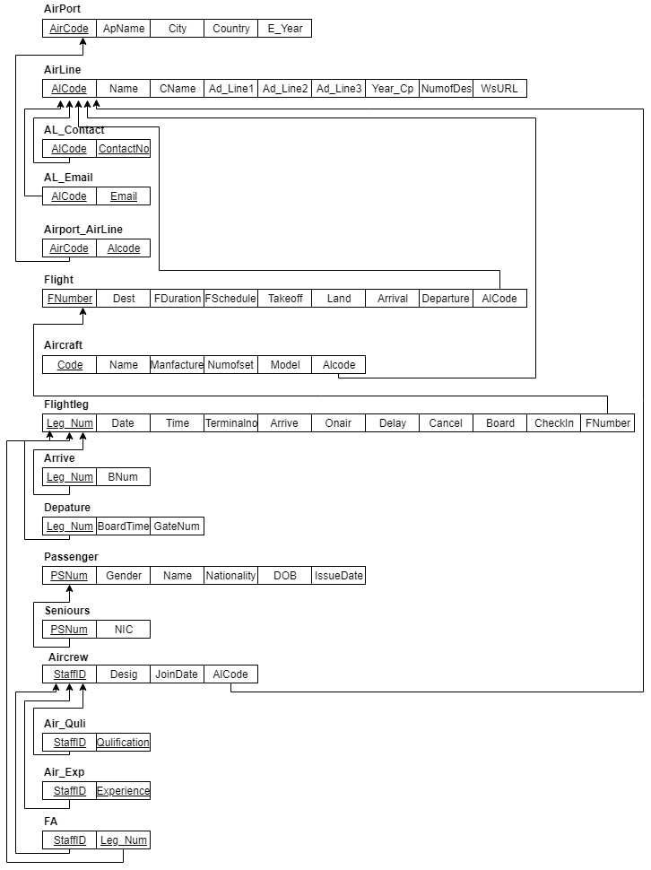
Relational Mapping

Slide 7
Normalization
Fnumber | Dest | FDuration | FSchedule | Takeoff | Land | Arrival | Departure | AlCode
1NF
2NF
3NF
Fnumber | AlCode

Slide 8
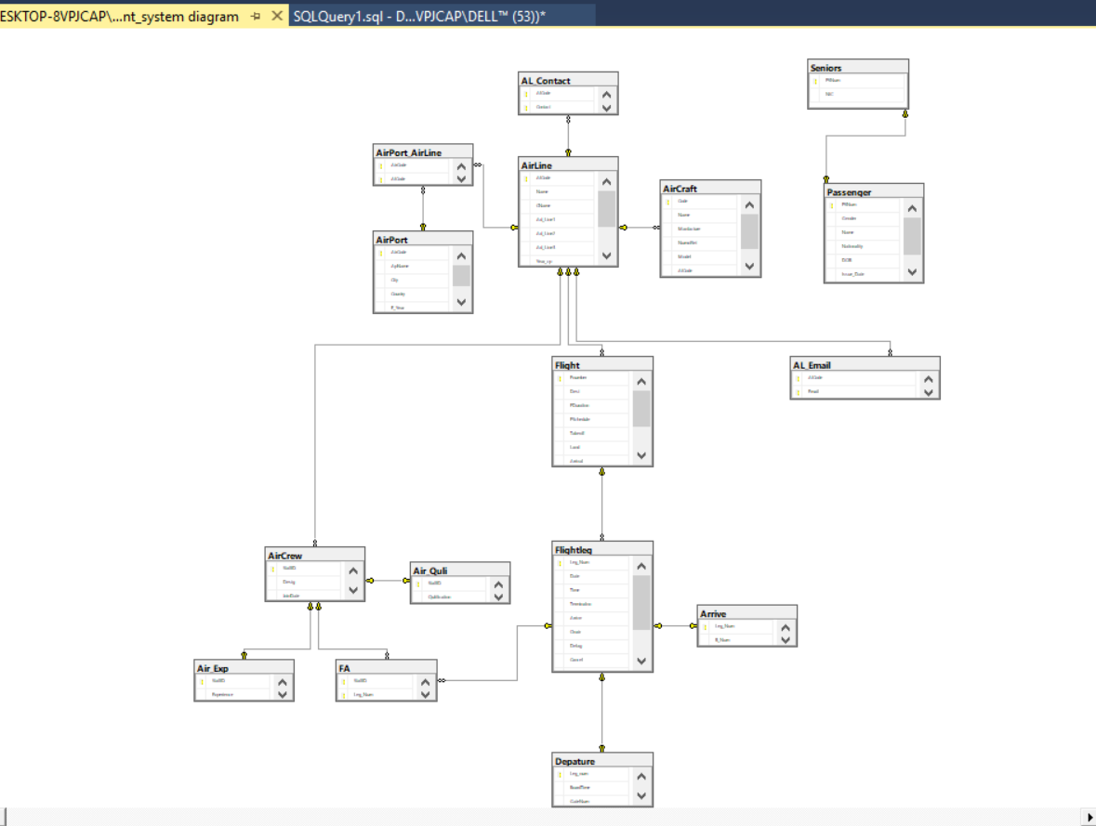
Database Diagram

Slide 9
Stored Procedure
A stored procedure is a set of Structured Query Language (SQL) statements with an assigned name, which are stored in a relational database management system as a group, so it can be reused and shared by multiple programs

Slide 10
Triggers
Used to specify automatic actions to be taken that the database system will perform when certain events and conditions occur.

Slide 11
Views
To view all Flight
To view all AIRLINE
To view all AIRPORT

Slide 12
THANK YOU…..

