Slide 1
AGRO-X
CULTIVATING LIFE – SAVING ANIMAL

Slide 2
AGRO-X
CULTIVATING LIFE – SAVING ANIMAL

Slide 3


PROBLEM STATEMENT
Animal invasion to agriculture lands has been a major drawbacks for the farmers.
WILD BOAR
ELEPHANT

Slide 4
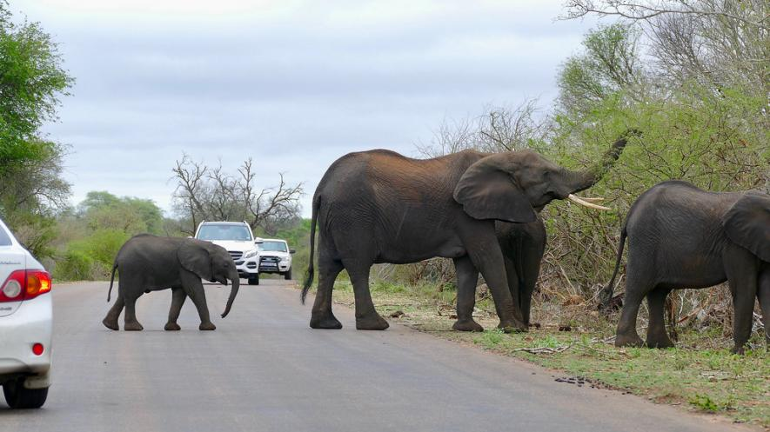
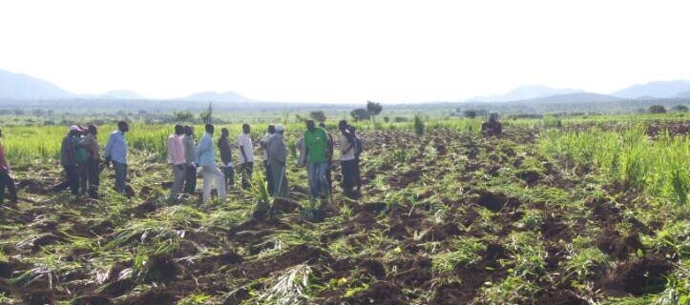
Animals Invading Farm lands
Farmlands destroyed by animals

Slide 5
PROBLEM STATEMENT
Animal invasion to agriculture lands has been a major drawbacks for the farmers.
ELEPHANT
WILD BOAR

Slide 6
TRADITIONAL METHODS
1
ELECTRIC FENCING
2
BURSTING CRACKERS

Slide 7
TRADITIONAL METHODS
1
2
ELECTRIC FENCING
BURSTING CRACKERS

Slide 8
SOLUTION OVERVIEW
It is essential to save both property and people from the animal in a way that doesn’t hurt them.
We have produced a Model which could solve the problem in an efficient way.
The device works on two factor verification.
`

Slide 9
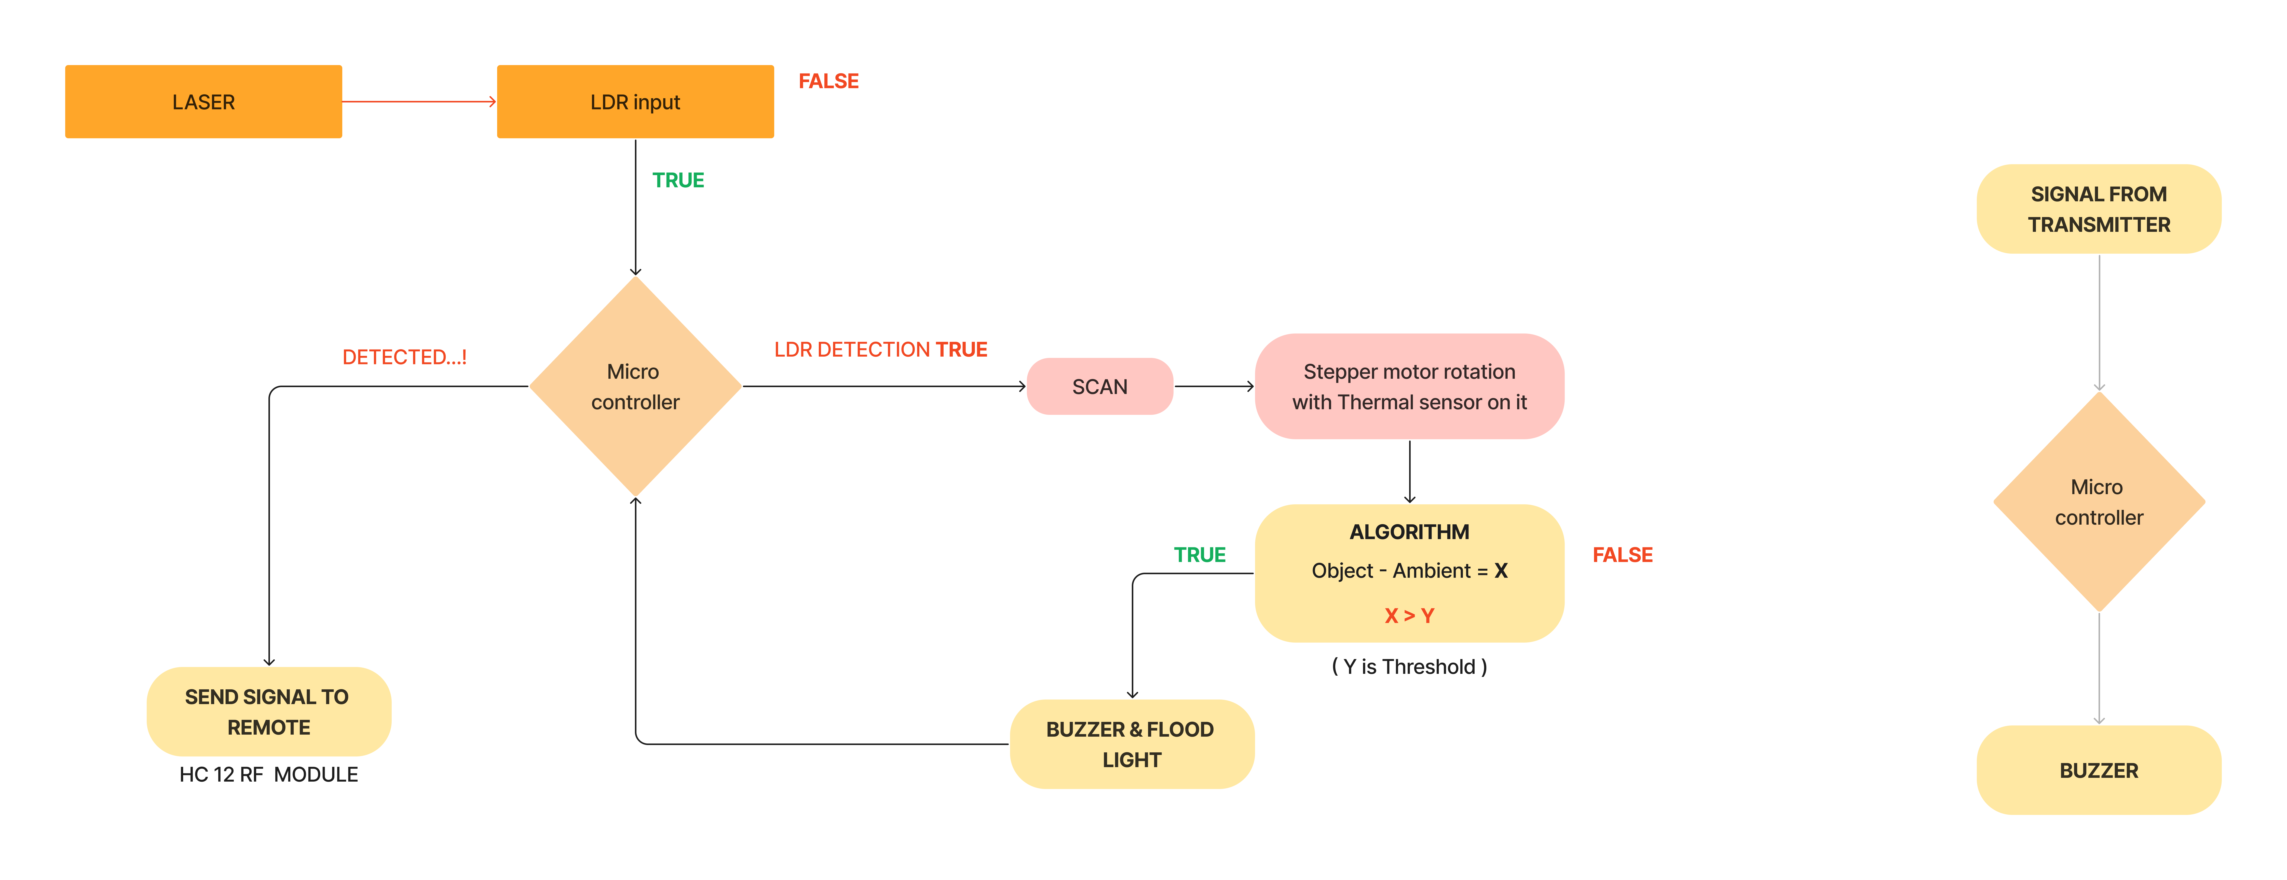
ARCHITECTURE

Slide 10
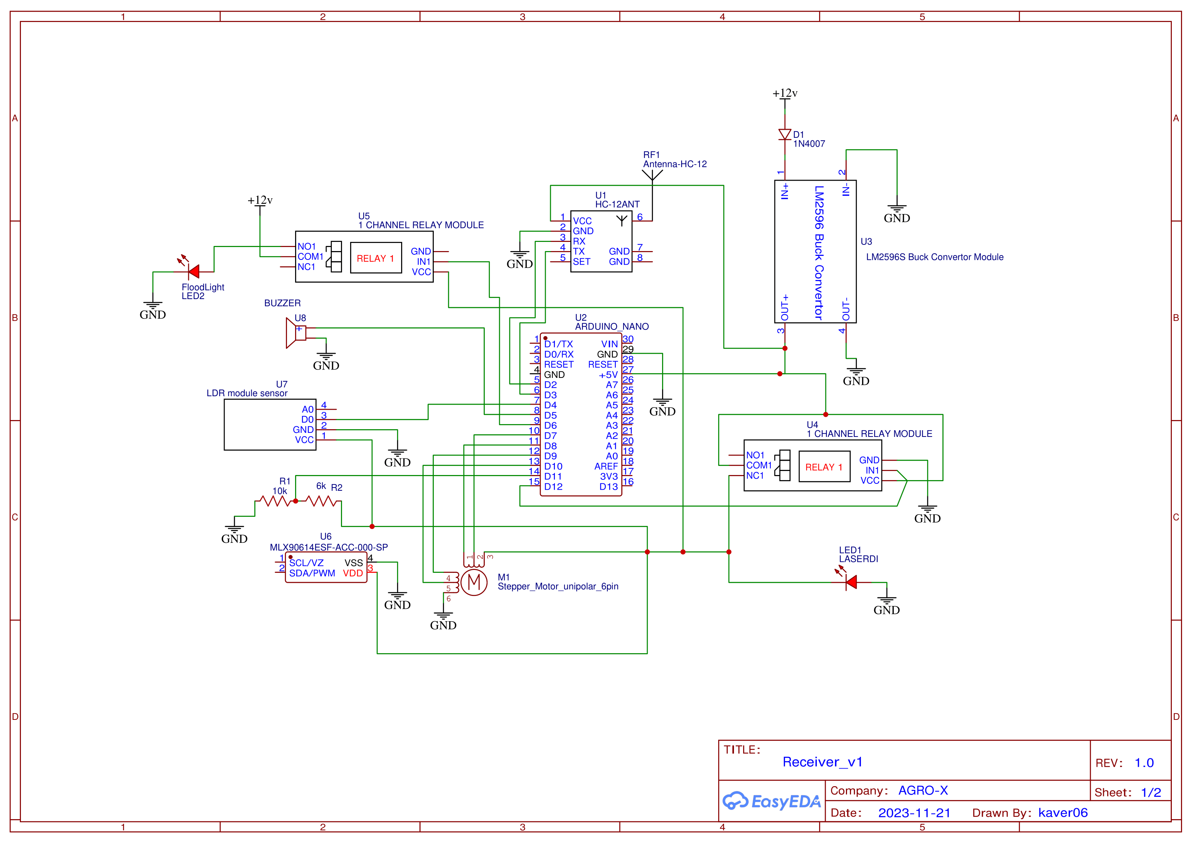
SCHEMATIC

Slide 11
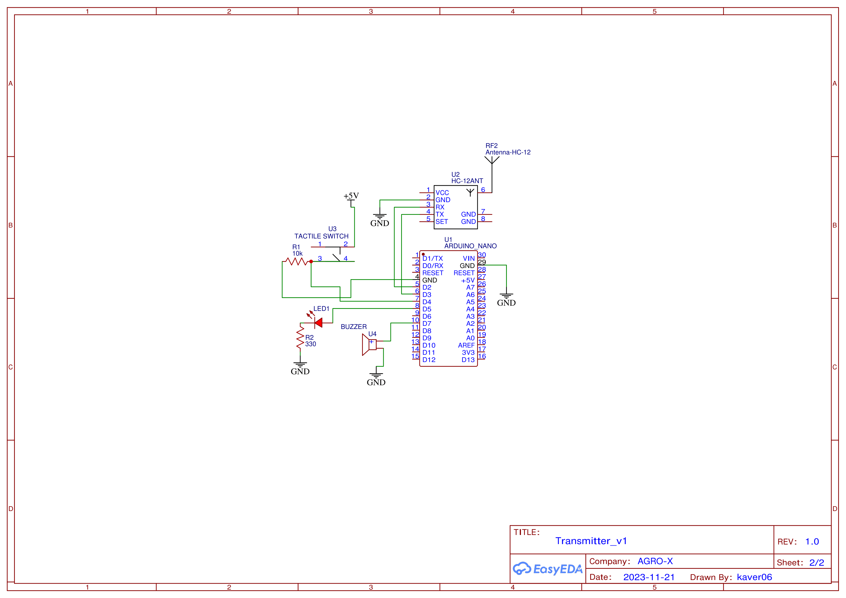
SCHEMATIC

Slide 12
COST ESTIMATION
MLX Thermal sensor | 904
Microcontroller | 1400
Stepper | 250
Miscellaneous | 2116
Total | 4670

Slide 13
CHALLENGES FACED
1ST ITTERATION
2ND ITTERATION
3RD ITTERATION
We came up with the idea of adding two LASERS
We thought of using thermal camera
Finally, we came up with idea of using thermal sensors

Slide 14
FUTURE SCOPE
GMS INTEGRATION
SOLAR PANELS
EASY UI
Upgrading wireless communication capability
Making it independent from conventional energy sources
Creating a easy to use interface for farmers

Slide 15
CONCLUSION

Slide 16
THANKS..!

