Slide 1
PROJECT INTRODUCTION
PROJECT TITLE : MEDICO
ONE – LINE IDEA : “A MERN Stack-based Medicine Reminder System that helps users manage medicine schedules, track dosages, and receive timely reminders to avoid missing doses.”
TEAM MEMBERS :
A.KAVERI – 25MVCSMR0096
B.AKSHITHA REDDY - 25MVCSMR0107
R.PRAVALLIKA - 25MVCSMR0168
V.MAYURI- 25MVCSMR0183
The problem domain of the above project is:
The Medicine Reminder System is Healthcare Technology (HealthTech).
Primary Domain: Healthcare / HealthTech
Technical Domain: Full-Stack Web Development (MERN Stack)
Subdomain: Medicine Schedule Management and Digital Health Monitoring
Application Domain: Web-Based Healthcare Management System
In one line:
Problem Domain : Technology (HealthTech) – Medicine Schedule Management System.

Slide 2
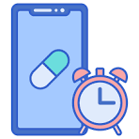
THE CHALLENGE
Real-World Problem
Forgetting to take medicines at the correct time.
Difficulty managing multiple medicines and dosages.
Missing doses or taking incorrect amounts.
Difficulty tracking medicine schedules and treatment duration.
Why It Matters
Helps users take medicines on time.
Reduces missed doses and dosage mistakes.
Improves medication schedule management.
Supports better treatment adherence and health management.
Key Challenges Faced
Managing multiple medicines and dosage schedules.
Sending reminders at the correct time.
Protecting personal and medical information.
tracking medicine start dates, end dates, and missed doses.
“A timely reminder today can make a healthier tomorrow.”

Slide 3
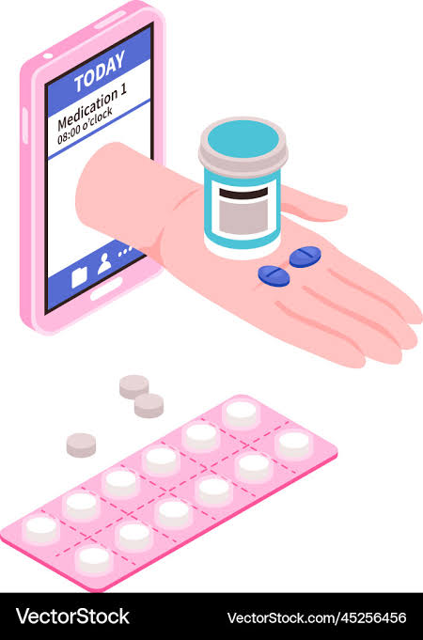
OUR INNOVATION
What Makes Our Solution Different
Core Idea
To develop a smart, user-friendly MERN Stack application that helps users schedule, track, and manage their medicines efficiently.
Key Features
Medicine Management: Add, view, update, and delete medicine records.
Dosage Scheduling: Store medicine names, dosages, and timings.
Timely Reminders: Notify users when it is time to take their medicines.
Schedule Tracking: Manage medicine start and end dates.
Secure Login: Protect user accounts and personal information.
Unique Approach
Displays all daily medicine schedules on a single dashboard.
Automatically organizes medicines according to their scheduled times.
Supports tracking of taken and missed doses.
Uses MongoDB to store records and React.js to provide a smooth user experience.

Slide 4
HOW IT WORKS
FLOW CHART:
USER JOURNEY:
Register/Login –
→ The user securely accesses the application.
2. Add Medicine –
→Enters medicine name, dosage, time, and duration.
3. Save Details –
→ The system stores the information in MongoDB.
4. View Schedule -
→ The user checks upcoming medicines on the dashboard.
5. Receive Reminder -
→ he system notifies the user when a dose is due.
6. Manage Medicines-
→ he user updates schedules or removes completed prescriptions.
INPUT
Medicine name, dosage, time, start date and end date
↓
Processing
React collects details; Node.js and Express.js validate and process them
↓
Algorithm
Save records in MongoDB, check schedules and identify reminder times.
↓
Output
Display medicine schedules and send reminders at scheduled times

Slide 5
TECHNOLOGY AND ALGORITHM
TECH STACK:
Main Algorithms
1. CRUD Operations
Add, view, update, and delete medicine records.
2. Schedule Checking Algorithm
Checks medicine timings against the current time.
3. Date Validation Algorithm
Ensures medicine schedules fall within the specified start and end dates.
4. Authentication Algorithm
Verifies user credentials and protects private records.
5. Reminder Scheduling Algorithm
Triggers notifications when a medicine dose is due.
Technology | Purpose
React.js | Builds an interactive user interface.
Node.js | Runs the backend server.
Express.js | Creates REST APIs for medicine management.
MongoDB | Stores medicine schedules and user details.
JWT & bcrypt | Supports authentication and password security.
Node-cron / Notification API | Helps schedule and deliver medicine reminders.

Slide 6
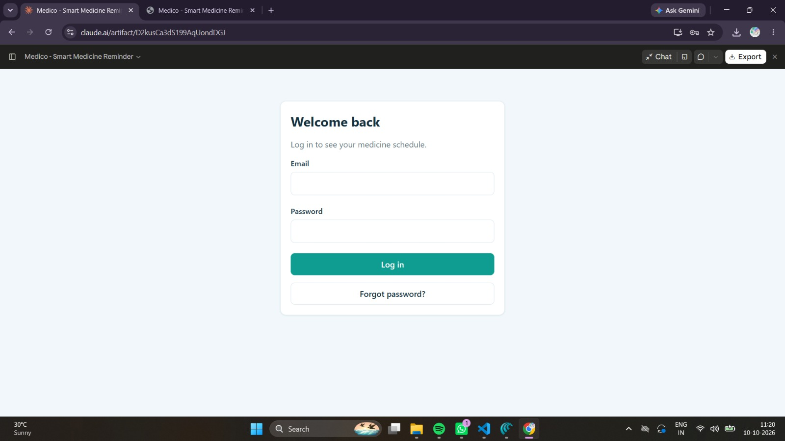
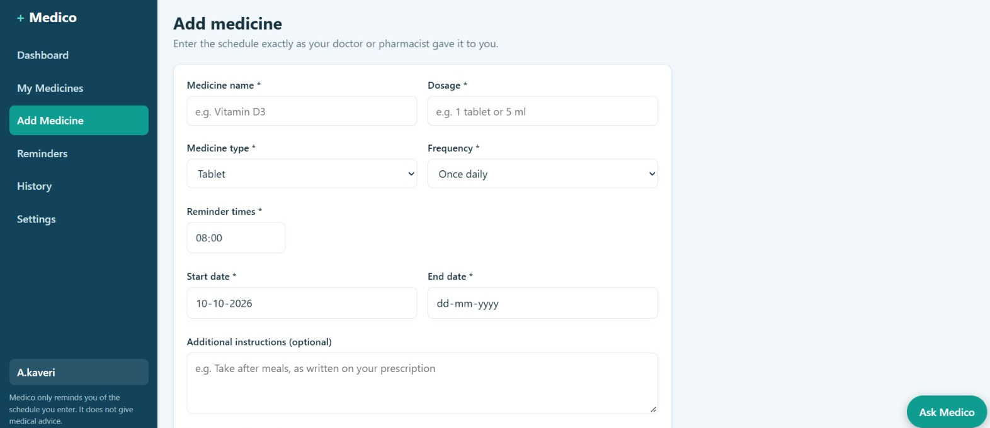
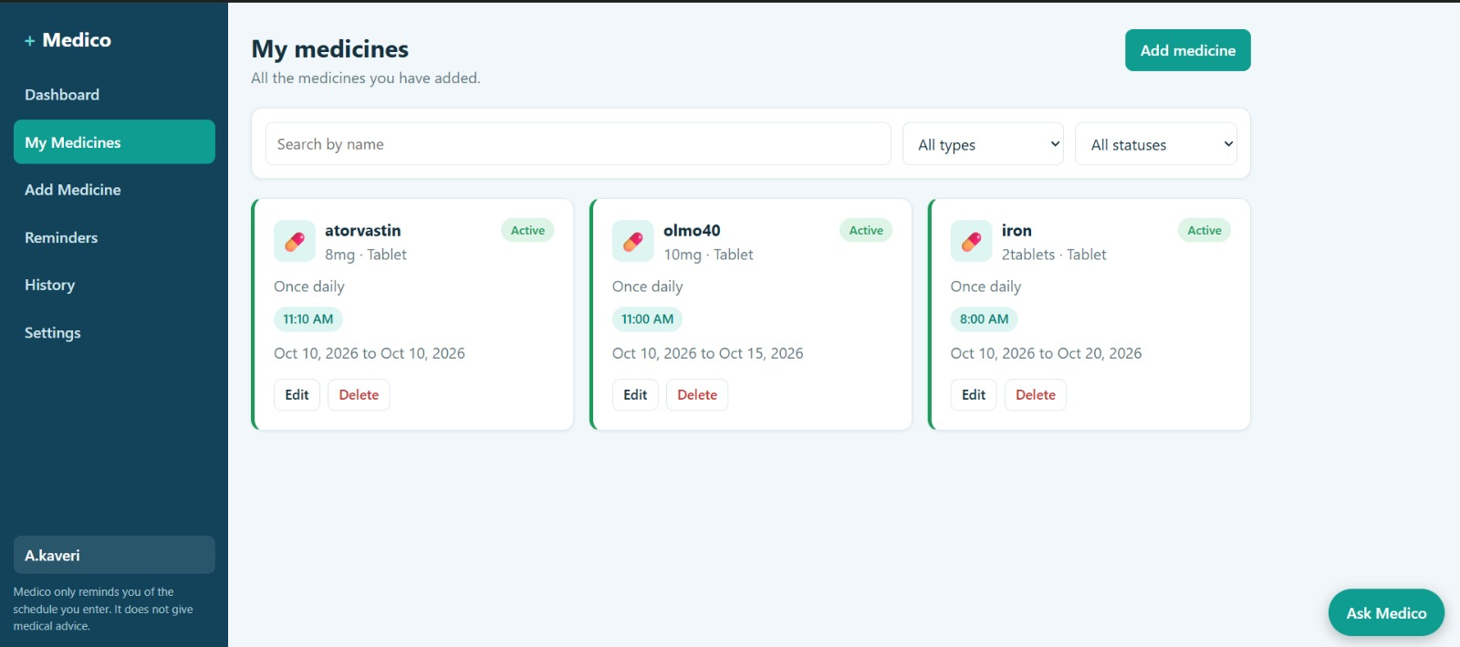
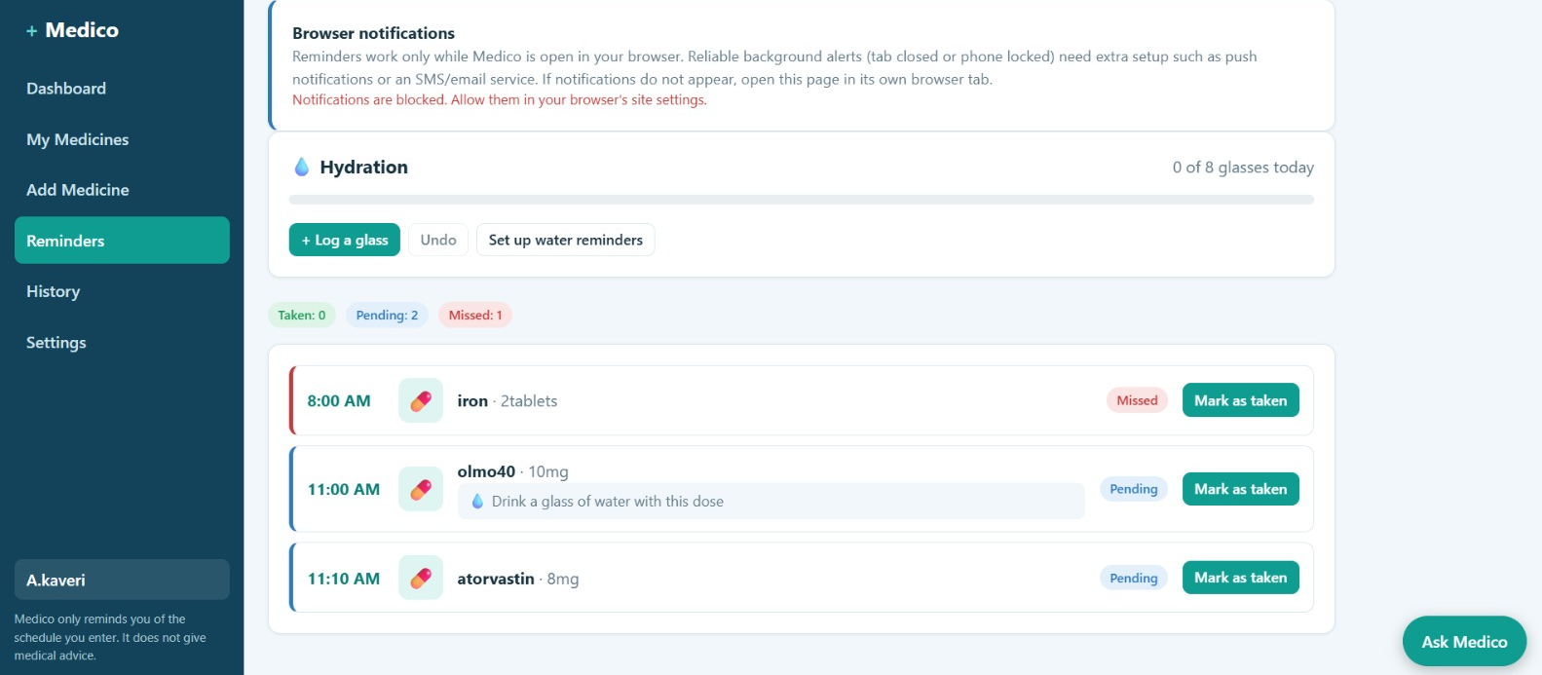
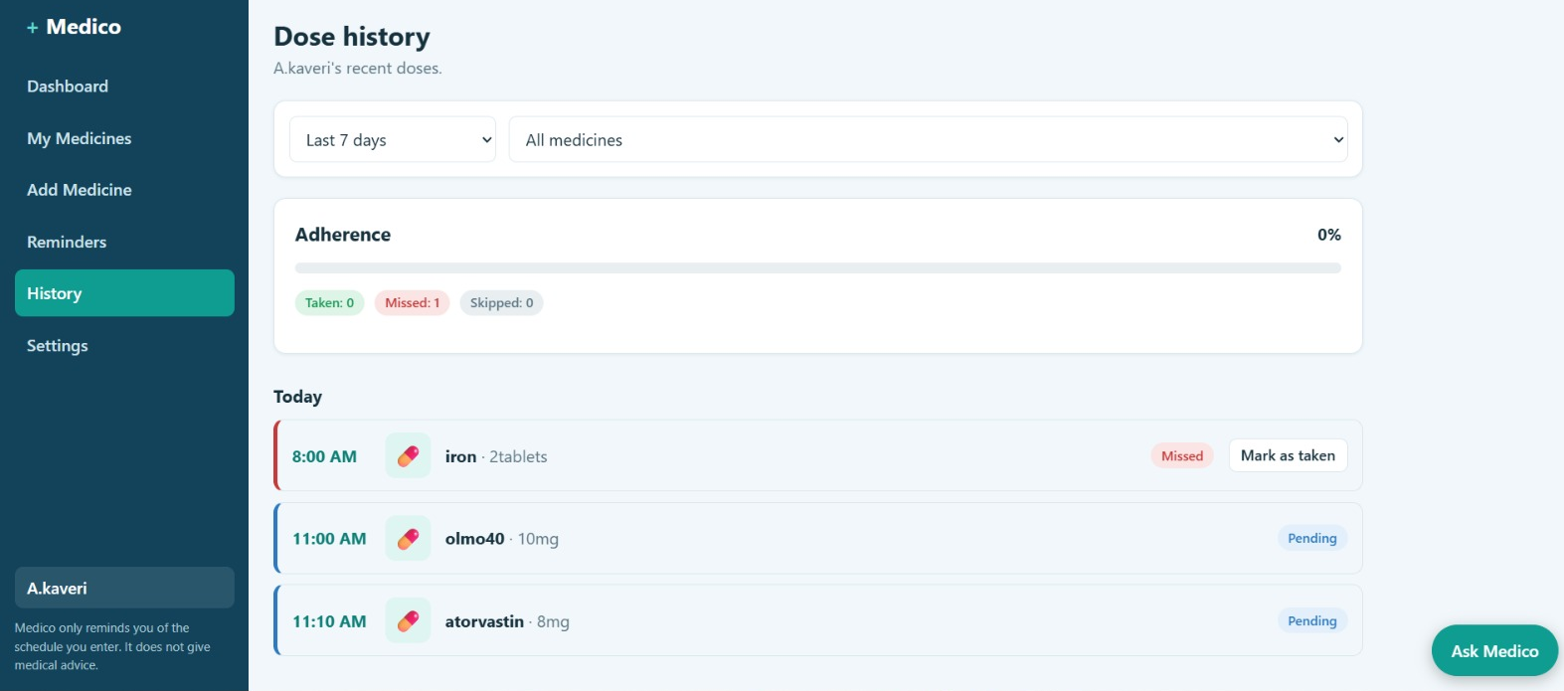
DEMO & IMPACT
LOGIN
MY MEDICINES
ADD NEW MEDICINE
REMAINDERS
DOSE HISTORY

Slide 7
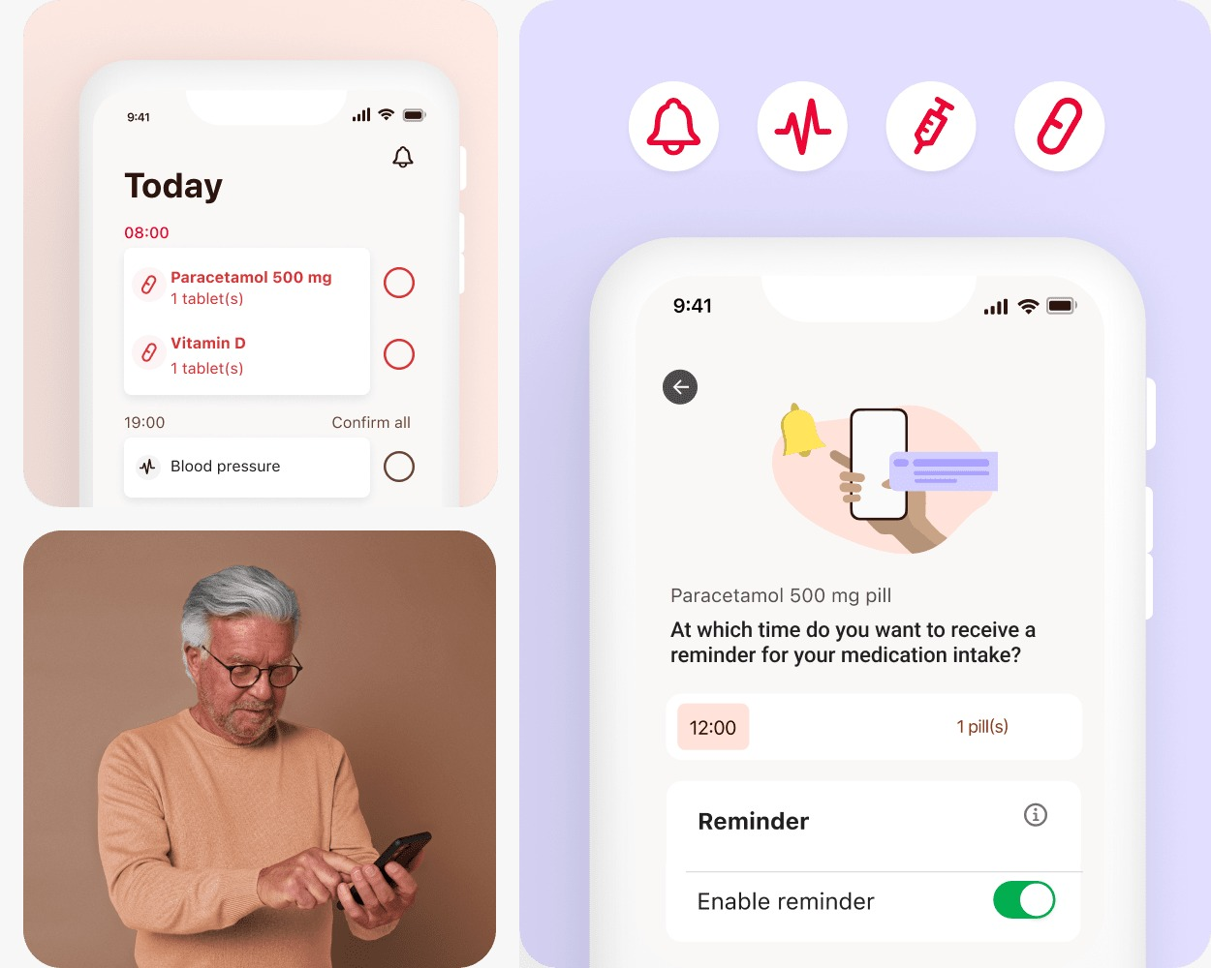
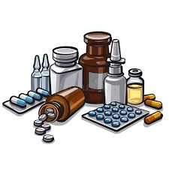
FUTURE VISION
Current Achievement
Developed a plan for a MERN-based medicine reminder system.
Supports medicine schedule management using CRUD operations.
Stores medicine names, dosages, timings, and start/end dates.
Provides a foundation for user authentication and reminders.
Future Improvements
Add SMS, email, and push notifications.
Introduce voice reminders for elderly users.
Add caregiver alerts for missed doses.
Develop a mobile application with medicine reports.
Final Takeaway
Use cloud hosting to support more users.
Optimize MongoDB queries for faster data retrieval.
Implement secure APIs and role-based access.
Integrate wearable devices and healthcare platforms in the future.

