Slide 1
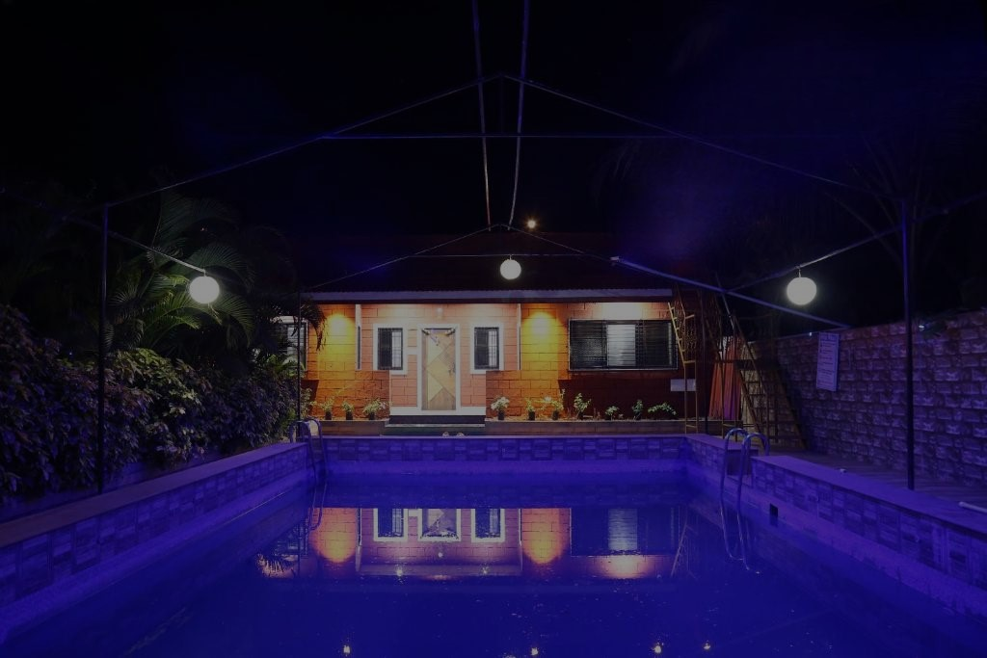
Radha Farm

Slide 2
Abstract
This website of Resort aims at creating an Online Resort Management system which can be used by customers to reserve resort rooms, read about resort, check resort gallery, etc. This website of resort will remove the hectic task of customers and executive for searching and booking rooms in resort. The system will help the administrative staff i.e. executive of the hotel to keep the daily and the history record details of the customers in proper Database. Customer can book rooms in advance seating anywhere across the world. The resort website will allow customer to remotely access to resort database only for customer after the authorization procedures. The customer could search, book rooms and give feedback. The administrator will know the details of reservations. Admin will also manage all the things for the resort.

Slide 6

Thank you!

