Slide 1
CS768: Learning with Graphs
GELib: A Graph Embedding Library for Common Graphs
BY
Kaveri Kale 194057002
Arjun Kashettiwar 180050012
Anish MM 203050066

Slide 2
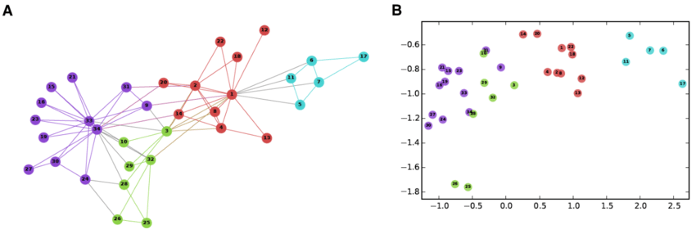
Introduction to Graph Embedding
Graph embedding provides an effective yet efficient way to solve the graph analytics problem. Specifically, graph embedding converts a graph into a low dimensional space in which the graph information is preserved.

Slide 3
Problem Statement
Generate graph embedding for given graph.
Input : Graph edge-list file.
Output : Graph embedding R^{d} , where is d is the embedding dimention d<<|V|

Slide 4
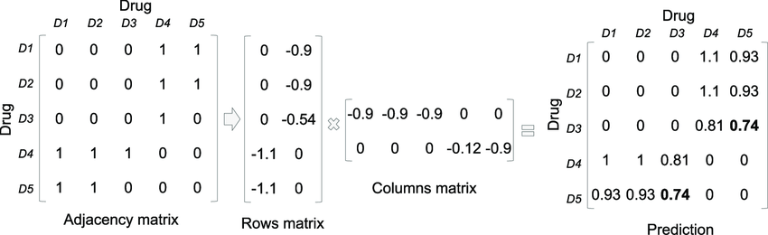
Matrix Factorization Based Embedding
Matrix factorization based graph embedding represent graph property (e.g., node pairwise similarity) in the form of a matrix and factorize this matrix to obtain node embedding.
Connection between two nodes are represented in matrix form.
Matrices used for representation are node adjacency matrix, Laplacian matrix, node transition probability matrix, and Katz similarity matrix etc.

Slide 5
Matrix Factorization Based Methods
Laplacian Eigenmaps
Graph Factorization
HOPE
GraRep
LINE
Singular Value Decomposition (SVD)

Slide 6
Laplacian Eigenmaps
If W_{ij} is high then it keeps the embedding of two nodes close.
Objective function :
where L is the Laplacian of graph G. The objective function is subjected to the constraint Y^{T} DY = I to eliminate trivial solution.
The solution to this can be obtained by taking the eigenvectors corresponding to the d smallest eigenvalues of the normalized Laplacian,

Slide 7
GF
To obtain the embedding, GF factorizes the adjacency matrix of the graph, minimizing the following loss function
where λ is a regularization coefficient.

Slide 8
HOPE
HOPE preserves higher order proximity by
minimizing ||S−Y_{s}Y_{t}^{T}||²_{F}
where S is some similarity matrix.
Similarity can be Katz Index, Common Neighbors, Adamic-Adar score, etc.
Each similarity measure is represented as S=M_{g}⁻¹M_{l}, where bothM_{g} and M_{l} are sparse. Then generalized SingularValue Decomposition (SVD) is used to obtain the embeddings efficiently.

Slide 9
Random Walk Based Methods
Deep learning based graph embedding, a graph is represented as a set of random walk paths sampled from it. The deep learning methods are then applied to the sampled paths for graph embedding which preserves graph properties carried by the paths.
Methods:
node2vec
DeepWalk

Slide 10
DeepWalk
DeepWalk preserves higher-order proximity between nodes by maximizing the probability of observing the last k nodes and the next k nodes in the random walk centered at V_{i} , i.e.
maximizing log Pr(v_{i−k}, . . . , v_{i−1}, v_{i+1}, . . . , v_{i+k}|Y_{i}),
where 2k + 1 is the length of the random walk.
The model generates multiple random walks each of length 2k + 1 and performs the optimization over sum of log-likelihoods for each random walk.

Slide 11
node2vec
The crucial difference from DeepWalk is that node2vec employs biased-random walks that provide a trade-off between breadth-first (BFS) and depth-first (DFS) graph searches, and hence produces higher-quality and more informative embeddings than DeepWalk.
Choosing the right balance enables node2vec to preserve community structure as well as structural equivalence between nodes.

Slide 12
Deep Learning Based Methods
Structural Deep Network Embedding (SDNE)
Graph Auto-Encoder (GCN based)
Variational Graph Auto-Encoder (GCN based)

Slide 13
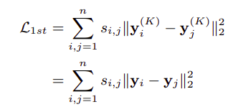

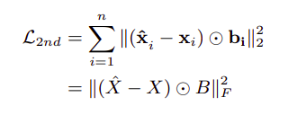
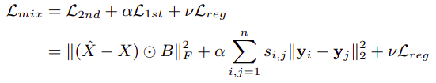
SDNE
After obtaining y^{(K)}_{i} , we can obtain the output xˆ_{i} by reversing the calculation process of encoder. The goal of the autoencoder is to minimize the reconstruction error of the output and the input.
The loss function is shown as follows:

Slide 14
GCN-AE and GCN-VAE
These models use a graph convolutional network (GCN) encoder and an inner product decoder.
The input is adjacency matrix and they rely on GCN to learn the higher order dependencies betweennodes.
It has been empirically shown that using variational autoencoders can improve performance compared to non-probabilistic autoencoders.

Slide 15
GELib(Graph Embedding Library)
GELib is a Python package which offers a general framework for graph embedding methods.
Features :
The main features of this libarary are:
  A variety of graph embedding models have been incorporated.
  Two evaluation tasks are provided.
  Results can be easily visualized and stored.
  A unified interface/pipeline has been provided to use all these facilities
It implements many state-of-the-art embedding techniques including Laplacian Eigenmaps, Graph Factorization, SVD , GraRep, LINE, Higher-Order Proximity preserved Embedding (HOPE), Structural Deep Network Embedding (SDNE) node2vec, DeepWalk, GCN-Autoencoder, GCN-Variational Autoencoder .
The framework implements functions to evaluate the quality of obtained embedding including link prediction and node classification.

Slide 16
Graph Format
We store all graphs using the DiGraph as directed weighted graph in python package networkx. The weight of an edge is stored as attribute "weight". We save each edge in undirected graph as two directed edges.

Slide 17
Python Libraries and Packages Used
Networkx – Graph
Scipy, numpy – Numerical computation
Tensorflow – Neural Network
Matplotlib – Visualization

Slide 18
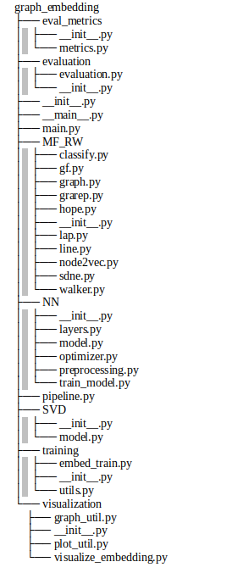
Repository Structure

Slide 19
Evaluation Metrics
Mean Reciprocal Rank (MRR)
Mean Average Precision (MAP)
F1 Score
AUC-ROC
AUC-PR

Slide 20
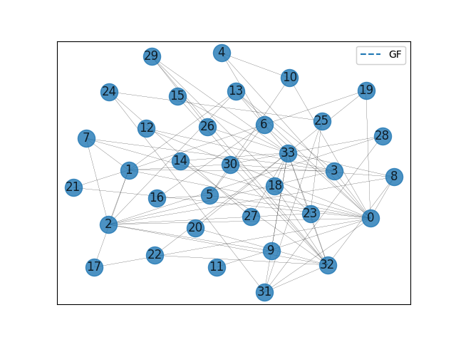
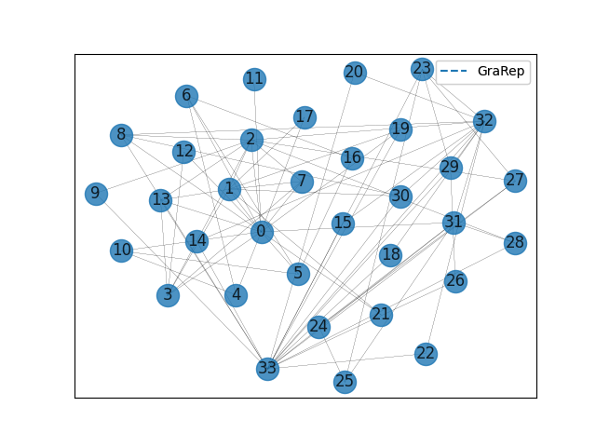
GF and GraRep

Slide 21
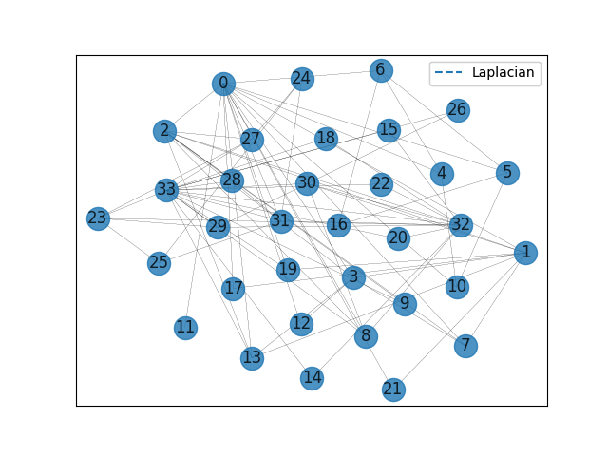
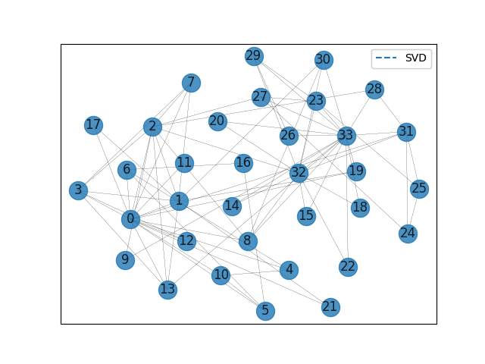
Laplacian and SVD

Slide 22
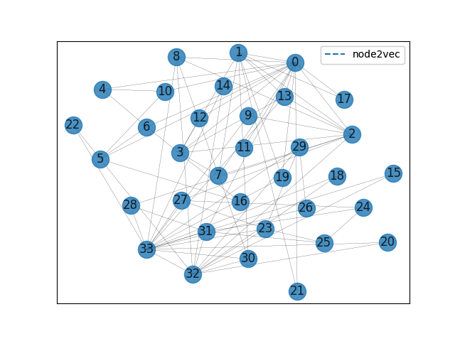
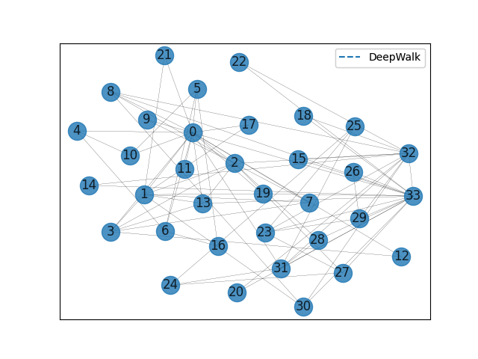
node2vec and DeepWalk

Slide 23
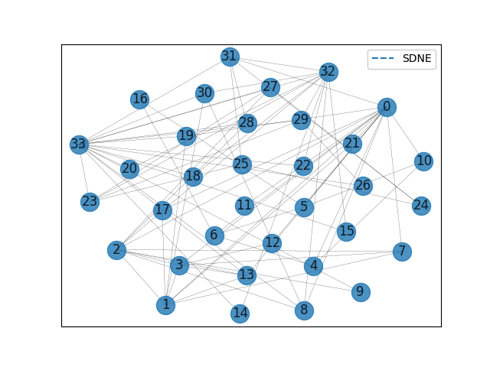
SDNE

Slide 24
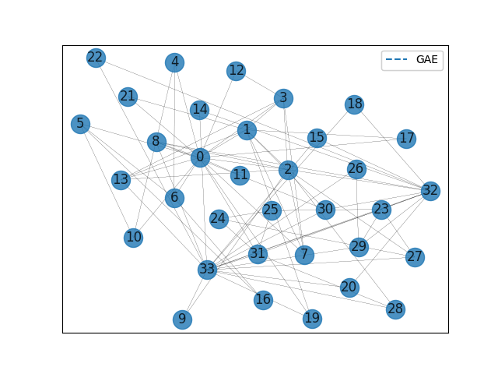
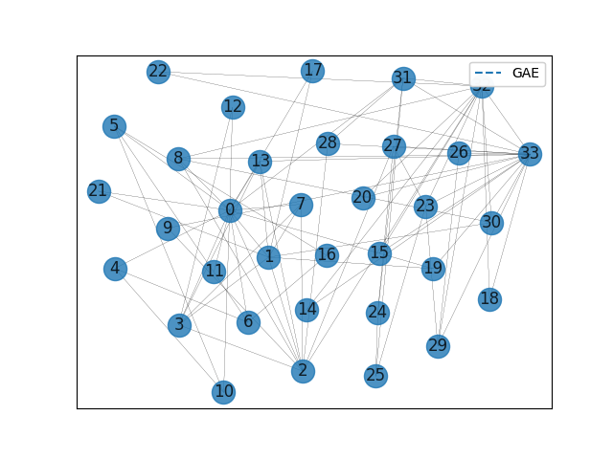
GCN-AE and GCN-VAE
GAE-AE
GAE-VAE

Slide 25
Link Prediction task evaluation:Karate Graph
Methods | MAP | MRR | AUC-ROC | AUC-PR | Accuracy | F1-score
Laplacian | 0.867 | 0.867 | 0.916 | 0.925 | 0.800 | 0.786
GF | 0.719 | 0.719 | 0.591 | 0.677 | 0.600 | 0.538
SVD | 0.609 | 0.609 | 0.622 | 0.667 | 0.533 | 0.533
HOPE | 0.000 | 0.000 | 0.500 | 0.500 | 0.500 | 0.000
GraRep | 0.778 | 0.778 | 0.884 | 0.907 | 0.800 | 0.800
node2vec | 0.630 | 0.630 | 0.689 | 0.701 | 0.633 | 0.645
DeepWalk | 0.652 | 0.652 | 0.689 | 0.695 | 0.667 | 0.706
LINE | 0.611 | 0.611 | 0.689 | 0.697 | 0.667 | 0.688
SDNE | 0.867 | 0.867 | 0.920 | 0.930 | 0.800 | 0.786
GCN-AE | 0.639 | 0.639 | 0.631 | 0.561 | 0.667 | 0.643
GCN-VAE | 0.620 | 0.620 | 0.644 | 0.562 | 0.700 | 0.727

Slide 26
Link Prediction task evaluation: Facebook Graph
Methods | MAP | MRR | AUC-ROC | AUC-PR | Accuracy | F1-score
Laplacian | 0.592 | 0.627 | 0.672 | 0.646 | 0.619 | 0.626
GF | 0.642 | 0.655 | 0.847 | 0.828 | 0.770 | 0.773
SVD | 0.744 | 0.752 | 0.919 | 0.891 | 0.854 | 0.858
HOPE | 0.325, | 0.248 | 0.604 | 0.618 | 0.579 | 0.298
GraRep | 0.782 | 0.777 | 0.941 | 0.891 | 0.893 | 0.898
node2vec | 0.733 | 0.731 | 0.919 | 0.877 | 0.859 | 0.864
DeepWalk | 0.766 | 0.763 | 0.935 | 0.892 | 0.892 | 0.886
LINE | 0.790 | 0.802 | 0.927 | 0.887 | 0.873 | 0.878
SDNE | 0.727 | 0.733 | 0.898 | 0.866 | 0.828 | 0.834
GCN-AE | 0.666 | 0.613 | 0.878 | 0.786 | 0.840 | 0.849
GCN-VAE | 0.597 | 0.547 | 0.852 | 0.768 | 0.798 | 0.808

Slide 27
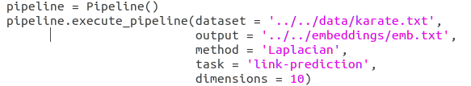
Demo
Demo to create pipeline

Slide 28
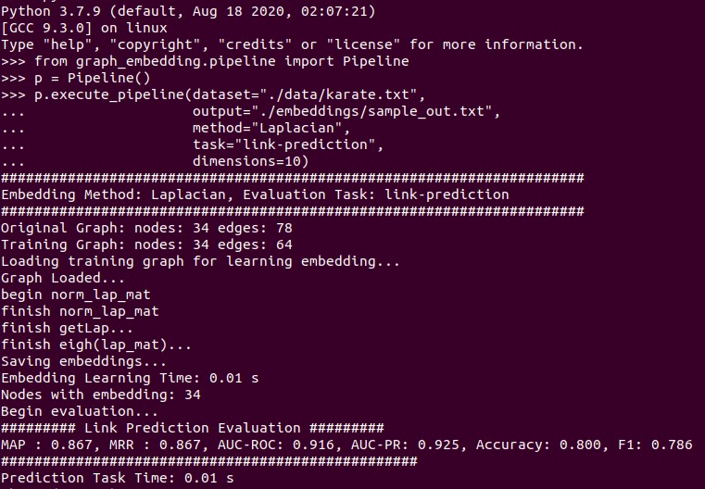
Demo : python interpreter

Slide 29
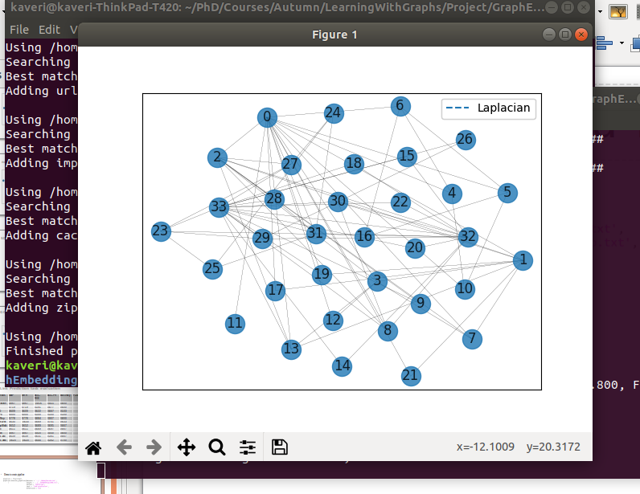
Output : Graph Embedding Visualization
It will give visualization for embedding.

Slide 30
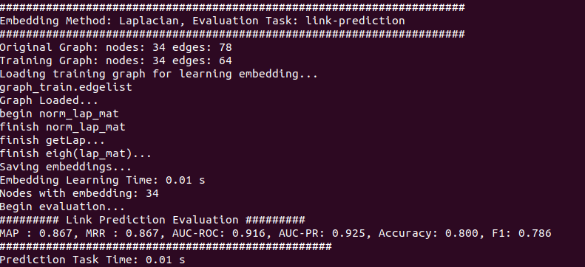
Output : Evaluation Result
It will print evaluation result

Slide 31
Conclusion
In GELib we have tried to incorporate various types of algorithms for graph embeddings.
Our intention is to make this repository contain implementations of all the major algorithms for this task to make model comparison easier.
We have also attempted to provide a single API that allows the user to run all the incorporated models.
We have also provided functionalities to load data, visualize created embeddings, store the embeddings and various evaluation metrics.

Slide 32
Future Work
More models need to be added.
Want to add more analysis tasks like Graph Reconstruction, Visualization, Clustering etc.
Want to extend this library for Knowledge Graph Embedding methods.
Restructure the code to mimic the structure of thePyKEEN library which implements various algorithms for Knowledge Graph embeddings in a modular and elegant manner.

Slide 33
Thank You

