Slide 1

A project about student’s behavioral health analyses on global school’s survey responses

Slide 2
Team Introduction
Section#001
Group#03
Team Members:
Kaveriben Patel
Dhruva Ray
Vitthlesh Sheth

Slide 3
Background/ Motivation
“The Mental Health of Children and Adolescents" report by the United Nations Children's Fund (UNICEF), which emphasizes there is a growing concern about the health and well-being of students worldwide. Despite efforts to improve the health of students, many continue to struggle with physical and mental health issues.
The World Health Organization (WHO) therefore organised the Global School-based Student Health Survey (GSHS) to gather information on the health behaviours and protective factors among students aged 13 to 17 across 223 nations.

Slide 4
Problem Statement
Global School-based Student Health Survey (GSHS) generated a big amount of data so its audience decision-makers, educators, public health experts, and WHO have difficulty turning the data into useful information.
They may find difficulty in identifying and resolving the numerous elements that affect student health and well-being
In order to provide evidence-based suggestions for policy and programmatic actions aimed at improving student health outcomes, a thorough examination of the GSHS data is required.

Slide 5
Project Proposal
There is a need for a more in-depth analysis of this GSHS’s data to identify patterns, trends, and factors affecting student health. Our aim is to process and clean the GSHS survey data, perform descriptive analysis to identify significant health behaviours and protective factors among students.
The analysis will involve exploring the prevalence of risk among juveniles, identifying trends and patterns in the data, and comparing the results across different countries
Additionally, we have planned to provide well-informed suggestions for health policies and programs that will have a beneficial effect on student health results.

Slide 6
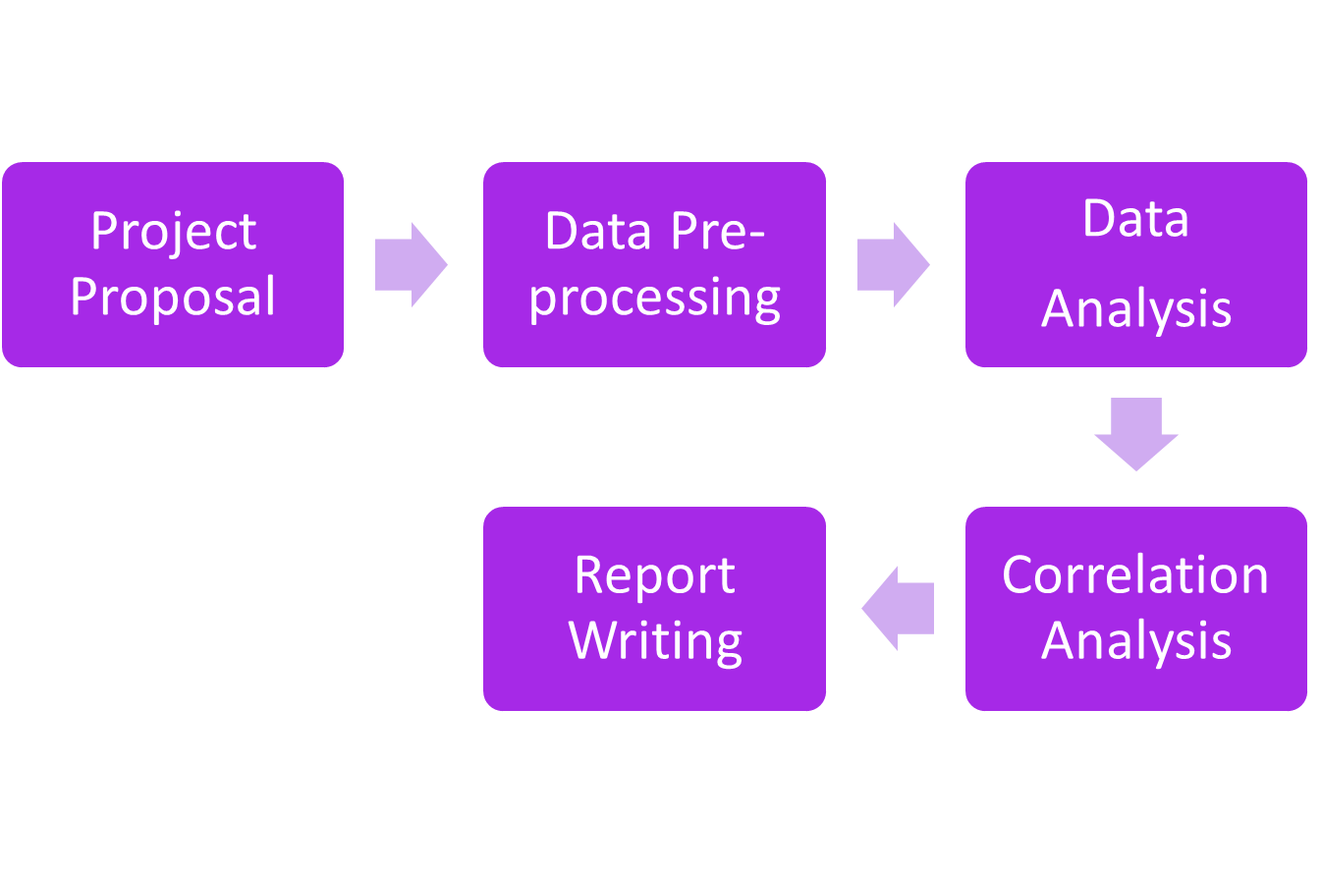
Workflow would be:

Slide 7
Analysis Questions
What types of trends or patterns have been observed in the behavioural risks of students, such as dietary behaviour, alcohol usage etc., over the years?
How do behavioural risks vary among different regions?
Which locations have the highest and lowest rates of juvenile mental health issues?
How do major and minor risk factors vary by gender and age among students?
In what ways do individual risk factors, such as tobacco use, alcohol use, bullying, and others, responsible to negative health behaviours among students?

Slide 8
Dataset Description
The dataset is based on global school, and we downloaded it from here.
The dataset included data between the year 2003 to 2015 and almost 223 countries.
It has 10 important behavioural modules for questions like mental health, Dietary Behaviours etc. It has data based on age, sex, city, and many other key points. It has questions and answers conducted during surveys.

Slide 9
Exploratory Data Analysis
(Data exploration for Missing/ Invalid Values)
In the dataset, we observe that six columns are entirely blank and several rows are blank.
We found 3 columns that have only codes, e.g., A2, A3, and no further relation in the entire dataset.
The same data was present in three columns in all of the rows. For example, in the data source column, there is only one text in all rows, which is GSHS.
We also noticed that the age column has a lot of entries with the text "total," making it difficult to tell if the entries belong to the particular age group, are blanks, or are invalid.
In the gender column, we also notice that there are a lot of entries with the text "total," and once again, it is difficult to tell how this text is being used in the gender.
We observe that certain entries have age ranges in the age column. For example, the numbers for ages 13–15 and 13–17 are shown instead of 13, 14, and 15.

Slide 10
Data Cleaning & Transformation
Data Cleaning
  The dataset's columns that are entirely empty, have the identical content in rows across all columns, or don't include links to other data have all been deleted.
  Replace all blank values with "NaN" in the whole data frame.
  Removed rows with "Total" text in the age column.
  Removed rows with "Total" text in the gender column.
Data Transformation
  For invalid data in the Age column, we find the middle point of the age group, which is also called the mean value, and store it in the new column Age_Midpoint. For example, there were few entries like 13–17, so we perform (13–17)/2 = 15 as Age_Midpoint.
  Also, we transform the Age_Midpoint to an integer.

Slide 11
Analysis Questions with Answers and Visualizations

Slide 12
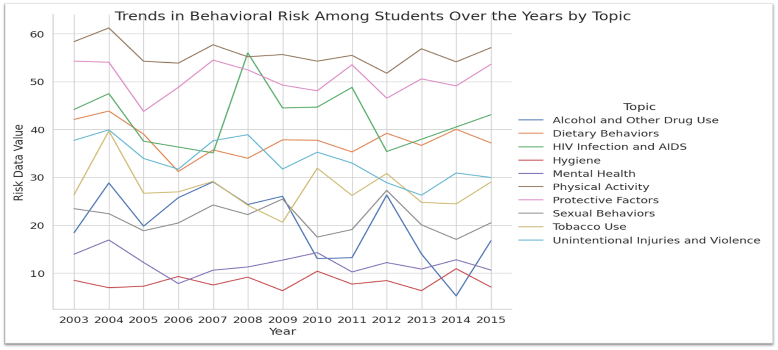
1. What types of trends or patterns have been observed in the behavioural risks of students, such as dietary behaviour, alcohol usage etc., over the years?

Slide 13
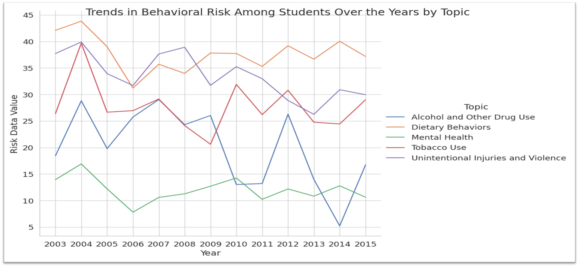
A closer view to Fig. 1

Slide 14
The visualization in Fig. 1 shows the trends and patterns of behavioural risk among students over the years for different topics such as dietary behaviour, mental health, physical activity, substance use, and violence. The line chart for each topic displays the mean value of data value on the y-axis and the year on the x-axis. The graph helps to understand the changes in behavioural risk over the years and identify which topics need more attention for improving student health.
For example, in Fig. 2 it is clearly displays for the topic of "Alcohol", we can see that the trend is generally decreasing from 1991 to 2015. Similarly, for the topic of "Dietary Behaviour", we can see a generally increasing trend over the years.
Other topics, such as "Physical Activity" and "Tobacco", show some fluctuations over time but generally maintain a relatively stable trend.
Overall, the graph suggests that there have been some improvements in behavioural risk among students in terms of tobacco and drug use, but there is still room for improvement in terms of dietary behaviours, mental health, and unintentional injuries and violence.

Slide 15
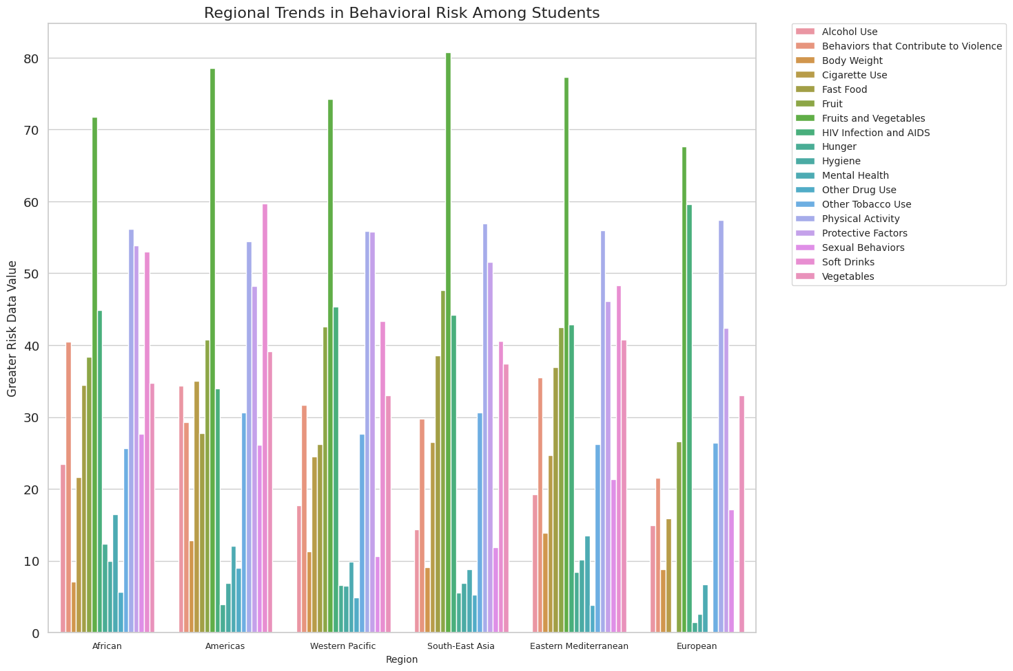
2. How do behavioural risks vary among different regions?

Slide 16
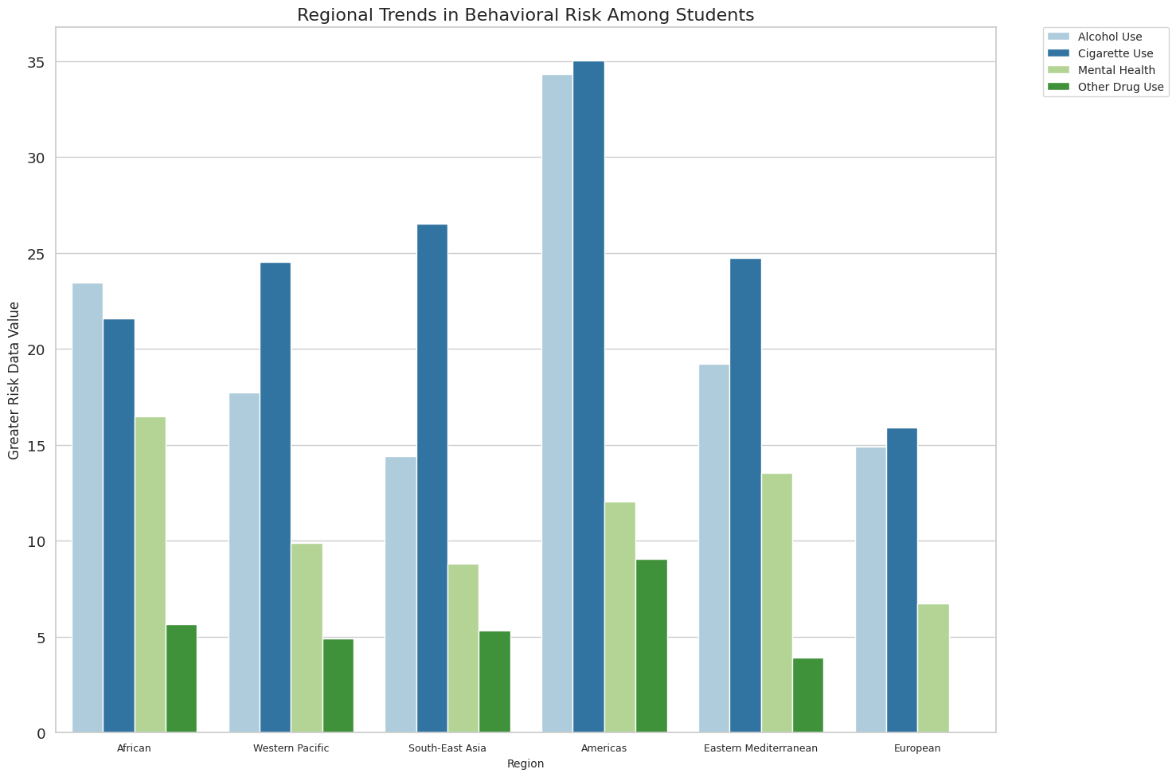
Closer View for Analysis Question 2

Slide 17
The bar plot in Fig. 1 displays regional variations in behavioural risks. The x-axis shows regions, while the y-axis shows greater risk data values. Each bar is divided into subtopics of behavioural risks. The legend on the right shows the colour code for each subtopic. The plot compares greater risk data values across regions and subtopics.
The Fig 2, graph shows that the greater risk data values for the four behavioural risks vary across the different regions. For instance, the US-affiliated Pacific Islands have the highest risk for alcohol use, while the Caribbean has the highest risk for cigarette use. Other drug use has the highest risk in Africa, and mental health has the highest risk in the Middle East.
Overall, the graph suggests that the greater risk data value for behavioural risk factors varies significantly across different regions, highlighting the need for region-specific interventions to address these risks.

Slide 18
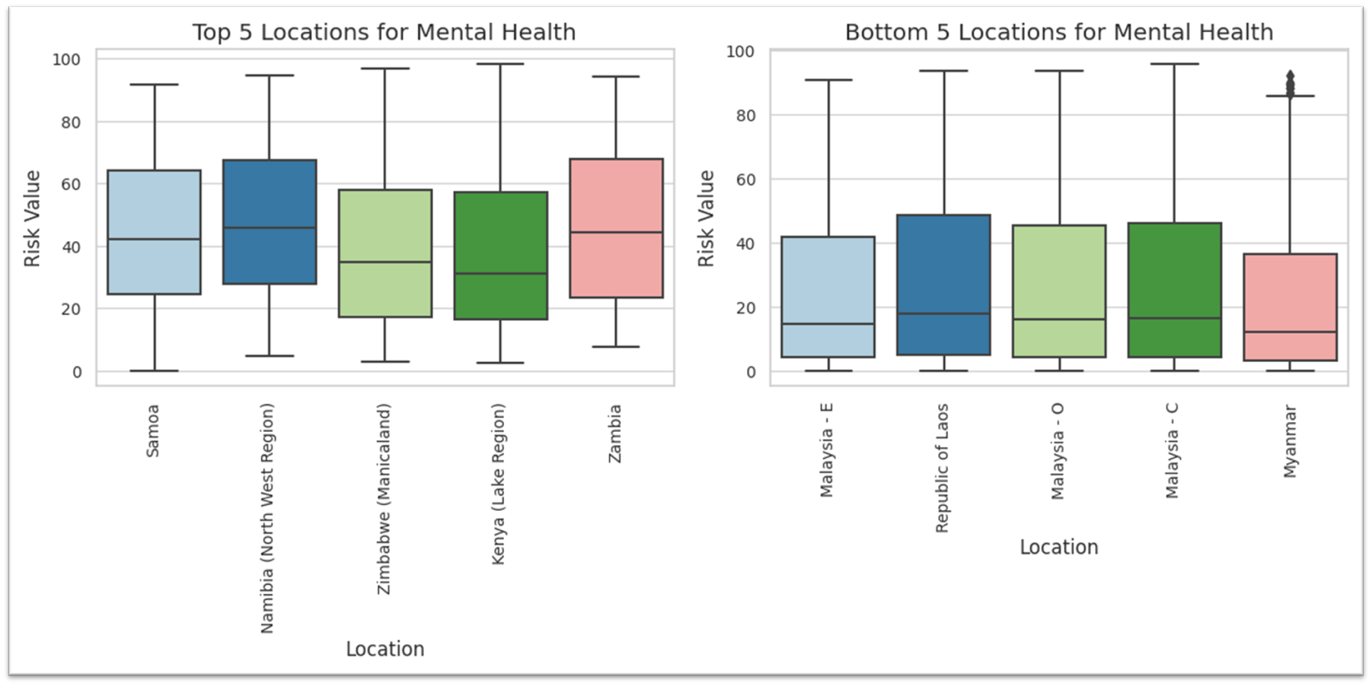
3. Which locations have the highest and lowest rates of juvenile mental health issues?

Slide 19
In this boxplot, The x-axis represents the locations, and the y-axis represents the Greater Risk Data Value. The visualization provides a quick and easy way to compare the risk values of different locations for the Mental Health subtopic.
From the visualizations, we can see that the top 5 locations with the highest rates of juvenile mental health issues are Samoa, Zambia, Namibia (North West Region), Zimbabwe (Manicaland), and Kenya (Lake Region). These locations have a higher median value and a larger range of values, indicating that the risk of mental health issues among juveniles in these locations is generally higher and more varied than in other locations.
On the other hand, the bottom 5 locations with the lowest rates of juvenile mental health issues are Myanmar, Malaysia - C, Malaysia - O, Republic of Laos, and Malaysia - E. These locations have a lower median value and a smaller range of values, indicating that the risk of mental health issues among juveniles in these locations is generally lower and less varied than in other locations.
It's important to note that this data only considers the greater risk of mental health issues among juveniles, and further analysis is needed to understand the underlying factors contributing to the prevalence of mental health issues in each location.

Slide 20
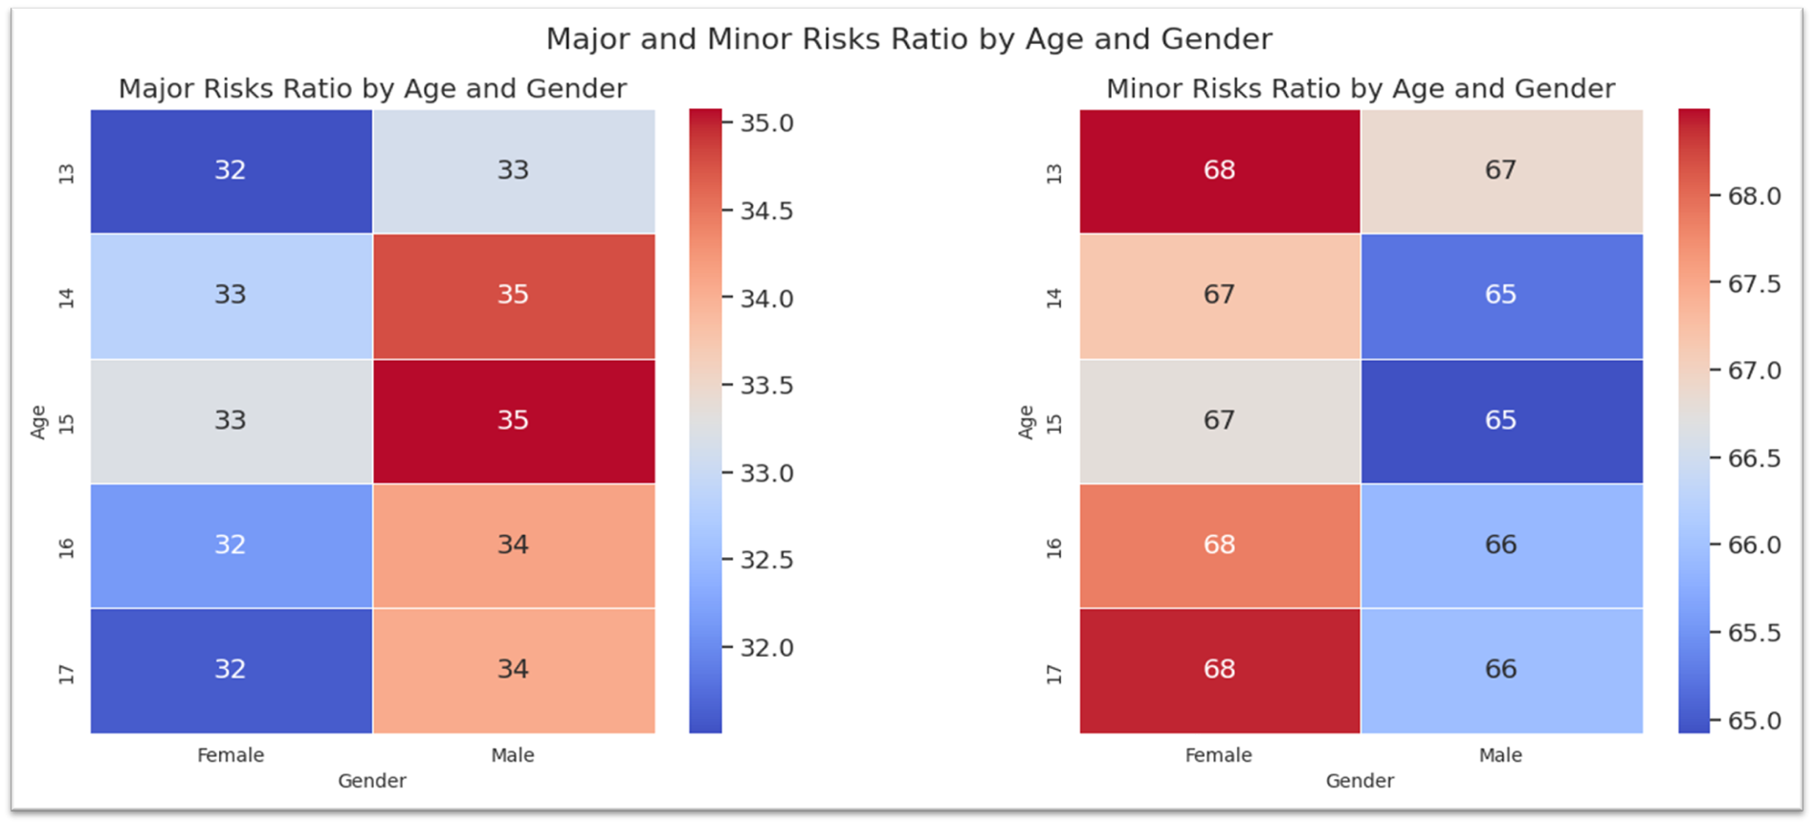
4. How do major and minor risk factors vary by gender and age among students?

Slide 21
The graph shows two heatmaps, one for major risks and one for minor risks, by age and gender among students. Each cell in the heatmap represents the ratio of risk value for a specific age and gender group. The colour of the cell indicates the magnitude of the ratio, with red cells indicating higher ratios and blue cells indicating lower ratios.
The heatmap for major risks shows that male students generally have a higher risk of major risks than female students, especially at younger ages. For example, male students aged 14-15 have a significantly higher risk of major risks than female students of the same age. However, at older ages, the difference in risk between genders becomes smaller.
The heatmap for minor risks shows a similar pattern, with male students generally having a higher risk of minor risks than female students, especially at younger ages. However, the difference in risk between genders becomes smaller at older ages.
Overall, the analysis suggests that gender plays a significant role in the occurrence of major and minor behavioural risks among students, with male students generally having a higher risk than female students, especially at younger ages. Age also plays a role, with risks generally decreasing as students get older.

Slide 22
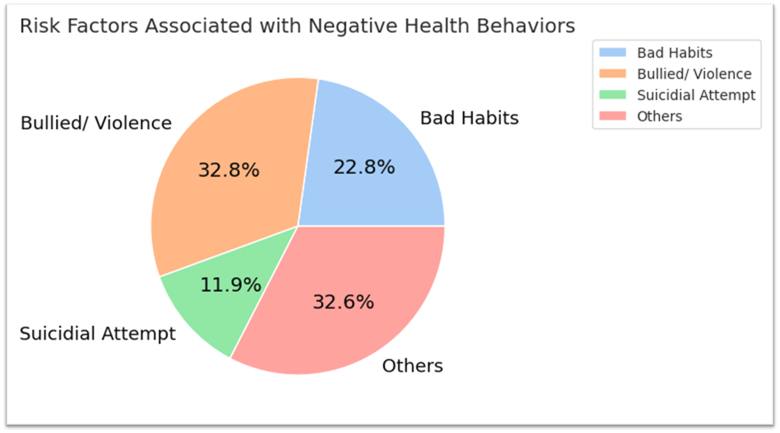
5. In what ways do individual risk factors, such as tobacco use, alcohol use, bullying, and others, responsible to negative health behaviours among students?

Slide 23
The pie chart show the percentages of different risk factors that are associated with negative health behaviours among students. The risk factors are categorized into four groups: "Bad Habits" (current alcohol use, current cigarette use, current marijuana use, current cigarette use, current tobacco use), "Bullied" (bullied, bullied by hitting), "Suicidal Attempt" (attempted suicide, considered suicide, could not sleep, current cigarette use, bullied), and "Others".
Of the total respondents, 32.8% reported being bullied or experiencing physical violence, making it the highest contributing factor to negative health behaviours. 22.8% of respondents reported bad habits such as Bad habits, including current alcohol use, current cigarette use, current marijuana use, and current tobacco use which is the second-highest risk factor.
11.9% of respondents reported suicidal attempts or mental health issues, which is the third-highest risk factor. Finally, 32.6% of respondents reported other factors that contribute to negative health behaviours.
It is important to note that this analysis is based solely on the data presented in the graph, and there may be other risk factors not included in this analysis. Additionally, it is unclear from the graph how the data was collected and what specific population it represents.

Slide 24
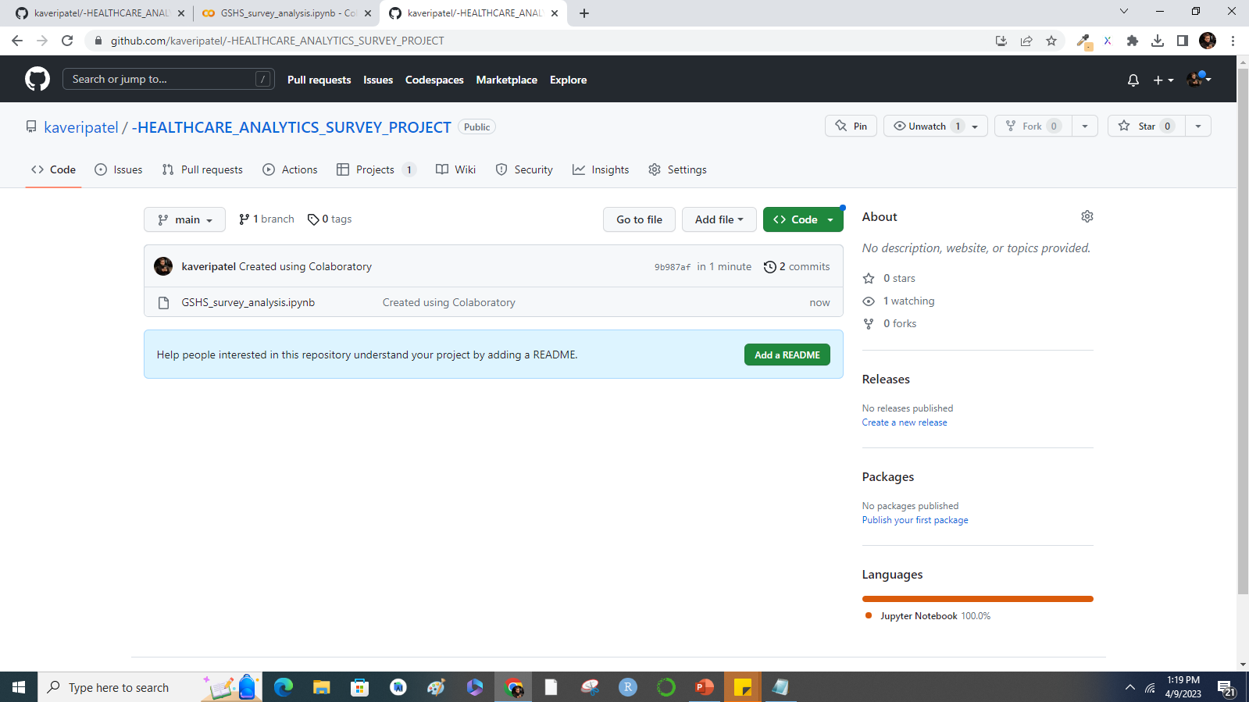
GitHub Repository Setup:

Slide 25
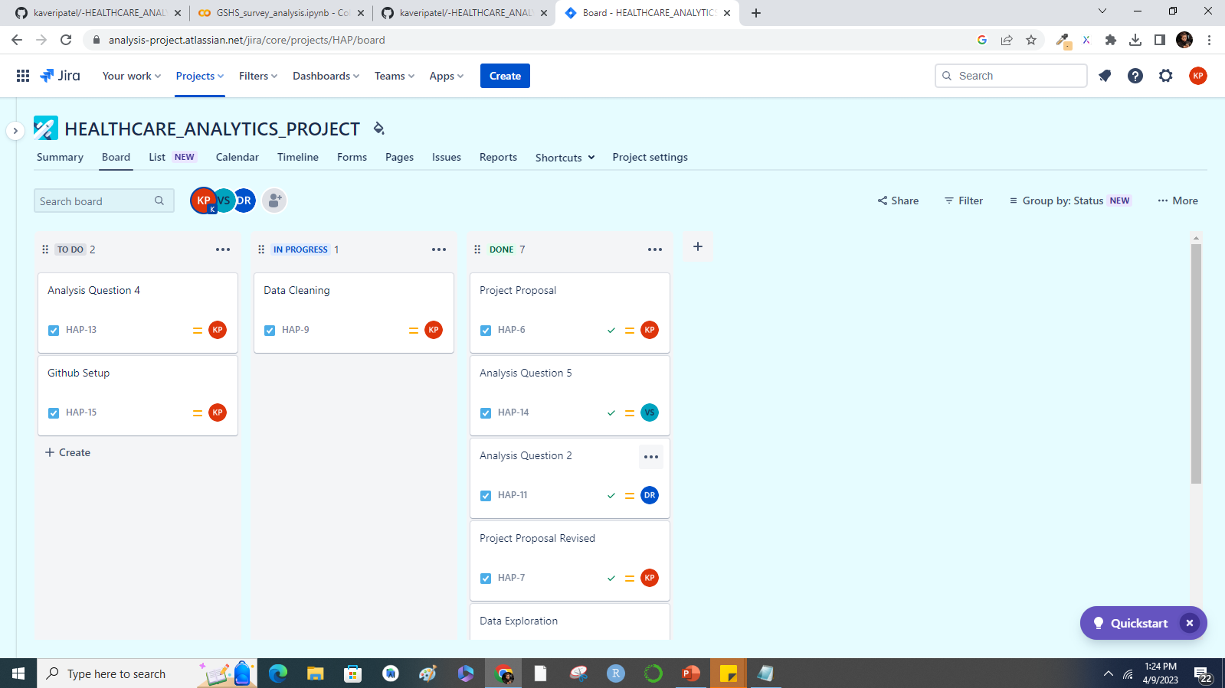
JIRA Project Plan:

Slide 26
Thank You…☺

