Slide 1
By T.KAVI BHARATH auttrtkvl004(Transfer_student) DEPARTMENT OF ELECTRONICS AND COMMUNICATION ENGINEERING
SMART PARKING

Slide 2
Problem statement
Design and implement an IoT-based smart parking system that optimizes parking space utilization, reduces traffic congestion, and enhances user experience by providing real-time parking availability information and seamless parking spot reservation and payment options.

Slide 3
SOLUTION
To address this issue Implement the following sollutions:
Enhace existing facilities-Upgrade current parking structures for improved functionality and safety.
Innovative design-Explore creative parking designs, like stacking or underground options.
Improved lighting and security-Enhance lighting and security measures within parking areas to boost safety and user confidence.

Slide 4
OBJECTIVE
To enhance urban parking infrastructure and user experience by implementing a multifaceted approach, including the upgrade of existing facilities, innovative parking designs, and improved lighting and security measures, ultimately reducing congestion, optimizing space utilization, and promoting safety.

Slide 5
WORKING PRINCIPLE
Incorporated within this system, an RFID reader serves as the means for user authentication upon entry. Additionally, a GSM module is integrated to facilitate the automatic transmission of pertinent information to the user as they exit the parking area, including their parking slot number, parking duration, and the corresponding fee deducted from their card. Furthermore, the system ensures efficient energy use by activating parking space lights solely in the presence of a vehicle.

Slide 6
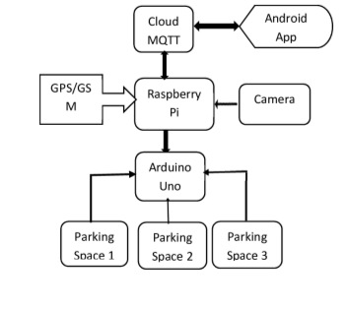
BLOCK DIAGRAM

Slide 7
THANK YOU

