Slide 1
Electric Vehicle Price and Range Prediction Using R
Kavipriyadharsan P | Roll No: 717825Z129
II MCA, Sem III, Section A
Karpagam College of Engineering, Coimbatore
R Mini Project

Slide 2
Problem Statement
Buying an electric vehicle (EV) is a big decision: price and driving range depend on battery size, speed, acceleration and charging power.
With hundreds of models on the market, it is hard to tell whether a car's price or range is reasonable for its specifications.
The problem is to build predictive models that estimate (A) the driving range in km and (B) the price in euros from the technical specifications.
Such predictions help buyers compare models and help manufacturers position new cars.

Slide 3
Project Objectives
1
Predict Range
Estimate the driving range (km) from Battery, Fast_charge, Top_speed and Acceleration.
2
Predict Price
Estimate the German list price (euros) from all the technical specifications.
3
Compare Models
Build Linear Regression, Decision Tree and Random Forest and compare them using RMSE, MAE and R-squared.
4
Find Key Drivers
Find which specifications matter most, using correlation and Random Forest feature importance.
Dataset: 360 electric vehicles, 9 columns (Kaggle, originally ev-database.org). Targets: Range (km) and Price (euros).

Slide 4
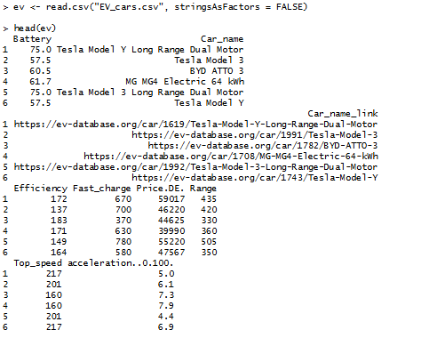
Loading Dataset
First six rows of the dataset (source: Kaggle, originally ev-database.org).

Slide 5
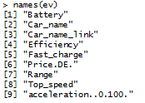

Anatomy of our Dataset
Dimensions
Features
360 rows (cars) and 9 columns
Source: Kaggle dataset repository
Targets: Range (km) and Price (euros)
Price is the German list price (Price.DE.)

Slide 6
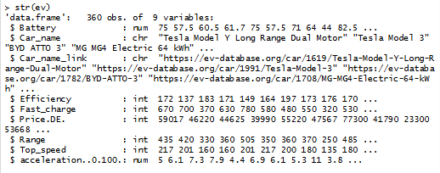
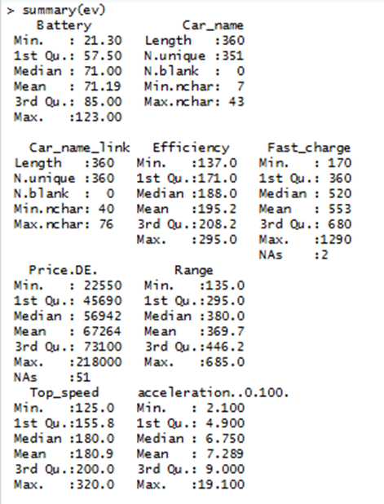
Structure and Summary of the Dataset
Output of summary(ev):

Slide 7
Data Structures Used in the Project
Structure | What it is | Where it is used in this project
Vector | One-dimensional, one data type | A single column such as ev$Range or ev$Price (360 values); c() lists of feature names
Matrix | Two-dimensional, one data type | Correlation matrix of the numeric columns (shown as a heat map)
Data frame | Table with mixed column types | ev (360 rows x 9 columns); trainA / testA and trainB / testB after the 80/20 split
List | Container for mixed objects | Fitted model objects (lm, rpart, ranger) and the evaluation results are stored as lists
Factor | Categorical variable | Brand, taken from the first word of Car_name, used for grouping
Real-time use: an EV comparison website keeps every car as a row in a data frame and predicts price or range for each new model.

Slide 8
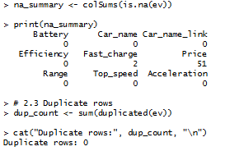
Stage 1: Data Cleaning
Checking missing values and duplicates
Fast_charge: 2 missing, filled with the median
Price: 51 missing (14%). It is a target, so these rows are not filled; the Price model uses the 309 cars with a known price
Car_name_link removed (text only)

Slide 9
Stage 1: Checking Outliers (IQR Rule)
Feature | Outliers
Battery | 0
Efficiency | 8
Fast_charge | 3
Price | 32
Range | 1
Top_speed | 5
Acceleration | 1
Price has the most outliers (32): luxury and performance EVs.
These are genuine cars, not data-entry errors, so they were kept.
Random Forest and Decision Tree handle outliers well; Linear Regression is the most affected.

Slide 10
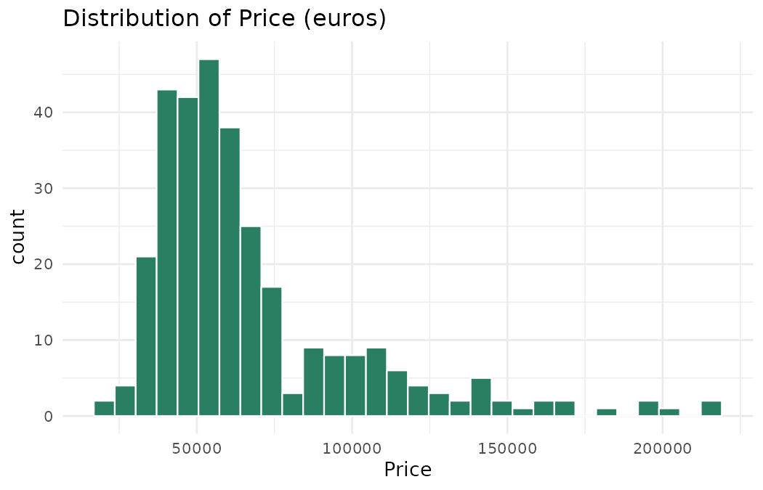
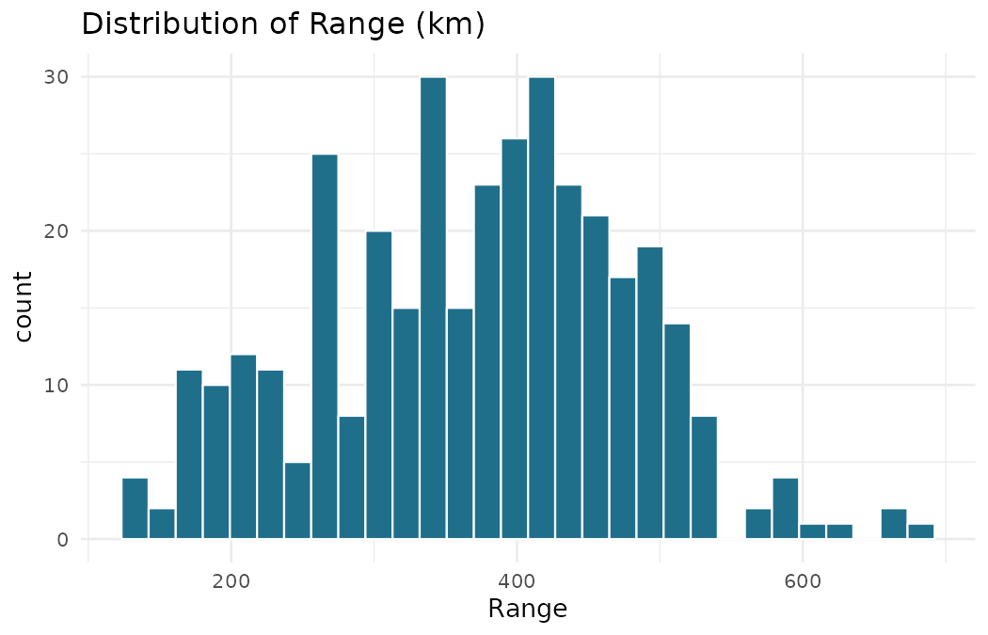
Stage 2: Data Visualization
Price is right-skewed (a few very expensive cars); Range is spread between 135 and 685 km.

Slide 11
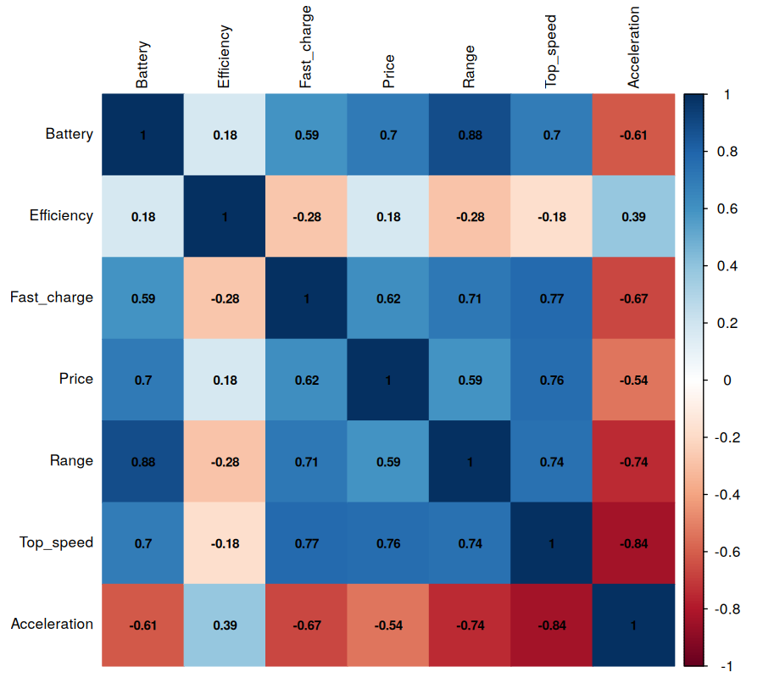
Stage 2: Correlation Matrix
Battery and Range: 0.88 (strongest link)
Top speed and Price: 0.76
Battery and Price: 0.70
Acceleration (0-100 s) is negatively related to Range (-0.74) and Top speed (-0.84)
Efficiency is weakly related to the others

Slide 12
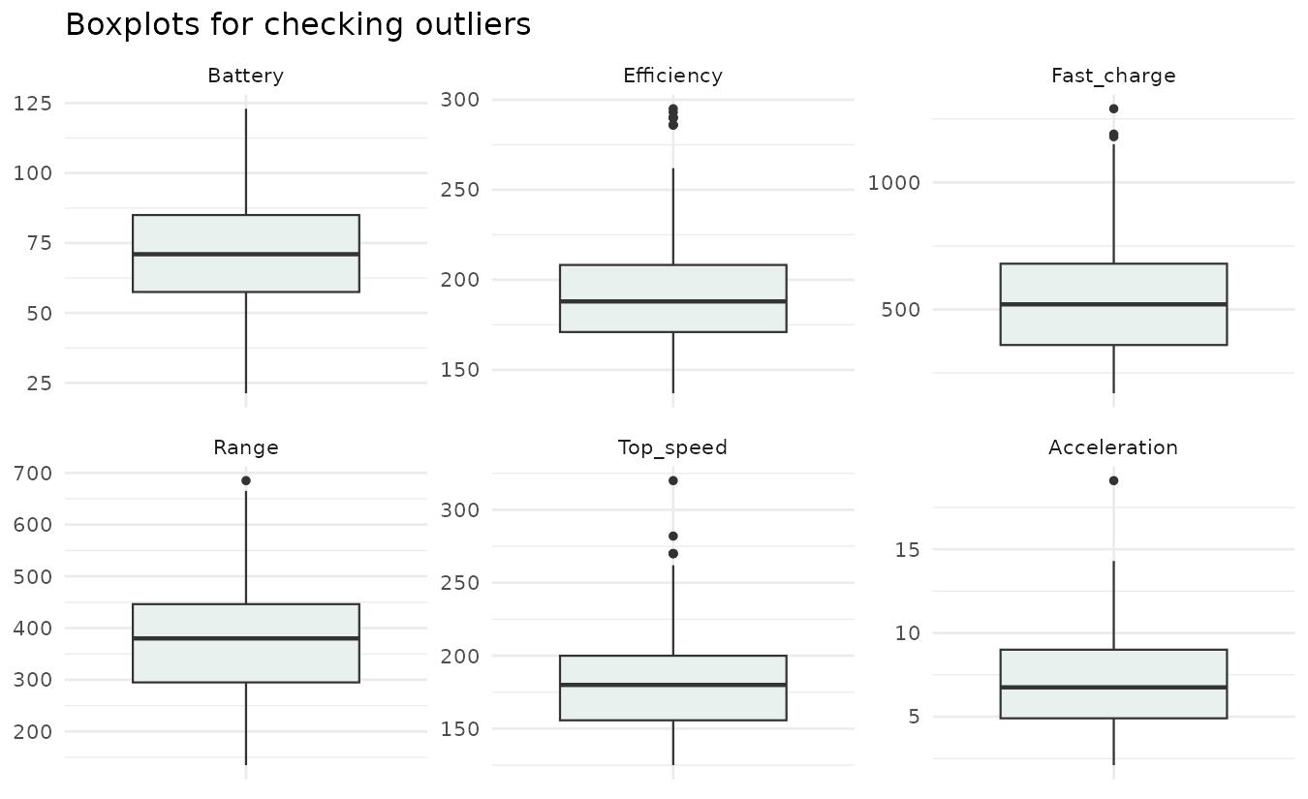
Stage 2: Boxplots for Checking Outliers
Dots above the whiskers are outlying values (for example very fast or very efficient cars).

Slide 13
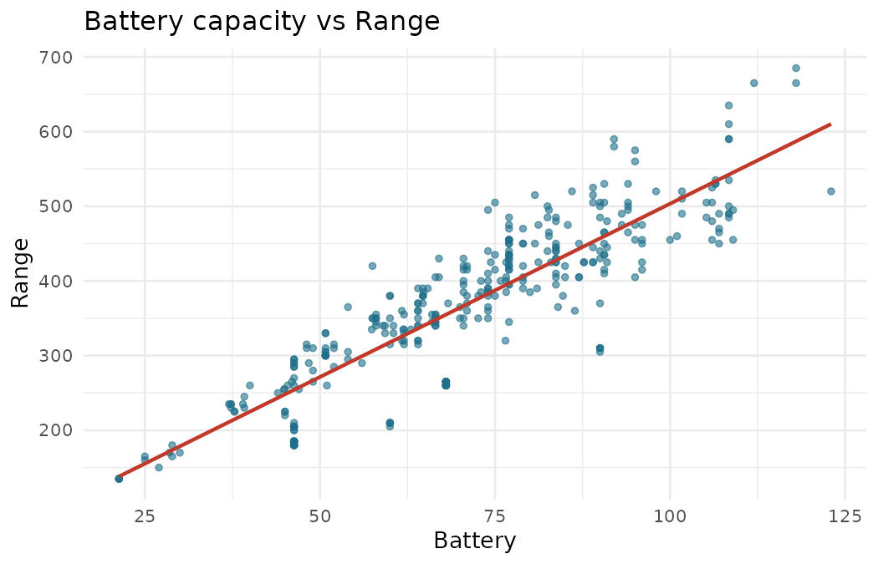
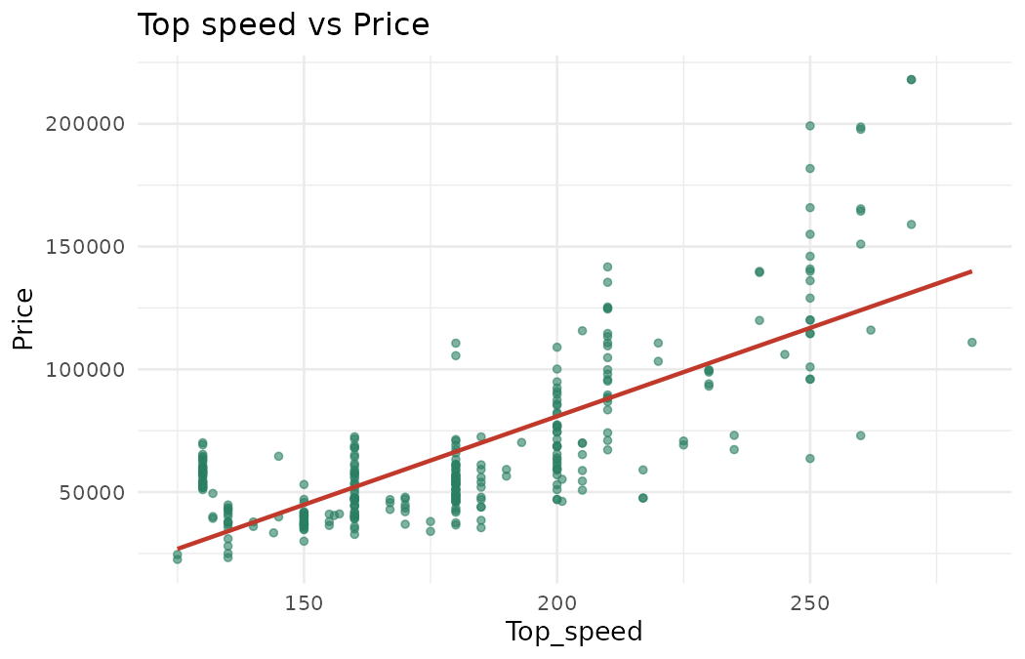
Stage 2: Relationships Between Features
Bigger batteries give more range; faster cars cost more. Both trends are close to linear.

Slide 14
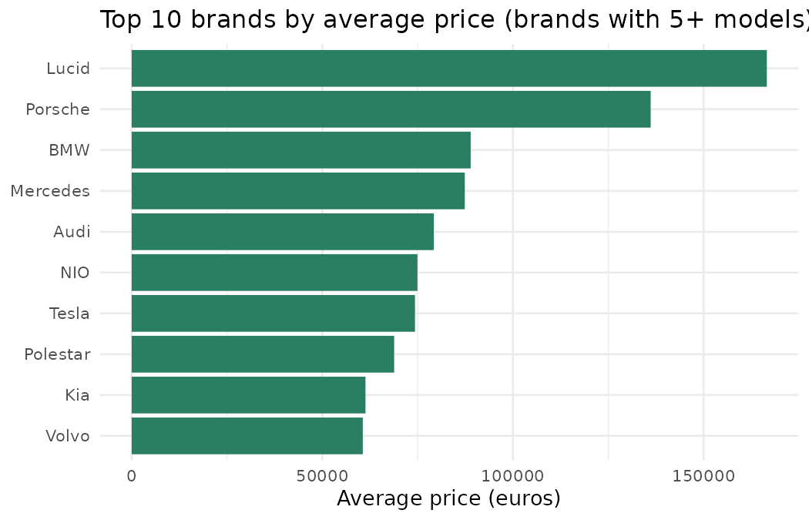
Stage 2: Price by Brand
Brand was extracted from the first word of Car_name.
Only brands with 5 or more models are shown.
Premium brands sit far above the mass-market average.

Slide 15
Stage 3: Feature Engineering and Data Leakage
Brand: first word of Car_name (used for exploration).
Price_per_km: Price divided by Range (euros for each km of range).
Data leakage check: Range is almost exactly Battery x 1000 / Efficiency.
Why this matters
If Efficiency were used to predict Range, the model would almost get the answer for free and show a fake R-squared near 1.
So the Range model does not use Efficiency. The Price model can use every specification.

Slide 16
Statistical Problems in the Project
Problem | Evidence in our data | How it was handled
Missing values | Fast_charge: 2 missing; Price: 51 missing (14%) | Fast_charge filled with the median; Price rows not filled because Price is a target (309 cars used)
Outliers | Price: 32, Efficiency: 8 (IQR rule) | Kept as genuine luxury cars; tree models handle them well
Skewed data | Price is right-skewed (a few very costly cars) | Kept as it is; Random Forest copes better than Linear Regression
Correlated predictors | Battery and Range 0.88; Acceleration and Top speed -0.84 | Checked with the correlation matrix; Random Forest is not affected by it
Data leakage | Range is almost Battery x 1000 / Efficiency (r = 0.9999) | Efficiency left out of the Range model
Overfitting | A model can look perfect on training data only | 80/20 split and 5-fold cross-validation (test R-squared close to CV R-squared)

Slide 17
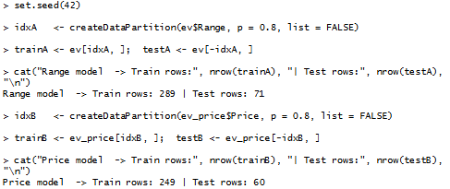
Stage 4: Data Splitting
80% of the data for training, 20% for testing
Model | Target | Inputs
A | Range (km) | Battery, Fast_charge, Top_speed, Acceleration
B | Price (euros) | Battery, Efficiency, Fast_charge, Top_speed, Acceleration, Range

Slide 18
Stage 5: Machine Learning Models Used
Linear Regression
Decision Tree
Random Forest
lm()
rpart()
ranger(), 300 trees
Fits a straight-line equation. Simple and easy to interpret.
Splits the data with if-else rules. Captures non-linear patterns.
Averages many trees. Usually the most accurate and stable.

Slide 19
Control Structures, Functions and Lists in R
# Control structures: for loop + if
for (col in names(ev)) {
if (any(is.na(ev[[col]]))) {
cat(col, "has missing values\n")
}
}
# User-defined function
evaluate <- function(actual, pred) {
rmse <- sqrt(mean((actual - pred)^2))
mae <- mean(abs(actual - pred))
r2 <- 1 - sum((actual - pred)^2) /
sum((actual - mean(actual))^2)
list(RMSE = rmse, MAE = mae, R2 = r2)
}
# List of results
results <- list(LM = evaluate(testA$Range, predLM),
RF = evaluate(testA$Range, predRF))
Control structures
for and if check every column for missing values; rpart splits the data with if-else rules.
Functions
Our evaluate() function, plus lm(), rpart(), ranger() and predict().
List
Collects the RMSE, MAE and R-squared of each model in one object.
Data frame
ev, trainA / testA, trainB / testB: one row per car, one column per specification.

Slide 20
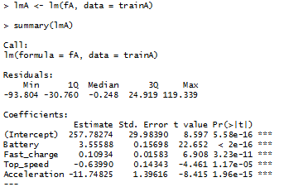
Linear Regression: Range Model
Each extra kWh of battery adds about 3.6 km of range.
Every predictor is significant.
The model explains about 87% of the variation in range on the training data.

Slide 21
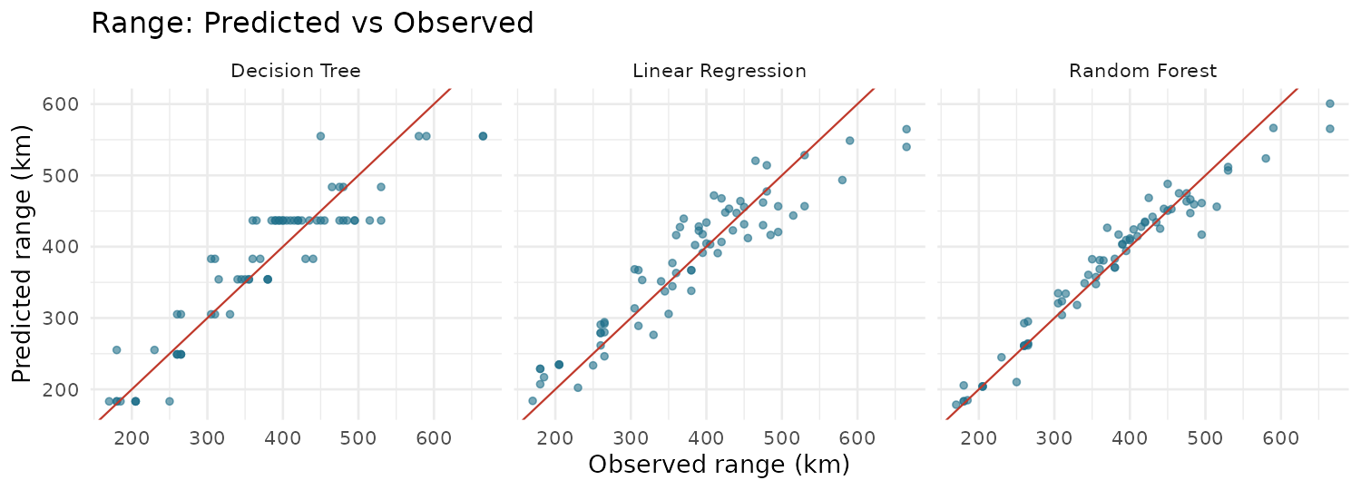
Range Prediction: Results on the Test Set
Model | RMSE (km) | MAE (km) | R-squared
Linear Regression | 41.41 | 33.02 | 0.866
Decision Tree | 43.43 | 33.59 | 0.852
Random Forest | 26.56 | 18.11 | 0.945

Slide 22
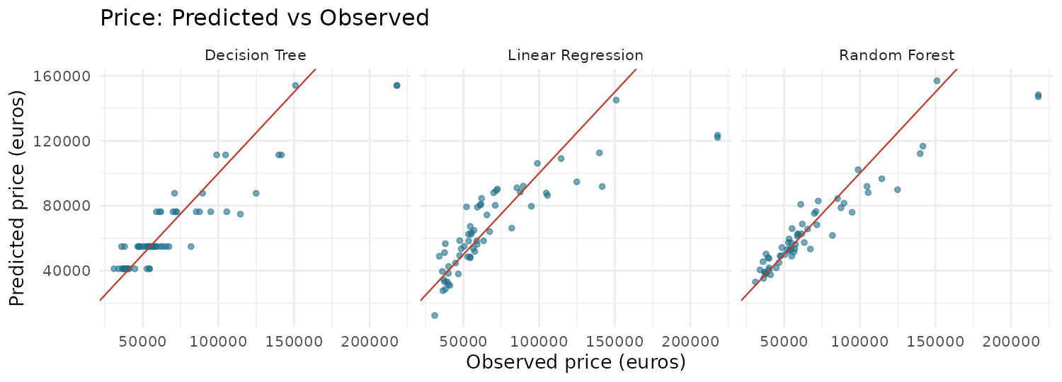
Price Prediction: Results on the Test Set
Model | RMSE (euros) | MAE (euros) | R-squared
Linear Regression | 22,182 | 13,575 | 0.678
Decision Tree | 17,504 | 11,237 | 0.800
Random Forest | 16,272 | 9,014 | 0.827

Slide 23
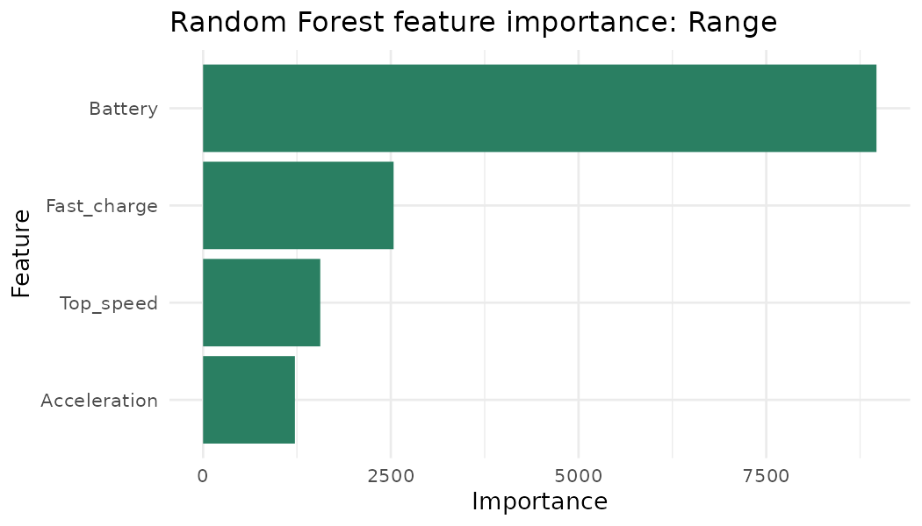
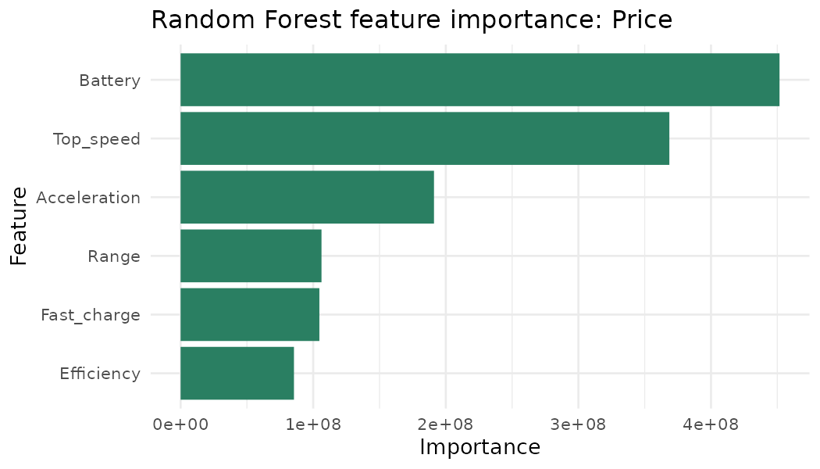
Random Forest: Feature Importance
Battery capacity is the most important feature for both Range and Price. Top speed is second for Price.

Slide 24
Comparison of Models
Target | Model | Test R-squared | 5-fold CV R-squared | Comments
Range | Linear Regression | 0.866 | 0.871 | Good, but misses curves
Range | Random Forest | 0.945 | 0.933 | Best and stable
Price | Linear Regression | 0.678 | 0.719 | Weakest, hurt by outliers
Price | Random Forest | 0.827 | 0.885 | Best and stable
5-fold cross-validation gives similar scores to the single test split, so the results are not a lucky split.
Decision Tree: R-squared 0.852 (Range) and 0.800 (Price), between the other two models.

Slide 25
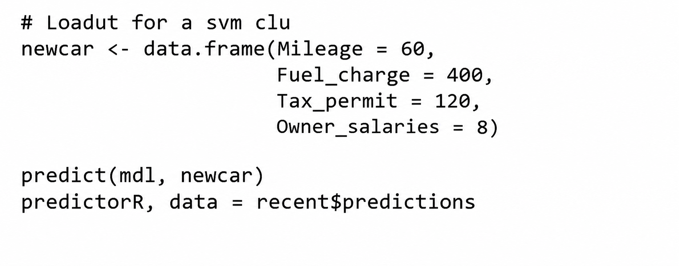
Prediction on a New Car
New car input | Value
Battery | 60 kWh
Fast_charge | 400 km/h
Top_speed | 160 km/h
Acceleration | 8.0 s
318.5 km
Linear Regression prediction
257.78 + 3.556 x 60 + 0.109 x 400 - 0.640 x 160 - 11.748 x 8, using the coefficients of the Range model.
The same predict() call on the Random Forest (best model, R-squared 0.945) gives the final estimate.

Slide 26
Results and Discussion
Random Forest is the most reliable model for both targets.
Battery capacity is the strongest driver of both range and price.
Price is harder to predict than range: brand, design and market positioning also affect price but are not in the dataset.
The Range model leaves out Efficiency to avoid data leakage, so the scores are realistic, not a suspicious perfect fit.
Limitations: only 360 cars, and 51 cars have no price.
0.945
26.6 km
0.827
16,272
Range R-squared
Range RMSE
Price R-squared
Price RMSE (euros)

Slide 27
Conclusion and Future Work
Conclusion
Future work
Built an end-to-end R pipeline: cleaning, visualization, splitting, three models and evaluation.
Random Forest predicts range within about 27 km and explains 94.5% of the variation.
Add brand, weight and body type as features.
Try gradient boosting (XGBoost) and tune hyper-parameters.
Build a Shiny app where a user enters specifications and gets the predicted range and price.

Slide 28
Project Reference
GitHub:
https://github.com/kavi0917/ev-price-range-prediction
THANK YOU!!!

