Slide 1
Digital Portfolio
STUDENT NAME: Kaviya R
REGISTER NO AND NMID: 24132011802522043 And asanm20124132011802522043
DEPARTMENT: Computer Science
COLLEGE:Arignar Anna Govt.Arts College/ Annamalai University

Slide 2
PROJECT TITLE
DIGITAL PORTFOLIO

Slide 3


AGENDA
Problem Statement
Project Overview
End Users
Tools and Technologies
Portfolio design and Layout
Features and Functionality
Results and Screenshots
Conclusion
Github Link
3/21/2024 Annual Review

Slide 4

PROBLEM STATEMENT
Traditional resumes fail to highlight skills effectively; a digital portfolio provides an interactive solution.

Slide 5

PROJECT OVERVIEW
The digital portfolio is an online platform to display skills, projects, and achievements. It enhances personal branding and makes information easily accessible.

Slide 6

WHO ARE THE END USERS?
The end users of a digital portfolio are students, job seekers, and professionals. Recruiters, employers, and academic evaluators also use it for assessment.

Slide 7

TOOLS AND TECHNIQUES
The digital portfolio is developed using HTML, CSS, and JavaScript for design and interactivity.

Slide 8
POTFOLIO DESIGN AND LAYOUT
The digital portfolio follows a clean and responsive layout with sections like Home, About Me, Skills, Projects, and Contact. A simple navigation bar.
8

Slide 9
FEATURES AND FUNCTIONALITY
The digital portfolio includes sections for skills, projects, and contact details. It offers responsive design, easy navigation, and accessibility across devices.

Slide 10
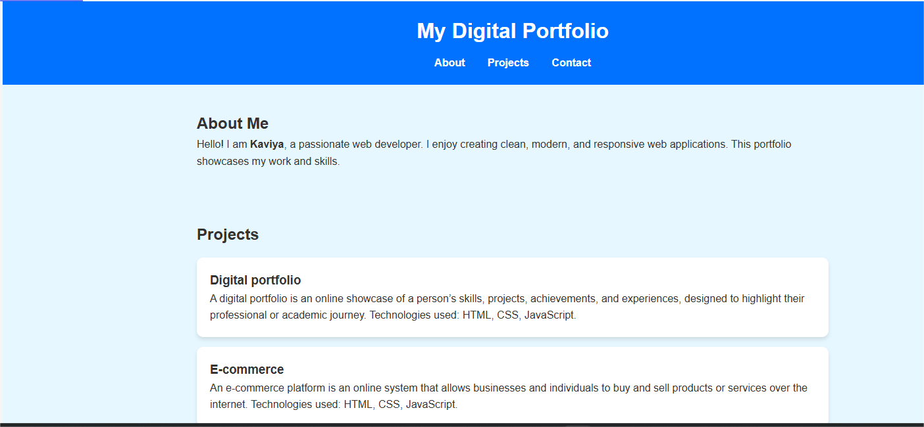
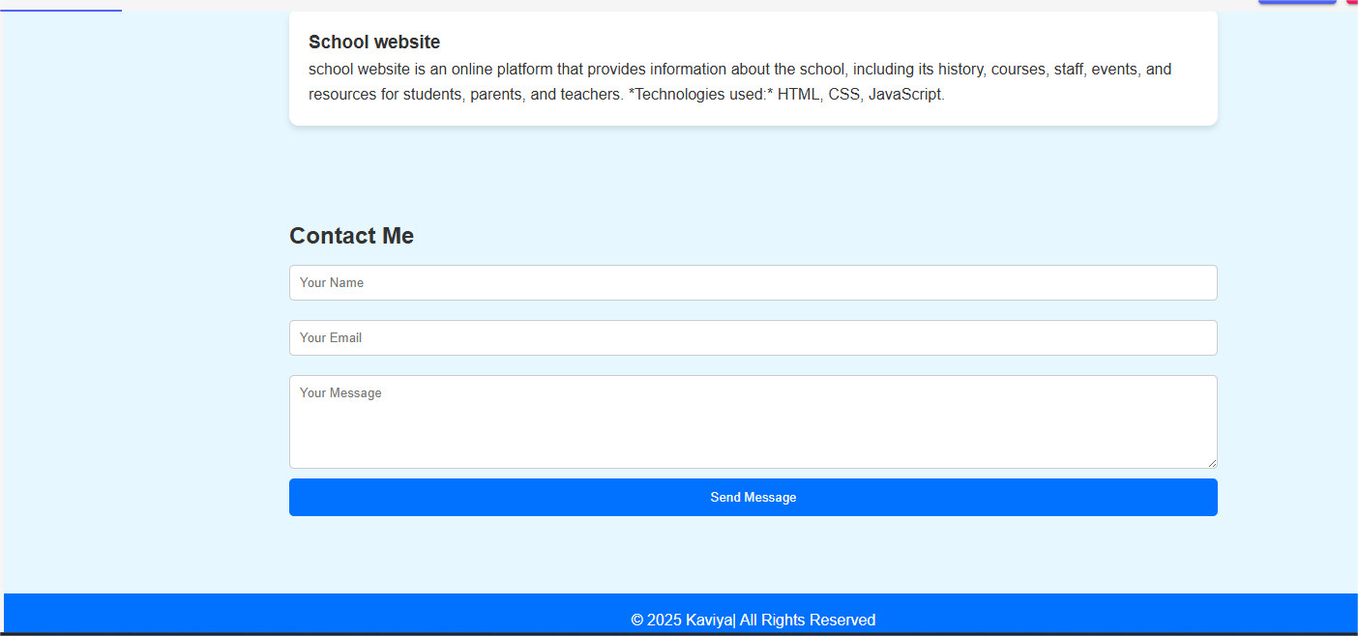
RESULTS AND SCREENSHOTS
Your digital portfolio shows a blue themed webpage with a header, footer, and sections like About, Skills, Projects, Contact.It looks neat, interactive, and highlights personal details and work.
3/21/2024 Annual Review
10

Slide 11
CONCLUSION
The digital portfolio serves as an effective platform to showcase skills, achievements, and projects in a professional way.
11

