Slide 1

MAHENDRA ENGINEERING COLLEGE (Autonomous)
CATCH ‘25 – Hackathon Final Round
21.3.2025
Name of the College : Mahendra college of engineering
Name of the Team : DKMN
Name of the Team Leader : Kavipriya S
Name of the Department : Biomedical engineering
Problem Statement ID : PS-OWN
Problem Statement : IOT Based Smart Gloves
Date : 21/03/2025

Slide 2
CREW DETAILS
NAME OF THE STUDENT | YEAR | DEPARTMENT | DESIGNATION | E MAIL ID
KAVIPRIYA S | 3rd | BIOMEDICAL | TEAM LEADER | kavipriya1914319@gmail.com
MADHUMITHA S | 3rd | BIOMEDICAL | TEAM MEMBER | mathumithasingaravel@gmail.com
NIVETHA K | 3rd | BIOMEDICAL | TEAM MEMBER | nivethakumaresan88@gmail.com
DEEPIKA D | 3rd | BIOMEDICAL | TEAM MEMBER | keerthideepi464@gmail.com
*For Example Contribution Type Can be : Coder, Team Leader, Team Member.

Slide 3
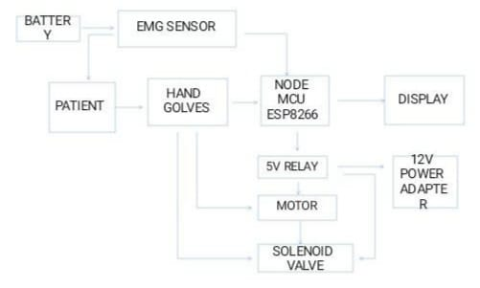
FLOW CHART

Slide 4
IDEA/APPROACH DETAILS
The main purpose of the smart gloves is to improve the healthcare of the patients.
Smart gloves can support rehabilitation of exercise, providing real-time feedback to the patients.
It should focus on improving the mobility ,providing affordable assisting technology and improve the communication tools to paralyzed individual of life.
We have demonstrated the reliability and functionality of the smart gloves in capturing hand movements, recognizing gestures, and providing intuitive feedback.

Slide 5
YOUTUBE VIDEO LINK OF OUR EXECUTED PROJECT
IOT based Smart Gloves
https://youtube.com/shorts/Js6pWVWABHw?si=_XTr-5JxClIUlqqu

Slide 6
THANK YOU !

