Slide 1
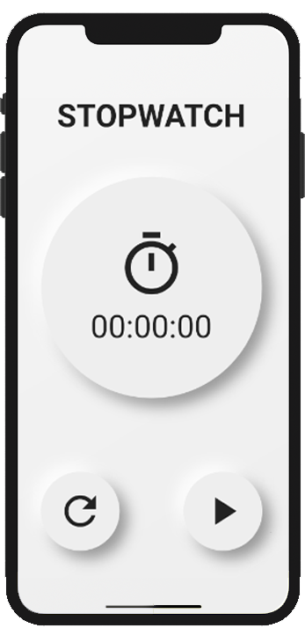
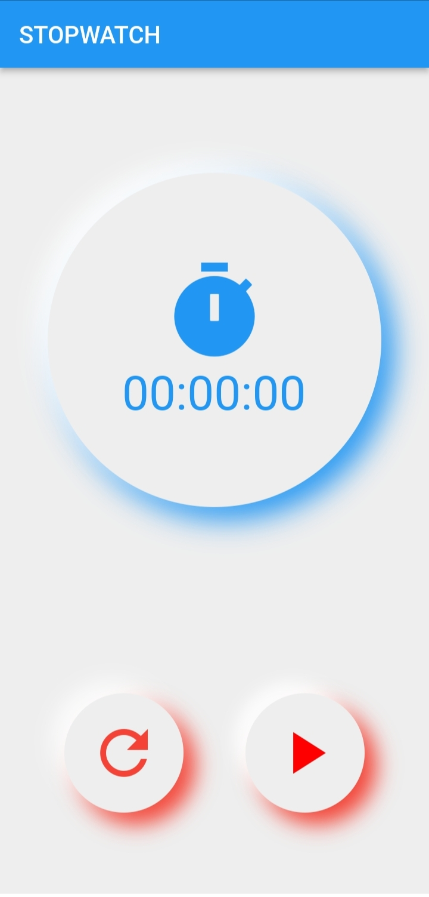
App Bar
Widget Tree
Column
Container
Column
Icon
Container
String Text
Row
Buttons
Icon
Icon

Slide 2
App Layout

