Slide 1






Name : Subrata B
Date : 24 Dec 2025
Digital RMG Weekly Metrics

Slide 2


Digital Applications: Data Engineering Skill Factory
Sprint 1 (11th Dec– 24th Dec)
TEAM MEMBERS
PROJECT HIGHLIGHTS
TEAM MEMBERS
Project Health
POC – Talent management dashboard
Tool to understand the employees’ skills
Find skill gaps and suggest training courses accordingly
Sl. No. | Emp Id | Name | Designation | Expertise
1 | 43916 | Kavyasri | Engineer | Pyspark, Data Engineering
2 | 43922 | Megha G | Engineer | Pyspark, Data Engineering
PROJECT LOWLIGHTS
Team Led by Data Engineering SME Aparna L
None
Key Activities completed in previous week
Key Activities planned for current week
Completed presentation on Data Engineering Essentials
Project topic research and discussion
PySpark Hands-on
Completed Pyspark and Data Engineering LinkedIn learning courses
Work on the POC - Talent management dashboard

Slide 3
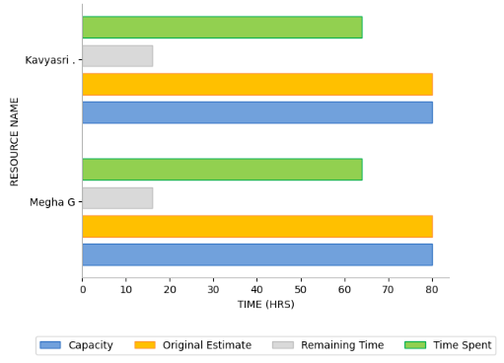
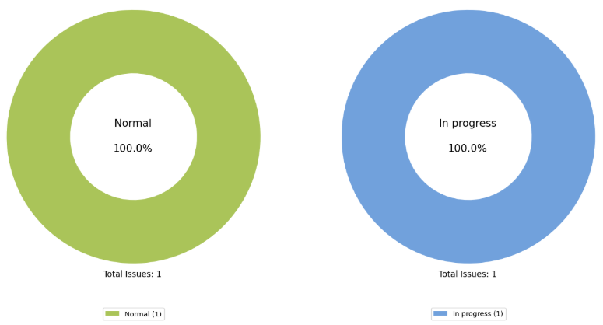
Digital Applications: Data Engineering Skill Factory
TEAM MEMBERS
3

Slide 4
Digital Applications: React + Java Skill Factory
Sprint 1 (11th Dec– 24th Dec)
TEAM MEMBERS
PROJECT HIGHLIGHTS
TEAM MEMBERS
Project Health
Initial Training – Learning paths, Mock interviews & assessments
Sl. No. | Emp Id | Name | Designation | Expertise
1 | 41604 | Rajashekara V M | Engineer | Java, Spring Boot, Angular
2 | 41603 | Maraka Hamsini | Engineer | Android, React, Java
3 | 32929 | Ranjitha A B | Senior Engineer | ReactJS, Brightscript
4 | 33839 | Kadambini Sahoo | Senior Engineer | Java, Spring Boot
PROJECT LOWLIGHTS
None
Team led by Pavanraj S N
Key Activities completed in previous week
Key Activities planned for current week
Completed assigned Java, React and Spring Boot LinkedIn courses
Attended interview
Prepared for Competency assessment
Delivered Competency talk on React Hooks (Ranjitha)
Work on the POC - Food Delivery App
Prepare for any upcoming interviews

Slide 5
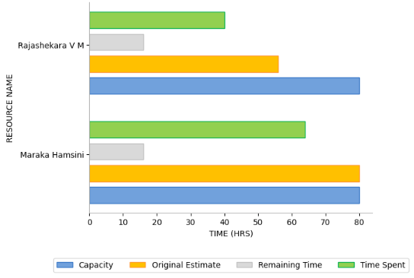
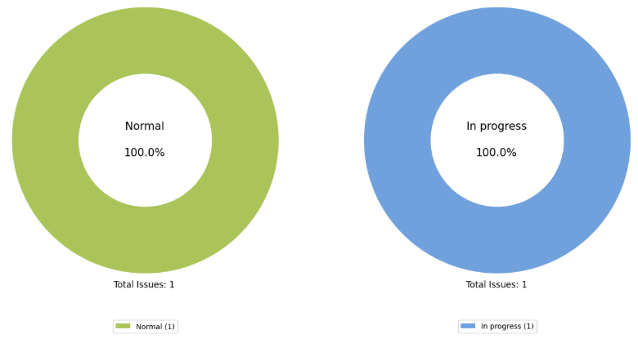
Digital Applications: React + Java Skill Factory
TEAM MEMBERS
5

Slide 6
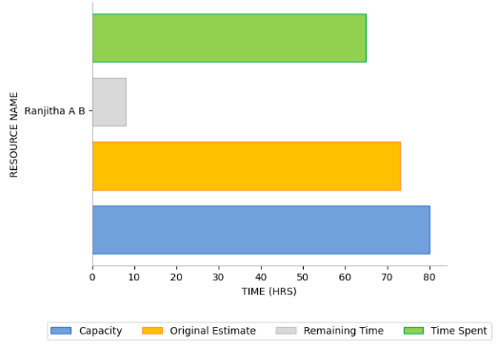
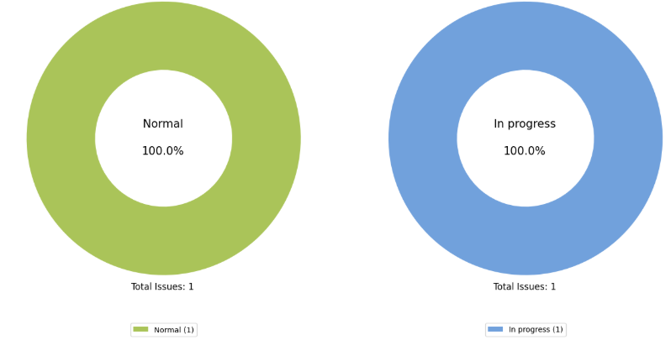
Digital Applications: React + Java Skill Factory
TEAM MEMBERS
6

Slide 7
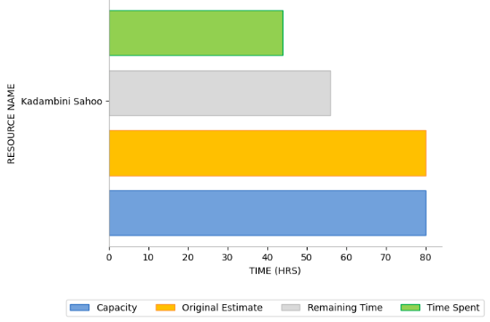
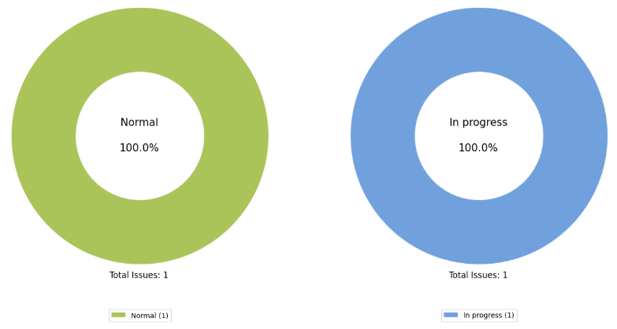
Digital Applications: React + Java Skill Factory
TEAM MEMBERS
7

Slide 8
Data Engineering: Continuous Assessment - RMG
Sl. No. | Emp ID | Resource Name | Technical Skills | Skill Factory | Strength | Weakness | Overall Performance
1 | 43916 | Kavyasri | PySpark, Data Engineering | Data Engineering | Good understanding of aggregation and basic functions in PySpark and good pace in Learning | Still in learning phase | Good
2 | 43922 | Megha G | PySprak, Data Engineering | Data Engineering | Good understanding of aggregation and basic functions in PySpark and good pace in Learning-- | Still in learning phase | Good

Slide 9
Digital Applications: Continuous Assessment - RMG
Sl. No. | Emp ID | Resource Name | Technical Skills | Skill Factory | Strength | Weakness | Overall Performance
1 | 41604 | Rajashekara V M | Java, Spring Boot, Angular | React + Java | Strong proficiency in Java, Spring Boot and REST API development. Good communication and collaboration skills | Need to improve documentation skills and DevOps exposure | Good
2 | 41603 | Maraka Hamsini | Android, React, Java | React + Java | Strong in Java coding | Needs improvement in React Coding part | Needs improvement
3 | 32929 | Ranjitha A B | ReactJS, Bright script | React + Java | Able to code in Bright script and ReactJS | Still Learning phase of java and python | Needs improvement
4 | 33839 | Kadambini Sahoo | Java, Spring Boot | React + Java | Able to code in Java | Still needs improvement in coding and communication | Needs improvement

Slide 10
Data Engineering: Feedback & Revised Rating
Sl. No. | Emp ID | Resource Name | Designation | Skill Factory | Feedback Given | Initial Rating Given on | Initial Rating | Intermittent Rating | Current Rating
1 | 43916 | Kavyasri | Engineer | Data Engineering | Good understanding in Pyspark basics. Strong Data bricks, SQL queries, big data | 03/12/2025 | Good | Good | Very Good
2 | 43922 | Megha G | Engineer | Data Engineering | Good understanding in Pyspark basics. Strong Data bricks, SQL queries, big data | 03/12/2025 | Good | Good | Very Good

Slide 11
Digital Applications: Feedback & Revised Rating
Sl. No. | Emp ID | Resource Name | Designation | Skill Factory | Feedback Given | Initial Rating Given on | Initial Rating | Intermittent Rating | Current Rating
1 | 41604 | Rajashekara V M | Engineer | React + Java | Strong in Java, Spring Boot and soft skills. Need to improve DevOps exposure | 10/12/2025 | Good | Good | Good
2 | 41603 | Maraka Hamsini | Engineer | React + Java | Strong in Java. Needs improvement in React | 10/12/2025 | Needs improvement | Good | Good
3 | 32929 | Ranjitha A B | Senior Engineer | React + Java | Able to code in Bright script and ReactJS. Needs to improve Java and Python | 10/12/2025 | Needs improvement | Good | Good
4 | 33839 | Kadambini Sahoo | Senior Engineer | React + Java | Able to code in Java. Still needs to improve Java skills and communication | 10/12/2025 | Needs improvement | Needs improvement | Needs improvement

Slide 12
Security: Progress Status
Key Activities In-Progress for current week
Key Activities completed
GenAI Phase II - Agentic AI course and cloud security learning path: In-progress
Thick client application testing and STAF POC: Dashboard Issue fix: In-progress
Will push all the updated code to the Gerrit
Completed the CompTIA Cloud+ (CV0-003) cert course in cloud security learning path: Completed (Keerthana)

Slide 13
Security: Feedback & Revised Rating
Sl. No. | Resource Name | Designation | Skill Factory | Feedback Given | Initial Rating Given On | Initial Rating | Current Rating
1 | Keerthana M S | Senior Engineer | Xstrahl project – Xbeam VAPT | Communication and soft skills can be improved | 03/04/2024 | Needs Improvement | Good - Shows improvement
2 | Anup Aditya | Senior Engineer | Currently preparing for the KSY firewall requirement interview | Need to improve on technical skills. | 04/06/2025 | Needs Improvement | Good

Slide 14






THANK YOU
FIND OUT MORE
www.tataelxsi.com
Confidentiality Notice
This document and all information contained herein is the sole property of Tata Elxsi Ltd.
No intellectual property rights are granted by the delivery of this document or the disclosure of its content.
This document shall not be reproduced or disclosed to a third party without the express written consent of Tata Elxsi Ltd.
This document and its content shall not be used for any purpose other than that for which it is supplied.

