Slide 1
Digital Portfolio
STUDENT NAME: KAVIRAJ
REGISTER NO AND NMID: 212405378 AND C72D78A6353C3A68DBF48AF029B67E3A
DEPARTMENT: BCA
COLLEGE: Apollo Arts And Science College Chennai /
MADRAS UNIVERSITY

Slide 2
PROJECT TITLE
PERSONAL PORTFOLIO WEBSITE USING FRONT-END DEVELOPMENT

Slide 3


AGENDA
Problem Statement
Project Overview
End Users
Tools and Technologies
Portfolio design and Layout
Features and Functionality
Results and Screenshots
Conclusion
Github Link
3/21/2024 Annual Review

Slide 4

PROBLEM STATEMENT
Students often struggle to present their skills and projects effectively.
Static resumes don't reflect creativity, coding ability, or interactivity.
A need for a responsive personal portfolio website to showcase talent in a professional way.

Slide 5

PROJECT OVERVIEW
This project is a Responsive Portfolio Website created using HTML, CSS, and JavaScript.
Purpose:
Introduce myself (About Me)
Highlight skills (Frontend, Backend, DB)
Showcase projects with live demos
Provide easy contact options

Slide 6

WHO ARE THE END USERS?
Recruiters - to check technical skills & projects
Faculty & Classmates - academic presentation
General Audience - online visibility & networking

Slide 7

TOOLS AND TECHNIQUES
Development - HTML (structure), CSS (styling), JavaScript (interactivity).
Design - Font Awesome icons, custom images, profile photo.
Hosting & Control - GitHub, GitHub Pages.
Features - Responsive design, smooth scrolling ,interactive buttons.

Slide 8
PORTFOLIO DESIGN AND LAYOUT
Hero Section - Intro with creative background gradient.
About Me - Profile + short description.
Projects Showcase - Expense Tracker, Responsive Website, Weather Now.
Contact Form - Easy communication option.
8

Slide 9
FEATURES AND FUNCTIONALITY
Fully responsive layout (works on mobile & desktop).
Projects with short descriptions .
Contact form for messages .
Clean, colorful U l with modern design.

Slide 10
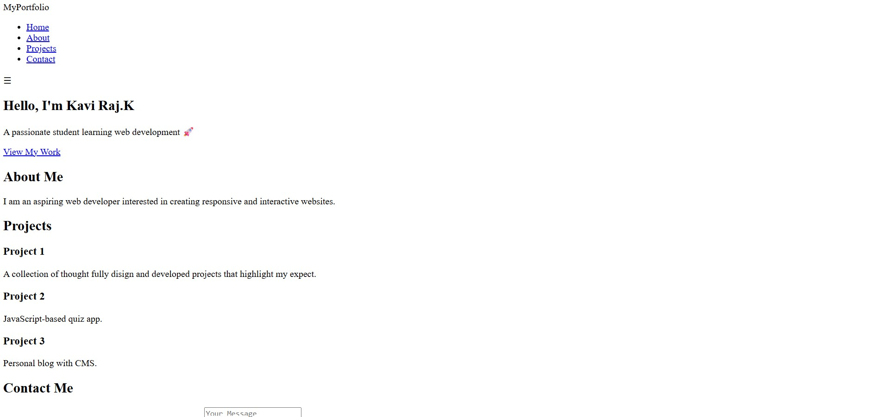
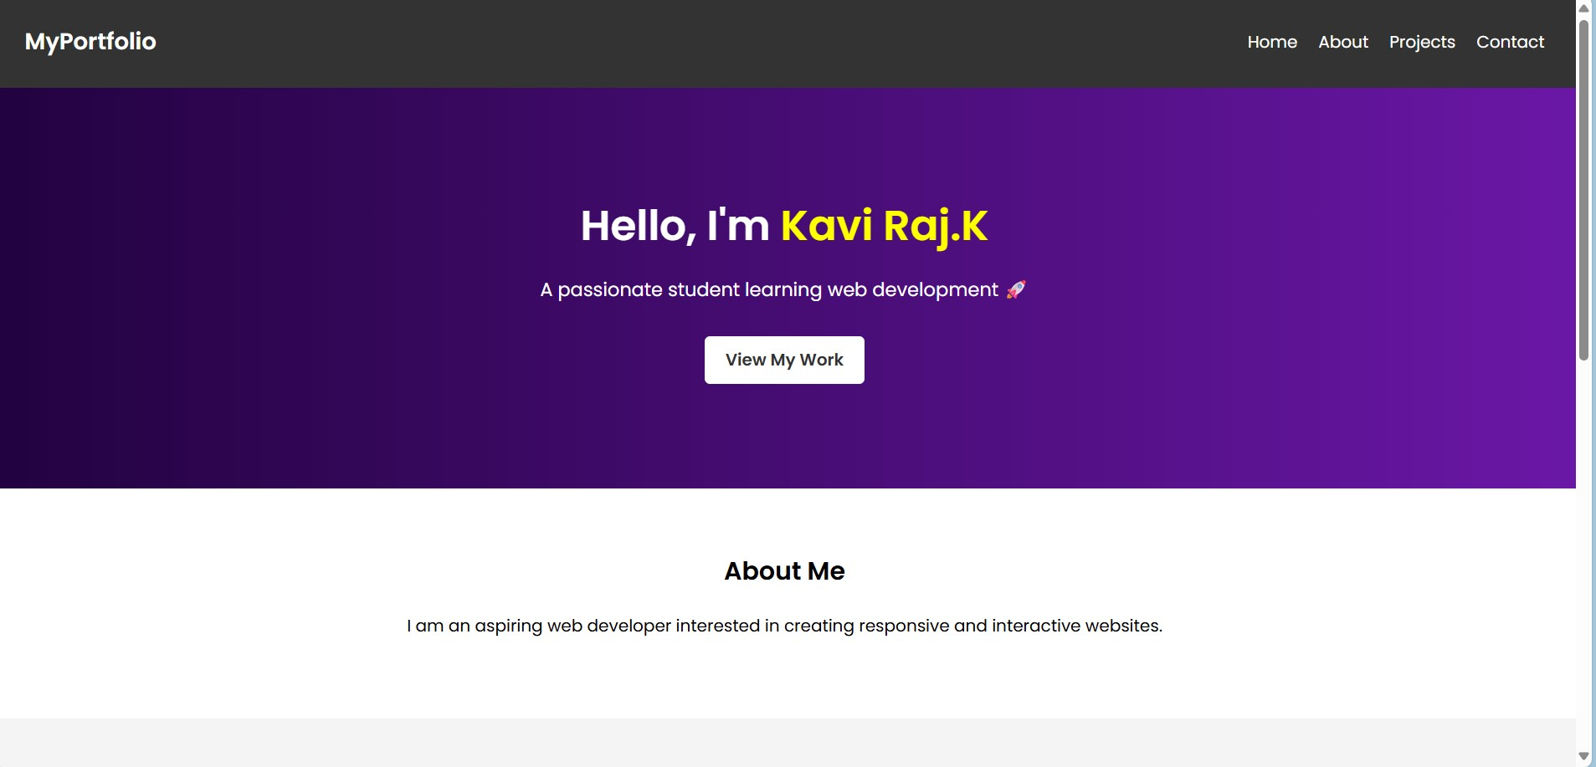
RESULTS AND SCREENSHOTS
BEFORE ADDING CSS : AFTER ADDING CSS:
3/21/2024 Annual Review
10

Slide 11
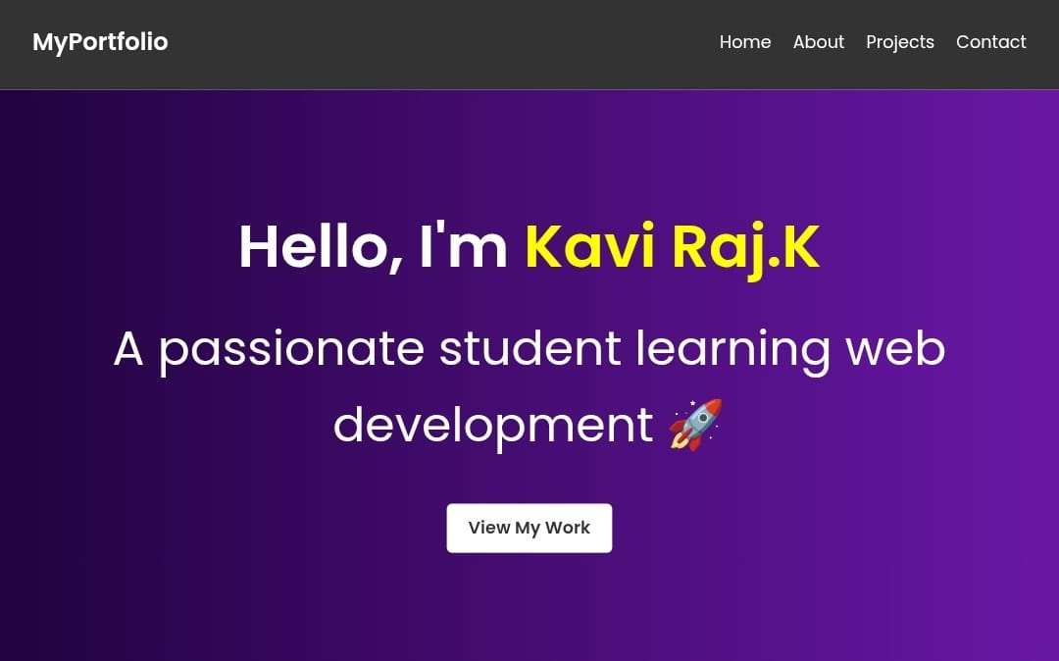
HOME SECTION:

Slide 12
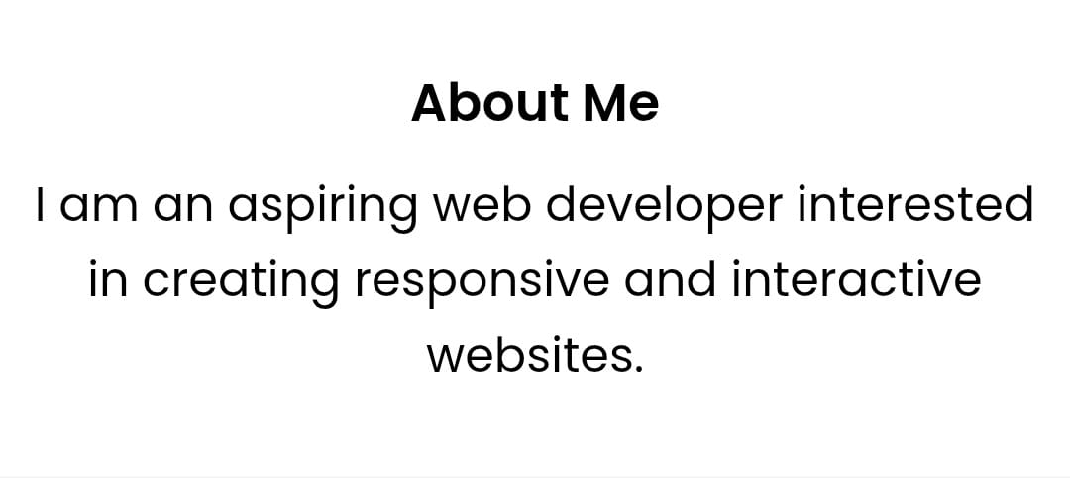
ABOUT SECTION:

Slide 13
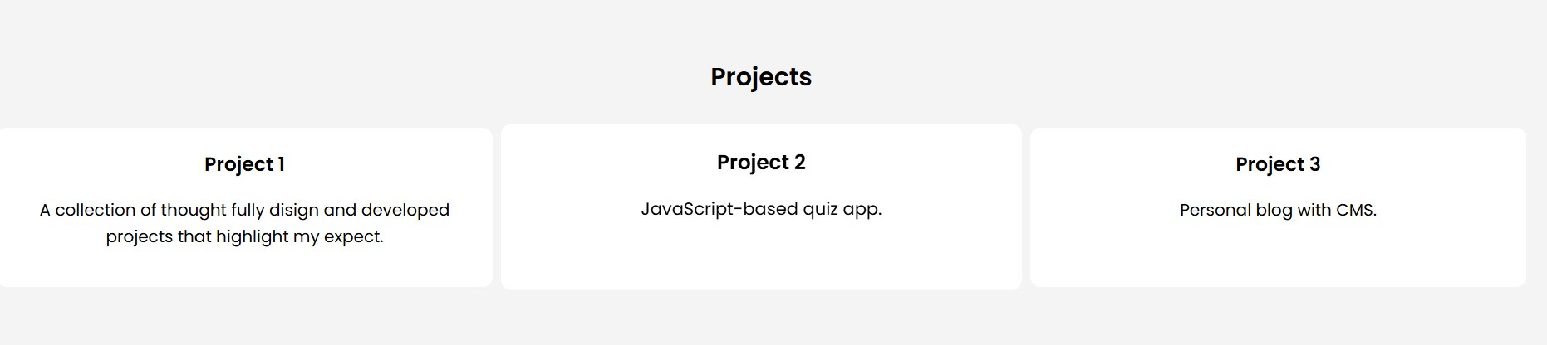
PROJECT SECTION:

Slide 14
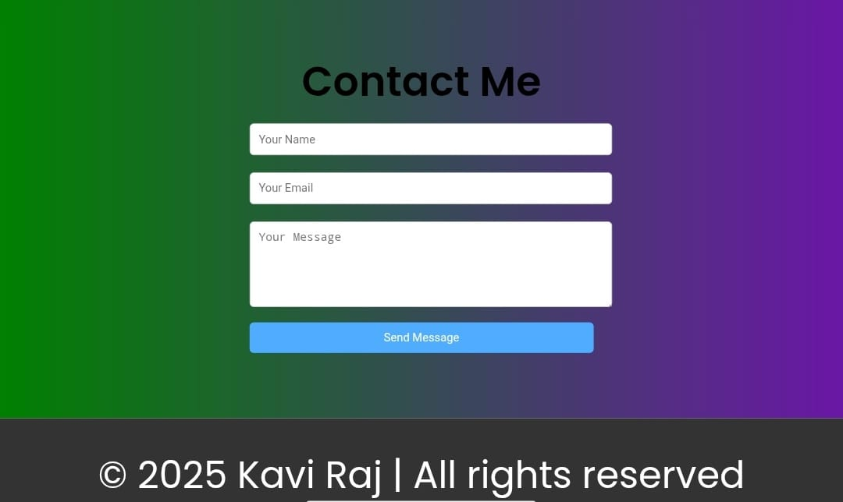
CONTACT SECTION:

Slide 15
CONCLUSION
The digital portfolio provides a modern way to present my skills and projects.
It serves as a dynamic resume for professors, recruiters, and clients .
Built with HTML, CSS, and JavaScript, it is responsive, interactive, and easy to update.
15

Slide 16
GITHUB LINK:
https://kavibca24aascc-png.github.io/TNSDC-FWD-Digitalportfolio/

