Slide 1

Linux: introduction and basic commands

Slide 2

Operating Systems

Slide 3

Operating Systems (Ess 2.1)
an Operating System is “software that controls the operation of a computer and directs the processing of programs (by assigning storage space in memory and controlling input and output functions)”
https://www.merriam-webster.com/dictionary/operating%20system

Slide 4
Operating Systems schematic diagram
User 1
User 2
User n
Application software
Operating System
Hardware
CPU
ALU
RAM
I/O
Notes:
CPU: central processing unit - contains all the circuitry needed to process input, store data, and output results
ALU: arithmetic logic unit - a combinational digital circuit that performs arithmetic and bitwise operations on integer binary numbers
RAM: random-access memory - essentially short-term memory where data is stored as the processor needs it
I/O: input / output devices

Slide 5

Operating System (OS) functions
every computer requires an OS to run other programs
coordinates use and sharing of hardware between system programs and apps
running and scheduling processes
supporting multi-tasking
networking
managing storage (RAM and long term)
controlling peripheral devices using drivers
ensuring security
managing application programming interfaces (APIs)
providing user interfaces

Slide 6
Boot process (or what happens when you press the ON button)
BIOS
(Basic Input / Output System)
performs a power-on self-test
checks hardware
independent of OS being used
searches for MBR
MBR
(Master Boot Record)
locates bootloader
tiny file (512 bytes)
GRUB
(Grand Unified Bootloader)
used to load the kernel
OS independent
replaces LILO which was just for Linux
used in dual boot to select OS
kernel
(core)
may be compressed
/boot/vmlinuz or /boot/vmlinux
last character indicates if it is compressed
SystemD
daemon that handles all other Linux processes
runs in the background
https://www.youtube.com/watch?v=sOIOY6Ks0xA

Slide 7


Kernel (Ess 3.1)
kernel is core of OS
kernel tasks
like air traffic controller for apps not planes
does not distinguish between
user-facing apps
network services
internal tasks...
stays in memory so must be small
loaded in a protective area to prevent overwriting
memory management:
track what memory is available
process and task management:
share resources (multitasking)
disk management:
access memory regardless of location

Slide 8
Kernel schematic diagram
Application software
Browsers
Word processors
Editors
IDEs
User mode
Application IPC
Device
drivers
Process management
File
servers
I/O management
Memory management
Operating
System
Kernel mode
Low level address management
Inter Process Communications
Low level process management
Notes:
IDE: interactive Development Environment
IPC: Inter-Process Communication

Slide 9



Major operating systems (Ess 2.2, 2.3, 2.4)
Microsoft Windows
Apple macOS
Linux
proprietary code base
mostly administered via GUI
has Microsoft equivalents of Linux command line functions
PowerShell
Windows Subsystem for Linux (WSL)
fully-qualified UNIX distribution based on BSD Unix
additional proprietary code
runs on hardware optimised for Apple software
any distribution package containing Linux kernel, GNU tools and apps
designed or optimised for required task
mostly using CLI in a terminal
not all apps supported by all distros
Notes:
GUI: Graphical User Interface - interface where user interacts with graphical components such as icons, buttons, and menus
BSD: Berkeley Software Distribution - version of Linux
GNU: Gnu's Not Unix - extensive collection of free software, which can be used as an operating system or with other operating systems
CLI: Command Line Interface - interface where user issues commands to control device or program

Slide 10
Brief history (Ess 1.2)
UNIX
developed at AT&T Bell Labs in 1970s
written in C
now a trademark and a specification, owned by the Open Group
only software certified by Open Group is called UNIX
GNU
GNU’s Not Unix
created by Richard Stallman in 1983
free tools for UNIX-like operating systems that make a kernel usable
editors, compilers and user interfaces
Linux
developed as a hobby project by Linus Torvalds in 1991
initially ran on Intel 386 PC
free, open source alternative to expensive UNIX
Linux has not been certified by Open Group, so is UNIX-like
uses GNU tools to create complete OS

Slide 11

Linux is everywhere (Ess 1.1)
computers:
client
server: over 50% of Internet servers
phones: Android is a Linux distro
networking equipment:
home routers
servers
embedded systems:
cars
rockets
watches
televisions
Internet of Things (IoT) devices
remote monitoring systems:
pipelines
factories

Slide 12



What makes Linux different?
Linux is Open Source
Linux has "distributions"
Linux embraces Command Line Interface (CLI)

Slide 13
Open source software (Ess 1.3, 4.1)
closed source restricts access to use of machine code
open source grants rights to use and modify source code as required
benefits:
open source can be inspected for backdoors, viruses and spyware
software is usually more robust, stable and adaptable than proprietary, closed source
standards are maintained allowing communication between software

Slide 14
Open source vs. closed source
Closed source
Open source
# This program prints greeting
print('Hello, world!')
print('Welcome to WDOS')
Source code
(human-readable)
No access to
source code
Conversion
(using compiler or interpreter)
Not permitted to reverse engineer
01000101010100101010101110101010101010101011101010101000101010101011010101010101010101000100001010110101
01000101010100101010101110101010101010101011101010101000101010101011010101010101010101000100001010110101
Machine code
(executable)
Machine code
(executable)

Slide 15

What is a "distribution"? (Ess 1.4)
distro is bundled software including:
Linux kernel
GNU tools
user-facing applications e.g. Word processors, browsers
tools required to
set up storage
install kernel
manage the system
package manager to add and remove software after installation
Linux kernel
GNU tools
user-facing apps
distro

Slide 16
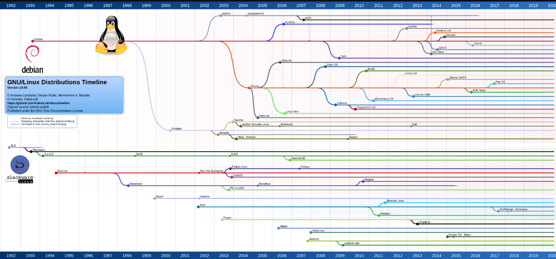
Linux distro families (Ess 2.4.1)
there are lots of them!

Slide 17

Distro families
Red Hat
Red Hat Enterprise Linux (RHEL): paid, commercial distro with long release cycle
Fedora: personal desktop with latest software
CentOS: free distribution based on source code of RHEL, but without paid support
Scientific Linux: specific-use distro based on RHEL
Slackware: one of oldest Linux distros (developed in 1993)
SUSE: optimised for security, reliability and performance
openSUSE: rolling release version, Tumbleweed and a regular release version, Leap
Debian: community development that maintains GNU OS
Ubuntu: stable distro with LTS (5 years on servers)
⁠⁠Linux Mint: community-driven Linux distro based on Ubuntu
Android:
world's most popular Linux distro, but largely incompatible with desktop distros

Slide 18


Choosing a distro
OK, so there are lots of them...
how do you choose?
questions to ask:
what kind of business?
what level of knowledge and skills possessed by employees?
are employees adaptable to new software?
what end-user features do employees need?
what level of security is required?
is technical support required?
even with this information, where do you start?
https://distrochooser.de/en
https://librehunt.org/

Slide 19
Software in a distro (Ess 3.1)
Linux desktop provides GUI to select programs, including terminal
eg. GNOME (used by Ubuntu), Cinnamon (used by Linux Mint)
although distros may vary, they all provide access to CLI via terminal
shell: user interface of a Linux system
terminal accepts what the user types and passes it to a shell
shell interprets user input into commands that are executed by the kernel
output (including error messages) is displayed in terminal

Slide 20



Applications (Ess 3.2, 3.5, 3.6)
server apps
desktop / mobile apps
security
direct interaction with user
provides information to clients
web servers (Apache, NGINX)
cloud servers (ownCloud, NextCloud)
database servers (MariaDB, MySQL)
email server
file sharing (Samba, NFS - Network File System)
user-facing apps
email client (Thunderbird)
web browsers (Firefox)
office suite: word processors, spreadsheets, presentation software (LibreOffice)
media editors and players (GIMP)
password managers (KeePassX)
firewall (Uncomplicated Firewall (UFW))
VPN

Slide 21

Console tools (Ess 3.3)
shells
Bourne shell
C shell (tcsh is a modern derivation of C shell)
Bourne Again Shell (Bash)
default shell on most systems
text editors
Vi (Vim modern derivation)
Emacs
Nano: simple open source editor

Slide 22

Package management (Ess 3.4)
distros contain files and dependencies that are bundled into apps and compressed into packages
package managers:
usually requires root access
install, upgrade, configure and use software
tracks files
downloads updates from remote repositories
examples:
APT (used by Debian based distros)
RPM package manager
npm (package manager built for Node)
https://sourceforge.net/software/package-managers/

Slide 23

The Cloud (Ess 3.7)
The Cloud: data centres providing remote access to computing resources
store, manage, process, and communicate information
well-known cloud providers:
AWS, Cisco, Microsoft Azure, Google Cloud, etc
four ways that cloud infrastructure is managed and accessed
public: shared by multiple tenants
private: bespoke cloud services restricted to single tenant
community: services (and costs) shared between groups with common goals
hybrid: combination of two or more clouds from the above

Slide 24
Benefits of the cloud
cost reduction
improved speed & bandwidth
better IT management
managed by experts
less downtime
scalable / elastic services
secure environment
24/7 monitoring
accessible from anywhere

Slide 25
Linux in the Cloud (Ess 3.7.1)
Linux powers 90% of public cloud provision
most virtual servers are based on some version of the Linux kernel
secure
cost-effective
secure and reliable OS
open source - easily inspect for vulnerabilities
power-efficient OS
kernel and many desirable apps are free
flexible due to modularity
accessible
each tenant may have different requirements
requirements will probably evolve
can be accessed by any device
Linux versions exist for multiple devices

Slide 26

Virtualisation (Ess 3.7.1)
servers spend most of their time doing nothing (YAWN)
virtualisation uses the idle time to provide services to other processes
optimise use of physical resources
reduce amount of space
reduce power
only pay for what you use
adapted from: https://mapandfire.com/blog/how-to-make-your-product-better-than-doing-nothing/

Slide 27
Virtualisation (Ess 3.7.1)
one physical machine hosts large number of virtual machines (guests)
host runs multiple copies of an operating system
uses hypervisor (eg. VMWare, Openbox, HyperV) to monitor virtual machines
switch resources between guests
create ("spin up"), configure and deploy virtual machines
remove virtual machines
VMs can be pre-configured for specific functions to be deployed rapidly

Slide 28





Virtualisation (Ess 3.7.1)
Guest 1
Guest 2
Guest 3
Host hardware
Hypervisor
Guest 4

Slide 29






Interfaces (Ess 1.5)
2 types of interface:
graphical user interface (GUI)
point, click, drag
just need to understand (recognise) icons
shields user from complexity (abstraction)
command line interface (CLI)
text based interface
type commands (need to remember / understand commands)
more power, speed and flexibility
write scripts to automate common tasks
Graphical User Interface (GUI)
>_
Command Line Interface (CLI)

Slide 30

Linux commands

Slide 31
Bash shell (Ess 5.2)
terminal is the interface (CLI) to the shell
shell interprets command and invokes the required program
Bash is most common shell and provides commands to:
manage command history
write script
write commands in a file and interpret them
conditions and functions
create aliases
nicknames for longer commands
declare variables
store values for later use
>_

Slide 32
Prompt
prompt indicates that CLI is expecting input
system name: localhost
current working directory: ~ is shorthand for user's home directory
username: sysadmin

Slide 33
Command syntax (Unhatched 2, Ess 5.3)
Linux is case-sensitive - so beware!
commands
options
arguments
variables
file names
command [options…] [arguments…]

Slide 34
Options (Unhatched 2.1, Ess 5.3.2)
used to modify command behaviour
frequently a single letter, but some also have a full length version
two dashes followed by full option
single dash followed by single letter short cut
single letters can be combined in a single string
ls --recursive
ls -R
ls -l -R
ls -Rl
ls -lR

Slide 35
Arguments (Unhatched 2.1, Ess 5.3.1)
additional information for command to work with
username
directory
filename
some commands allow multiple arguments
separated by space

Slide 36

Hello world!

Slide 37

DEMO: echo for literals
echo is used to output content
default is to output to screen
text literals in quotes
file and directory names
variables
more on these later in the module...
outputs quoted text to screen
echo "Hello world!"

Slide 38

File hierarchy and current directory

Slide 39
File hierarchy (Ess 7.2)
files are stored in a hierarchical system with root (represented by /) as top node
every user has a home directory
sysadmin
user has full access
other users normally have no access by default
everything in Linux is considered as a file
directory is a "file" that contains names of other files and their location in memory
when a new virtual machine is created, user is logged in as sysadmin in the home directory
can be done by resetting the emulator

Slide 40
File structure for emulator in Linux essentials course
/
top level
known as root
bin
boot
dev
etc
home
...
usr
var
essential binary files
hardware devices
can also use ~
sysadmin
bin
...
src
Desktop
Documents
Downloads
Music
Pictures
Public
Templates
Videos
School
Work
Art
Engineering
Math

Slide 41
File structure for emulator in Linux essentials course
/
top level
known as root
bin
boot
dev
etc
home
...
usr
var
essential binary files
hardware devices
sysadmin
also represented by ~
Desktop
Documents
Downloads
Music
Pictures
Public
Templates
Videos
School
Work
Art
Engineering
Math

Slide 42
Relative and absolute paths (Unhatched 4, Ess 7.3)
paths specify where to find a directory
path is a list of directories separated by /
these can be relative to the current directory
Documents/School is the School directory within the Documents directory relative to the sysadmin directory
they can also be absolute, starting from the root directory
/home/sysadmin/Documents/School is the absolute path from the root directory to the School directory
can also specify absolute path from home using ~ (tilde)
~/Documents/School is the absolute path from the home directory to the School directory

Slide 43
Relative vs absolute paths
/
root directory
home
current directory
YOU ARE HERE!
sysadmin
Documents/School
relative to current directory
Documents
/home/sysadmin/Documents/School
absolute path from the root
School
Work
~/Documents/School
absolute path from the home directory
Art
Engineering
Math

Slide 44
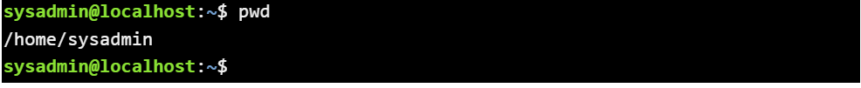
DEMO: print working directory (Unhatched 3, Ess 7.2.2)
pwd used to "print" working directory (current)
outputs full path of working directory
sysadmin directory
in home directory
in root directory
first slash represents the root directory
pwd

Slide 45
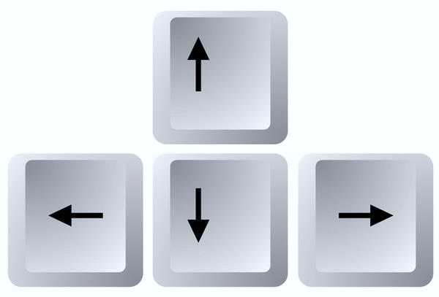
DEMO: navigating the CLI
can move through commands that have been typed:
up and down arrows to move to previous command
commands can be executed again by pressing Enter
left and right arrows to position cursor for editing
home and end to move to start or end of current line
backspace and delete

Slide 46

Listing files

Slide 47
File structure for emulator in Linux essentials course (recap)
/
top level
known as root
bin
boot
dev
etc
home
...
usr
var
essential binary files
hardware devices
can also use ~
sysadmin
bin
...
src
Desktop
Documents
Downloads
Music
Pictures
Public
Templates
Videos
School
Work
Art
Engineering
Math

Slide 48
DEMO: list files in directory (Unhatched 4, Ess 7.4)
ls used to list contents of directory
default is to print current directory in alphabetic order
short for listing
list contents of current directory
alphabetic order by default
ls

Slide 49
DEMO: list files in directory - specific directories (Unhatched 4, Ess 7.4)
can specify which directories to display using arguments
relative
absolute
what do you want to do? | sample command
list contents of current directory | ls
list directory contents using relative path | ls Documents/School
list directory contents using absolute path | ls /usr
list contents of multiple directories | ls /usr ~ Documents
directory names separated by spaces

Slide 50
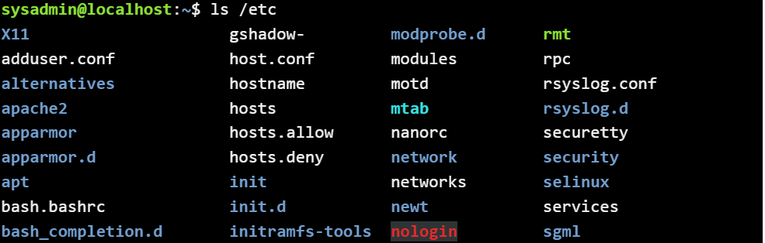
DEMO: list files in directory - colour coding (Unhatched 4, Ess 7.4)
many Linux distros colour the file types to distinguish between them
white: standard file
cyan: symbolic link (a file that points to another file)
green: executable file
blue: directory
red: archive file
ls /etc

Slide 51
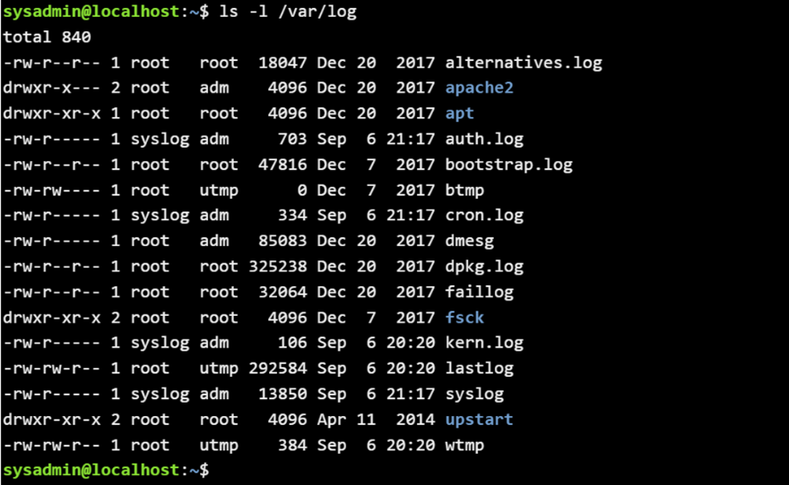
DEMO: list files in directory - long listing (Unhatched 5, Ess 7.4.2)
can specify how directories are displayed using options
-l displays additional details of files (permissions, file sizes)
long listing of files in /var/log directory
ls -l /var/log

Slide 52

List files in directory - long listing (Unhatched 5, Ess 7.4.2)
what does it all mean?
file type, including: d (directory)
- (regular file)
timestamp: last time file modified, or file added to or deleted from a directory
owners: every file is owned by a user who can set permissions
permissions: who can access file and what they can do
file size in bytes
name of file or directory

Slide 53
DEMO: list files in directory - display options (Unhatched 4, 5, Ess 7.4.2)
NB: order of options is immaterial
what do you want to do? | sample command
list contents in reverse order | ls -lr Documents or ls -rl Documents
list contents using date order | ls -lt /etc
list contents using size order | ls -lS /var/log
uppercase S

Slide 54
DEMO: list files in directory - more options (Unhatched 4, 5, Ess 7.4.2)
some rarely-used system files are hidden to reduce clutter
size given in Kb rather than bytes
what do you want to do? | sample command
list contents in human readable format | ls -lh Documents
include all hidden files | ls -la
include sub-directories in the listing | ls -lR ~
hidden files are preceded by full stop
uppercase R for recursive (not to be confused with -r which is reverse)

Slide 55
Globbing (Ess 8.2)
wild cards are called glob characters (yes, really)
used to specify patterns to match when using filenames
* matches zero or more characters
? matches exactly one character
[] matches with any of the characters enclosed by brackets
can specify ranges as well as individual characters
all character comparison is based on ASCII values
! is used with square brackets to negate the match
glob characters are interpreted by the shell before they are used
pattern will be expanded before it is used to filter matches
must use -d option to prevent ls behaving inconsistently and searching subdirectories [for full explanation, see Ess 8.2.5]

Slide 56
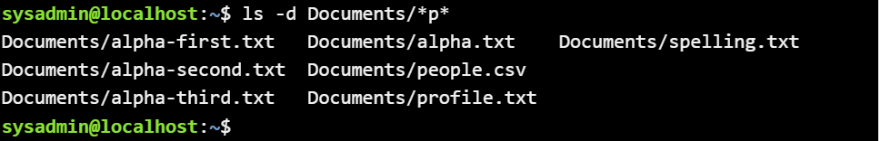
Globbing (Ess 8.2)
globbing characters are used within the path
shows what to match against
match any name with:
zero or more characters
followed by p
followed by zero or more characters
prevent subdirectories being searched
ls -d Documents/*p*

Slide 57
DEMO: globbing - examples (Ess 8.2)
what do you want to match? | sample command
filenames in Documents containing p | ls -d Documents/*p*
conf files in /etc directory | ls -d /etc/*.conf
filenames in Documents with 3 characters | ls -d Documents/???.*
filenames in Documents with at least 3 characters | ls -d Documents/???*.*
filenames in Documents starting with a, b, c or d | ls -d Documents/[abcd]*
filenames in Documents starting with h to o | ls -d Documents/[h-o]*
filenames in /etc with at least 1 number in name | ls -d /etc/*[0-9]*
filenames in /etc which do not end with a number before the file extension | ls -d /etc/*[!0-9].*

Slide 58
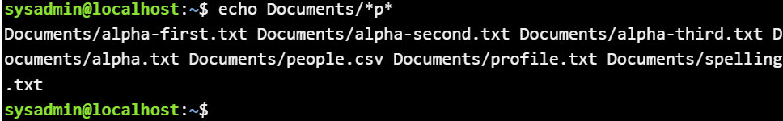
DEMO: echo for file names and directories
echo is used to output content
default is to output to screen
text literals in quotes
file and directory names
variables
more on this later in the module...
output everything that matches the given pattern
echo Documents/*p*

Slide 59

Changing directories

Slide 60
File structure for emulator in Linux essentials course (recap)
/
top level
known as root
bin
boot
dev
etc
home
...
usr
var
essential binary files
hardware devices
can also use ~
sysadmin
bin
...
src
Desktop
Documents
Downloads
Music
Pictures
Public
Templates
Videos
School
Work
Art
Engineering
Math

Slide 61
DEMO: changing directories (Unhatched 4, Ess 7.2.3, 7.3)
cd used to change directory to directory given by specified path
no output indicates that the move is successful
check the prompt to see the current directory
error if directory does not exist
everything is case-sensitive
prompt shows name of current directory (Documents)
cd documents; cd Documents

Slide 62
DEMO: changing directories examples (Unhatched 4, Ess 7.2.3, 7.3)
starts with / so is absolute from root
path doesn't start with / or ~ so is relative to current directory
which directory do you want to move to? | sample command
nested directory relative to current directory | cd School/Art
nested directory with absolute path from root | cd /home/sysadmin/Documents/School
nested directory with absolute path from home | cd ~/Documents/School/Math
root directory | cd /
home directory | cd ~ cd
up one level from current directory | cd ..
up two levels from current directory | cd ../..
starts with ~ so is absolute from home

Slide 63
What we have covered
introduction to Operating Systems
boot process
kernel
Linux
distros
package management
virtualisation
CLI
prompt
syntax
options and arguments
file hierarchy
relative and absolute paths
globbing
wild cards
commands:
echo - print to screen
pwd - print working directory
ls - list files in hierarchy
cd - change directory

Slide 64

Any questions?

