Slide 1
Parallel Machine Learning for Password Strength Analysis with Breach Intelligence on Big Data
Group Name: Blank
Names: Wijesekara Arachchige Kavindu Prabhashwara and Waqas Ali
wijkav24@student.hh.se, waqali24@student.hh.se

Slide 2
Introduction
Passwords are still the primary defense
Many users choose weak/reused passwords
Traditional checkers use fixed rules only
We use ML + breach data to classify passwords into Weak, Medium, Strong

Slide 3
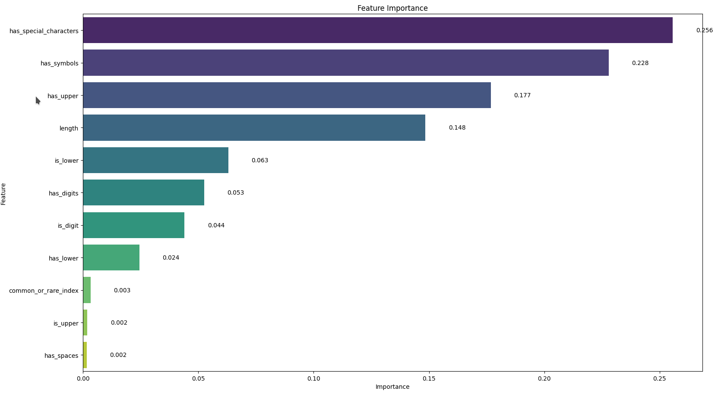
Problem Statement
Goal: Classify passwords as Weak, Medium, or Strong
Features: Structure (length, digits, symbols), and breach history
Techniques: Random Forest & RNN, evaluated on large datasets

Slide 5
Datasets Used
```curl -s --retry 10 --retry-all-errors --remote-name-all --parallel --parallel-max 150 "https://api.pwnedpasswords.com/range/{0,1,2,3,4,5,6,7,8,9,A,B,C,D,E,F}{0,1,2,3,4,5,6,7,8,9,A,B,C,D,E,F}{0,1,2,3,4,5,6,7,8,9,A,B,C,D,E,F}{0,1,2,3,4,5,6,7,8,9,A,B,C,D,E,F}{0,1,2,3,4,5,6,7,8,9,A,B,C,D,E,F}"```
rockyou.txt (1M passwords)
Source: The well-known rockyou.txt leak, often used in password security research.
Size: ~1 million password entries (subset extracted for manageability).
Have I Been Pwned (50GB, 14M records)
Source: “Have I Been Pwned” (HIBP), a collection of billions of real-world leaked passwords.
Size: Approximately 50 GB of data (SHA-1 hash format).
PySpark used for parallel data handling and processing

Slide 6
Feature Engineering
13 features: 11 Boolean, 1 length, 1 contextual
Tools: PySpark, VectorAssembler, StringIndexer
Feature example: has_upper, has_digits, common_or_rare_index
We create label accroding to a score system df = df.withColumn("password_strength",F.when(F.col("score")==5 ,"Strong").when(F.col("score")>=3,"medium").otherwise("weak"))

Slide 7
SMOTE vs Downsampling
Password Strength | Count
Weak | 15,152
Medium | 14,994
Strong | 14,989
SMOTE uses KNN to generate synthetic samples
May cause dataset to grow too large and overfit
Downsampling used in our case to improve speed and avoid overfitting(Good if you have lot of data)
Balanced dataset: ~15k per class (Weak, Medium, Strong)

Slide 8
Effect of Class Balancing
Before Equal Class Split (Unbalanced Training Set):
Accuracy: 99.737%
F1 Score: 0.9962
Weighted Recall: 0.9974
Weighted Precision: 0.9951
Training Time: 1183.96 ± 30.99 sec
After Equal Class Split (Balanced Training Set):
Accuracy: 99.770%
F1 Score: 0.9978
Weighted Recall: 0.9977
Weighted Precision: 0.9980
Training Time: 360.10 ± 19.56 sec

Slide 9
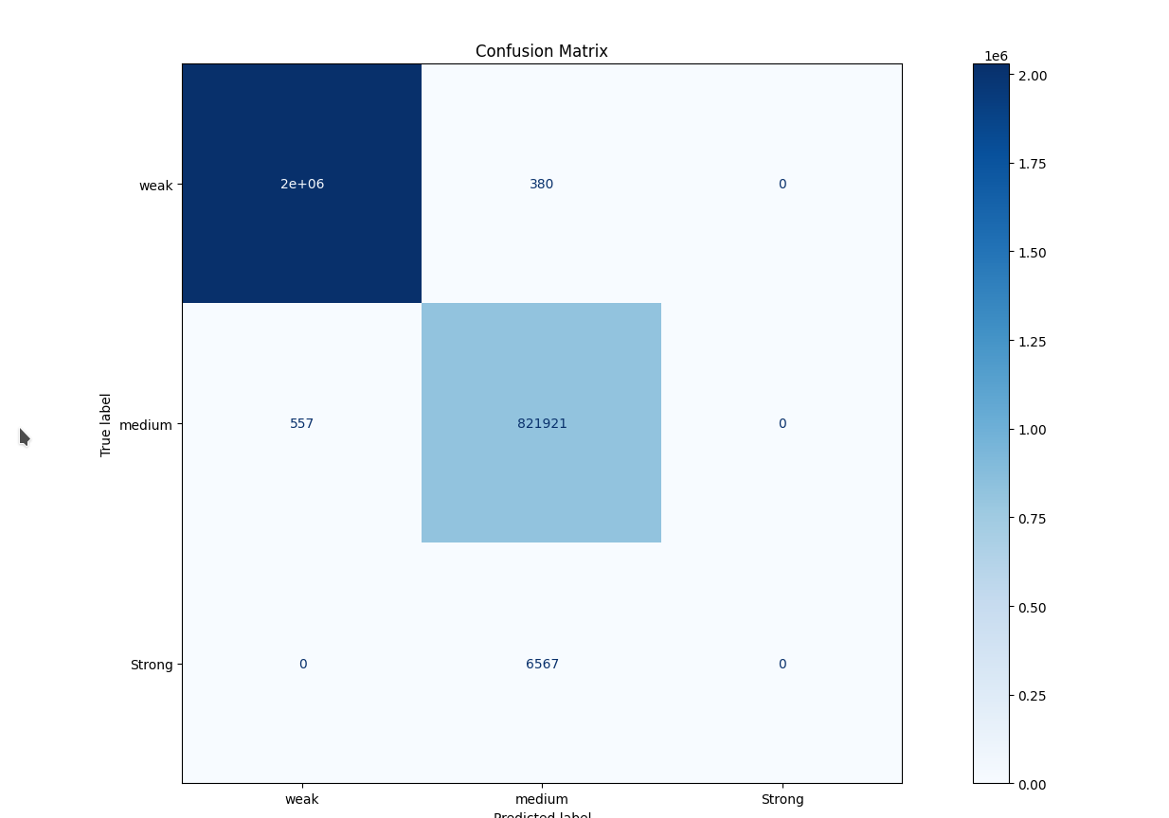
Before Equal Class Split (Unbalanced Training Set)

Slide 10
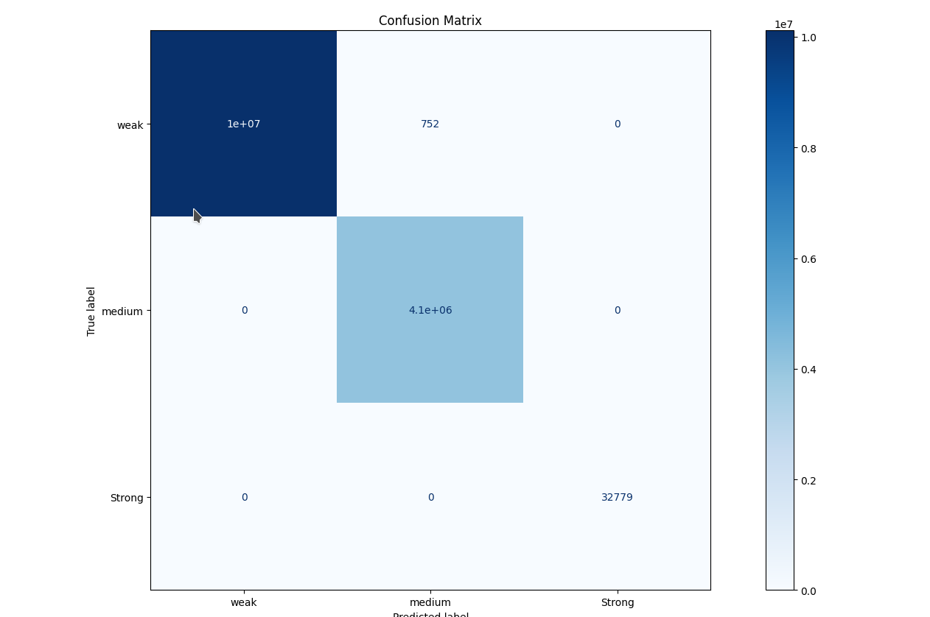
After Equal Class Split (Balanced Training Set)

Slide 11
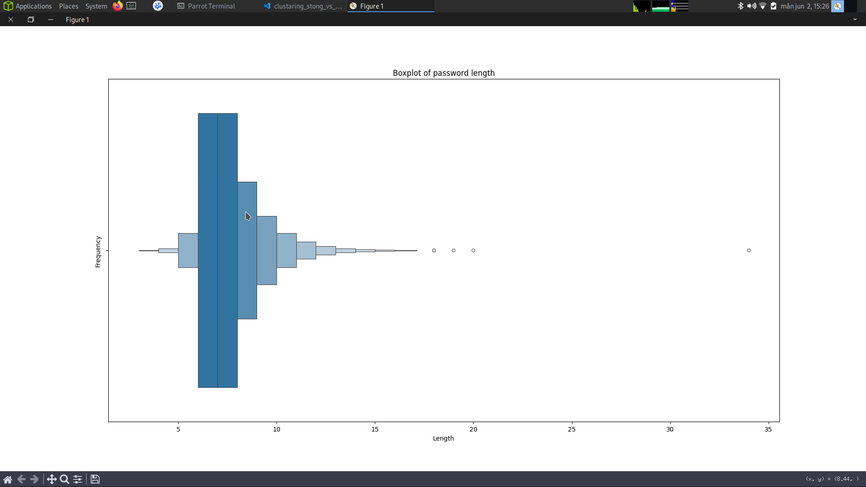
Removing outliers

Slide 12
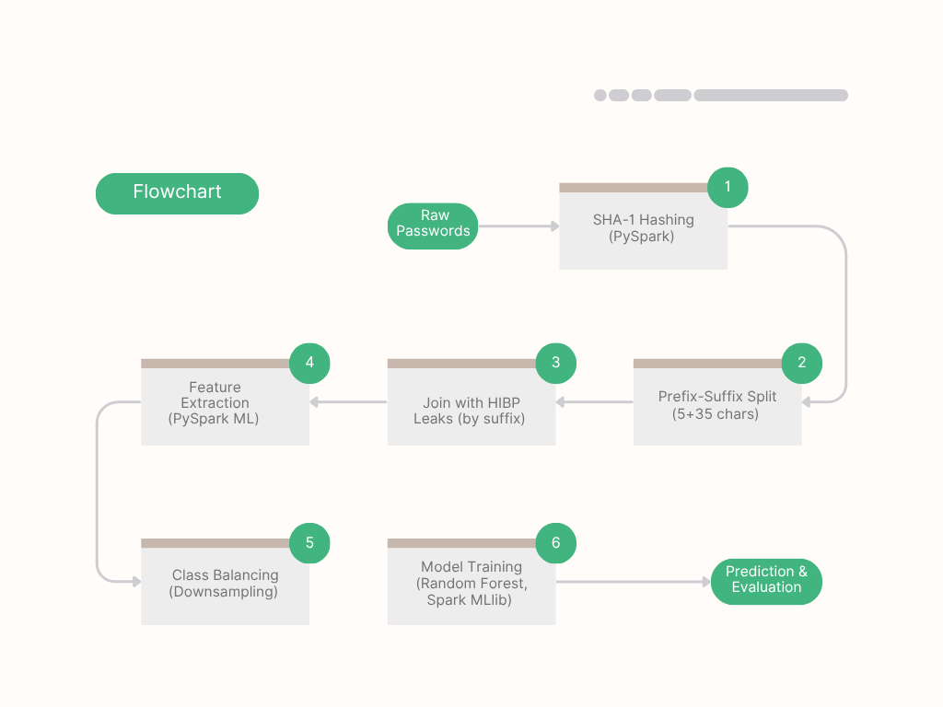

Slide 13
Why The Huge Speedup?
With balanced training data:
Less impurity to compute → Faster tree splits
No need to overcompensate for dominant class
Smaller training set = fewer cross-validation iterations
Enough diverse samples in small balanced set → No performance loss
Data set | Weak | Medium | Strong
Train | 15,152 | 14,994 | 14,989
Test | 10,130,299 | 4,090,838 | 17,925

Slide 14
Spark Optimization
Partitioning :
More partitions ≠ better.
Follow rule of thumb: partition_count ≈ file_size_MB / 128
For column-based partitioning, use:
```df.repartition("column_name")```
Rows with same value grouped = faster joins, less shuffle.
Avoid broadcast joins for datasets >10MB
JVM does real parallelism, Python just orchestrates
AVOID loops try to do them using join (AVOID exponential Problems O(m x n)
Converted .txt/csv to Parquet
Dynamic partitioning in Spark
Spark local dir set manually
.master([*]) for local if we want distribution executor will store the spark web UI while ,works store the master IP address and port (default port:7077 worker connection)
(8080: for spark master web UI)
(8081: for servants web UI)
Increase swap memory (RAM will not get used up)
set("spark.local.dir","/home/jack/Documents/spark_space")\

Slide 15
RNN Chunking + Multithreading Impact
Before: Accuracy=95.80%, Time=6332s
After: Accuracy=95.82%, Time=3903s
Massive 38% speed boost with no drop in performance!
Accuracy and F1-score remained stable despite threading.
ThreadPoolExecutor + Parquet I/O improved read efficiency.
Python didn’t do real parallelism—but I/O concurrency still helped.
Class | Precision | Recall | F1-score | Support
Weak | 0.97 | 1.00 | 0.98 | 10,125,574
Medium | 1.00 → 0.99 | 0.86 | 0.92 | 4,090,648
Strong | 0.07 | 0.99 | 0.13 | 22,237

Slide 16
Threading vs Processing in Python
ThreadPoolExecutor worked well for I/O (reading files)
ProcessPoolExecutor failed due to PyTorch multiprocessing issues
CUDA (C/C++) for GPU & JVM (Java) in Spark do real multi-threading, not Python
Careful tuning of threads & partitions is key for large-scale jobs
PyTorch doesn’t play well with multiprocessing (fork)
Process-based parallelism breaks when:
Using shared memory for big tensors

Slide 17
Why Google Colab T4 Performed Poorly
We trained SparkXGBClassifier
But it took average_time:571.64 to complete training
Google Colab T4 Limitations:
VRAM Limit: ~15 GB only
Usage Cap: Limited free GPU time and sessions per day
Concurrency: Only 1 task at a time allowed
Model Complexity Constraints: Can't train large deep models or handle big batch sizes
GPUs are great at parallel math, not complex logic.
But Colab’s T4 has:
Fewer CUDA cores (~2560 vs 10000+ in A100)
Less VRAM
No parallel job scheduling in free tier
Component | Analogy | Traits
CPU | Highly skilled workers | Few cores, smart & flexible (good for branching logic)
GPU | Massive worker group | Thousands of simple MAC (multiply-accumulate) units

Slide 18
Conclusion & Future Work
Balanced sampling improves accuracy & speed
Threaded I/O + Spark chunking = massive time gains
Random Forest trains fast Tend to overfit, RNN generalizes better
Plan: Deploy on distributed GPU clusters for industrial scaling
Even though GPUs are built for parallelism, the T4's hardware limits + Colab's restrictions made it worse than a local 7-core CPU with enough RAM.
Through Spark-based prefix-suffix SHA-1 hash joins, we successfully identified breached passwords at scale—without the need for conventional password-cracking tools such as Hashcat or Hydra.

Slide 19

Thank You / Q&A

