Slide 1
DIALOG AXIATA PLC
Financial Due Diligence — PE Acquisition Analysis
FY2020 – FY2024 | Sri Lanka Telecom Sector
Telecom
Sri Lanka
Emerging Market
PE Due Diligence
Prepared by: Kavindi Gamage | Tools: Python · R (ggplot2) · Excel · PDF Extraction
Data: Dialog Axiata Annual Reports 2020–2024 (PDF verified) · yfinance API · April 2025

Slide 2
Executive Summary
SLIDE 2 OF 10
RECOMMENDATION: Dialog Axiata is a CAUTIOUS BUY. Strong operational fundamentals, cleanest balance sheet in peer group, and proven resilience through macro crisis — offset by 2024 revenue decline.
01
Revenue peaked LKR 187.8Bn in 2023
+56% over 4 years. 2024 dip of 8.9% reflects macro normalisation, not structural decline.
02
2022 loss was macro, not operational
Net loss LKR 33,409Mn driven by LKR 30,280Mn FX losses. EBITDA stayed positive at LKR 43,663Mn.
03
EBITDA hit all-time high in 2024
LKR 66,276Mn — despite lower revenue. EBITDA margin recovering to 38.7% from 24.5% in 2022.
04
Cleanest balance sheet in peer group
Debt/Equity 1.38x vs peer average 75x. Net Debt/EBITDA 1.11x. Minimal leverage risk.
05
DCF base case: Equity Value LKR 220Bn
At 12% WACC, 5% terminal growth. Bull case reaches LKR 619Bn. Current mkt cap ~LKR 240Bn.
Dialog Axiata PLC | Financial Due Diligence | FY2020–2024
CONFIDENTIAL | For Discussion Only | Slide 2 of 10

Slide 3
Investment Thesis
SLIDE 3 OF 10
Why does Dialog Axiata matter to a PE investor?
BULL CASE
BEAR CASE
KEY QUESTIONS
• Market leader — #1 mobile, #1 broadband in Sri Lanka
• Revenue declined 8.9% in 2024 — momentum slowing
• Can 5G monetisation drive a 3rd revenue growth cycle?
• 5G spectrum secured — next growth cycle loading
• Net margin 7.3% vs 12% in 2021 — pressure ongoing
• Will management reduce debt now capex cycle peaks?
• EBITDA all-time high LKR 66,276Mn in 2024
• Total debt LKR 107,694Mn — interest costs rising
• Enterprise & IoT — how large can this segment grow?
• Axiata Group (MY) backing — regional capital access
• Sri Lanka macro risk — debt restructuring ongoing
• Impact of LKR volatility on USD-denominated debt?
• LKR stabilisation removes key 2022 tail risk
• EBITDA margin 38.7% below peer avg 43.4%
• Is 2024 revenue dip cyclical or structural saturation?
Thesis: Dialog is a resilient telecom franchise with proven crisis recovery. Entry valuation and 5G execution are the key swing factors for investor return.
Dialog Axiata PLC | Financial Due Diligence | FY2020–2024
CONFIDENTIAL | For Discussion Only | Slide 3 of 10

Slide 4
Market & Macro Context
SLIDE 4 OF 10
Sri Lanka Telecom Industry | Investment backdrop
Sri Lanka Telecom Market
2022 Economic Crisis Impact
~22M population. Mobile penetration >140%. Mature voice market — growth driven by data, 4G/5G, enterprise digital. Dialog holds ~40% mobile market share — clear #1 player.
Worst economic crisis since independence. GDP contracted 7.8%. LKR depreciated ~80% vs USD. Dialog absorbed LKR 30,280Mn FX losses but maintained positive EBITDA — operational resilience confirmed.
Post-Crisis Recovery (2023–24)
5G & Digital Growth Opportunity
IMF bailout stabilised macro. LKR partially recovered. Dialog revenue recovered to LKR 187,813Mn in 2023. 2024 dip reflects consolidation. Inflation declined from 70%+ peak to single digits.
Dialog received 5G spectrum. Enterprise IoT, cloud services, fixed wireless are emerging revenue streams. Regional peers (Bharti Airtel, Telkom) are 2–3 years ahead on 5G — Dialog has a clear playbook.
Dialog Axiata PLC | Financial Due Diligence | FY2020–2024
CONFIDENTIAL | For Discussion Only | Slide 4 of 10

Slide 5
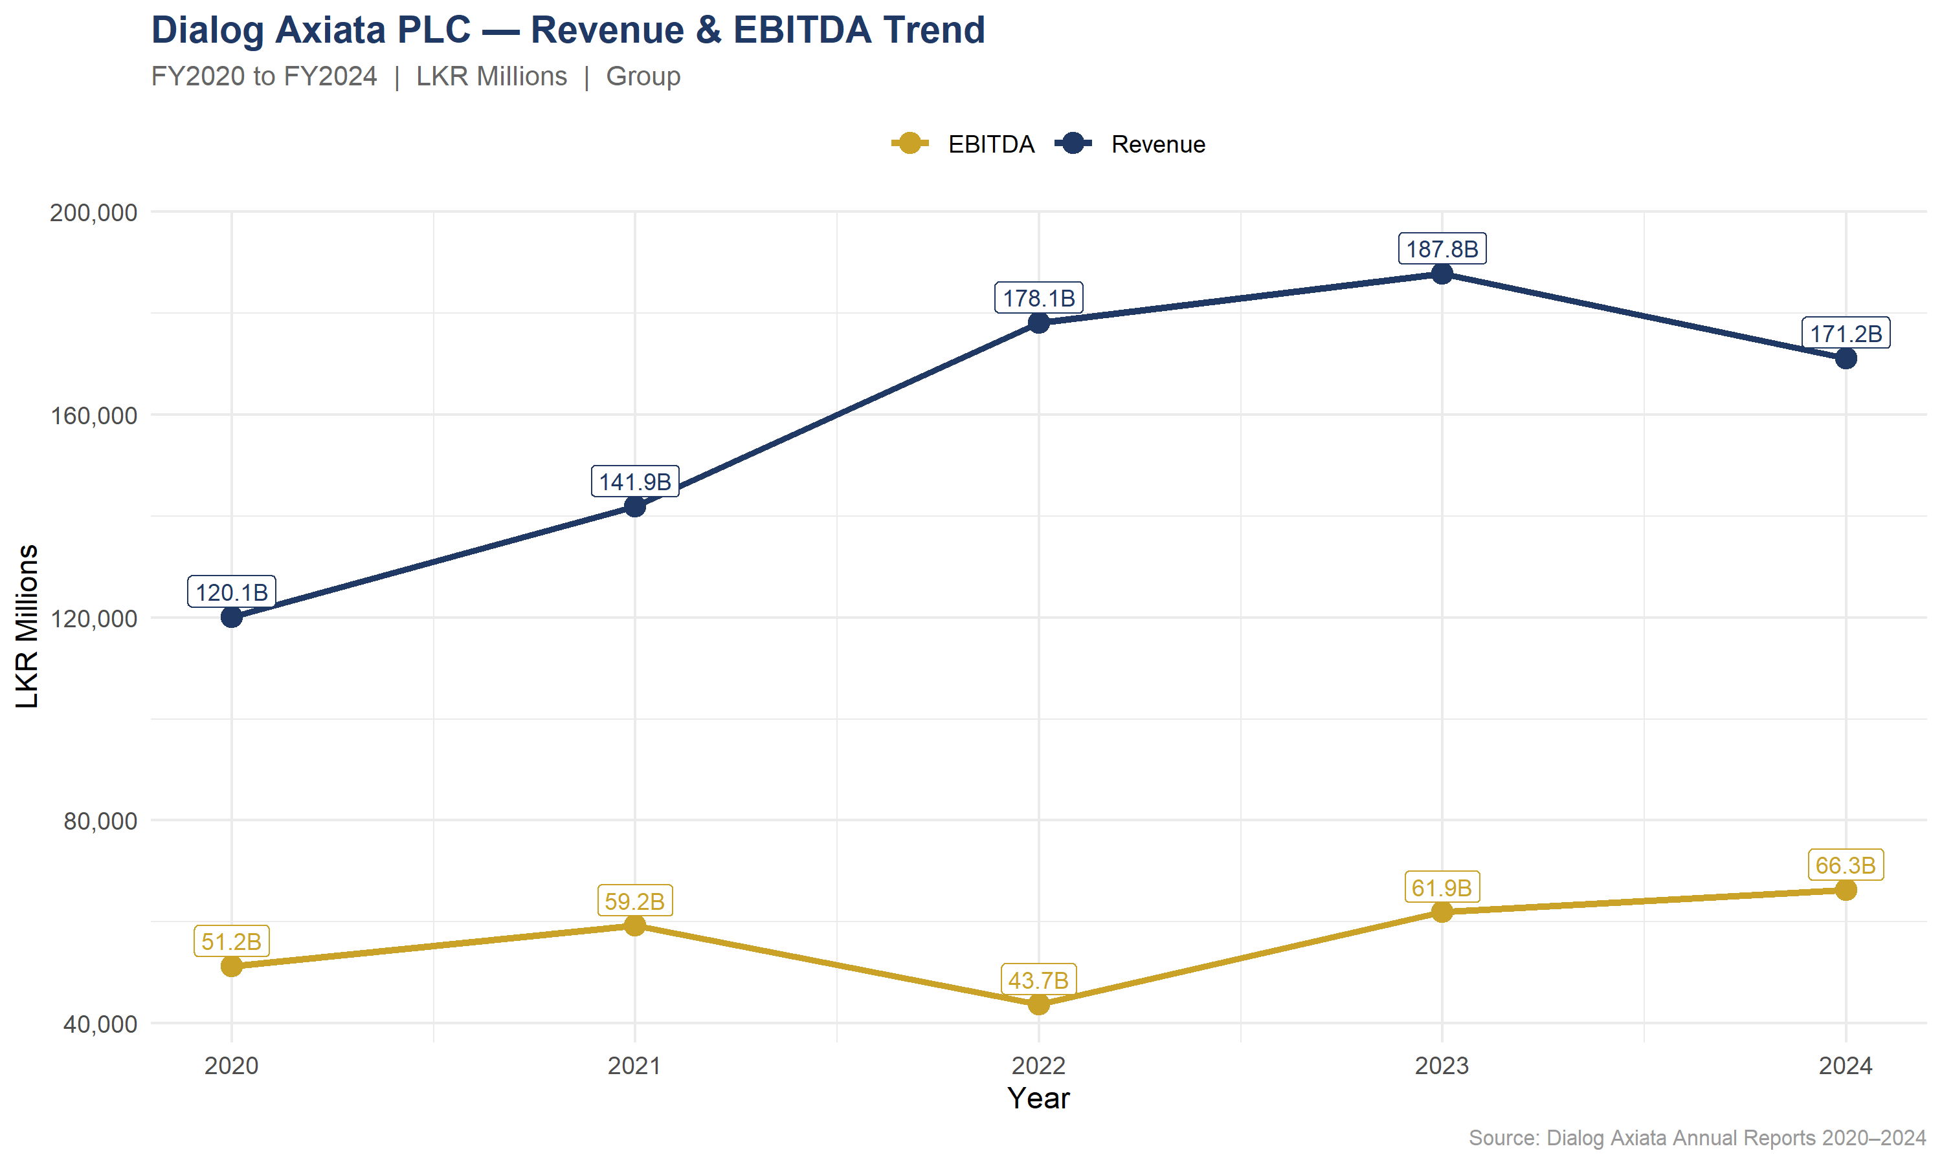
Revenue & Growth Analysis
SLIDE 5 OF 10
Revenue CAGR 2020–2023
+16.1%
3-year growth phase
Peak Revenue 2023
187.8B
LKR Millions
2024 Change vs 2023
−8.9%
Consolidation phase
EBITDA 2024 All-time High
66.3B
LKR Millions
Analyst note: 2022 EBITDA dip was FX-driven, not operational. Revenue grew +56% cumulatively from 2020–2023. EBITDA 2024 at all-time high despite lower revenue.
Dialog Axiata PLC | Financial Due Diligence | FY2020–2024
CONFIDENTIAL | For Discussion Only | Slide 5 of 10

Slide 6
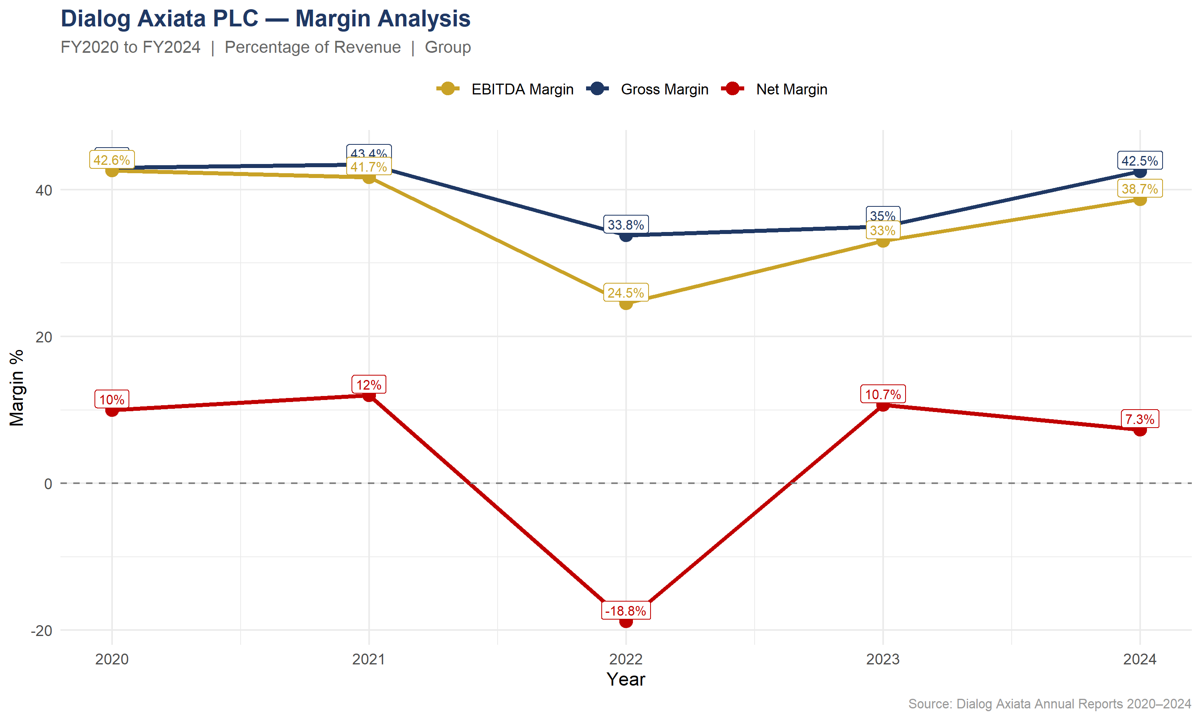
Profitability Analysis
SLIDE 6 OF 10
Gross Margin 2024
42.5%
Recovered to 2021 level
EBITDA Margin 2024
38.7%
Below 42.6% peak
Net Margin 2024
7.3%
Down from 12% in 2021
Net Margin 2022 (crisis)
−18.8%
FX shock — not ops
Key insight: Gross and EBITDA margins recovered strongly post-2022. Net margin compression in 2024 driven by higher interest costs — not deteriorating operations.
Dialog Axiata PLC | Financial Due Diligence | FY2020–2024
CONFIDENTIAL | For Discussion Only | Slide 6 of 10

Slide 7
Balance Sheet & Leverage
SLIDE 7 OF 10
Net Debt/EBITDA 2024
Debt/Equity 2024
Total Assets Growth
Peak Debt Year
1.11x
1.38x
+64.9%
2023
Down from 1.44x in 2022
Peer avg: 75x — cleanest
LKR 187.7Bn → 309.1Bn
LKR 122.8Bn — now declining
Metric
2020
2021
2022
2023
2024
Total Assets (LKR Bn)
187.7
219.0
267.2
286.2
309.1
Total Equity (LKR Bn)
82.2
93.5
45.2
66.3
78.3
Total Debt (LKR Bn)
40.4
41.8
103.6
122.8
107.7
Net Debt (LKR Bn)
23.8
19.8
63.0
82.2
73.9
Debt / Equity
0.49x
0.45x
2.30x
1.85x
1.38x
Net Debt / EBITDA
0.46x
0.33x
1.44x
1.33x
1.11x
Dialog Axiata PLC | Financial Due Diligence | FY2020–2024
CONFIDENTIAL | For Discussion Only | Slide 7 of 10

Slide 8
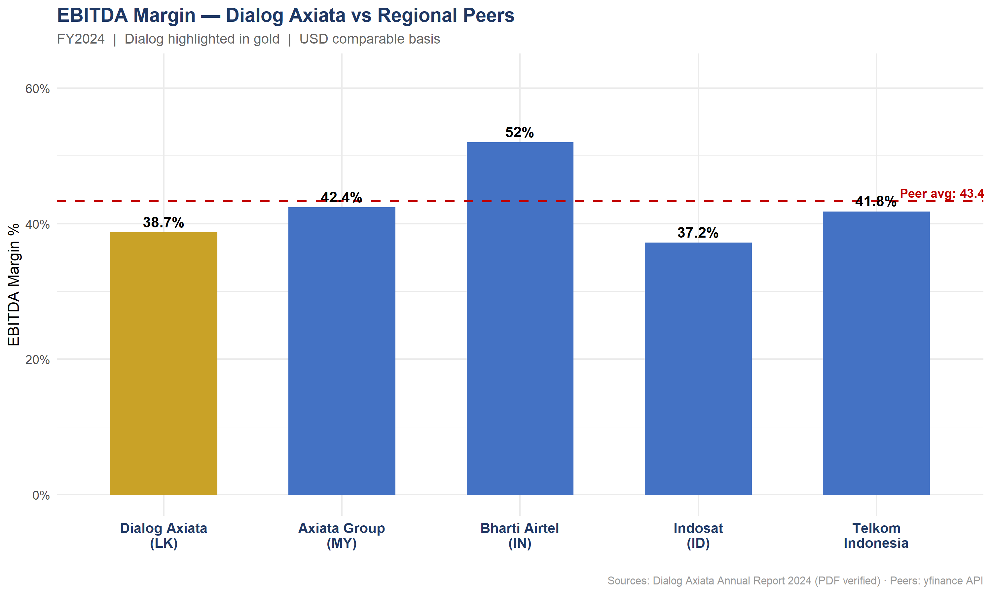
Competitor Benchmarking
SLIDE 8 OF 10
Company
EBITDA Margin
Debt/Equity
ROE %
Dialog Axiata (LK)
38.7%
1.38x
15.9%
Axiata Group (MY)
42.4%
70.0x
1.3%
Bharti Airtel (IN)
52.0%
117.1x
23.1%
Indosat (ID)
37.2%
139.0x
15.3%
Telkom Indonesia
41.8%
50.1x
18.3%
Peer Average
43.4%
94.1x
14.5%
LEVERAGE
Dialog 1.38x D/E vs 94x peer avg. Cleanest balance sheet — lowest acquisition financing risk.
MARGIN GAP
4.7pp below peer average. Closing this gap on LKR 171Bn revenue = significant EBITDA upside.
ROE
15.9% ROE — above peer average 14.5% and well above Axiata Group (1.3%).
Source: Dialog data from Annual Report 2024 (PDF verified). Peers: yfinance API with FX conversion to USD (2024 avg rates).
Dialog Axiata PLC | Financial Due Diligence | FY2020–2024
CONFIDENTIAL | For Discussion Only | Slide 8 of 10

Slide 9
DCF Valuation — 3 Scenarios
SLIDE 9 OF 10
Base year: FY2024 | 5-year explicit period | WACC-based terminal value
BULL CASE
BASE CASE
BEAR CASE
WACC
10%
WACC
12%
WACC
14%
Rev Growth
12% / 10%
Rev Growth
6% / 5%
Rev Growth
0% / 2%
EBITDA Margin
40%
EBITDA Margin
37%
EBITDA Margin
32%
Capex % Rev
18%
Capex % Rev
20%
Capex % Rev
22%
Enterprise Value
LKR 693Bn
Enterprise Value
LKR 294Bn
Enterprise Value
LKR 117Bn
Equity Value
LKR 619Bn
Equity Value
LKR 220Bn
Equity Value
LKR 43Bn
Price/Share: LKR 75.48
Price/Share: LKR 26.86
Price/Share: LKR 5.25
5G monetisation accelerates, margins recover to peer average
Steady recovery, moderate growth, stable macro environment
Macro headwinds persist, margin pressure, limited growth
Current market cap ~LKR 240Bn | Base case equity LKR 220Bn | Bull case LKR 619Bn | Net debt deducted: LKR 73,908Mn | Source: Excel DCF model (PDF-verified inputs)
Dialog Axiata PLC | Financial Due Diligence | FY2020–2024
CONFIDENTIAL | For Discussion Only | Slide 9 of 10

Slide 10
Risks & Recommendation
SLIDE 10 OF 10
KEY RISKS
RECOMMENDATION
HIGH
Macro / FX risk — Sri Lanka sovereign debt restructuring ongoing. LKR volatility can recur.
CAUTIOUS BUY
HIGH
Revenue decline — 2024 dip of 8.9% needs 2–3 quarters of data to confirm recovery.
1. Entry at or below LKR 7.50/share
2. Condition: 2 consecutive quarters of revenue recovery
MED
Debt load — LKR 107,694Mn total debt manageable but interest compressing net margins.
3. Monitor: LKR/USD stability & IMF programme milestones
MED
Competition — SLT-Mobitel competing aggressively on pricing in broadband.
4. Catalyst: 5G commercial launch & enterprise traction
5G execution risk — capex for rollout could delay deleveraging timeline.
5. Exit: 18–24 months at 7–8x EV/EBITDA
LOW
Built with: Python (yfinance, pandas) · R (ggplot2, dplyr) · Excel Financial Model · PDF extraction from 5 official Dialog Axiata Annual Reports

