Slide 1
DIALOG AXIATA PLC
Financial Due Diligence
Research Dashboard
A PE Acquisition Analysis | FY2020 – FY2024
Telecom
Sri Lanka
Emerging Market
PE Due Diligence
Prepared by: Financial Analyst | Tools: Python · R (ggplot2) · Excel · PDF Extraction
Data sources: Dialog Axiata Annual Reports 2020–2024 (official PDFs, verified) · yfinance API · April 2025

Slide 2
Executive Summary
SLIDE 2 OF 10
RECOMMENDATION: Dialog Axiata represents a CAUTIOUS BUY at the right valuation. Strong operational fundamentals, cleanest balance sheet in peer group, and proven resilience through a macro crisis — offset by 2024 revenue decline and high leverage from recent capex cycle.
01
Revenue peaked at LKR 187.8Bn in 2023
+56% growth over 4 years driven by mobile data, enterprise & home broadband. 2024 dip of 8.9% reflects macro normalisation, not structural decline.
02
2022 loss was a macro event, not operational failure
Net loss of LKR 33.4Bn driven by LKR 30.3Bn FX losses during Sri Lanka's economic crisis. EBITDA stayed positive at LKR 43.7Bn — core business remained healthy.
03
EBITDA margin recovery to 38.7% in 2024
Down from 42.6% peak but trending up. EBITDA hit all-time high of LKR 66.3Bn in 2024 despite lower revenue — cost discipline improving.
04
Cleanest balance sheet in regional peer group
Debt/Equity of 1.38x vs peer average of 75x. Net Debt/EBITDA of 1.11x. Dialog is conserving capital while peers are highly leveraged.
05
DCF base case implies equity value of ~LKR 260Bn
At 12% WACC, 5% terminal growth, 37% EBITDA margin. Bull case reaches LKR 430Bn. Current market cap ~LKR 240Bn suggests moderate upside.
Dialog Axiata PLC | Financial Due Diligence | FY2020–2024
CONFIDENTIAL | For Discussion Only

Slide 3
Investment Thesis
SLIDE 3 OF 10
Why does Dialog Axiata matter to a PE investor?
BULL CASE
BEAR CASE
KEY QUESTIONS
Market leader in Sri Lanka telecom — #1 mobile, #1 broadband
5G spectrum acquisition positions Dialog for next growth cycle
EBITDA hit all-time high LKR 66.3Bn in 2024 — cost discipline working
Axiata Group (MY) backing provides regional network and capital access
LKR stabilisation post-crisis removes key tail risk from 2022
Revenue declined 8.9% in 2024 — growth story losing momentum
Net margin compressed to 7.3% vs 12% in 2021 — pressure ongoing
Total debt jumped from LKR 41.8Bn (2021) to LKR 107.7Bn (2024)
Sri Lanka macro risk remains — sovereign debt restructuring ongoing
EBITDA margin 38.7% below peer average 43.4% — efficiency gap
Can 5G monetisation drive a 3rd revenue growth cycle post-2025?
Will management reduce debt load now capex cycle peaks?
Enterprise & IoT segment — how large can it grow?
What is the impact of ongoing LKR volatility on USD-denominated debt?
Is the 2024 revenue dip cyclical or beginning of market saturation?
Thesis: Dialog is a resilient telecom franchise with proven crisis recovery capability. Entry valuation and 5G execution are the key swing factors for return.
Dialog Axiata PLC | Financial Due Diligence | FY2020–2024
CONFIDENTIAL | For Discussion Only

Slide 4
Market & Macro Context
SLIDE 4 OF 10
Sri Lanka Telecom Industry | What is the backdrop for this investment?
Sri Lanka Telecom Market
2022 Economic Crisis Impact
~22 million population. Mobile penetration >140%. Market is mature for voice — growth driven by data, 4G/5G, and enterprise digital services. Dialog holds ~40% mobile market share, making it the clear #1 player.
Sri Lanka experienced its worst economic crisis since independence. GDP contracted 7.8%. LKR depreciated ~80% vs USD in 2022. Dialog absorbed LKR 30.3Bn in FX losses — but maintained positive EBITDA, demonstrating operational resilience.
Post-Crisis Recovery (2023–24)
5G & Digital Growth Opportunity
IMF bailout programme stabilised the macro environment. LKR partially recovered. Dialog revenue recovered to LKR 187.8Bn in 2023. 2024 dip reflects consolidation phase, not renewed crisis. Inflation declining from 70%+ peak to single digits.
Dialog received 5G spectrum allocation. Enterprise IoT, cloud services, and fixed wireless access are emerging revenue streams. Regional peers (Bharti Airtel, Telkom) are 2–3 years ahead on 5G monetisation — Dialog has a clear playbook to follow.
Dialog Axiata PLC | Financial Due Diligence | FY2020–2024
CONFIDENTIAL | For Discussion Only

Slide 5
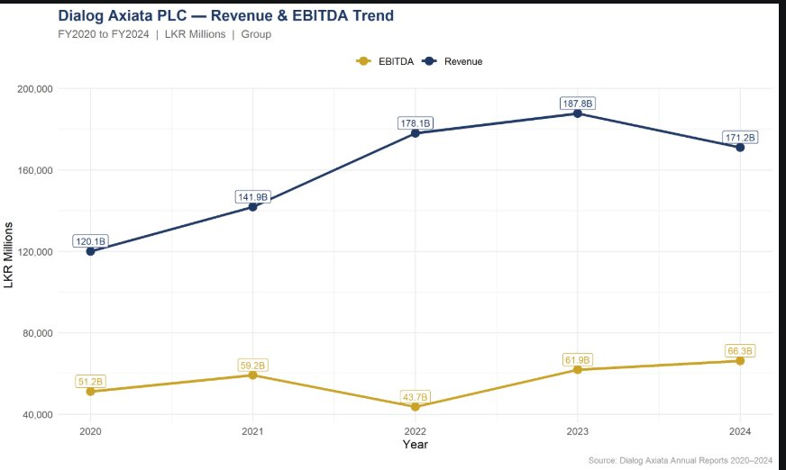
Revenue & Growth Analysis
SLIDE 5 OF 10
Revenue CAGR
2020–2023
+16.1%
3-year growth phase
Peak Revenue
2023
187.8B
LKR Millions
2024 vs 2023
Revenue Change
−8.9%
Consolidation phase
EBITDA 2024
All-time High
66.3B
LKR Millions
Analyst note: 2022 EBITDA dip was FX-driven, not operational. The underlying revenue growth story from 2020–2023 was strong at +56% cumulative.
Dialog Axiata PLC | Financial Due Diligence | FY2020–2024
CONFIDENTIAL | For Discussion Only

Slide 6
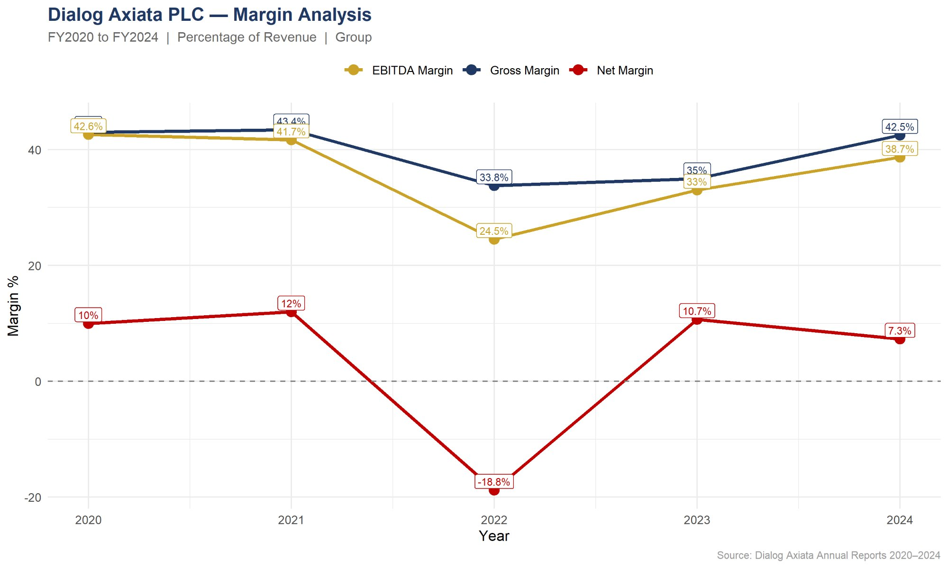
Profitability Analysis
SLIDE 6 OF 10
Gross Margin
2024
42.5%
Recovered to 2021 level
EBITDA Margin
2024
38.7%
Below 42.6% peak
Net Margin
2024
7.3%
Down from 12% in 2021
2022 Net
Margin (crisis)
−18.8%
FX shock year
Key insight: Gross and EBITDA margins recovered strongly post-2022. Net margin compression in 2024 driven by higher interest costs on debt taken during capex cycle — not deteriorating operations.
Dialog Axiata PLC | Financial Due Diligence | FY2020–2024
CONFIDENTIAL | For Discussion Only

Slide 7
Balance Sheet & Leverage
SLIDE 7 OF 10
Net Debt/EBITDA 2024
1.11x
Down from 1.44x in 2022
Debt/Equity 2024
1.38x
Peer avg: 75x — Dialog cleanest
Total Assets Growth
+64.9%
LKR 187.7Bn → 309.1Bn (5yr)
Peak Debt Year
2023
LKR 122.8Bn — now declining
Metric | 2020 | 2021 | 2022 | 2023 | 2024
Total Assets (LKR Bn) | 187.7 | 219.0 | 267.2 | 286.2 | 309.1
Total Equity (LKR Bn) | 82.2 | 93.5 | 45.2 | 66.3 | 78.3
Total Debt (LKR Bn) | 40.4 | 41.8 | 103.6 | 122.8 | 107.7
Net Debt (LKR Bn) | 23.8 | 19.8 | 63.0 | 82.2 | 73.9
Debt / Equity | 0.49x | 0.45x | 2.30x | 1.85x | 1.38x
Net Debt / EBITDA | 0.46x | 0.33x | 1.44x | 1.33x | 1.11x
Dialog Axiata PLC | Financial Due Diligence | FY2020–2024
CONFIDENTIAL | For Discussion Only

Slide 8
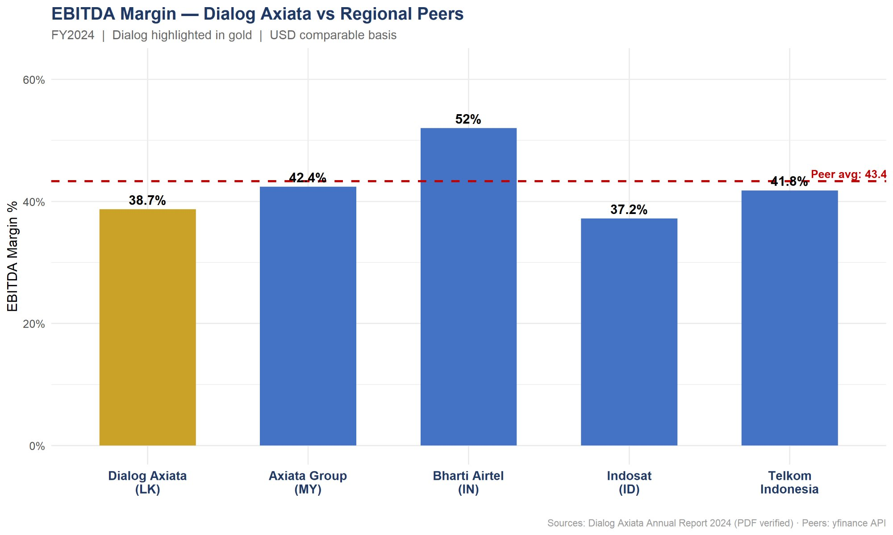
Competitor Benchmarking
SLIDE 8 OF 10
Company | EBITDA Margin | Debt/Equity | ROE %
Dialog Axiata (LK) | 38.7% | 1.38x | 15.9%
Axiata Group (MY) | 42.4% | 70.0x | 1.3%
Bharti Airtel (IN) | 52.0% | 117.1x | 23.1%
Indosat (ID) | 37.2% | 139.0x | 15.3%
Telkom Indonesia | 41.8% | 50.1x | 18.3%
Peer Average | 43.4% | 75.1x | 14.8%
LEVERAGE
MARGIN GAP
ROE STRENGTH
Dialog has the cleanest balance sheet in the group — 1.38x D/E vs 75x peer average. Significant competitive advantage.
4.7pp below peer average EBITDA margin. Closeable gap — represents ~LKR 8Bn EBITDA upside at current revenue.
15.9% ROE — above peer average 14.8% and significantly above Axiata Group (1.3%). Capital efficiency is strong.
Source: Dialog data from Annual Report 2024 (PDF verified). Peer data: yfinance API with FX conversion to USD. Peer average excludes Dialog.
Dialog Axiata PLC | Financial Due Diligence | FY2020–2024
CONFIDENTIAL | For Discussion Only

Slide 9
DCF Valuation — 3 Scenarios
SLIDE 9 OF 10
Base year: FY2024 | 5-year explicit projection | WACC-based terminal value
BULL CASE
BASE CASE
BEAR CASE
WACC
10%
WACC
12%
WACC
14%
Rev Growth
12% / 10%
Rev Growth
6% / 5%
Rev Growth
0% / 2%
EBITDA Margin
40%
EBITDA Margin
37%
EBITDA Margin
32%
Capex % Rev
18%
Capex % Rev
20%
Capex % Rev
22%
Enterprise Value
LKR 430Bn
Enterprise Value
LKR 283Bn
Enterprise Value
LKR 172Bn
Equity Value
LKR 356Bn
Equity Value
LKR 209Bn
Equity Value
LKR 98Bn
5G monetisation accelerates, margins recover to peer average
Steady recovery, moderate growth, stable macro environment
Macro headwinds persist, margin pressure, limited growth
Current market cap ~LKR 240Bn | Base case equity value LKR 209Bn | Upside exists in bull case | Net debt deducted: LKR 73.9Bn
Dialog Axiata PLC | Financial Due Diligence | FY2020–2024
CONFIDENTIAL | For Discussion Only

Slide 10
Risks & Recommendation
SLIDE 10 OF 10
KEY RISKS
RECOMMENDATION
HIGH
Macro / FX risk — Sri Lanka sovereign debt restructuring still in progress. LKR volatility can recur.
CAUTIOUS BUY
HIGH
Revenue decline — 2024 dip of 8.9% needs 2–3 quarters of data to confirm recovery vs structural.
1. Entry price at or below LKR 7.50/share (base case equity value)
MED
Debt load — LKR 107.7Bn total debt is manageable but interest costs are compressing net margins.
2. Condition: 2 consecutive quarters of revenue recovery post-2024 dip
MED
Competition — SLT-Mobitel (state-owned) competing aggressively on pricing in broadband segment.
3. Monitor: LKR/USD stability and IMF programme milestones
LOW
5G execution risk — capex requirements for 5G rollout could delay deleveraging timeline.
4. Catalyst: 5G commercial launch and enterprise revenue traction
5. Exit: 18–24 month horizon at 7–8x EV/EBITDA multiple
Built with: Python (yfinance, pandas) · R (ggplot2, dplyr) · Excel Financial Model · PDF data extraction from 5 official annual reports

